Slide 1
Business Anaytics
Assignment 03
15146314 Yang, Seunghyuck

Slide 2


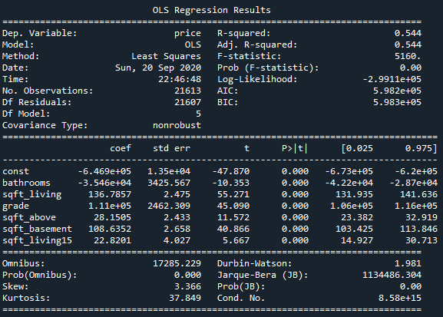
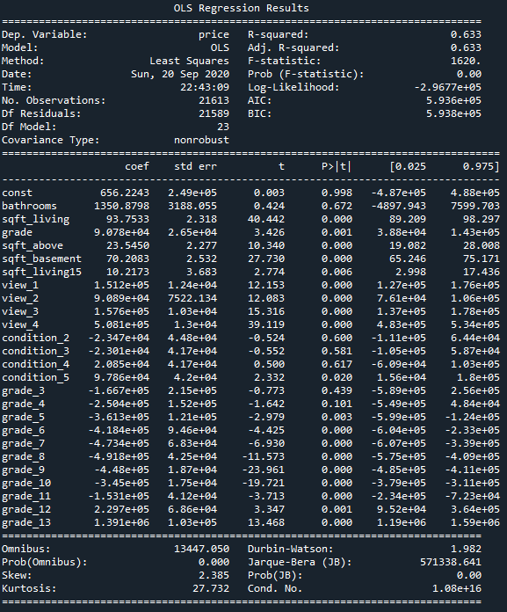
Add categorical variables to variable set
Variable set from last assignment
Add categorical variables into dummy variables
Interpretation
1.
R-squared value increased
F-statistic is decreased
Result after adding categorical variables
Result before adding categorical variables
1
1
Statistical Uncertainty has increased
2.
P > | t | is increased significantly
for ‘const’, ‘bathrooms’
2
2
Statistical Uncertainty has increased
3
3.
P > | t | is unusually high
for some variables
1. Variable ‘condition’ is not
appropriate factor to predict target
2. Variable ‘grade’ has potential as factor
after preprocessing (removing 3, 4)

Slide 3

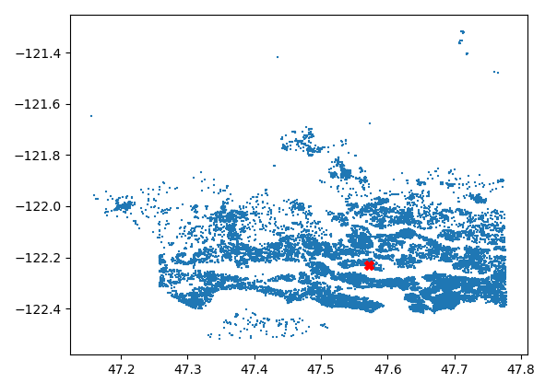
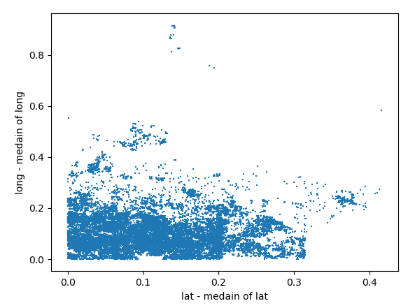
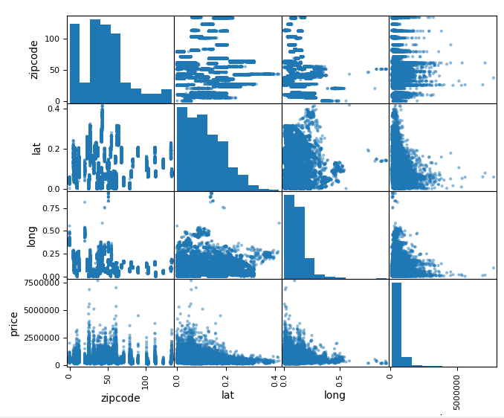
Ideas to utilize zipcode, lat, and long
Without other resources:
With other resources:
They are related with location
Problem is how to distinguish in same location
it would be possible
to rearrange them with new standard
Rural area, which means far away from center, is secured
How about near center?
How about designating center and
rearrange them by distance from center?
Need criterion to use in center to classify:
Possibly size of residual space
1
Especially in urban area, size of house is directly connected
to price of house
Result
I might be able to predict correlation between ‘price’ and ‘distance’
only in case of far from center.
1.
Even after arrange variables based on center,
they are not well centralized
Maybe we can split them
into two groups
By using k-means
Other resources which could be regarded:
‘sqft_xxx’

