Slide 1
Assignment 04
Forecast Sales
15146314 Yang, Seunghyuck

Slide 2
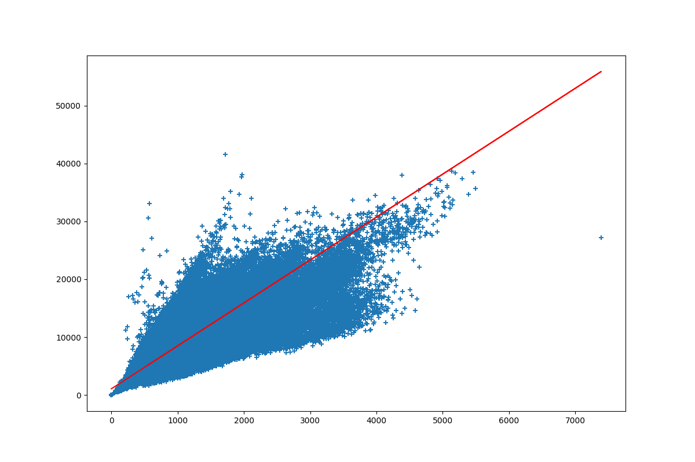
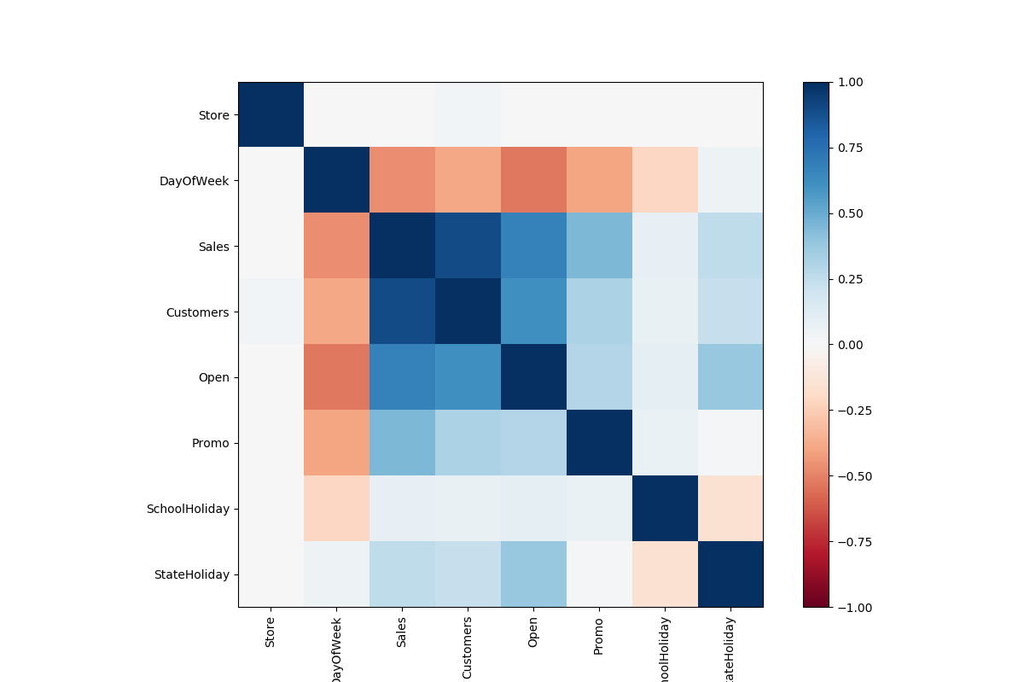
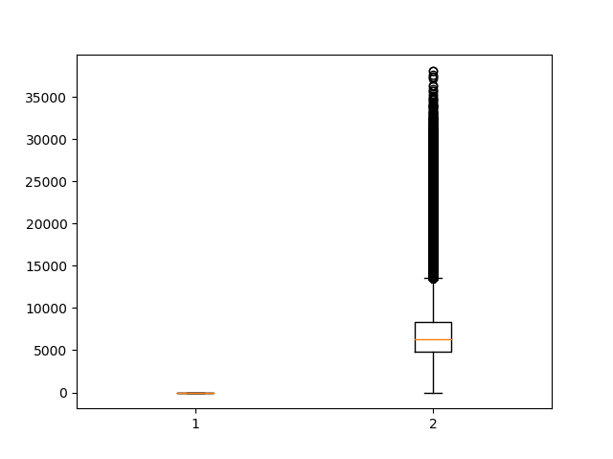
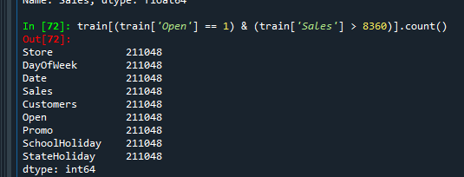

Select explanatory variables
Select learning methods
Summarize
Correlation Graph
Customer
Open
Tier 1: Customers, Open, Promo
Tier 2: SchoolHoliday, StateHoliday, DayOfWeek
High correlation
Observable data
Select
Binary data
Clear relationship
Reasonable correlation
Outliner is too lot
Select without transform

Slide 3
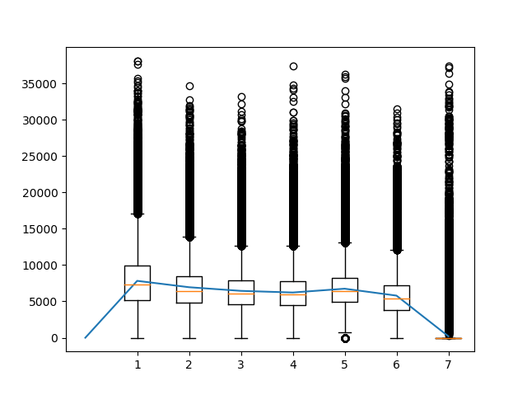
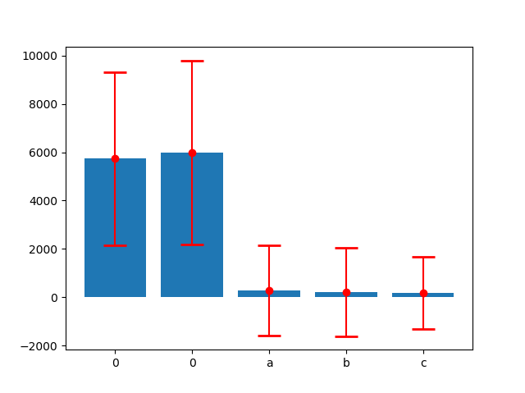
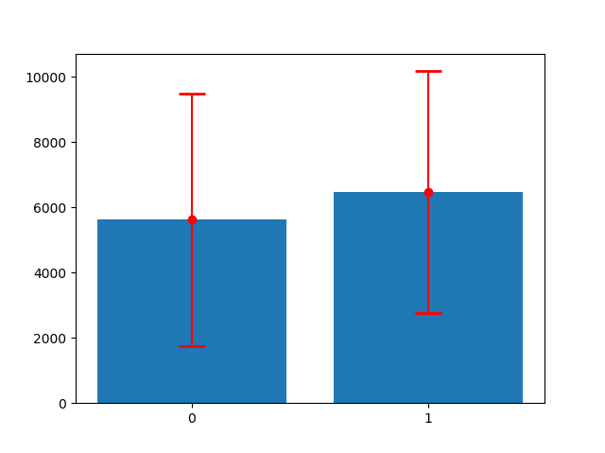
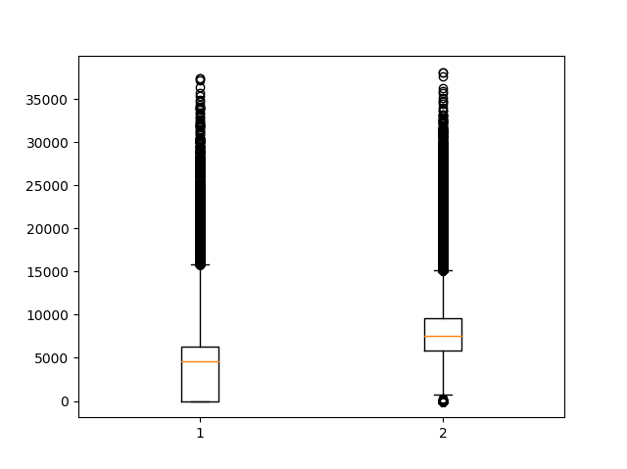
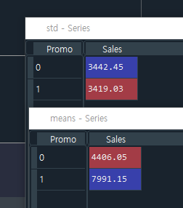
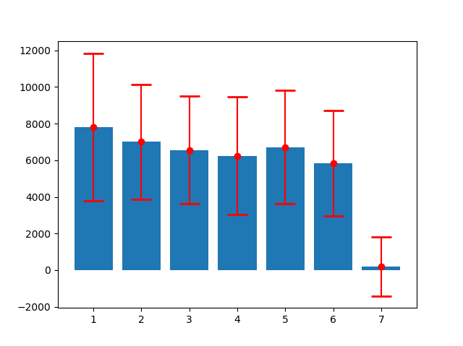
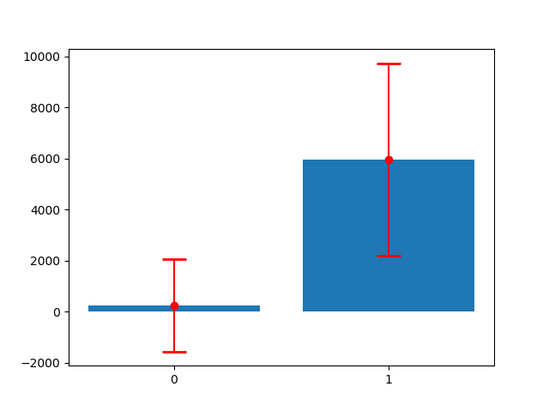
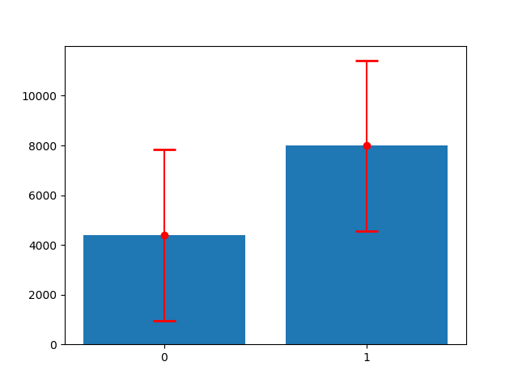
Select explanatory variables
Select learning methods
Summarize
Promo
DayOfWeek
SchoolHoliday
StateHoliday
Binary data
Prominent correlation
Observable gap
Standard deviation is too high
Discard
Categorical data
Low correlation
Barely see difference in overall
Clear gap between 7 and others
Select with transform
Binary data
Low correlation
Barely see difference in overall
Discard
Categorical data
Low correlation
Barely see difference in overall
Low correlation after transform
Discard

Slide 4
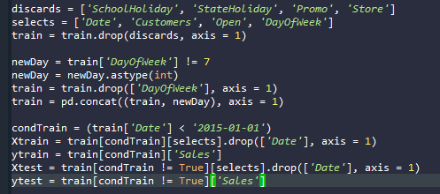
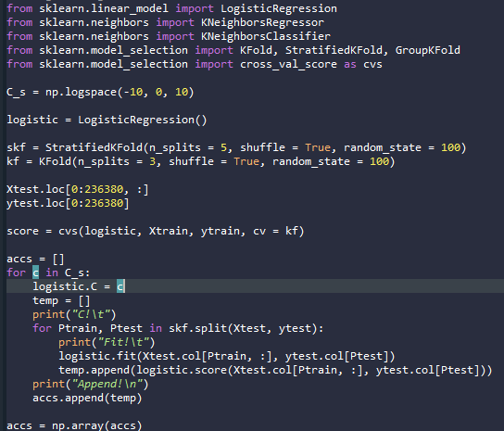
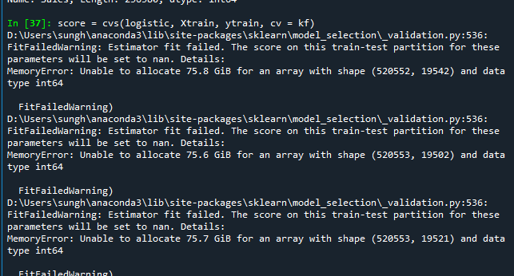

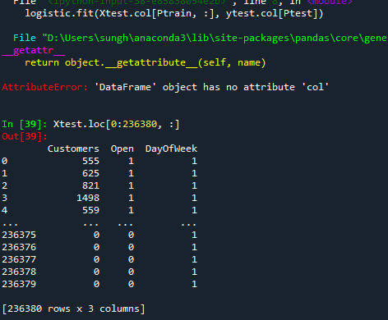
Select explanatory variables
Select learning methods
Summarize
Preparing data
Evaluating variables through Cross Validation
Logistic Regression
KFold
StratifiedKFold
Transforming data
Split data into 4 pieces
2013 – 2014 / 2015
Xtrain, ytrain, Xtest, ytest
Choose Logistic Regression
KFold, StratifiedKFold
Compare Accuracy
Modify variable sets
Find better variable sets

Slide 5
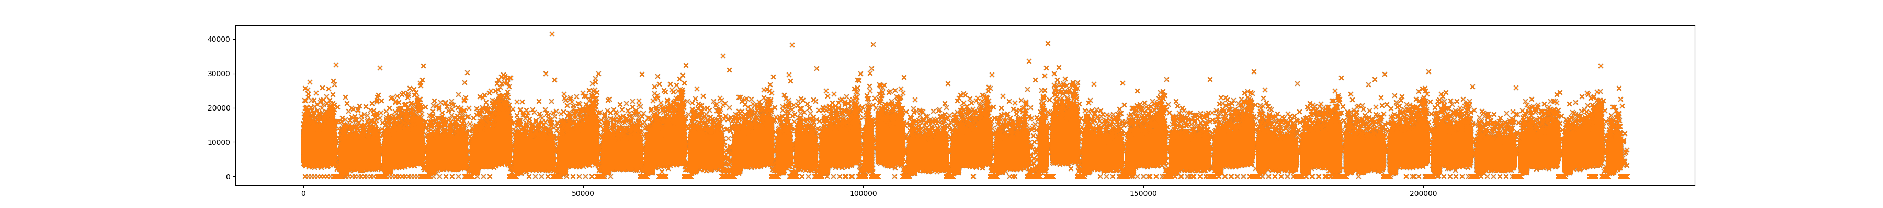
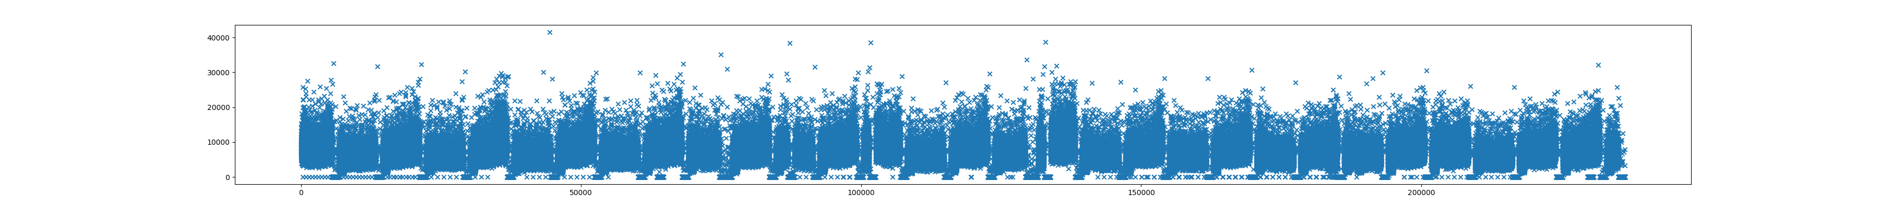
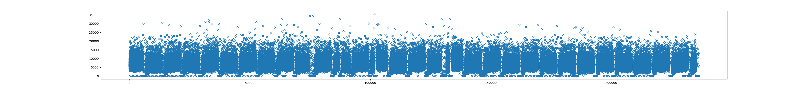
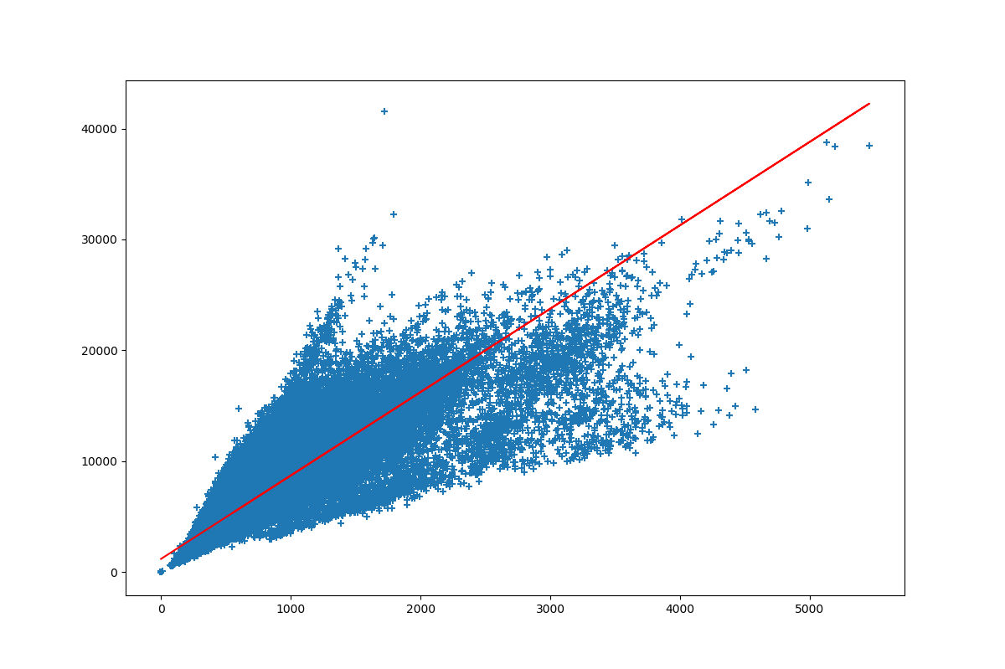
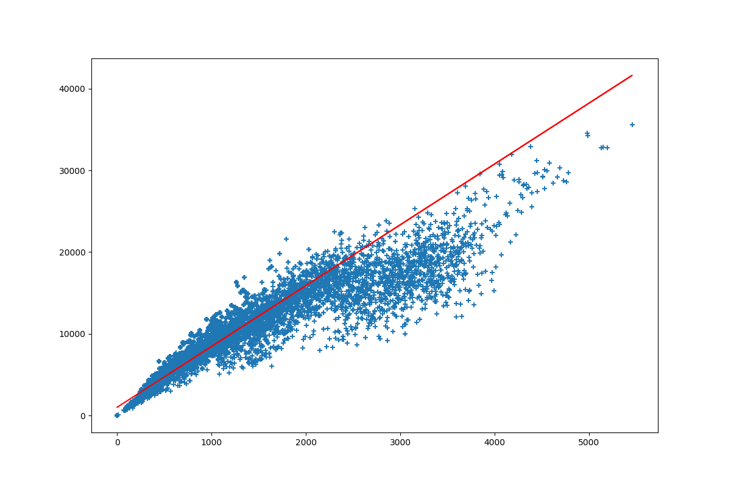
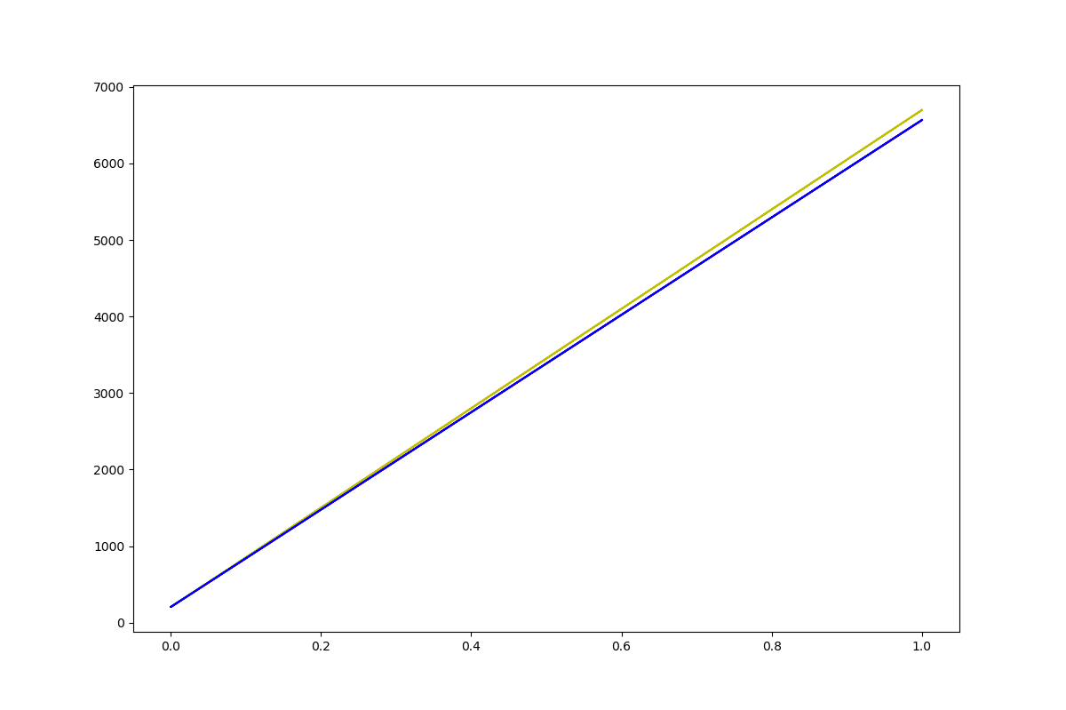
Select explanatory variables
Select learning methods
Summarize
Linear Regression
Actual data
KNeighbors Regression
Scatter plot with regression line for each Sales ~ Dates
Scatter plot with regression line for each Sales ~ Customers
Regression lines for each Sales ~ DayOfWeek (Binary)
R^2: 0.82970197
R^2: 0.80344976

