Slide 1

Reaction Coordinate & Electron Density Analysis
LABORATORY NOTEBOOK / 2030 EXPERIMENTS
Automated IGM Analysis of
Reaction Mechanism Pathways
Students: NOOR Manahil
LOPEZ MATA Ivan
MOJICA FLORES Randy
SPASOVSKA Anja
SOROUT Payal
Supervisor:
Dr. Yann Cornaton
Project :
Hackathon 2026– IGM Automation

Slide 2
Outline
1 Introduction & Challenges
2 Theoretical Background
3 Methodology
4 Analysis & Results
5 Conclusion
2

Slide 3
Introduction
3

Slide 4
Why the Reaction Coordinate Matters
What Is the Reaction Coordinate?
A path showing how a reaction proceeds from reactants to products
The IRC is the lowest-energy path through this landscape
Our project analyzes 46 points along this path, each a distinct molecular arrangement
Why the IRC Matters
Reveals where bonds break and form
Identifies the transition state precisely
Validates the reaction mechanism
Tracks electron redistribution quantitatively
4

Slide 5

From Manual Effort to Automation
The Manual Process
Manual Steps
Why It Is a Problem
46 points along the path (02-47)
Manual: ~1~3 min/point
Automated: <1 sec/point
Automated total: ~5 min for all 46 points
PER POINT (MANUAL)
Time-consuming
Error-prone & inconsistent
1~3 min
Automation lets scientists focus on chemistry!
5

Slide 6

Project Objectives
Automate the analysis of Intrinsic Reaction Coordinate (IRC) points using IGM interaction descriptors.
Quantify how electron density is shared between atoms along the reaction path
Build a scripting pipeline that scales effortlessly from a handful of files to thousands, removing manual bottlenecks.
6

Slide 7
Theoretical Background
7

Slide 8

The IGM Concept
How can we tell if two atoms are interacting?
Virtual system (no interaction): ∇ρ_IGM = |∇ρ_A| + |∇ρ_B|
Real system (interacting): ∇ρ_real = ∇ρ_A + ∇ρ_B
The difference = δg (delta-g)
δg = 0 → no interaction; δg > 0 → interaction exists
8

Slide 9
IGMPlot
Methodology
9

Slide 10







The Automated Workflow
1
Input: 46 IRC Geometries
2
Geometry Parsing
3
Python Extraction
Binary coordinates (.rkf)
Individual input file generation
QM optimization at each IRC point
Output file mining from QM single-point energies calculation
6
Visualization & Interpretation
Final Analysis
5
4
Coordinate Harvesting
δg Profile
Transition State ID
Mechanism Insight
Parse results into master.csv
IGM Interfacing
Batch call to IGMPlot for δg
10

Slide 11
Integrated Technology Stack
From geometry files to interaction maps
Python Scripting
Input generation and master loop control
IGMPlot Core
Advanced interaction index calculation
Visual Analytics
Matplotlib & VMD for mechanistic mapping
11

Slide 12
Automatization
Methodology

Slide 13
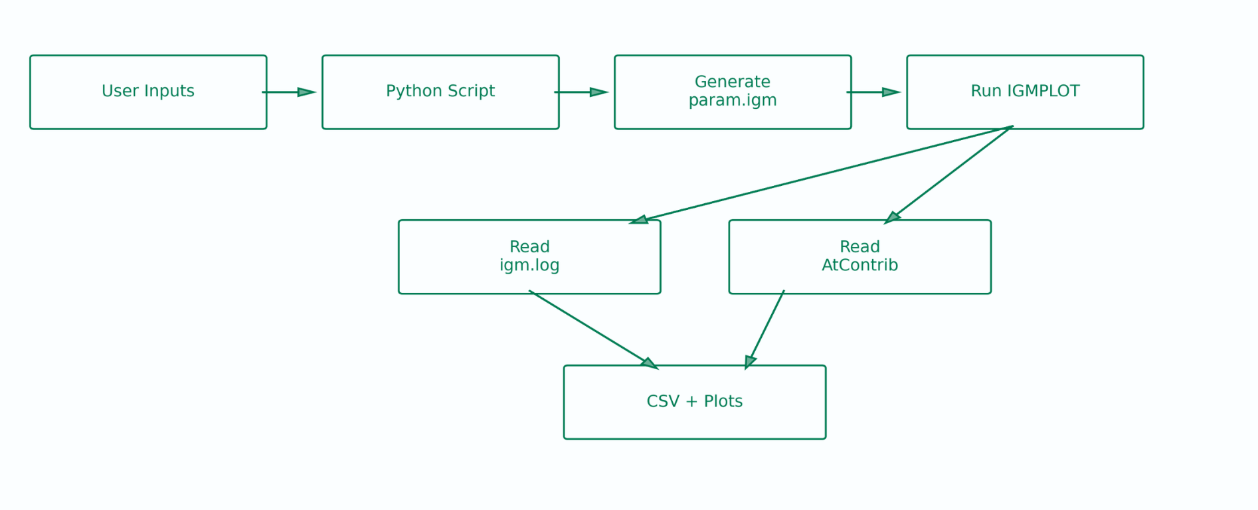
Script-workflow
11

Slide 14
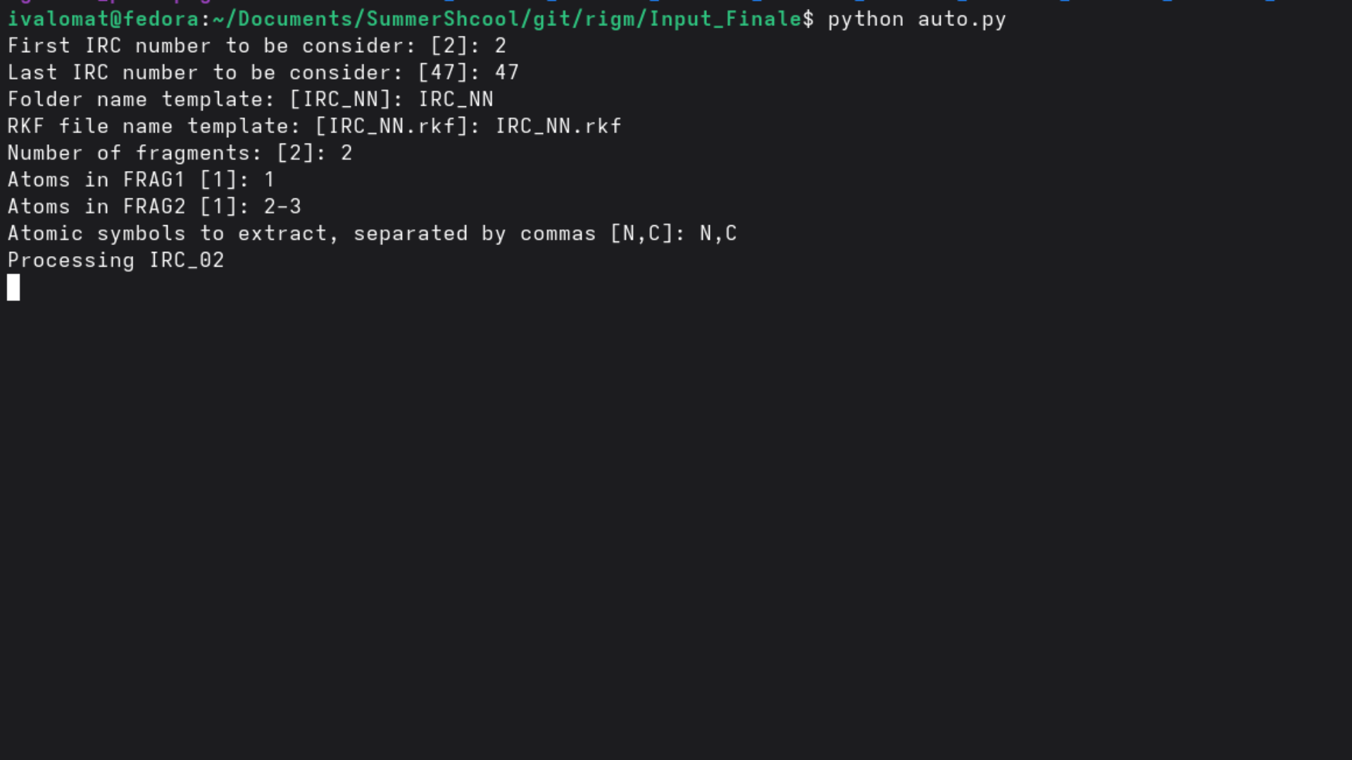

Slide 15
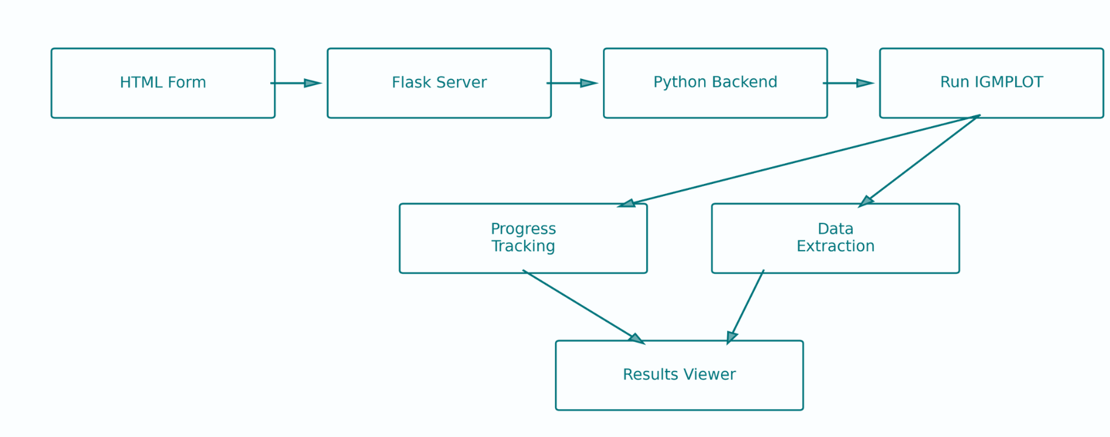
HTML-workflow
11

Slide 16
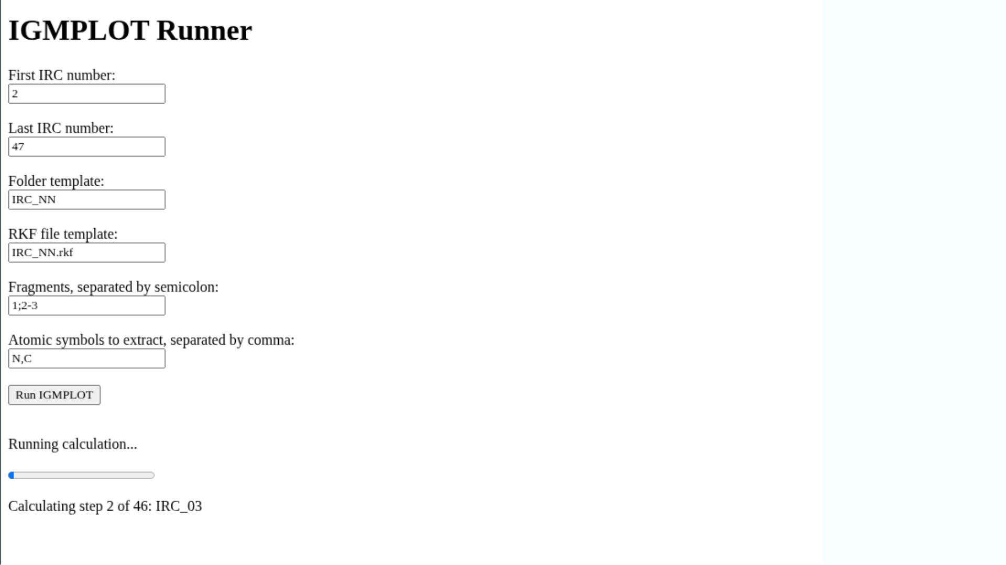

Slide 17
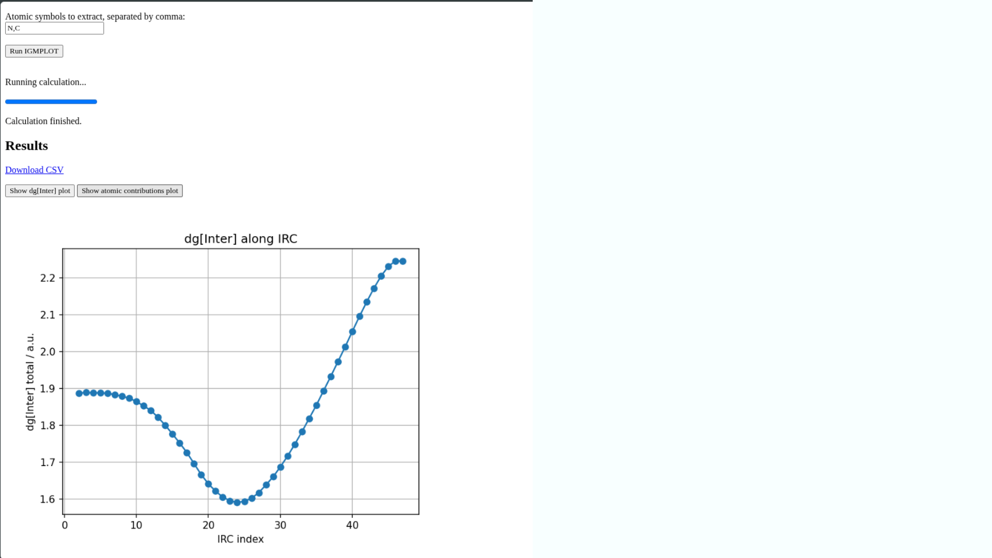

Slide 18
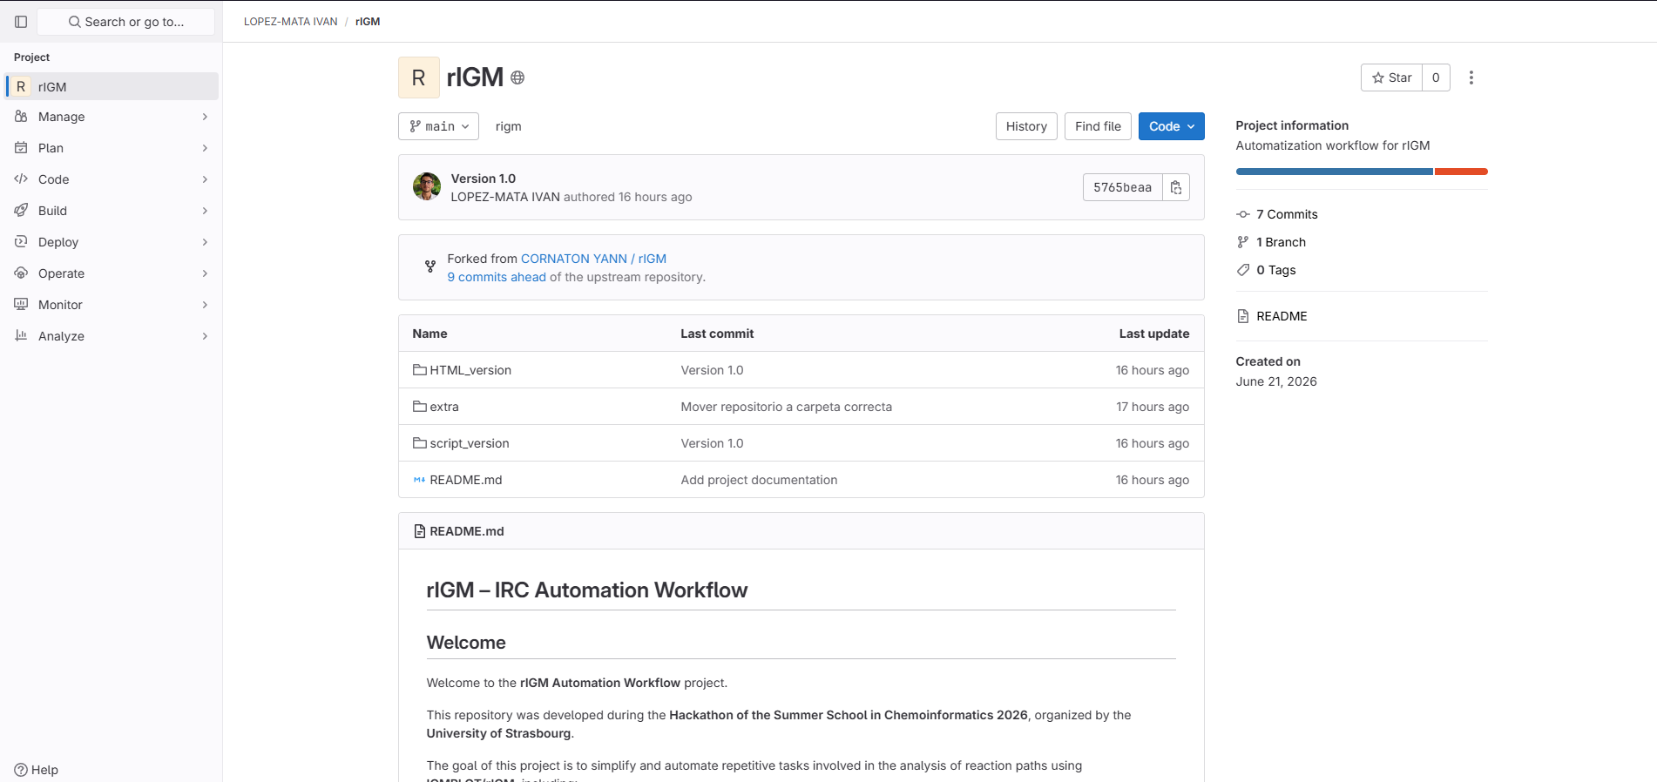
https://git.unistra.fr/ilopezmata/rigm

Slide 19
Analysis & Results
13

Slide 20
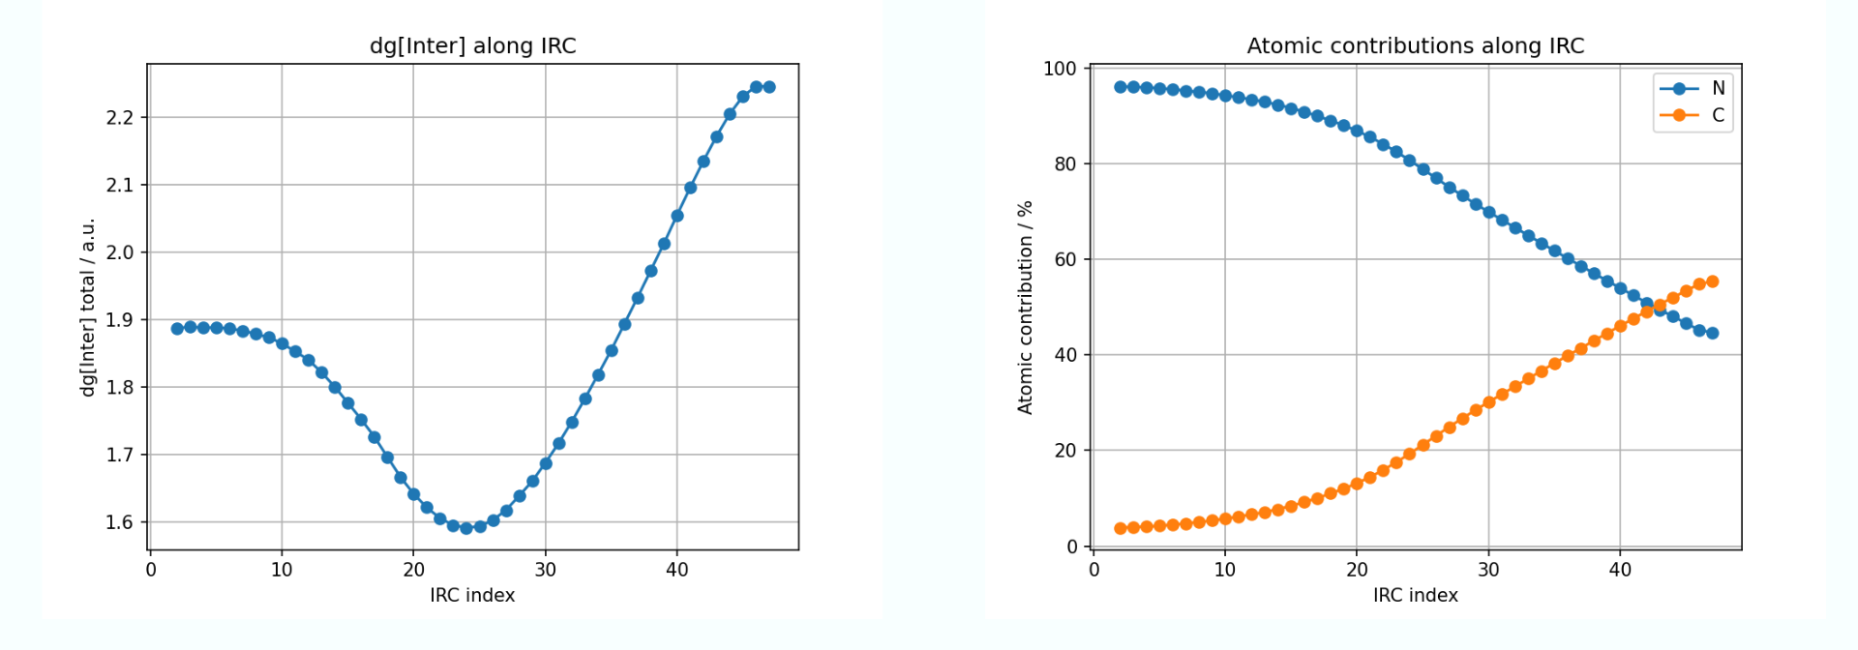
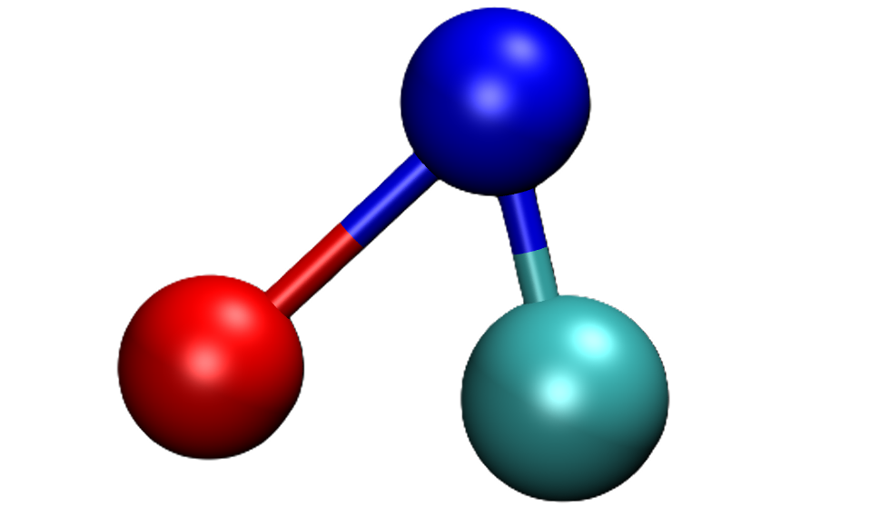
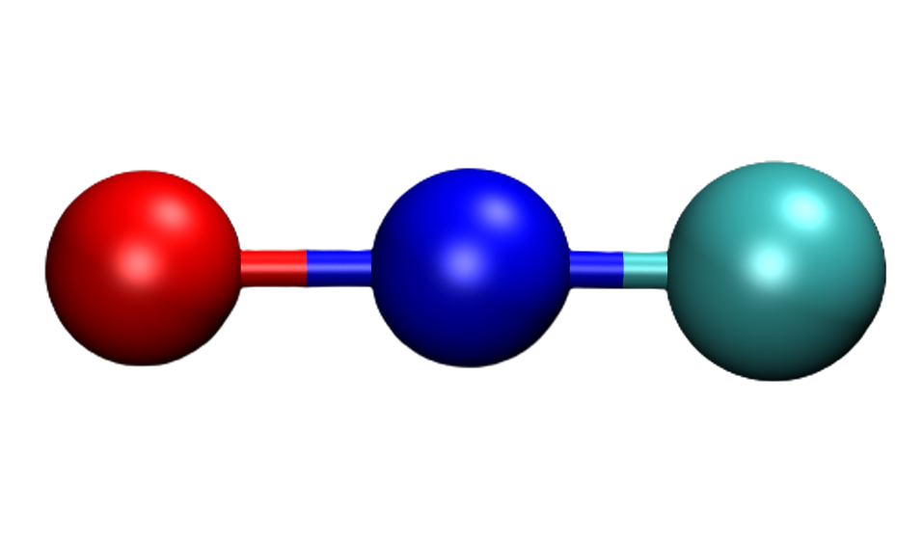
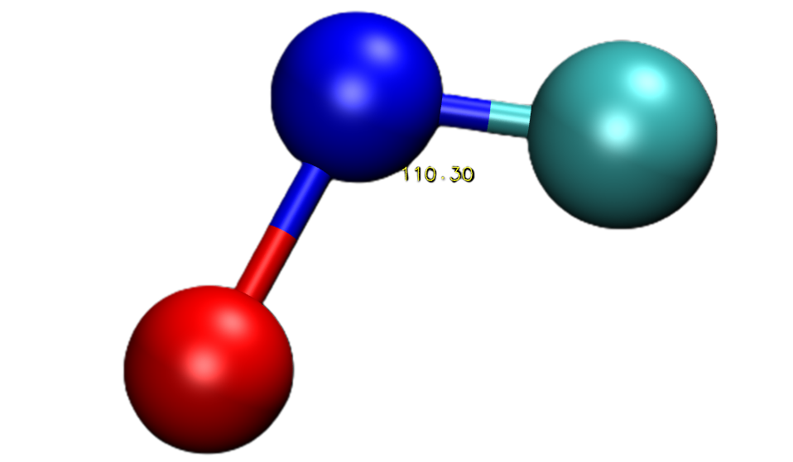
RESULTS

Slide 22
Conclusion
15

Slide 23
Conclusion
1. The script scales effortlessly:
Python scripting with interactive system where user can add IRC range, file templates, fragment definitions and atomic symbols and python generates all the input files automatically. It calls IGM plot which do all the QM calculations.
2. Automation removes the bottleneck without losing accuracy:
The same 46 points now process in ~5 minutes, with data visualization included (matplotlib for 2D and VMD for 3D), with fully reproducible results.
3. Manual mechanism analysis does not scale:
A single 46-point IRC took 1~3 minutes by hand — impractical for larger studies sampling hundreds of coordinate optimization steps, even more so with frequency calculations.
4. This paves the way for larger chemoinformatics pipelines:
Automated, reproducible analysis can feed directly into machine learning and large-scale reaction screening.
16

Slide 24
Thank you!!
Thank you for your attention. Questions?
17

