Slide 1
MedOracle
Final
Evaluation
2026
Multimodal Emotion Recognition
with Explainability
Suhira Balarajan
Vanaiyan Kirupagaran
Adshaya Balarajah
214206G
214215H
214024V
Physiological (EEG+GSR)
Video + Fusion
Explainability + Web App
University of Moratuwa — Level 4 FYP, 2026
Supervisor: Dr. Firdhous M.F.M.

Slide 2
The Problem
⚠
Single-modality systems are unreliable
MedOracle
Solution
EEG-only or video-only models fail when signal quality degrades. Real environments are noisy.
Fuses EEG, GSR
& facial video
🔍
No explainability in clinical settings
Confidence-gated
fusion with quality
penalty
Clinicians cannot trust black-box predictions. SHAP explanations bridge the gap between model and expert.
SHAP explanations
per modality
📊
No graceful degradation
Existing fusion models collapse when one modality is missing. MedOracle falls back gracefully.
Graceful degradation
when signal is poor

Slide 3
System Architecture
M1 — Physiological
(Suhira 214206G)
EEG + GSR
(DEAP — 32 subjects)
BiCrossModal Attention
EEGEncoder + GSREncoder
M3 — SHAP + Web App
(Adshaya 214024V)
Macro-F1: 0.4171 (random split)
0.1791 (LOSO)
Prediction
+
Explanation
Gated Fusion Layer
(confidence × quality penalty)
Kernel SHAP + FastAPI
React Dashboard + LLM Chatbot
M2 — Video + Fusion
(Vanaiyan 214215H)
5 emotions: stress · calm · happy · sad · angry
Facial Video
(CREMA-D + RAVDESS)
ResNet50 + BiLSTM
Gated Confidence Fusion
Video Macro-F1: 0.6615
Datasets: DEAP (32 subjects, EEG+GSR) · CREMA-D (91 actors, video) · RAVDESS (video)

Slide 4
Datasets & Label Harmonization
DEAP Dataset
CREMA-D + RAVDESS
32 subjects, 40 trials each (60s per trial)
CREMA-D: 91 actors, ~7,442 video clips
EEG: 32 channels @ 128 Hz
RAVDESS: additional video data
GSR: 1 channel @ 128 Hz (resampled)
6 original labels: ANG, DIS, FEA, HAP, NEU, SAD
Labels: Valence · Arousal · Dominance (1–9 scale)
DIS label dropped — no clean mapping
19,200 windows (4s × 15 windows × 40 trials × 32 subjects)
~6,250 usable clips after filtering

Slide 5


Label Harmonization
Unified 5-Class Label Mapping (Russell 1980 · Mehrabian 1996 · Kreibig 2010)
Unified Emotion | DEAP V/A/D Thresholds | CREMA-D Label Mapping | Psychological Foundation
Stress | Valence < 5, Arousal ≥ 5, Dominance < 5 | Fear (FEA) | Kreibig 2010 (High Arousal Negative)
Calm | Valence ≥ 5, Arousal < 5, Dominance ≥ 5 | Neutral (NEU) | Russell 1980 (Low Arousal Positive)
Happy | Valence ≥ 5, Arousal ≥ 5 (Any Dominance) | Happy (HAP) | Mehrabian 1996 (High Arousal Positive)
Sad | Valence < 5, Arousal < 5, Dominance < 5 | Sad (SAD) | Russell 1980 (Low Arousal Negative)
Angry | Valence < 5, Arousal ≥ 5, Dominance ≥ 5 | Angry (ANG) | Mehrabian 1996 (High Arousal Negative)
Datasets used: DEAP (32 subjects, 19,200 windows) · CREMA-D (91 actors, 6,250 clips) · RAVDESS (additional video validation).

Slide 6

M1 — Physiological Module
Suhira Balarajan — 214206G
EEG Input
32 ch × 512 samples
EEG Encoder
(Conv1D + Transformer)
BiCrossModal
Attention
Classification
Head (5-class)
Emotion
Output
GSR Input
1 ch × 512 samples
GSR Encoder
(Conv1D + Linear)

Slide 7


M1 — Physiological Module
Signal Processing & Pipeline
Key Design Decisions
EEG Input: 32 channels × 512 samples fed to Conv1D + Transformer encoder.
LOSO Evaluation: 32-fold Leave-One-Subject-Out protocol representing strict cross-subject generalization.
GSR Input: 1 channel × 512 samples processed via Conv1D + Linear layer.
Model Soup: Averages weights across all 32 LOSO folds (Wortsman et al. 2022) to prevent overfitting.
BiCrossModal Attention: Bidirectional attention allowing EEG features to attend to GSR features and vice versa.
Quality Pre-checker: Computes per-modality signal quality flags (good / degraded / poor).

Slide 8
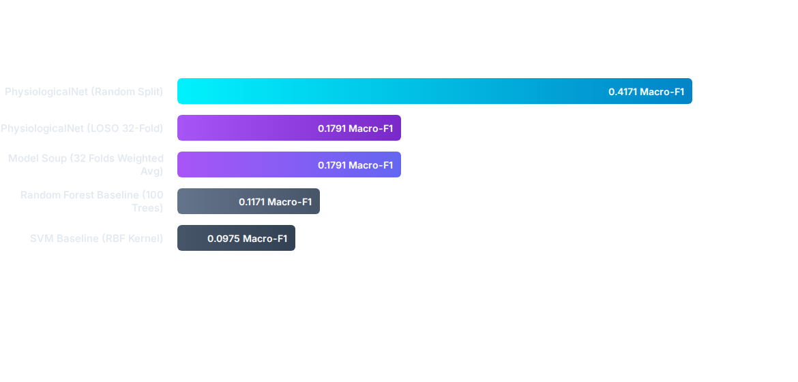
M1 Performance & Baselines

Slide 9
M2 — Video Recognition Pipeline
0.6615
Video
Macro-F1
Vanaiyan Kirupagaran — 214215H
Video
(.mp4)
16 Frames
Uniform
Sampling
ResNet50
(layer3+4
fine-tuned)
BiLSTM
(2 layers
256 hidden)
Softmax
5-class
P_video
Training Strategy & Key Fixes
Per-Class Test F1 (788 held-out clips)
Discriminative LR: backbone (layer3+4) @1e-5, head+BiLSTM @5e-4
happy
0.82
strongest
Fixed overfitting (train 0.88/val 0.63) → healthy 0.62-0.66 generalisation
angry
0.73
Frozen BatchNorm + cutout augmentation for robustness
calm
0.62
Actor-independent StratifiedGroupKFold — no actor leaks across folds
stress
0.60
Full-frame input outperforms YOLO-cropped face (0.70 vs 0.56 macro-F1)
sad
0.54
weakest — confused with stress

Slide 10
M2 — Gated Confidence Fusion
Vanaiyan Kirupagaran — 214215H
Quality-Aware Fusion Formula
Graceful Degradation
Confidence: c_m = 1 − H(P_m) / log(K) (H = entropy, K = 5 classes)
Both modalities good
→ Full gated fusion
Guo et al. (2017): entropy-based confidence calibrates better than raw softmax
Quality penalty α: good = 1.0 · degraded = 0.5 · poor = 0.1
Video poor / missing
→ Physio only
Gate score: g_m = c_m × α_m
Physio poor / missing
→ Video only
Weights: w_m = g_m / Σ g_m (L1-normalised — preserves extreme gaps,
unlike softmax, which compresses large confidence differences)
Both poor / missing
→ Uniform dist. + flag
Fused prediction: P_fused = Σ w_m × P_m → argmax = final emotion
Verified: 18 unit tests confirm this implementation is numerically
identical (±1e-9) to Member 3's independent reference fusion.

Slide 11
M2 — Ablation Study Results
Vanaiyan Kirupagaran — 214215H
Macro-F1 by Condition (k=20/emotion, n=50 pairings)
Key Finding
Cond.
Description
Macro-F1
Fusion (C5) significantly beats BOTH single modalities (p < 0.001 in both cases).
C1
Physio only
0.443
C2
Video only
0.631
Correctly degrades to physio-only (C7 = C1) when video is unavailable — no crash, no unpredictable output.
C3
Equal weight (0.5/0.5)
0.692
C4
Confidence only (no quality)
0.685
Does not yet beat naive equal-weight (C3): the shipped physio checkpoint has "good" signal quality but weak accuracy, so gating currently over-trusts it.
C5
FULL METHOD (conf × quality)
0.653
C6
Robust: video poor
0.652
C7
Robust: video missing
0.443
Diagnosed, not hidden — expected to resolve once a properly-calibrated physio model replaces the current checkpoint.
C8
Robust: physio poor
0.650
Wilcoxon signed-rank (one-tailed, α=0.05): C5 > C1 p=8.9e-16 ✓ ·
C5 > C2 p=5.5e-10 ✓ · C5 vs C3 p=1.0 (not significant)

Slide 12
M3 — Explainability + Web Application
Adshaya Balarajah — 214024V
Explainability: SHAP + Integrated Gradients on the fused decision
Trust layer: faithfulness verification + modality-conflict resolution
Web app: FastAPI backend, React dashboard, SQLite storage
Chatbot: RAG-grounded, multi-provider LLM (Gemini/Groq/DeepSeek)
★ Key Novelty
Real Integrated Gradients through BOTH trained models (not per-modality) — paired with counterfactual, conflict-based explanation when modalities disagree.

Slide 13
M3 Workflow — Fusion Output to Explanation
Adshaya Balarajah — 214024V
① FastAPI Backend
② SHAP + IG Explain
③ Faithfulness Check
Receives prediction_output via /predict
9 REST endpoints, JWT-authenticated
Persists sessions + SHAP/IG logs
Kernel SHAP: exact Shapley, 4 coalitions
Fused IG: gradients thru both models
Per-channel + per-frame attribution
Perturbs features, re-checks prediction
Completeness / efficiency axiom check
Gap ≈0.06 confirmed on live sessions
④ Conflict Explain
⑤ RAG Chatbot
⑥ React Dashboard
Detects physio vs video disagreement
States which modality gate trusted
Counterfactual: flips the decision
Gemini → Groq → DeepSeek chain
Grounded in ingested research PDFs
Faithfulness-gated, auto-retry
Emotion trend + SHAP/IG charts
Conflict panel + session history
One live view, end-to-end

Slide 14
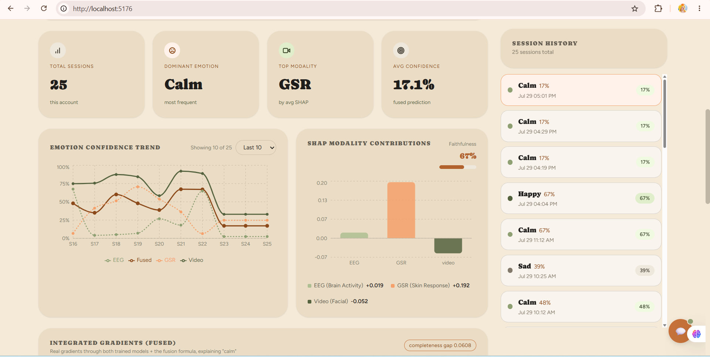
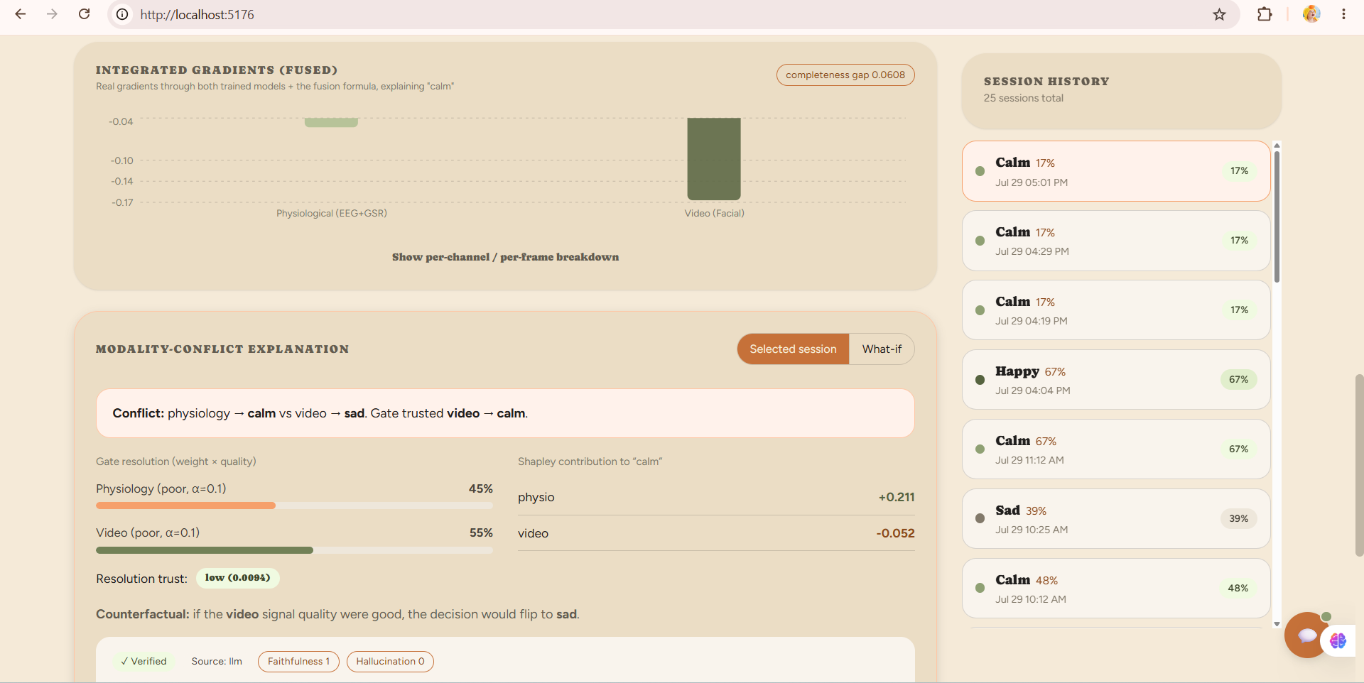
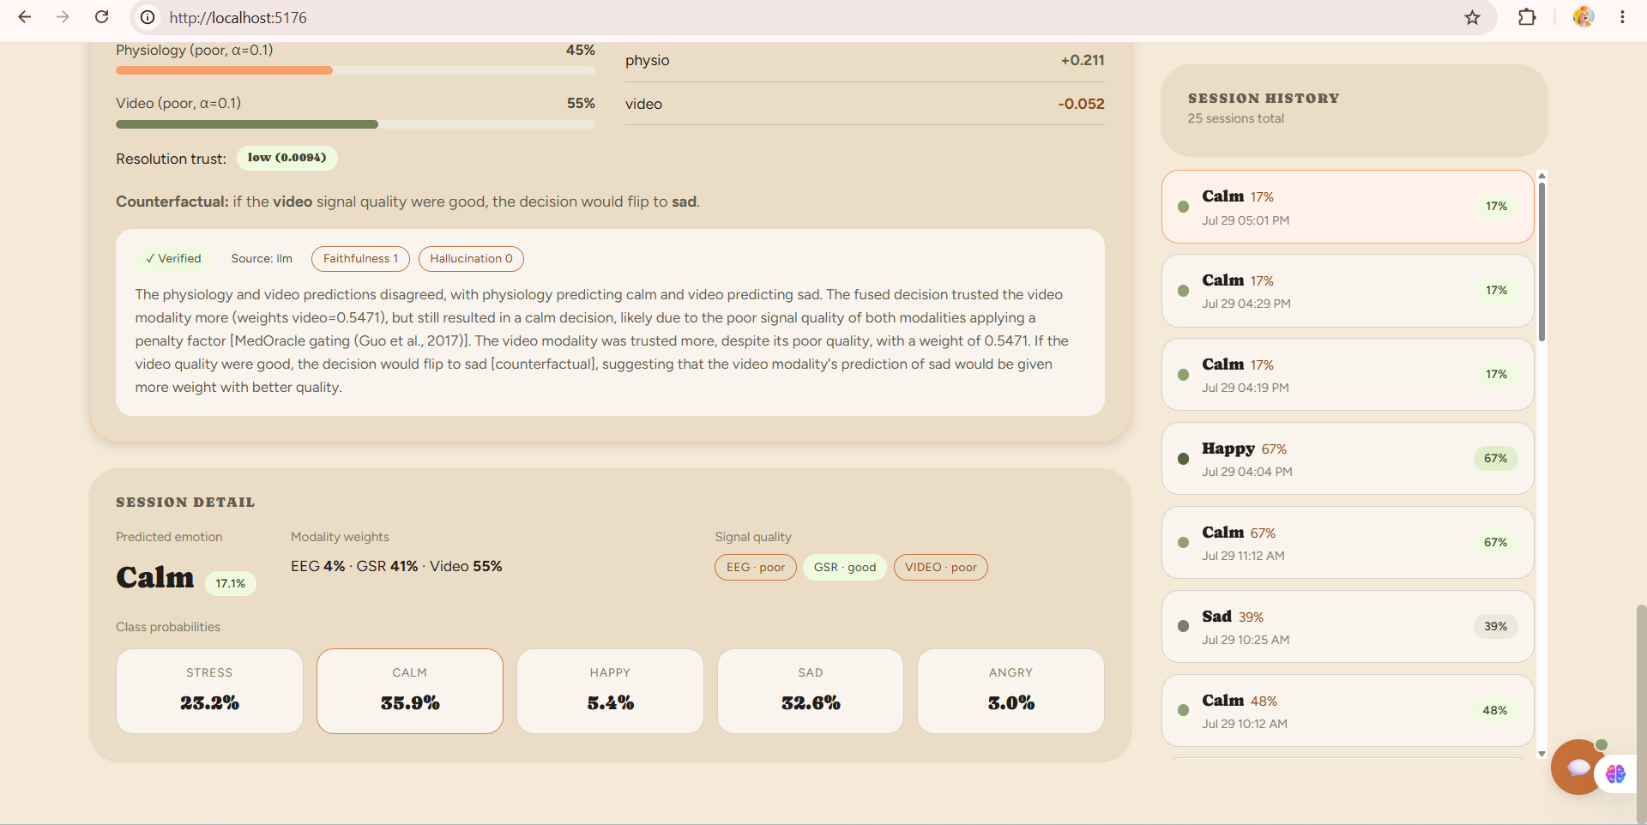
M3 — Live Web Application
Adshaya Balarajah — 214024V
SHAP + confidence analytics
Fused Integrated Gradients
LLM-verified conflict resolution
Every screen above is a real, live prediction — no synthetic demo data.

Slide 15
Demo Flow — End-to-End
User inputs data via the web UI → both models run → fusion → final prediction + explanation
1
User Input via Web UI
🎥 Video file upload (.mp4)
📊 EEG + GSR data selection (DEAP subject · trial · window)
2
M1 — EEG + GSR Model
2
M2 — Video Model
BiCrossModal Attention (BDCA)
EEGEncoder + GSREncoder → 5-class softmax
Outputs: emotion · confidence · class_probabilities · signal_quality
ResNet50 + BiLSTM (16 frames)
Full-frame resize → ImageNet normalise → 5-class softmax
Outputs: emotion · confidence · class_probabilities · video_quality
3
Gated Fusion Layer
Confidence (entropy-based) × quality penalty α
L1-normalised weights → weighted sum of both P vectors
Graceful degradation if one modality is poor
4
Final Output + Explanation
Predicted emotion · confidence score
Kernel SHAP values per modality
React dashboard · LLM chatbot explanation

Slide 16
Evaluation Summary
M1 — Physiological (EEG+GSR)
M2 — Video + Fusion
Protocol
Protocol
Macro-F1
Macro-F1
Accuracy
Random Split
5-fold GroupKFold
0.6615
0.4171
~42%
LOSO (32 folds)
Video-only inference
0.66+
0.1791
~32%
Model Soup
0.1791
—
Ablation Study (Planned)
SVM baseline
0.0975
16.48%
C1: Physio only (M1)
RF baseline
C2: Video only (M2)
0.1171
24.13%
C3: Equal weights fusion
C4: Confidence-weighted (no quality)
C5: Full method (confidence + quality)
C6–C8: Robustness — poor/missing modality

Slide 17
What We Built
🧠
M1: BiCrossModal Attention
LOSO F1 0.1791 · Random Split F1 0.4171 · Model Soup from 32 folds · Outperforms SVM/RF baselines
🎥
M2: Video + Gated Fusion
ResNet50+BiLSTM · CREMA-D+RAVDESS · Macro-F1 0.6615 · Graceful degradation for missing modalities
📊
M3: SHAP + Web App
Kernel SHAP · FastAPI 9 endpoints · React dashboard · LLM chatbot · /predict/synthetic endpoint
🔗
Full Integration
M1→M2→M3 interface contracts locked · Confidence-gated fusion with quality penalty · End-to-end demo ready

Slide 18
Thank You
Questions?
Suhira Balarajan
Vanaiyan Kirupagaran
Adshaya Balarajah
214206G
214215H
214024V
Physiological (EEG+GSR)
Video + Fusion
Explainability + Web App
University of Moratuwa · Faculty of Information Technology · Level 4 FYP 2026 · Supervisor: Dr. Firdhous M.F.M.

