Slide 1
M2M Communication (MQTT)

Slide 2
INTRODUCTION
M2M communication plays a major role in remote monitoring.
Applications like product refilling, for e.g. a coffee machine can inform the vendor when any of its components (milk, sugar, coffee powder, etc.) quantity is running low.
When comes to the real time world, the volume of data increases with the rapidly increasing network devices. Increased data rate increases data traffic in the network and affects the performance of the system
The main aspect of M2M communication includes remote sensing and control, logistic services, robotics, data warehouse management traffic control, etc

Slide 3
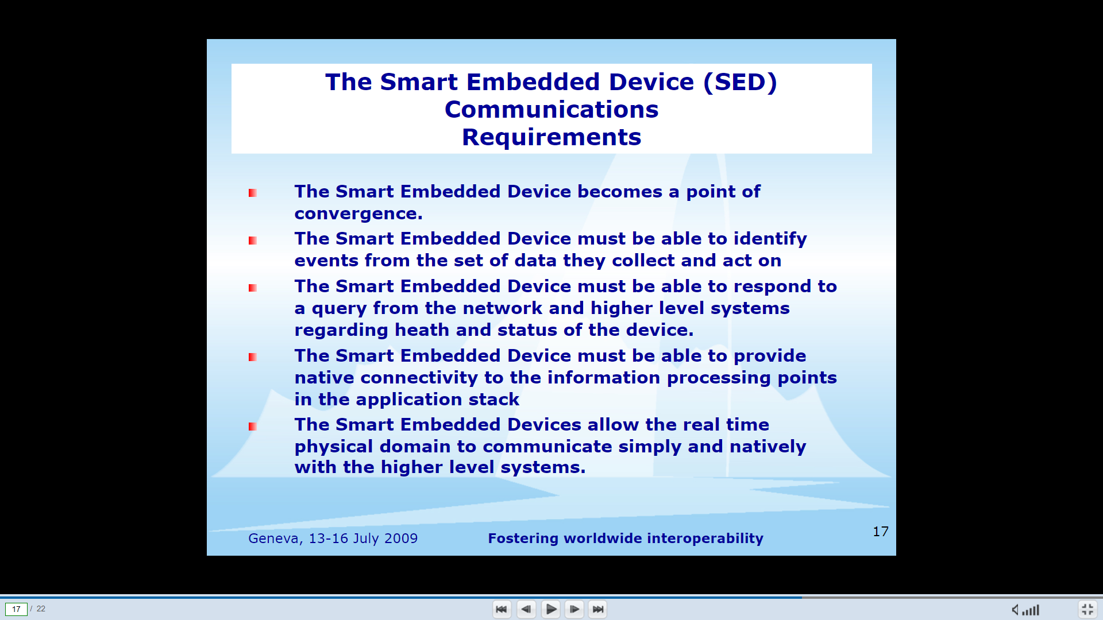

Slide 4
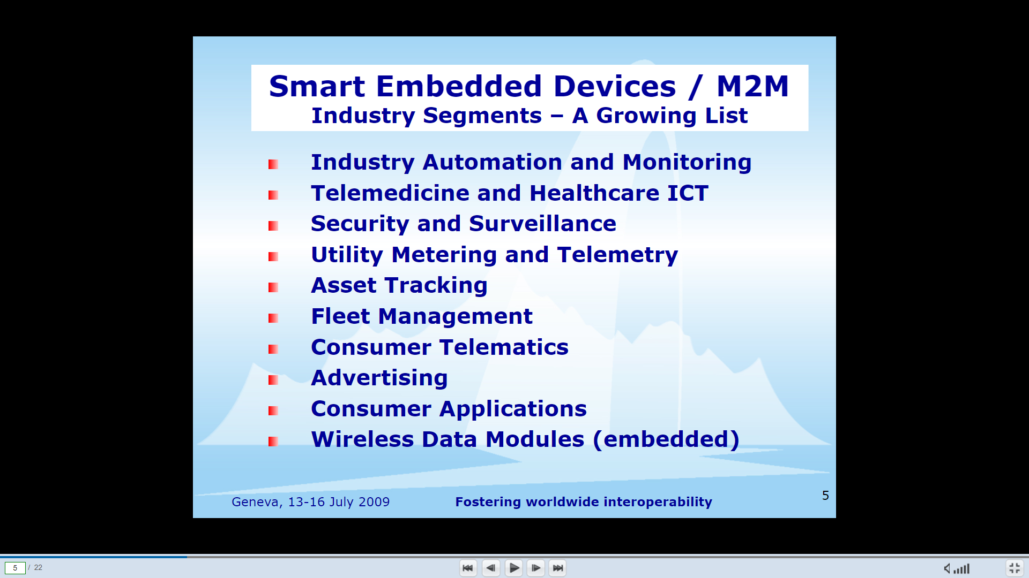

Slide 5
Challenges
The heterogeneity in hardware/ software platforms and complex system structure has resulted in challenges for pervasive access and interoperable sharing of the machine generated data.
The Quality of Information (QoI) becomes an issue.Particularly, machines which perform different functionalities on heterogeneous software and hardware, a standard messaging mechanism for cross-platform technologies which supports the communication between them becomes a concern to make the autonomous industrial systems effective.

Slide 6
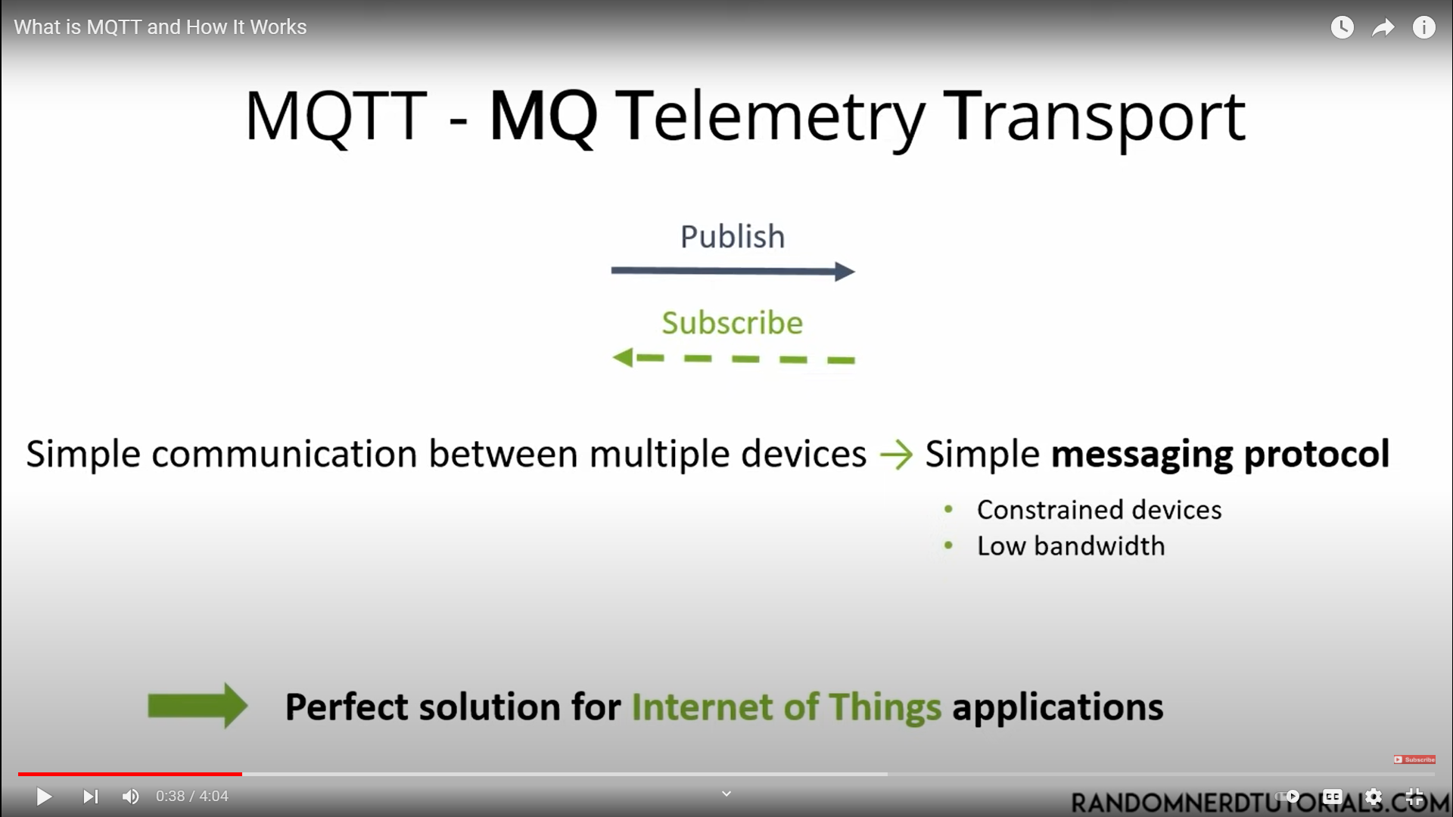

Slide 7
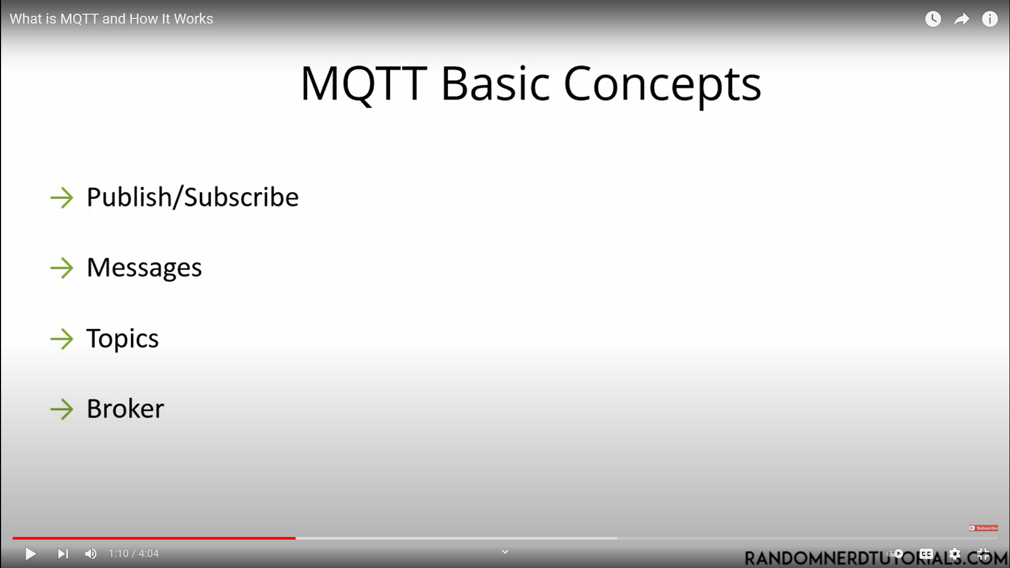

Slide 8
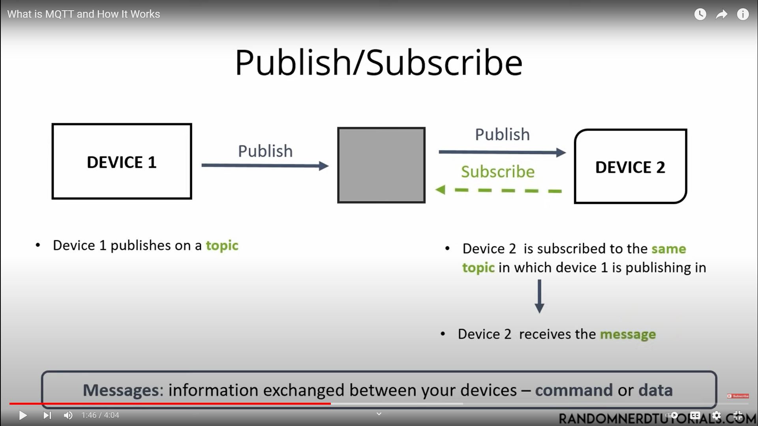

Slide 9
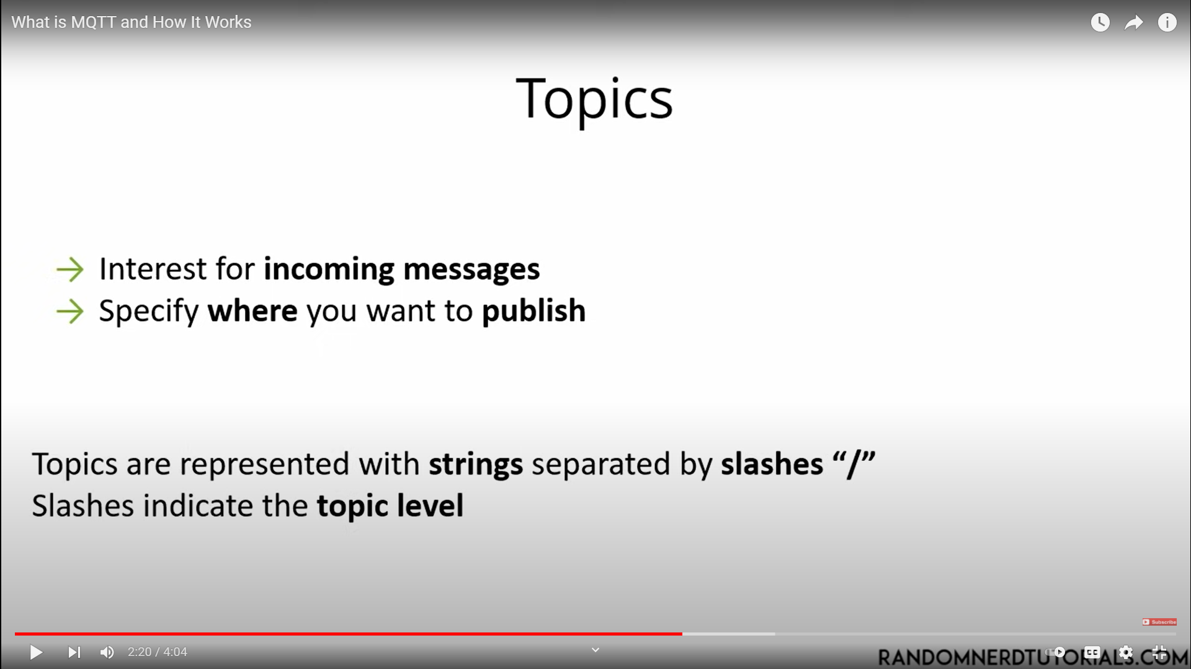

Slide 10
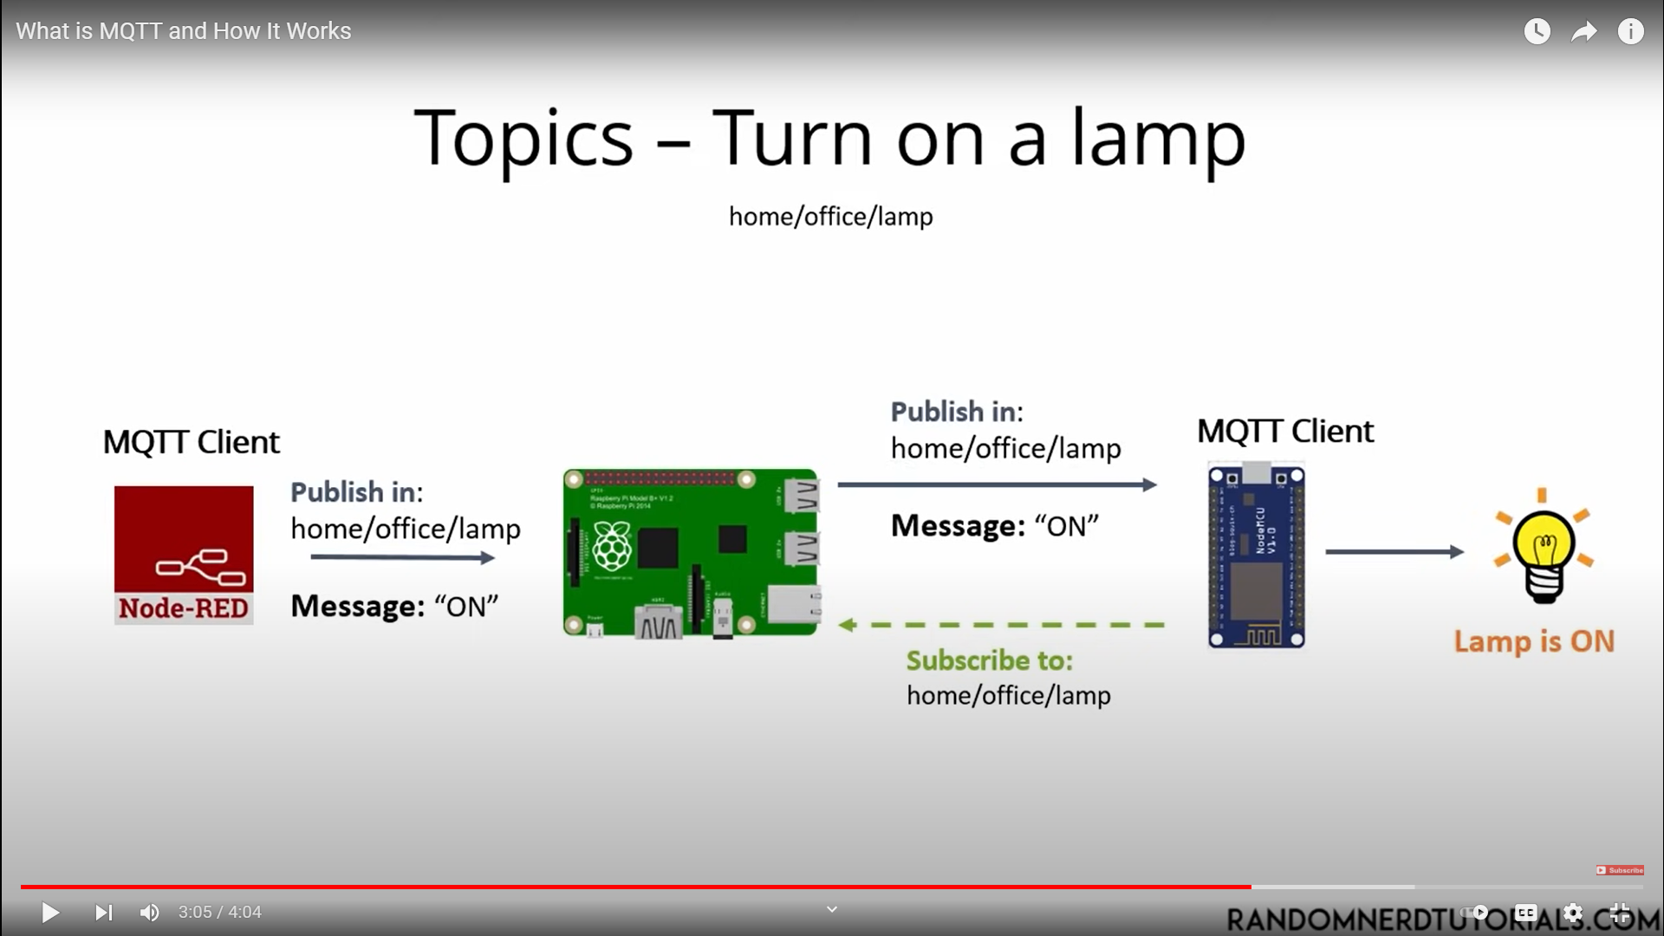

Slide 11
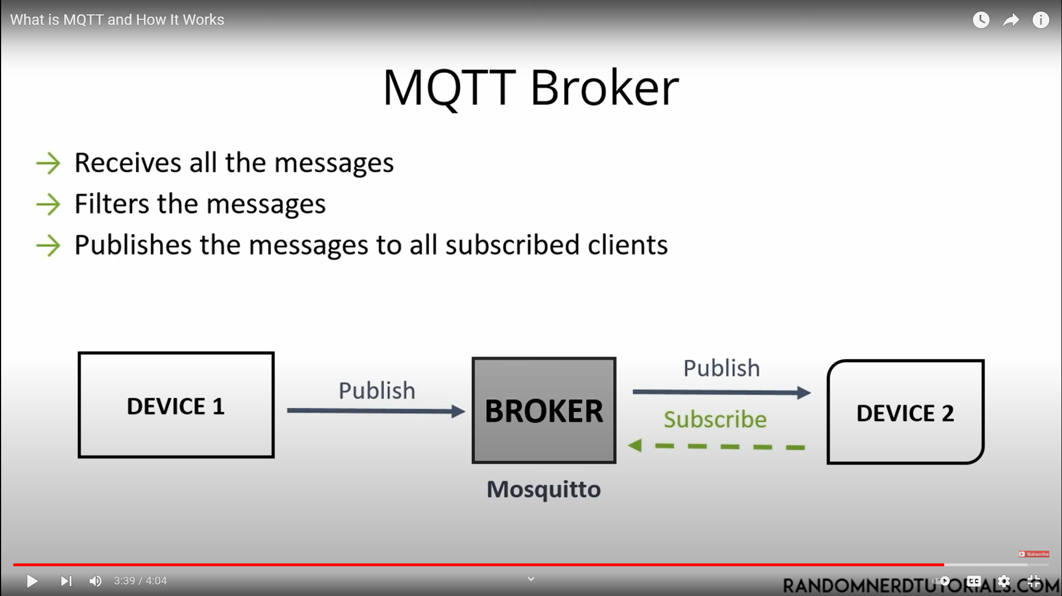

Slide 12
Benefits
efficient data transmission and quick to implement, due to its being a lightweight protocol;
low network usage, due to minimized data packets;
efficient distribution of data;
successful implementation of remote sensing and control;
fast, efficient message delivery;
uses small amounts of power, which is good for the connected devices; and
optimizes network bandwidth.

Slide 13
Drawbacks
MQTT has slower transmit cycles compared to Constrained Application Protocol (CoAP).
MQTT's resource discovery works on flexible topic subscription, whereas CoAP uses a stable resource discovery system.
MQTT is unencrypted. Instead, it uses TLS/SSL (Transport Layer Security/Secure Sockets Layer) for security encryption.
It is difficult to create a globally scalable MQTT network.
Other MQTT challenges relate to security, interoperability and authentication.

Slide 14
RESOURCES
https://internetofthingsagenda.techtarget.com/definition/MQTT-MQ-Telemetry-Transport
https://acadpubl.eu/hub/2018-118-22/articles/22a/13.pdf

Slide 15
THANK YOU
Presented By
VanAJA Malla

