Slide 1
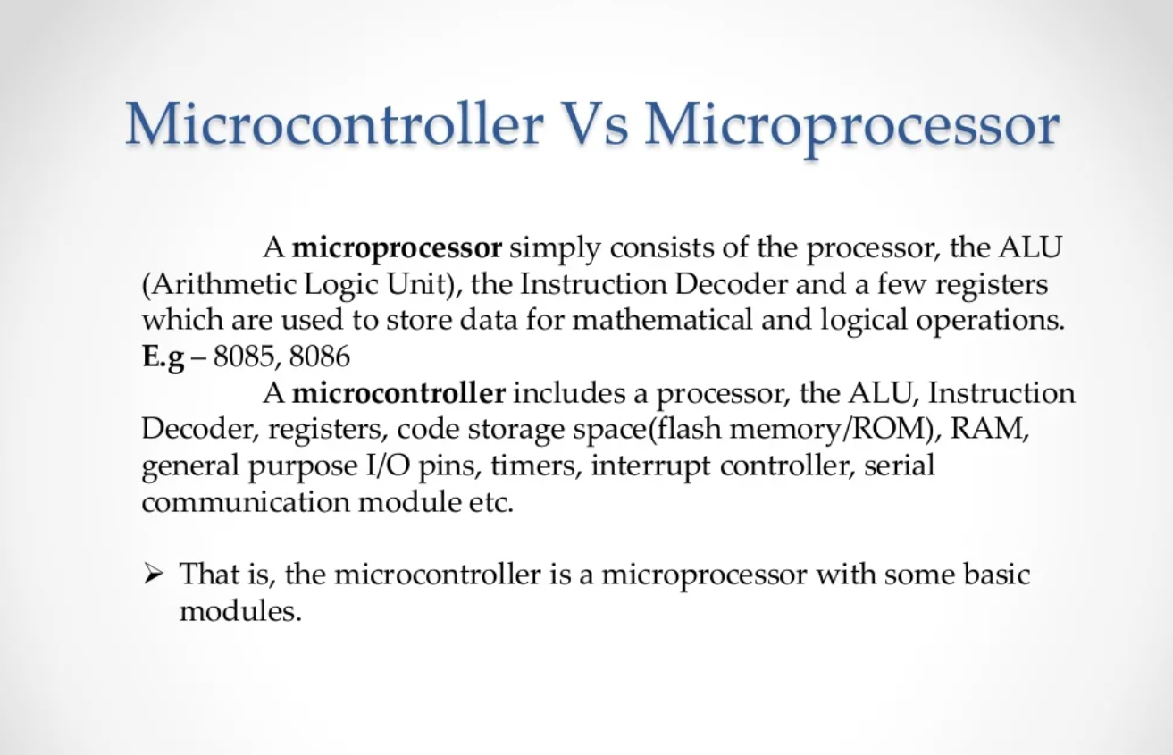

Slide 2
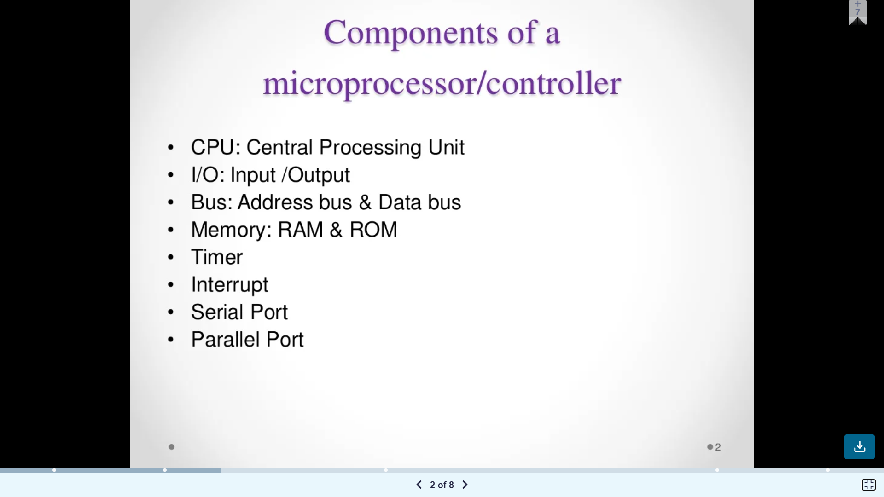

Slide 3
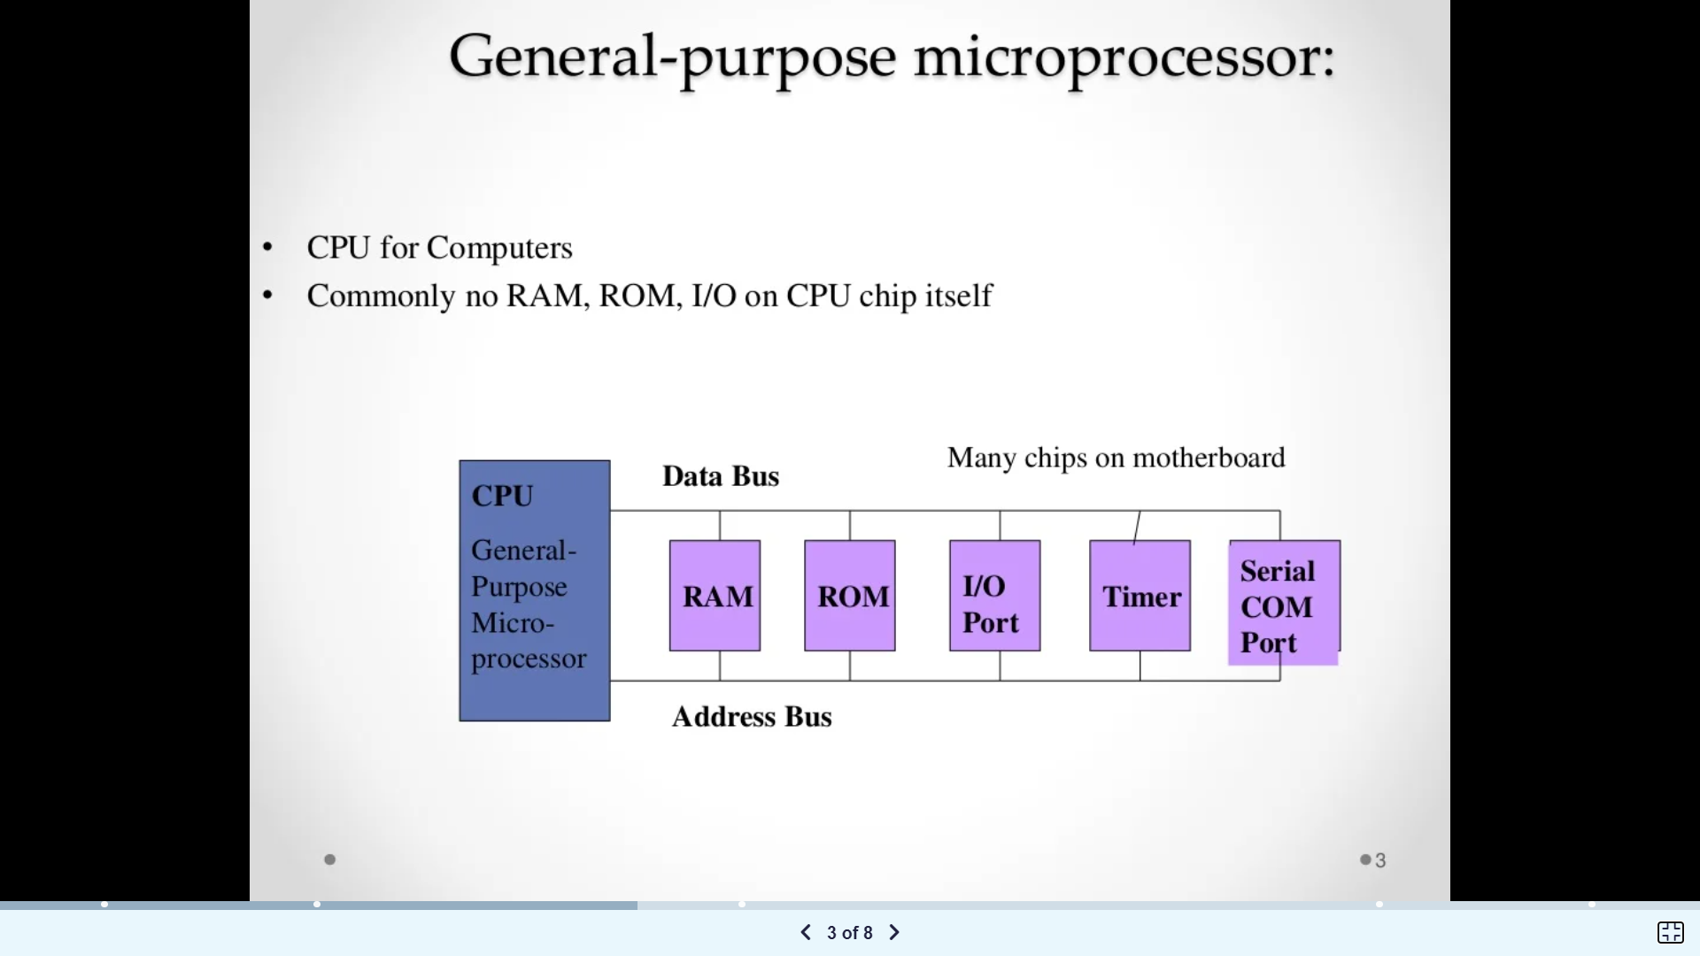

Slide 4
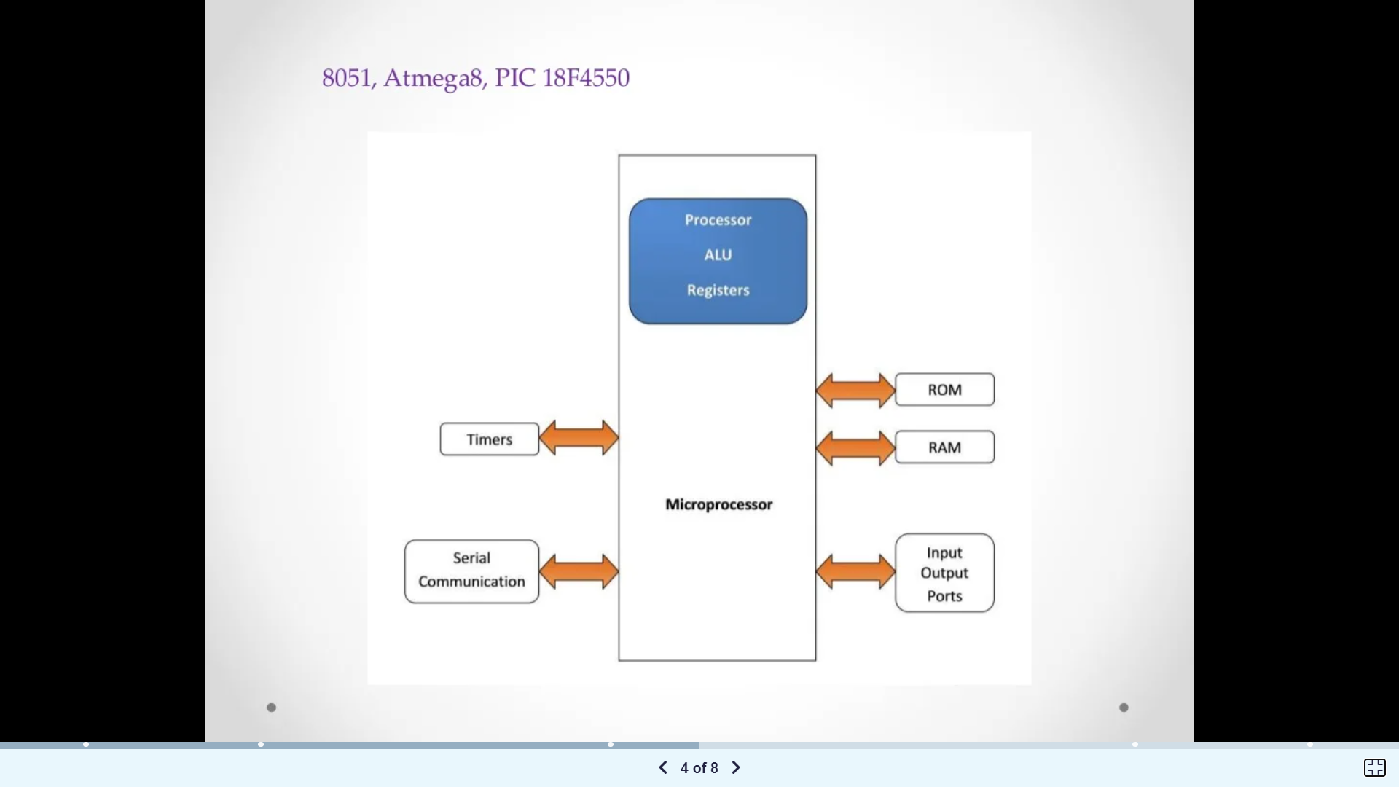

Slide 6
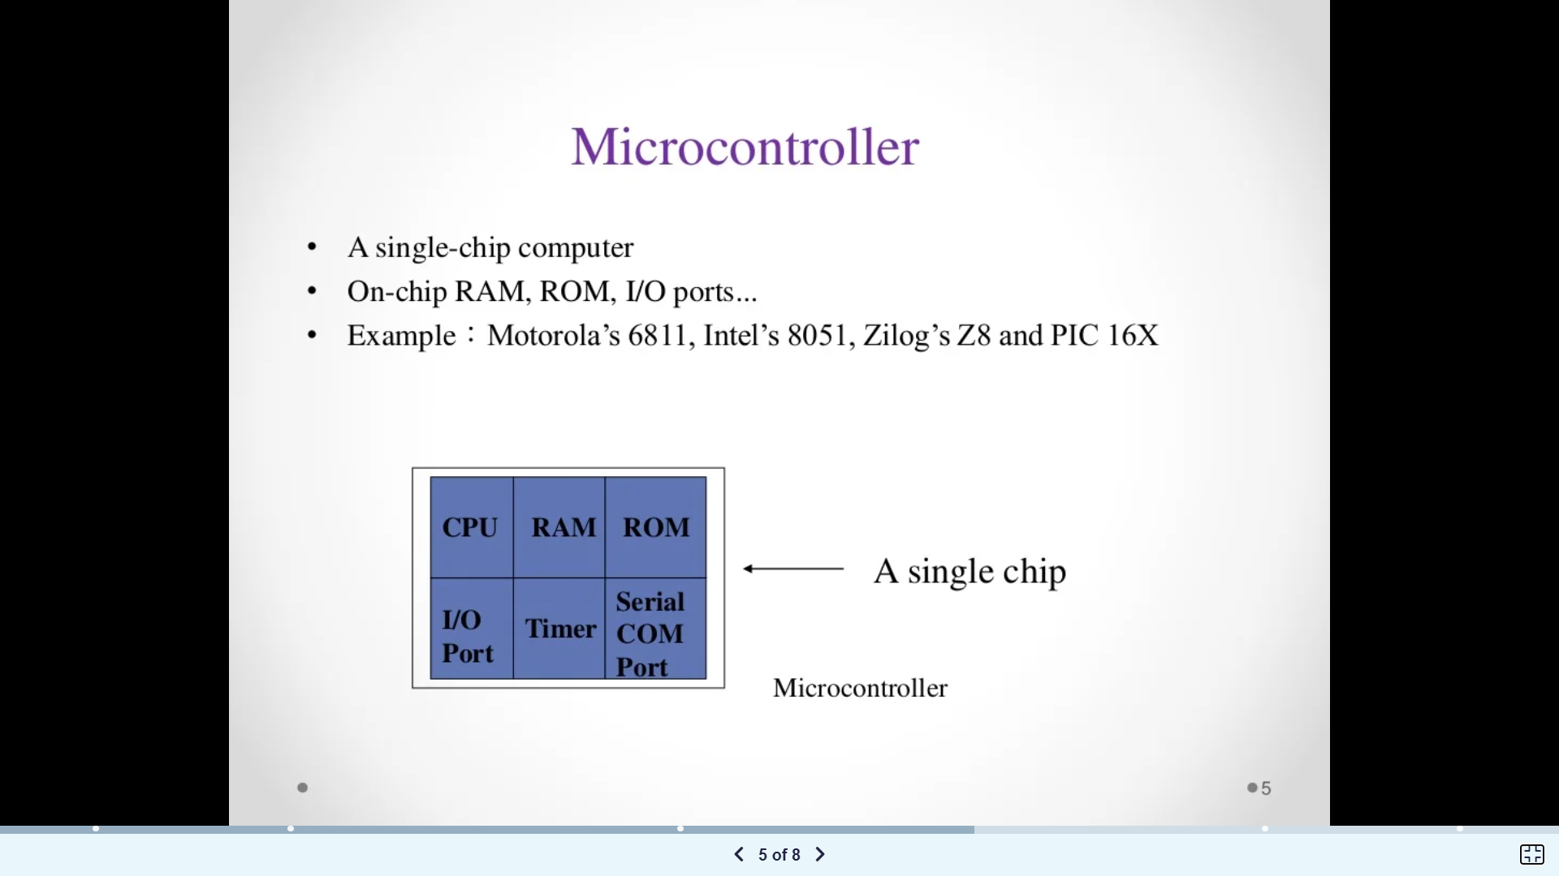

Slide 7
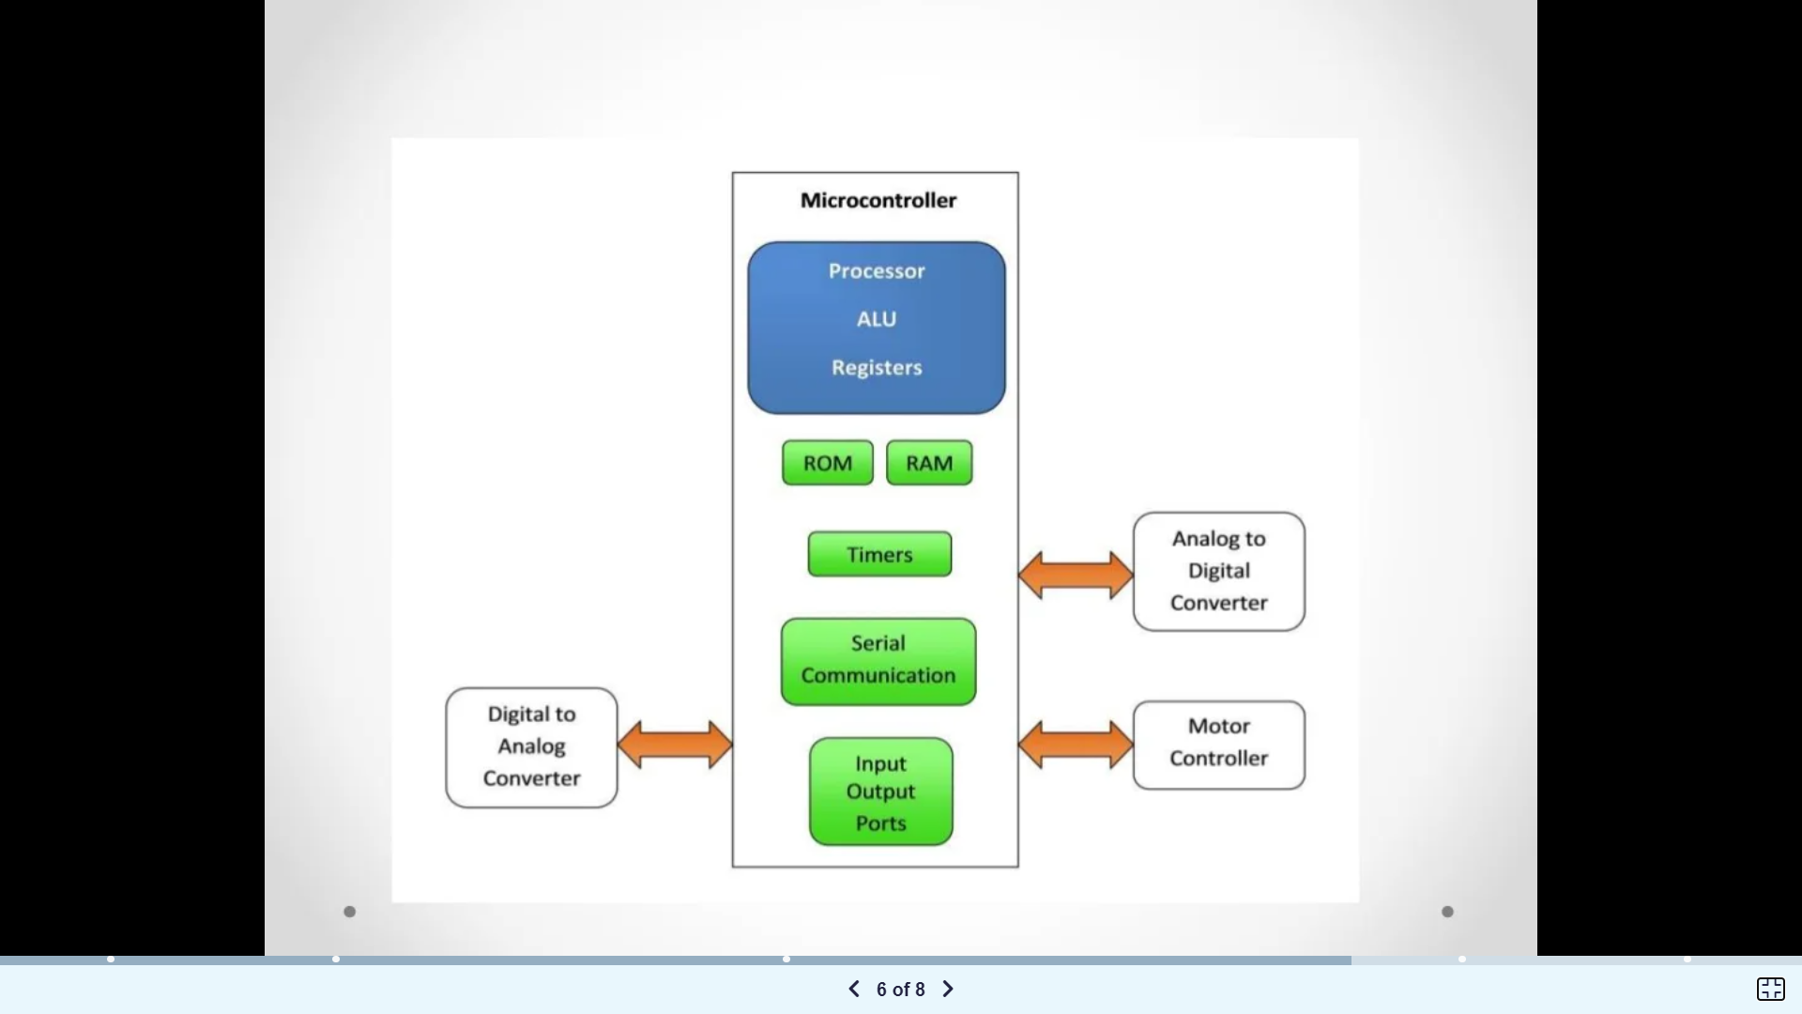

Slide 8
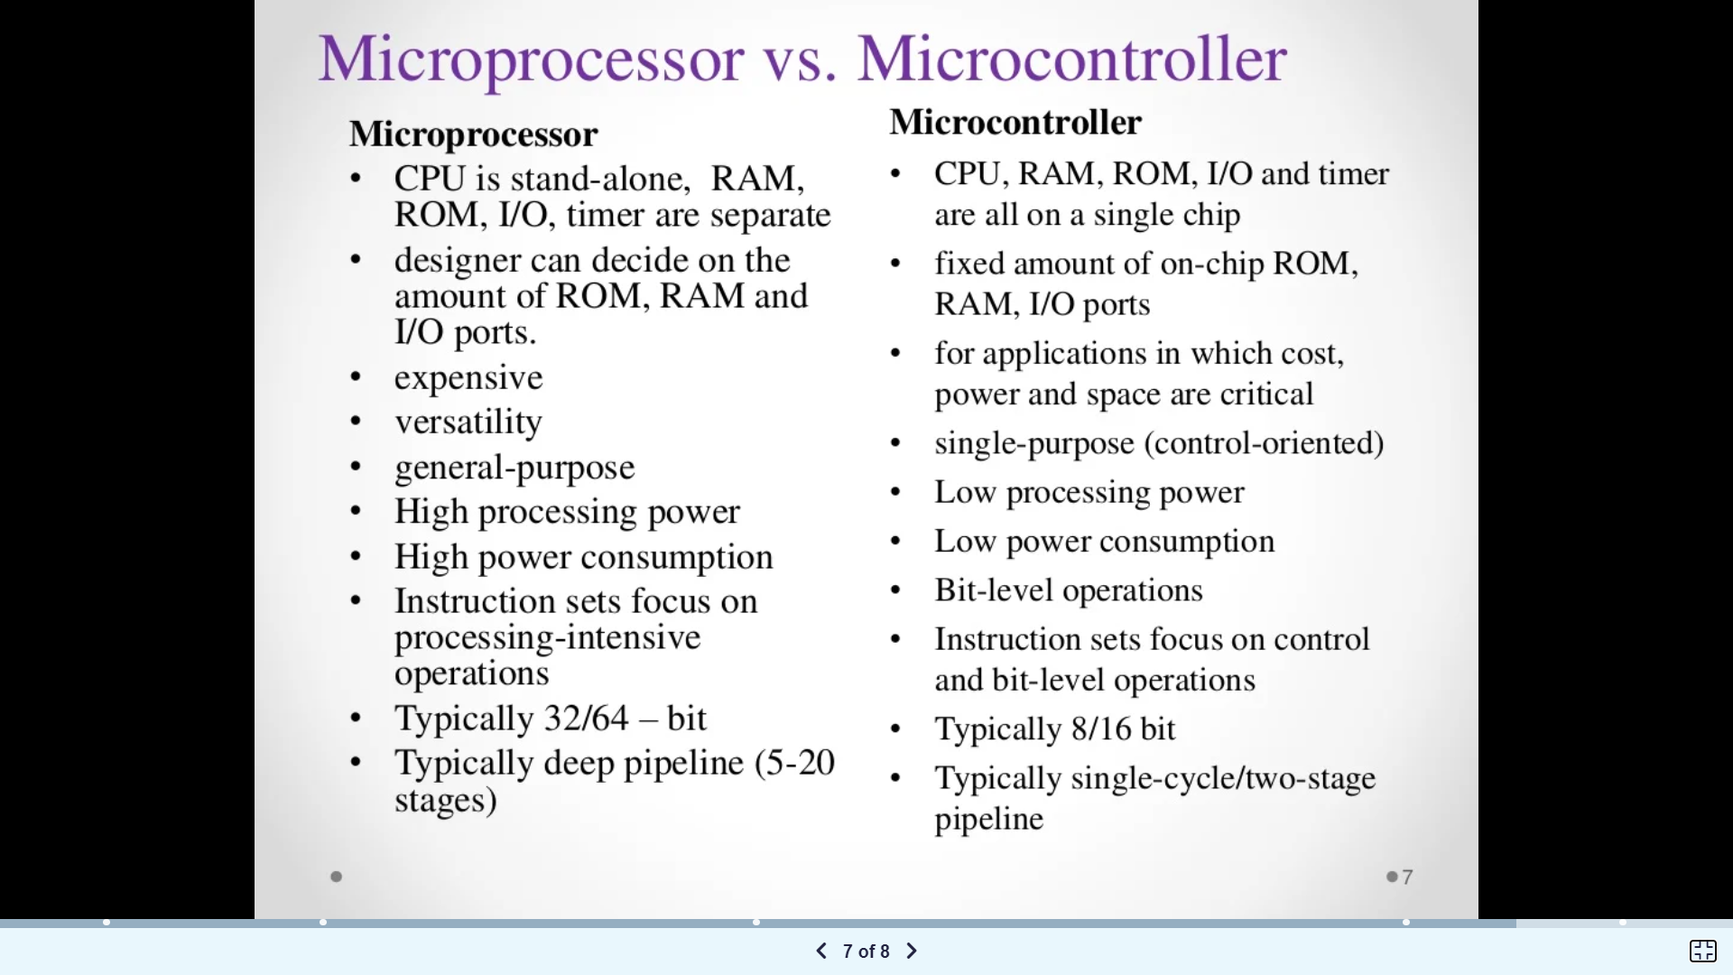

Slide 9
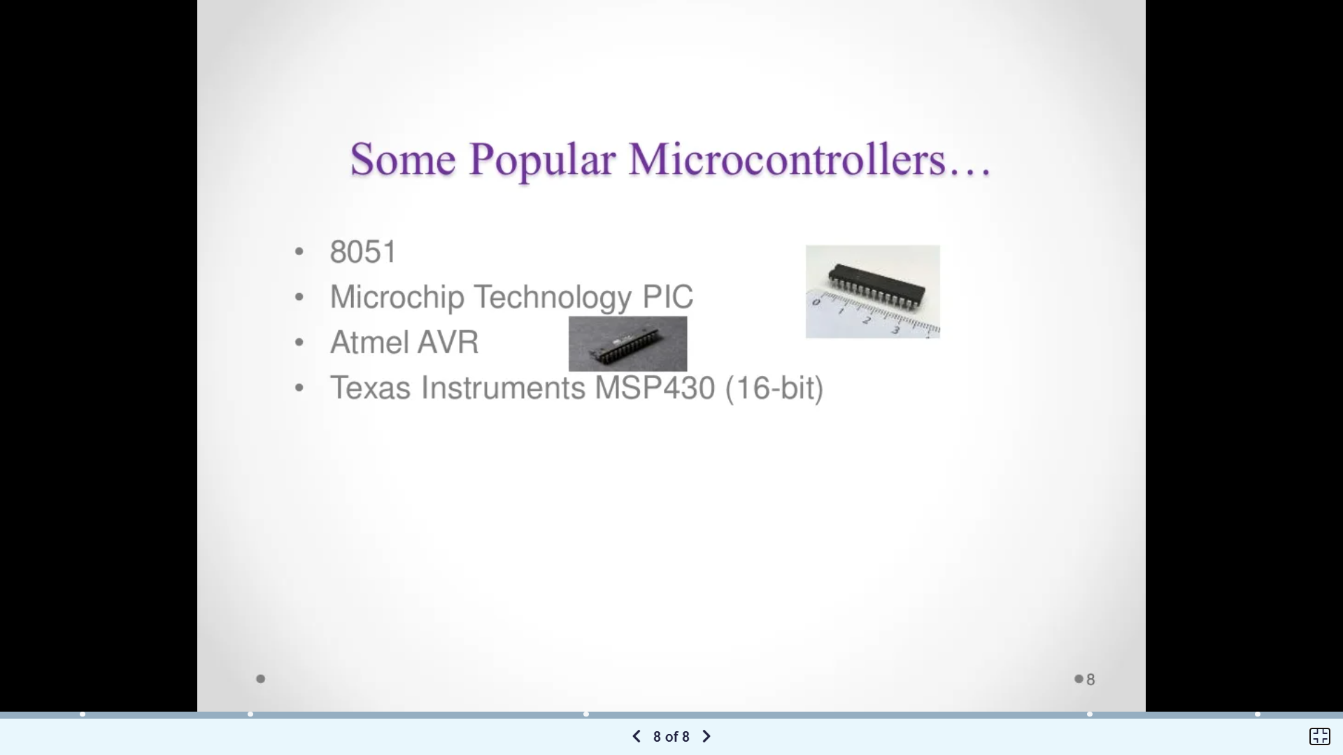

Slide 10
Types of Microcontrollers
Based on bit configuration
8-bit microcontroller −To execute arithmetic and logical operations like addition, subtraction, multiplication division, etc. For example, Intel 8031 and 8051 are 8 bits microcontroller.
16-bit microcontroller − To perform arithmetic and logical operations where higher accuracy and performance is required. For example, Intel 8096 is a 16-bit microcontroller.
32-bit microcontroller − Used in automatically controlled appliances like automatic operational machines, medical appliances, etc.

Slide 11
Based on the memory configuration,
External memory microcontroller − Do not have a program memory on the chip. Hence, it is named as external memory microcontroller. For example: Intel 8031 microcontroller.
Embedded memory microcontroller − The microcontroller has all programs and data memory, counters and timers, interrupts, I/O ports are embedded on the chip. For example: Intel 8051 microcontroller.

Slide 12
Based on the instruction set configuration, the microcontroller is further divided into two categories.
CISC − CISC stands for complex instruction set computer. It allows the user to insert a single instruction as an alternative to many simple instructions.
RISC − RISC stands for Reduced Instruction Set Computers. It reduces the operational time by shortening the clock cycle per instruction.

