Slide 1


Movie Data Analysis
Group Members:
Alekha polavarapu
Vanaja karpurapu
Priyanka yakkateela
Sithamshu Teegala

Slide 2
Introduction Project Description Background Problem Definition The Proposed Techniques Results Future work Conclusion
Outline

Slide 3
What is Data Mining?
Large data sets are sorted to find patterns and relationships that may be used in data analysis to assist solve business challenges and this can be achieved by using data mining techniques.

Slide 4
Introduction
From the last 10 years, popularity of social media has increased at an alarming rate. People are now sharing their emotions and opinions on social media sites allowing others to know what they think about a particular thing. Many companies are utilizing the data from various websites to generate meaningful information out of it which can be further used for business purposes. Huge textual movie data is available on sites like Amazon, IMDB, Rotten tomatoes and analyzing such massive data manually is a tiresome and time-consuming activity. As a result, individuals are unable to form sound judgments on whether to watch movies or not. So, to speed up the process, programmers use certain data mining techniques to extract out public opinion on watched movies.

Slide 5
Project Description
Sentiment analysis is a sub module of opinion mining where the analysis focuses on the extraction of text and opinions of the people on a particular topic.
In this project, we are making use of IMDB reviews on movies to predict how the users have rated the movies and predict the movies that have a positive or negative review.
We proposed a model that includes different sentiment analysis methods which will help us to extract useful information from the data and predict which is the most suitable classifier for this particular domain by looking at accuracy.
Models like Naive Bayes, Support Vector Machine and Logistic regressions were used for the purpose of data analysis.

Slide 6
Background
Development tools:
Python Programming Language
Dataset:
IMDB dataset of 50k movie reviews is taken from www.kaggle.com
The dataset comprises of movie review text and its respective sentiment of whether it is a positive or negative one.

Slide 7
Problem Definition
The rating on different websites determine the success of the movie by giving it a score out of 10 based on the stars given by the viewers. But, there isn’t any method that can provide the prediction based on movie reviews.
Due to the lack of strong grammatical formats in movie reviews, we might have large amount of noise text, special characters, stop words.
Presence of this huge unwanted words in the reviews makes the analysis harder and also takes large amount of time for the completion of our analysis.
Hence, there is huge need to eliminate, normalize these noise text, stop words, special characters from the reviews.

Slide 8
Solution
In order to determine the success of the movie based on the different reviews, sentiment analysis comes into picture.
In this project, tokenization is used to transfer the input string into a word vector, stemming is used for extracting the root of the words, while feature selection fetches the essential word and lastly classification is used to classify the movie as positive or negative.

Slide 9
Solution
The working principle of sentiment analysis includes tokenization, word filtering, stemming and classifications.
In tokenization, text needs to be segmented into units such as words/ numbers or punctuations.
Next step stemming which is the process of removing prefixes and affixes to convert a particular word into its stem.
After preprocessing, we analyze the dataset by performing classification using Naïve Bayes, Support Vector Machine and Logistic Regression.
Here, we determine the best model based on accuracy. Hence, We analyze and study the features that affect the scores of our review text and finally classify the movie as positive or negative

Slide 10
Steps to Analyze the Movie Data:
Importing Libraries, packages and datasets.
Splitting, training, testing the dataset.
Text Normalization, removing noise text and special characters.
Text stemming, removing stop words.
Performing Logistic Regression, LSVM, Multinomial Naive Bayes Models.
Word cloud for positive and negative review words.

Slide 11
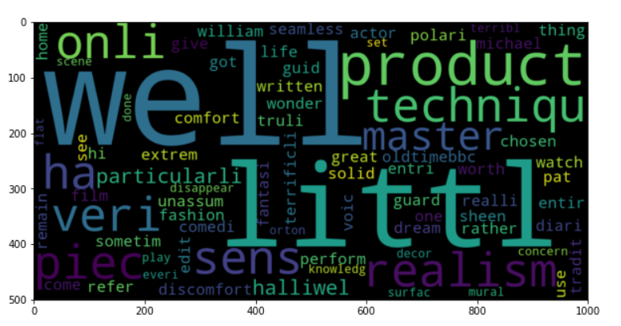
Experimental Evaluation
Word cloud for positive review words

Slide 12
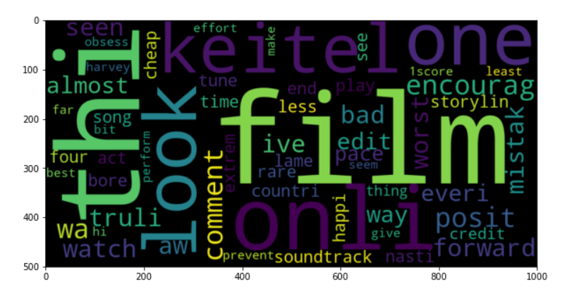
Experimental Evaluation
Word cloud for negative review words

Slide 13
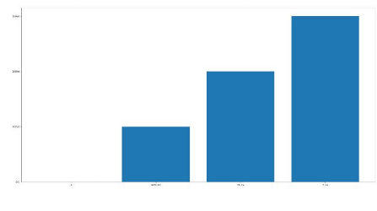
Experimental Evaluation
Accuracy graph for Naive Bayes, SVM, Logistic Regression

Slide 14
Experimental Evaluation
The analysis of accuracies of all the models is given below:
nb_cv = Naïve Bayes with Count Vectorizer = 85.48
svm_cv = SVM with Count Vectorizer = 85.29
lr_cv = Logistic Regression with Count Vectorizer = 86.89
We can say that the Higher the accuracy, the better the model.
Hence, logistic regression can be observed as the better model with more accuracy over other models.

Slide 15
Future work and Conclusion
The main motive behind this project was to construct a sentiment analysis model that will help us to get a better understanding of movie reviews that we have collected, We compared the results of the 3 classifiers - Naive Bayes, Logistic Regression and Support Vector Machine (SVM).
For Evaluation, we observed the accuracy provided by each model. By evaluating the models, we found out that Logistic Regression gives us the highest accuracy score of 86.89%.
In future we can still improve the accuracy of the models by preprocessing data and by using lexicon models like Textblob.

Slide 16
References
Nisha Rathee, Nikita Joshi, Jaspreet Kaur.“Sentiment Analysis Using Machine Learning Techniques on Python”. 978-1-5386-2842-3
https://ieeexplore.ieee.org/document/8663224
MaisYasen, Sara Tedmori. “Movies Reviews Sentiment Analysis and Classification”. IEEE Jordon International Joint Conference on Electrical Engineering and Information Technology (JEEIT). 978-1-5386-7942-5.
Sagar Chavan, Akash Morwal,Shivam Patanwala,Prachi Janrao, “Sentiment Analysis of Movie Rating System”, IOSR Journal of Computer Engineering (IOSR-JCE), eISSN: 2278-0661, p- ISSN: 2278-8727 , PP 43-47, 2017.
Asiri Wijesinghe, “Sentiment Analysis on Movie Reviews”, Australian National University Technical Report – RESEARCH GATE, October 2015.

Slide 17
Thankyou

