Slide 1
CREATE SALES CONTRACT USING BAPI AND DISPLAY OOALV RECORDS

Slide 2
TABLE OF CONTENTS
ZG05_TABLE1
VBAK
VBAP

Slide 3
INTRODUCTION
CREATING SALES CONTRACT BY UPLOADING CSV FILE USING BAPI
DISPLAYING OOALV OUTPUT FOR CONTRACT DETAILS
DISPLAYING THE ADOBE FORM FOR CONTRACT DETAILS

Slide 4
SALES CONTRACT?
A sales contract legally binds both parties to the terms and conditions of the sale, protecting their rights and interests.
It outlines what is being sold, at what price, and under what conditions, reducing the risk of misunderstandings or disputes later on.

Slide 5
FUNCTION MODULE USED
KCD_CSV_FILE_TO_INTERN_CONVERT Function call is used to upload the csv files using BAPI.
BAPI_CONTRACT_CREATEFROMDATA is used for creating the Sales Contract.

Slide 6
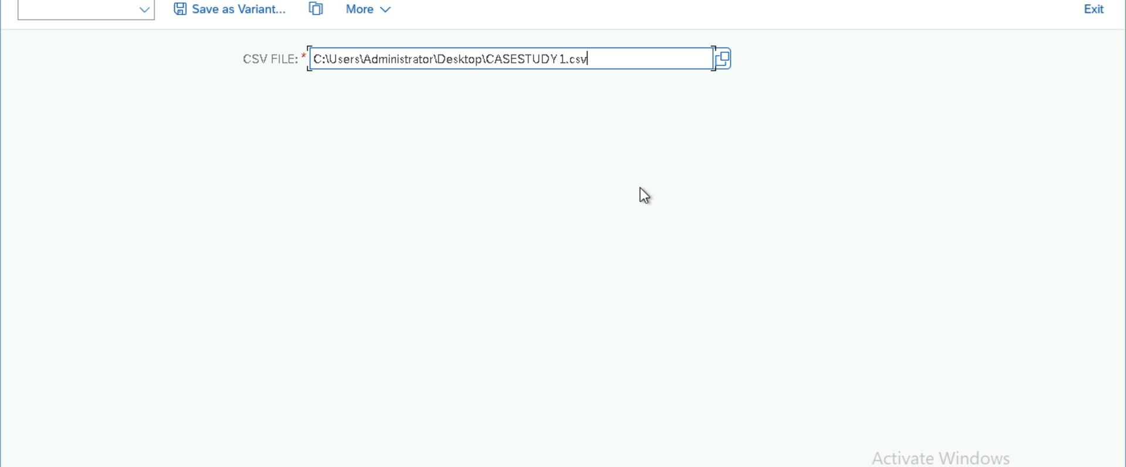
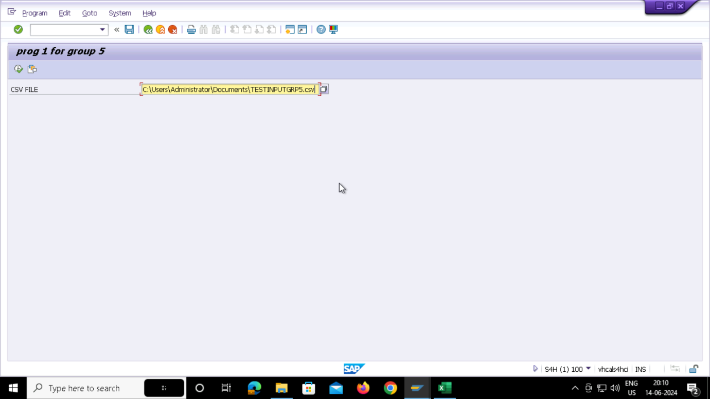
INPUT FILE

Slide 7
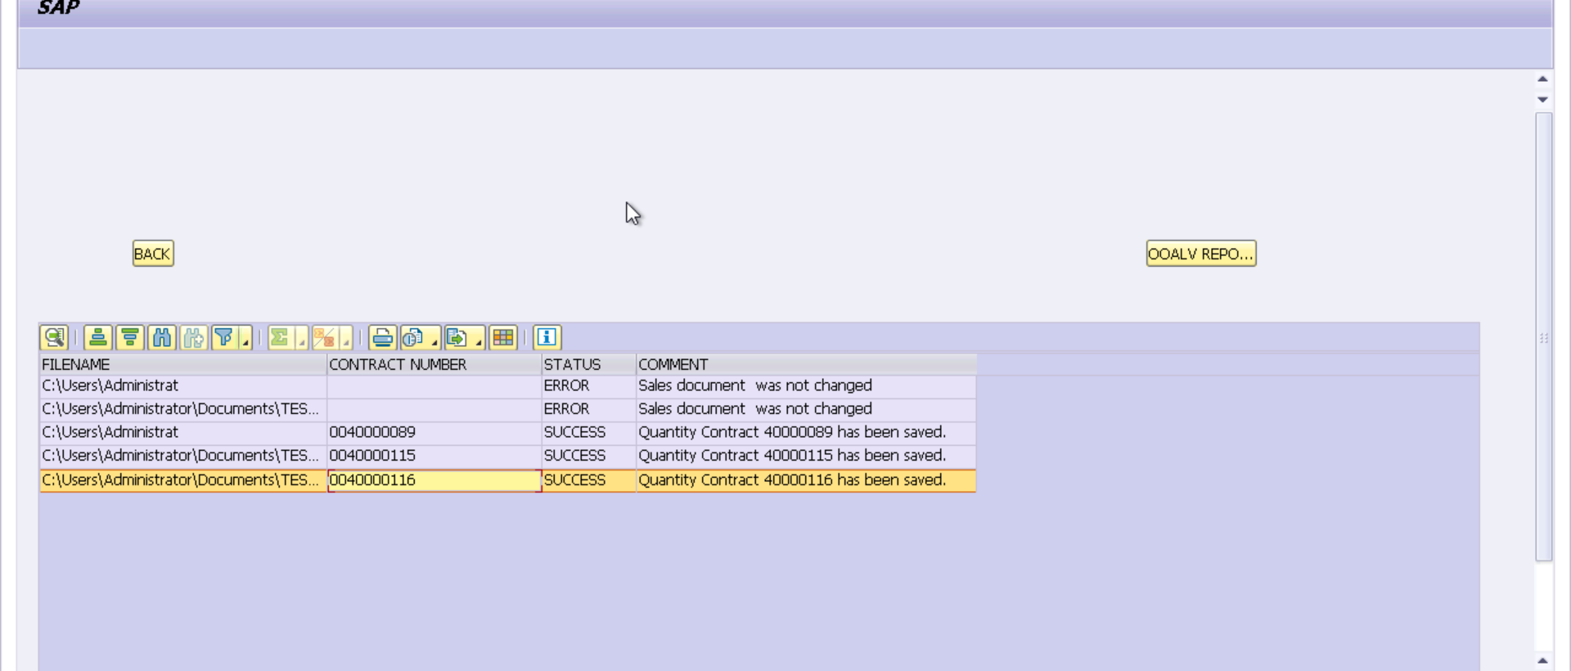
OOALV OUTPUT FOR CONTRACTS

Slide 8
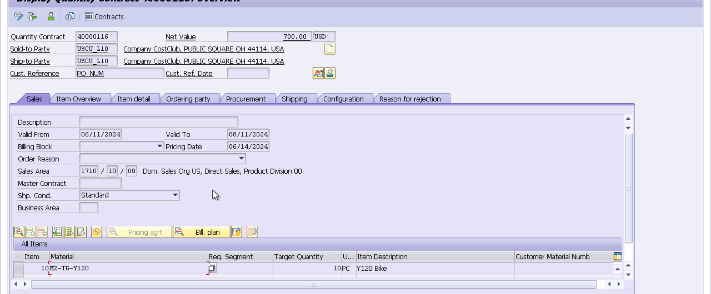
AFTER DOUBLE CLICKING ON CONTRACT NUMBER

Slide 9
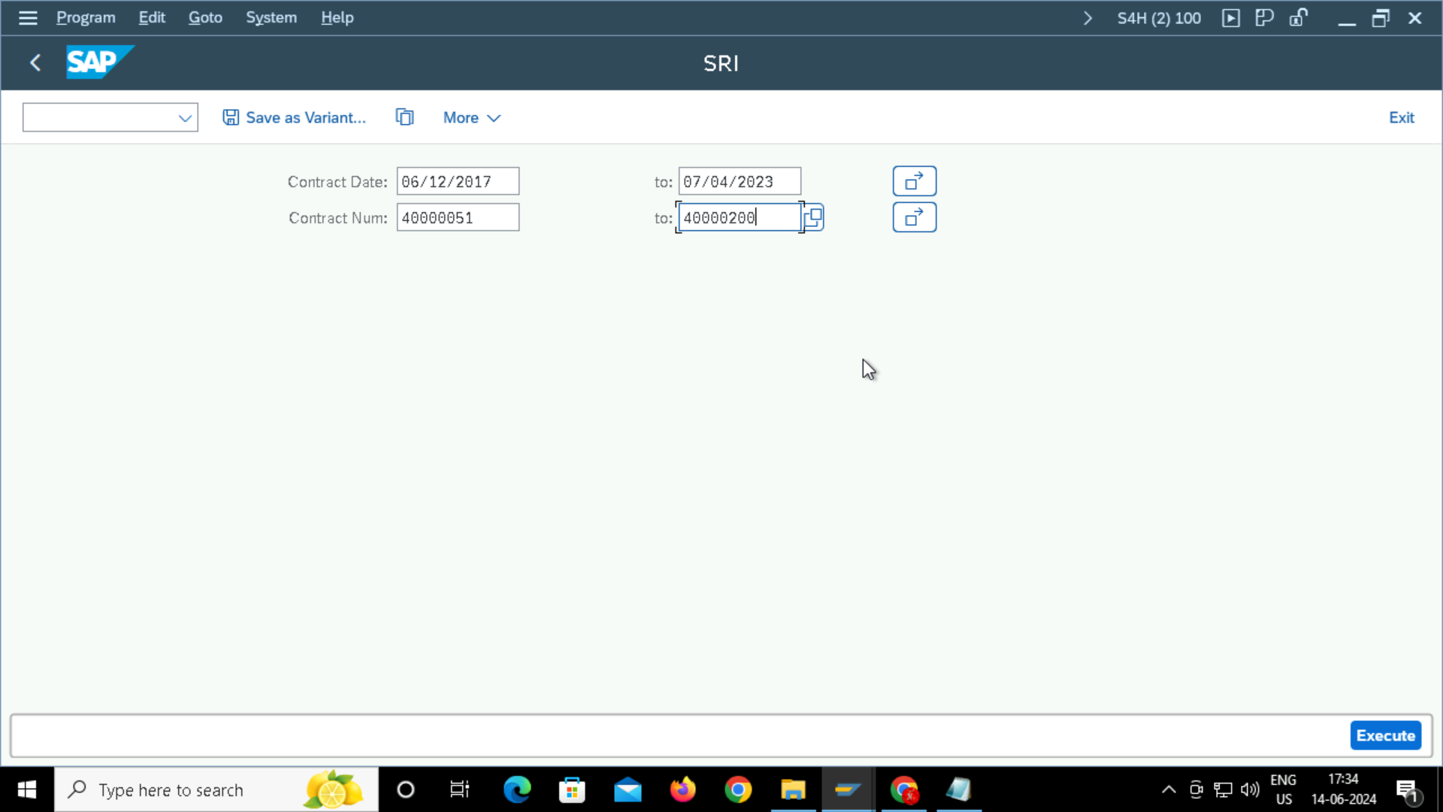
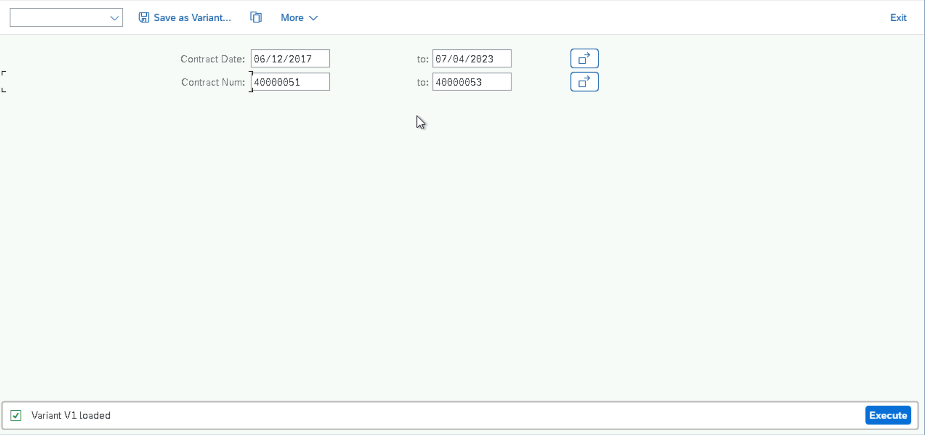
SELECTION SCREEN FOR OOALV

Slide 10
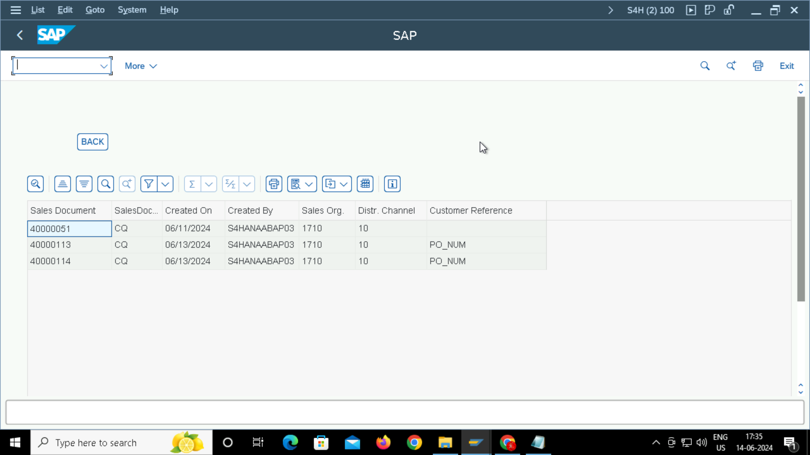
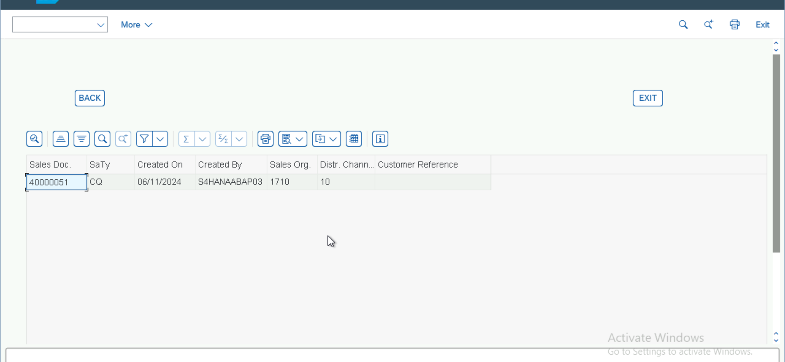
HEADER DETAILS

Slide 11
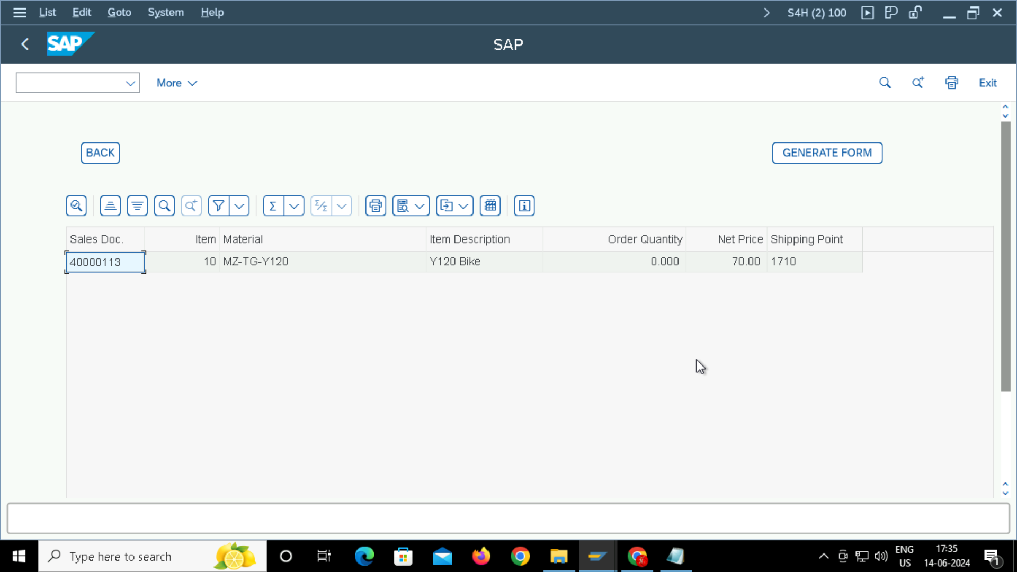
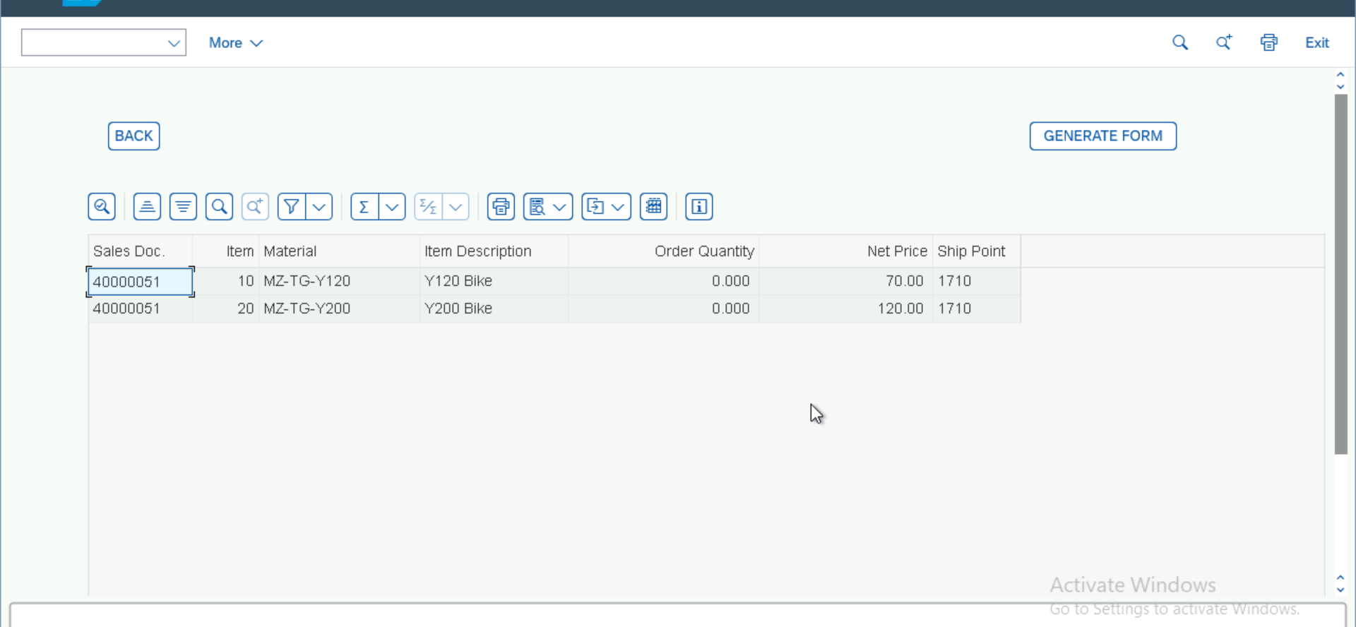
LINE ITEMS DETAILS

Slide 12
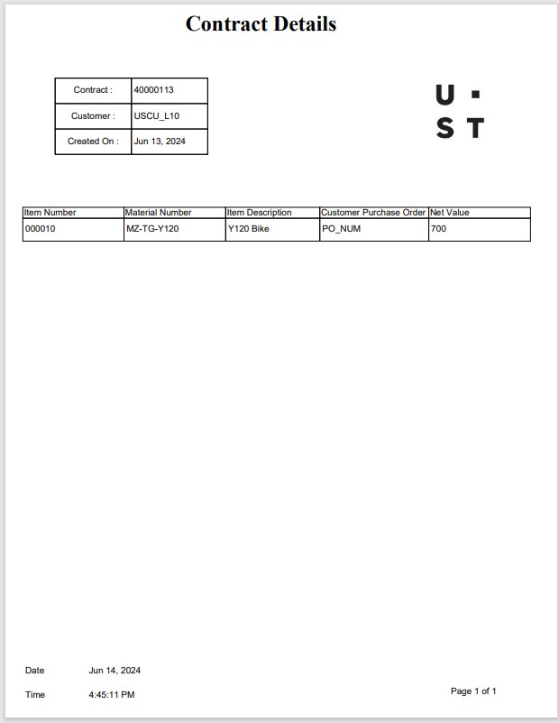
ADOBE FORM FOR CONTRACT DETAILS

