Slide 1

Design patterns
FACTORY
February 1, 2017

Slide 2
Creational patterns
These design patterns provide a way to create objects while hiding the creation logic, rather than instantiating objects directly using new operator. This gives program more flexibility in deciding which objects need to be created for a given use case.
Simple Factory
Factory Method
Abstract Factory

Slide 3
Simple Factory
Encapsulate the creation of objects in an extern class.
Easy to maintain if new subclasses should be added!
A good way to work with abstract classes (Polymorism!) in the main user class.

Slide 4
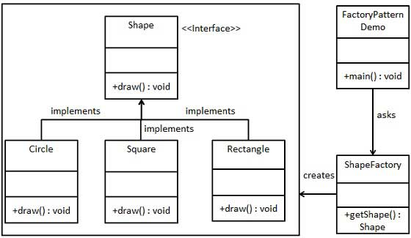
A simple factory

Slide 5
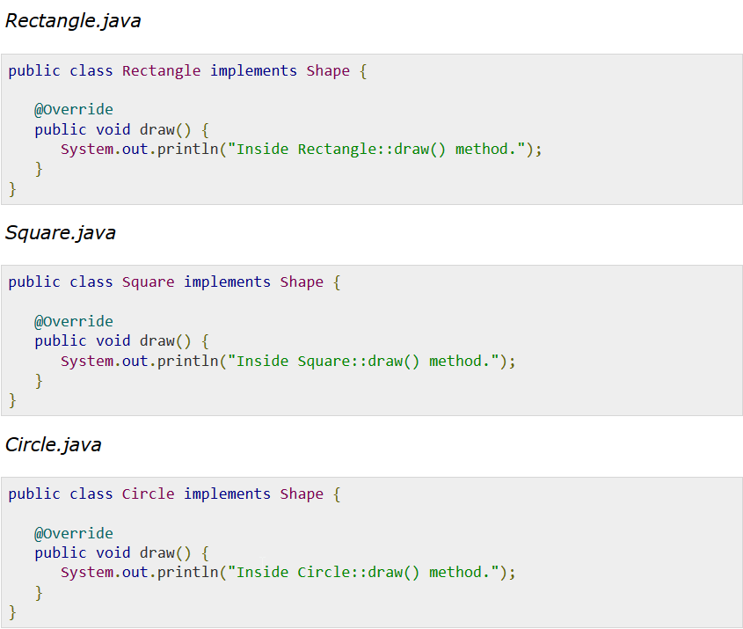

Slide 6
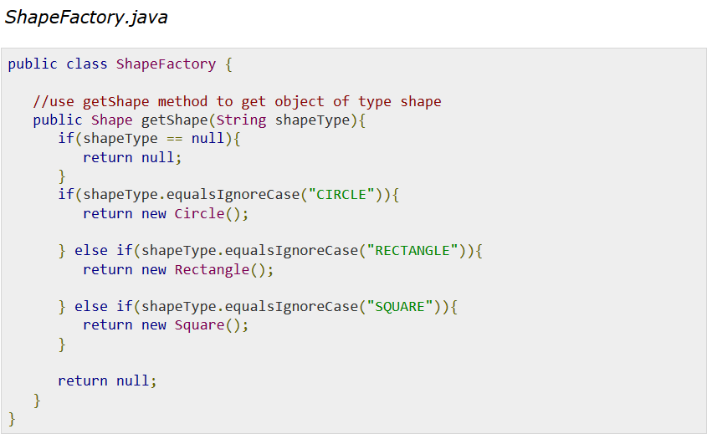

Slide 7
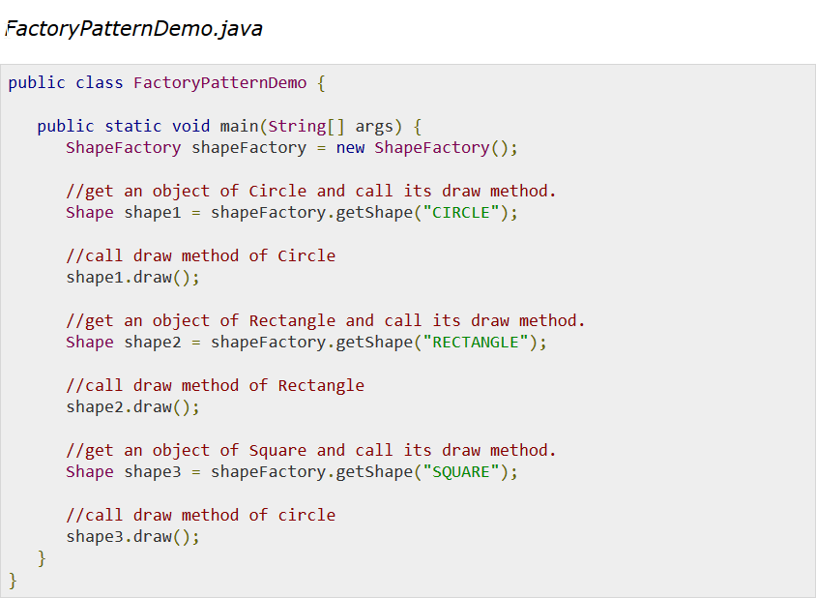

Slide 8
Factory Method
It is the task of the subclasses to create the specific objects.
We will provide an abstract factory method in the superclass and make a concrete implementation in the subclasses!
Relies on inheritance!

Slide 9
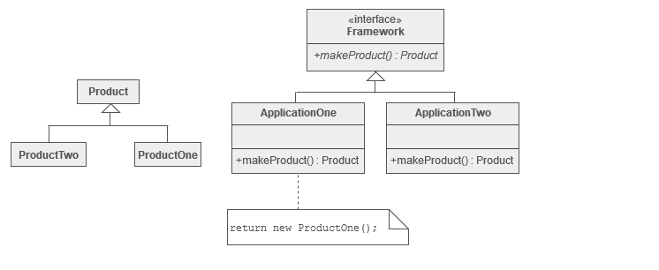

Slide 10
Abstract Factory
Provides an interface for creating families of related or dependent objects without specifying their concrete classes.
For different concrete products we use a different factrory!
Relies on composition!

Slide 11
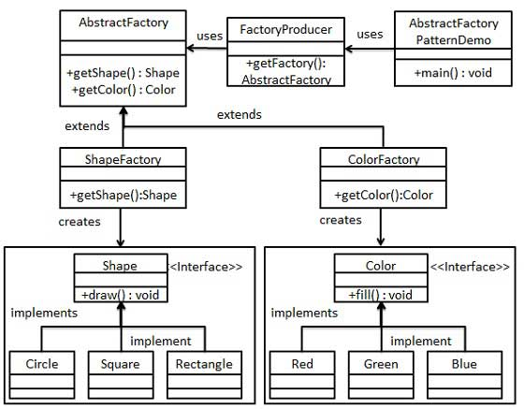
Abstract Factory Pattern

