Slide 1
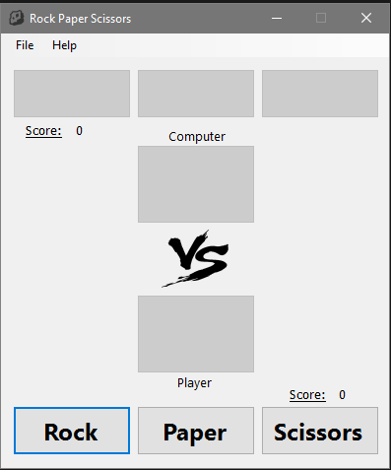
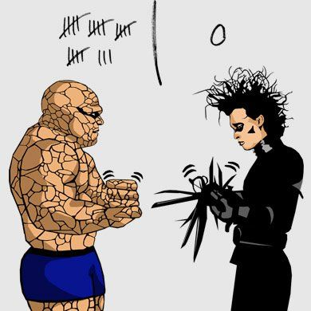

Slide 2
FRONT END
Interface GameService
Initializes SingeplayerGame + PlayGame (Click) + MatchResult
GameService
Interface Game
GameFactory
SinglePlayerGame
Initializes PlayerFactory to create players

Slide 3
PlayerFactory
FACTORY PATTERN
Creates HumanPlayer & ComputerPlayer
Get’s hand from Front end (click)
Generate random hand
HumanPlayer
ComputerPlayer
Hand object from Ihand
FRONT END
(Abstract) Player
Counter (wins) + Determine winner
Useful for extension – other players …
MatchResult
Match Result logic (winner) + Player’s names, hands, score counter
Hand Object back to ENUM value (FRONT END)
GameService

Slide 4
ENUM Hand
HandFactory
Converts ENUM Hand to Object
Interface Hand
Wins, Draw logic
STRATEGY PATTERN
Rock
Paper
Scissors

