Slide 1



ZipCord 2024 - 2025
Automate expenses, optimize business spending
GenAI-T3- 2024-2025-Q1-001
GenAI-2024-2025-Q1

Slide 2






ZipCord
Team Information
GenAI-2024-2025-Q1-001
Vanazhagan K
Bharath N
Akshaya Roopa R
Monisha M
Student Team
III - BCA DRSNSRCAS
Technical Developer
III - BCA
DRSNSRCAS
UI/UX Designer
III - BCom
DRSNSRCAS
Compliance & Risk Consultant
III - BCom
DRSNSRCAS
Research & Development
Lalitha S
Harish Ghugan
Faculty Team
Project Guide
DRSNSRCAS
Technology Mentor
DRSNSRCAS
GenAI-2024-2025-Q1

Slide 3
ZipCord
GenAI-2024-2025-Q1-001
Project Overview
Requirement / Problem statement
Streamlining expense management and financial operations for businesses with a modern corporate card solution.
Description
ZipCord combines innovative fintech solutions with AI-driven analytics to revolutionize how businesses handle corporate expenses and financial management. The company helps organizations automate financial tasks through its corporate card platform, empowering smarter spending decisions with real-time tracking and intelligent insights.
Scope
GenAI | AI
ZipCord provides a comprehensive financial management ecosystem for businesses through its AI-powered corporate card platform and expense automation software.
Automated expense categorization, anomaly detection, spending insights, budget optimization, predictive analytics.
Key factors & features
Target Audience
Domain
Expense automation
AI categorization
Receipt analysis
Growing startups
Finance departments
Medium enterprises
AI Analytics
Corporate Cards
Financial Technology
GenAI-2024-2025-Q1

Slide 4
ZipCord
GenAI-2024-2025-Q1-001
Project Features
Project Features / Journeys
Scalability
ZipCord's platform seamlessly handles growing transaction volumes while maintaining real-time processing capabilities. The cloud-based infrastructure automatically scales to accommodate businesses from startups to enterprise-level organizations.
Inventory Management
The system tracks company assets and subscription services linked to corporate spending, providing visibility into resource allocation. Automated notifications alert finance teams about renewal dates and underutilized services.
User Experience (UX)
ZipCord's intuitive interface simplifies complex financial workflows through customizable dashboards and one-click expense submission. AI-powered suggestions reduce manual input while mobile compatibility ensures on-the-go expense management.
GenAI-2024-2025-Q1

Slide 5
ZipCord
GenAI-2024-2025-Q1-001
Technology Stack
Presentation Layer
Methodology
React-based web application
Next.js Framework, Tailwind CSS
Hosting Platform: Netlify (for deploying the frontend)
Integration of AI and APIs
Scalable Architecture
Lean UX Methodology:
Application Layer
Products, Tools & Utilities
Backend Framework Node.js and Express.js
API Integration
Data Processing
Node.js for running the backend and supporting Next.js.
Next.js for server-side rendering and frontend development.
Tailwind CSS for styling and UI design..
GitHub for version control and collaboration.
Data Layer
Infrastructure
Cloud Hosting
Version Control System (GitHub)
Cloud Storage
DBMS (MYSQL)
Source Code
API
Project code repository is available at Link
Gemini API for expense categorization and insights
Accounting software API for financial integration
Bank transaction API for real-time data access
Note: Artefacts locations are provided as clickable hyperlink available as “Link”
GenAI-2024-2025-Q1

Slide 6
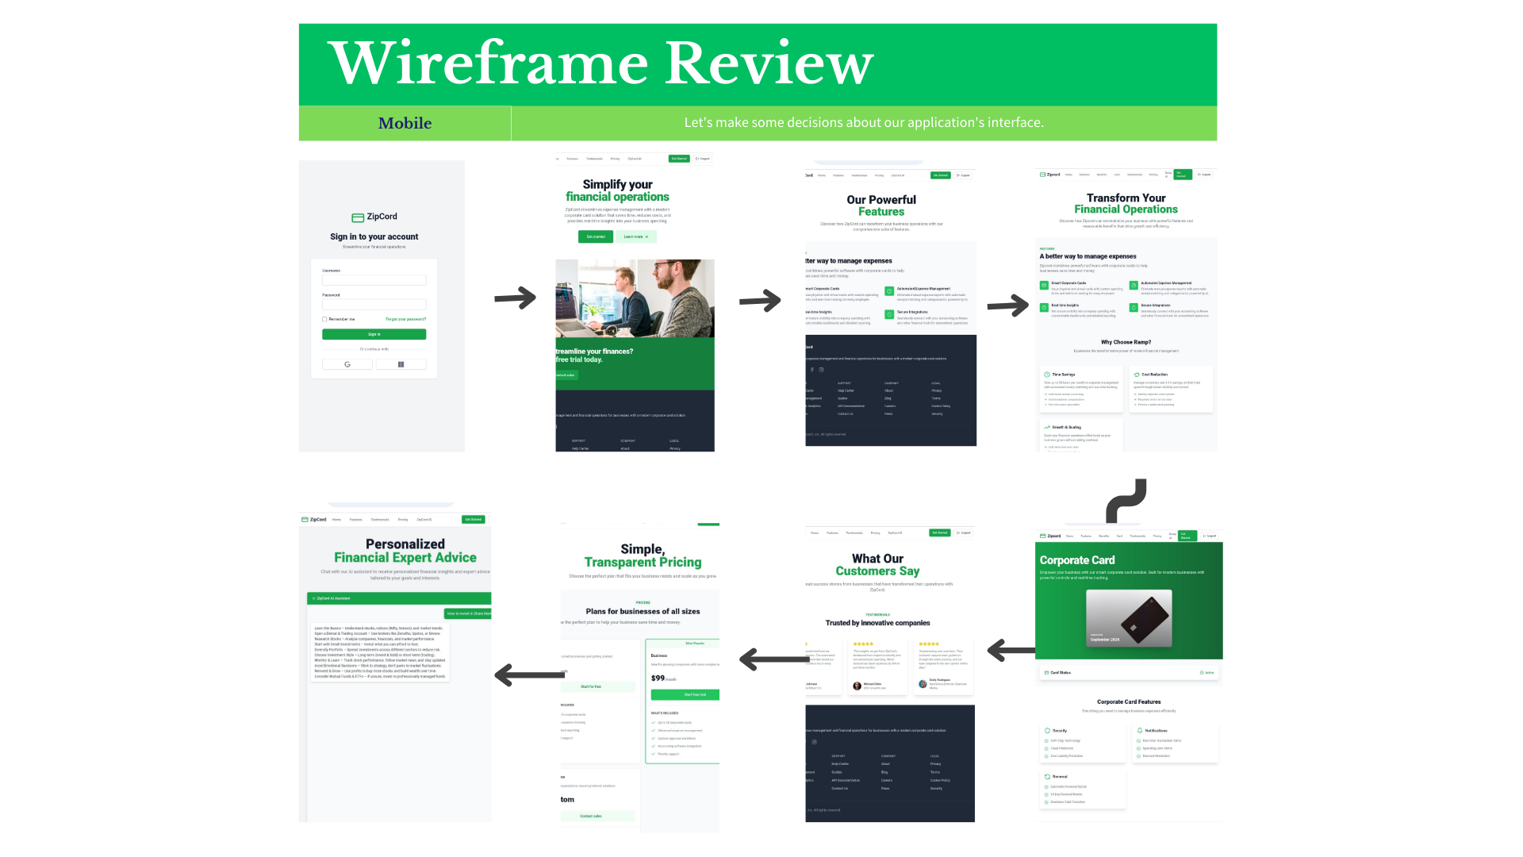
ZipCord
GenAI-2024-2025-Q1-001
Wireframe | UI
Wireframe | UI
GenAI-2024-2025-Q1

Slide 7
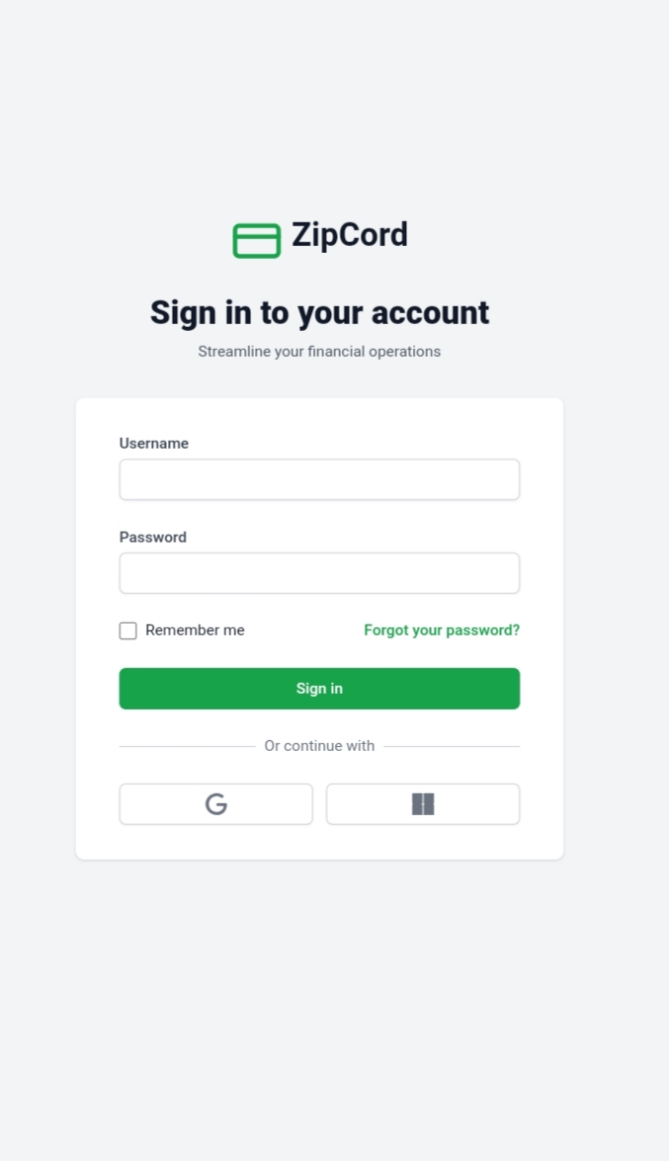

ZipCord
GenAI-2024-2025-Q1-001
Application Screenshots
Application Screenshots
GenAI-2024-2025-Q1

Slide 8
ZipCord
GenAI-2024-2025-Q1-001
Project / Product Roadmap
Project / Product Roadmap | Milestones | Features
Short Term | Mid Term | Long Term
Focus on setting up the core infrastructure and implementing essential expense management features. Establish API integrations and ensure smooth data handling.. | Enhance AI-driven insights for better financial tracking and fraud detection. Improve UI/UX with interactive dashboards and reporting tools. | Expand ZipCord’s offerings with advanced financial services like lending solutions. Scale the platform for global expansion with compliance-ready features.
GenAI-2024-2025-Q1

Slide 9
ZipCord
GenAI-2024-2025-Q1-001
Artefacts
Project Portal
Wireframe | UI
Project Portal / website is available at Link
Project wireframe / UI designs are available at Link
Presentation
Application
Project presentation (this document) is available at Link
Application is available at Link
Requirement Document / Specification
DT Playbook
Project requirement document / specification is available at Link
Project DT Playbook is available at Link
Technical Document / Specification
Overview Video
Project technical document / specification are available at Link
Project overview video is available at Link
Source Code
Project code repository is available at Link
Note: All links are provided as clickable hyperlink available as “Link”
GenAI-2024-2025-Q1

Slide 10
ZipCord
GenAI-2024-2025-Q1-001
Thanks
Thanks
GenAI-2024-2025-Q1

