Slide 1
Wind Tunnel Alpha
October 30, 2013
Vance Turnewitsch

Slide 2
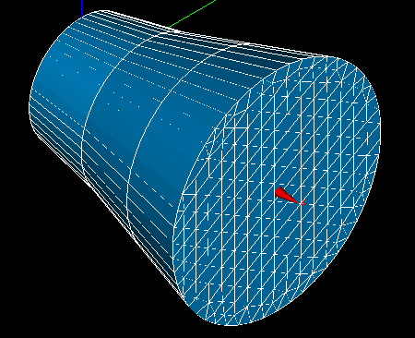
Previous Goal
Internal Fluid Flow
Fluid Flow

Slide 3
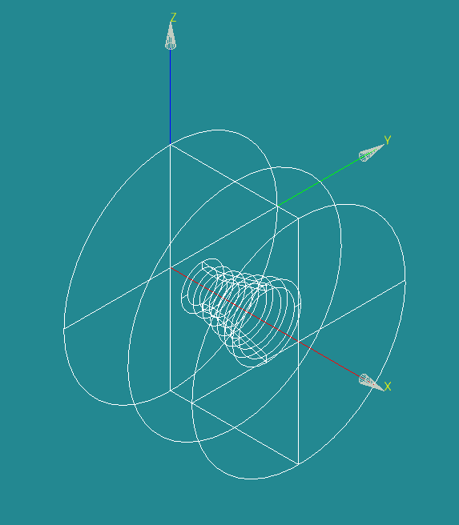
Wind Tunnel Alpha
Internal and External, Tunnel + Shroud

Slide 4
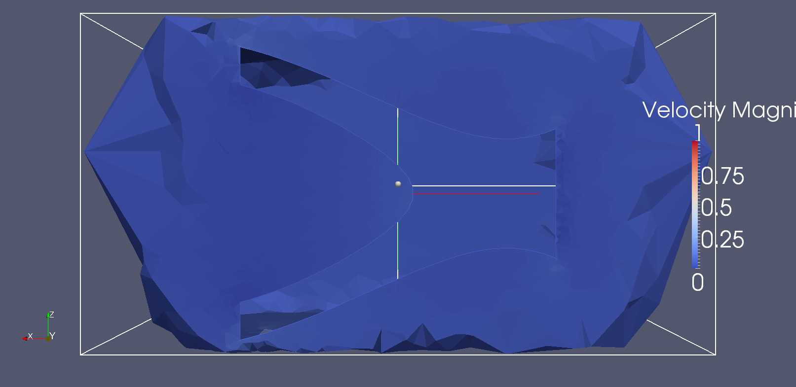
Simulation Result
Solid Area
Fluid Flow

