Slide 1
Rehabilitation Center Experience
Kennedy Krieger Institute | Neurobehavioral Unit (Inpatient)
585.617 Rehabilitation Engineering | Module 10
Vance Van Volkenburgh | Visit: November 10, 2026
Notes:
About 10 seconds. Name, facility, date.

Slide 2
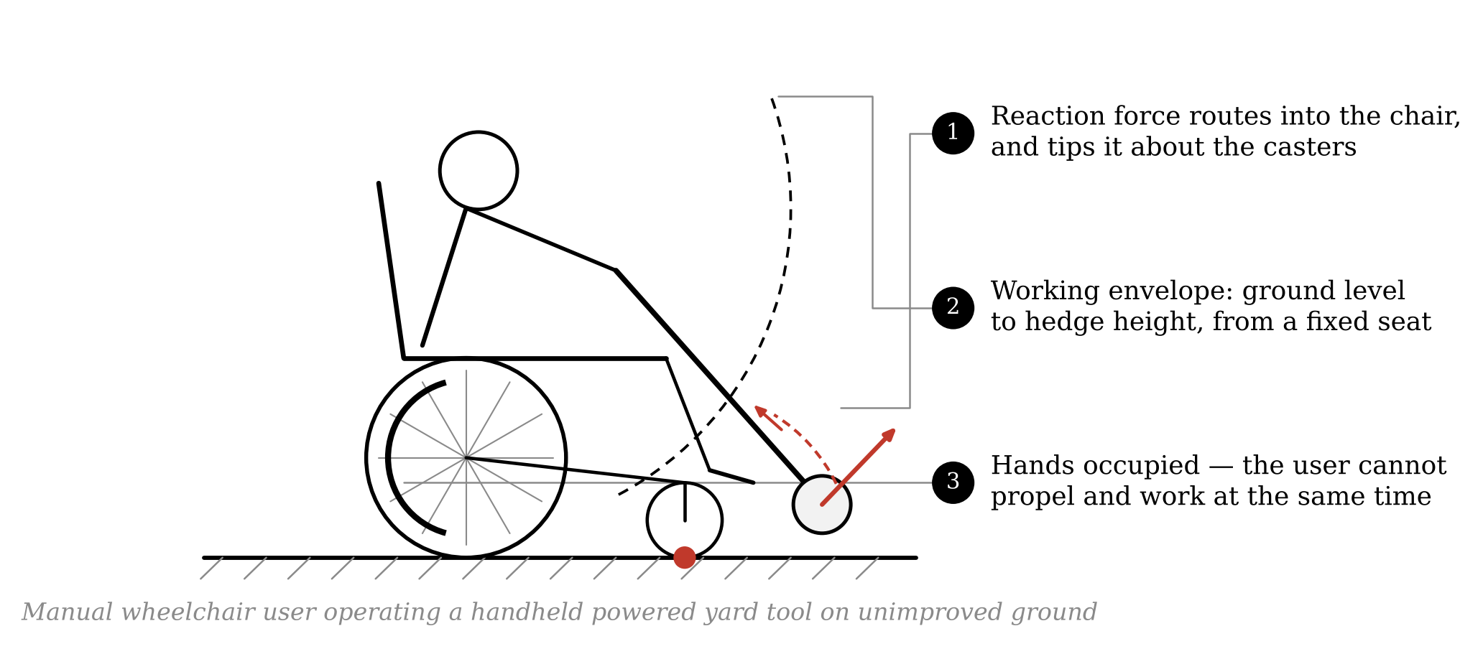
Project Topic
under one minute
• Wheelchair-mounted interface for handheld powered yard tools — trimmers, edgers, hedge trimmers, blowers.
• Users: manual wheelchair users with full upper-limb function, on their own residential yard.
• Scope: an interface and mounting problem. Not a new tool, not a new chair.
• Three constraints are coupled, and that coupling is the problem.
• No design has been selected. This visit was for input on the problem.
2
Notes:
Spend about 50 seconds. Walk the three numbered callouts on the figure, then say the coupling sentence.

Slide 3

The Center
Kennedy Krieger Institute, Baltimore, Maryland
• Pediatric brain, spinal cord and musculoskeletal disorders; treats individuals up to age 21.
• 25-bed inpatient rehabilitation unit, accredited by CARF and the Joint Commission.
• Patients receive several hours a day of occupational, physical and speech therapy.
• I visited the Neurobehavioral Unit (Inpatient) — children and adolescents with developmental disabilities and severe problem behavior.
• Treatment is applied behavior analysis; admissions run weeks to months.
3
Notes:
Make clear this is a behavioral service, not a mobility service. You use that fact deliberately on slide 7.

Slide 4
Patient Observation
what I was able to see
• I observed a behavioral treatment session, not a physical or occupational therapy session.
• What stood out was how the session was structured, rather than its clinical content:
  – Behavior was recorded continuously and in real time, not summarised afterward.
  – Staffing was high, and a second staff member was present purely for safety.
  – The environment was part of the treatment — surfaces, fixtures and equipment chosen for what they prevent.
• Patient privacy limited what I could observe, and I did not record or photograph anything on the unit.
4
Notes:
If you saw something more specific, replace the middle bullets. The honest version scores better than an invented one.

Slide 5
What the Observation Changed
impact on my preliminary design
• Measurement is part of the intervention. Nothing was judged by impression. My PDS should carry measurable acceptance criteria — task time, number of attempts, setup time — not qualitative aims.
• Staff presence is a design variable. A task needing a second person is a different product. My equivalent question: can the user deploy and stow the tool without a second pair of hands?
• Safety is designed into the environment before it is trained into the person. I had treated stability as something the user manages by technique. The better framing is to make the unsafe state hard to reach.
5
Notes:
Rubric slide. Do not rush. About 60 seconds.

Slide 6
Technology Overview
what is used, and how often
• Used constantly, deliberately low-tech: visual schedules, token boards, timers, picture cards, protective equipment, padded surfaces.
• Used constantly, sophisticated: real-time behavioural data capture on tablets, and video monitoring of sessions.
• Used selectively, sophisticated: augmentative and alternative communication devices, including speech-generating devices.
• The most sophisticated element was methodological, not physical — the functional analysis protocol itself. The hardware supporting it is simple on purpose.
• Durability is the dominant hardware requirement. Equipment must survive deliberate destruction, not just wear.
6
Notes:
The last two bullets are the interesting ones.

Slide 7
Relevance to My Project
nothing directly related, and why that matters
• I saw no technology related to my project — no wheelchair-mounted tooling, no outdoor task equipment, few manual wheelchair users.
• That absence is structural. The unit treats behaviour; it is not a mobility service, and its population is not mine.
• But the constraints transfer, and they are harder than a rehab gym would impose:
  – Abuse tolerance — against deliberate destruction, not incidental wear.
  – Cleanability — a requirement, not a preference.
  – No ligature points, no entrapment, nothing readily detached or thrown.
  – Engagement as an engineering requirement — if the user disengages, the device has failed.
• If my interface meets that bar, residential yard use is a far easier environment.
7
Notes:
The assignment asks for this explicitly. Frame the absence as a finding, not an apology.

Slide 8
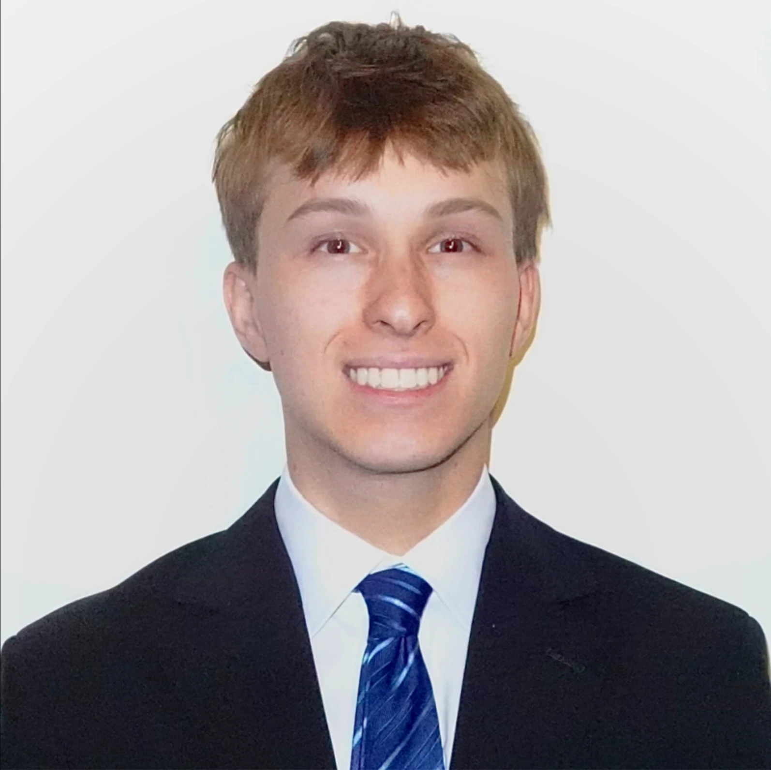
Care Provider Interviewed
Daniel Dobin, Clinical Assistant II
• Clinical Assistant II, Neurobehavioral Unit (Inpatient) — eighteen months on the unit, now training incoming clinical assistants.
• Johns Hopkins University undergraduate, 2024–2028.
• Research Fellow, JHU Center for Suicide Prevention — first author on systematic reviews in JAACAP and Neurotherapeutics, 2026.
• Crisis Text Line counsellor, two years.
• Why this background mattered: he sees equipment in daily use, trains the people who use it, and reads evidence critically.
8
Notes:
The last bullet justifies the choice of interviewee. Say it.

Slide 9
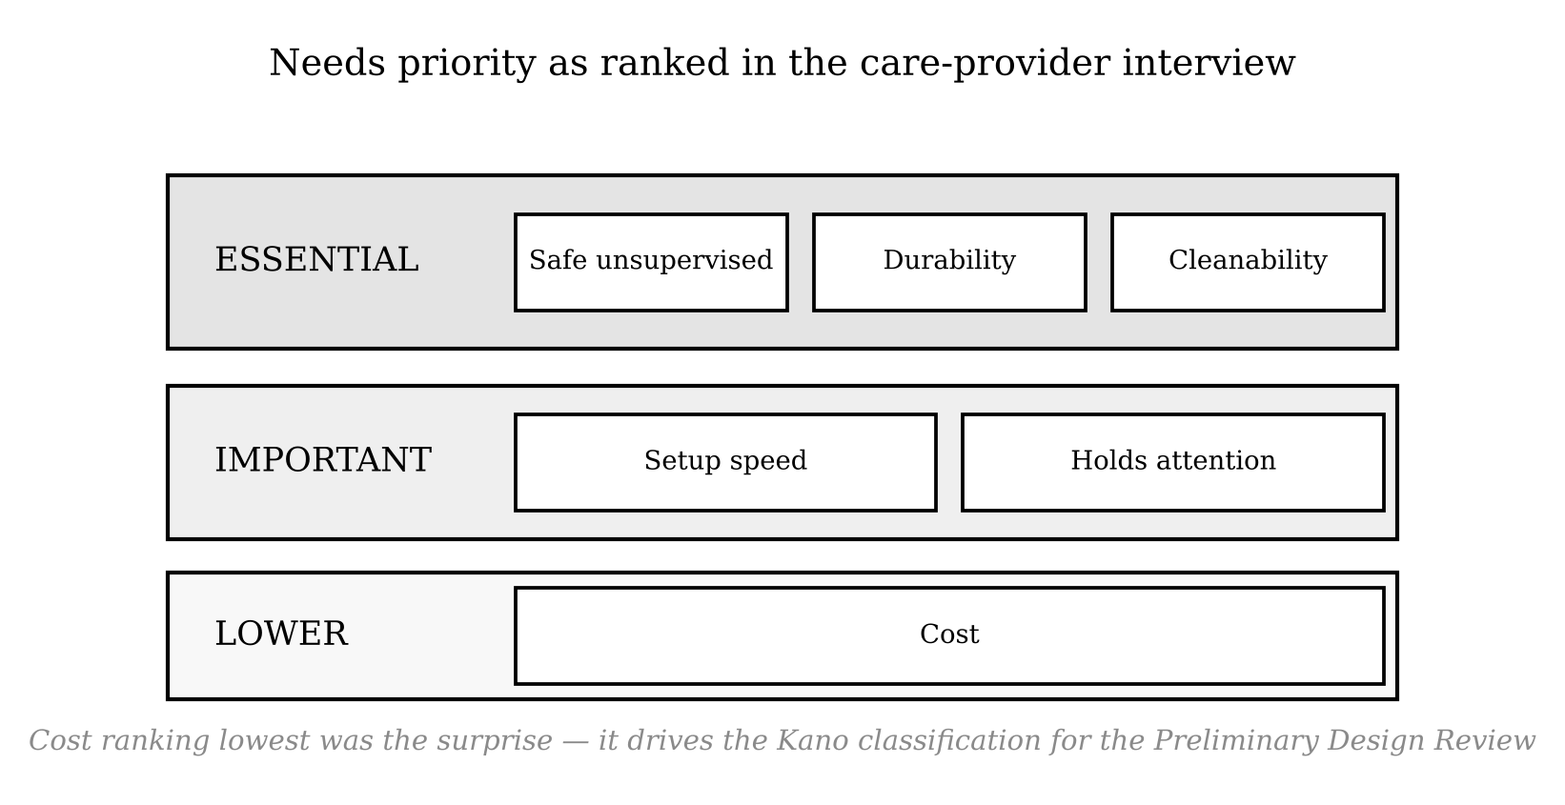
Interview Themes (1 of 2)
constraints and priorities
• Safety screening comes before function. Ligature risk, pinch points, parts that detach or can be thrown — these are pass/fail, not trade-offs.
• Cleanability sits with safety, not with convenience.
• Cost ranking lowest was the surprise. I had assumed affordability was the binding constraint.
9
Notes:
Flag the surprise explicitly. Graders reward the thing that changed your mind.

Slide 10
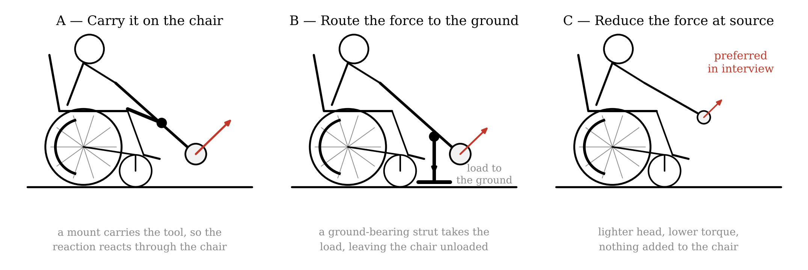
Interview Themes (2 of 2)
failure modes and solution directions
• How devices actually fail: breakage under deliberate force, lost parts, setups too slow to start, and patients disengaging — mechanical failure was not the most common mode.
• On my three directions: preference for reducing the force at source, since fewer attachments means fewer failure points and faster setup.
10
Notes:
Be honest about which of these you actually got.

Slide 11
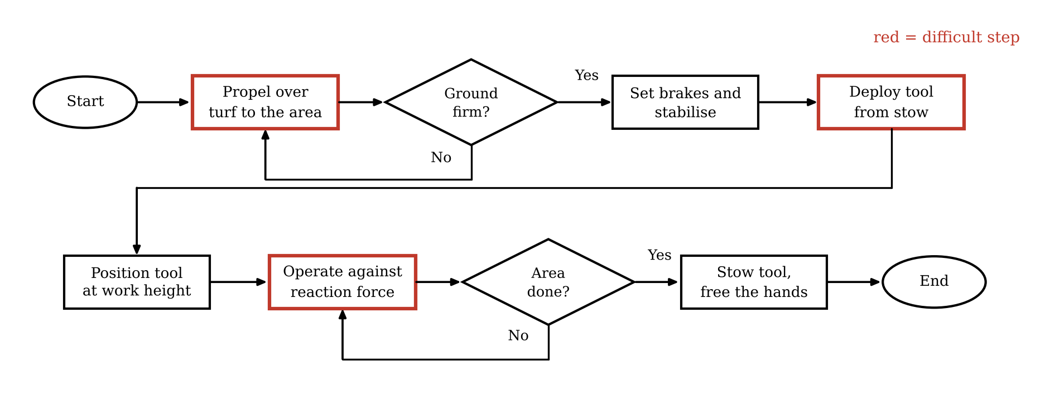
Impact on My Preliminary Design
what changes as a result
1. Quick-release becomes essential, not nice-to-have. Safety-driven, and the clearest single message of the visit.
2. Abuse tolerance and cleanability enter the PDS as requirements, not finishing details.
3. Abandonment becomes a design criterion. Setup time gets a target.
4. Acceptance criteria become measurable — attempts, elapsed time, setup time.
5. Scope confirmed, source corrected. Quantitative inputs must come from an adult mobility clinician.
Where the design must act
11
Notes:
This carries the rubric line about impact on preliminary design. About 90 seconds.

Slide 12
What I Could Not Gather, and Next Steps
• No client interview. A pediatric inpatient behavioural unit; patient privacy and the clinical setting made a client conversation inappropriate. The user perspective is still missing.
• No quantitative mobility data. Tipping margins, propulsion penalties and reimbursement are outside a direct-care behavioural role.
• Next steps:
  – Follow up with a PT, OT or seating and mobility specialist for the quantitative inputs.
  – Interview adult manual wheelchair users — the population the project actually targets.
  – Carry the needs ranking into a Kano diagram for the Preliminary Design Review.
  – Use the safety and durability constraints as screening criteria in concept generation.
12
Notes:
End on next steps rather than on gaps.

