Slide 1
Data Analytics: Module 2
Lesson 10
Understand star schema and the importance for Power BI

Slide 2
Outline of Previous Lecture
Star schema overview
Normalization vs. denormalization
Star schema relevance to Power BI models
Data Grain
Measures
Surrogate keys

Slide 3
Outline
Snowflake dimensions
Slowly changing dimensions
Role-playing dimensions
Junk dimensions
Degenerate dimensions

Slide 4
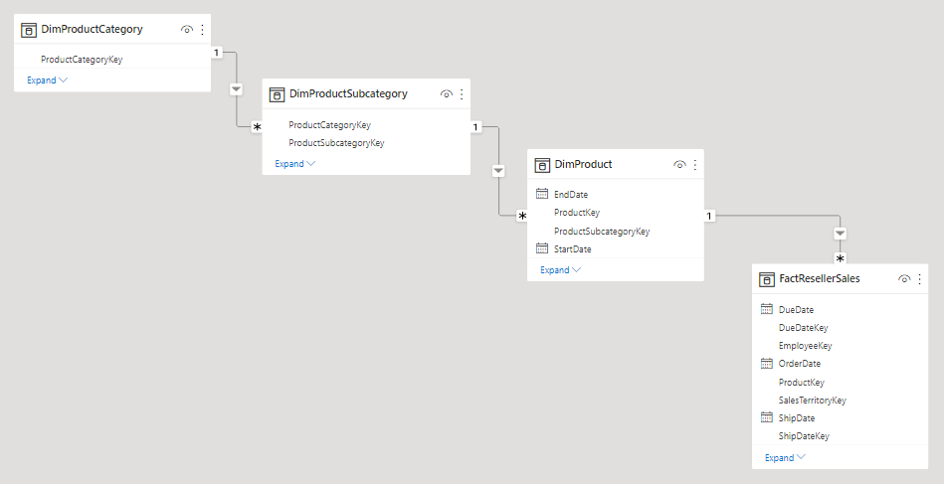
Snowflake dimensions
A snowflake dimension is a set of normalized tables for a single business entity.
E.g.: The product dimension is normalized and stored in three related tables: DimProductCategory, DimProductSubcategory, and DimProduct.
Adventure Works relational data warehouse

Slide 5
When you choose to mimic a snowflake dimension design
Power BI loads more tables, which is less efficient from storage and performance perspectives. These tables must include columns to support model relationships, and it can result in a larger model size.
Longer relationship filter propagation chains will need to be traversed, which will likely be less efficient than filters applied to a single table.
The Fields pane presents more model tables to report authors, which can result in a less intuitive experience, especially when snowflake dimension tables contain just one or two columns.
It's not possible to create a hierarchy that spans the tables.

Slide 6
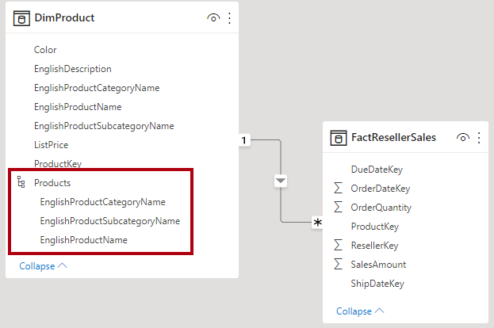
When you choose to integrate into a single model table
You can also define a hierarchy that encompasses the highest and lowest grain of the dimension.
Possibly, the storage of redundant denormalized data can result in increased model storage size, particularly for very large dimension tables.

Slide 7
Slowly changing dimensions
Type 1 SCD
Type 2 SCD
Star schema design theory refers to two common SCD types: Type 1 and Type 2.
A dimension-type table could be Type 1 or Type 2, or support both types simultaneously for different columns.

Slide 8
Slowly changing dimensions
A slowly changing dimension (SCD) is one that appropriately manages change of dimension members over time.
It applies when business entity values change over time, and in an ad hoc manner.
A good example of a slowly changing dimension is a customer dimension, specifically its contact detail columns like email address and phone number.
In contrast, some dimensions are considered to be rapidly changing when a dimension attribute changes often, like a stock's market price. The common design approach in these instances is to store rapidly changing attribute values in a fact table measure.

Slide 9
Type 1 SCD
A Type 1 SCD always reflects the latest values, and when changes in source data are detected, the dimension table data is overwritten.
This design approach is common for columns that store supplementary values, like the email address or phone number of a customer.
When a customer email address or phone number changes, the dimension table updates the customer row with the new values. It's as if the customer always had this contact information.
A non-incremental refresh of a Power BI model dimension-type table achieves the result of a Type 1 SCD.
It refreshes the table data to ensure the latest values are loaded.

Slide 10
Type 2 SCD
A Type 2 SCD supports versioning of dimension members.
If the source system doesn't store versions, then it's usually the data warehouse load process that detects changes, and appropriately manages the change in a dimension table.
In this case, the dimension table must use a surrogate key to provide a unique reference to a version of the dimension member.
It also includes columns that define the date range validity of the version
E.g.: StartDate and EndDate, and
Possibly a flag column (E.g.: IsCurrent) to easily filter by current dimension members.

Slide 11
Type 2 SCD
For example, Adventure Works assigns salespeople to a sales region.
When a salesperson relocates region, a new version of the salesperson must be created to ensure that historical facts remain associated with the former region.
To support accurate historic analysis of sales by salesperson, the dimension table must store versions of salespeople and their associated region(s).
Time Validity: the table should also include start and end date values.
Current versions may define an empty end date (or 12/31/9999), which indicates that the row is the current version.
The table must also define a surrogate key because the business key
in this instance, employee ID won't be unique.

Slide 12
Type 2 SCD
It's important to understand that when the source data doesn't store versions
You must use an intermediate system (like a data warehouse) to detect and store changes.
The table load process must preserve existing data and detect changes.
When a change is detected, the table load process must expire the current version.
It records these changes by updating the EndDate value and
Inserting a new version with the StartDate value commencing from the previous EndDate value.
Also, related facts must use a time-based lookup to retrieve the dimension key value relevant to the fact date.
A Power BI model using Power Query can't produce this result.
It can, however, load data from a pre-loaded SCD Type 2 dimension table.
The Power BI model should support querying historical data for a member, regardless of change, and for a version of the member, which represents a particular state of the member in time.
In the context of Adventure Works, this design enables you to query the salesperson regardless of assigned sales region, or for a particular version of the salesperson.

Slide 13
Type 2 SCD
To achieve this requirement
Power BI model dimension-type table must include a column for filtering the salesperson, and
A different column for filtering a specific version of the salesperson.
It's important that the version column provides a non-ambiguous description
Like "Michael Blythe (12/15/2008-06/26/2019)" or "Michael Blythe (current)".
It's also important to educate report authors and consumers about the basics of SCD Type 2, and
How to achieve appropriate report designs by applying correct filters.
It's also a good design practice to include a hierarchy that allows visuals to drill down to the version level.

Slide 14
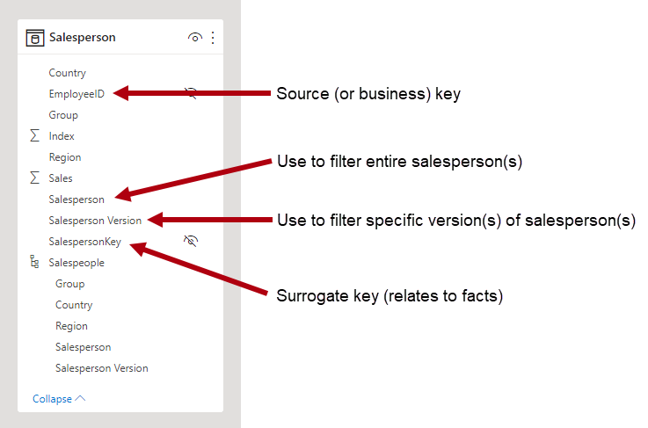
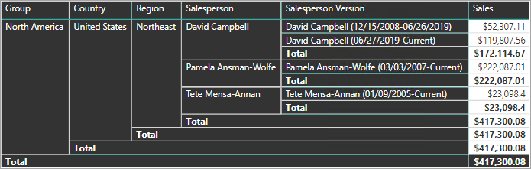
Type 2 SCD

Slide 15
Role-playing dimensions
Solution 1 to Role-playing dimensions
Solution 2 to Role-playing dimensions

Slide 16
Role-playing dimensions
A role-playing dimension is a dimension that can filter related facts differently.
E.g.: at Adventure Works, the date dimension table has three relationships to the reseller sales facts.
The same dimension table can be used to filter the facts by order date, ship date, or delivery date.
In a data warehouse, the accepted design approach is to define a single date dimension table.
At query time, the "role" of the date dimension is established by which fact column you use to join the tables.
For example, when you analyze sales by order date, the table join relates to the reseller sales order date column.

Slide 17
Role-playing dimensions
In a Power BI model, this design can be imitated by creating multiple relationships between two tables.
In the Adventure Works example, the date and reseller sales tables would have three relationships.
While this design is possible, it's important to understand that there can only be one active relationship between two Power BI model tables.
All remaining relationships must be set to inactive.
Having a single active relationship means there is a default filter propagation from date to reseller sales.
In this instance, the active relationship is set to the most common filter that is used by reports, which at Adventure Works is the order date relationship.

Slide 18
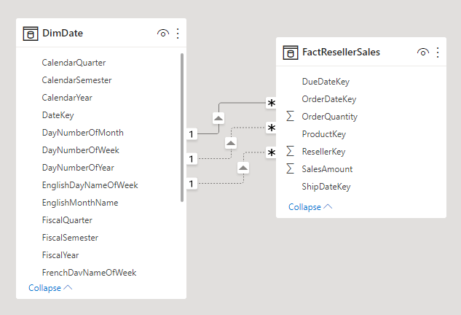
Role-playing dimensions

Slide 19
Solution 1 to Role-playing dimensions
The only way to use an inactive relationship is to define a DAX expression that uses the USERELATIONSHIP function.
In our example, the model developer must create measures to enable analysis of reseller sales by ship date and delivery date.
This work can be tedious, especially when the reseller table defines many measures.
It also creates Fields pane clutter, with an overabundance of measures.
There are other limitations, too:
When report authors rely on summarizing columns, rather than defining measures, they can't achieve summarization for the inactive relationships without writing a report-level measure. Report-level measures can only be defined when authoring reports in Power BI Desktop.
With only one active relationship path between date and reseller sales, it's not possible to simultaneously filter reseller sales by different types of dates. For example, you can't produce a visual that plots order date sales by shipped sales.

Slide 20
Solution 1 to Role-playing dimensions
The only way to use an inactive relationship is to define a DAX expression that uses the USERELATIONSHIP function.
In our example, the model developer must create measures to enable analysis of reseller sales by ship date and delivery date.
This work can be tedious, especially when the reseller table defines many measures.
It also creates Fields pane clutter, with an overabundance of measures.
There are other limitations, too:
When report authors rely on summarizing columns, rather than defining measures, they can't achieve summarization for the inactive relationships without writing a report-level measure. Report-level measures can only be defined when authoring reports in Power BI Desktop.
With only one active relationship path between date and reseller sales, it's not possible to simultaneously filter reseller sales by different types of dates. For example, you can't produce a visual that plots order date sales by shipped sales.

Slide 21
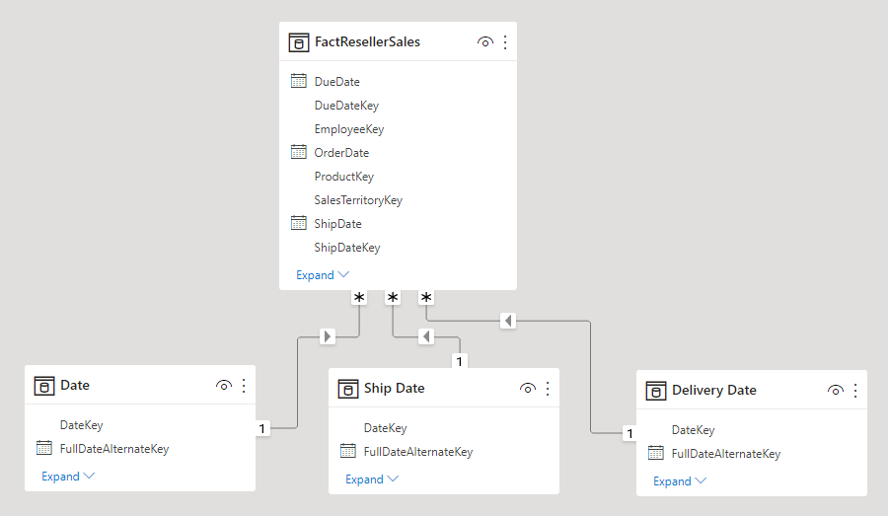
Solution 2 to Role-playing dimensions
To overcome these limitations
A common Power BI modeling technique is to create a dimension-type table for each role-playing instance.
The additional dimension tables as calculated tables, using DAX.
Using calculated tables, the model can contain a Date table, a Ship Date table and a Delivery Date table, each with a single and active relationship to their respective reseller sales table columns.

Slide 22
Solution 2 to Role-playing dimensions
This design approach
It doesn't require to define multiple measures for different date roles, and
It allows simultaneous filtering by different date roles.
A minor price to pay with this design approach is that duplication of the date dimension table resulting in an increased model storage size.
As dimension-type tables typically store fewer rows relative to fact-type tables, it is rarely a concern.

Slide 23
Solution 2 to Role-playing dimensions
Observe the following good design practices when you create model dimension-type tables for each role:
Ensure that the column names are self-describing.
While it's possible to have a Year column in all date tables, column names are unique within their table.
Consider renaming columns in each dimension role table, so that the Ship Date table has a year column named Ship Year, etc.
When relevant, ensure that table descriptions provide feedback to report authors (through Fields pane tooltips) about how filter propagation is configured.
This clarity is important when the model contains a generically named table, like Date, which is used to filter many fact-type tables.
In the case that this table has, for example, an active relationship to the reseller sales order date column, consider providing a table description like "Filters reseller sales by order date".

Slide 24
Junk dimensions
A junk dimension is useful when there are many dimensions
Especially consisting of few attributes/ one, and when these attributes have few values.
Good candidates include order status columns, or customer demographic columns (gender, age group, etc.).
The design objective of a junk dimension
Is to consolidate many "small" dimensions into a single dimension to both reduce the model storage size and
Also reduce Fields pane clutter by surfacing fewer model tables.
A junk dimension table is typically the Cartesian product of all dimension attribute members, with a surrogate key column.
The surrogate key provides a unique reference to each row in the table.
You can build the dimension in a data warehouse, or by using Power Query to create a query that performs full outer query joins, then adds a surrogate key (index column).

Slide 25
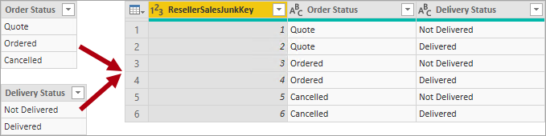
Junk dimensions
You load this query to the model as a dimension-type table.
You also need to merge this query with the fact query, so the index column is loaded to the model to support the creation of a "one-to-many" model relationship.

Slide 26
Degenerate dimensions
A degenerate dimension refers to an attribute of the fact table that is required for filtering.
At Adventure Works, the reseller sales order number is a good example.
In this case, it doesn't make good model design sense to create an independent table consisting of just this one column, because it would increase the model storage size and result in Fields pane clutter.
In the Power BI model, it can be appropriate to add the sales order number column to the fact-type table to allow filtering or grouping by sales order number.
It is an exception to the formerly introduced rule that you should not mix table types (generally, model tables should be either dimension-type or fact-type).
However, if the Adventure Works resellers sales table has order number and order line number columns, and they're required for filtering, a degenerate dimension table would be a good design.

Slide 27
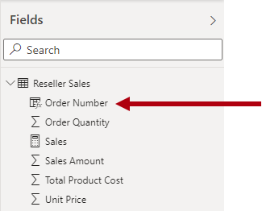
Degenerate dimensions

Slide 28
Factless fact tables
A factless fact table doesn't include any measure columns. It contains only dimension keys.
For example, at a particular date and time, a particular customer logged into your web site.
You could define a measure to count the rows of the factless fact table to perform analysis of when and how many customers have logged in.
A factless fact table could store observations defined by dimension keys.
A more compelling use of a factless fact table is to store relationships between dimensions, and it's the Power BI model design approach we recommend defining many-to-many dimension relationships. In a many-to-many dimension relationship design, the factless fact table is referred to as a bridging table.
For example, consider that salespeople can be assigned to one or more sales regions. The bridging table would be designed as a factless fact table consisting of two columns: salesperson key and region key. Duplicate values can be stored in both columns.

Slide 29
Factless fact tables
A more compelling use of a factless fact table is to store relationships between dimensions, and it's the Power BI model design approach
It’s recommended defining many-to-many dimension relationships.
In a many-to-many dimension relationship design, the factless fact table is referred to as a bridging table.
This many-to-many design approach is well documented, and it can be achieved without a bridging table.
However, the bridging table approach is considered the best practice when relating two dimensions.
For example, consider that salespeople can be assigned to one or more sales regions.
The bridging table would be designed as a factless fact table consisting of two columns: salesperson key and region key.
Duplicate values can be stored in both columns.

Slide 30
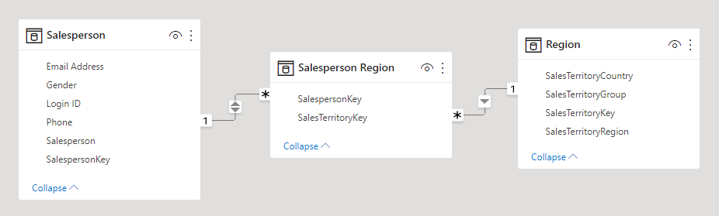
Factless fact tables

Slide 31
References
https://learn.microsoft.com/en-us/power-bi/guidance/star-schema#measures
https://mozartdata.com/data-grain-whats-the-right-level-of-granularity-when-building-data-models/
https://stackoverflow.com/questions/39181036/whats-the-grain-in-the-context-of-dw
https://www.phdata.io/blog/how-to-model-and-choose-the-right-data-model/
https://docs.getdbt.com/terms/grain
https://help.salesforce.com/s/articleView?id=sf.c360_a_normalized_and_denormalized_data.htm&type=5
https://docs.getdbt.com/terms/grain
https://www.kimballgroup.com/2003/03/declaring-the-grain/
https://medium.com/analytics-vidhya/database-normalization-vs-denormalization-a42d211dd891

Slide 32

Thanks for your attention !

