Slide 1
CSE7101- Capstone Project
Review-2
“AI-Based Real-Time Flood Monitoring & Forecasting”
Batch Number: CAI_3
Under the Supervision of,
Dr.Mohammadi Akheela Khanum
Professor
School of Computer Science and Engineering
Presidency University
Roll Number | Name
20231CAI3009 | VANDAN GOWDA R
20221CAI0118 | VAISHNAVI SALUNKE
20221CAI0112 | ANUSHA H G
Name of the Program: B.Tech Computer Science & Engineering(Artificial Intelligence & Machine Learning)
Name of the HoD: Dr.Zafar Ali Khan N
Name of the Program Project Coordinator: Ms. Suma N G
Name of the School Project Coordinators: Dr. Sampath A K , Dr. Geetha A

Slide 2
ABSTRACT
Flood forecasting systems involve predetermination of flood events necessary to help the implementation of structural measures for the mitigation of flood damages.
It also helps for regulation and operation of the multipurpose reservoirs with a focus on the control of incoming floods, and the evacuation of the affected people to the safer places.
Existing tools were typically based on manually input and prepared data. The processes were tedious and thus prohibitive for real-time and early forecasts.
A novel flood forecasting system is based on fusing meteorological, hydrological, geospatial, and crowd source big data in an adaptive machine learning framework.

Slide 3
Literature Survey
No | Reference (year, source) | Methods | Limitations
01 | Nearing et al., Global prediction of extreme floods in ungauged watersheds (2024, Nature) | AI models trained on multi-basin data; benchmark against Copernicus EMS GloFAS. | Requires extensive training data and careful uncertainty quantification.
02 | Li et al., Optimizing flood predictions by integrating LSTM (2024) | LSTM + feature engineering + hyperparameter optimization | May need per-site tuning; risk of overfitting if not regularized
03 | Wahba et al., Flash-flood susceptibility mapping using Random Forest (2024) | Random Forest, GIS predictors, susceptibility maps | Susceptibility real-time forecasting; needs static input layers.
04 | Wahba et al., Flash-flood susceptibility mapping using Random Forest (2024 | Minimalist data-driven hydrology + ML components | May underperform where physics detail is needed for inundation mapping

Slide 4
05 | Rajab et al., Flood forecasting with ML: a study (2023, Water) | ML algorithms (incl. RF, ANN, SVM), evaluation by R², RMSE | Region-specific results; meteorological data quality impacts results
06 | Wahba et al., Flash-flood susceptibility mapping using Random Forest (2024) | Random Forest, GIS predictors, susceptibility maps | spatial predictors (elevation, land-use, drainage).
07 | Albertini et al., Multi-source Random Forest classification of floods (2024) | RF on multi-source inputs (satellite, hydromet). | Transferability between regions requires testing
08 | Tang et al., Flood forecasting based on ML patterns (2023) | extreme flood events and classify flood risk. | Class imbalance challenges for extremes; needs careful sampling.
09 | Tang et al., Flood forecasting based on ML patterns (2023) | Ensemble ML (various classifiers), feature selection, extreme-event focus. | Class imbalance challenges for extremes; needs careful sampling
10 | Hirpa et al., Calibration of GloFAS (2018, Journal of Hydrology) | Hydrological modelling, ensemble streamflow forecasting, evaluation metrics. | Coarse resolution for local/urban flooding; dependent on meteorological inputs.

Slide 5
Objectives
To collect the flood forecasting data such as
  Geospatial,
  Meteorological and hydrological, obtained from GLOFAS,
  Crowd source data.
Normalization of data and make a common coordinate frame, a pre-processing need to be done.
Data integration preprocessed data.
It was elucidated empirically that the developed system could be used to alert the public and authorities alike of not only a current flood but also future ones.
This system also enhanced user experience via responsive graphical interfaces, interoperable on different computing devices including mobiles.

Slide 6
Existing Methods and Drawbacks
Physics-based & Statistical Models– Require heavy calibration, high-quality data, and often fail in ungauged basins or extreme events
Machine Learning & Deep Learning – High accuracy for short-term forecasts but need large datasets, are computationally expensive, and act as “black boxes.”
Hybrid & GIS/Remote Sensing Approaches –Improve accuracy but complex to integrate, and most provide susceptibility maps rather than real-time forecasts

Slide 7
Proposed Method & Feasibility Study
Our Novel Flood Forecasting System based on fusing meteorological, hydrological, geospatial, as well as crowdsourcing data, and integrating them into an ML framework.
These data were compiled from various big data platforms, by using online application programming interfaces (API).
The forecasting mechanism was driven by a machine learning strategy. To determine the most suitable one for the task, several state-of-the-art MLs, i.e., Decision tree, Random forest, Naïve Bayes, Artificial Neural Networks, Support Vector Machine

Slide 8
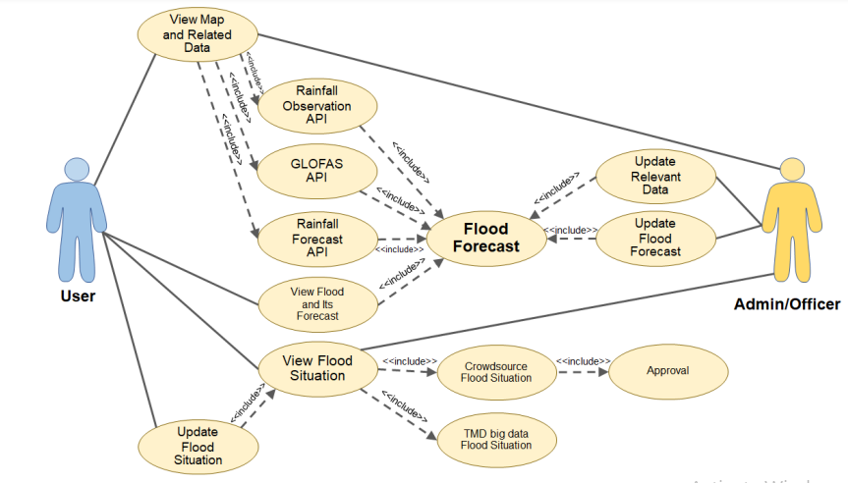
Architecture Diagram

Slide 9
Modules
Data Collection
Meteorological, hydrological, geospatial, and crowdsourced data.
Data Preprocessing & Storage
Cleaning, validation, integration, and feature storage.
Prediction & Modeling
Physics-based models, ML/DL models, and hybrid fusion.
Visualization & Alerting
Web dashboard, maps, and real-time alerts (SMS/Email/Mobile).
Monitoring & Updates
Model retraining, performance monitoring, and continuous improvement.

Slide 10
Hardware and Software Details
HARDWAER
Hard disk : 50 GB
SOFTWAER
Operating system : Windows 8,10
Coding Language : Python 3.10.4,
Database : "https://weather.visualcrossing.com”

Slide 11
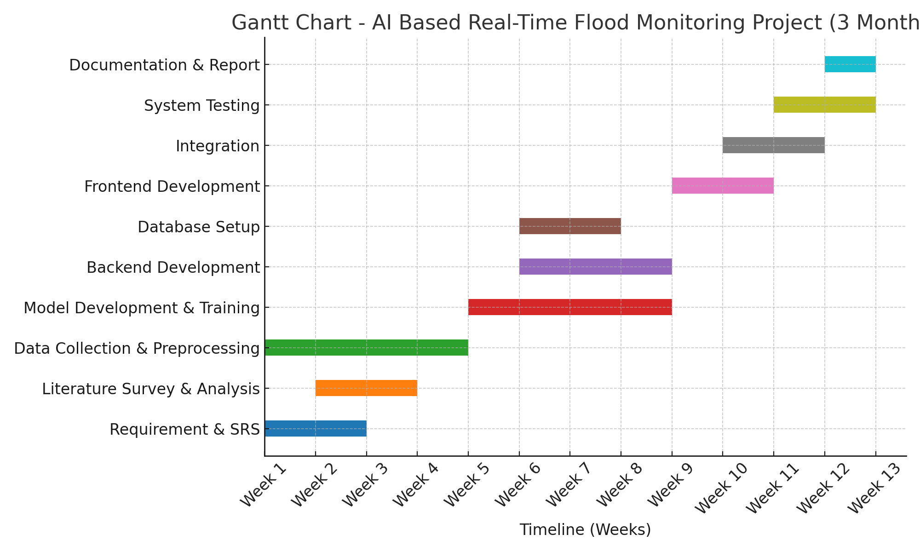
Timeline (Gantt Chart)

Slide 12
References
P. Ghorpade, A. Gadge, H. Chordiya, B. Hooli, A. Lende, G. Gosavi, Y. S. Ingle, A. Mishra, and N. Shaikh, “Flood Forecasting Using Machine Learning: A Review,” in Proc. 2021 8th International Conference on Smart Computing and Communications
S. Ramasamy, P. Ranjith Kumar, M. Vimala, N. Najmul Sahi, A. Rajesh, and S. Siddharth, “Flood Prediction Using Supervised Machine Learning Algorithms,” in Proc. 2024 5th International Conference on Smart Electronics and Communication
J. Gupta, “AI-Enhanced Flood Warning Systems with IoT Sensors in Urban Zones,” International Journal for Research in Applied Science and Engineering Technology, vol. 6, no. (issue), pp. 73561–73571, 2018, doi: 10.14569/IJACSA.2018.091187. (Published via IEEE Access)

Slide 13


