Slide 1
CHAROTAR UNIVERSITY OF SCIENCE &TECHNOLOGY (CHARUSAT)
Chandubhai S. Patel Institute of Technology (CSPIT)
Department of Information Technology
PROJECT–I [IT266]
ProjectID: 35
Learning App for Deaf And Mute and sign language-English/Gujarati converter
Name of Student & ID:
Vandan Kambodi (23IT042)
Prashant Gangani (23IT033)

Slide 2




INTRODUCTION
In alignment with the Government of Gujarat's commitment to inclusive education, this project aims to develop a web-based learning platform for deaf and mute individuals. The website bridges communication gaps by integrating Indian Sign Language (ISL) with Gujarati and English, enhancing learning experiences.
It serves as a learning and communication tool, helping users recognize and understand signs in real time. The platform provides bilingual resources in English and Gujarati, making education more accessible while fostering better communication through sign language conversion and interactive learning.

Slide 3
OBJECTIVE
The primary objective of this web-based learning platform is to empower deaf and mute people by providing an interactive, accessible, and inclusive educational environment that supports Gujarati and Indian Sign Language (ISL).
The website aims to bridge communication and learning gaps by leveraging technology-driven solutions in education.
Create a user-friendly learning platform

Slide 4
SCOPE
Educational Scope
Gujarati Learning
Mathematics
Science
Exercises
Functional Scope
Interactive Learning Modules
Data Analytics & Report Generation
Multi-Language Support

Slide 5
PLAN COMPONENTS
Frontend: React (Vite) + Tailwind
Backend: Node.js + Express
DataBase: MongoDB Atlas
Version Control: Github & Github Desktop

Slide 6
LIMITATIONS
Accuracy of Sign Language Translation:
Automated Gujarati-to-Sign Language and Speech-to-Sign conversions may not always be 100% accurate.
Some complex sentences or regional variations in sign language might not be well-represented.
Need for Continuous Content Updates:
New learning materials, updated sign language videos, and exercises must be frequently added.
Teachers and content creators will need to regularly maintain the platform.
Limited Gesture Recognition (Future Enhancement Needed):
Currently, the website does not support real-time gesture recognition for sign language input.
Future development may include AI-based gesture tracking for better interaction.

Slide 7
RESOURCE ADHERENCE
The project team managed their allocated resources effectively, maintaining an estimated 80% alignment with the original resource distribution plan. While there were slight challenges in acquiring certain components, timely adjustments and alternative arrangements were made without causing major disruptions. These proactive measures ensured that the project's progress and deliverables remained largely unaffected, demonstrating strong adaptability and overall resource efficiency.

Slide 8
CHALLENGES & INNOVATIVE SOLUTIONS
managing large video content
User authentication
Ensuring accessibility for hearing-impaired users

Slide 9
SOLUTIONS
Used Linked videos that can play on the same platform
Used custom id-password for authentication
Focused on Visual-first interface
clear categorization of signs and video contents

Slide 10
ROLE
Vandan:
React.js
Node.js & Express.js
Git, GitHub
Prashant:
HTML, CSS, JavaScript
MongoDB
Git, GitHub

Slide 11
FEATURES
Alphabet and Number Interpretation: Interactive web modules to teach Gujarati alphabets and numbers.
Vocabulary and Sentence Formation: Basic words and sentences in Gujarati, starting from each alphabet.
Mathematics: Lessons on tables, arithmetic operations, and problem-solving with interactive assessment tools.
Science: Sign language tutorials for scientific concepts, paired with exercises to test comprehension.
Interesting Video Lectures: The ability to convert Gujarati sentences into sign language.
Report Card: After giving quiz there is chance to win certificates.

Slide 12
FUNCTIONAL REQUIREMENTS
User Sign up/ login / log out
Sign language tutorial videos with text content
Interactive quizzes with scoring
Certificate generation after quiz completion

Slide 13
INDUSTRY PRACTICE ADOPTED
MERN Stack Architecture
RESTful APIs: For clear client-server interaction
Environment Variables: Used .env and .env.example to manage secrets
Accessibility Considerations: Alt text, proper labels, keyboard navigation

Slide 14
FUTURE WORK
AI-based Sign Language Recognition: Developing a gesture recognition system for better interaction.
Live Sign Language Interpretation: Real-time video-based sign language translation for improved communication.
Integration with Schools & Companies: Expanding usage to educational institutions and workplaces to promote inclusivity.

Slide 15
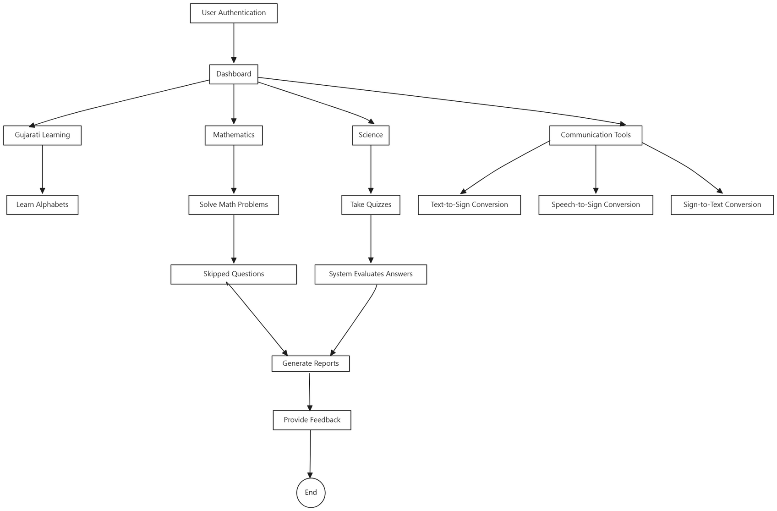

Slide 16
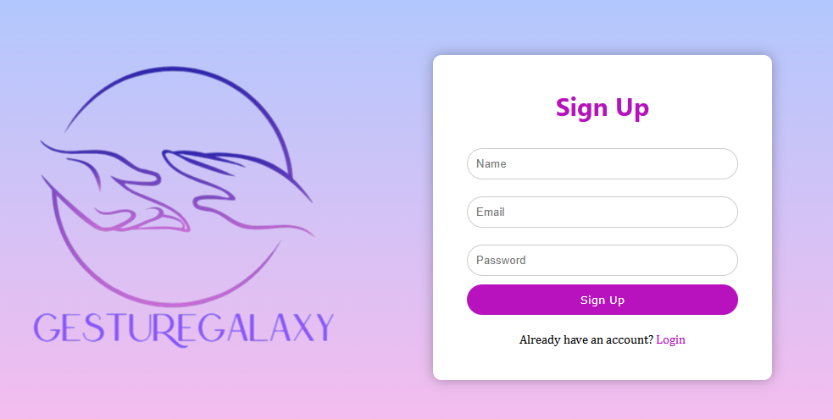
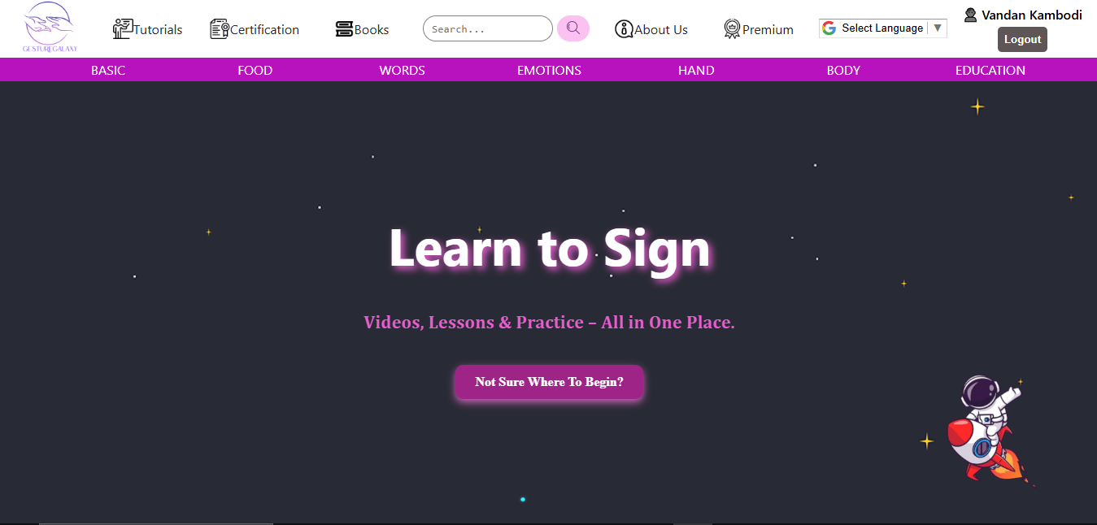

Slide 17
CONCLUSION
This website is designed to revolutionize learning and communication for deaf and mute people by providing a comprehensive, accessible, and interactive educational platform. It will bridge the gap between specially-abled students and mainstream education, enhancing inclusivity and accessibility in India.

Slide 18
REFERENCES
https://www.learnsign.in/about-1
https://www.signlanguage101.com/books
https://www.design.com/maker/logo/af70ff4b-35f7-49f5-8a37-5891ac728a5d/draft/8563fa51-9593-44a6-94d8-346487cf280f
https://www.istockphoto.com
https://www.remove.bg/upload
https://pinetools.com/overlay-images
https://www.freepik.com/icons/education
https://islrtc.nic.in/ncert-books-in-isl/

Slide 19
THANK
YOU!

