Slide 1
project on scientific calculator
N Vandana

Slide 2
AGENDA
Introduction
How it Works
Coding
Output
Summary

Slide 3
INTRODUCTION
Stepping into this futuristic Generation There is always a new pieces of knowledge every Minute. So to make it even more faster calculator had been brought into actions . Main moto of this project is to create a simple scientific calculator using python modules for easy Mathematic calculations.

Slide 4
How it works
Designing a Scientific Calculator using Python modules And providing the input by the User . For Illustrating simple Mathematical calculations..

Slide 5
PYthon Code For Executing the Scientific calculator
import math
def add(x, y):
return x + y
def subtract(x, y):
return x - y
def multiply(x, y):
return x * y
def divide(x, y):
if y != 0:
return x / y
else:
return "Error: Cannot divide by zero."

Slide 6
def power(x, y):
return x ** y
def square_root(x):
return math.sqrt(x)
def logarithm(x, base=10):
return math.log(x, base)
def sin(x):
return math.sin(math.radians(x))
def cos(x):
return math.cos(math.radians(x))
def tan(x):
return math.tan(math.radians(x))

Slide 7
# Main calculator loop
while True:
print("Scientific Calculator")
print("1. Add")
print("2. Subtract")
print("3. Multiply")
print("4. Divide")
print("5. Power")
print("6. Square Root")
print("7. Logarithm")
print("8. Sine")
print("9. Cosine")
print("10. Tangent")
print("0. Exit")
choice = input("Enter your choice (0-10): ")
if choice == '0':
print("Exiting the calculator...")
break
if choice in ('1', '2', '3', '4', '5'):
num1 = float(input("Enter the first number: "))
num2 = float(input("Enter the second number: "))

Slide 8
if choice == '1':
print("Result:", add(num1, num2))
elif choice == '2':
print("Result:", subtract(num1, num2))
elif choice == '3':
print("Result:", multiply(num1, num2))
elif choice == '4':
print("Result:", divide(num1, num2))
elif choice == '5':
print("Result:", power(num1, num2))
elif choice == '6':
num = float(input("Enter a number: "))
print("Result:", square_root(num))

Slide 9
elif choice == '7':
num = float(input("Enter a number: "))
base = float(input("Enter the base (default is 10): "))
print("Result:", logarithm(num, base))
elif choice == '8':
num = float(input("Enter an angle in degrees: "))
print("Result:", sin(num))
elif choice == '9':
num = float(input("Enter an angle in degrees: "))
print("Result:", cos(num))
elif choice == '10':
num = float(input("Enter an angle in degrees: "))
print("Result:", tan(num))
else:
print("Invalid input. Please enter a valid option.")

Slide 10

Output
Using Visual Studio code as a Platform for executing the Python program . Having A knowledge of user ,illustrating the program taking 2 variables at most And rendered to get an output.

Slide 11
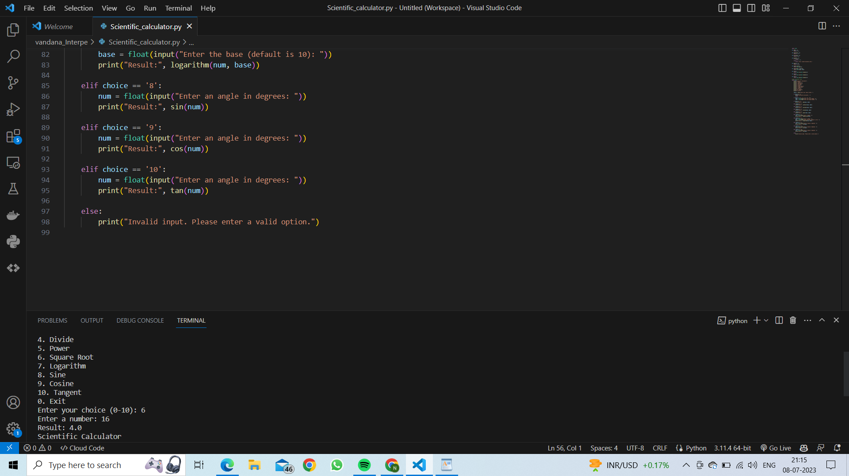

Slide 12
SUMMARY
This Project has Been guided by the Instructors of
"INTERNPE"
Learning this Sort of Knowledge is much important...
Source: Internet

Slide 13

THANk YOU

