Slide 1
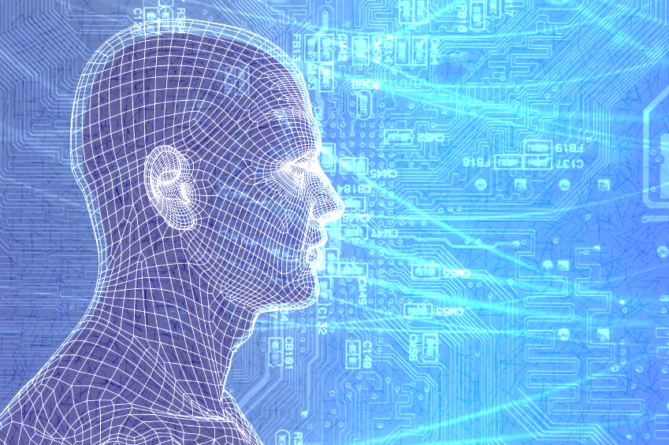
A NOVEL APPROACH ON IMAGE PROCESSING ALGORITHMS
Vandana Balakrishnan

Slide 2
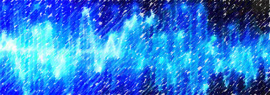
Introduction
What is a Neural Network?
It is a network of many simple processors, each possibly having a small amount of local memory
These processors are connected by communication channels, usually carrying encoded numeric data.

Slide 3
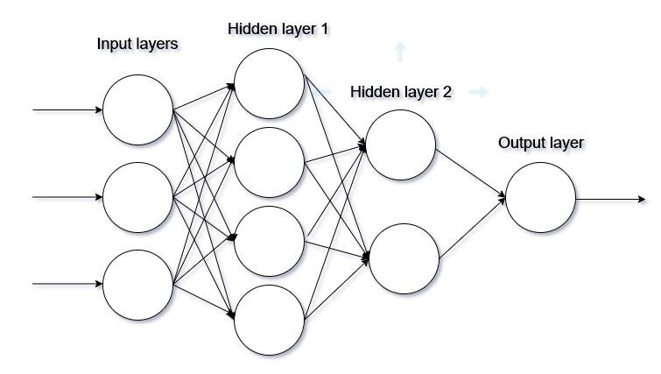
Diagram:

Slide 4
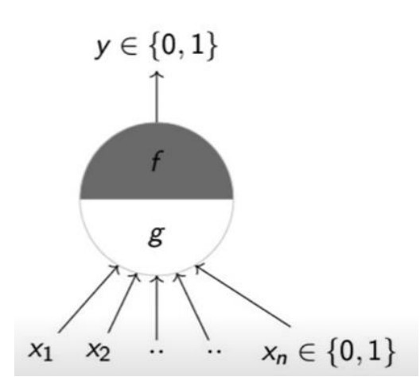
Artificial Neurons
Definition: The most fundamental unit of a neural network
It was given by Mc Culloh (Neuroscientist) and Pitts(Logician).
Diagram:

Slide 5
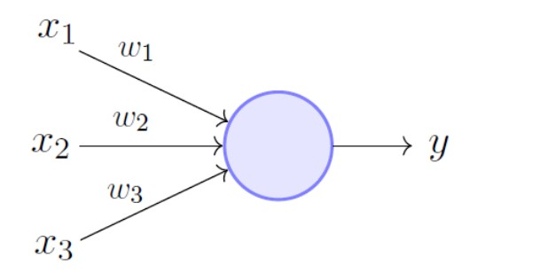
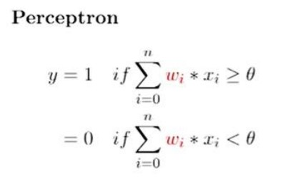
Perceptrons:
Introduced by Frank Rosenblatt
Introduced numerical weight for the inputs.

Slide 6
Neural networks Vs other ML algorithms
(difference in the approach)
While a Machine Learning model makes decisions according to what it has learned from the data, a Neural Network arranges algorithms in a fashion that it can make accurate decisions by itself.
In machine learning, there is a number of algorithms that can be applied to any data problem. These techniques include regression, k-means clustering, etc.

Slide 7
Architecturally, an artificial neural network is exhibited with layers of artificial neurons, also called as computational units able to take input and apply an activation function along with a threshold to find out if messages are passed along.

Slide 8
Types of Neural Networks
Artificial Neural Network(ANN)
Convolutional Neural Network(CNN)
Recurrent Neural Network(RNN)

Slide 9
Artificial Neural Network
An artificial Neural Network, or ANN, is a group of multiple perceptrons/ neurons at each layer. ANN is also known as a Feed-Forward Neural network because inputs are processed only in the forward direction:

Slide 10
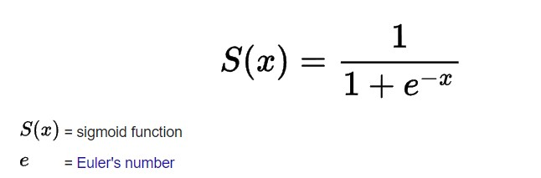
Advantages of ANN
The greatest advantage of using ANN is the use of activation functions!
One such example is the sigmoid function.
Formula:

Slide 11
Disadvantages of ANN
While solving an image classification problem using ANN, the first step is to convert a 2-dimensional image into a 1-dimensional vector prior to training the model. This has two drawbacks:
The number of trainable parameters increases drastically with an increase in the size of the image, this makes the training process complex.
ANN loses the spatial features of an image due to this transformation.
ANN cannot capture sequential information in the input data.

Slide 12
Convolutional Neural Network(CNN)
CNNs are based on kernels
Kernels are used to extract the relevant features from the input using the convolution operation.
This eliminates the need for dimensionality reduction of the image, and thus is mostly used for solving problems on image data.

Slide 13
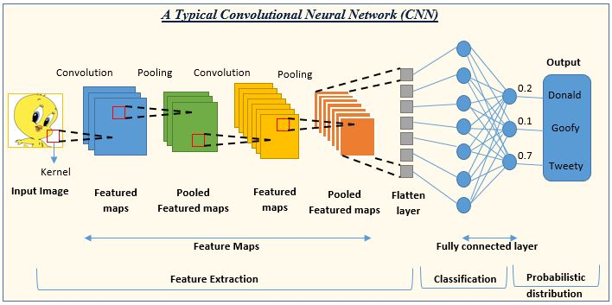

Slide 14
Advantages of CNN
CNN learns the filters automatically without mentioning them explicitly. These filters help in extracting the right and relevant features from the input data
CNN captures the spatial features from an image, therefore, it doesn’t compromise the quality of the image.

Slide 15
Disadvantages of CNN
a lot of training data is needed for the CNN to be effective
they fail to encode the position and orientation of objects.

Slide 16
Recurrent Neural Network(RNN)
A few of the issues in the feed-forward neural network are:
Cannot handle sequential data
Considers only the current input
Cannot memorize previous inputs
The solution to these issues is the RNN.
An RNN can handle sequential data, accepting the current input data, and previously received inputs.

Slide 17
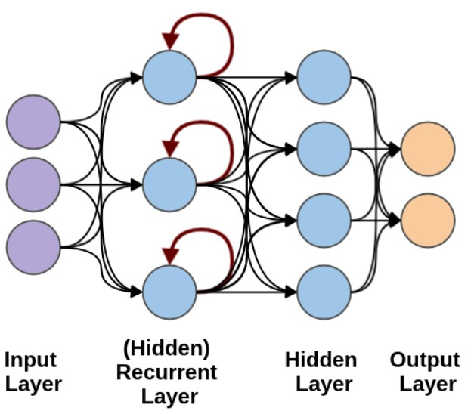
Diagram of RNN

Slide 18
Weights:
The architecture of neural networks is such that it has weights associated with each of the inputs in the input layer
These weights are “mandatory” and “arbitrary”
We may not have control over the mandatory aspect of it, but we have control over the value of the weights in the network

Slide 19
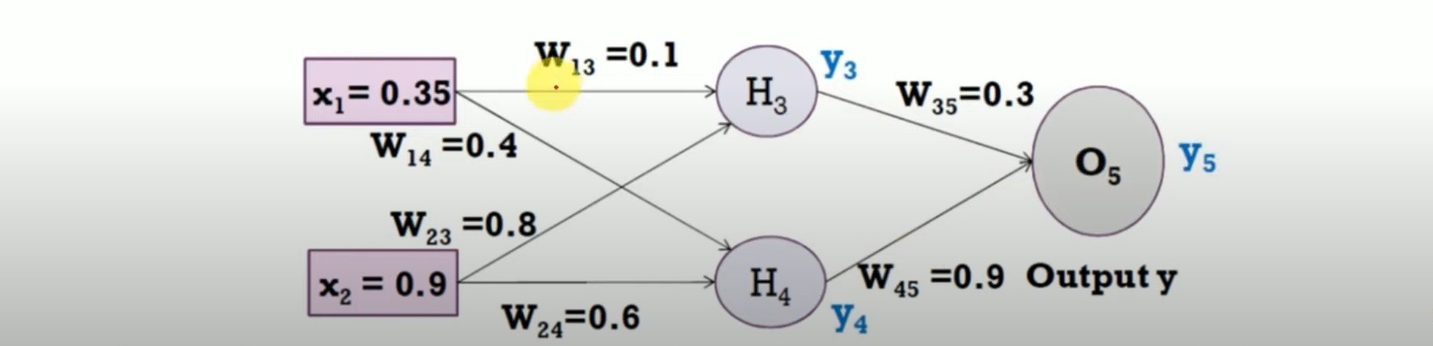
Control over weights:
This is a two-layer neural network
Let Learning rate = 1
Inputs to the network are 0.35 & 0.9 and the actual output is 0.5

Slide 20

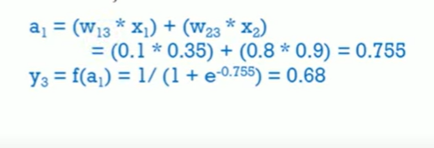
Aggregation, decision:
The final output is obtained as: 0.69

Slide 21

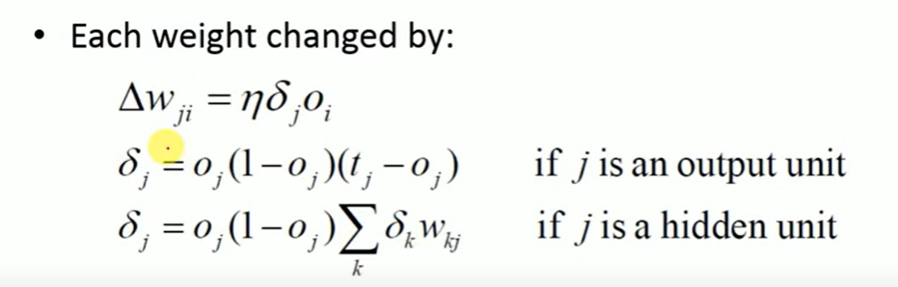
The loss function is:
Now reducing the error and increasing the accuracy of the output (degree of accuracy is arbitrary) by using backpropagation.

Slide 22
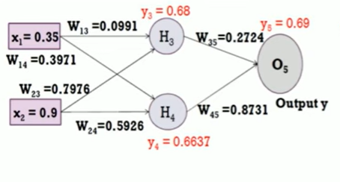
Applying the same on the original weights of the network, we get the updated network as:
After performing the forward pass again on this network, our output is 0.6820 with an error of -0.182.

Slide 23
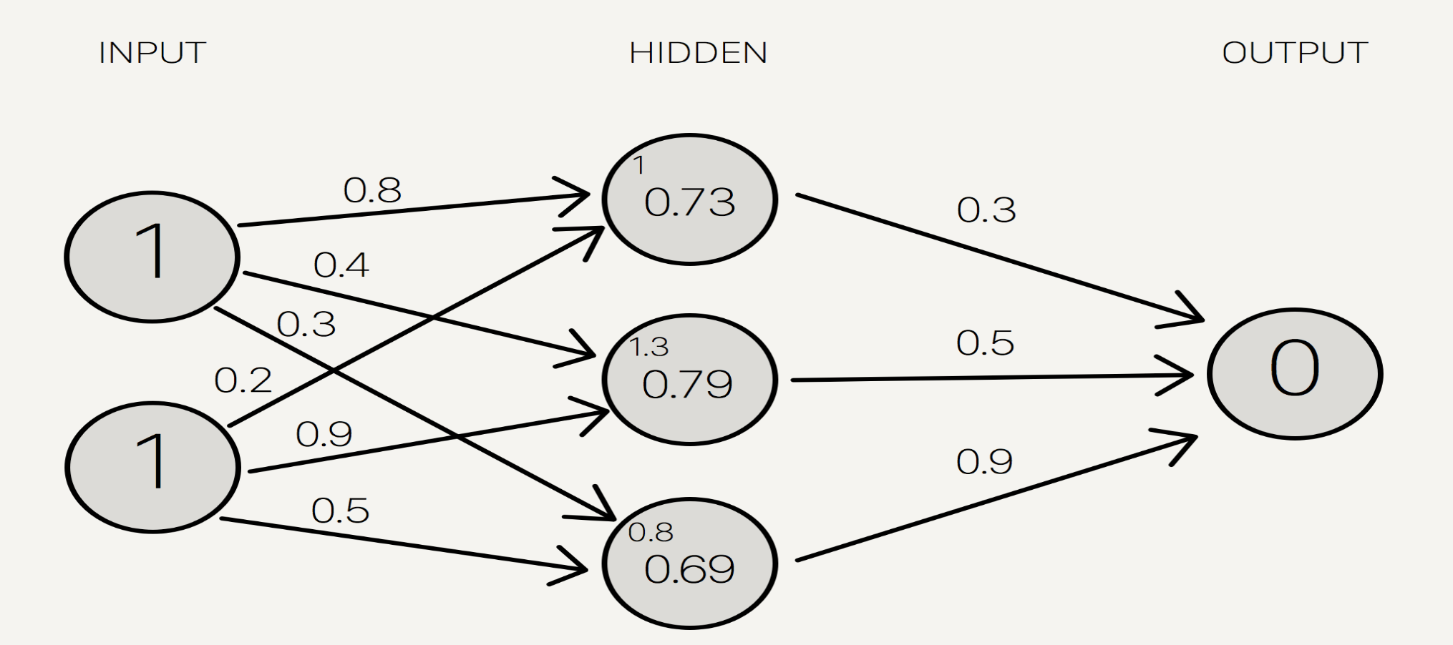
Proposed Approach:
Output = ∑ 𝑤_{𝑖}𝑥_{𝑖} ;
w_{i} → weights & x_{i}→ inputs

Slide 24
Representing the linear combination of the inputs as a product of matrices as:
WX = Y
Where, the W→ weight matrix, consisting of all the weights in each of the layers
X → The set of inputs to the network, and
Y → The set of outputs from the network.

Slide 25
In our novel approach, there is no requirement of the backpropagation method
Rather, we structurally simplify the weight matrix, W as a product of two matrices, Q & R and,
We then find the product of the input image matrix under consideration with these two matrices, Q & R to get the final image output.
This corresponds to the result we obtained after backpropagation on the same network.

Slide 26
The structural simplification implemented on the weight matrix is QR Decomposition
W= Q*R,
Where,
Q is a KxL matrix whose columns form an orthonormal set and,
R is an LxL upper triangular matrix whose diagonal entries are strictly positive.

Slide 27
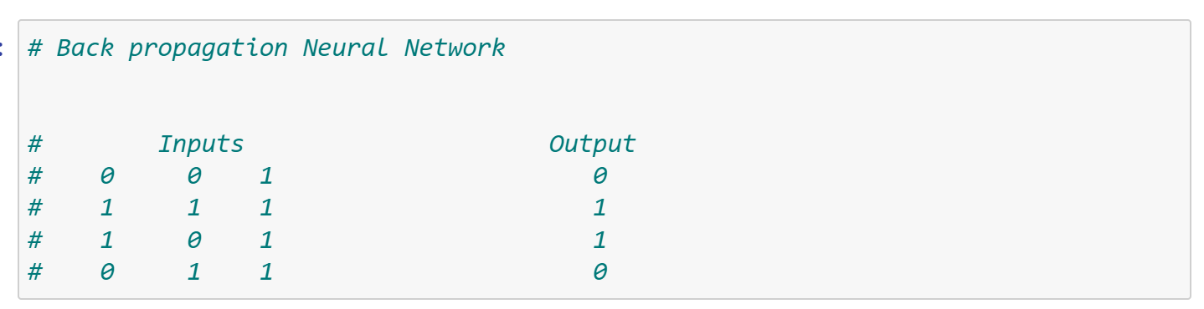
Demonstration:
Consider the following dataset

Slide 28
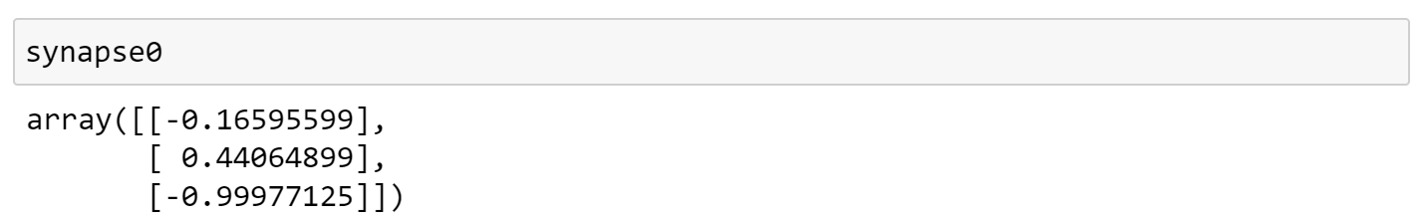
Now, we create an artificial neural network with three inputs, one hidden layer, and one output to represent the same.
We initialize the weights of the network randomly as:

Slide 29
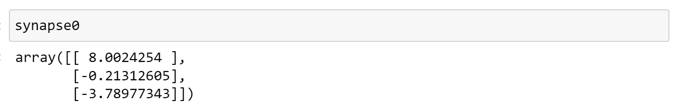
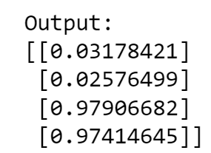
Applying forward pass followed by backpropagation, we found the updated weights as
Followed by this, we performed the dot product of the input vector and the updated weights(∑ 𝑤_{𝑖}𝑥_{𝑖} ) to obtain the output vector as

Slide 30
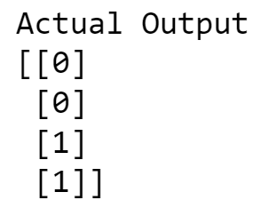
This output vector corresponds to the actual output which was, to a greater degree of accuracy:

Slide 31
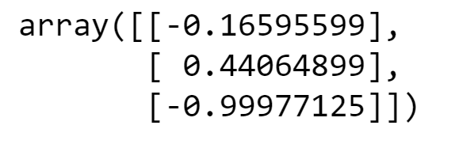
In place of using the backpropagation method repeatedly to obtain the updated weights, we apply our proposed algorithm to the initial weight vector which was
We applied QR Decomposition on the weight matrix in order to get a simplified version of the matrix as

Slide 32
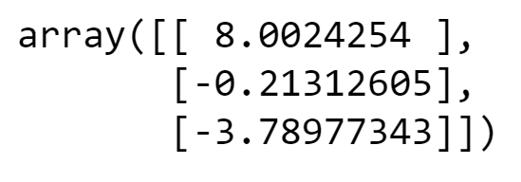
We applied QR Decomposition on the weight matrix in order to get a simplified version of the matrix as

Slide 33
This structurally simplified version of the original weight matrix was enough to obtain the final results which were obtained after the dot product with the input vector.
This yields the results as

Slide 34

Results
Extensive simulation studies have been made for performance evaluation of the proposed technique on several sample images considered as input for the purpose of image compression. One such is given below
Image:

Slide 35

We used our proposed method on the image which yielded an RMSE value of 27.099 which showed a deviation of (0.04-0.06) %, compared to the compression which can be achieved from backpropagation.
Original Vs. Compressed

Slide 36
Conclusion:
The existing image compression methods using artificial Neural Networks mostly focus on backpropagation which is very much computationally intensive and a slow process.
Our approach bypasses the need for backpropagation through the implementation of QR decomposition, a linear algebra concept without compromising the image quality
The experimental results prove that our algorithm is an effective, fast image compression algorithm with very little image quality loss showing a lesser RMSE value

Slide 37
References
[1] Abbas Razavi, Rutie Adar, Isaac Shenberg, Rafi Retter and Rami Friedlander “VLSI implementation of an image compression algorithm with a new bit rate control capability” Zoran Corporation, 1705 Wyatt Drive, Santa Clara, CA 95054.This paper was published in IEEE international conference on 26 th march 1992 on volume 5 and pages 669-672.
[2] Ronald A.DeVore, Bjorn Jawerth, and Bradley J.Lucier. “Image compression through wavelet transforms coding” IEEE TRANSACTIONS ON INFORMATION THEORY, VOL. 38. NO.2, MARCH 1992.
[3]https://www.amazon.com/Deep-Learning-AdaptiveComputationMachine/dp/0262035618?dchild=1&keywords=Deep+Learning+( Adaptive+Computation+and+Machine+Learning+series)+by+Ian+ Goodfellow,+Yoshua+Bengio,+Aaron+Courville,+Francis+Bach& qid=1590471595&sr=8-1&linkCode=sl1&tag=mltut20&linkId=dae1a1c43c68b6218364b1f91cdda7b0&language=en_ US&ref_=as_li_ss_t

