Slide 1

ATTRITION
HR_ANALYTICS

Slide 2
Introduction
Project Domain : HR Analytics Project Name : Employee Retention Dataset Used : HR_1 & HR_2 Dataset Type : Excel Data Dataset Size : 50k records in each dataset

Slide 3
Project Members
Vandana Babasaheb Thange
Mohammed Naji Ullah Khan
Rohini Govind Arkhade
Shruti Pandey

Slide 4


Agenda
Date | Time | Task Description
29th Jan 2023 | 6 PM – 7 PM | Project Kick-off Meeting
5th Feb 2023 | 4 PM – 5 PM | Implementation of KPI’s using Excel & MySQL
12th Feb 2023 | 4 PM – 5 PM | Implementation of KPI’s using Tableau
19th Feb 2023 | 4 PM – 5 PM | Implementation of KPI’s using Power BI
26th Feb 2023 | 4 PM – 5 PM | Final Presentation of the Project
Average Attrition rate for all Departments
Average Hourly rate of Male Research Scientist
Attrition rate Vs Monthly income stats
Average working years for each Department
Job Role Vs Work life balance
Attrition rate Vs Year since last promotion relation
A

Slide 5
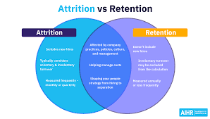
About The Project
This project is the study of employee retention in HR Analysis. In this study various KPI’s (Key Performance Indicators) are presented to find out the attrition rate of employees. This study also help’s to find out the reason of attrition. The images used in this presentation are charts which were created using Excel, Sql, Power Bi, Tableau tools.

Slide 6
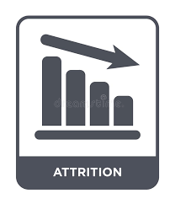

Employee attrition occurs when the size of your workforce diminishes over time due to unavoidable factors such as employee resignation for personal or professional reasons. Employees are leaving the workforce faster than they are hired, and it is often outside the employer’s control
But there are other reasons for attrition as well, including the lack of professional growth, a hostile work environment, or declining confidence in the company’s market value. Weak leadership is another factor that often drives attrition among employees.
”

Slide 7
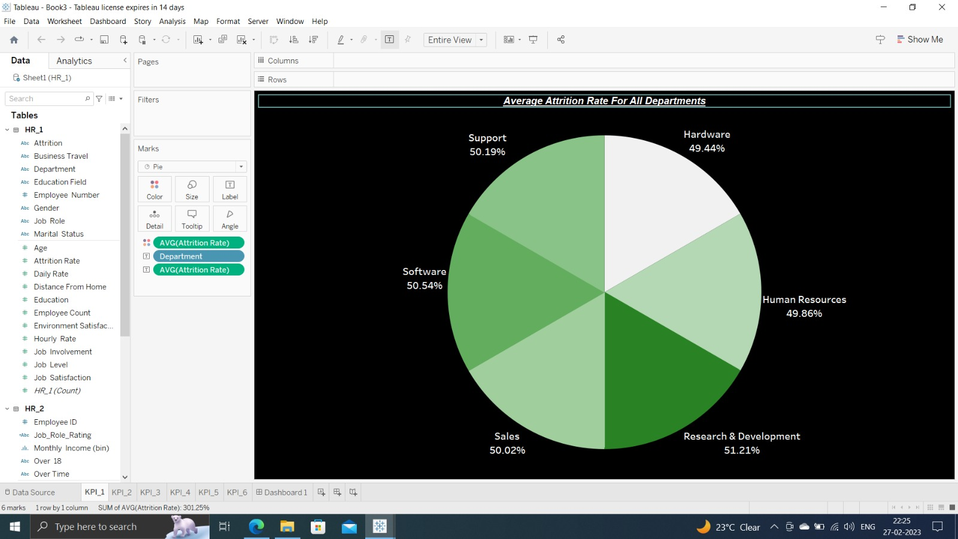
1.. Average Attrition Rate for all Departments
F
The pie chart shows us the information about the average attrition rate for all department’s.
With the help of this chart we are able to know that there is not much difference in attrition rate for different department’s.
Only Minute difference in Fractions.
We can conclude that Department dosent matter for the Attrition Of Employee..

Slide 8
2.. Average Hourly rate of Male Research Scientist
F
The table gives Information about Average Hourly Rate of Male Research Scientist which is 114.45

Slide 9
3.. Attrition rate Vs Monthly income stats
F
The bar chart explains attrition rate of employees in monthly income group.
The groups are created according to monthly salary income having that range. Ex. The employee having salary >30,000 & <=40,000 are belongs to 30K – 40K group and so on
The count of employees having monthly income between particular group who have left the company are presented in vertical column bar.
In this bar chart we can see that employees who are having higher salaries are also resigning from the company.

Slide 10
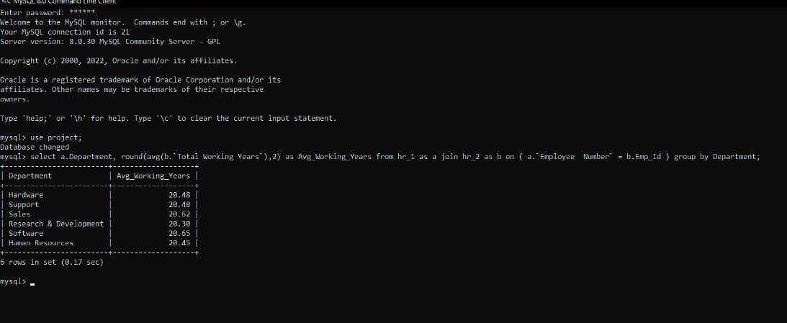
4.. Average working years for each Department
F
The following Query describes the average working years for each department’s.
select a.Department, round(avg(b.`Total Working Years`),2) as Avg_Working_Years from hr_1 as a join hr_2 as b on ( a.`Employee Number` = b.Emp_Id ) group by Department;
By seeing the table we can say that there is not much difference in average working years for each department’s.
All the departments have average working years of more than 20 years.

Slide 11
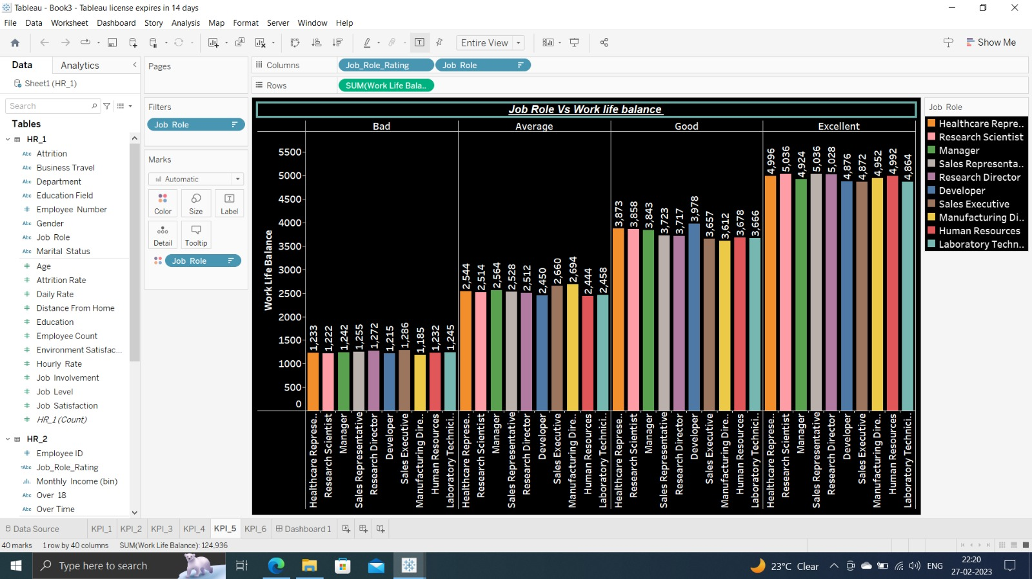
5.. Job Role Vs Work life balance
F
This bar chart shows the work life balance for each job roles.
This is divided by the ratings given by employees.
The count of employees who have given 1★ are in Bad, the employees who have rated 2★ are in Average, the employees who have rated 3★ are in Good & the employees who have rated 4★ are in Excellent.
By this we can see that number of employees who have rated 4★ Is more when compared to 1,2 & 3★‘s.

Slide 12
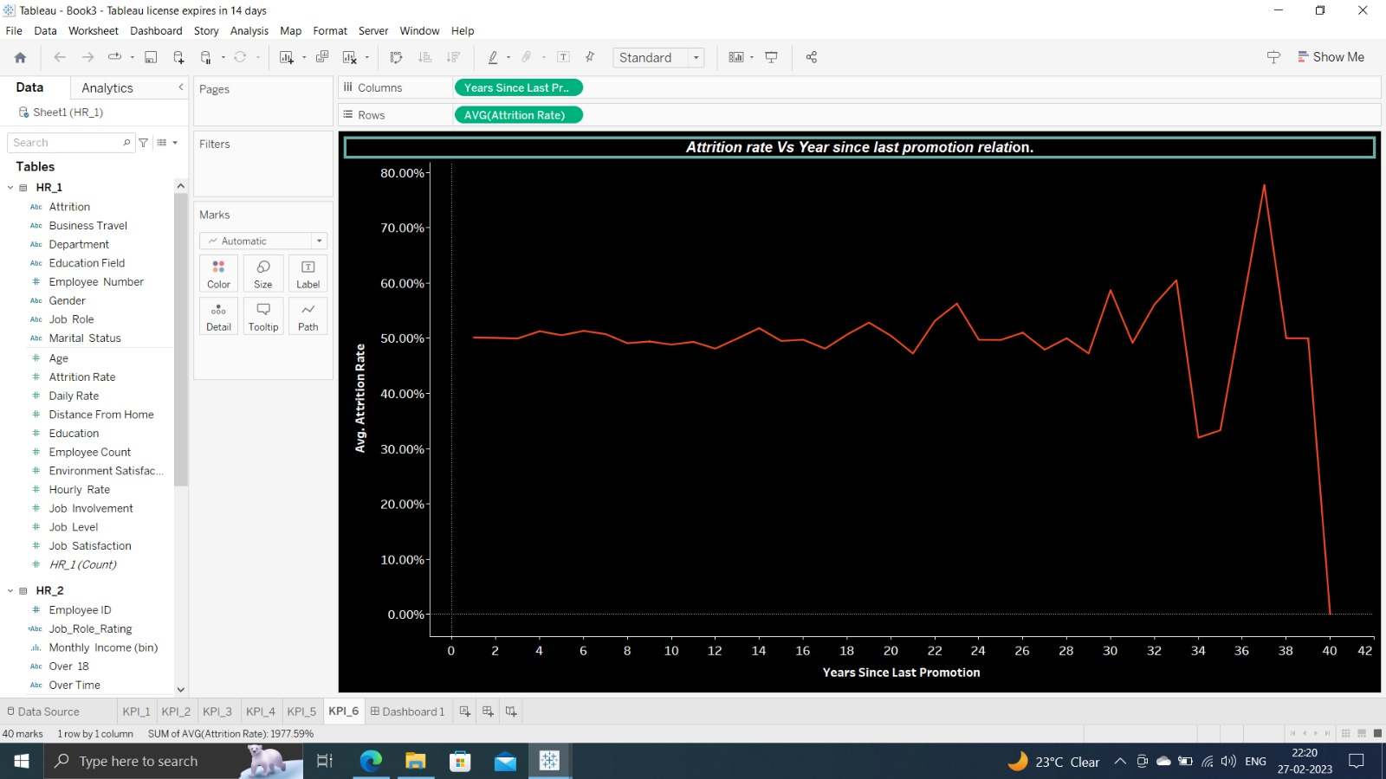
6.. Attrition Rate Vs Year since last promotion relation
F
This line chart explains attrition rate of employees vs their year since last promotion.
In this chart we can see that attrition rate is almost stable from 0 – 20 Year since last promotion and it fluctuates from 21 – 39 Year since last promotion and it reaches to 0% if Year since last promotion is 40.
From this Analysis we got to know that the Attrition Rate is high those who haven’t received their promotion since last 36 – 41 Years i.e.(60%).
We can conclude that Promotion plays an important role in Attrition.

Slide 13
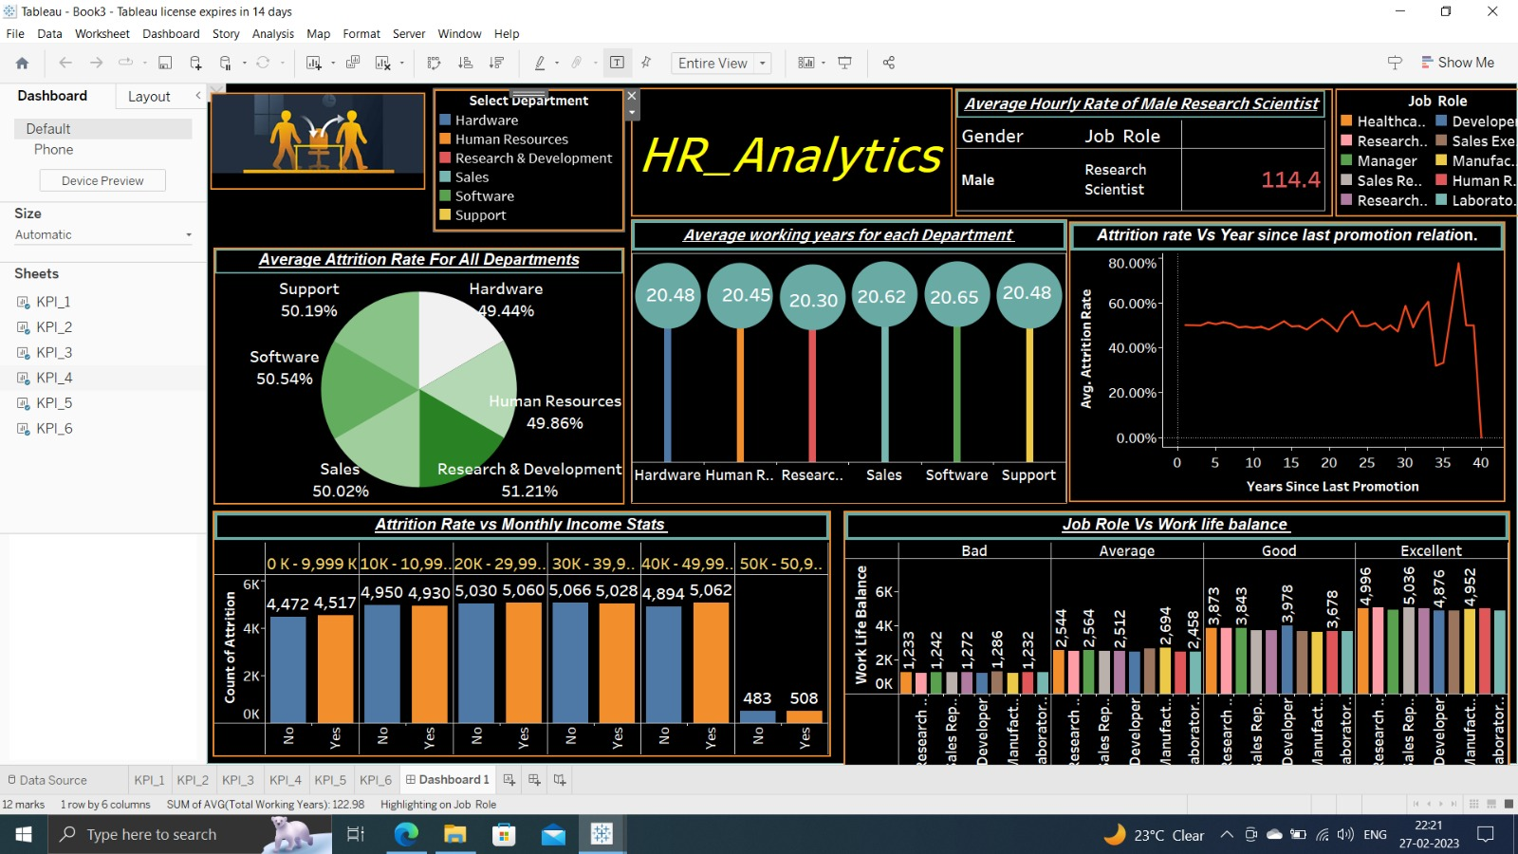
Dashboard
F
B2B market scenarios
Develop winning strategies to keep ahead of the competition
Capitalize on low-hanging fruit to identify a ballpark value
Visualize customer directed convergence
Cloud-based opportunities
Iterative approaches to corporate strategy
Establish a management framework from the inside

Slide 14
Summary
We took this task and extract meaningful insights from the HR Dataset.
The dataset does not portray substantial degree of variation in order to obtain insights for the attrition of employees. Given the lack of data variation in our analysis, we have concurred minute difference in Attrition Rate.
In our findings we got to know that the only factor which is affecting the Attrition Rate is Promotion.
From this we can say that the organization’s management has to take some steps to improve the work life balance of Sales Executive.
Our Final conclusion is that the office employees are very satisfied with their respective Salary & Job Roles.

Slide 15

VANDANA THANGE vandanathange777@gmail.com

