Slide 1

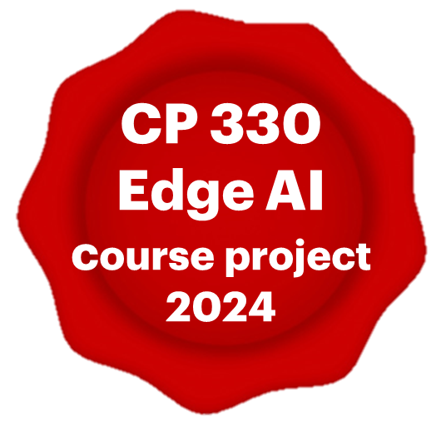

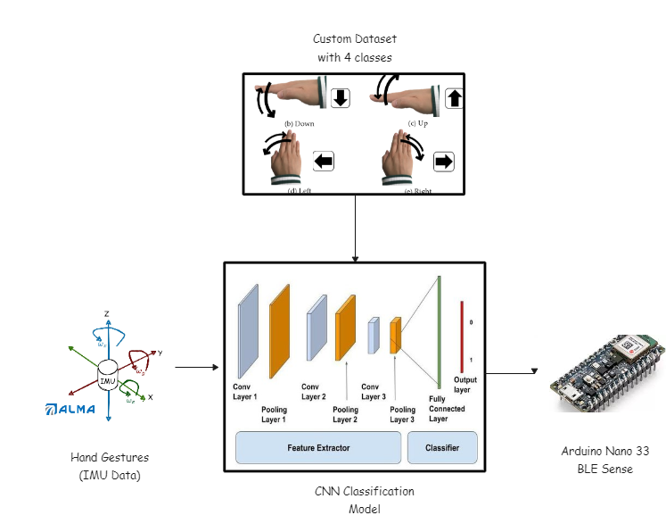
GESTURE CONTROLLED SLIDE PRESENTATION
Sayli Sawant (CPS), Vandana Maurya (CPS), and Pandarasamy Arjunan
Motivation
Accessibility Challenges
Overcoming Ergonomic Limitations
User Experience Enhancement
Technological Innovation
Objectives
Develop Hand Gesture-Controlled Interface
Utilize sensor data and signal processing algorithms for gesture interpretation
Providing Intuitive and accessible interface
Explore applications across accessibility, gaming, multimedia and presentations
Dataset / Data collection
Number of classes: 4
Number of samples: 50/class
Pre-processing:
Preprocessing and Rasterization
Data Augmentation
Shuffling
Edge AI Model
Architecture:
Utilizes DL architecture to interpret hand gestures
Employs CNN for feature extraction
Fully connected layers for gesture classification
Model compression:
Tensorflow: 646173 bytes
Tensorflow Lite Quantized: 31016 bytes
Model characteristics
High accuracy
Low latency
Hardware and Software spec.
Hardware
Arduino Nano 33 BLE Sense
Software
UART Interface
Arduino IDE
Python, Tensorflow and Keras
Prototype & demonstration
EdgeAI_project_video.mp4

Slide 2

Gesture Controlled
Slide Presentation
Project Members:
Sayli Sawant
Vandana Mourya
Project Guide: Prof. Pandarasamy Arjunan

Slide 3
SCOPE & OBJECTIVE
Utilize Arduino Nano BLE for gesture recognition
Develop a gesture controlled system for navigating PowerPoint Slides
Implement machine learning algorithm for gesture classifications

Slide 4
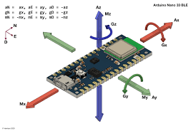
LIST OF RESOURCE REQUIRED
Hardware
Arduino Nano 33 BLE Sense Board (IMU sensor)
Software
Arduino IDE
Python environment for ML as well as controlling powerpoint actions
Gesture dataset for training the model
Computer/Laptop for running presentation

Slide 5
FLOW OF THE PROJECT
Data Collection and visualization using IMU
Model training
Integrating the model in Arduino code
Python code implementation for presentation control

Slide 6
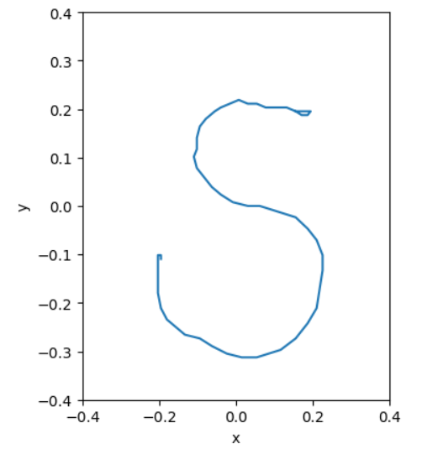
DATA COLLECTION
Number of classes: 4
Labels: {"N", "S", "U", "X"}
Number of samples: 50/class
The strokes data is collected as training samples.
Then we perform pre-processing steps to convert these strokes to rasterized images.

Slide 7
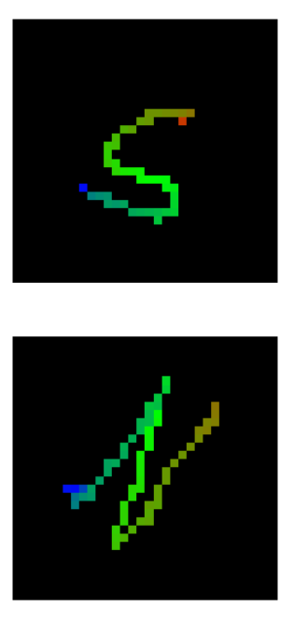
DATA PRE-PROCESSING
1 .Preprocessing and Rasterization
Convert the strokes into rastered images using the helper functions
2. Data Augmentation
3. Shuffling
Once we converted the dataset to rasterized images we have generate a Keras dataset for use in training.

Slide 8
MODEL
Input Shape: (32, 32, 3)
Architecture:
Utilizes Convolutional Neural Networks (CNNs) for feature extraction.
Employs three Conv2D layers with 16, 32, and 64 filters respectively, each followed by Batch Normalization, ReLU activation, and Dropout layers.
Utilizes Global Average Pooling to reduce spatial dimensions and obtain global information.
Output:
Activation Function: Softmax - Used for multi-class classification.
Number of Output Units: 4

Slide 9
Regularization:
Dropout layers with a dropout rate of 0.5 are employed after each convolutional block to reduce overfitting.
Model Training:
The model is trained to minimize a categorical cross-entropy loss function.
Utilizes image preprocessing through Rescaling to normalize pixel values between 0 and 1.
Employes strides of 2 for downsampling in the Conv2D layers, maintaining spatial dimensions.
Padding "same" is used to ensure that the output has the same height and width as the input.

Slide 10
SPECIFICATIONS
SIZE:
TRAIN-TEST SPLIT:
TEST_PERCENTAGE = 10%
VALIDATION_PERCENTAGE = 10%
TRAIN_PERCENTAGE = 80%
PERFORMANCE:
TRAINING_ACCURACY =0.9351
VALIDATION_ACCURACY = 0.9524
TESTING_ACCRURACY = 1.00
MODEL | SIZE
TensorFlow | 657647
TensorFlow Lite | 99076
TensorFlow Lite Quantized | 31016

Slide 11
APPLICATIONS
Home automation
Vehicle Motion Control
Robot Movement Control
Media Control on Laptop/Phone

