Slide 1






Handwritten
Digit Recognition
Using ANN and CNN
Beginner-level Machine Learning practice
MNIST TensorFlow / Keras
Presented by Vandana

Slide 2
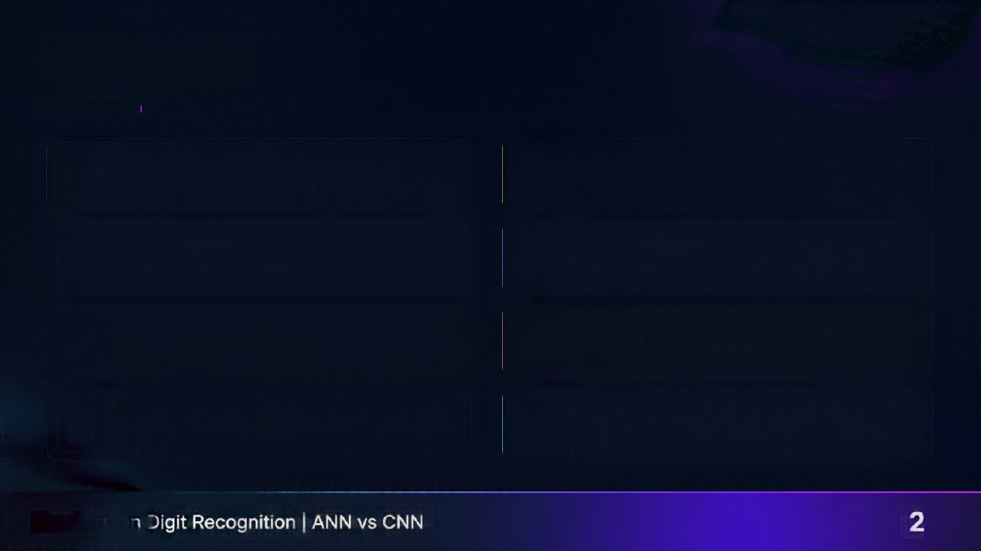
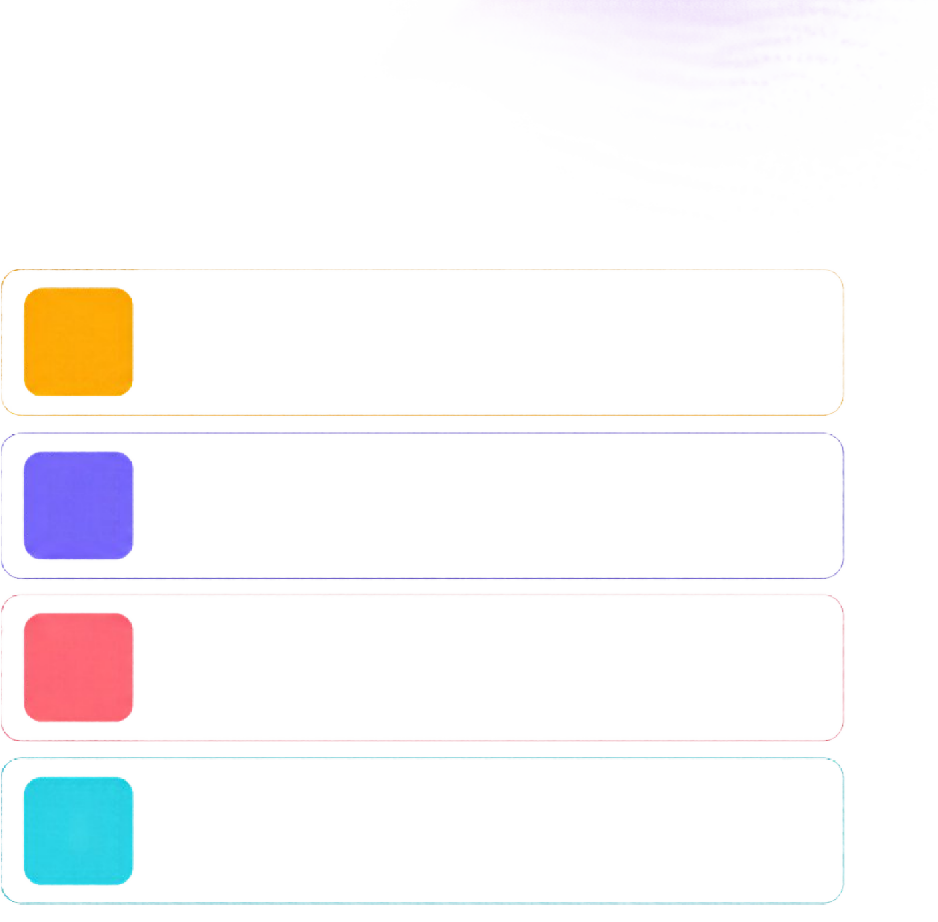

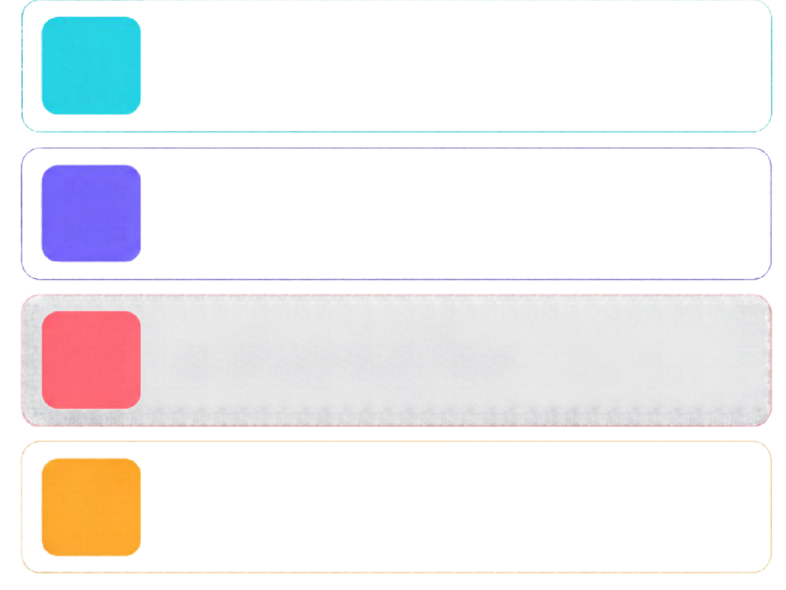

Agenda
1
Introduction and objective
5
ANN model
2
Dataset: MNIST
6
CNN model
3
Tools and workflow
7
Results and comparison
4
Data preparation
8
Improvements and conclusion
Handwritten Digit Recognition |
2

Slide 3
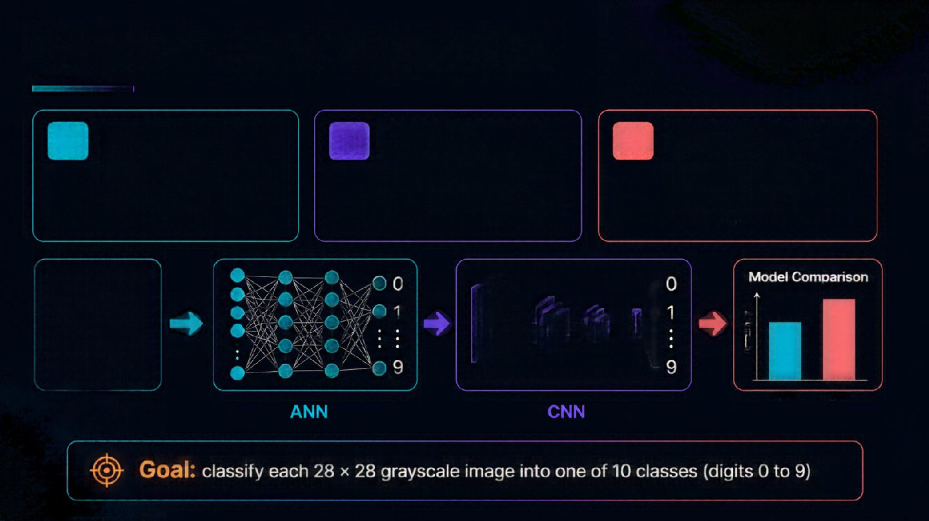


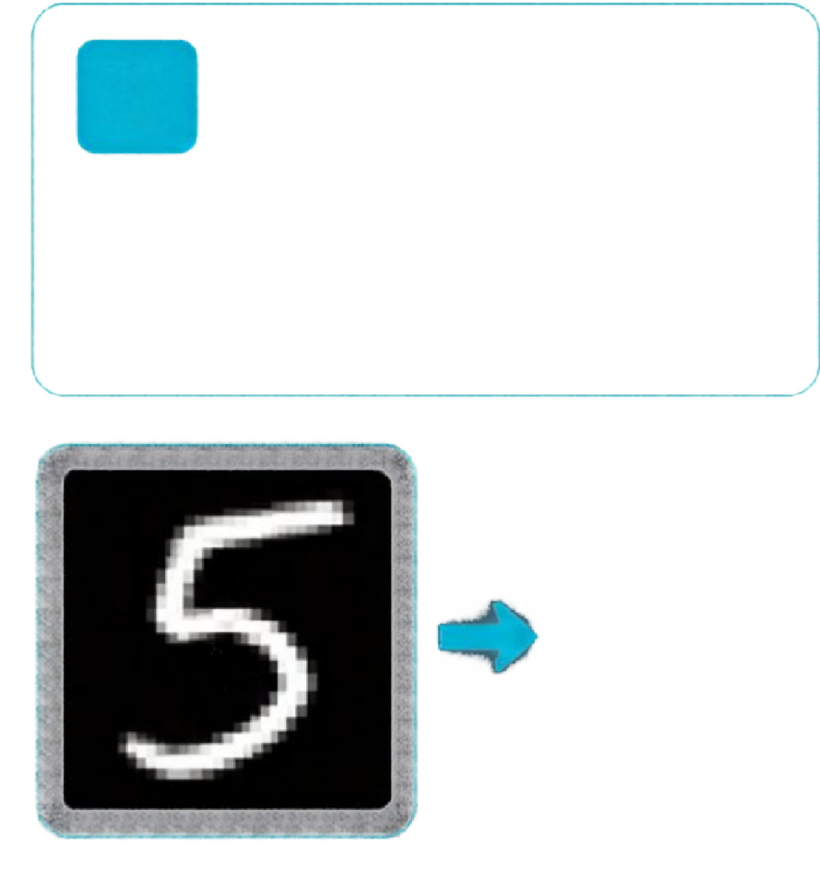
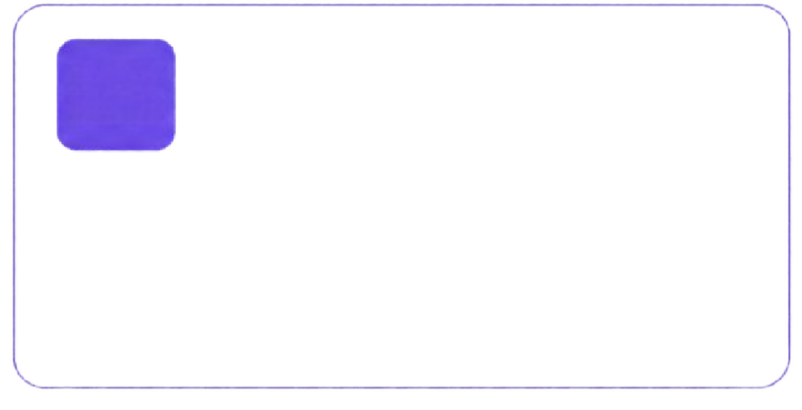
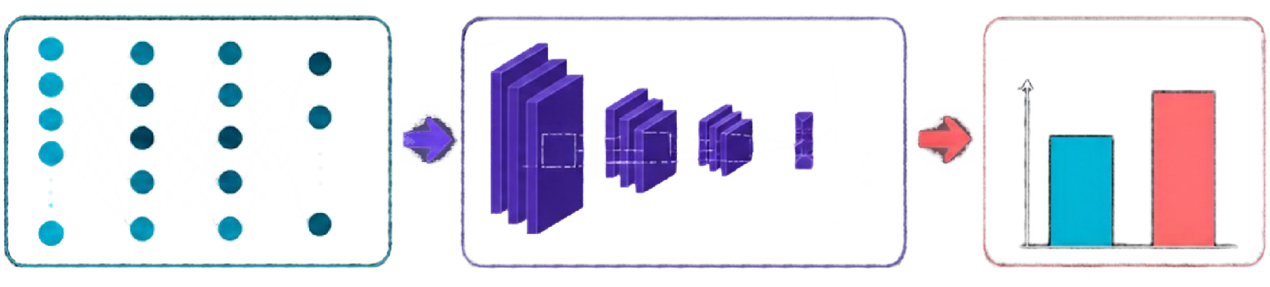

Problem and Objective
1
Build an ANN —
Flatten each image into 784 values and classify with fully connected layers.
2
Build a CNN —
Use convolution and pooling layers to learn edges and shapes directly from the image.
3
Compare both —
Measure test accuracy on unseen images and see which model recognises digits better.
0
1
0
1
Model Comparison
Accuracy
9
9
28 × 28
grayscale image
ANN
CNN
:

Slide 4


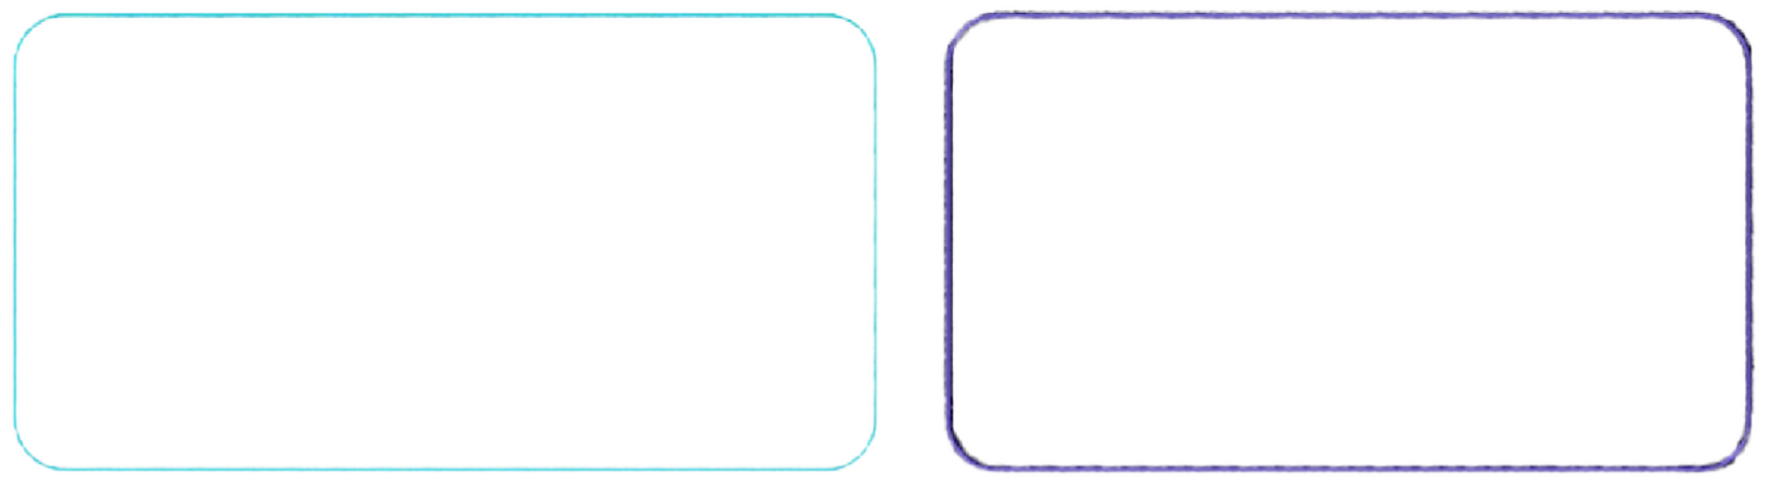

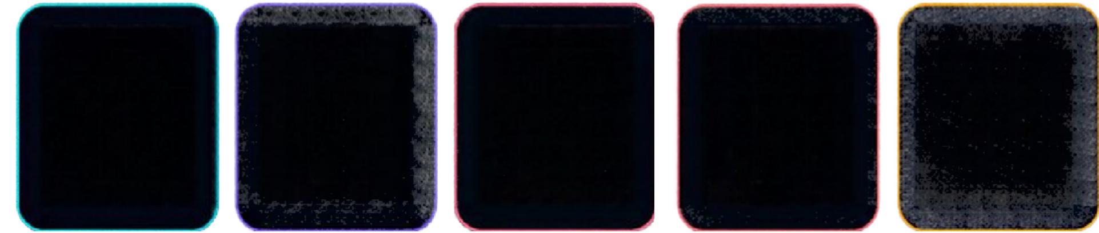

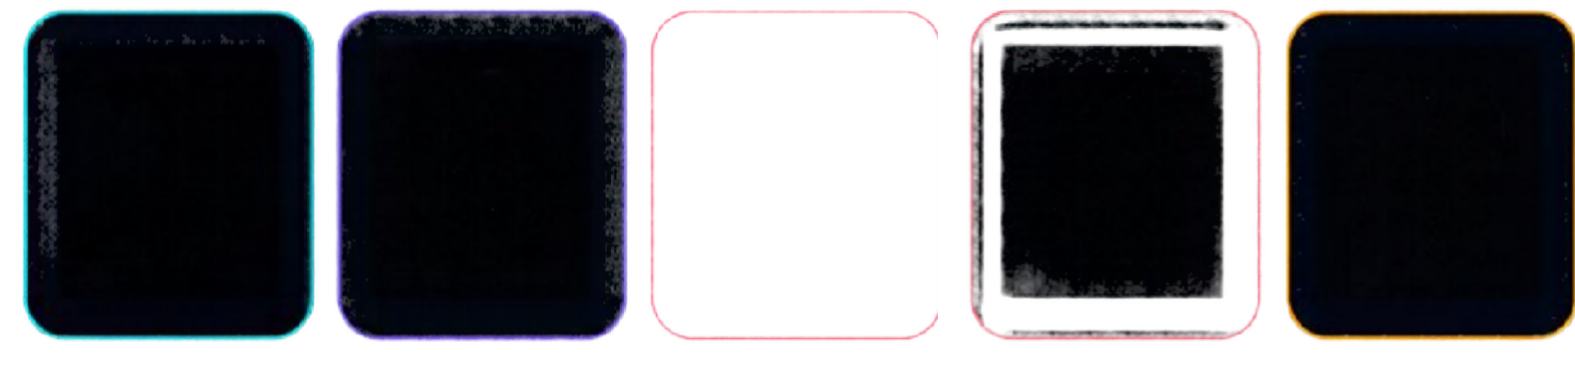
Dataset: MINIST
60,000
Training images
10,000
Test images
28 × 28
Pixels per image
0 l
10
Classes (0 to 9)
What each image holds —
Grayscale pixels from 0 (black) to 255 (white), plus one integer label giving the correct digit.
2
3 4
How the data is split
validation_split = 0.1 gives 54,000 training and 6,000 validation images.
The 10,000 test images stay untouched.
5
6
7
8
9
—

Slide 5
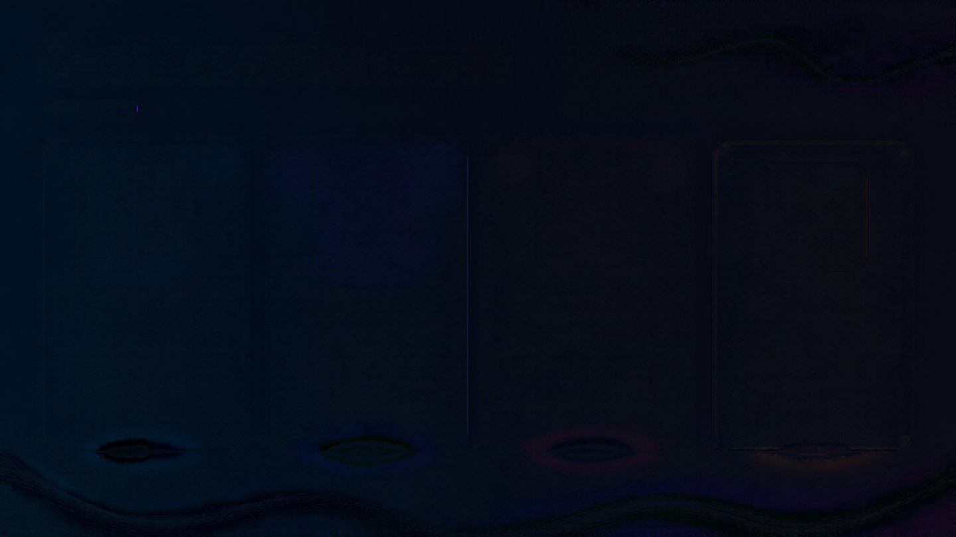
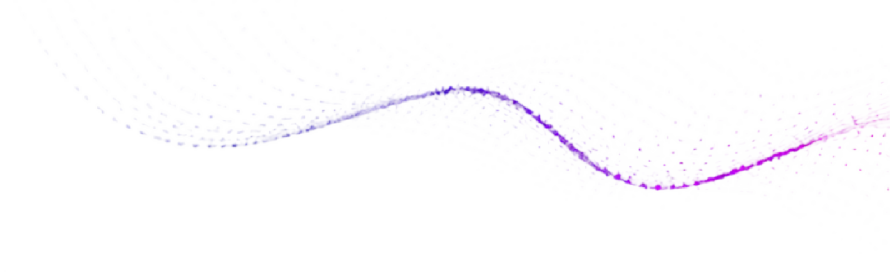

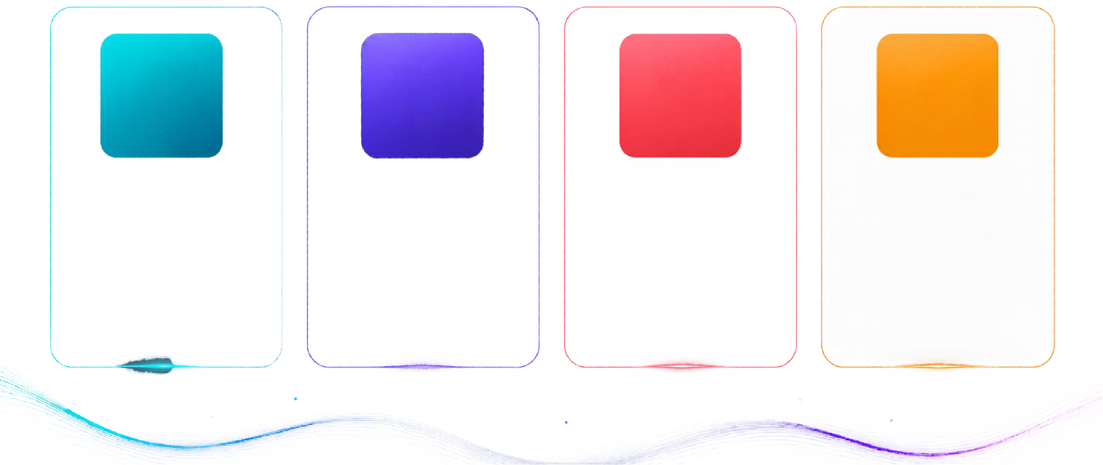
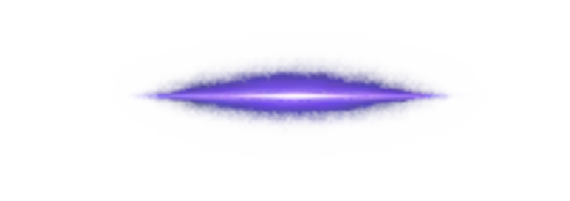
Tools and Libraries
T
TensorFlow / Keras
N
NumPy
M
Matplotlib
C
Google Colab
Builds, trains and evaluates the ANN and CNN models.
Array handling, adding the channel dimension, argmax for predictions.
Shows sample digits and the accuracy comparison chart.
Free cloud notebook; MNIST downloads on the first run.

Slide 6
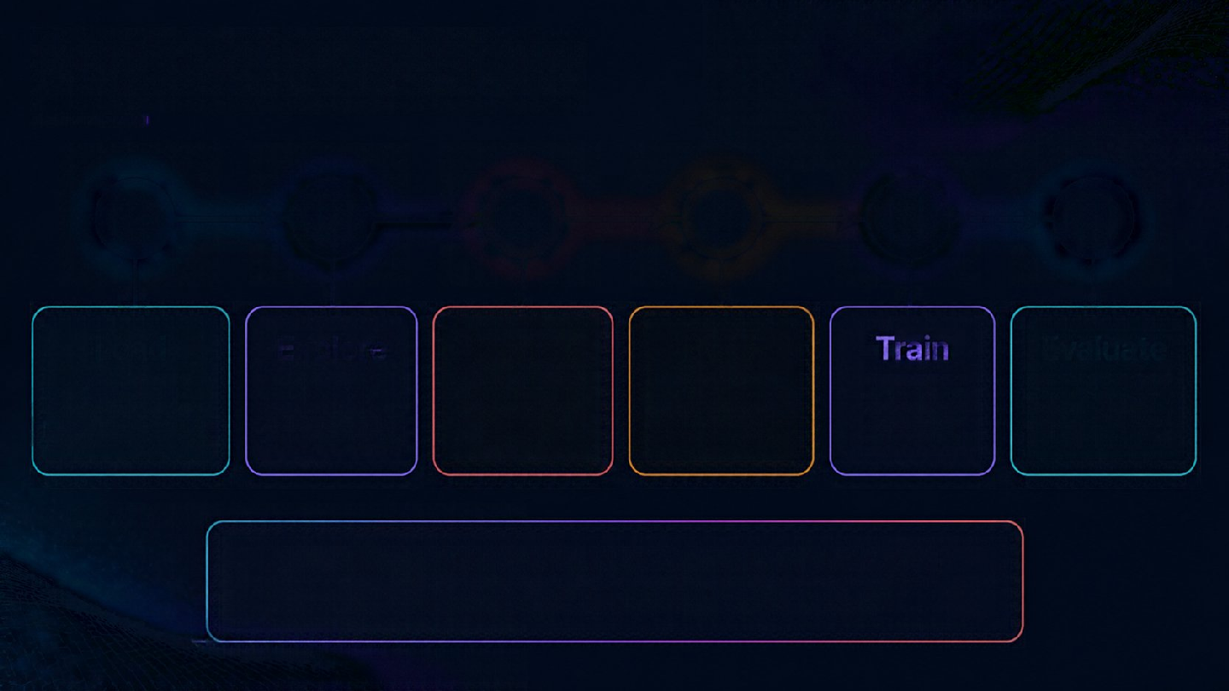
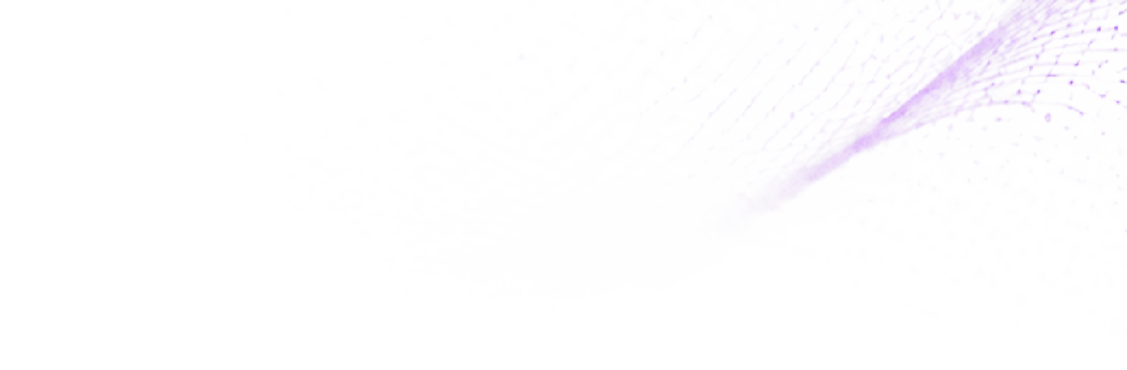

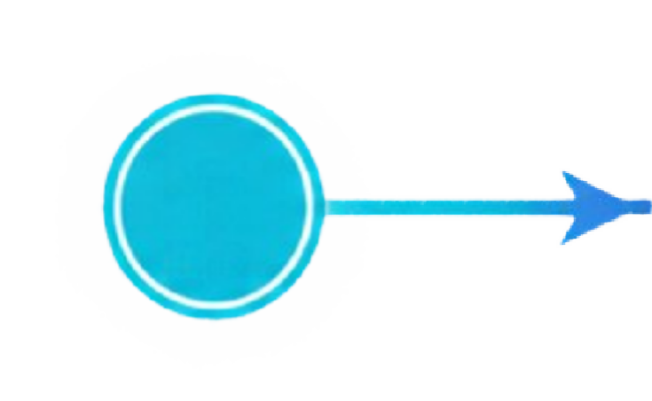
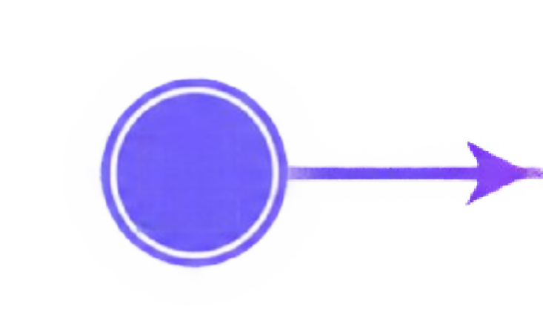
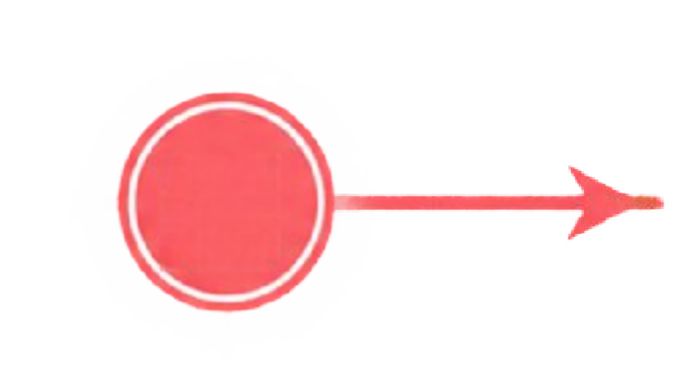
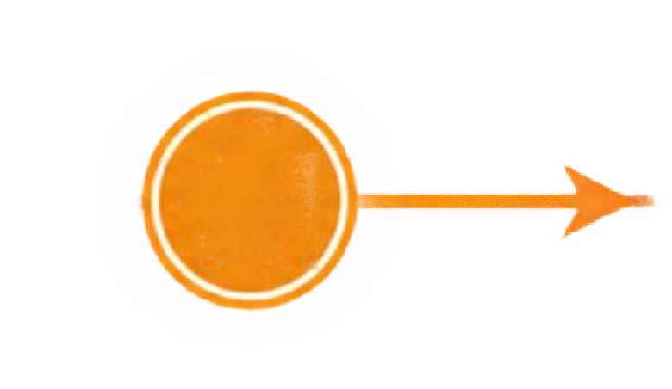
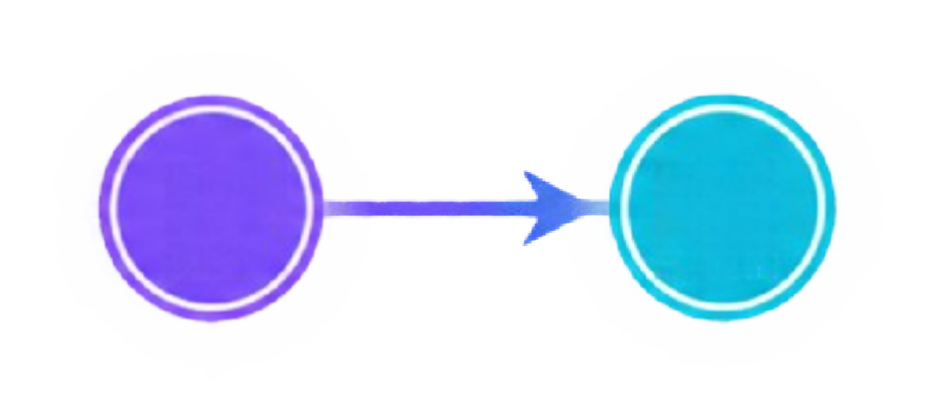







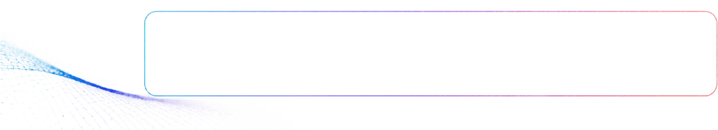
Project Workflow
1
2 3
4
5 6
Prepare
Scale pixels to 0 to 1
Train
5 epochs,
batch 64
Evaluate
Test accuracy and predict
Load
Download MNIST from Keras
Explore
Plot 10 sample digits
Buil d
Create ANN and CNN
The same preprocessing, optimizer and epochs are used for both models, so the comparison stays fair.

Slide 7
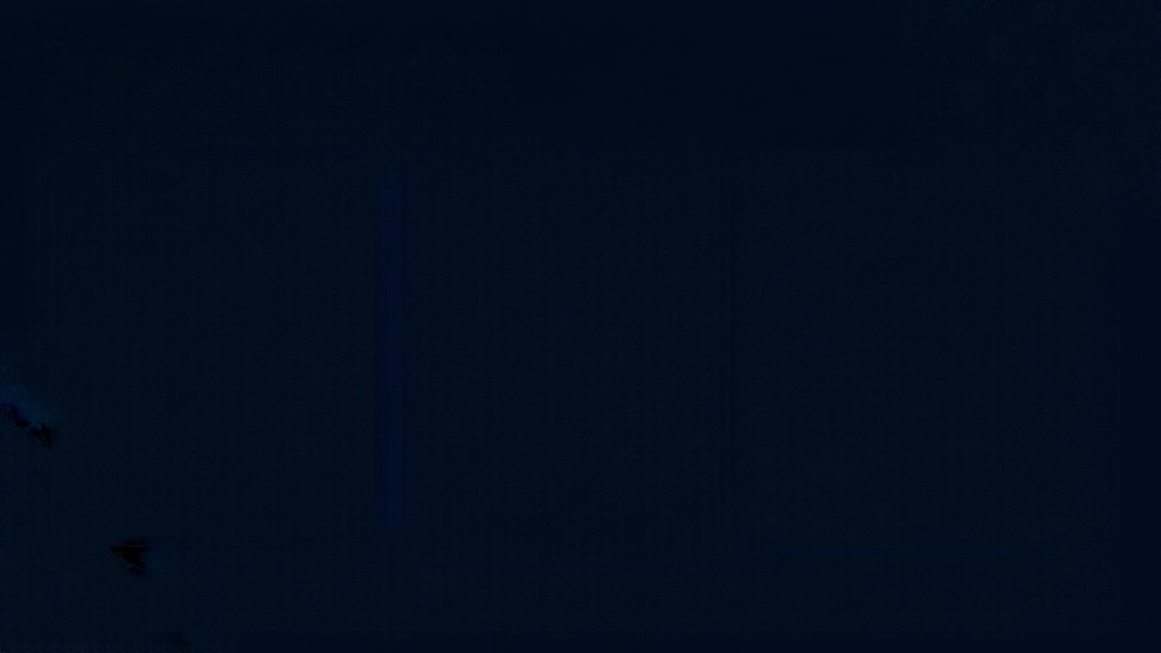
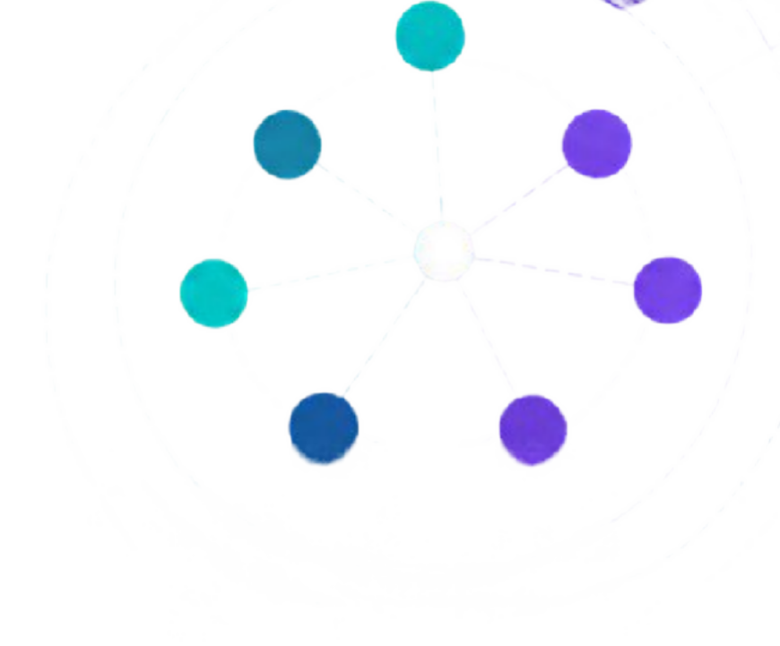
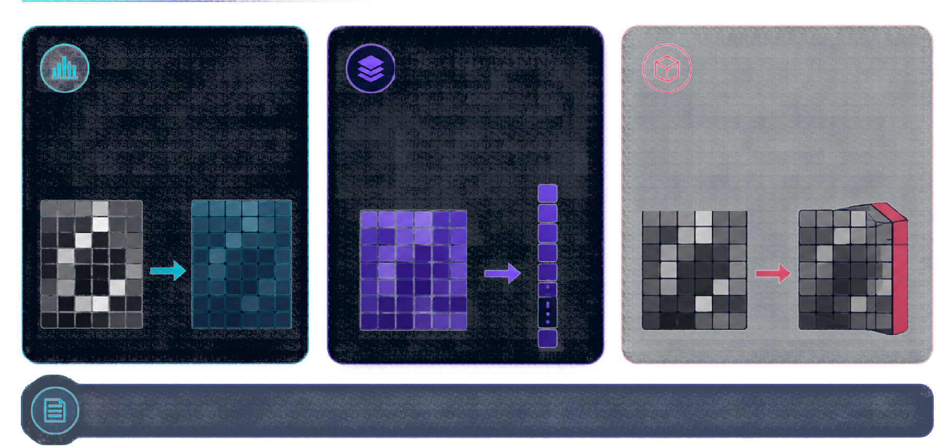
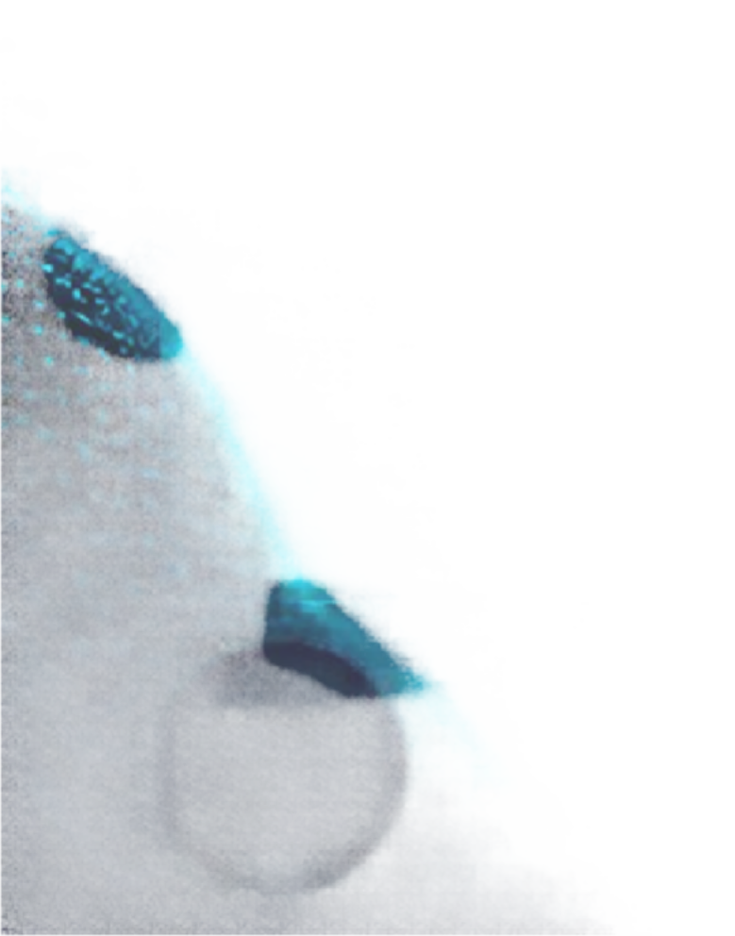
Data Preparation
Flatten (ANN) 28 × 28 → 784
Normalize
0 to 255 → 0 to 1
Add channel (CNN)
28 × 28 → 28 × 28 × 1
Divide pixels by 255 so the model learns more easily.
Conv2D layers expect a channel dimension for grayscale images.
The ANN needs a one-dimensional list of values per image.
Labels stay as integers 0 to 9, so sparse_categoricalcrossentropy is used and no one-hot encoding is needed.

Slide 8

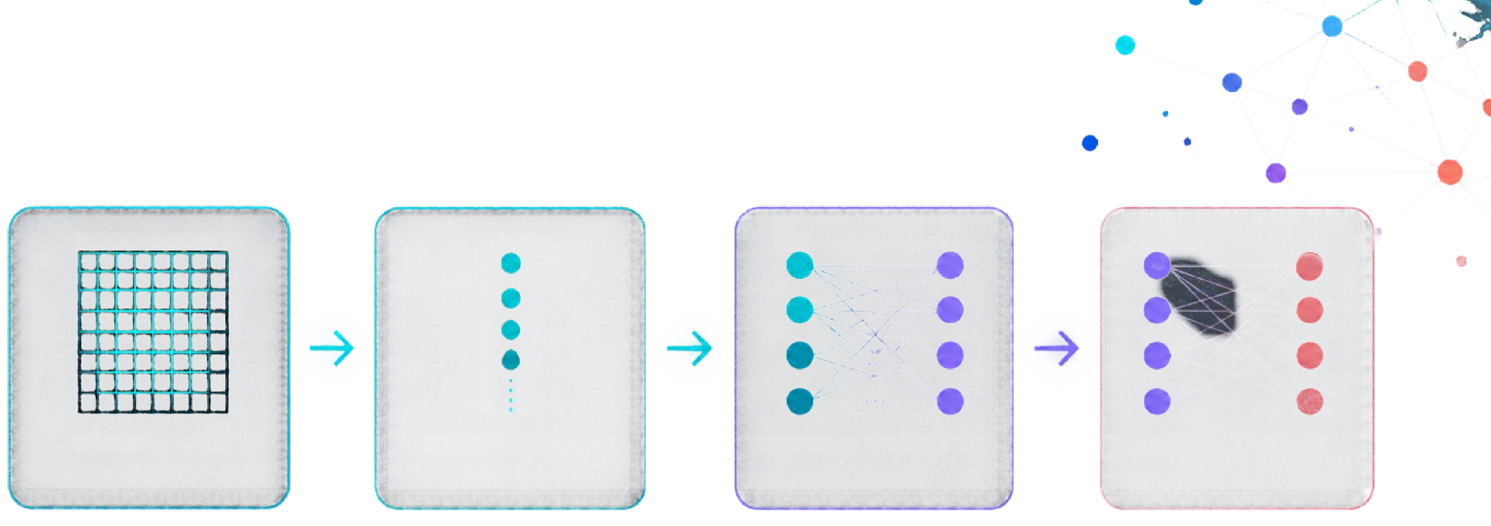
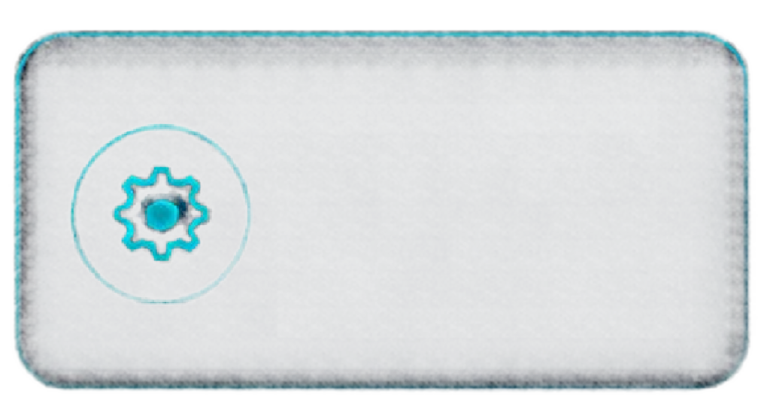
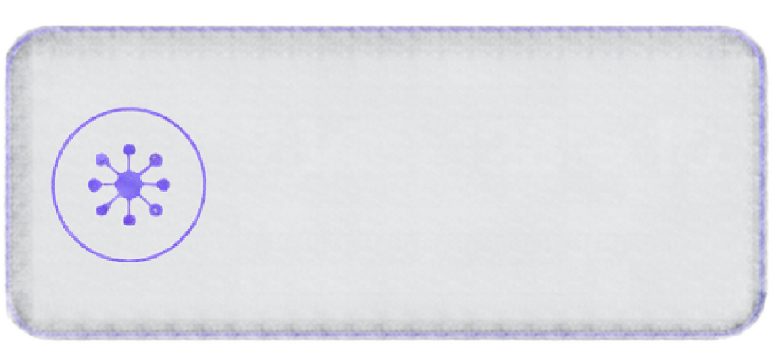
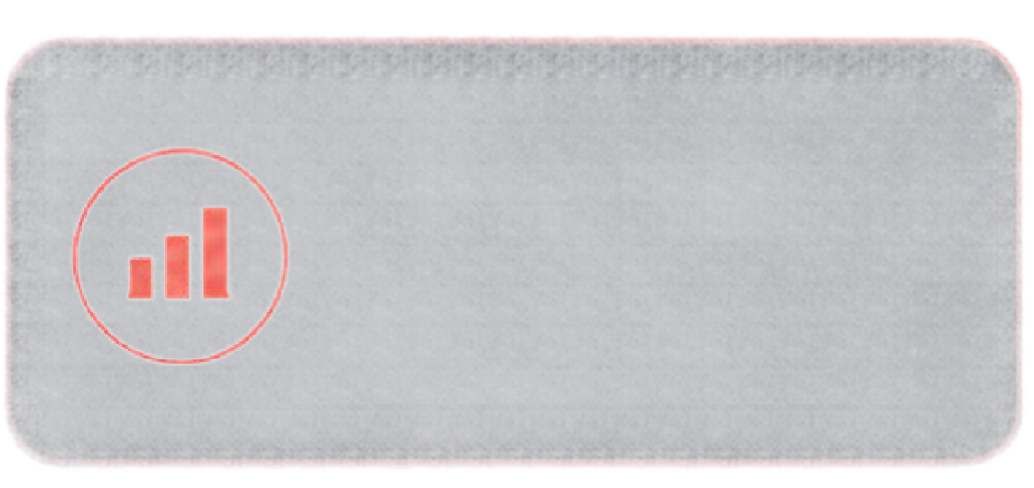
ANN Architecture
Input — 28 × 28
Flatten — 784 values
Dense 128 — ReLU
Dense 10 — Softmax
101,770
Total parameters
784 → 128 → 10
Neurons per stage
Adam + softmax
Optimizer and output

Slide 9
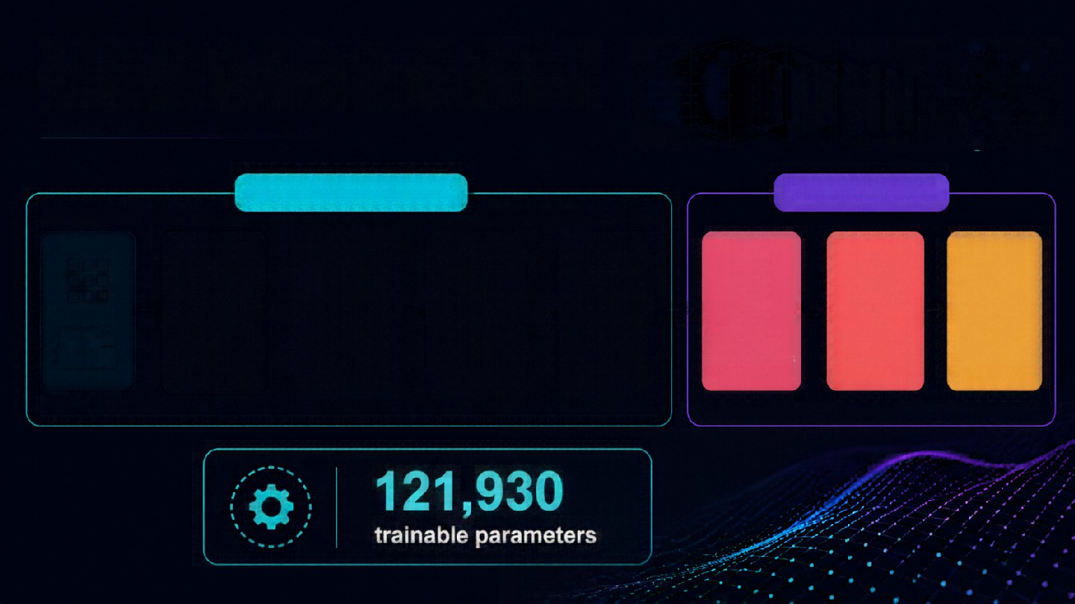
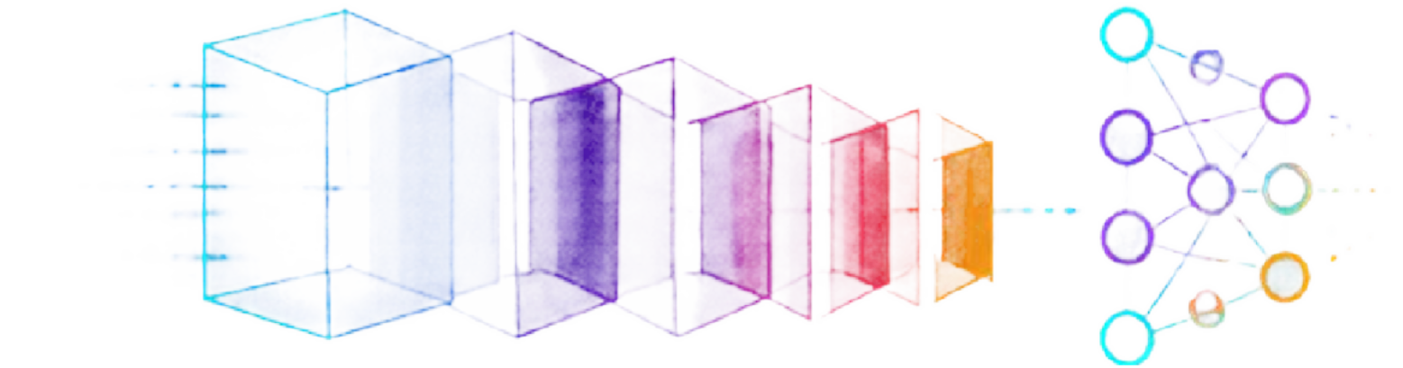
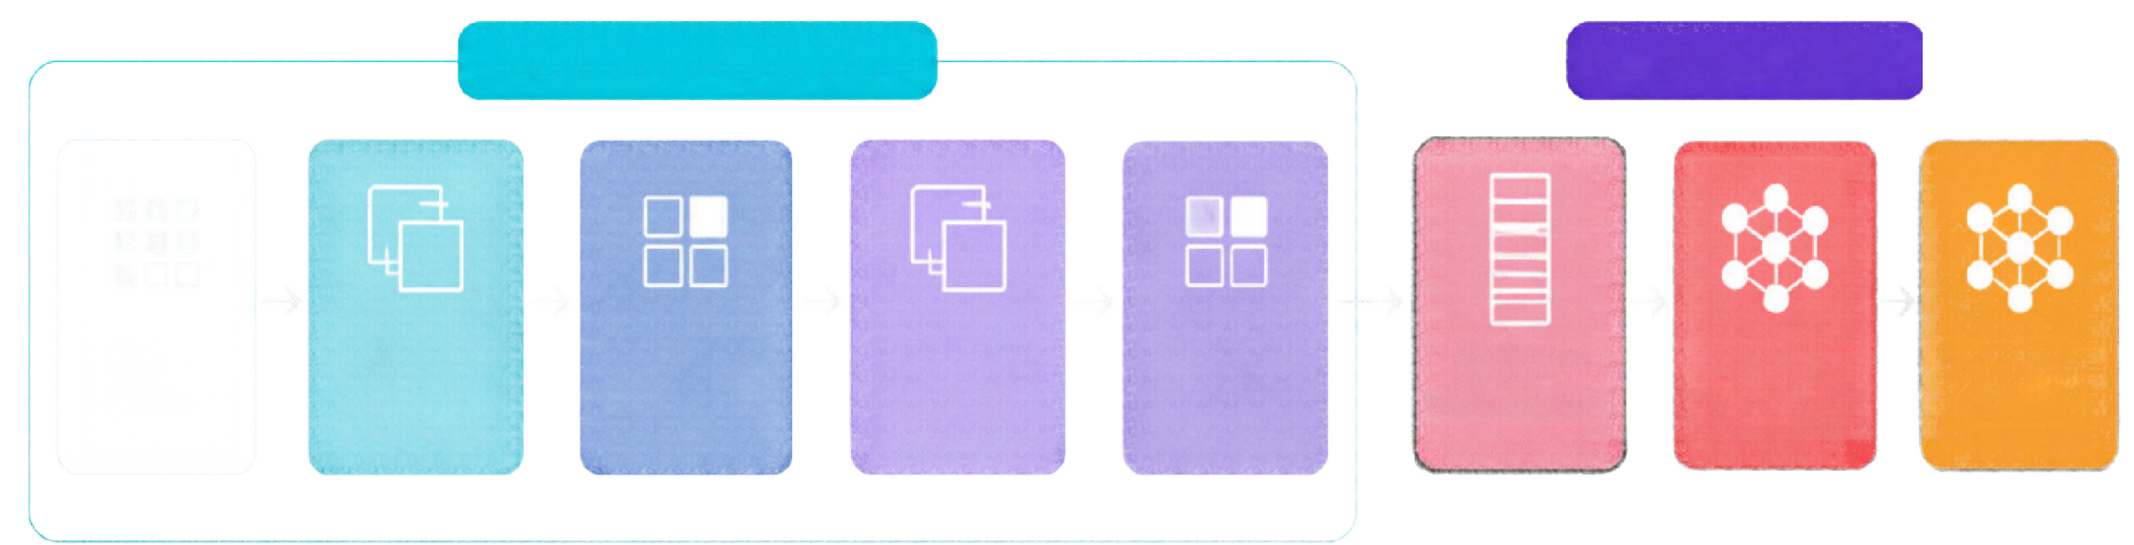
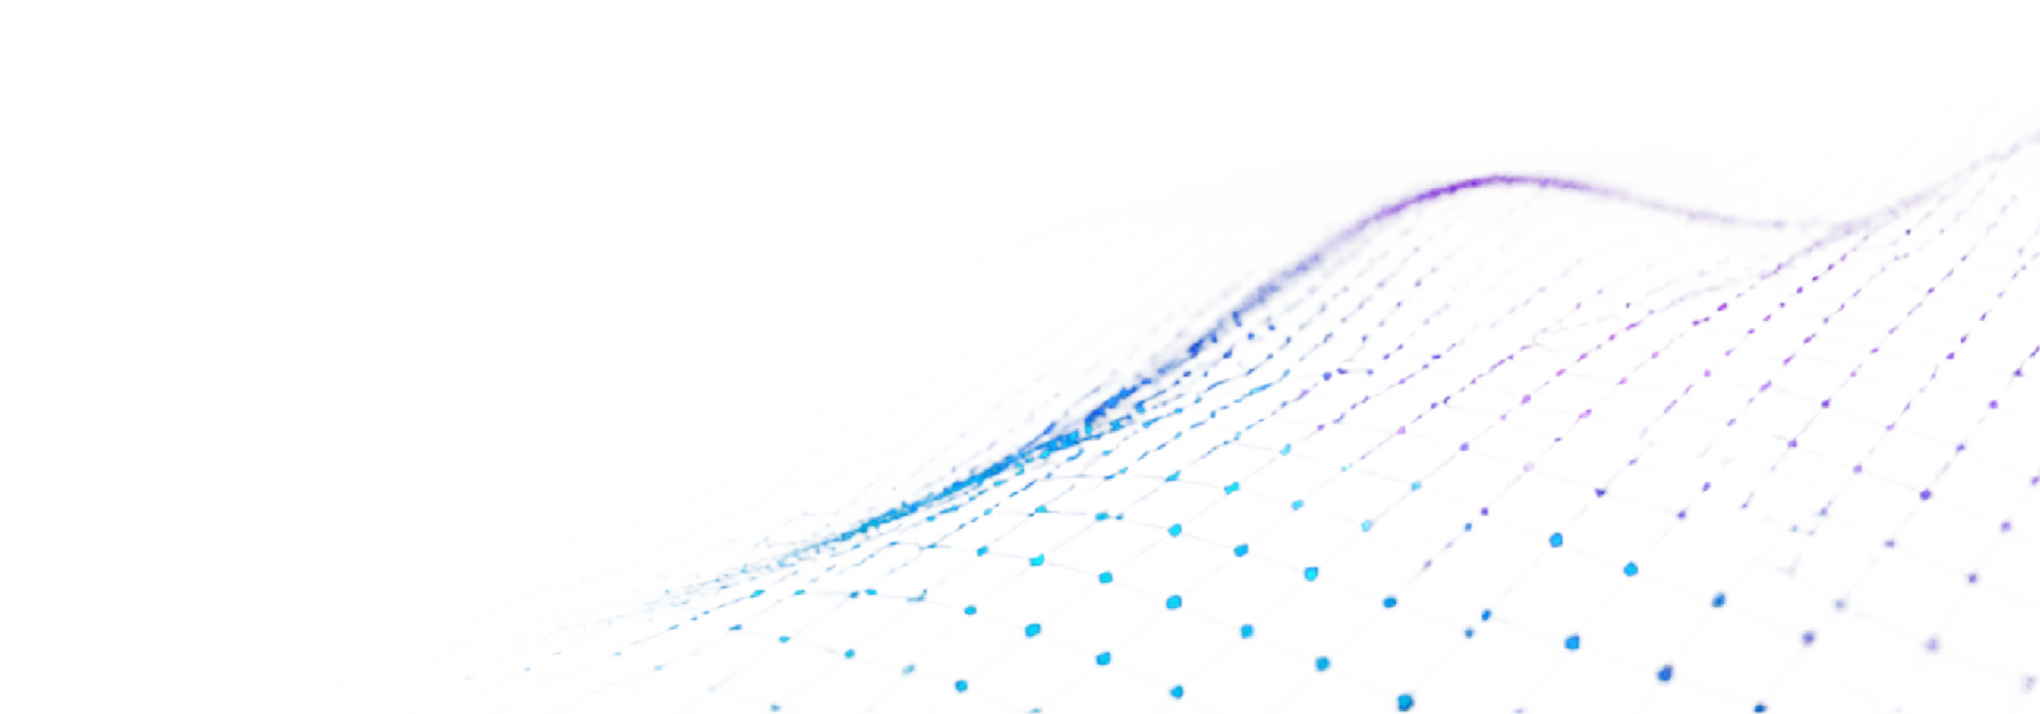
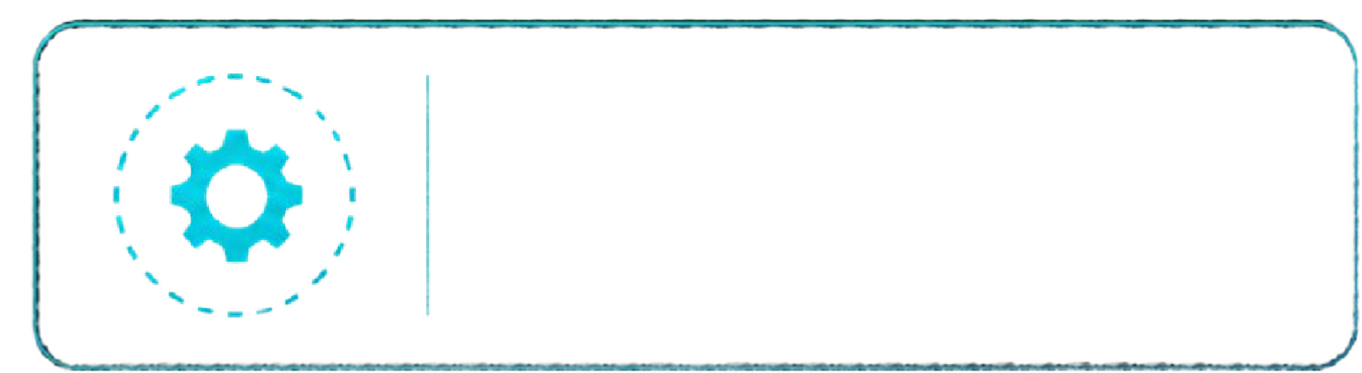
Archite_{F}c_{EAT}t_{UR}u_{E} re
CNN
CLASSIFICATI ON
EXTRACTION
Input
Conv2D — 32 filters, 3x3
→
26×26×32
MaxPool
Conv2D — 64 filters, 3x3
→
11×11×64
MaxPool
Flatten —
→ 1,600
values
Dense 64
Dense 10
—
—
—
—
—
28×28
×1
2×2
→ 13×13×32
2×2
→ 5×5×64
ReLU
Softmax
121,9
30
trainable
parameters

Slide 10

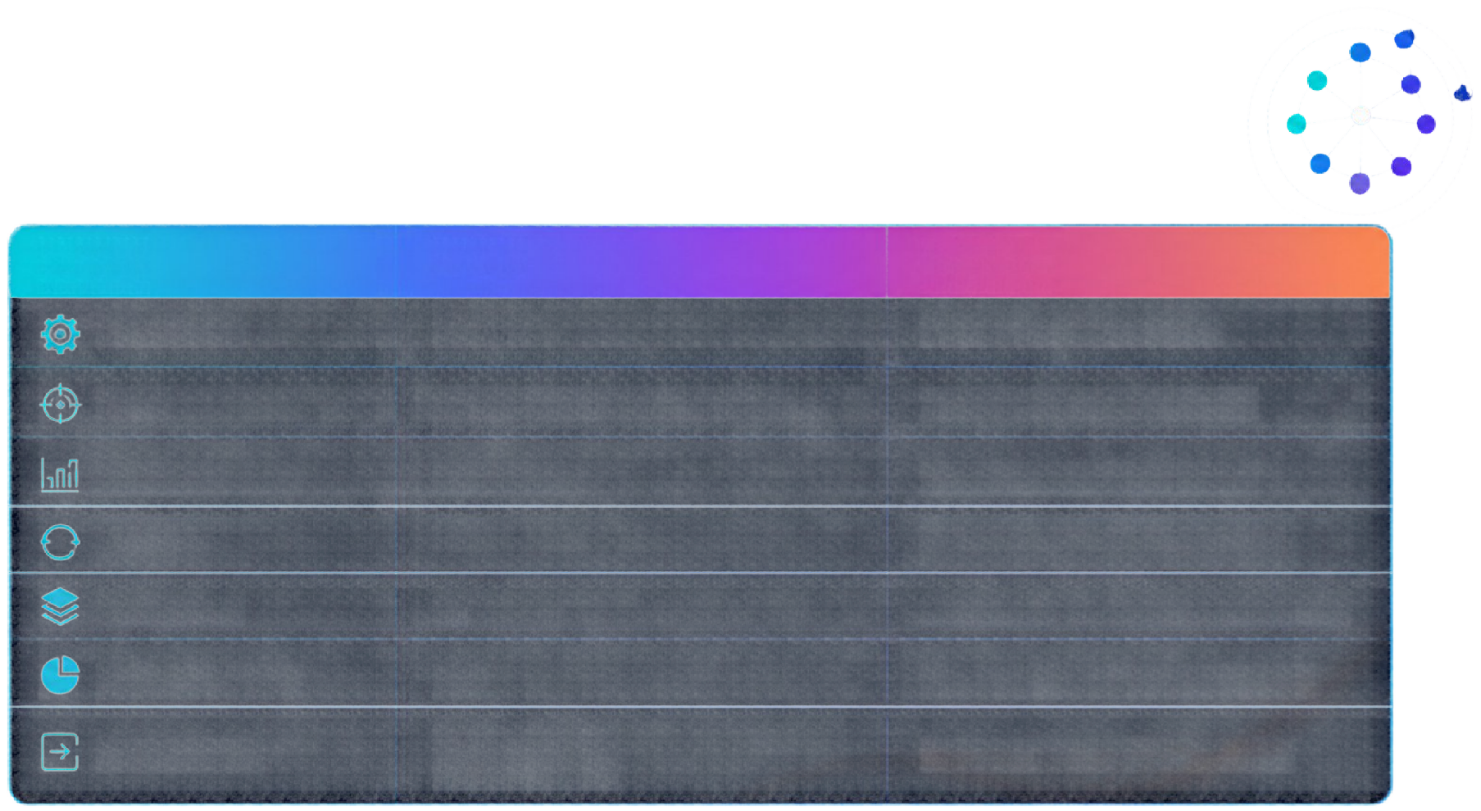
Training Configuration
Setting
Value
Purpose
optimizer
adam
Adjusts weights efficiently
Los s
Metric
sparse_categorical_crossentropy
Multi-class labels as integers
accuracy
Share of correct predictions
Epochs
Short run for a beginner exercise
Batch size
Images processed per weight update
Validation split
10% of training data for monitoring
Input shape
(28, 28) ANN
(28, 28, 1) CNN
Matches each model's first layer

Slide 11


Model Size: ANN vs CNN
Trainable parameters
What the numbers say
140,000
121,930
120,000
CNN has about 20% more parameters.
101,770
100,000
80,000
ANN: 98.7% of weights are in its first Dense layer.
60,000
40,000
CNN: only 18,816 weights are in the Conv layers; the rest are
in Dense.
20,000
0
ANN
CNN

Slide 12

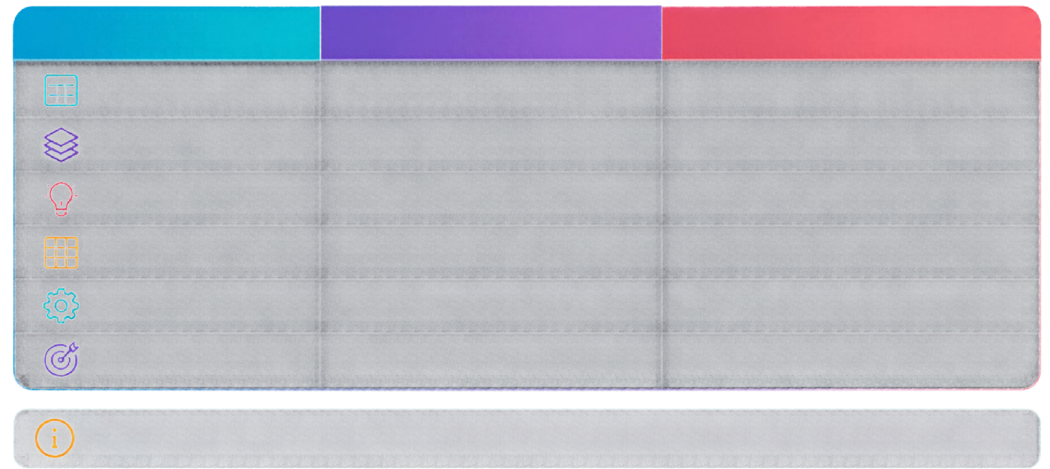
ANN vs CNN:
Side by Side
Aspect
ANN
CNN
Input
Flattened 784 values
28 × 28 × 1 image
Key layers
Dense 128, Dense 10
2 × Conv2D, 2 × MaxPool, Dense
What it learns
Pixel-by-pixel weights
Local patterns: edges, shapes
Spatial layout
Lost after flattening
Preserved by convolution
Parameters
101,770
121,930
Expected accuracy
Good (about 97–98%)
Usually higher (about 98–99%)
Expected ranges are typical for MNIST after 5 epochs; your own run gives the exact figures.

