Slide 1



WIND POWER GENERATION FORECASTING

Slide 2

Learning Objectives
Understand the Fundamentals of Wind Energy
Explain how wind energy is converted into electricity.
Identify key components of a wind turbine.
Recognize the Importance of Forecasting in Wind Power Generation
Describe challenges of integrating wind power into the grid.
Explain how forecasting improves energy reliability and planning.
Explore Different Wind Forecasting Techniques
Distinguish between short-term, medium-term, and long-term forecasts.
Compare statistical vs. machine learning vs. physical models.
Analyze Key Meteorological Inputs
Understand the role of wind speed, direction, and atmospheric conditions.
Interpret weather model outputs (e.g., NWP - Numerical Weather Prediction).
GOAL
Source :
www.freepik.com/

Slide 3
Tools and Technology used
Tool / Technology | Purpose / Use Case
Jupyter Notebook | Interactive coding environment for data analysis and visualization
Python | Core programming language for building forecasting models
NumPy | Efficient numerical computation and handling large arrays
Pandas | Data manipulation, cleaning, and time-series analysis
Seaborn (sns) | Advanced data visualization, especially for statistical plots
Matplotlib | Plotting and visualizing trends and comparisons

Slide 4
Methodology
1. Data Collection
Source wind data from weather APIs or historical datasets (e.g., NOAA, NREL).
Include features like wind speed, direction, temperature, pressure, etc.
2. Data Preprocessing
Clean and filter raw data using Pandas.
Handle missing values, outliers, and normalize data.
Create lag features and rolling averages.
3. Exploratory Data Analysis (EDA)
Visualize wind patterns using Seaborn and Matplotlib.
Analyze distributions, correlations, and trends.
4. Feature Engineering
Generate time-based features (hour, day, seasonality).
Compute derived metrics like wind power potential using:
5. Model Selection & Training
Choose models (e.g., Linear Regression, Random Forest, XGBoost).
Split into train/test sets; apply cross-validation.
6. Forecasting
Predict wind power generation based on input features.
Use Jupyter Notebook to iterate and refine models.
7. Model Evaluation
Evaluate accuracy using MAE, RMSE, and MAPE.
Compare model performance visually and statistically.

Slide 5
Problem Statement:
The integration of wind power into national grids faces significant challenges due to the inherent variability of wind energy, leading to issues such as grid instability, increased operational costs, and inefficiencies in energy trading. Accurate forecasting is critical to address these challenges and improve decision-making for grid operators, energy suppliers, and market traders. However, wind power forecasting is hindered by the high variability of wind patterns, limited data availability, and the complex relationships between meteorological factors and energy generation. Therefore, developing a reliable and efficient wind power generation forecasting model is essential for optimizing grid management and reducing operational inefficiencies.

Slide 6
Solution:
Objective: Address challenges of wind power integration with a robust forecasting model.
Core Technologies:
Data analytics
Machine learning techniques
Data Utilization:
High-quality meteorological data (wind speed, direction, atmospheric conditions)
Statistical and machine learning algorithms for forecasting
Forecasting Goals:
Accurate short-term and long-term forecasts
Expected Outcomes:
Improve grid stability
Optimize energy trading
Reduce operational costs
Enable better decision-making for grid operators and energy suppliers
Continuous Model Improvement:
Incorporate real-time data for model refinement
Use advanced performance metrics for high accuracy and reliability

Slide 7
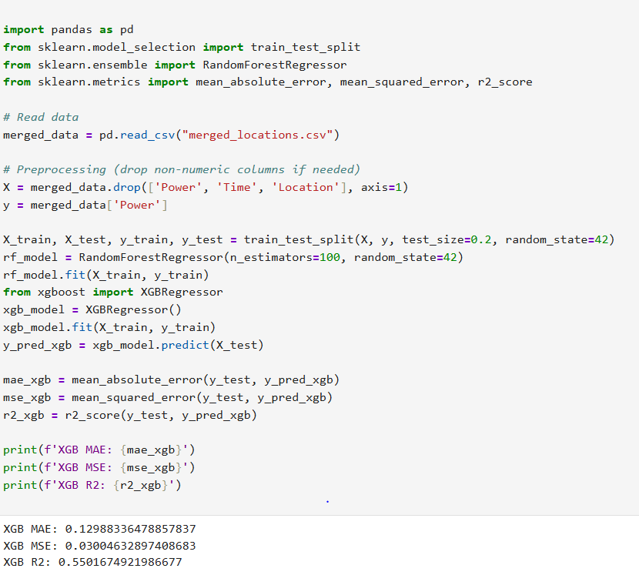
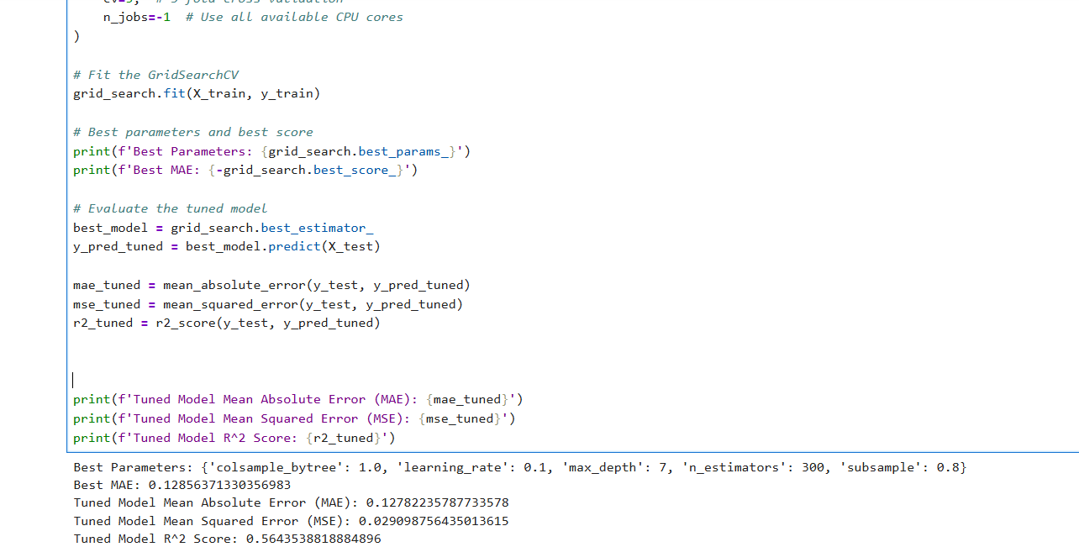
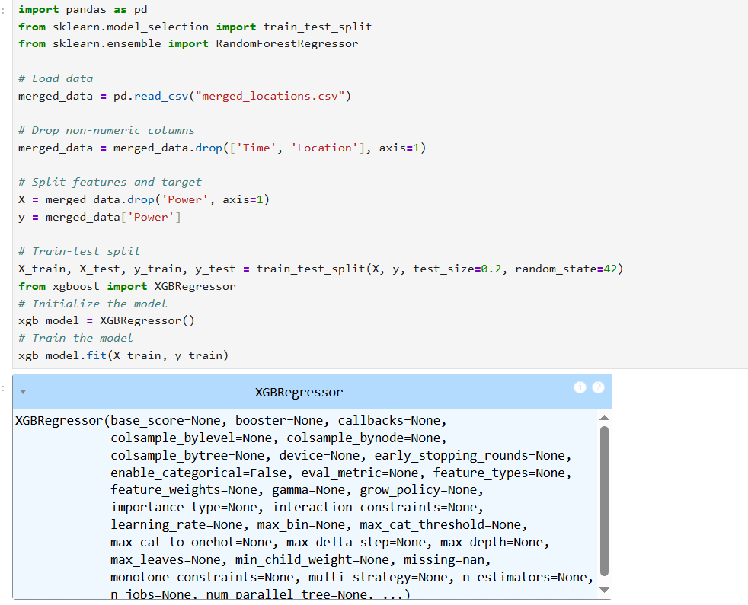
Screenshot of Output:

Slide 8
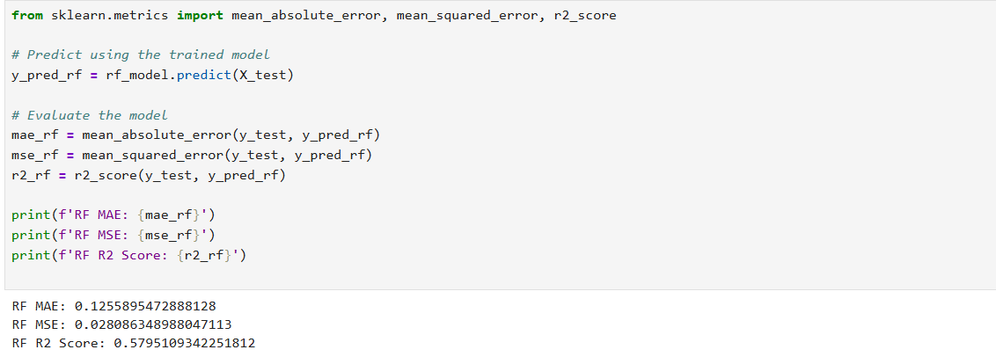
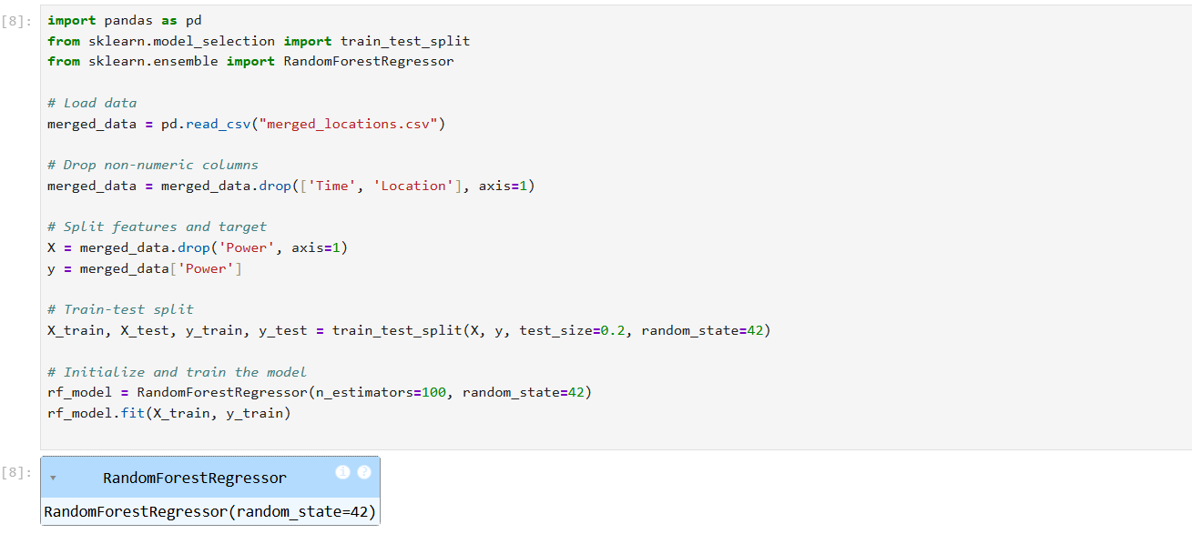
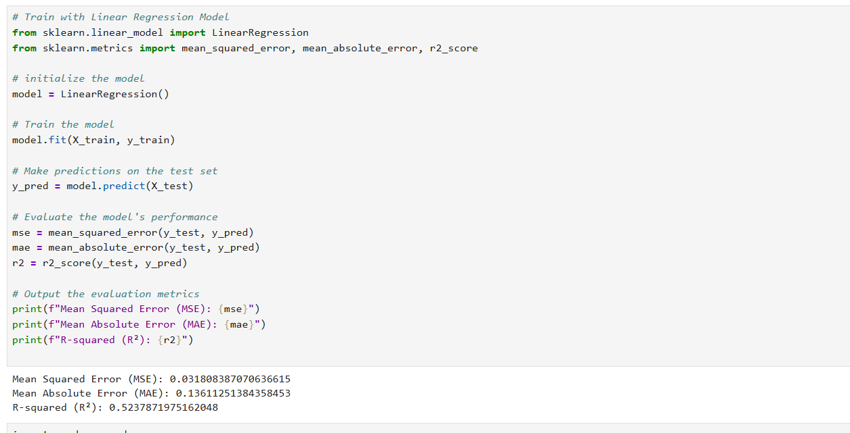
Screenshot of Output:

Slide 9
Conclusion:
Wind power forecasting using machine learning offers a reliable and efficient way to predict energy output based on weather parameters.
With models like Random Forest and XGBoost—especially when fine-tuned—forecast accuracy significantly improves, supporting smarter energy decisions.
We can predict future power output with high accuracy, enabling better energy management and reducing operational uncertainty.
This approach paves the way for enhanced grid reliability, reduced fossil fuel dependency, and a sustainable energy future.

