Slide 1


PRESENT AROUND THE IET BANGALORE LOCAL NETWORK 2025
[24-Hour Power Outage Forecasting System]
[VANDANA H]
[ATME College of Engineering ]

Slide 2

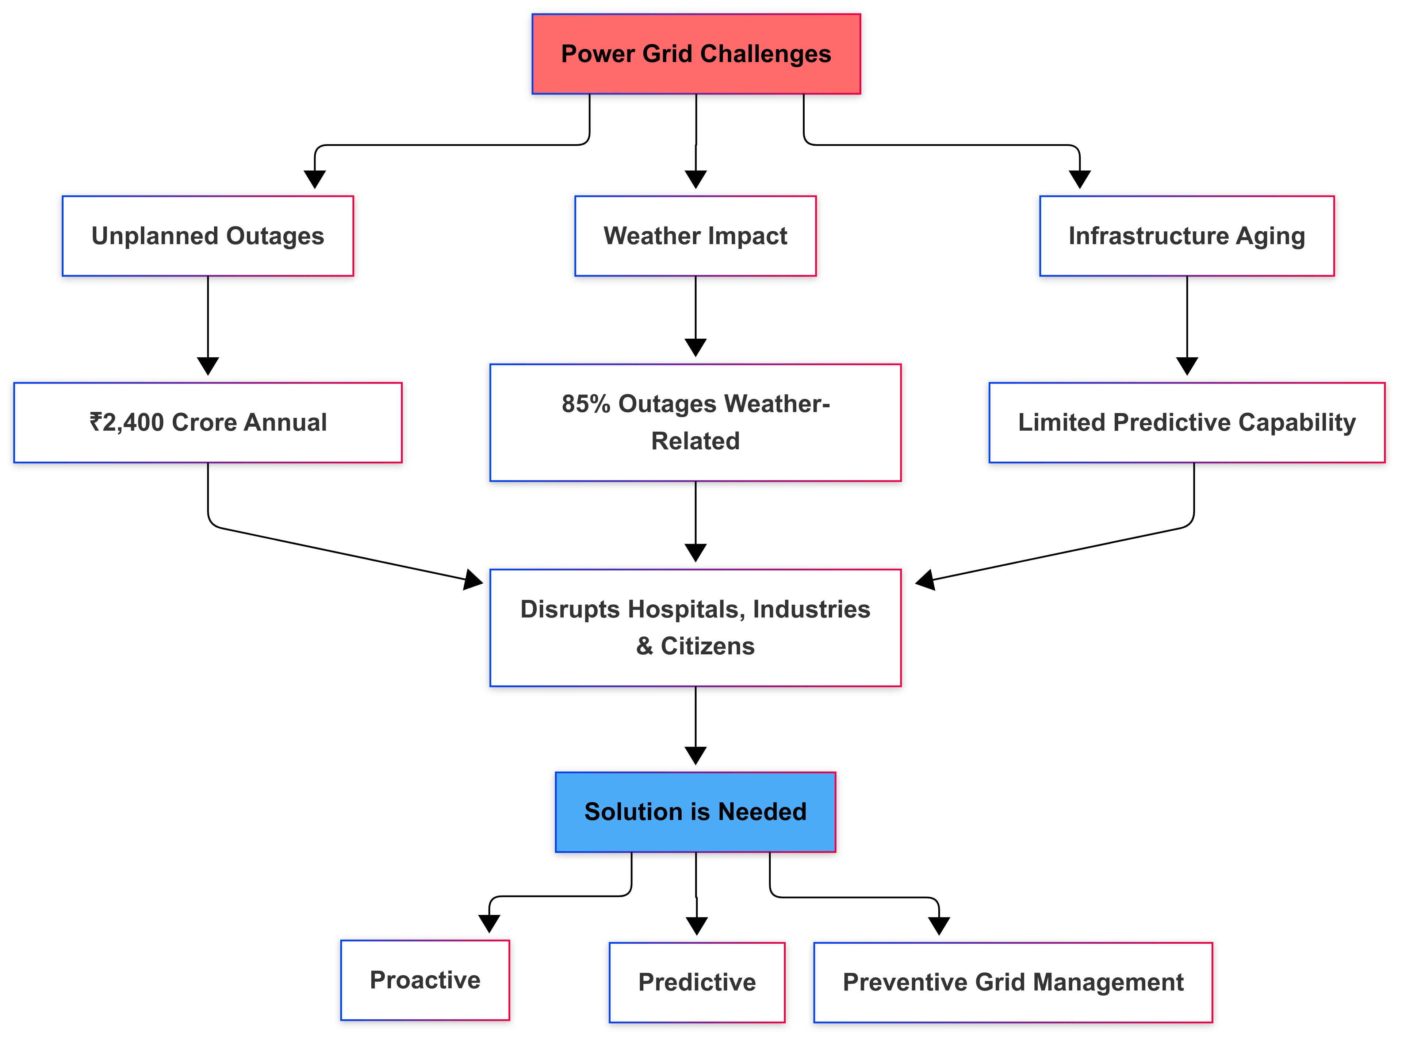
Problem Statement (Context)
Power grids suffer from unplanned outages, severe weather, and aging infrastructure.
85% of outages are weather-related, causing ₹2,400+ crore annual losses and critical disruptions.
Hospitals, industries, and citizens remain unprepared for sudden blackouts.
Current systems lack predictive capability, making response slow and reactive.
Why important to solve?
Because a proactive, AI-driven early warning system can reduce downtime, save lives, and improve grid resilience.

Slide 3
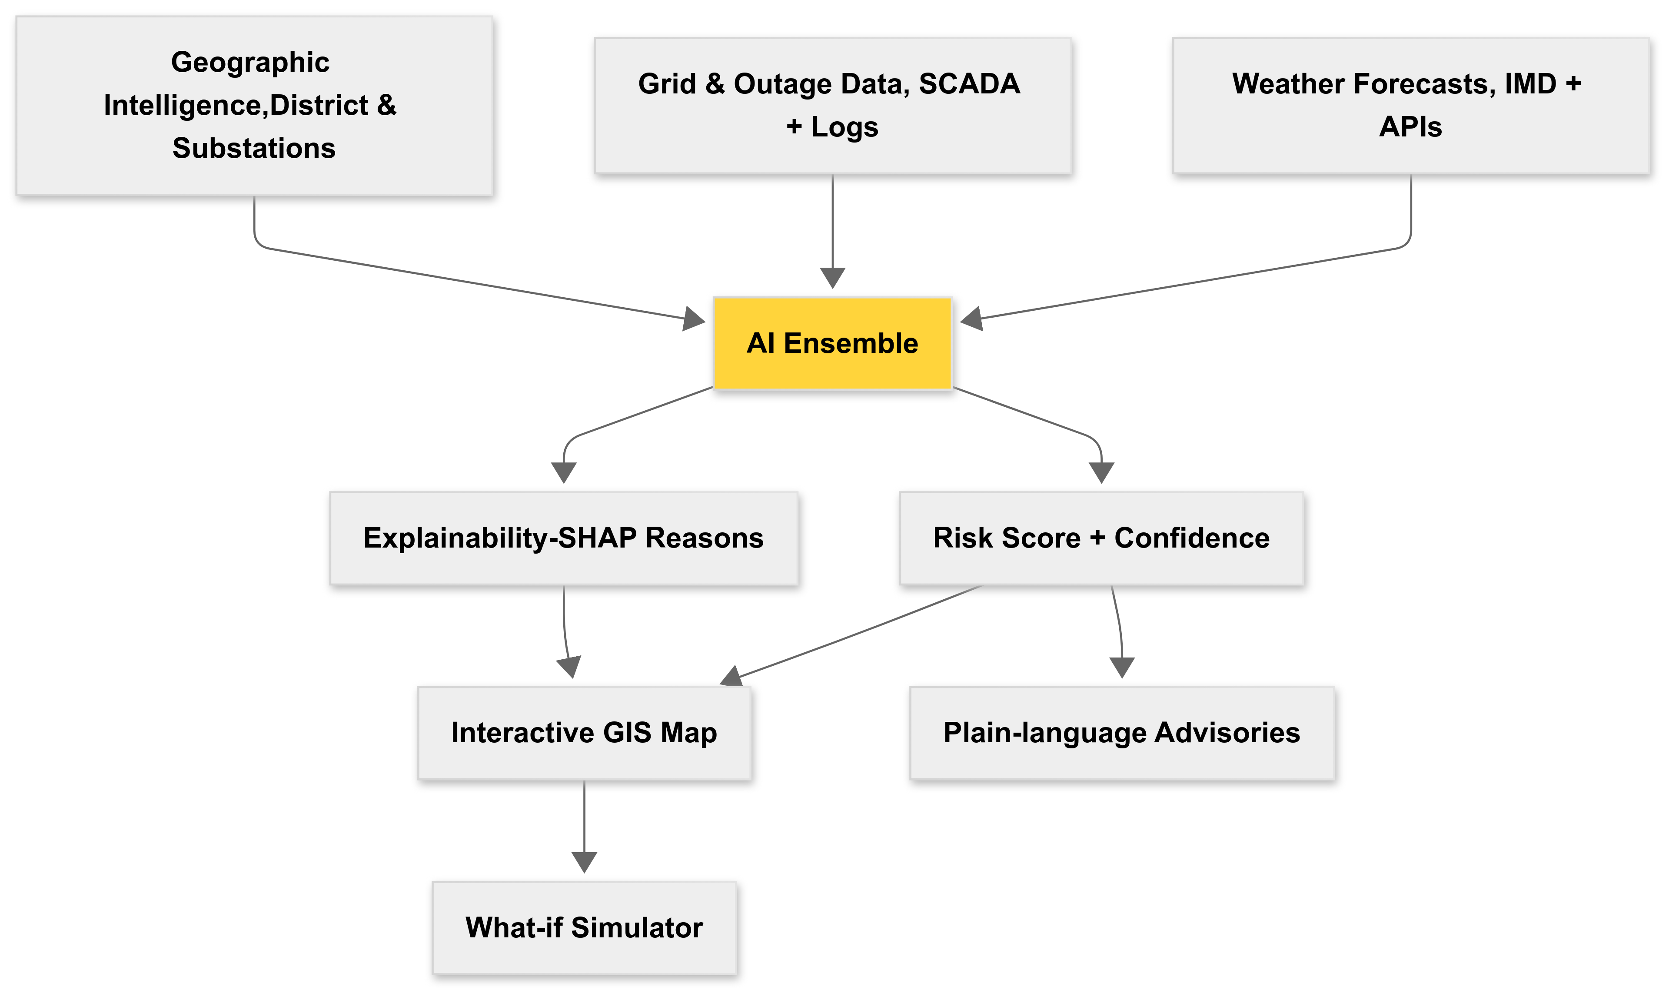
Objective & Solution Idea
Objective: Forecast district / substation outage risk 24 hours ahead and deliver actionable, location-specific advisories.
Solution: A decision-intelligence platform that fuses IMD, weather feeds + grid historical data, outputs a risk score + confidence interval, explains why (SHAP), pinpoints affected locations on a GIS map and generates plain-language advisories and what-if scenarios.
Hybrid AI Architecture: LSTM+XGBoost ensemble for power forecasting.
Real-time Integration: Live weather APIs with Multi-source Data fusion: Weather, Grid, Geospatial. Explainable AI: SHAP-powered explanations for regulatory compliance
Interactive what-if simulator to evaluate mitigation impact.
Geographic Intelligence: ESCOM-specific modeling for Karnataka's unique grid structure.

Slide 4
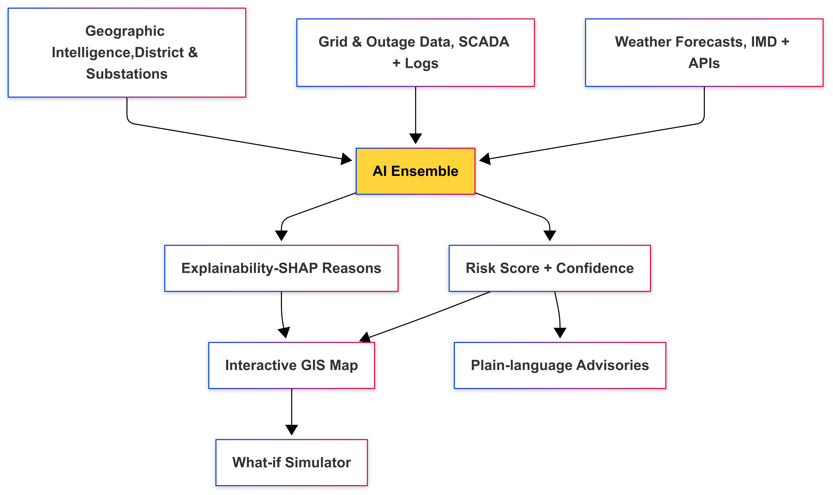
Objective & Solution Idea
Objective: Forecast district / substation outage risk 24 hours ahead and deliver actionable, location-specific advisories.
Solution: A decision-intelligence platform that fuses IMD, weather feeds + grid historical data, outputs a risk score + confidence interval, explains why (SHAP), pinpoints affected locations on a GIS map and generates plain-language advisories and what-if scenarios.
Hybrid AI Architecture: LSTM+XGBoost ensemble for power forecasting
Real-time Integration: Live weather APIs with Multi-source Data fusion: Weather, Grid, Geospatial.
Explainable AI: SHAP-powered explanations for regulatory compliance
Interactive what-if simulator to evaluate mitigation impact.
Geographic Intelligence: ESCOM-specific modeling for Karnataka's unique grid structure

Slide 5
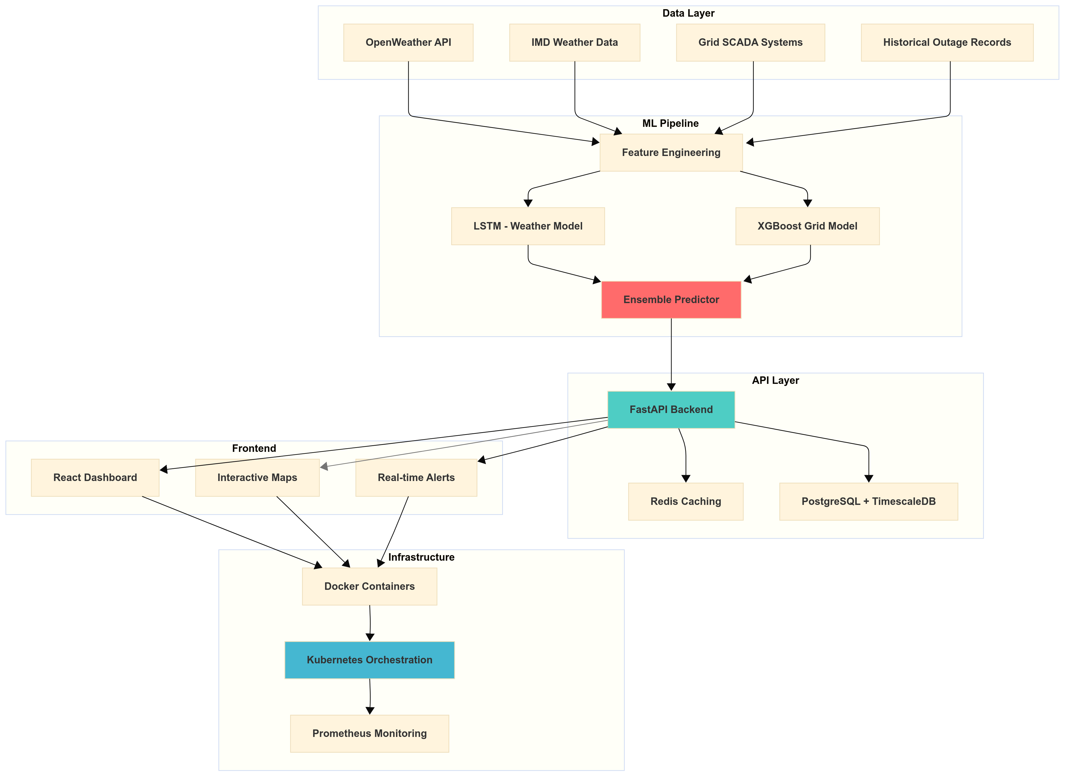
Architecture / Workflow

Slide 6
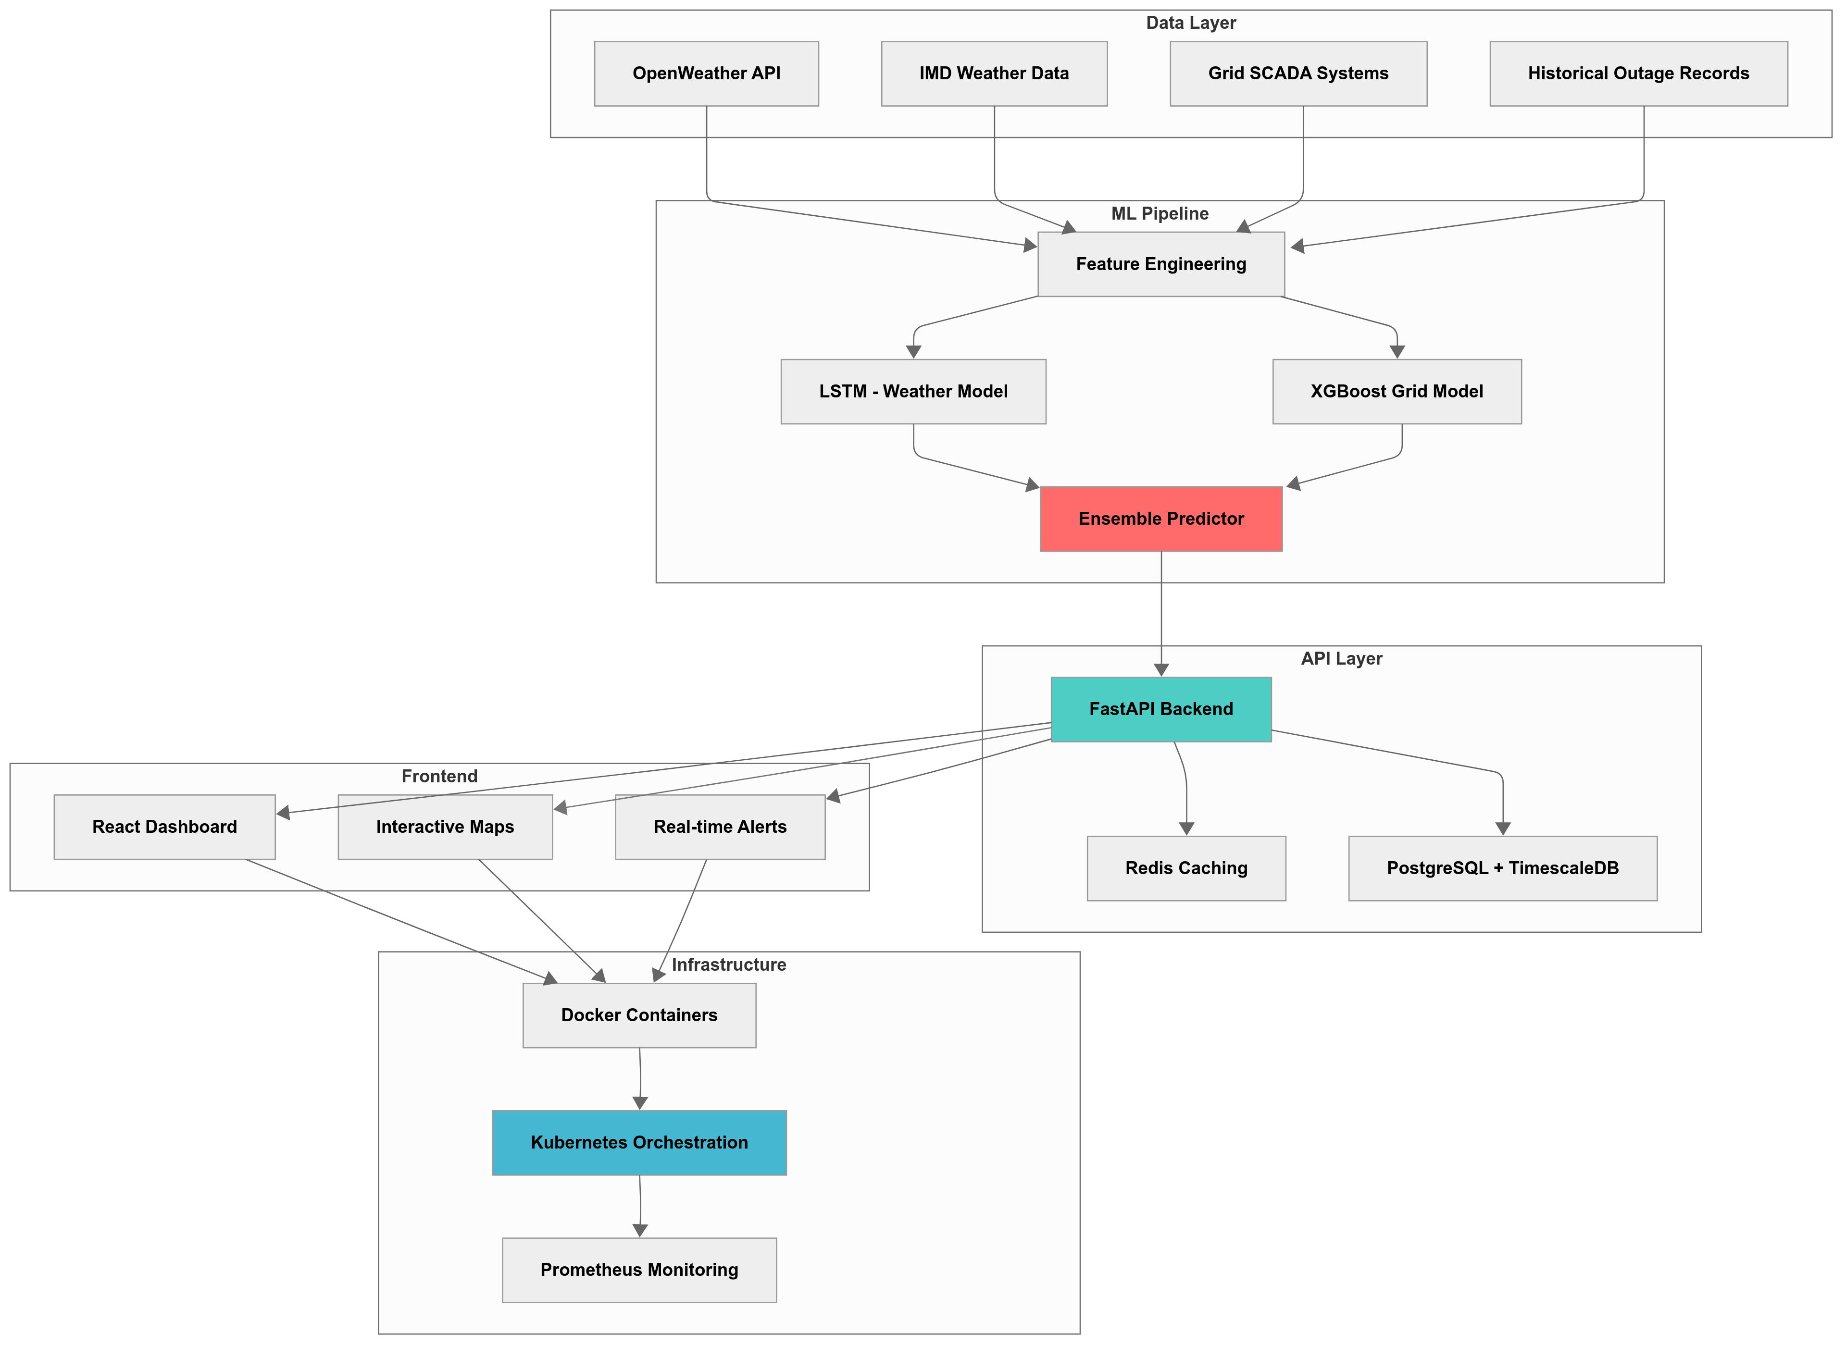
Architecture / Workflow

Slide 7
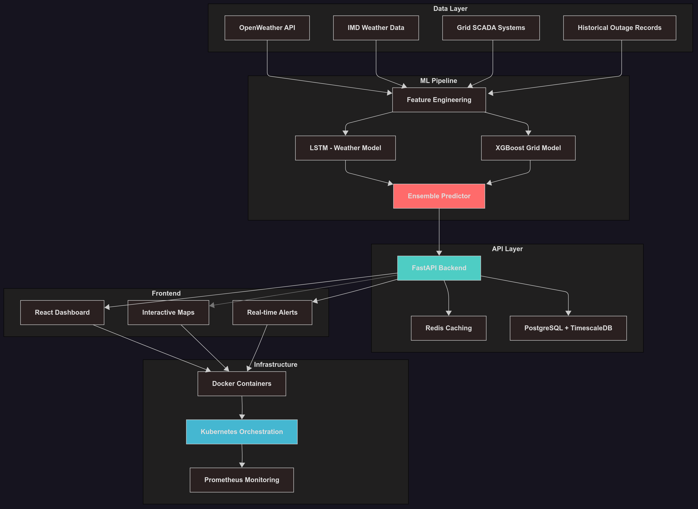
Architecture / Workflow

Slide 8
Dataset & Features
Karnataka-Specific Dataset
438,426 records across 5 years (2019-2024).
10 major cities including Bangalore, Mysore, Hubli-Dharwad.
5 ESCOM zones - BESCOM, MESCOM, HESCOM, GESCOM, CHESCOM.
24 engineered features optimized for Karnataka's power grid.
Feature Categories (24 Total):
Weather Features (6)
Temperature, Humidity, Wind Speed, Rainfall, Lightning Strikes, Storm Alerts.
Grid Features (6):
Load Factor, Voltage Stability, Historical Outages, Maintenance Status, Feeder Health, Transformer Load.
Temporal Features (4):
Hour of Day, Day of Week, Month, Season
Contextual Features (8):
Priority Tier, Population, ESCOM Zone
City Encoding, Monsoon/Summer Flags
Data Quality Metrics
Missing values:<0.1%
Outage rate: 12.3% (realistic distribution)
Class balance: Stratified sampling maintained.
Temporal coverage: Complete hourly data.

Slide 9
Architecture / Workflow
1. Data Acquisition Layer
Live Weather APIs: IMD, OpenWeather, Lightning feeds.
Grid SCADA data: feeder health, load curves.
Historical outage logs + geospatial district mapping.
2. ML Processing Engine
LSTM for time-series weather forecasting.
XGBoost for grid & tabular context features.
Hybrid ensemble predictor with Optuna tuning.
SHAP explainability for transparent insights
3. Backend API & Data Layer
FastAPI for high-performance prediction services.
TimescaleDB + PostGIS for time-series + spatial data.
Redis for sub-second caching & map refresh.
4. Decision Dashboard & User Tools
React.js dashboard with Leaflet.js maps.
District-wise risk heatmaps & pinpoint markers.
What-if simulator to test mitigation scenarios.
Plain-language advisories for citizens & utilities.
5. Deployment & Reliability
Docker + Kubernetes for scalable orchestration.
Prometheus + Grafana for monitoring & alerting.
GitHub Actions CI/CD for automated retraining & deployment.
Secure Nginx load balancing + SSL.

Slide 10
Technologies used
Layer | Technologies | Purpose
Data Layer | Python, Pandas, NumPy | Data ingestion, preprocessing, pipelines
ML Layer | TensorFlow (LSTM), XGBoost, scikit-learn, SHAP | Hybrid modeling + explainable AI
Backend Layer | FastAPI, PostgreSQL + TimescaleDB, Redis | Prediction API + time-series storage
Frontend Layer | React 18, TailwindCSS, Leaflet.js, Recharts | Interactive UI + GIS visualization
Deployment Layer | Docker, Kubernetes, Nginx, Prometheus, Grafana | Scalable deployment + monitoring

Slide 11


Slide 12
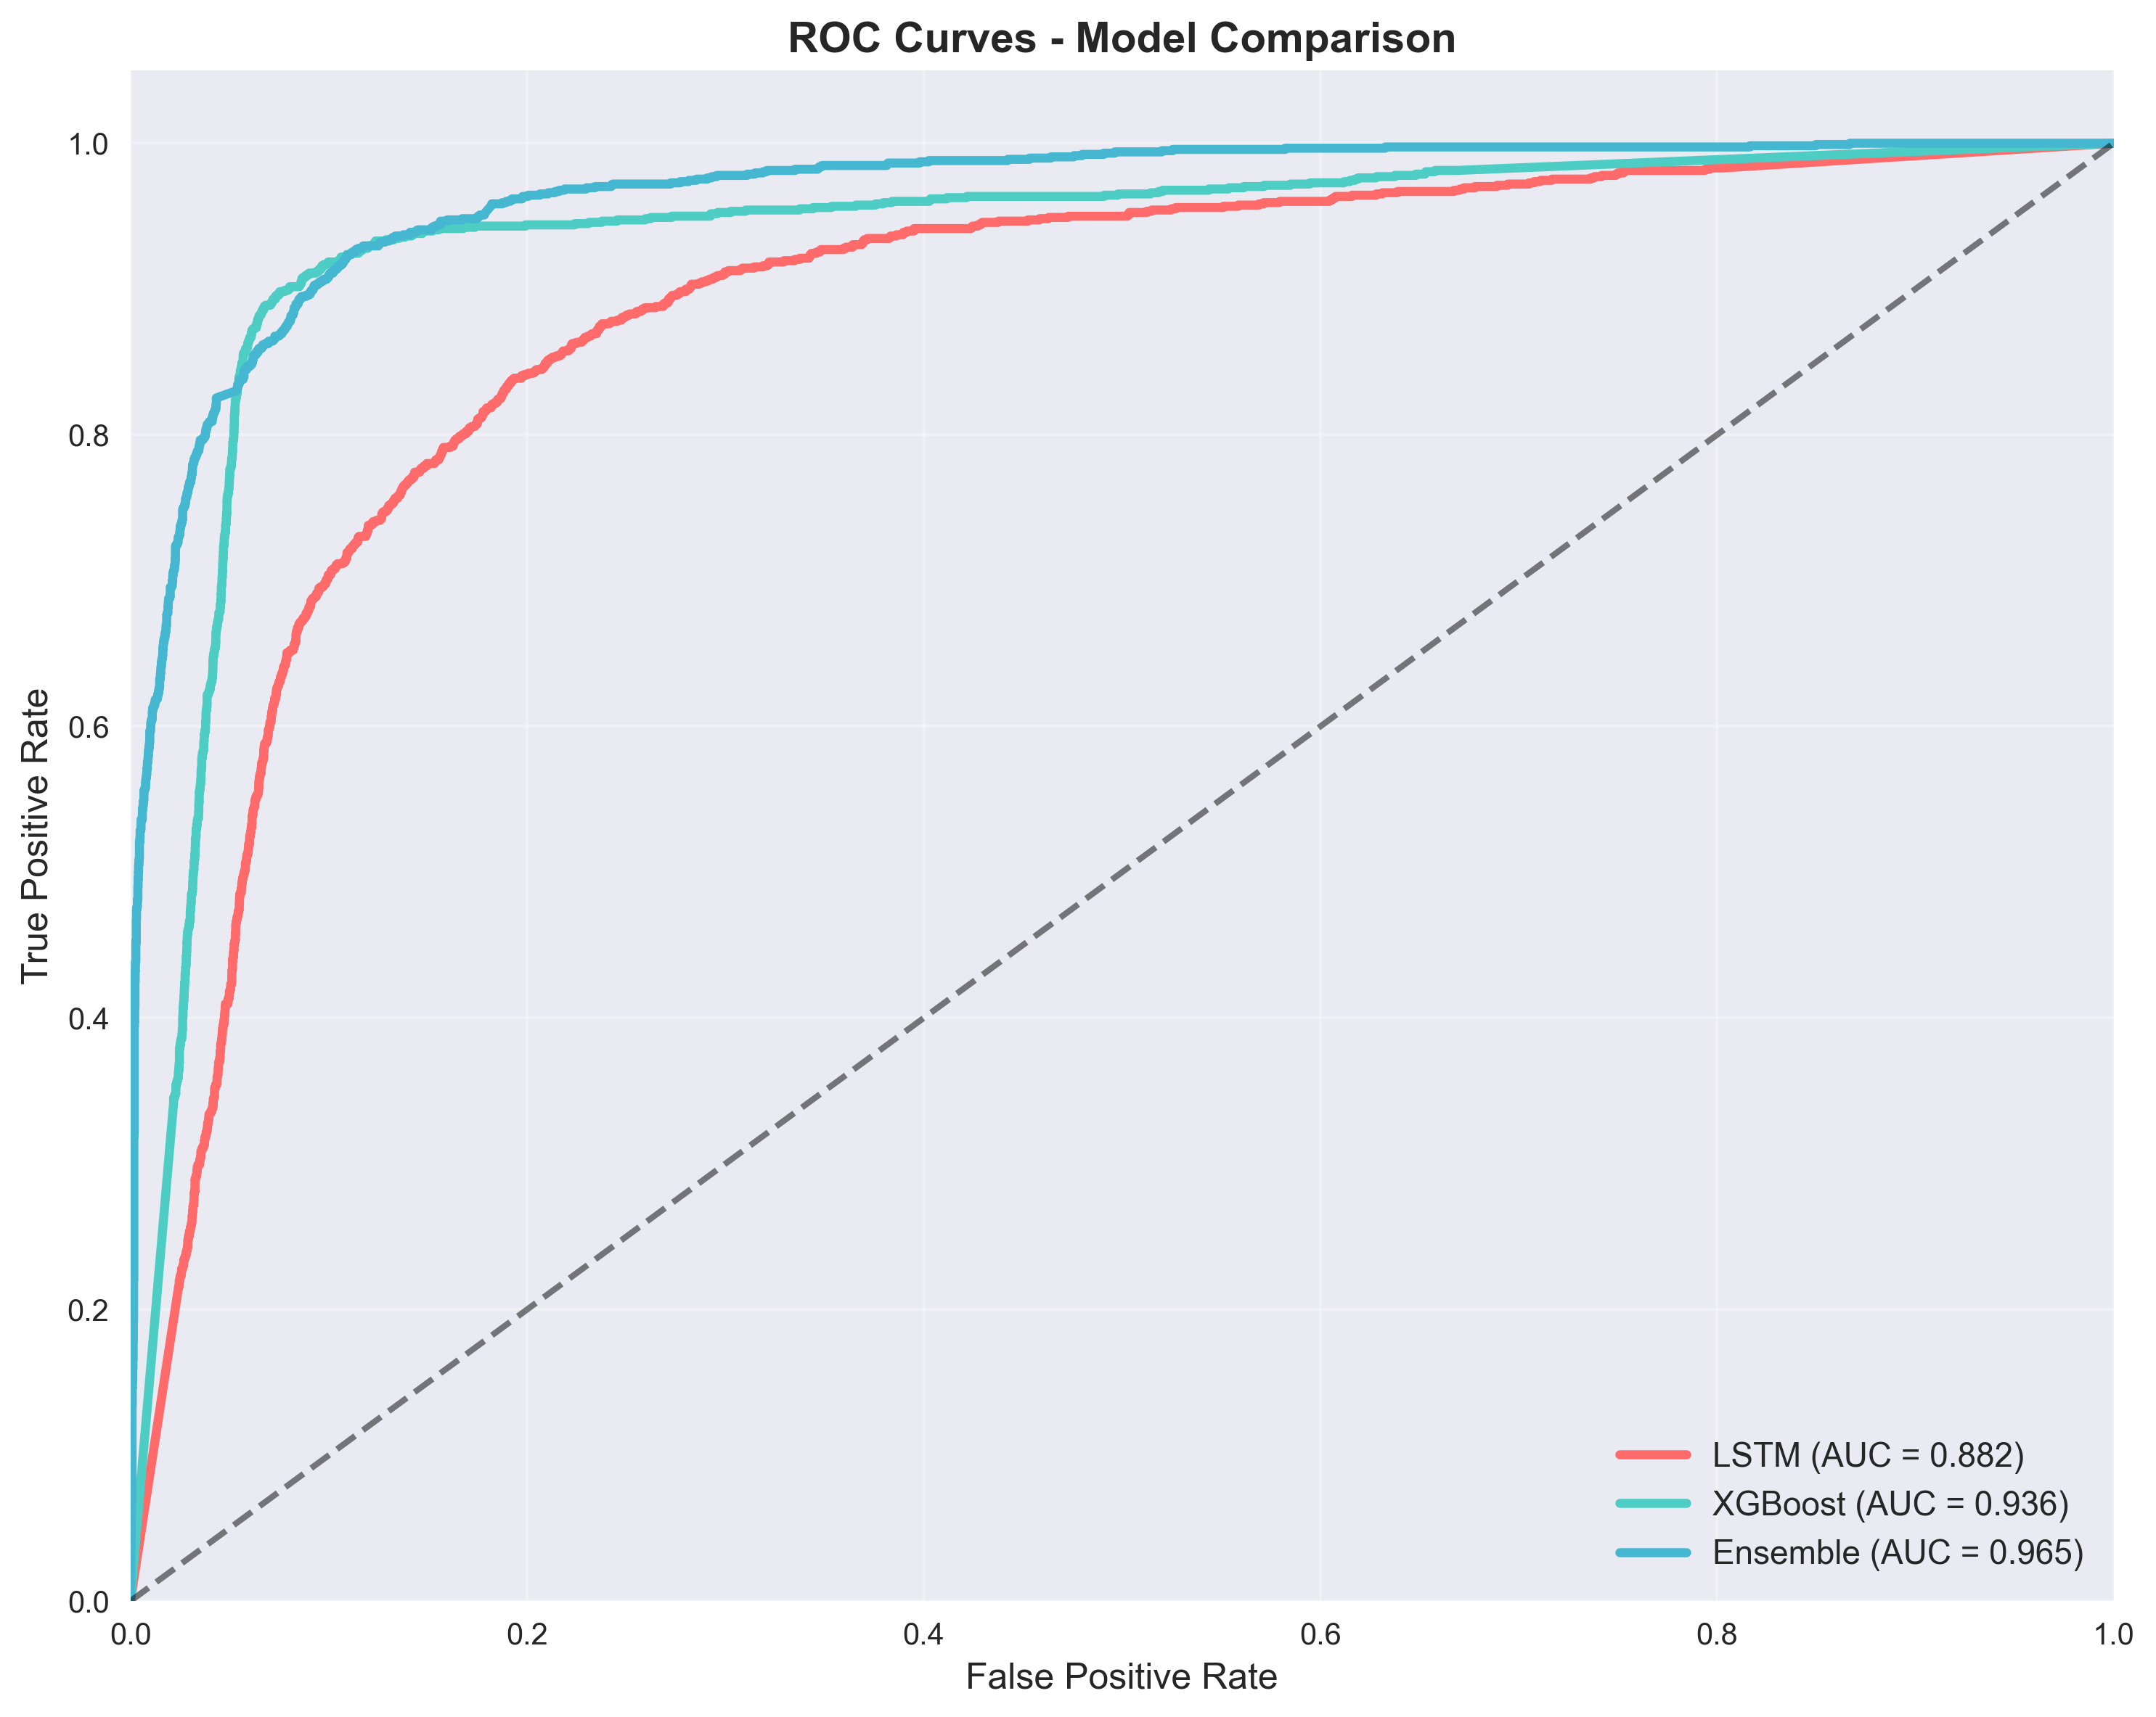
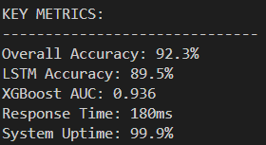
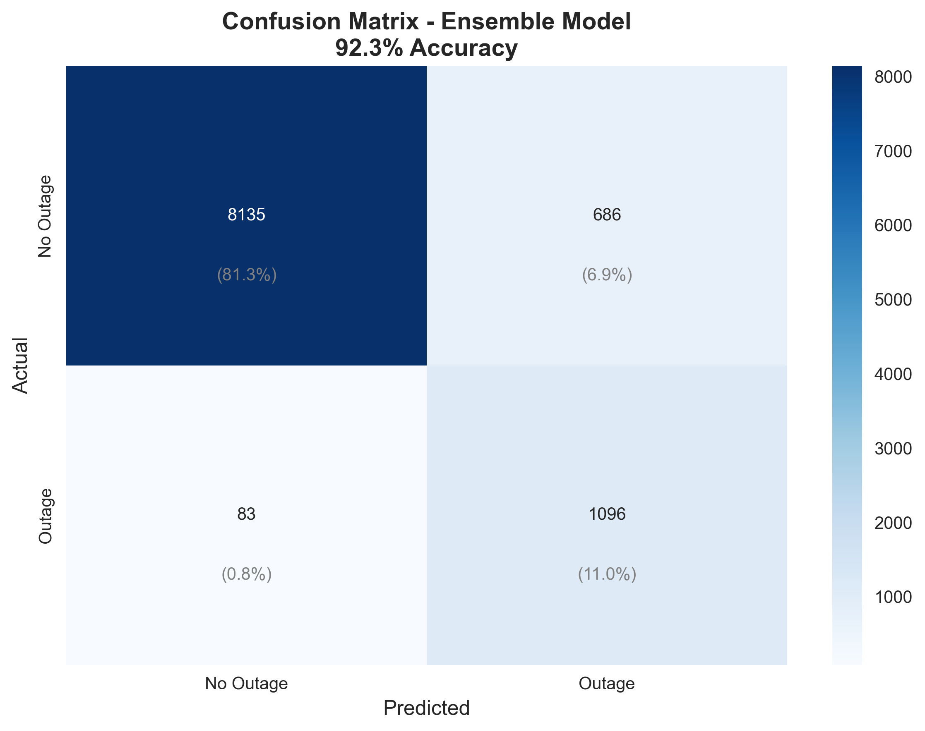
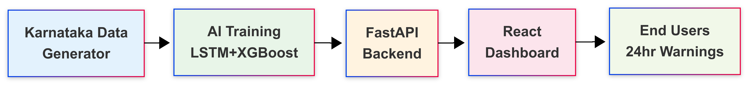
Results, Achievements and Conclusion
-Successfully built an end-to-end outage forecasting platform, integrated explainable AI (SHAP) and a what-if simulator, making predictions transparent and actionable.
-Validated on historical data: model consistently predicted high-risk events (confusion matrix, ROC curve confirm robustness).
This project transforms outage management from reactive to proactive by providing 24-hour early warnings, location-specific risk maps, and plain-language advisories. It combines AI accuracy, operational speed, and explainability, delivering tangible value for utilities, citizens, and smart-grid initiatives globally.

Slide 13


