Slide 1
Spring Security with DB
Team members:
Alla-Anastasiia Gnatkiv
Hanish Dilip Kaprani
Vandana

Slide 2
What is Spring Security?
Spring Security is a powerful and highly customizable authentication and access-control framework for Java applications, particularly for Spring-based applications."
"It is a standard for securing Spring-based applications, focusing on providing both authentication and authorization to Java applications.

Slide 3

Database Integration in Spring Security
Spring Security can be integrated with a database (like MySQL) to manage user authentication and authorization.
This integration allows for storing, retrieving, and managing user credentials and roles in a database, enhancing security and scalability.

Slide 4
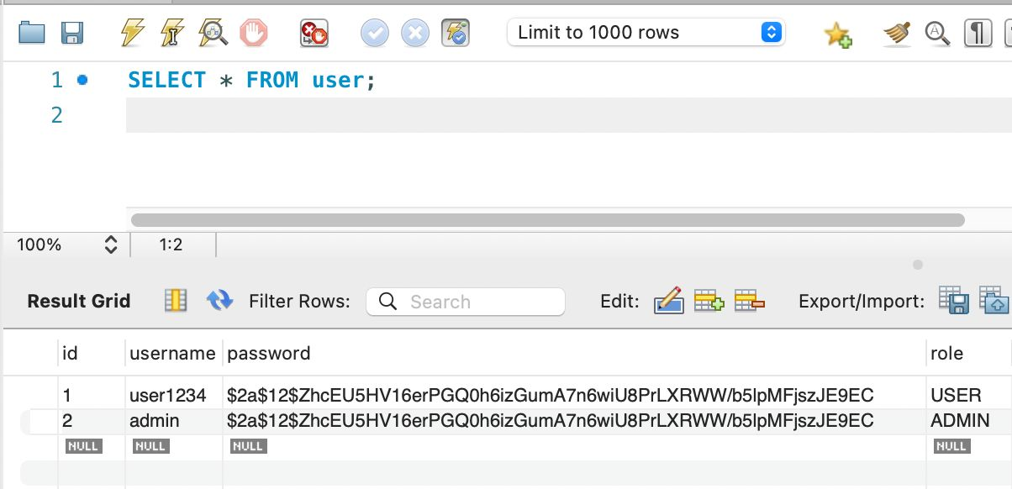
Mysql Datbase

Slide 5
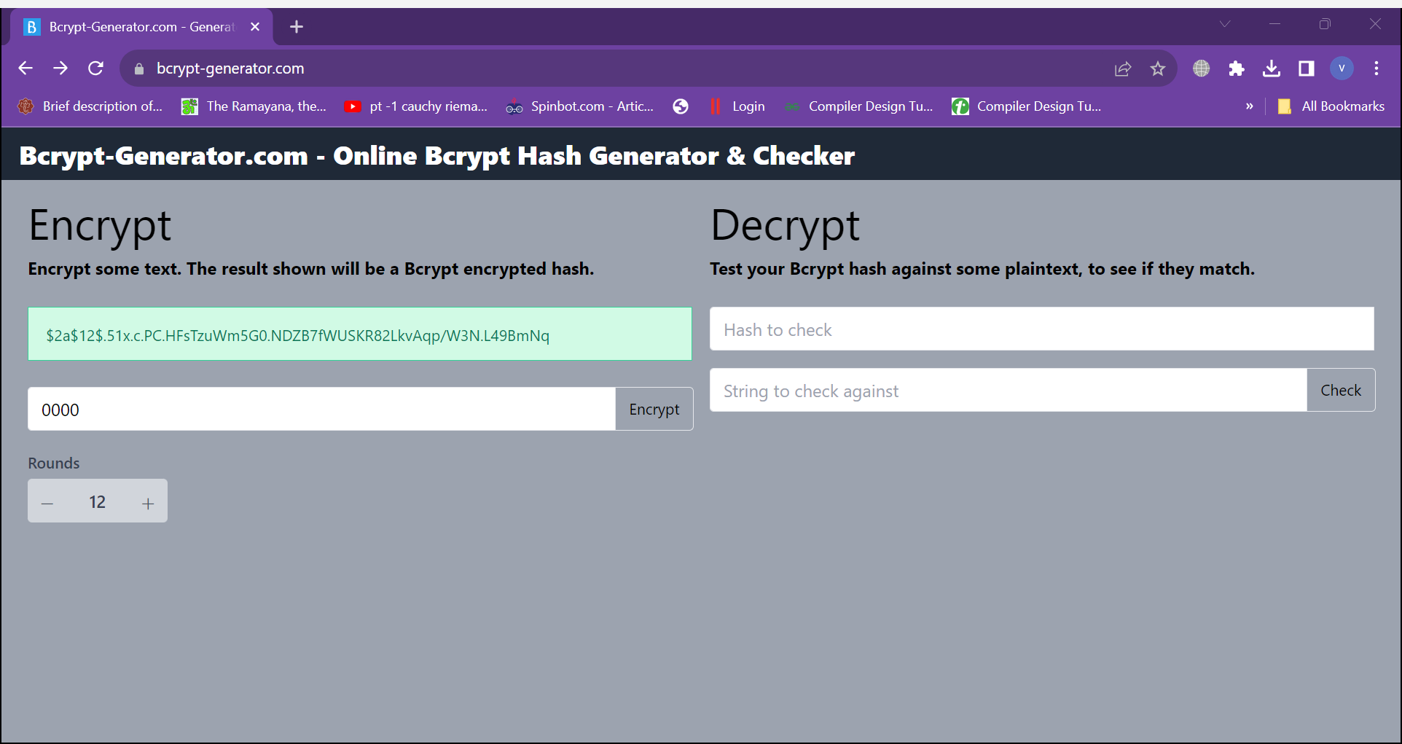
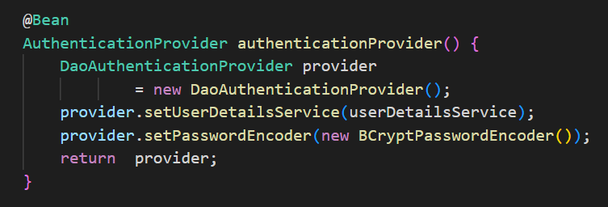
Password encryption
We have used https://bcrypt-generator.com/ to create Bcrypt encrypted hash which we have used to encrypt our password in database.

Slide 6
Thanks!
Let's move towards code explanation

