Slide 1

Data Exploration & Cleaning for Machine Learning
Lauren Vanderlinden, PhD, MS
T15 Postdoctoral Fellow Computational Biology
Division of Rheumatology & Department of Biomedical Informatics
School of Medicine, University of Colorado Anschutz Medical Campus
CPBS 7602 - December 12, 2024

Slide 2
Outline
Basics of data exploration
Histograms and boxplots
Outliers
Missing data
Prepping data for ML

Slide 3
Exploration Basics – Where does it fit in the process?
Why do we do data exploration?
Understanding data
Data preparation
Data Collection
Data Cleaning
Interpretation
Data Analysis

Slide 4
Summary Statistics

Slide 5
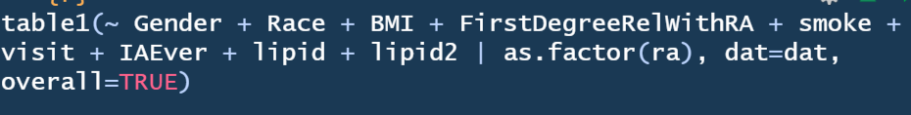
Univariate Summary
Mean, median, standard deviation (and so on) for continuous measures
N’s and percentages for categorical variables
R/table1 is a great tool I use for this

Slide 6
Table 1
 | 0 (N=67) | 1 (N=20) | Overall (N=87)
smoke
Mean (SD) | 0.471 (0.507) | 0.0909 (0.302) | 0.378 (0.490)
Median [Min, Max] | 0 [0, 1.00] | 0 [0, 1.00] | 0 [0, 1.00]
Missing | 33 (49.3%) | 9 (45.0%) | 42 (48.3%)
visit
Mean (SD) | 1.03 (0.171) | 1.10 (0.308) | 1.05 (0.211)
Median [Min, Max] | 1.00 [1.00, 2.00] | 1.00 [1.00, 2.00] | 1.00 [1.00, 2.00]
IAEver
 | 63 (94.0%) | 0 (0%) | 63 (72.4%)
No | 4 (6.0%) | 0 (0%) | 4 (4.6%)
Yes | 0 (0%) | 20 (100%) | 20 (23.0%)
lipid
Mean (SD) | 36200 (32100) | 41000 (28400) | 37300 (31200)
Median [Min, Max] | 26500 [1000, 181000] | 33700 [15700, 133000] | 27100 [1000, 181000]
lipid2
Mean (SD) | 11000 (13700) | 11700 (12400) | 11100 (13300)
Median [Min, Max] | 5830 [1030, 80300] | 9450 [3180, 61100] | 6140 [1030, 80300]
 | 0 (N=67) | 1 (N=20) | Overall (N=87)
Gender
Female | 47 (70.1%) | 14 (70.0%) | 61 (70.1%)
Male | 20 (29.9%) | 6 (30.0%) | 26 (29.9%)
Race
Asian | 1 (1.5%) | 0 (0%) | 1 (1.1%)
Biracial | 3 (4.5%) | 4 (20.0%) | 7 (8.0%)
Black | 1 (1.5%) | 0 (0%) | 1 (1.1%)
Hispanic | 3 (4.5%) | 0 (0%) | 3 (3.4%)
NHW | 59 (88.1%) | 16 (80.0%) | 75 (86.2%)
BMI
Mean (SD) | 31.6 (32.8) | 27.2 (4.90) | 30.6 (28.9)
Median [Min, Max] | 26.6 [17.0, 285] | 26.2 [20.7, 41.2] | 26.5 [17.0, 285]
Missing | 3 (4.5%) | 1 (5.0%) | 4 (4.6%)
FirstDegreeRelWithRA
No | 18 (26.9%) | 10 (50.0%) | 28 (32.2%)
Yes | 49 (73.1%) | 10 (50.0%) | 59 (67.8%)

Slide 7
Visuals

Slide 8
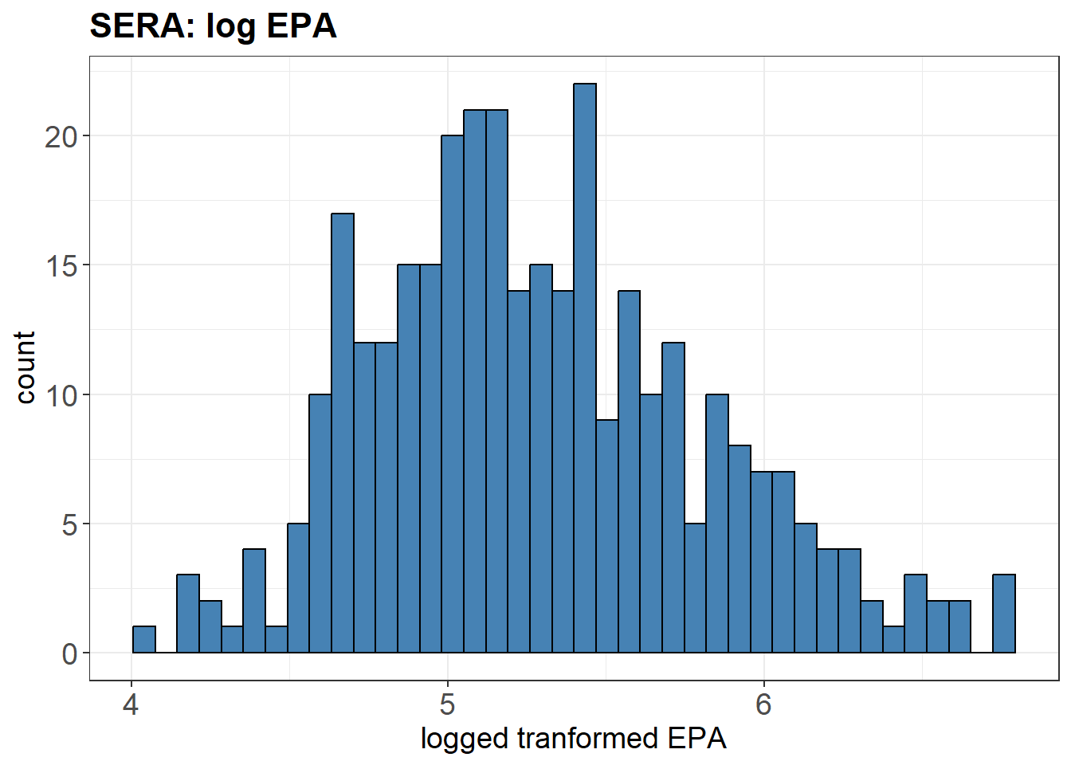
Histograms
It is a representation of a frequency distribution by means of rectangles whose widths represent class intervals and whose areas are proportional to the corresponding frequencies.

Slide 9
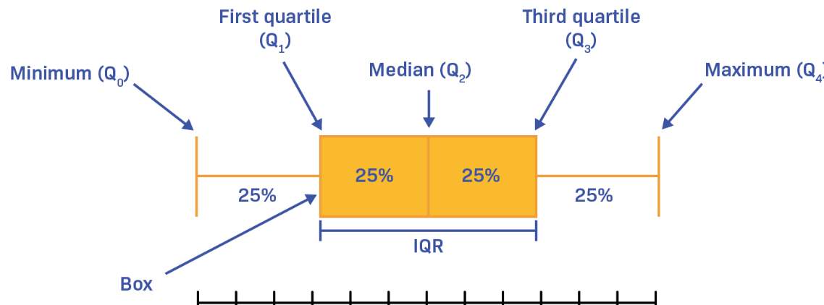
Box plots

Slide 10
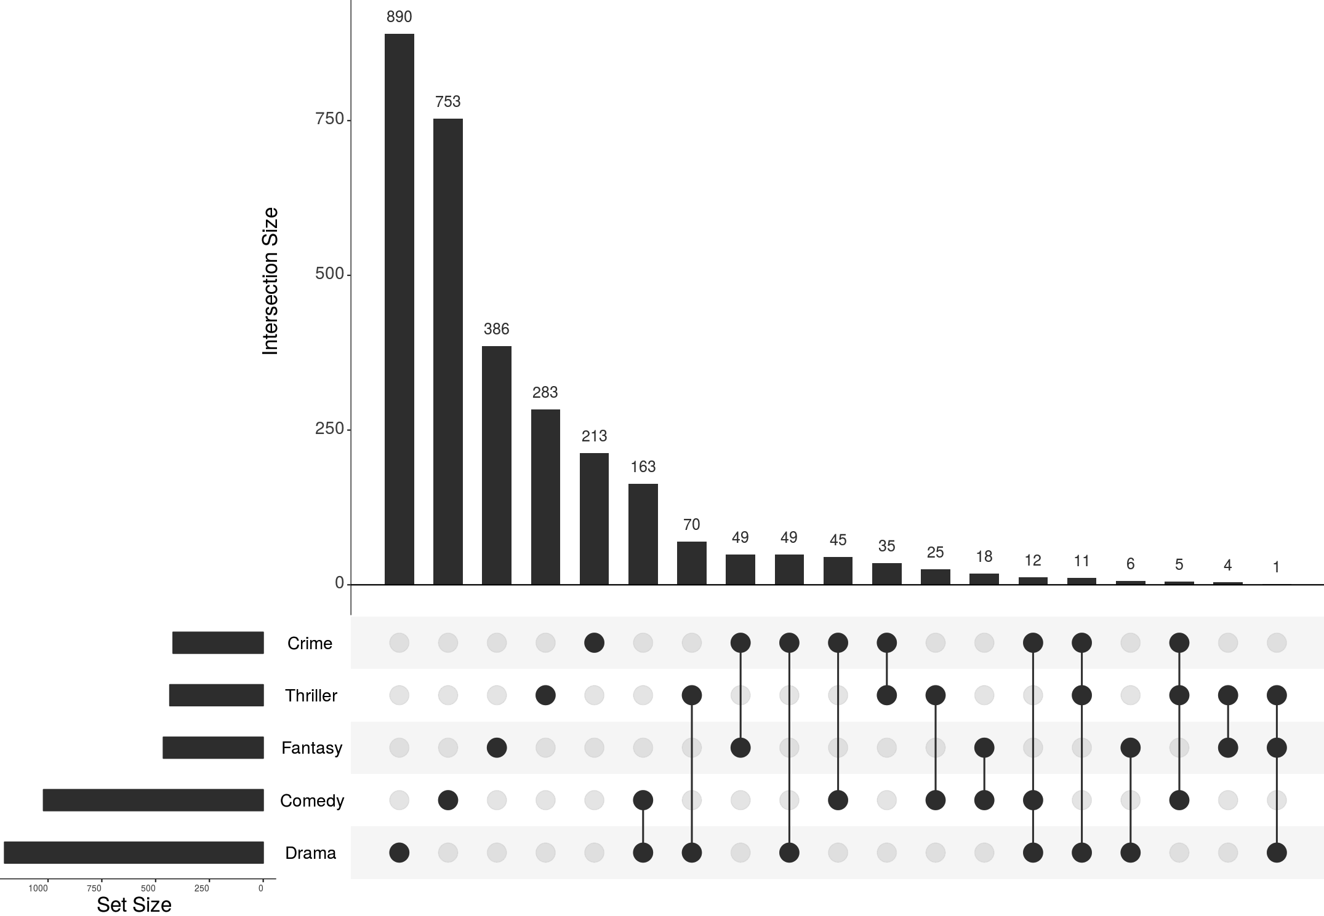
UpSet Plots
Very helpful when looking at data availability
Example: movie genre overlaps

Slide 11
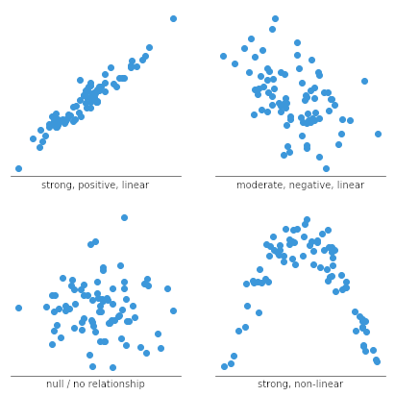
Scatter plots

Slide 12
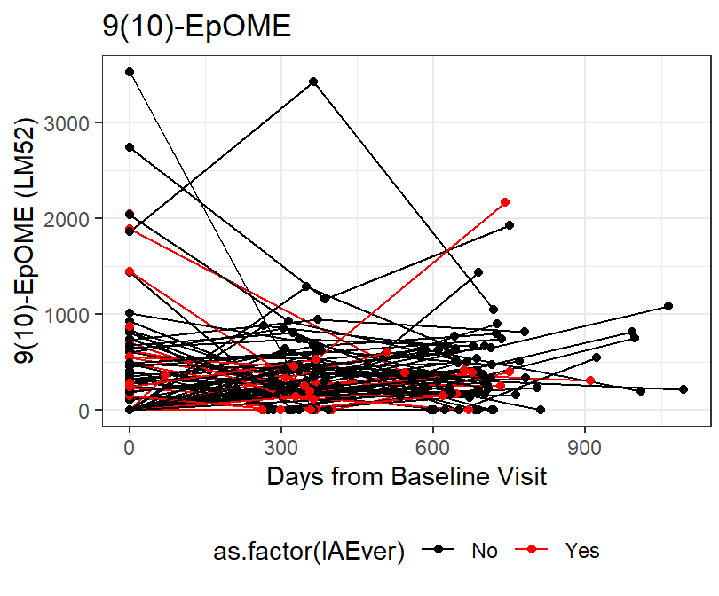
Spaghetti plots

Slide 13
Modifying Variables

Slide 14
Outliers
We can identify outliers in the summary stats and visually
What is technically considered an “outlier” is really subjective
+/- 3SD from the mean
“Tukey's method”: points below Q1 - 1.5IQR or above Q3 + 1.5IQR
Solutions
Transformation: log, box-cox
Removing
Change value: winsorization, trimming, or imputation

Slide 15
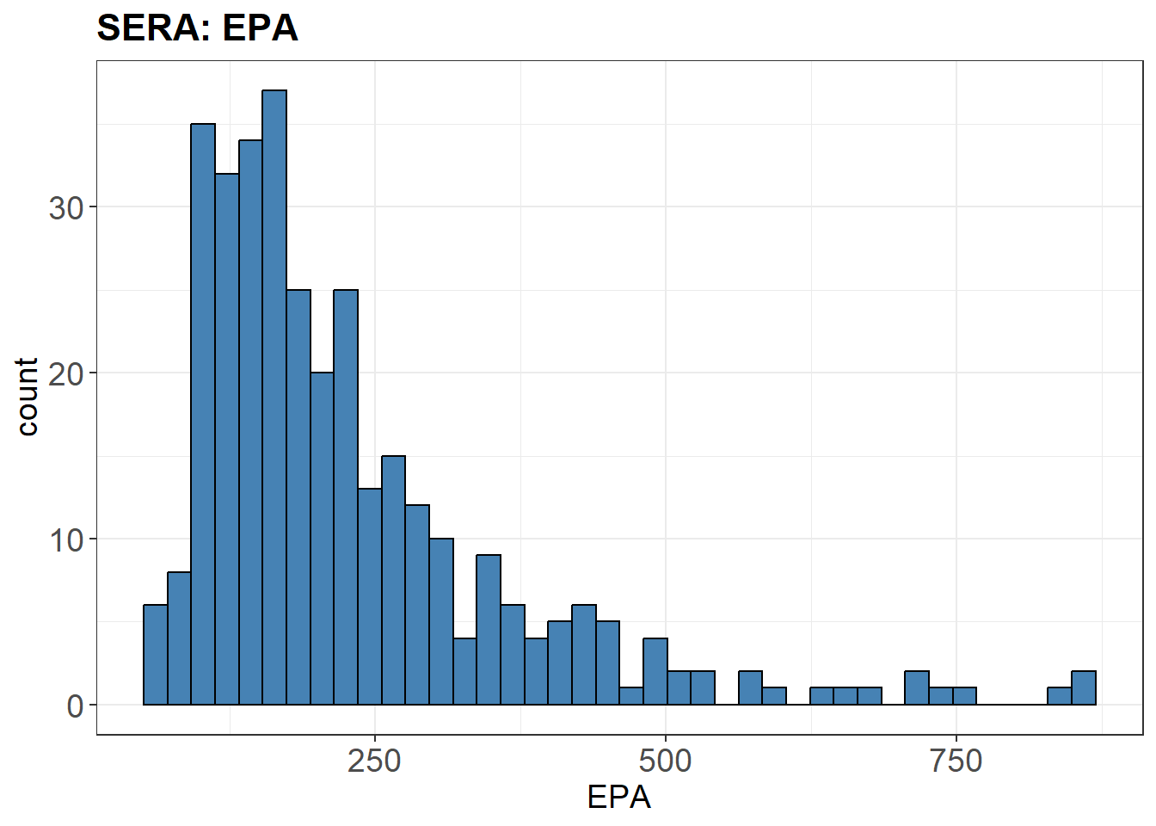
Transformation

Slide 16
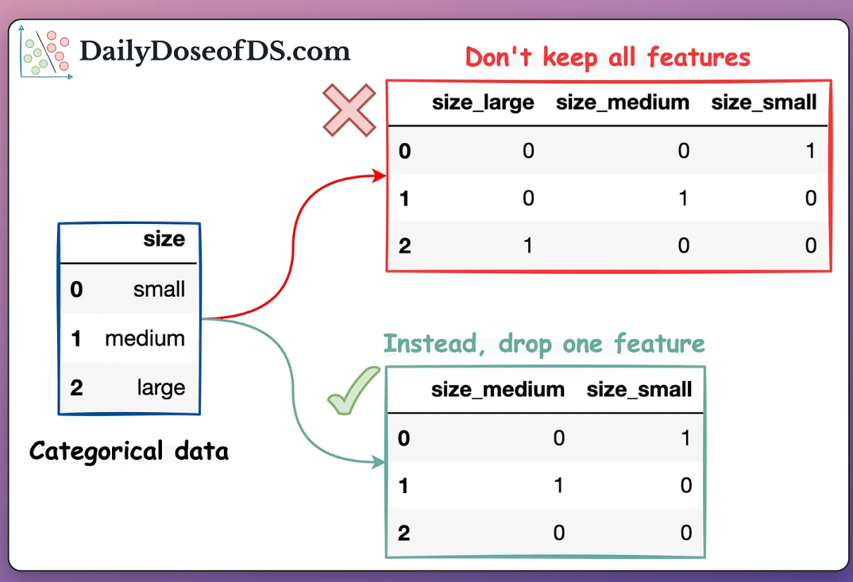
Categorical Variables & ML
Majority of ML only work with numerical variables
Need to “dummy code” (traditional statistical language) or “one-hot encoding” (more data science language)
If you keep ALL dummies, induce multicollinearity because you can predict another variable, so remove 1 redundant feature
https://blog.dailydoseofds.com/p/the-most-overlooked-problem-with

Slide 17
Missingness

Slide 18
Machine Learning & Missingness
Only works on complete data
Even if each variable contains a small amount of missing data, this can add up in ML methods that use lots of variables and sample size can be reduced DRAMATICALLY
Sample | Variable 1 | Variable 2 | Variable 3 | Variable 4 | Variable 5 | … | Variable 400,000
Sample 1 | Missing
Sample 2 |  | Missing
Sample 3 |  |  |  |  | Missing
…
Sample 1000 |  |  |  |  |  |  | Missing

Slide 19
Why do I have missing data?
Survey data:
Participant refused to respond or doesn’t know the answer
Interviewer accidentally skipped questions (or entire sections of instrument)
Errors with data entry or quality control
Biomarker data:
Insufficient volume of biospecimen for analysis
Undetectable concentration of analyte
Laboratory errors, data entry errors
Participant refusal to provide biospecimen
Medical/vital record data:
Clinician did not enter data, or data not correctly digitized
Lost track of participant due to many different providers/residence
Are participants with missing data different from those with complete data?

Slide 20
Types of missing data
Missing completely at random (MCAR): Missingness of subject’s value for Z is independent of every variable in the analysis, including Z
Example: When analyzing serum total cholesterol, whether or not the value of cholesterol is missing is unrelated to the actual concentration of cholesterol, and also unrelated to exposure, outcome, covariates (e.g. age, sex, etc.)
Missing at random (MAR): Missingness of subject’s value for Z is independent of the value of Z, within levels of (i.e., conditional on) every other variable in the analysis
Example: Some participants fail to report smoking behavior. Within categories defined by gender, age, and income, the probability of missingness is not related to whether or not the participant is actually a smoker or not.
Missing not at random (MNAR): Missingness of subject’s value for Z is dependent on the actual value of Z (also called non-ignorable)
Example: Participants with highest income are least likely to report income.

Slide 21
Missing “at random” is not really random
Source: Bhaskaran and Smeeth (2014) Int J Epidemiol

Slide 22
Common approaches to missing data
Create a “missing” category and enter a substitute value (e.g. “999”) for participants with missing data
Pro: Allows you to use data from all potential participants
Con: Biased under many circumstances, including MCAR
Complete case analysis: Exclude participants from analysis if any missing data for modeled variables
Pro: Unbiased under MCAR (and sometimes under MAR)
Con: Reduces the number of participants (power), may result in selection bias
Single imputation: Replace missing entries with a single random draw from distribution (different from imputation with overall sample mean)
Pro: Simple and unbiased under MCAR and MAR
Con: Underestimates variance, produces incorrect standard errors
Multiple imputation: Replace missing entries with a set of random draws
Pro: Unbiased under MCAR and MAR, appropriately estimates standard errors
Con: Relative complexity, require specific analysis packages

Slide 23
How to tell if my data are MCAR, MAR, MNAR
Create a missing indicator for the variable with missing values. Use bivariate associations (t-test, ANOVA, chi-square) to determine if missingness is associated with levels of other observed variables (MAR) or independent of all observed variables (MCAR).
Cannot evaluate MNAR vs MAR from available data. May be hypothesized from subject matter knowledge.

Slide 24
Multiple imputation
Principle: predicting and “filling in” missing values based on the observed associations with other variables in the dataset, and doing this multiple times to achieve better estimate of variability
Assumption: the probability of missingness depends only on the other observed variables in the dataset (not valid for MNAR)
Advantages:
Allows analysis using the full dataset, unlike complete case analysis
Correctly estimates the uncertainty of estimates, by generating multiple possible “fill-in” values for each missing value (unlike single imputation)

Slide 25
Notes on multiple imputation
As a general rule, you should only impute data if the proportion of missing values is relatively small, typically considered to be less than 5% of your data; if more than 20% of your data is missing, it's usually better to discard that data rather than impute it extensively
There is randomness to the procedure so results will vary each time. Need to set a seed if you want to replicate results.

Slide 26
Does my treatment of missing data matter?
If less than 5% missing values, probably not
If 5-15% missing values, maybe
If >15% missing values, very likely yes

Slide 27
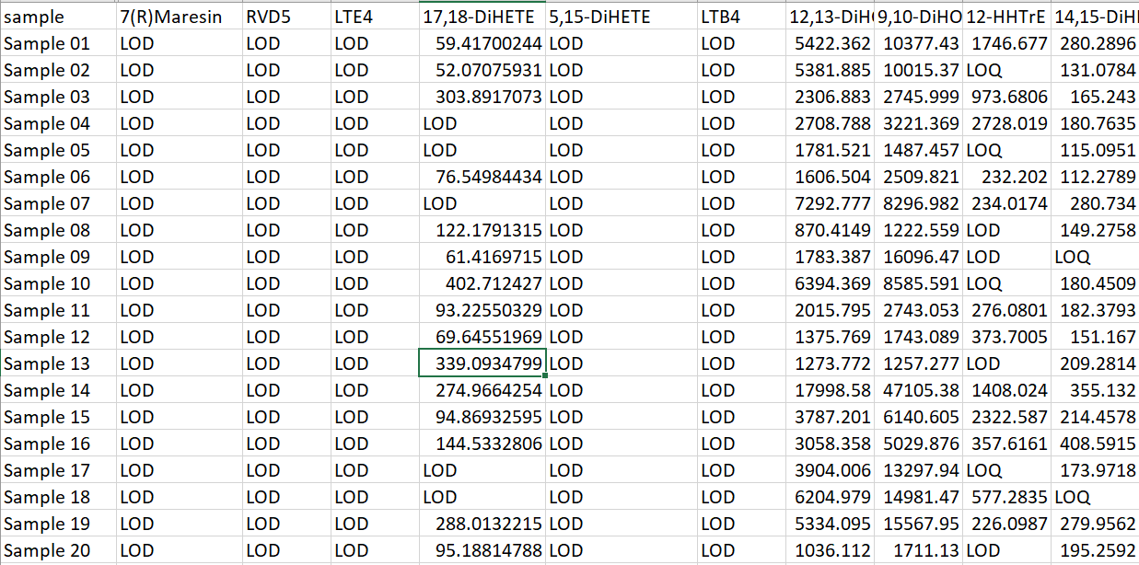
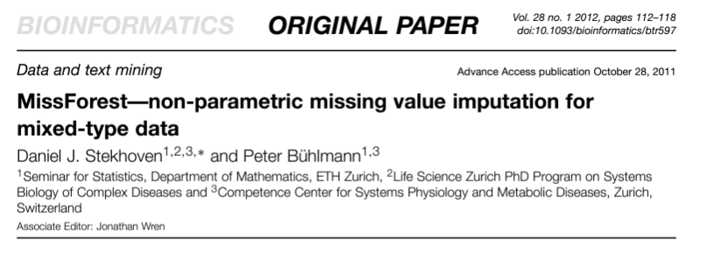
Imputation in Mass Spec Data
In mass spec data you have missing due to 2 different reasons: values are below LOD (limit of detection) or LOQ (limit of quantitation)
MissForest used to impute for both types of missingness

Slide 28
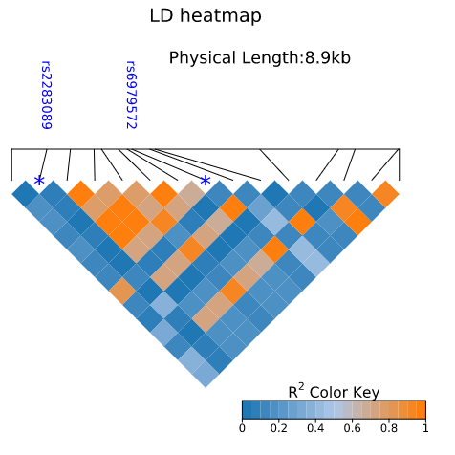
Quick Note on Genetic Imputation
Many people use impute genome-wide genetic data from array chips
i.e. imputing variables we don’t have a single data point collected on
Imput genome-wide set of SNP markers based on reference LD
Imputation is only as good as your reference
Select reference that most aligns with the population you are imputing

Slide 29
Real World Example: NIDDK AI Challenge

Slide 30

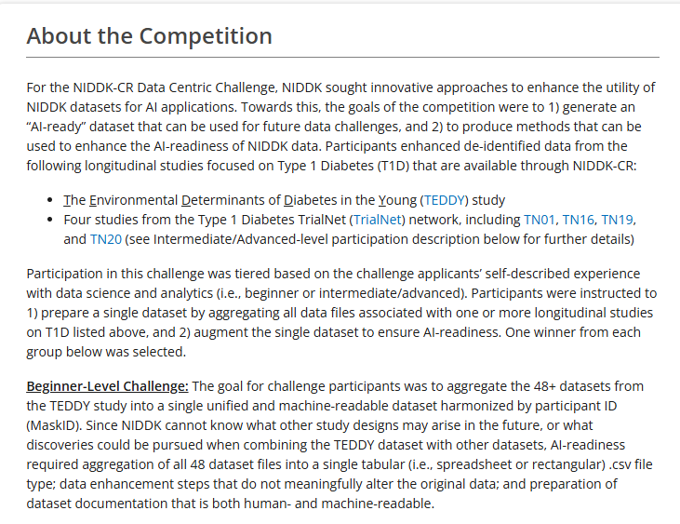
NIDDK AI Challenge
https://repository.niddk.nih.gov/data_challenges/data_centric_challenge/
TEDDY study followed children at-risk for T1D (FDR or high risk HLA allele) to understand the environmental factors that contribute to the disease
Across multiple sites in USA and Europe
Assays performed at different sites (example: CO got grant to assay DNAm, FL RNA-seq data…)
Winners got free access to the AI ready data!

Slide 31






Team Members
Milton Pividori
Marc Subirana Granés
Randi Johnson
Sarah Slack
Kirk Hohsfield
Lauren Vanderlinden

Slide 32
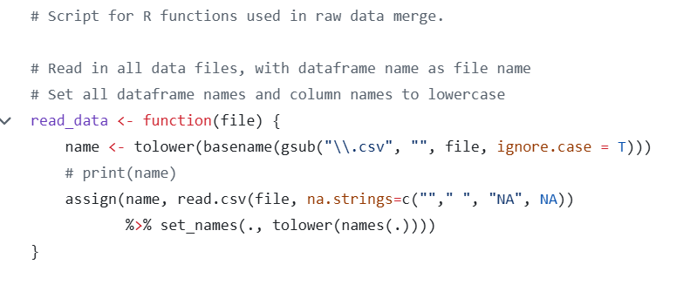
Reading in Data
48 datasets is a LOT
Noticed capitalization was just a mess between datasets
Sometimes “MaskID”, “maskid”, “MASKID”

Slide 33
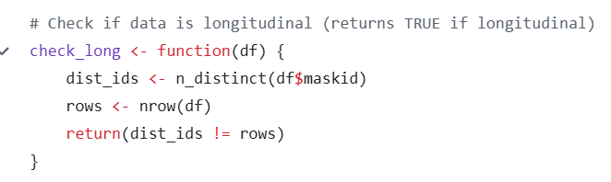
Check if longitudinal data
We know some datasets collected longitudinal data, some didn’t
Really need to know what variable to merge on the cross-sectional datasets did NOT include time variable
For example, some cross-sectional datasets included “at-birth survey”, “9 month survey”

Slide 34
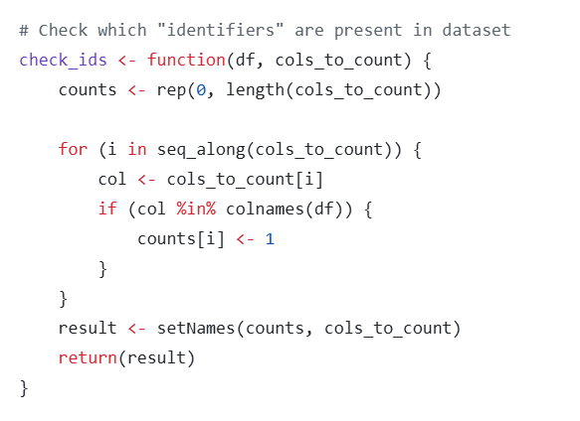
What type of identifier is included?
Maskid was suppose to be the individual id in all datasets
However, in longitudinal datasets there may be different sample id variable names (it was messy…)
This one required lots of “institutional knowledge” of individuals working with TEDDY data before

Slide 35
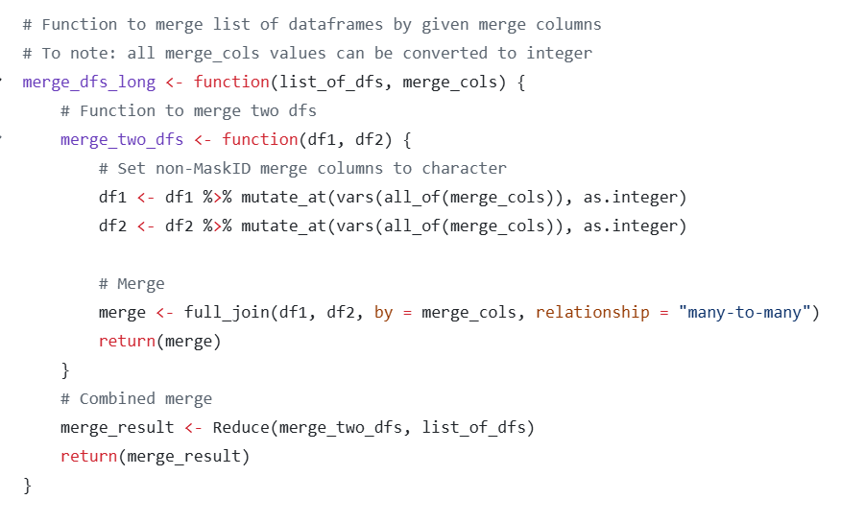
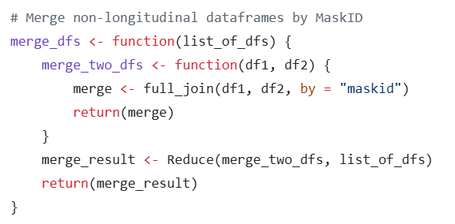
Merge multiple datasets
Longitudinal merge
Cross-sectional merge

Slide 36
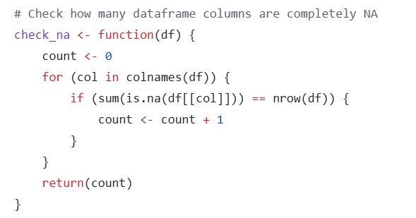
Check bad variables
Any column missing all data was removed
We identified 1 dataset (particular assay) that truly failed and was missing vast majority of their variables. We ended up just removing that dataset entirely

Slide 37
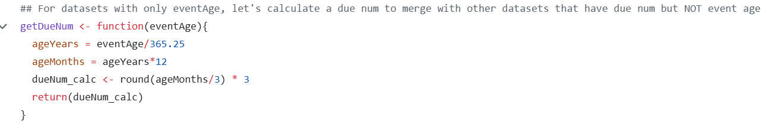
Longitudinal “Time”
TEDDY had set follow-up check points (every 6 months for first 3 years and then annually)
Some longitudinal datasets had “age” and some had “due num” that reflected the visit # that they are suppose to be checked up on

Slide 38
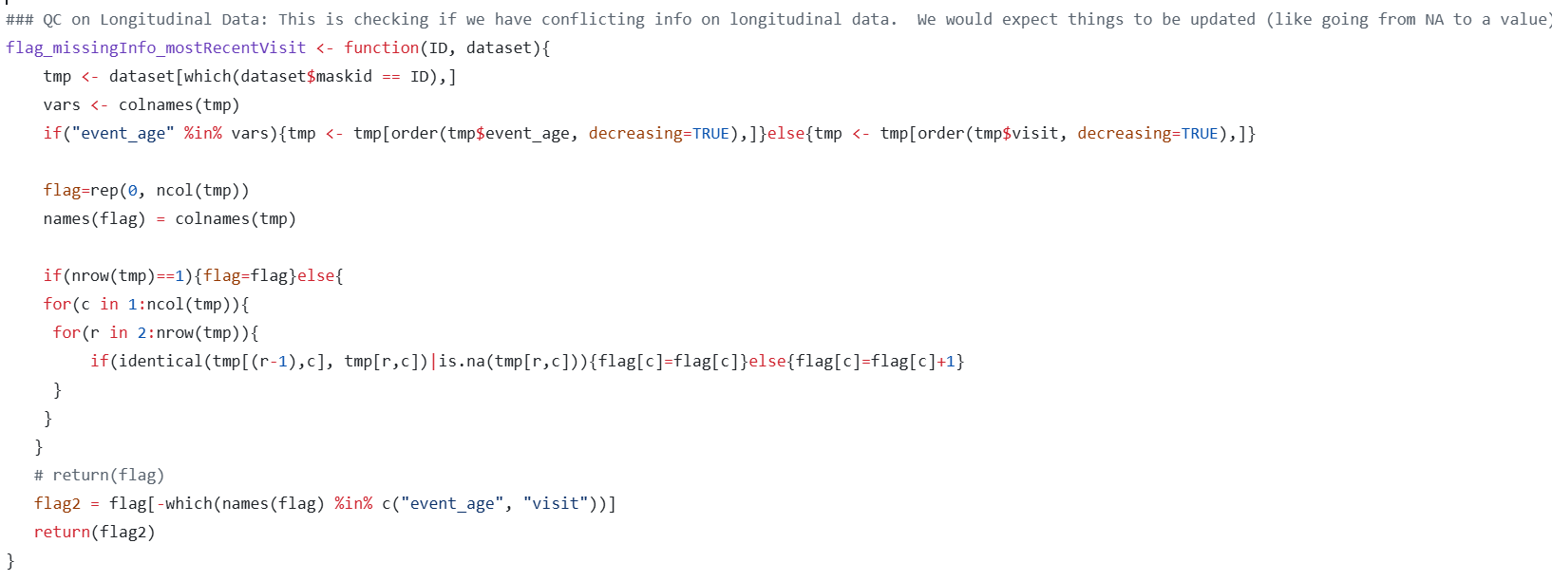
Flagging potential errors

Slide 39
Collapsing down longitudinal
We made the decision most ML doesn’t account for repeated measures, so making data wide and using time as a different variable:
Example
Long format
Wide format
ID | Visit | Gene A
1 | 1 | 100
1 | 2 | 120
2 | 1 | 87
2 | 2 | 65
…
ID | Gene A at Visit 1 | Gene A at Visit 2
1 | 100 | 120
2 | 87 | 65
…

Slide 40
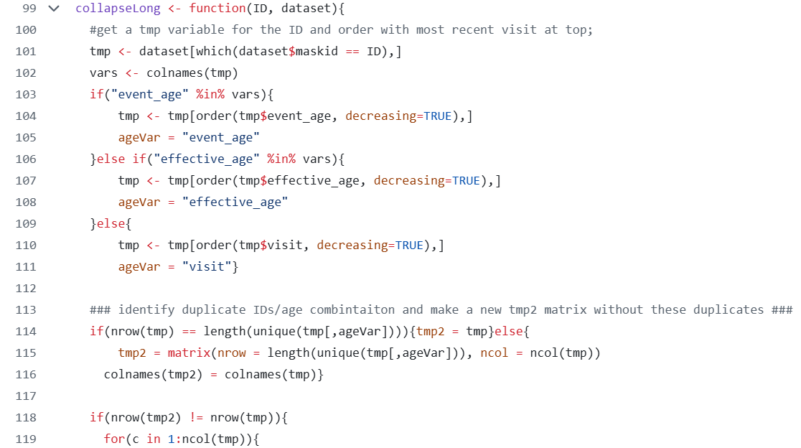

Slide 41
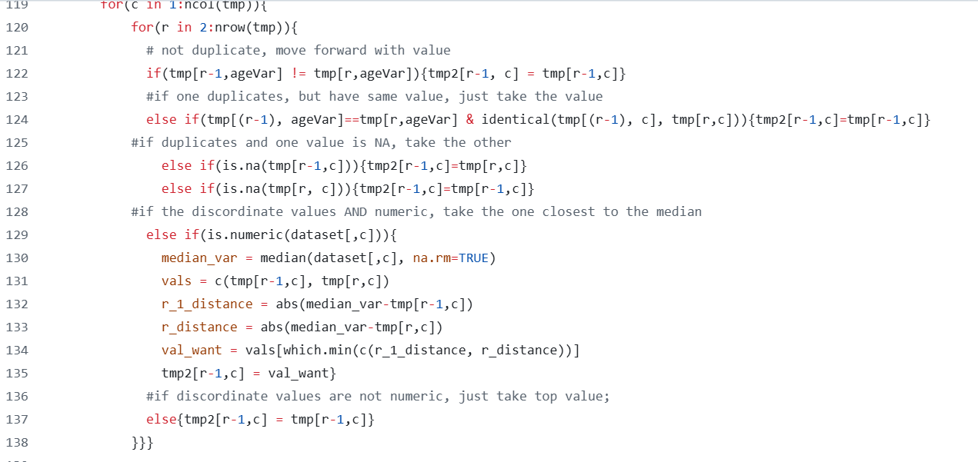

Slide 42
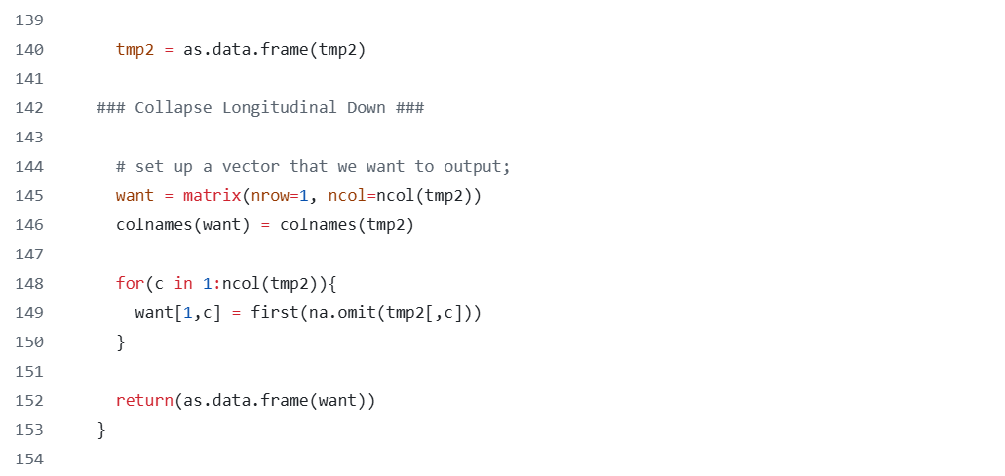

Slide 43
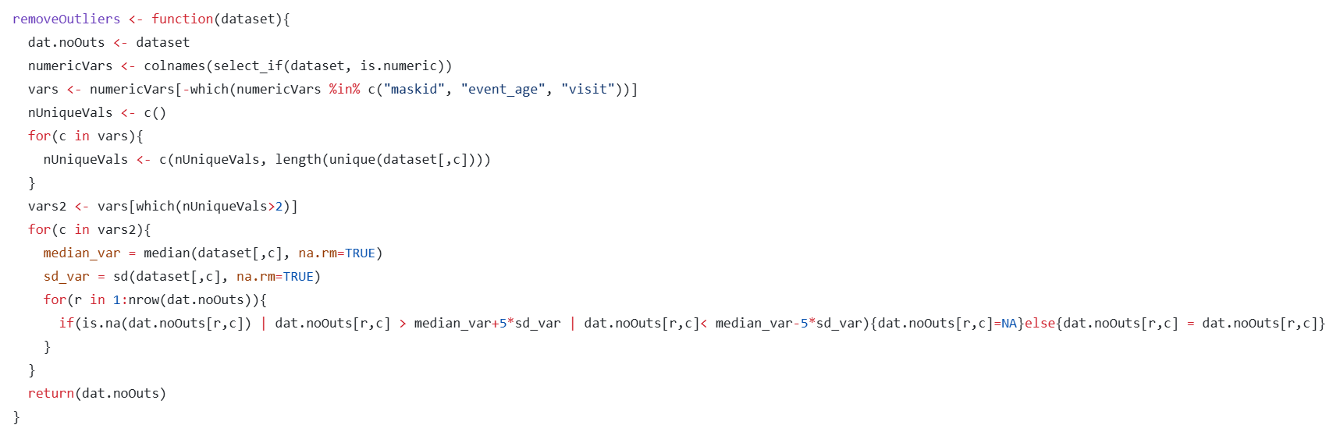
Address Outliers
We called outliers as anything outside 5 standard deviations of the median
We removed those values and replaced with missing

Slide 44
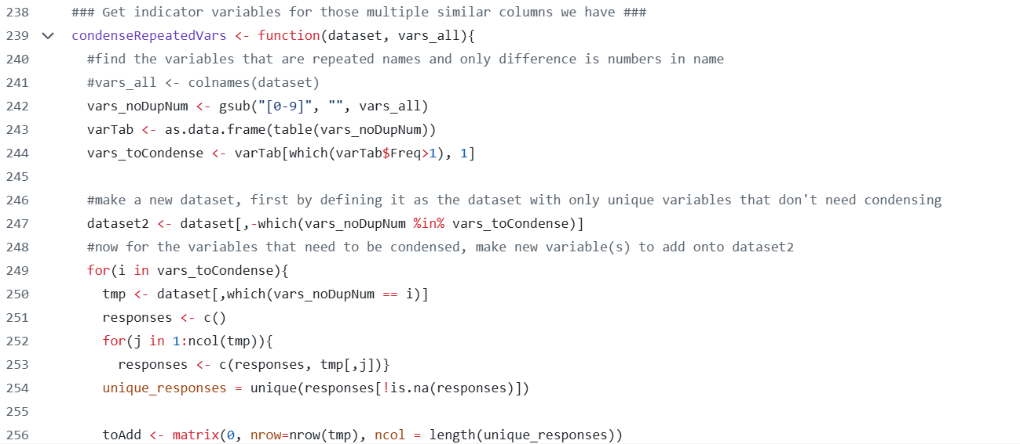
Remove Repeated Variables

Slide 45
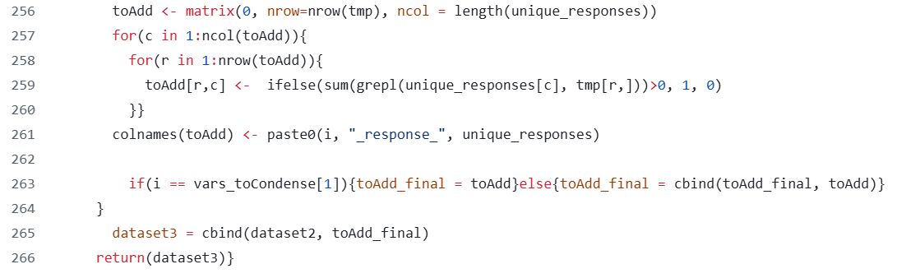

Slide 46
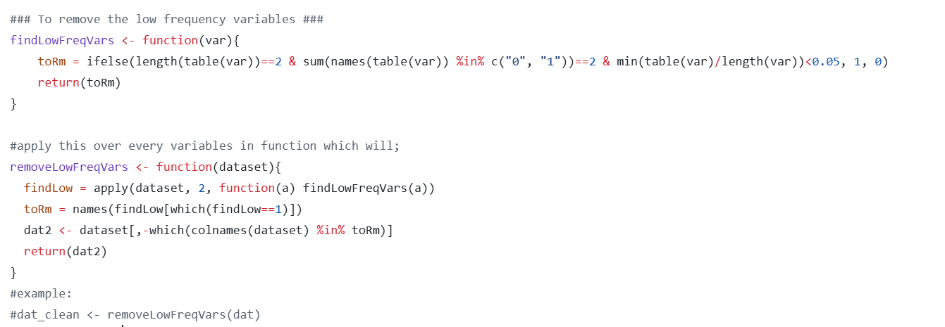
Removing low frequency variables

Slide 47
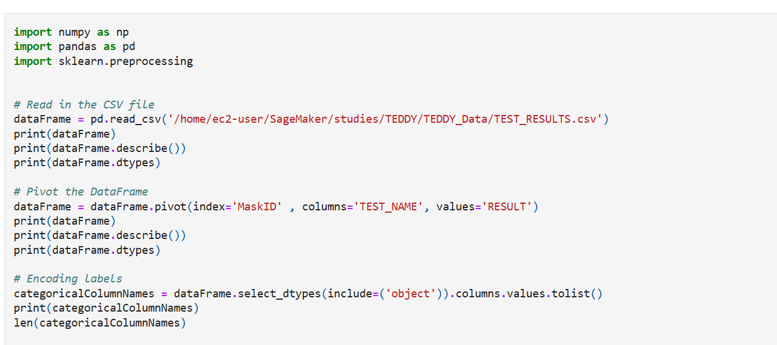
Python code for one-hot encoding

Slide 48
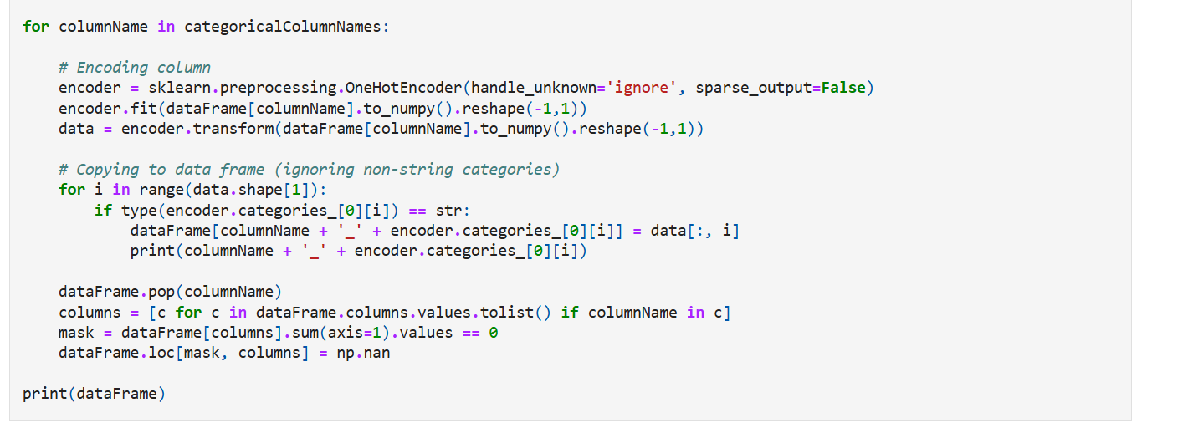

Slide 49
Repositories
The proposal got a perfect score! Just did not pull off the overall win.
We could only access data on the NIDDK workbench and had issues with environments
Also first time we worked together on a project with all of us working on code at the same time, leading to git issues.
Our teams code:
https://github.com/pivlab/niddk-ai-challenge/tree/main
Winner’s code: https://github.com/niddk-data-challenge/Beginner-Level-Challenge-AI-Ready-TEDDY-Dataset

Slide 50
Conclusions
No standard on how to best pre-process data
Examine quality both visually and with summary stats
Missing data is an issue in ML
Examining and pre-processing data can take just as long or even longer than running the statistical analyses itself

