Slide 1
Small RNA Pre-Processing & Normalization
Lauren Vanderlinden
Saba Lab Meeting
11/6/2017

Slide 2
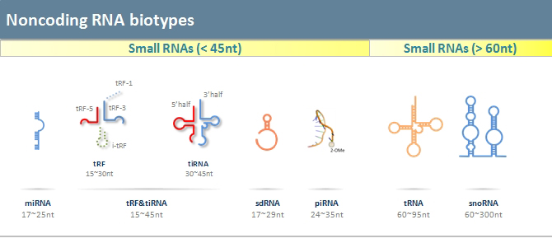
Data
Currently HXB/BXH panel
Will get HDRP 11/17
GOAL: Normalize for PhenoGen 2nd week of December (12/11).
3 types
microRNA: about 22 nucleotides, that functions in RNA silencing and post-transcriptional regulation of gene expression
Small nucleolar RNA: guide chemical modifications (e.g. methylation) to other RNAs (mainly rRNA, tRNA, and snRNA)
Miscellaneous Small RNA
Quantitation: median counts/ base
For the total RNA, we use the expected counts from RSEM algorithm
Focusing on Liver
http://www.arraystar.com/reviews/arraystar-small-rna-profiling/
Type | Number of Features | % of Total smallRNA
miRNA | 1,538 | 73.98%
snoRNA | 378 | 18.18%
miscRNA | 163 | 7.84%
TOTAL | 2,079 | 100%
https://en.wikipedia.org

Slide 3
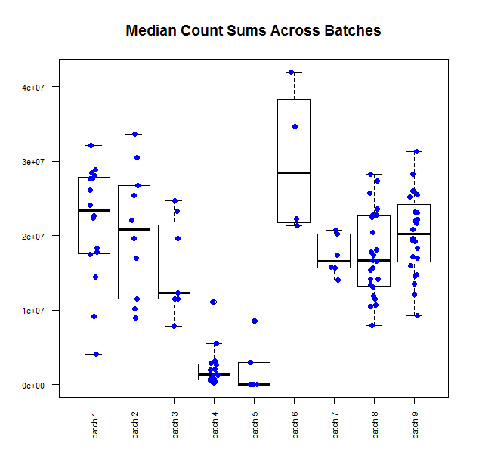
9 batches
31 HXB/BXH strains plus parental strains
Only changed 1 strain ID XXB15 to HXB15
113 unique RNAseq runs
87 unique samples
17 samples with at least 1 technical replicate
Initial Feature Filter (SM):
At least 1 sample needed ≥ 10 median counts
Total Counts Range 0 to ~40 million
Batches 4 & 5 don’t look so great
Decided to remove all technical replicates and only keep the one with the largest library size in the dataset (except for SHR_1)

Slide 4
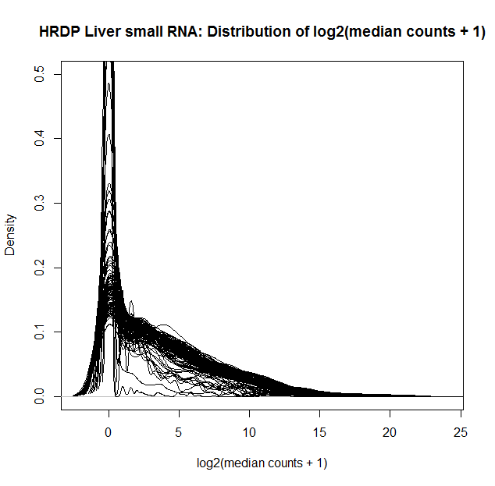
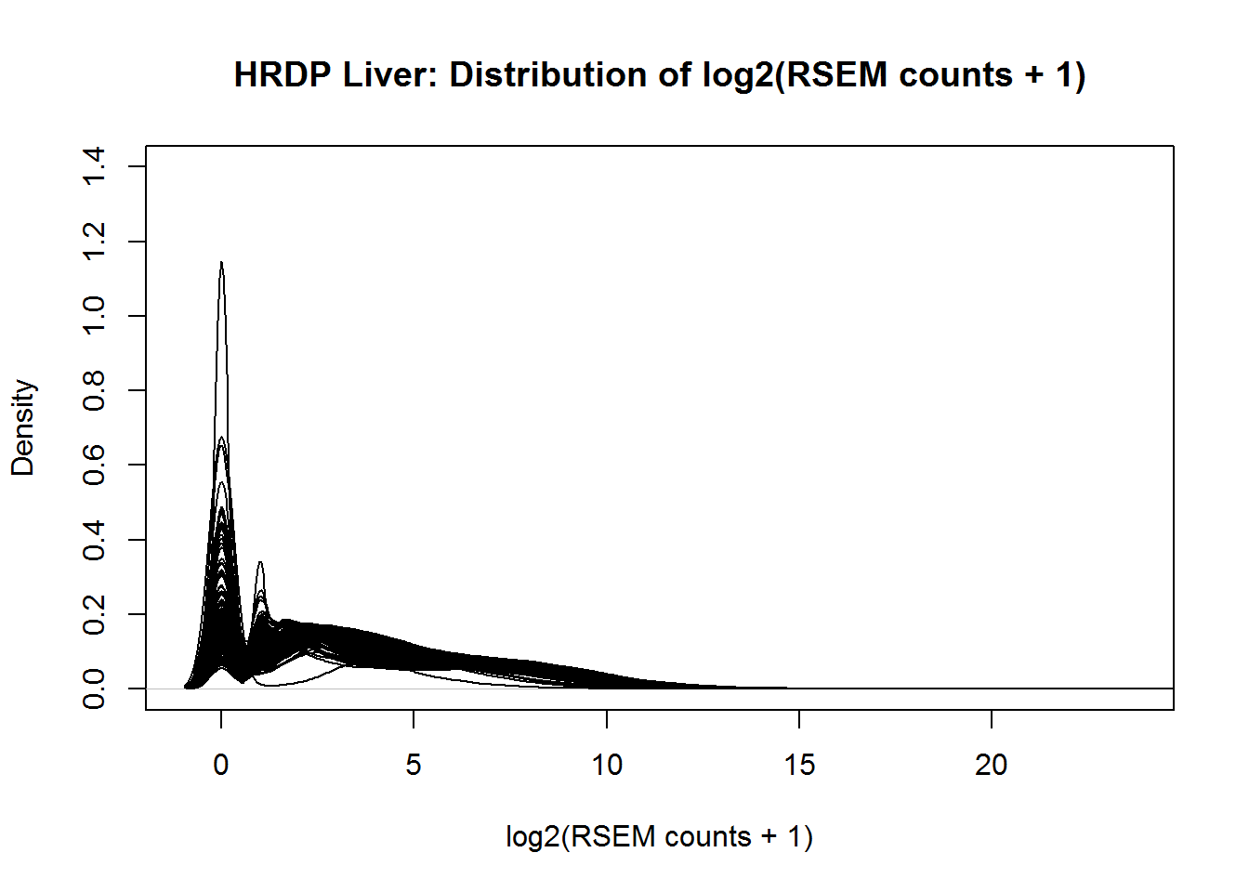
Density Plots
Lots of 0 counts
Ugly…
Comparison: this is the HDRP liver total RNA prior to any cleaning for bad samples

Slide 5
Are counts coming from few highly expressed features?
Sample | Total Median Counts | Top 5 Feature Counts | Top 5 Feature % | Features with 0 Counts | % Features with 0 Counts
HXB9_1_batch5 | 0 | NA | NA | 2,079 | 100%
HXB8_1_batch5 | 0 | NA | NA | 2,079 | 100%
SHR1_1_batch4 | 198,875 | 89,068 | 44.79% | 1,451 | 69.79%
XXB15_1_batch4 | 392,090 | 199,911 | 50.99% | 1,322 | 63.59%
HXB10_1_batch4 | 1,389,538 | 610,791 | 43.96% | 946 | 45.50%
… | … | … | … | … | …
HXB1_1_batch5 | 2,946,665 | 2,768,424 | 93.95% | 1,266 | 60.89%
… | … | … | … | … | …
BXH6_2_batch2 | 33,650,888 | 17,351,645 | 51.56% | 528 | 25.40%
HXB31_1_batch6 | 34,690,140 | 15,905,370 | 45.85% | 555 | 26.70%
BXH2_1_batch6 | 41,983,932 | 19,329,199 | 46.04% | 532 | 25.59%

Slide 6
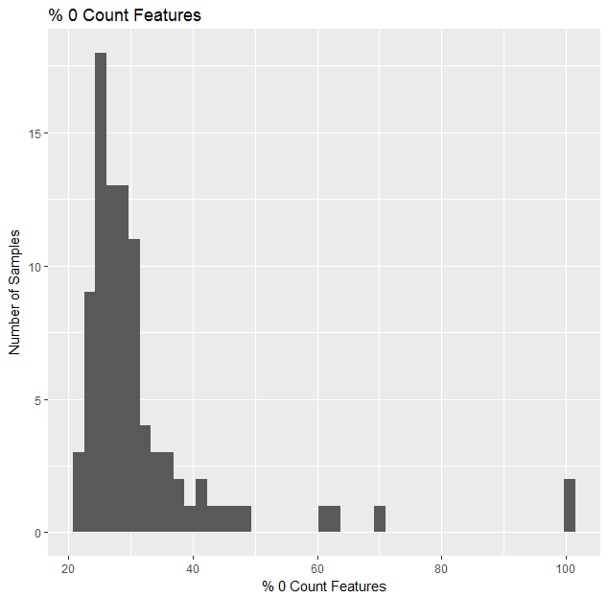
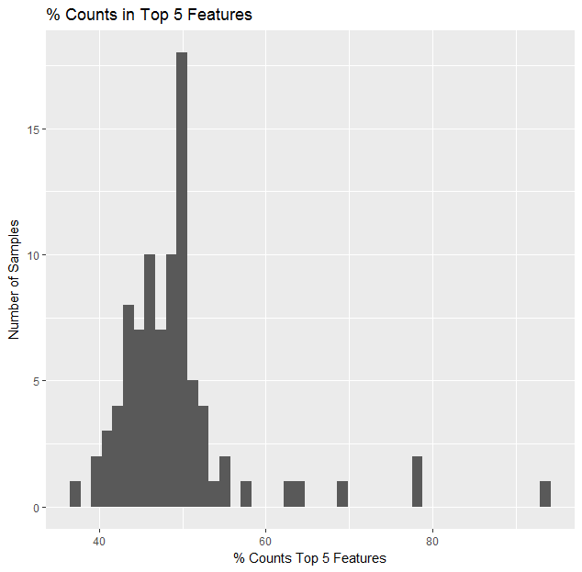
Examine 0 counts & top 5 features
Should we be doing more sample filtering? Already went from 113 to 89 with technical reps and those 2 bad samples with 0 counts
There are 21 unique Top5 features for the 89 samples

Slide 7
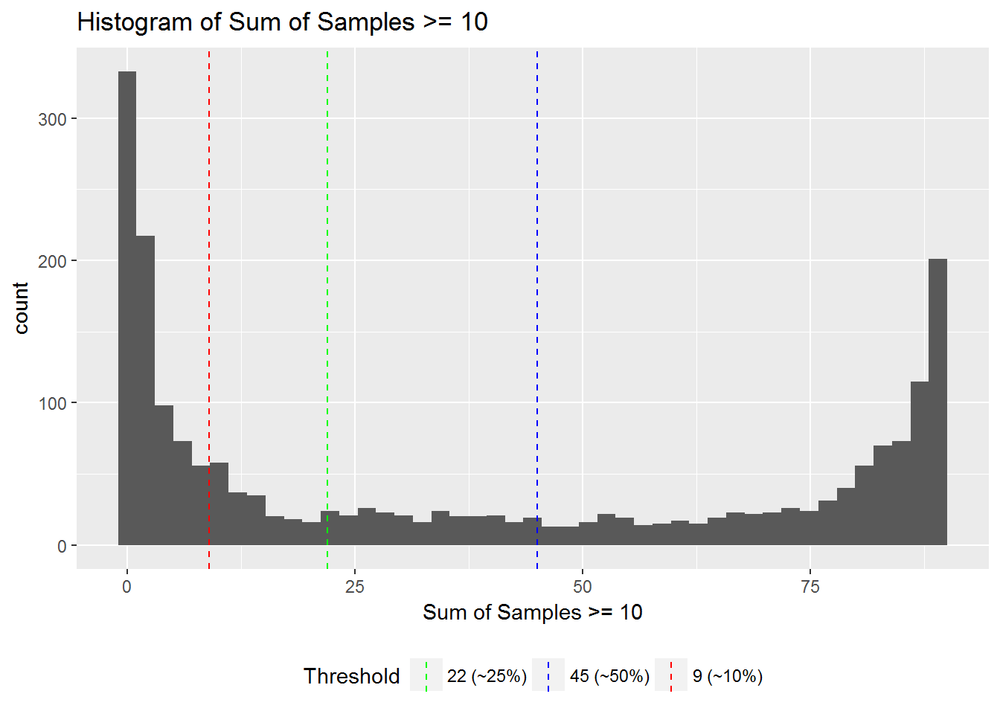
Detection Above Background Filtering
Spencer already performed each filter needed at least 1 sample ≥ 10 median counts
To consider a feature “present”, it needs at least a median count ≥ 10
But we removed some samples, so need to re-evaluate
Decided to go with a 50% of samples need to be present to keep the feature in the dataset
Leaves us with 875 features

Slide 8
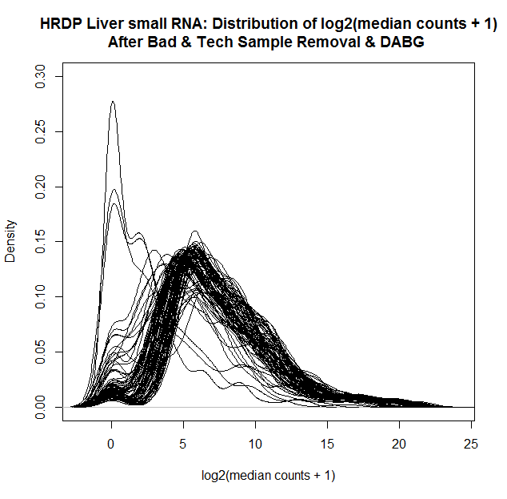
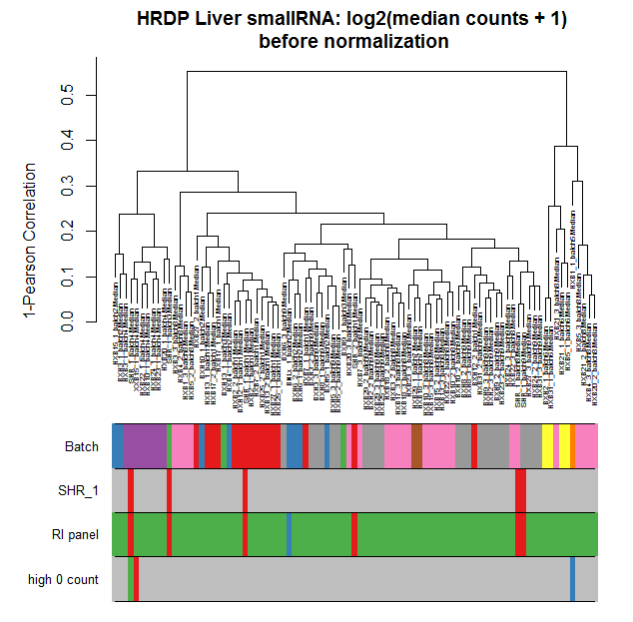
Visualize Data After Cleaning
Thought about removing the 3 that have high 0 counts:
Not clear outliers on dendrogram
Not all on the bottom of total median counts
Is number of features with 0 counts good enough?
Keeping in for now
Notes:
The 3 samples that have high 0 counts are
XXB15_1_batch4 : 259 0 counts
HXB1_1_batch5: 300 0 counts
SHR_1_batch4: 331 0 counts
Sample with next highest 0 counts is HXB5_3_batch8 with 113 0 counts

Slide 9
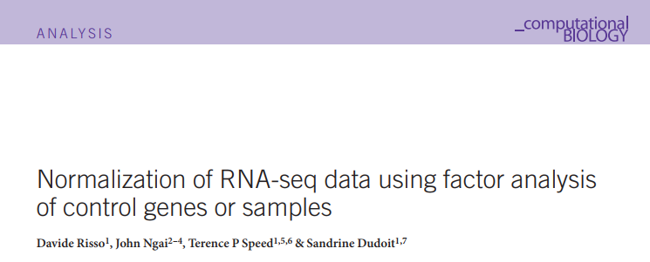

Normalization using RUV
μ = n x J matrix of observed counts
W = n x k matrix of factors corresponding to “unwanted variation”
α = k x J matrix of nuisance parameters
X = n x p matrix of p covariates of interest
β = p x J matrix of parameters of interest
O = n x J matrix of offsets
The simultaneous estimation of W, α, β, and k is infeasible.
You set the number of nuisance parameters (k) you want to model
Why not use raw data?
Between-sample distribution differences
Total counts
Within-sample gene-specific effects
Gene length
GC-content
Batch effects
RUV using empirical control genes
Type of factor analysis
GLM where RNA-Seq counts regressed on both known covariates (strain) and unknown factors (technical issues)
$\log{μ=Xβ+Wα+O}$
Notes:
Between-sample read coverage:
If 2 samples are exact sample, and 1 has 10 million depth and other 20 million, everything will have a fold-change of 2.
Factor Analysis is a method for modeling observed variables, and their covariance structure, in terms of a smaller number of underlying unobservable (latent) “factors.” The factors typically are viewed as broad concepts or ideas that may describe an observed phenomenon.

Slide 10
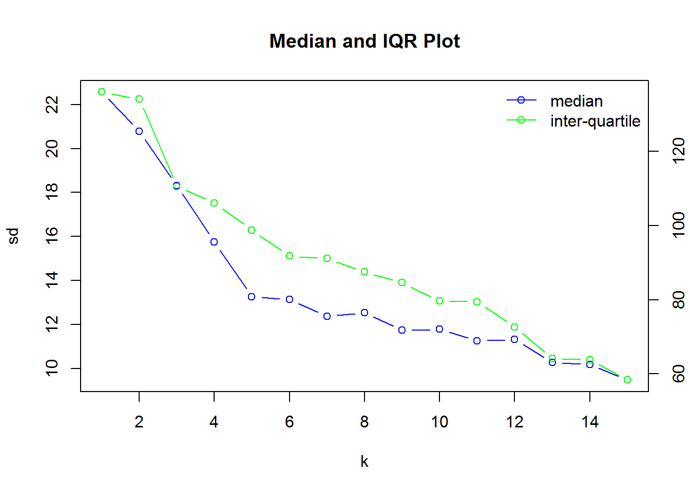
Normalization using RUV continued…
For a given k, use negative control genes which we assume have constant expression across all samples to estimate the factors of unwanted variation W
We generate a list of “in-silico empirical” negative control genes by taking the least significant differentially expressed genes based on a first-pass analysis
First, get control genes
I used the lowest quintile of results, 175 genes
lowest unadjusted p-value = 0.505 & FDR = 0.631
Second, find what k we want

Slide 11
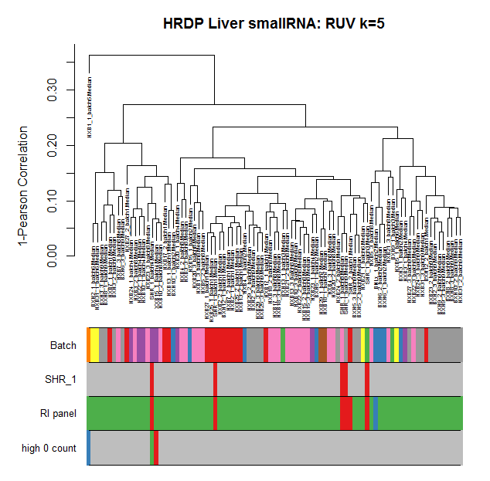
Dendrogram pre- and post-RUV (k=5)

Slide 12

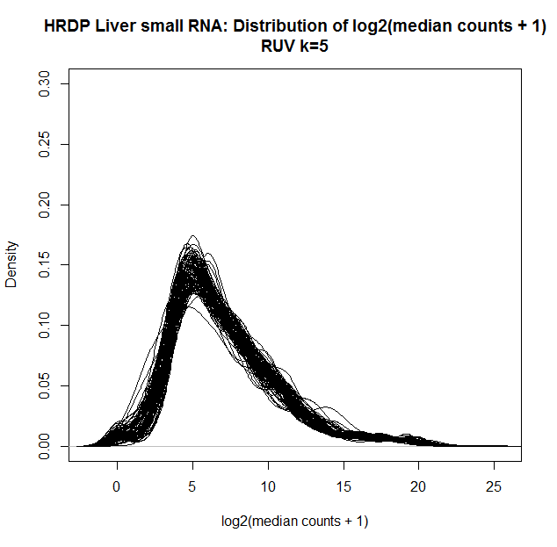
Density plots pre- and post- RUV (k=5)

Slide 13
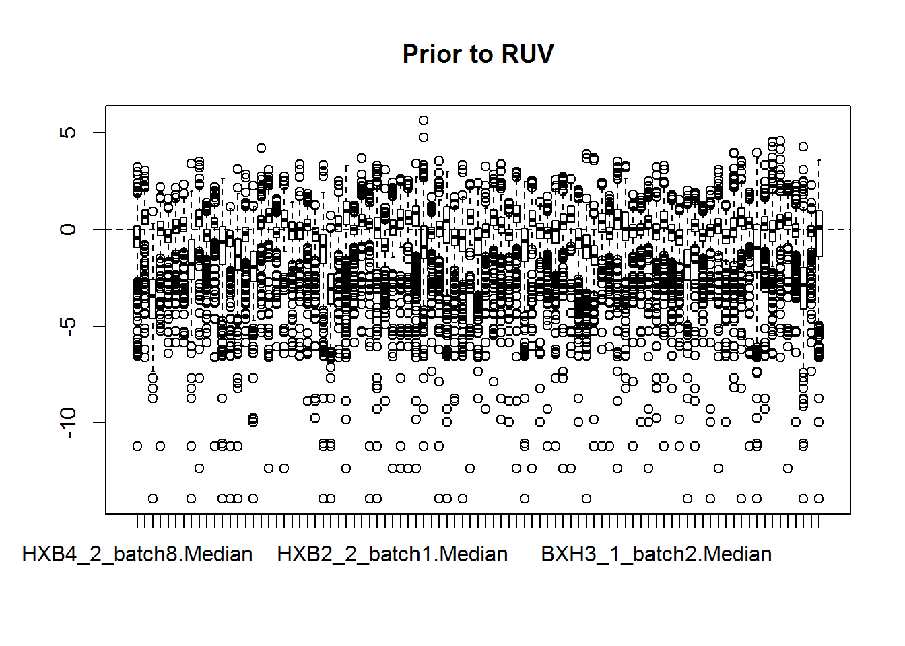
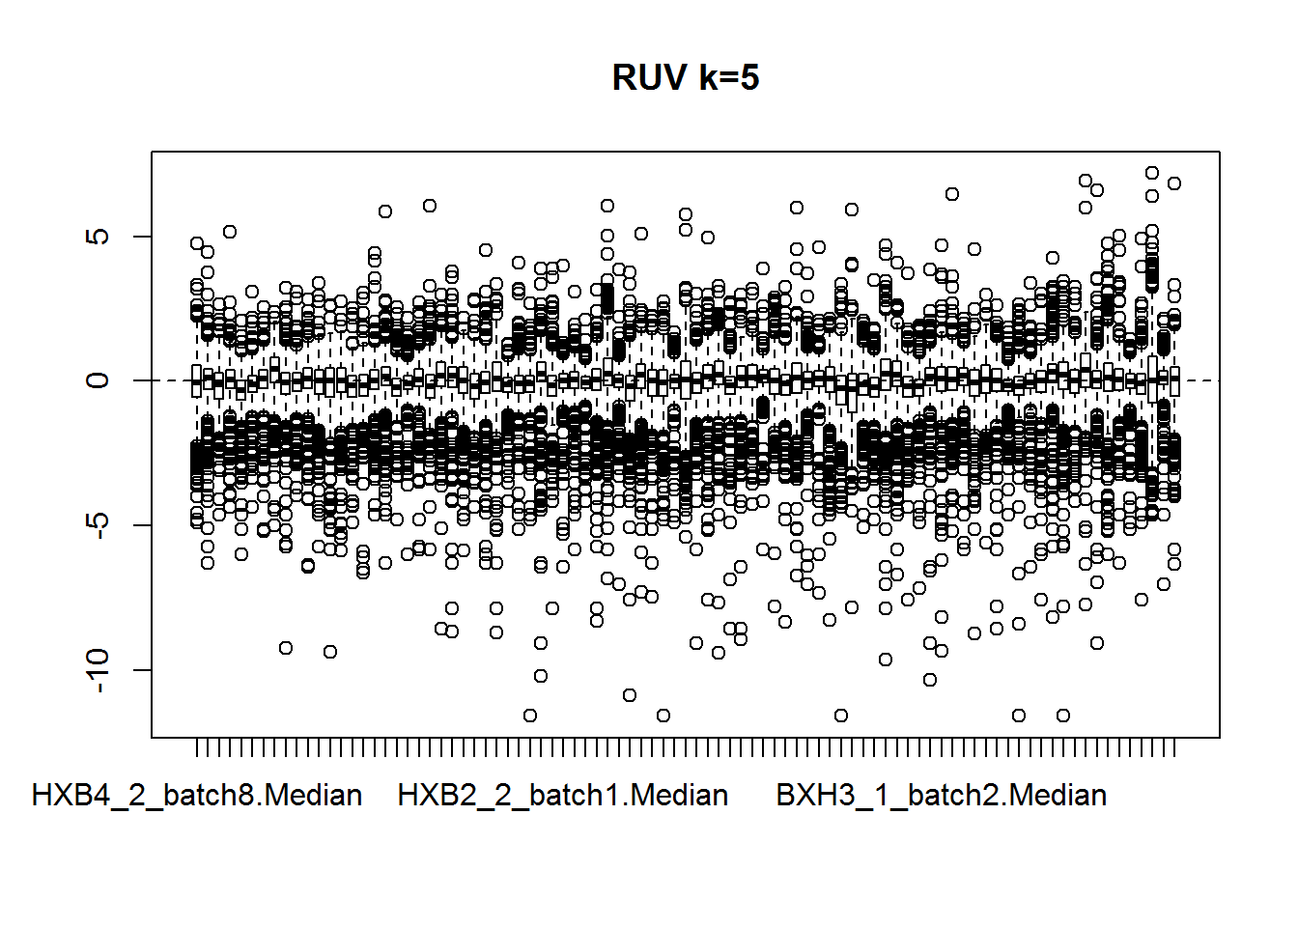
RLE plots pre- and post- RUV (k=5)

Slide 14
What is happening to the 0 counts heavy samples?
Sample | Features with 0 Counts | % Features with 0 Counts | RUV Features with 0 Counts | % RUV Features with 0 Counts
SHR1_1_batch4 | 331 | 37.83% | 1 | 0.11%
HXB1_1_batch5 | 300 | 34.29% | 1 | 0.11%
XXB15_1_batch4 | 259 | 29.60% | 2 | 0.23%
HXB5_3_batch8 | 113 | 12.91% | 3 | 0.34%
HXB23_1_batch4 | 103 | 11.77% | 1 | 0.11%
… | … | … | … | …
BXH13_1_batch3 | 12 | 1.37% | 8 | 0.91%
BXH9_2_batch9 | 10 | 1.14% | 10 | 1.14%
HXB13_2_batch1 | 10 | 1.14% | 7 | 0.8%
HXB7_1_batch1 | 10 | 1.14% | 9 | 1.03%

Slide 15
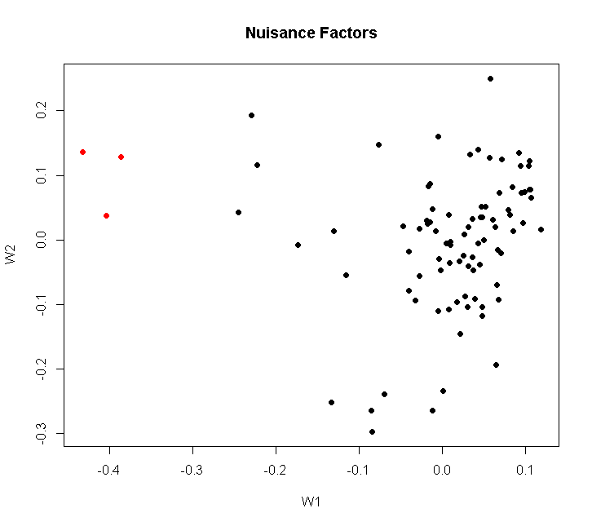
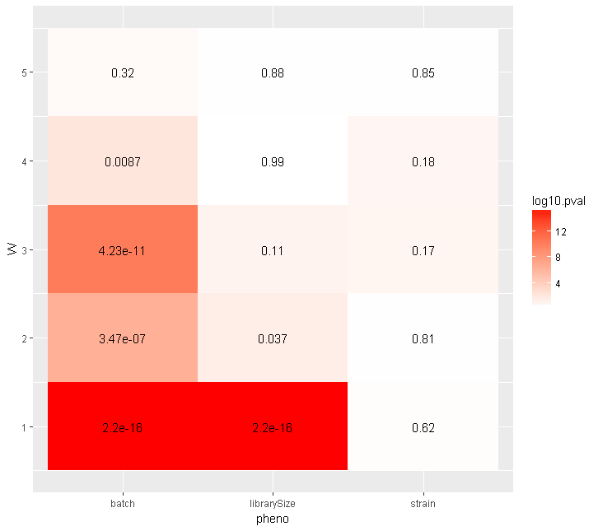
Examine Nuisance Factors

Slide 16
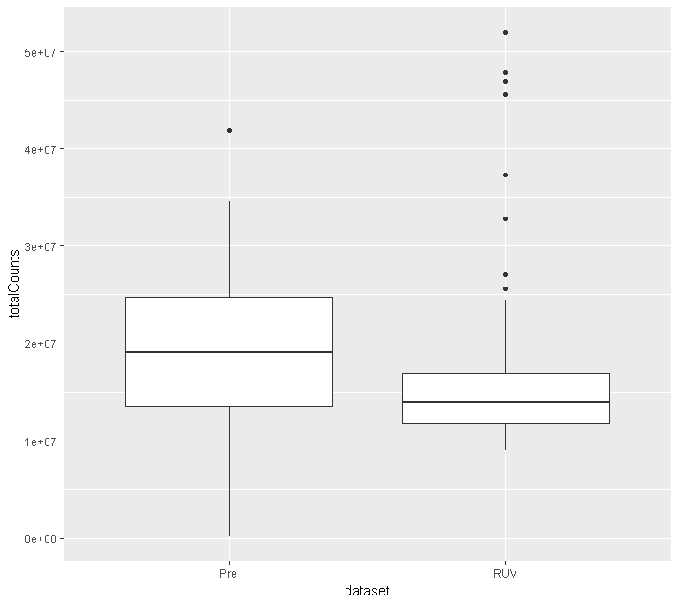
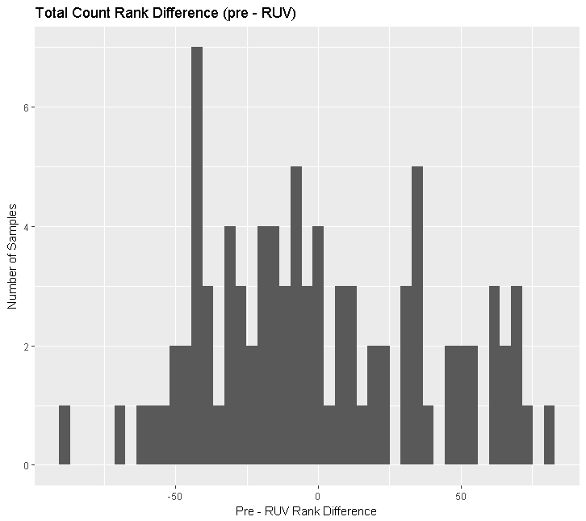
Total Counts Pre- and Post- RUV

Slide 17
Concerning?
Only 1 sample did not change rank.
Largest change in rank was sample HXB21_2_batch8 went from rank 88 to 5!

Slide 18
Remove Low Total Count Samples
Remove any sample < 3 million
Removes 6 samples
Remove any sample < 10 million
Removes 12 samples

