Slide 1
Multiple Testing Correction
CIDA Project Meeting
January 30, 2018

Slide 2
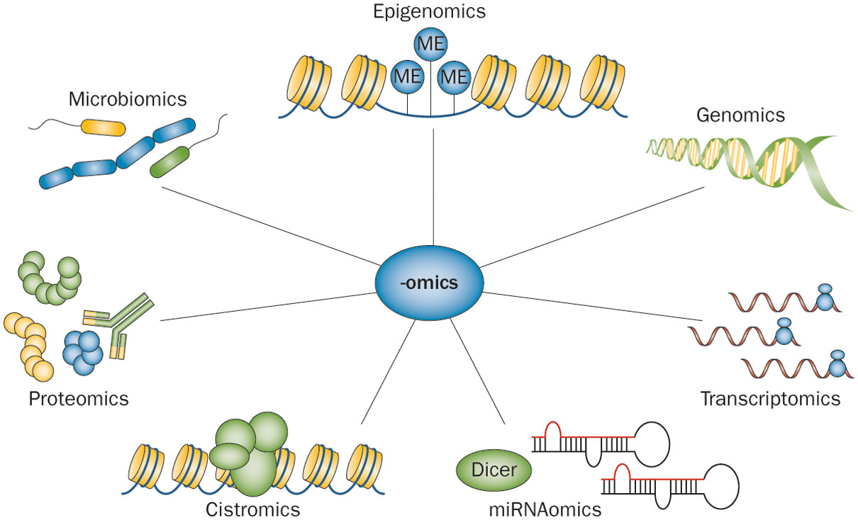
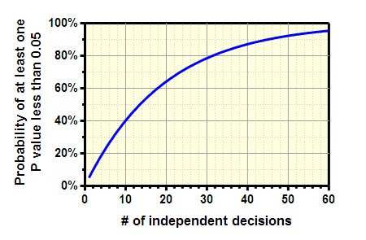
High Throughput Technologies (-omics data) & Multiple Testing Issue
High throughput technologies produce a large amount of data
DNA SNP array: 1 million markers
Gene Expression: 45,000 probesets or transcripts
Methylation Array: 850,000 probes
If you test several independent null hypotheses and leave the threshold at 0.05 for each comparison, the chance of obtaining at least one “statistically significant” result is greater than 5% (even if all null hypotheses are true).
10,000 tests and leave alpha = 0.05 you would expect 500 false positive results (Yikes!)
Normally False Positives aren’t an issue, but with omics data this is a huge issue
http://www.nature.com/nrgastro/journal/v11/n1/fig_tab/nrgastro.2013.150_F2.html

Slide 3
Multiple Testing Correction Methods
Bonferroni¹
Take the p-value and multiple by n total tests
Most conservative and considered too conservative
False Discovery Rate (FDR)
Benjamini-Hochberg Method²
Both methods “adjust” p-values (i.e. make them larger)
Assuming all tests are independent
We know this is not true in a biological system
Bonferroni, C. E., (1936) Teoria statistica delle classi e calcolo delle probabilità, Pubblicazioni del R Istituto Superiore di Scienze Economiche e Commerciali di Firenze
2. Benjamini, Yoav; Hochberg, Yosef (1995). "Controlling the false discovery rate: a practical and powerful approach to multiple testing". Journal of the Royal Statistical Society, Series B. 57 (1): 289–300.

Slide 4
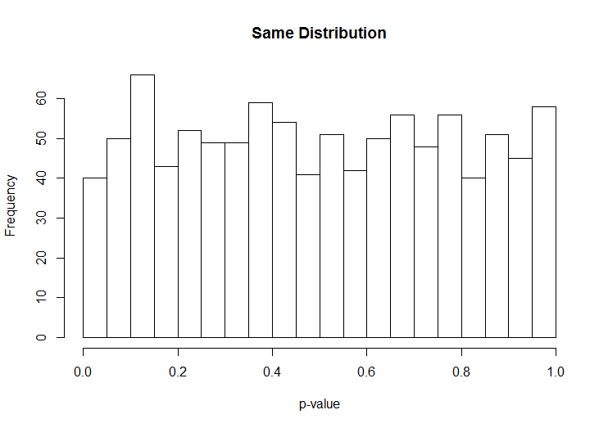
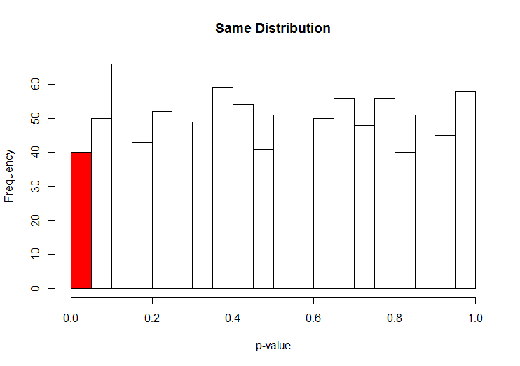
Distribution of p-values in Null Hypothesis
False Positives
Basic 2-group comparison
T-test
Took random 4 samples from same distribution
Normal (mean = 1, sd = 1)
Looking at 1,000 tests
Histogram of p-values: Looks very uniform
Equal probability a test p-value falls into any 1 of these bins
Expect 50 false positives by chance
My example got 40 false positives

Slide 5
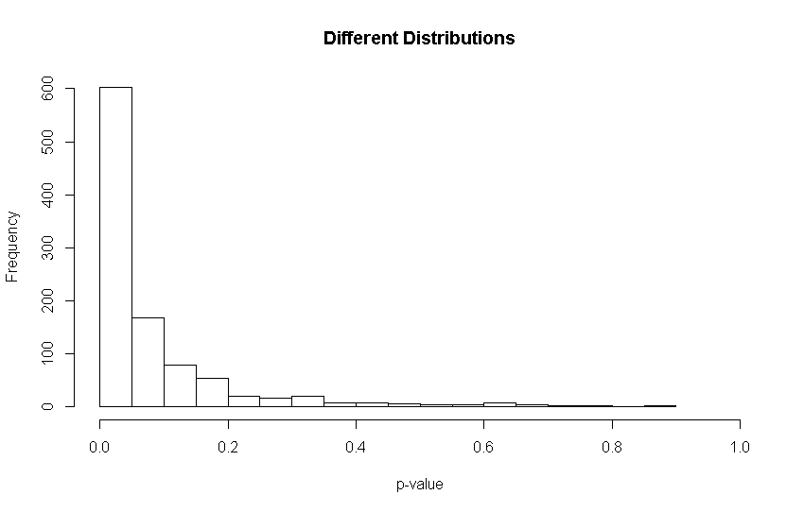
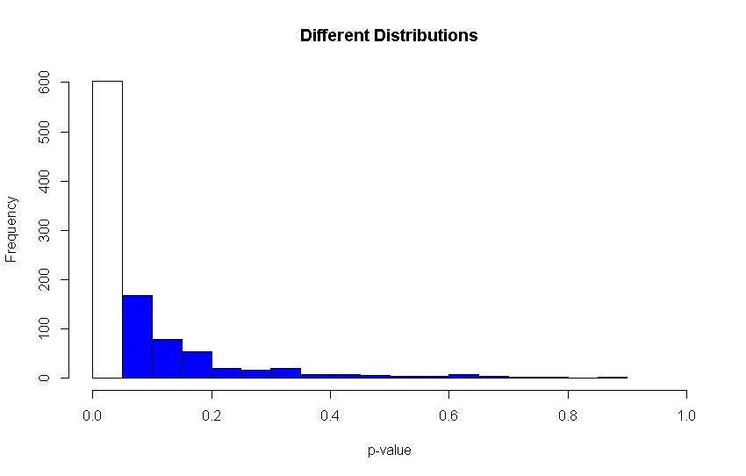
Distribution of p-values from different distributions
Basic 2-group comparison
T-test
Took random 4 samples from 2 different distributions
Normal (mean = 1, sd = 1)
Normal (mean = 3, sd = 1)
Looking at 1,000 tests
Histogram of p-values: Heavily skewed towards 0
False Negatives

Slide 6
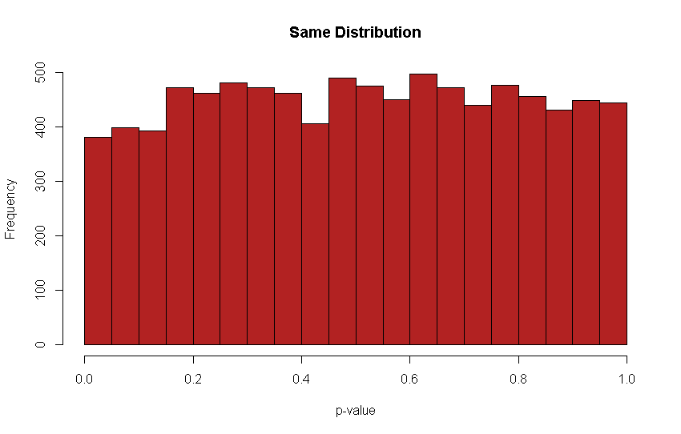
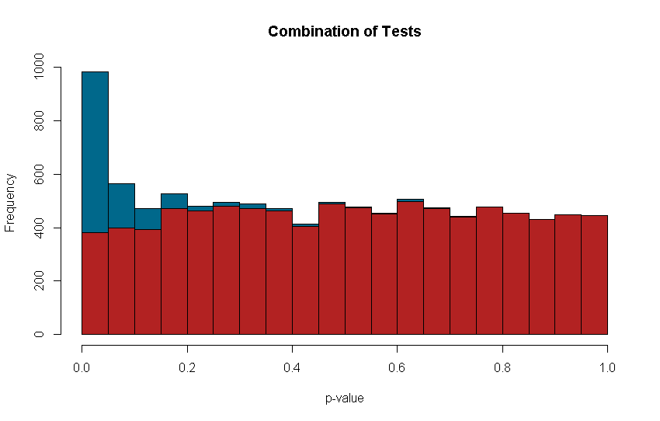
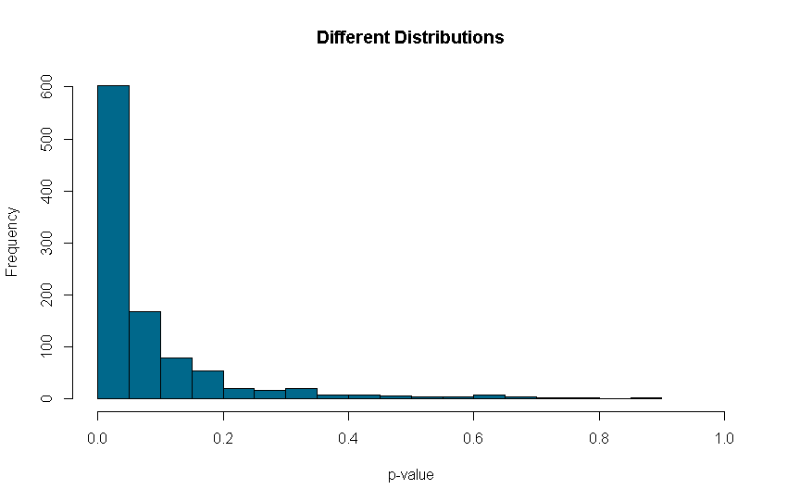
Realistic Distribution of p-values
In a study, you will have some features effected and some not
For example, you are testing 10,000 genes in a treated vs control study
9,000 genes are not effected by treatment
9,000 p-values coming from same distribution
1,000 genes are effected by treatment
1,000 p-values coming from 2 different distributions

Slide 7
FDR Estimates Uniform Background
Tries to estimate a uniform background based on high p-values
For our example here, about 450
Extend this line out to the lower p-values
At the <0.05 bin, we have about 550 above the dotted line
How to sort out significant bin?
Take the smallest 550 p-values
Makes sense because of skewness seen in the true different p-value histogram
Still will expect 5% false positives because not all true positive will be extremely small

Slide 8

Mathematical Model
Rank p-values (say 10 from uniform distribution of p-values)
Largest p-value is the same
Moving down in descending rank, FDR the smallest option of
$pvalue∗\frac{\# Tests}{\# Tests −rank}$
FDR for previous rank (rank + 1)
For the 9th rank p-value:
0.81 * (10/9) = 0.90
Since 0.90 < 0.91, the FDR = 0.90
Keep moving down the rank….
p-value | 0.01 | 0.11 | 0.21 | 0.31 | 0.41 | 0.51 | 0.61 | 0.71 | 0.81 | 0.91
rank | 1 | 2 | 3 | 4 | 5 | 6 | 7 | 8 | 9 | 10
FDR |  |  |  |  |  |  |  |  |  | 0.91
p-value | 0.01 | 0.11 | 0.21 | 0.31 | 0.41 | 0.51 | 0.61 | 0.71 | 0.81 | 0.91
rank | 1 | 2 | 3 | 4 | 5 | 6 | 7 | 8 | 9 | 10
FDR | 0.10 | 0.55 | 0.70 | 0.77 | 0.82 | 0.85 | 0.87 | 0.89 | 0.90 | 0.91
p-value | 0.01 | 0.11 | 0.21 | 0.31 | 0.41 | 0.51 | 0.61 | 0.71 | 0.81 | 0.91
rank | 1 | 2 | 3 | 4 | 5 | 6 | 7 | 8 | 9 | 10
FDR |  |  |  |  |  |  |  |  | 0.90 | 0.91

Slide 9
Challenges
Even though less conservative than Bonferroni, still considering all tests are independent from one another. In biological system we know this is not the case.
Makes power calculations difficult. Most times in grants we say “using an alpha level of 5e-06, which is a 0.05 p-value Bonferroni adjusted for 10K tests…” and mention that this is a conservative estimate of power since we will be doing FDR, not Bonferroni in the analysis plan.
p-value | 0.01 | 0.11 | 0.21 | 0.31 | 0.41 | 0.51 | 0.61 | 0.71 | 0.81 | 0.91
rank | 1 | 2 | 3 | 4 | 5 | 6 | 7 | 8 | 9 | 10
FDR | 0.10 | 0.55 | 0.70 | 0.77 | 0.82 | 0.85 | 0.87 | 0.89 | 0.90 | 0.91
Bonferroni | 0.10 | 1.0 | 1.0 | 1.0 | 1.0 | 1.0 | 1.0 | 1.0 | 1.0 | 1.0

Slide 10
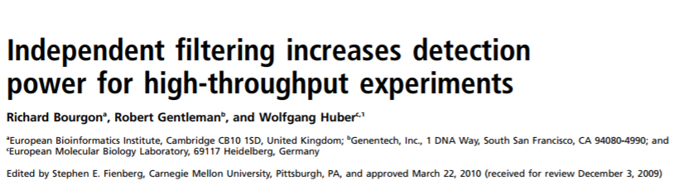
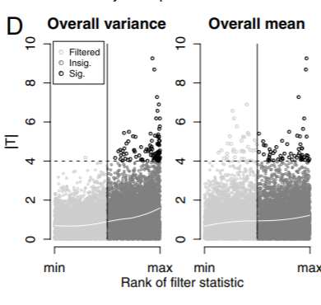
Independent Filtering
DESeq2 is a package to analyze RNASeq data.
Uses negative binomial GLM
Default method in their analysis is to use this independent filtering
Example of 2x2 design:
15,127 genes
4,681 filtered out prior to multiple testing correction
Suppose to optimize the number of adjusted p-value less than a critical alpha level (default = 0.1). In the DESeq2 manual it says the mean (regardless of group) of the normalized counts is used as a filter, but the paper mentions also filtering on overall variance as if you used just the mean you would loose a lot of significant results.

Slide 11
Thanks!
https://www.youtube.com/watch?v=K8LQSvtjcEo

