Slide 1
P30 Work On HRDP
Saba Lab Meeting
April 16, 2018

Slide 2
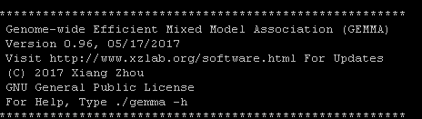
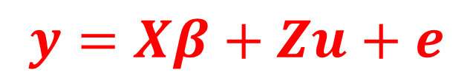

Expression QTLs Using GEMMA
Previously looking for new method for calculating qtl’s.
GEMMA is what people in TN using
Solves Population Stratification:
Confounding by ethnicity
Non-random mating between groups
Can run multivariate models
Uses a mixed model with a kinship matrix is used as a random effect
Data inputted as PLINK or BIMBAM format
$$y=Xβ+Zu+e$$
$$Var\left(u\right)=σ_{g}^{2} K$$
K is the t x t kinship matrix inferred from genotypes
Notes:
Confounding by ethnicity
Differences in allele frequencies due to differences in ancestry rather than association of genes with disease
Non-random mating between groups
Different relationships between each combination of strain (admixture)
True for the HRDP
In humans, physical separation (say African vs European descent)
Genetic drift of allele frequencies in each group

Slide 3
STAR Consortium Marker Set
SNP information on 20,283 markers & 466 strains
BLATed probes and those with 100% match to RN6 and unique kept
19,391 markers
Kinship matrix calculated on the cleaned 19,391 markers
For BIMBAM format, your genotype needs to be a continuous number between 0 and 2
Filter On Missing and Heterozygous | # Markers | # Markers If F344-NHsd is removed
Remove markers missing or heterozygous 5% strains (3 or more strains for HRDP) | 16,399 | 17,675
Remove markers with any missing or heterozygous | 6,561 | 11,407

Slide 4
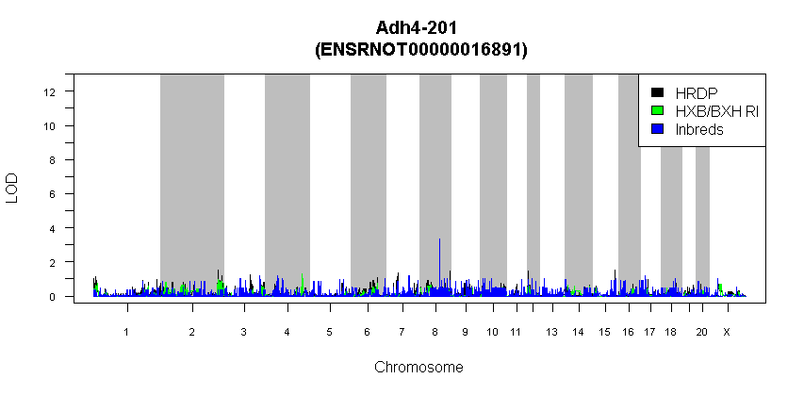
Adh4 eQTL
Expecting a HUGE peak on chromosome 2. What happened?

Slide 5
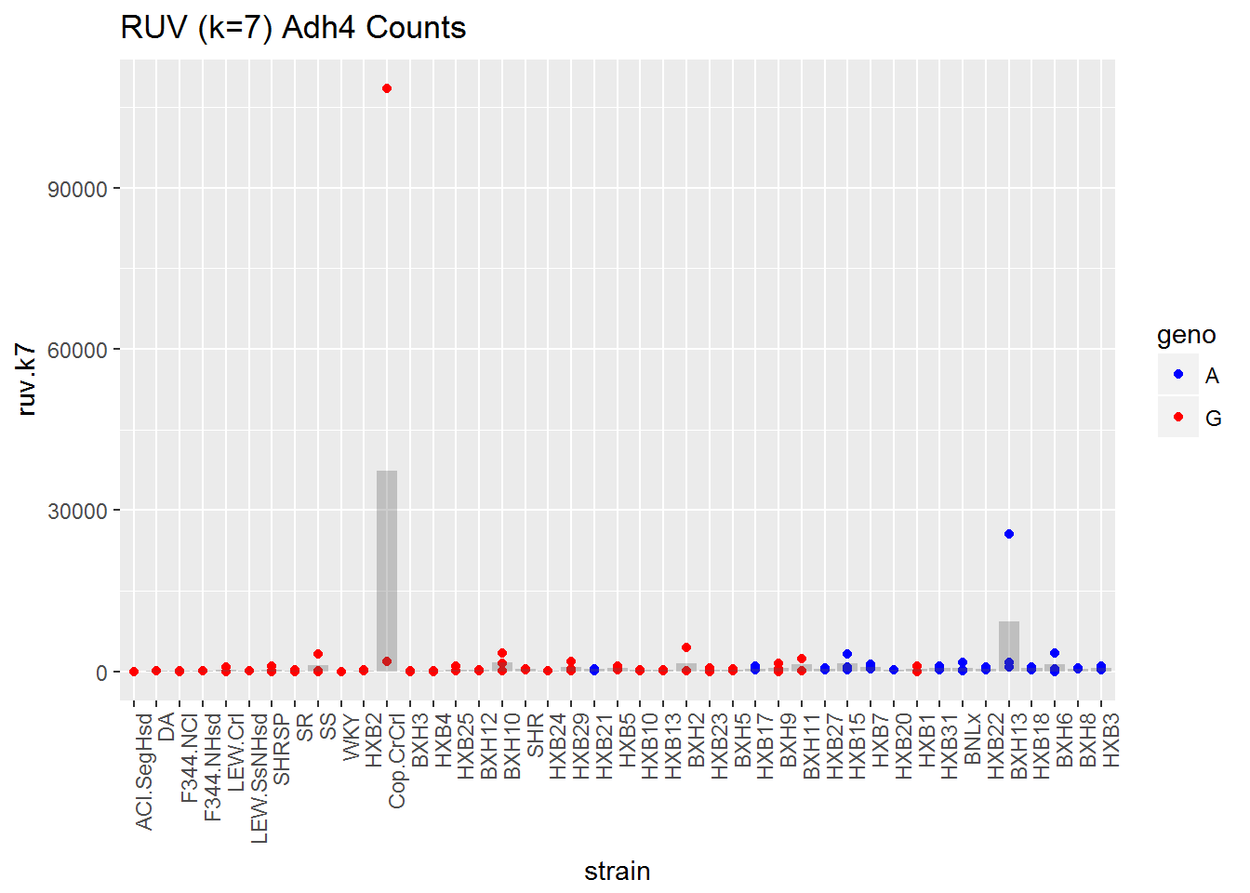
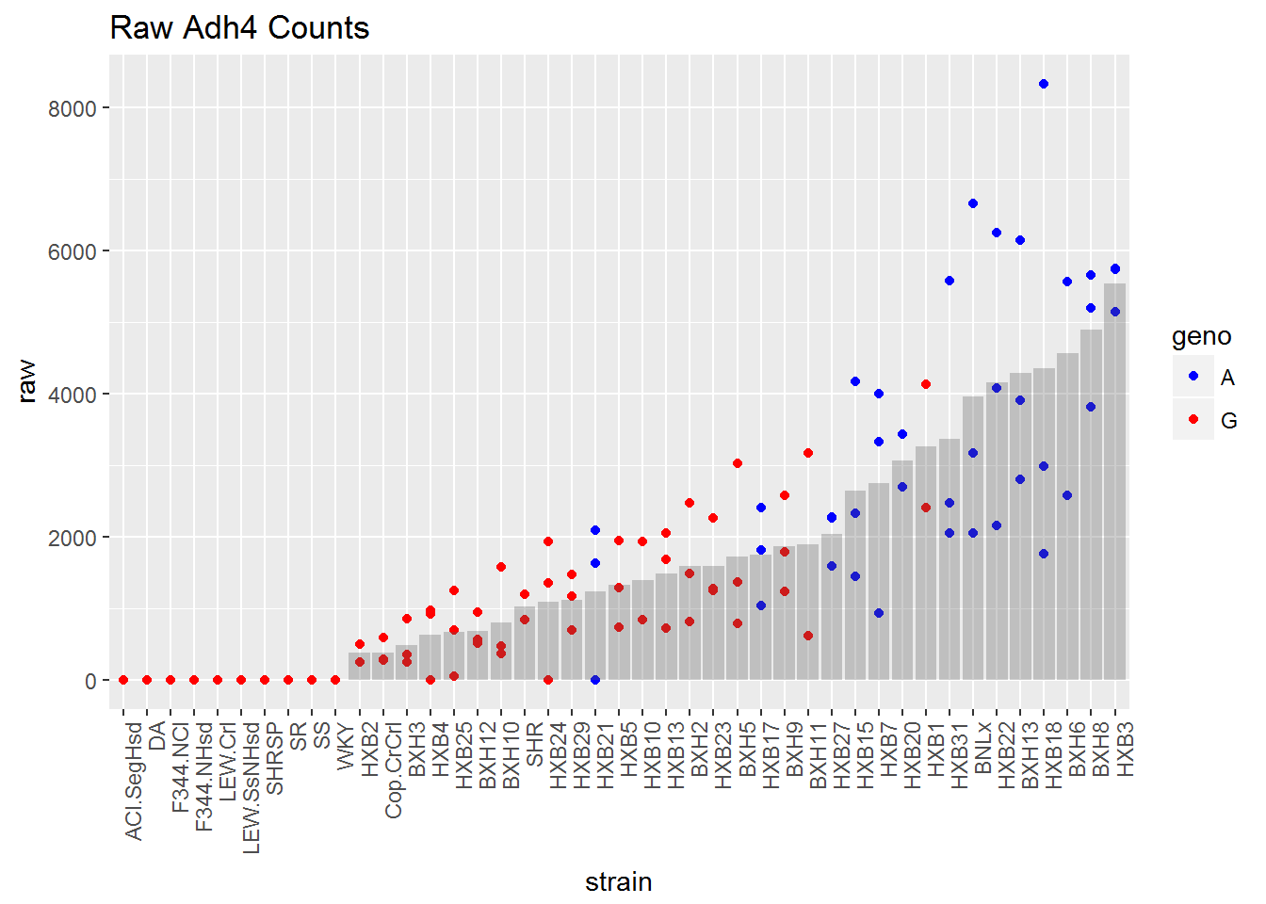
Looking at Data
After RUV adjustment
Raw Counts from RSEM

Slide 6
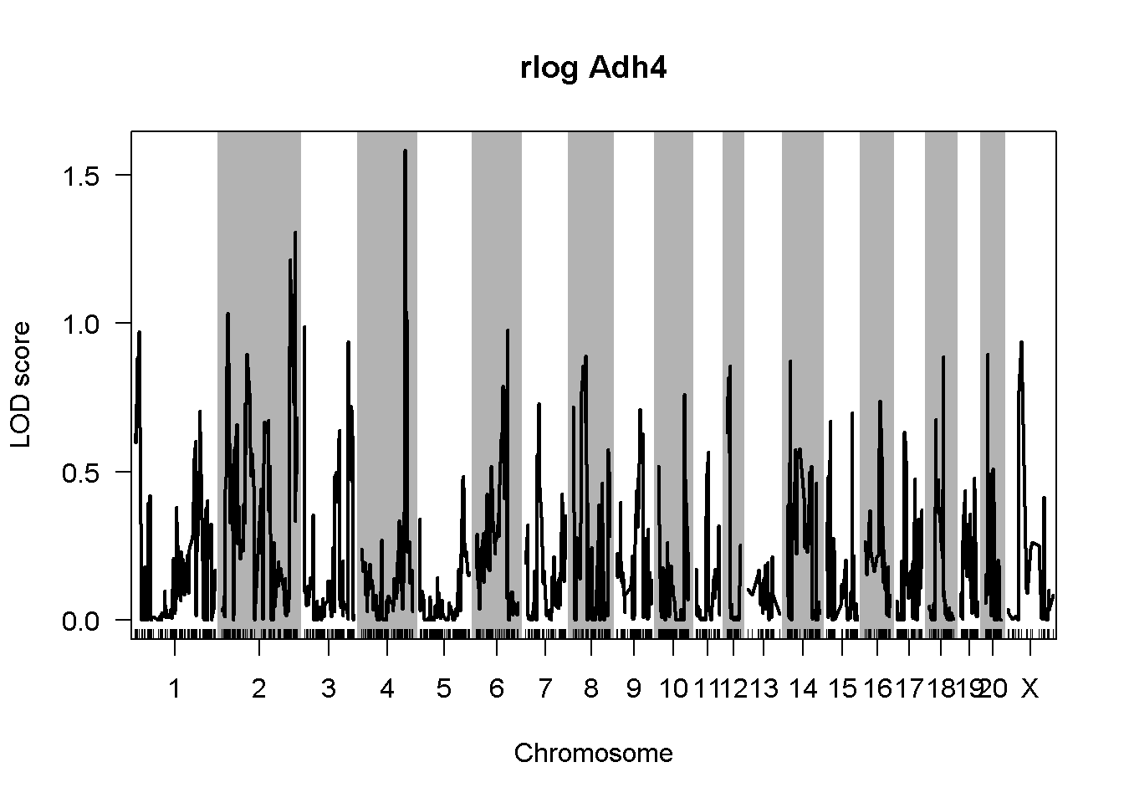
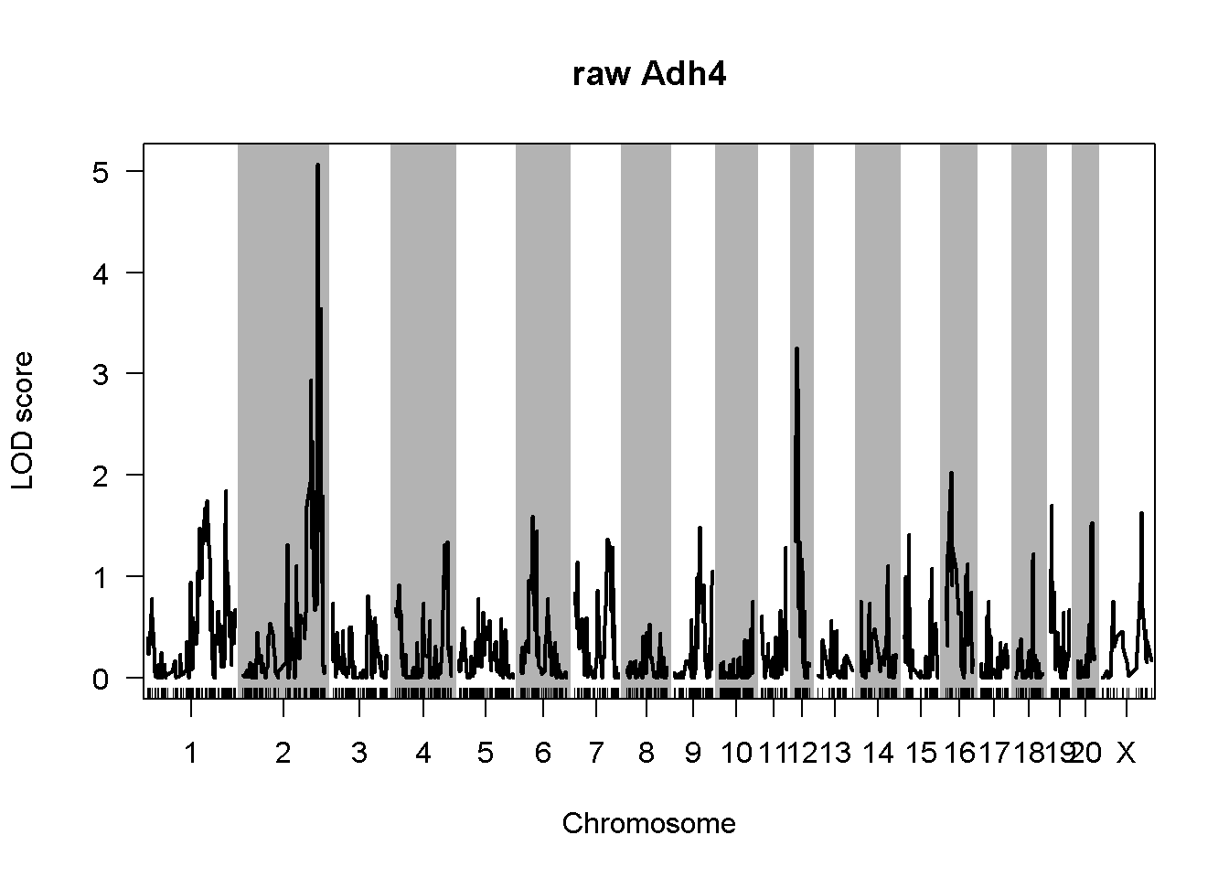
Notes:
Using the HXB/BXH RI panel in R/qtl

Slide 7
Preprocessing Flowchart
Re-evaluating since previous version was optimized on first reconstruction on the gene level (72,095) and now working on a transcript level with the Harry’s reconstruction (328,188).
RSEM Expected Counts
Filter Low Quality Features & Samples
RUV Normalization
rlog transformation
Upper Quartile Normalization
148 samples & 328,188 transcripts
Samples < 10 million reads and features average 1 count/sample
(121 samples and 178,974 transcripts)
121 samples & 178,974 transcripts
K=7

Slide 8
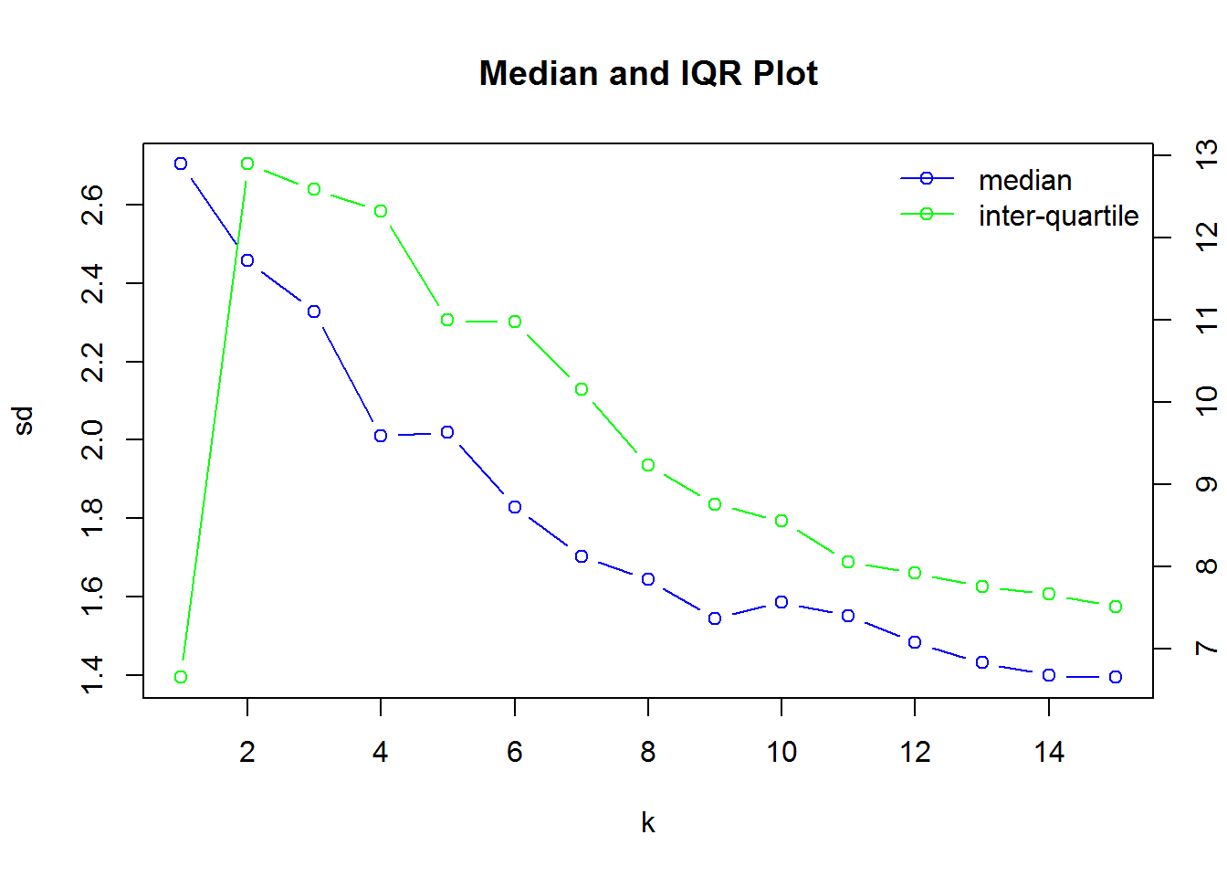
Selecting k for RUV
Most subjective part of the process. No good rule on what to select
Elbow plot:
Looking at the standard deviations of both the median value and interquartile range (IQR) across samples. Where the line inflects, that should be the best k.
Dendrograms with technical replicates
Notes:
I haven’t seen this jump in IQR before. Harry has and said no good solution.
Also tried svaseq which is a similar method and actually estimates the best k for you. This was k=8.

Slide 9
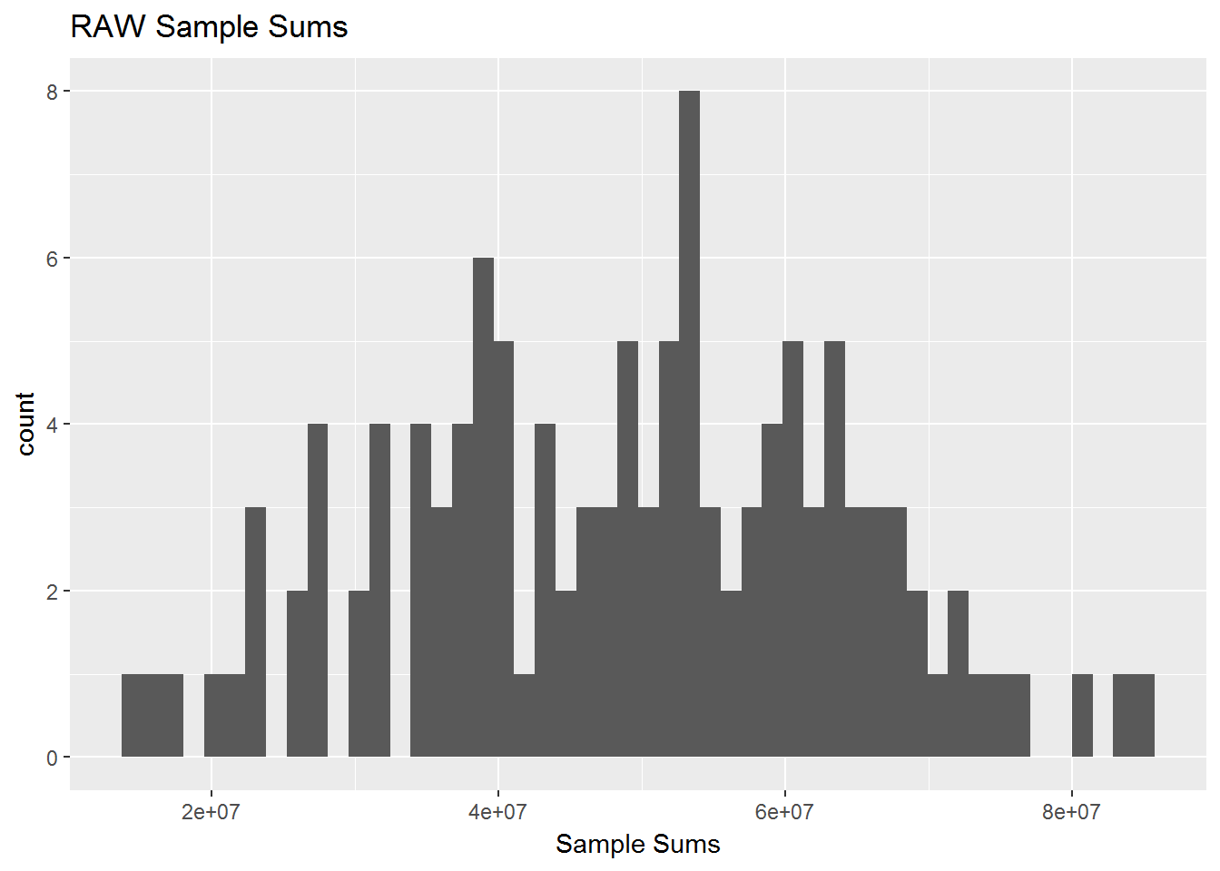
Follow Adh4 & Sample Sums (Library Size) Through k’s

Slide 10
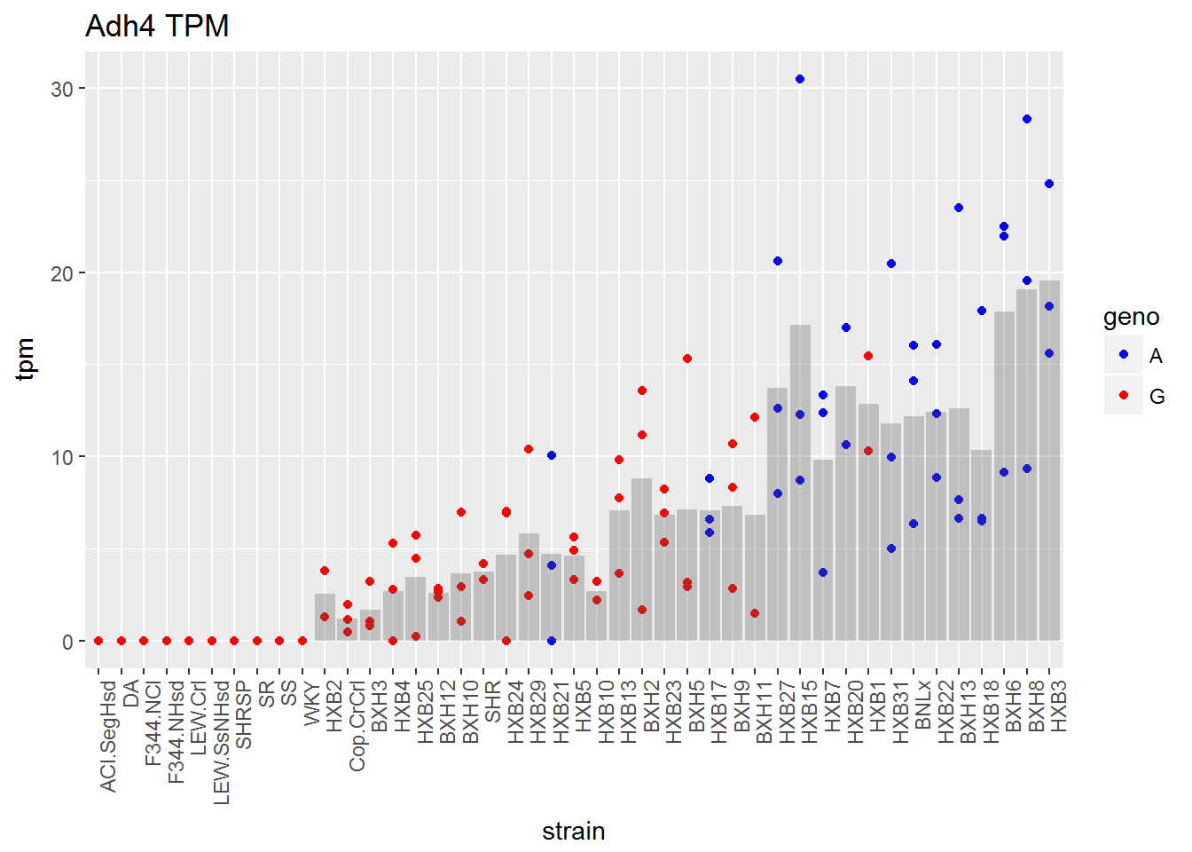
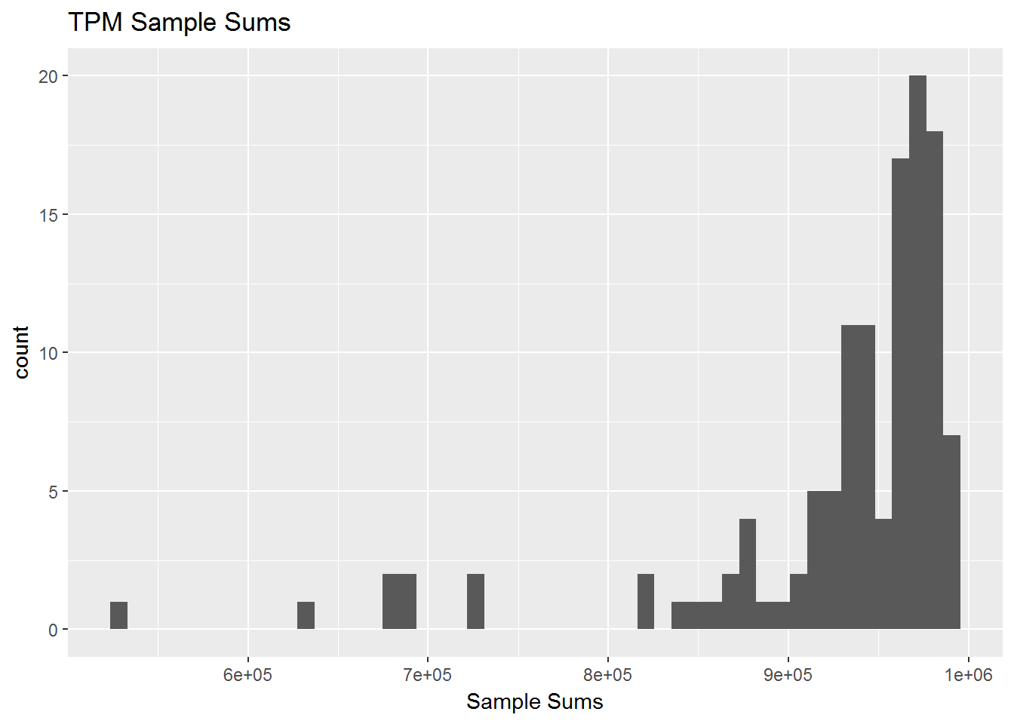
TPM from RSEM

Slide 11
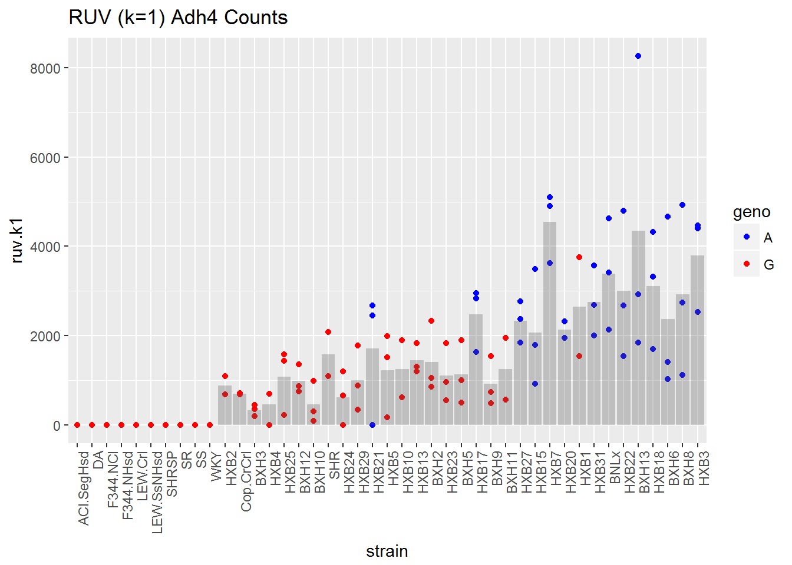
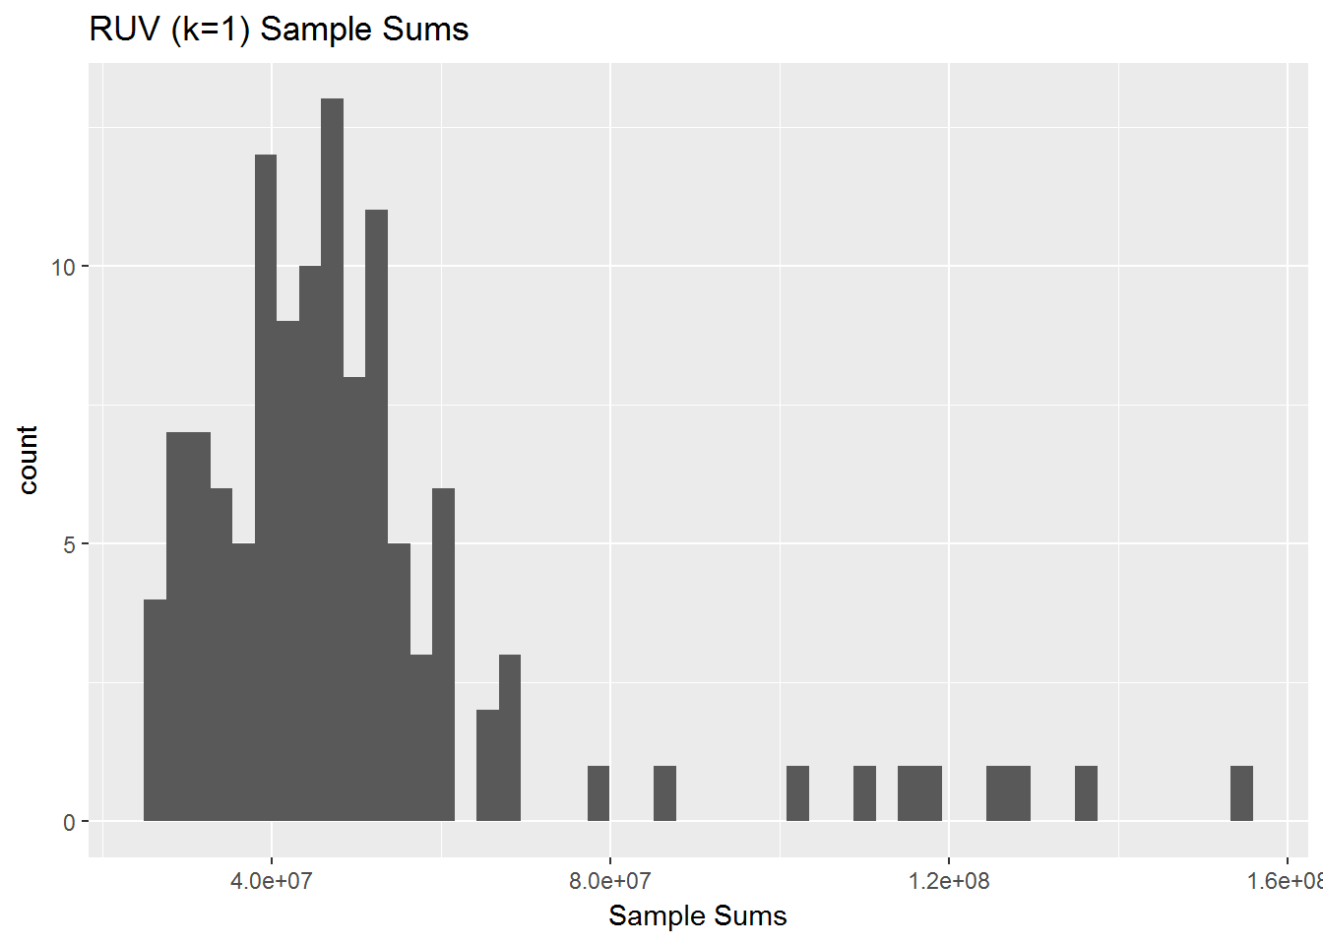
RUV k=1

Slide 12
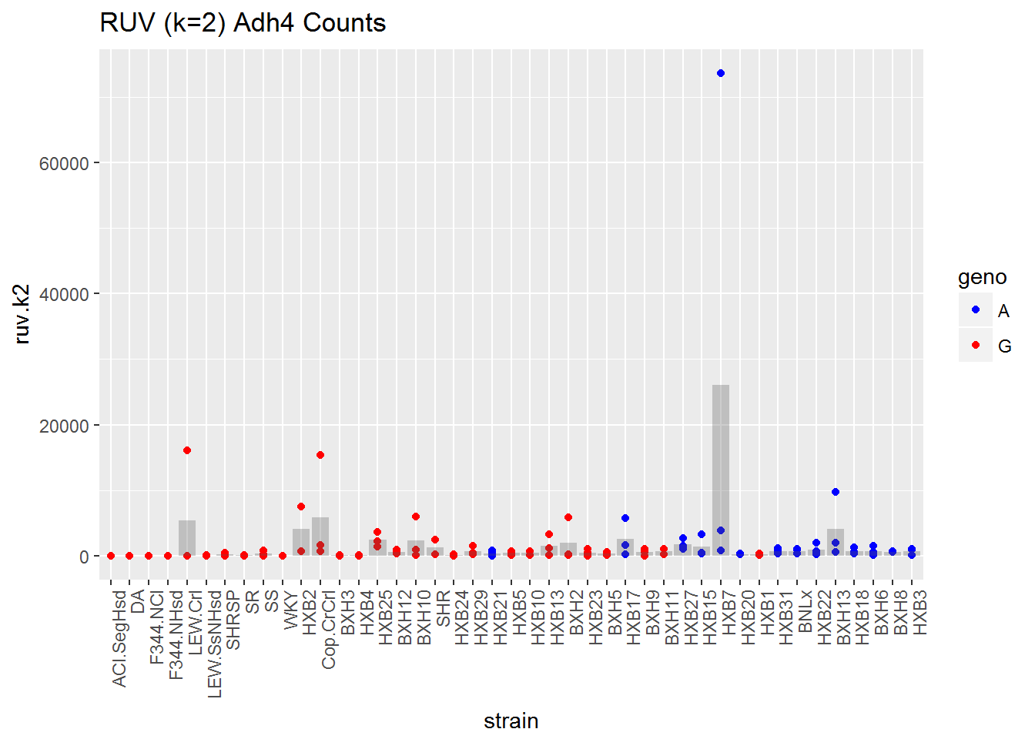
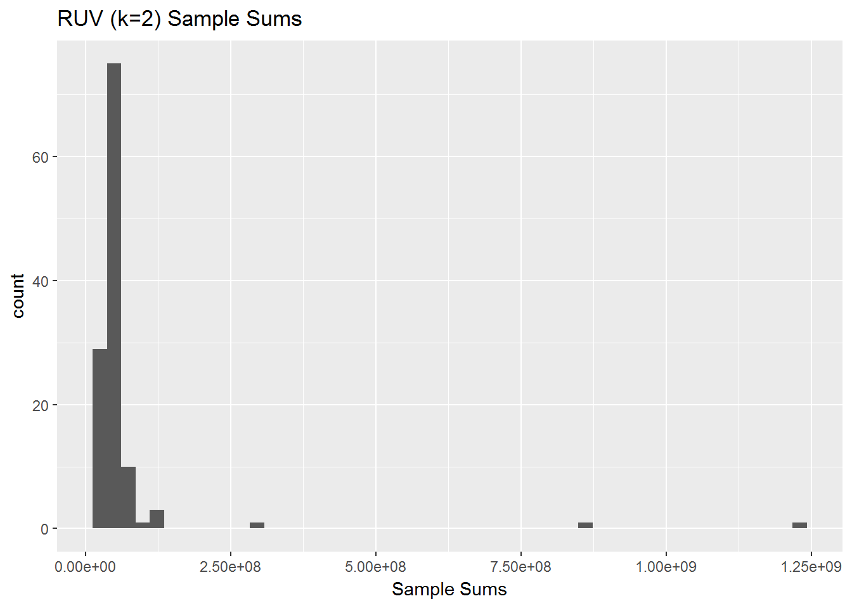
RUV k=2

Slide 13
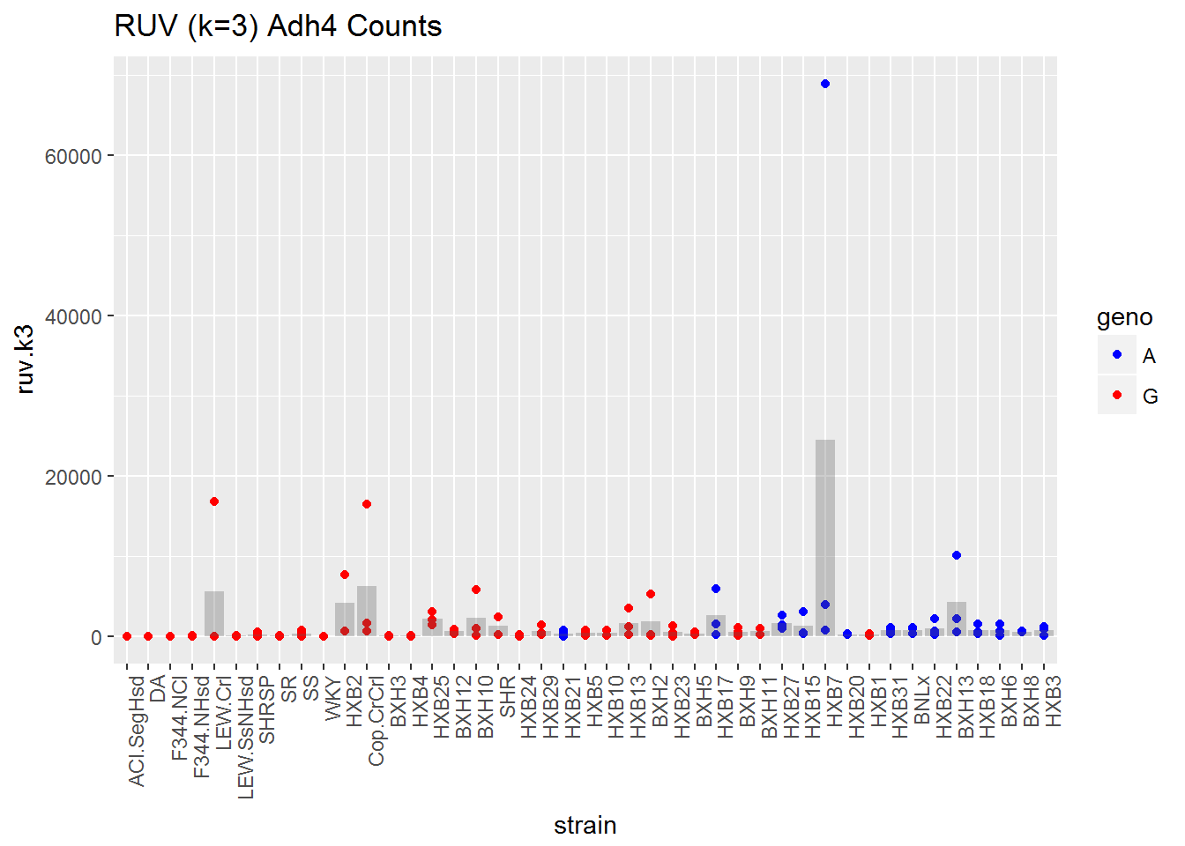
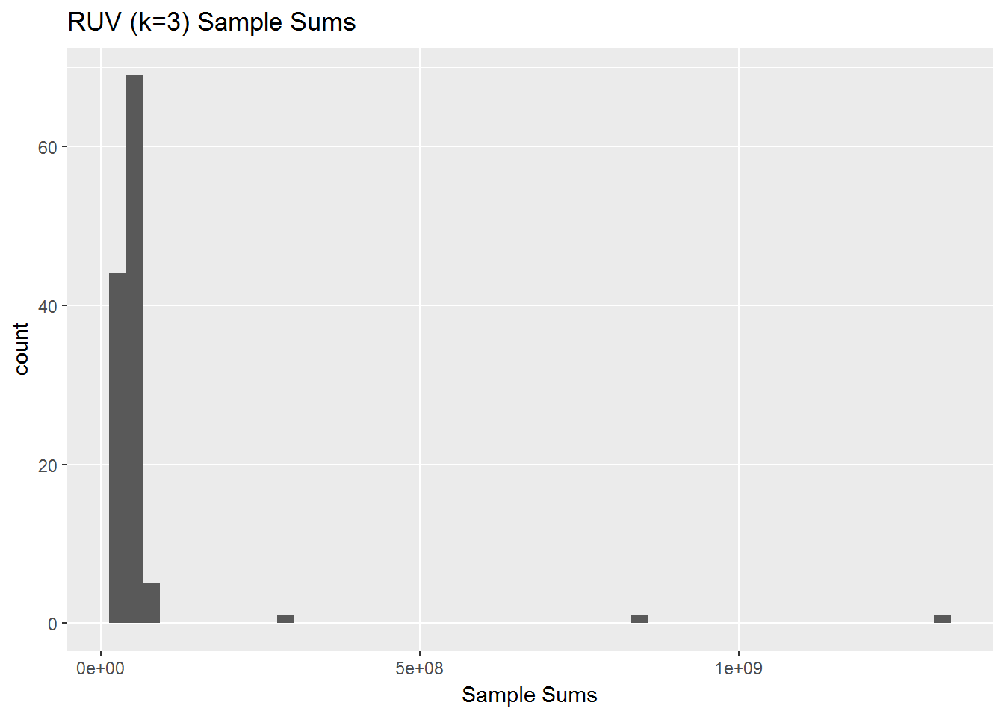
RUV k=3

Slide 14
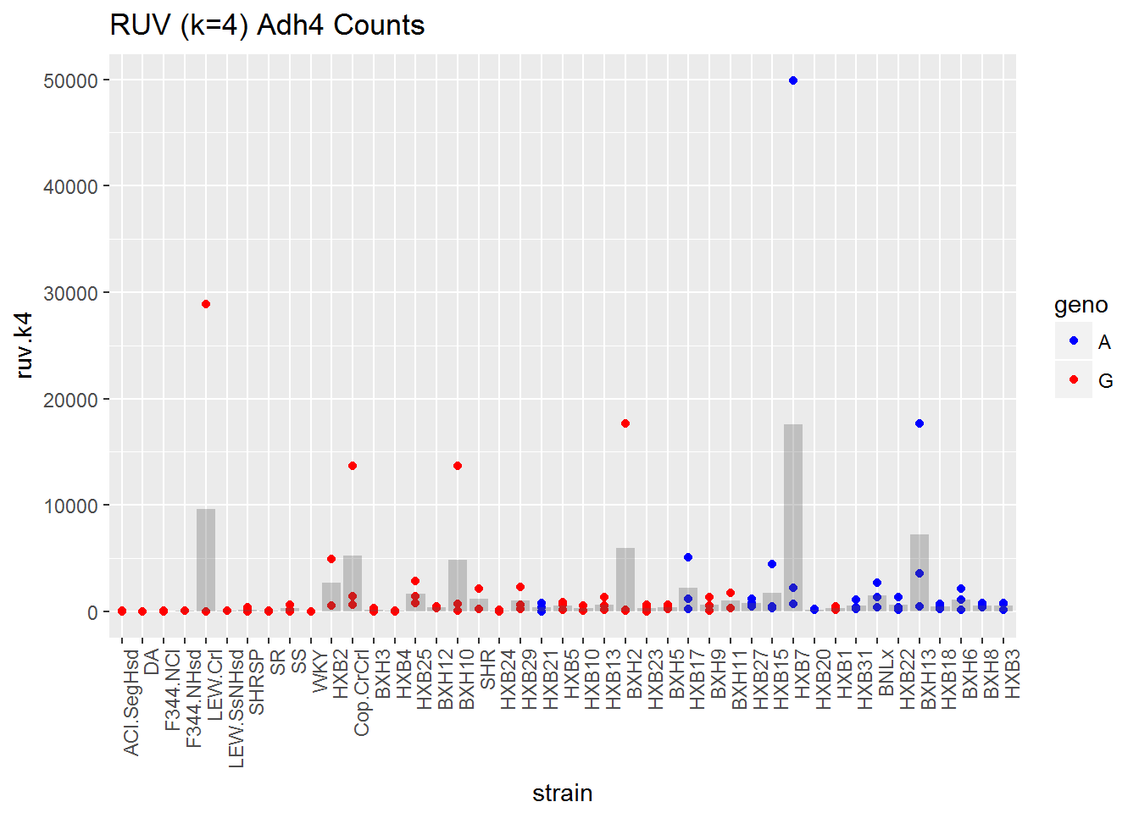
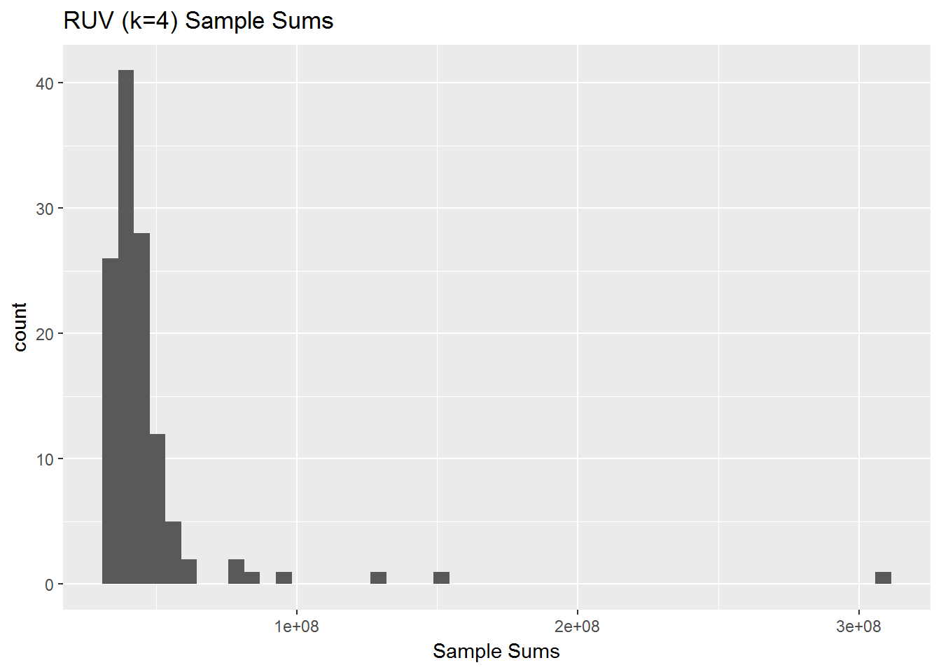
RUV k=4

Slide 15
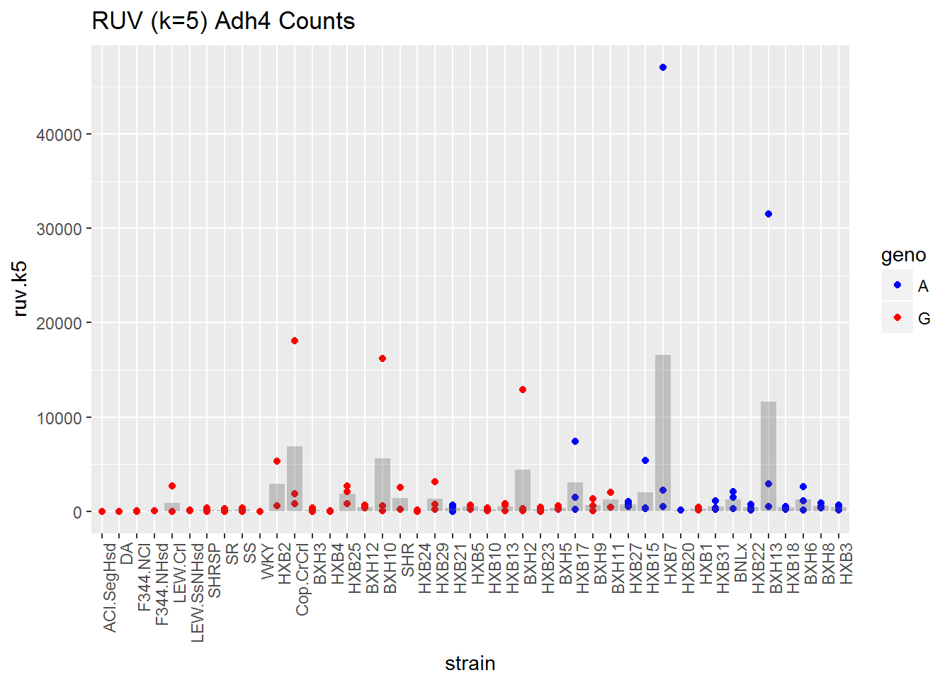
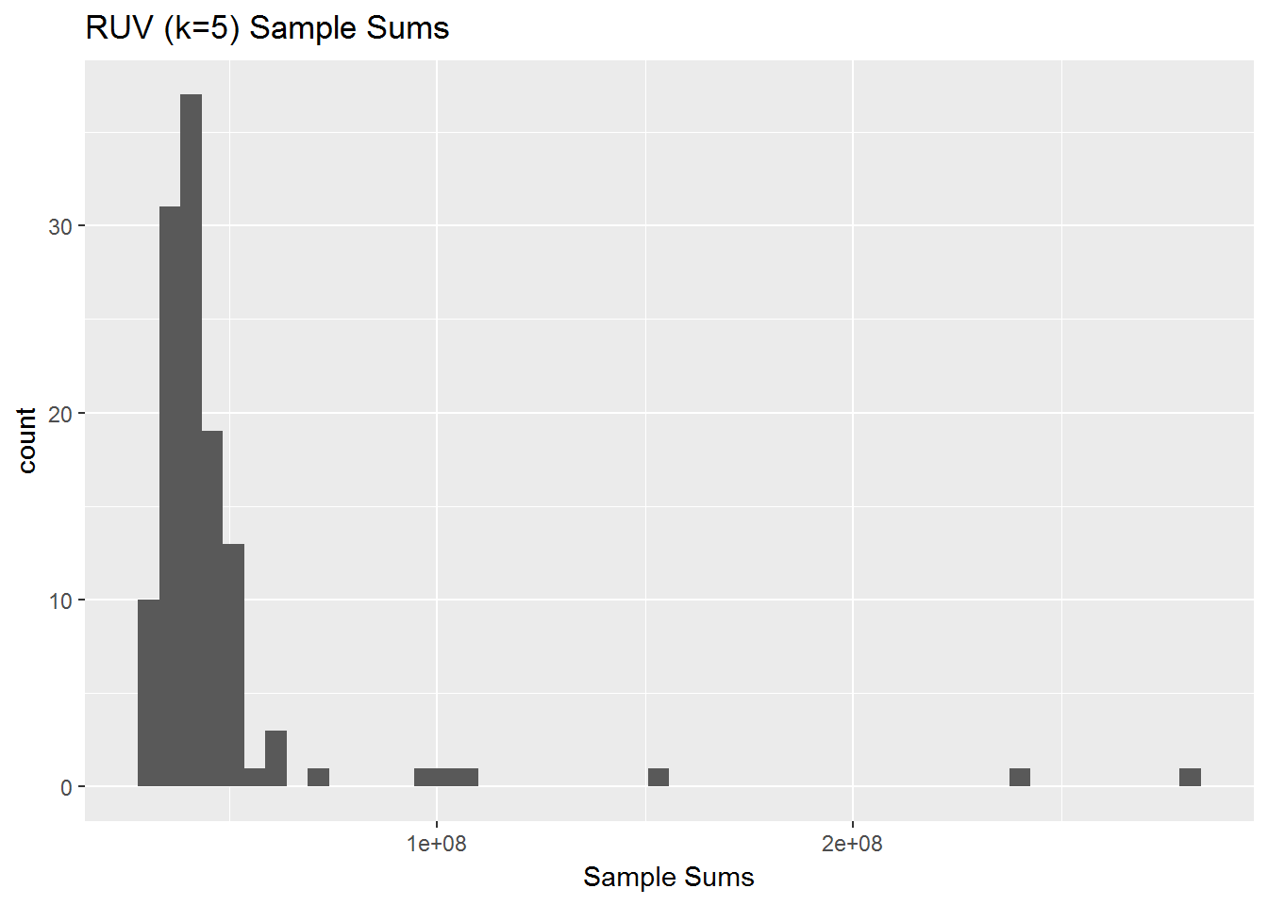
RUV k=5

Slide 16
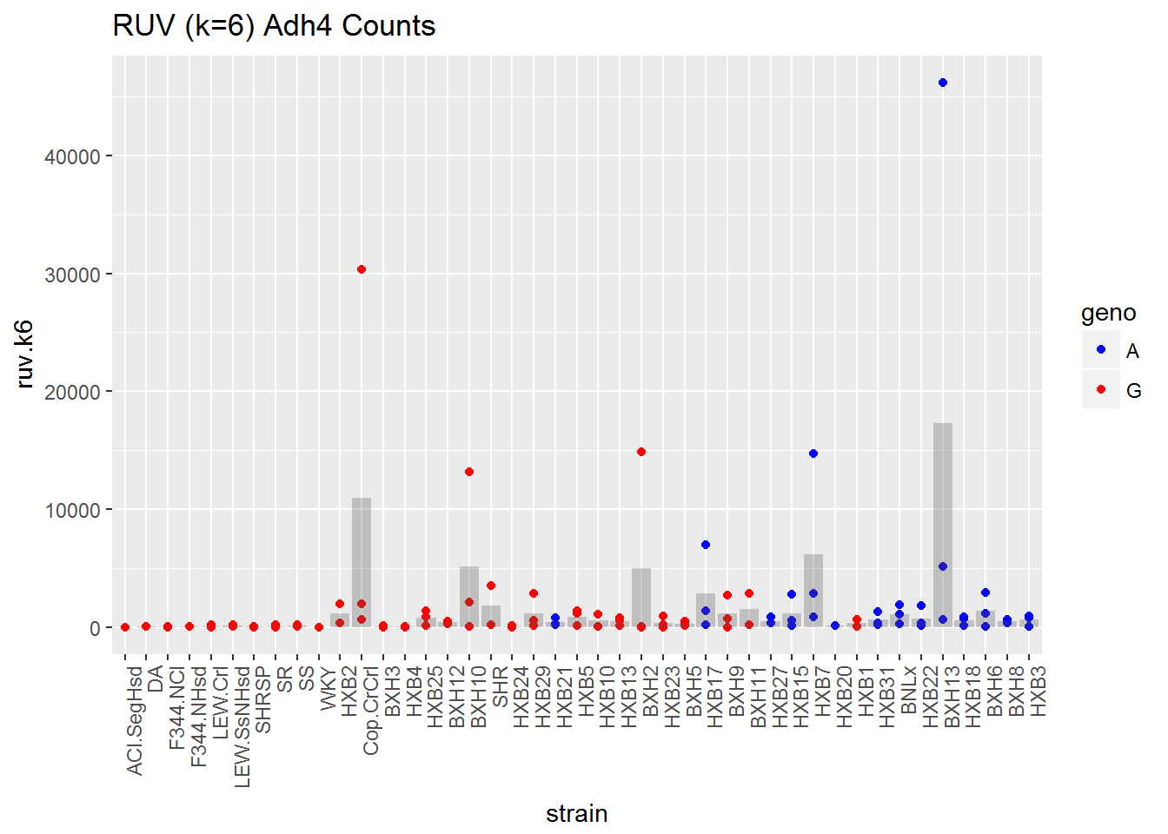
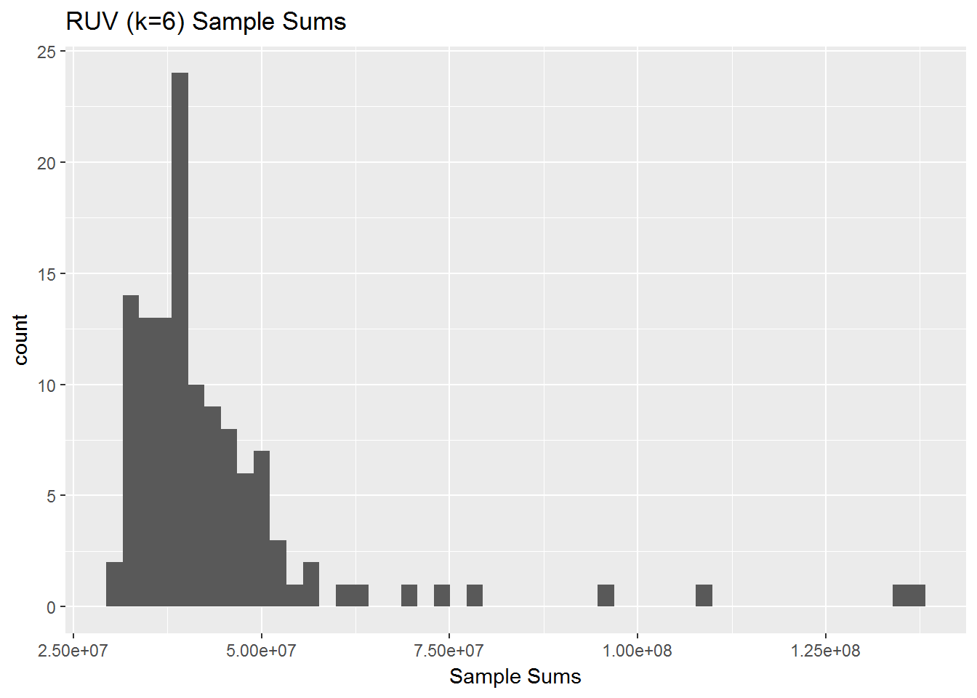
RUV k=6

Slide 17
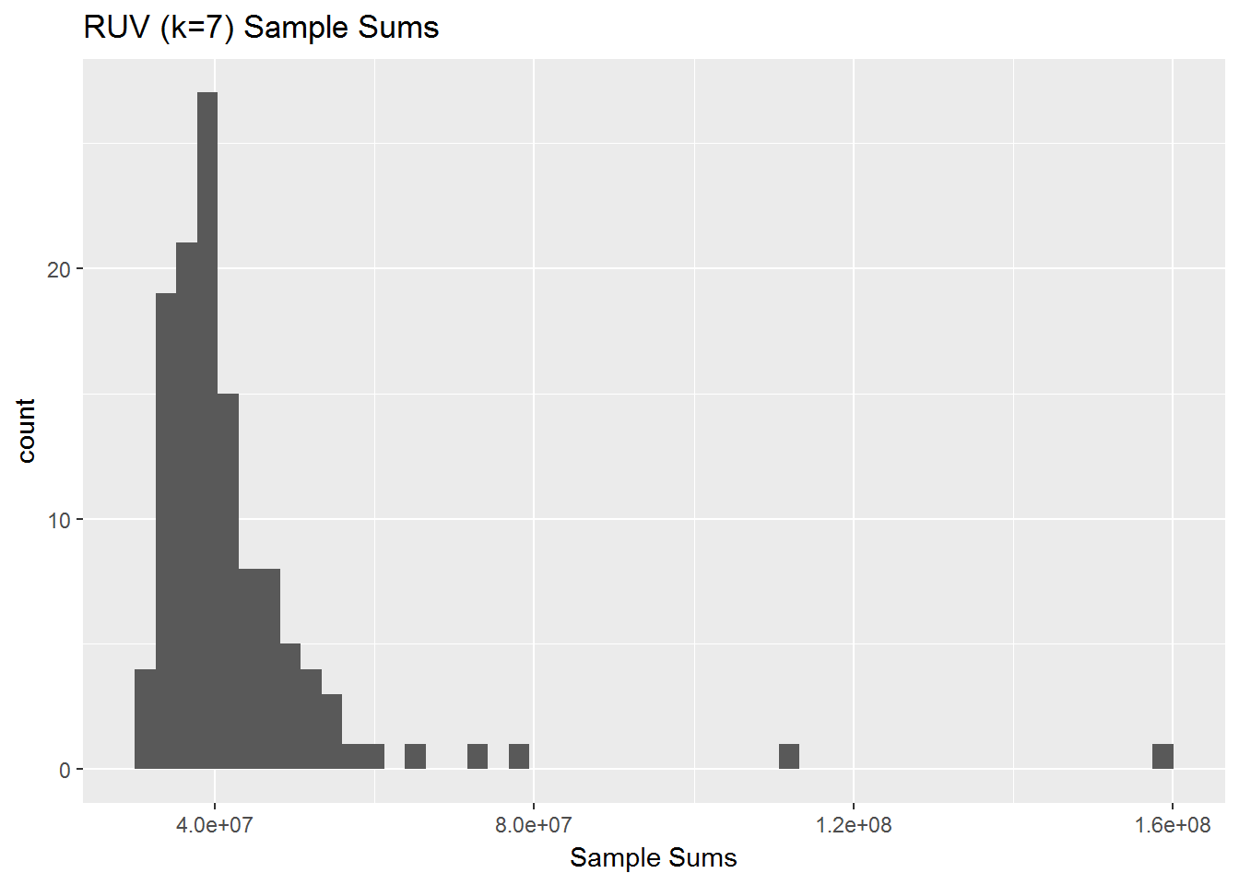
RUV k=7

Slide 18
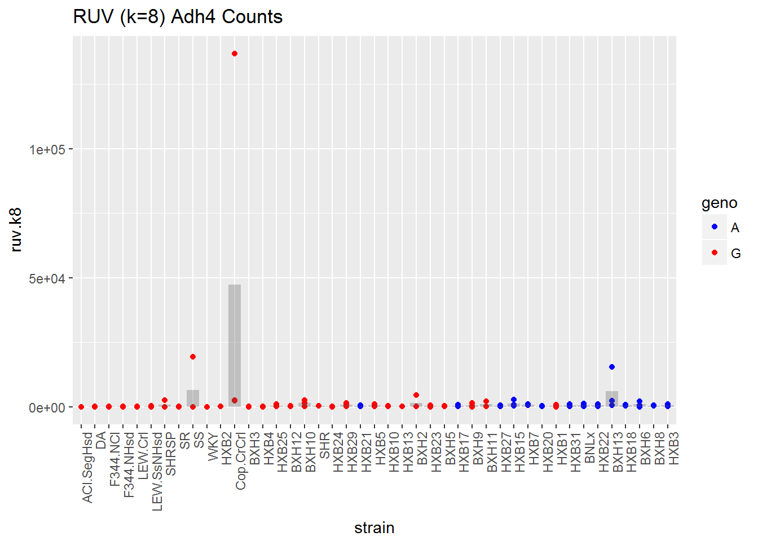

RUV k=8

Slide 19
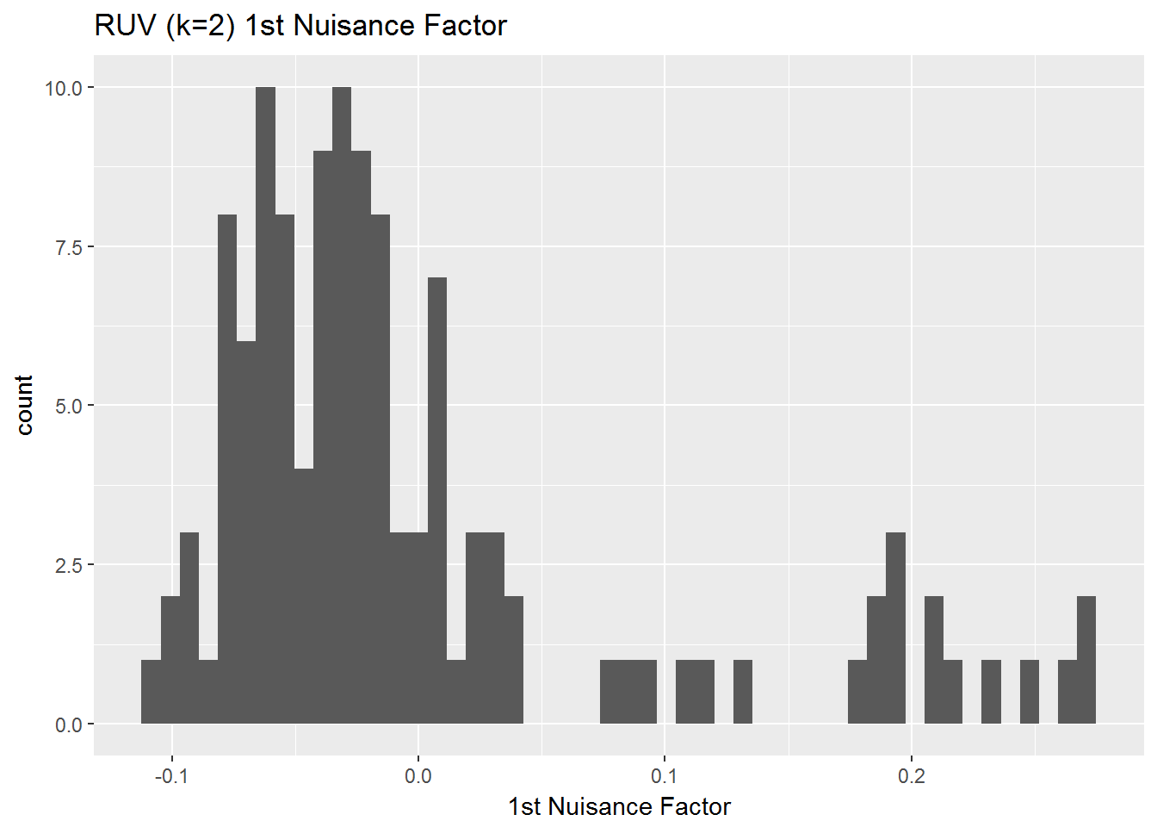
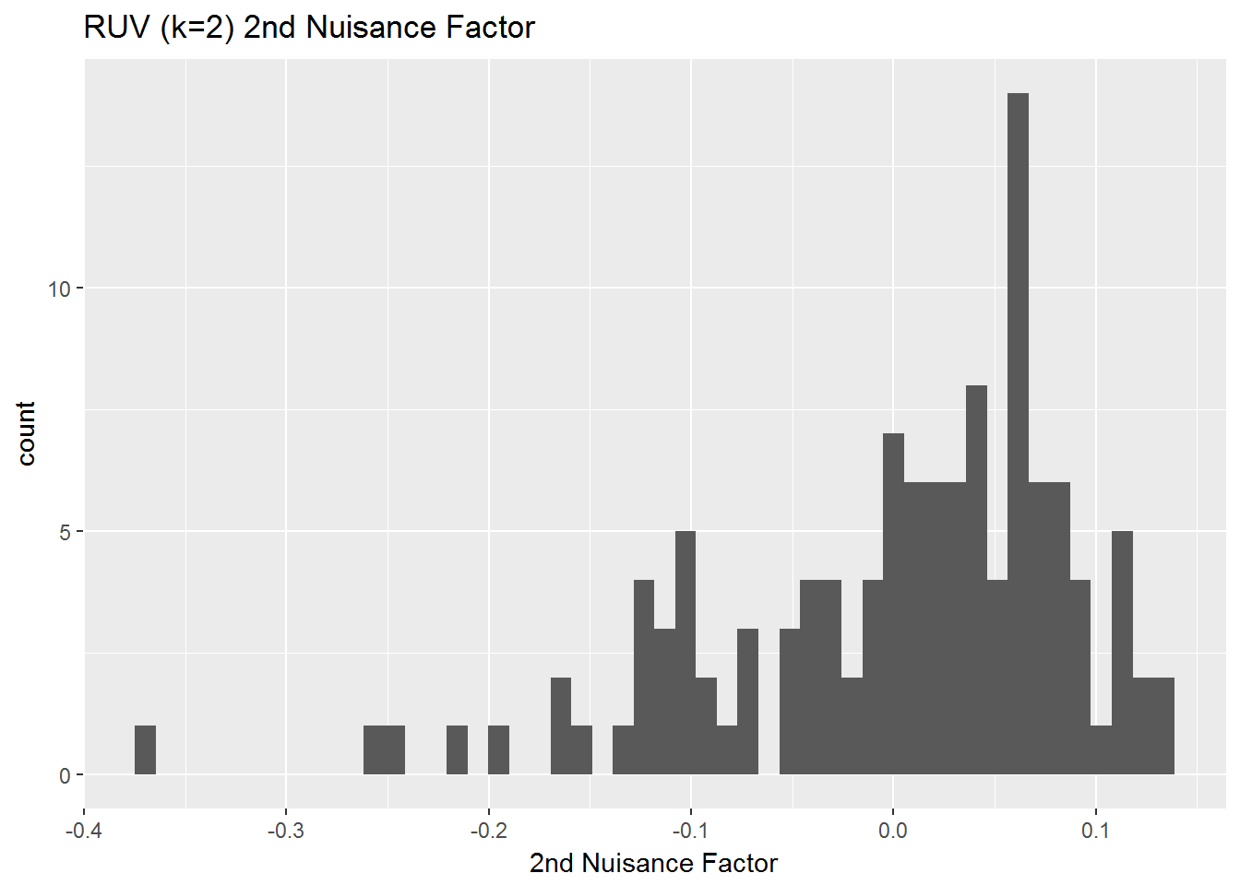
Examine RUV k=2 (where things fall apart)
Maybe we are too lenient on poor quality samples (corresponds to LEW-Crl_3_batch10)

Slide 20
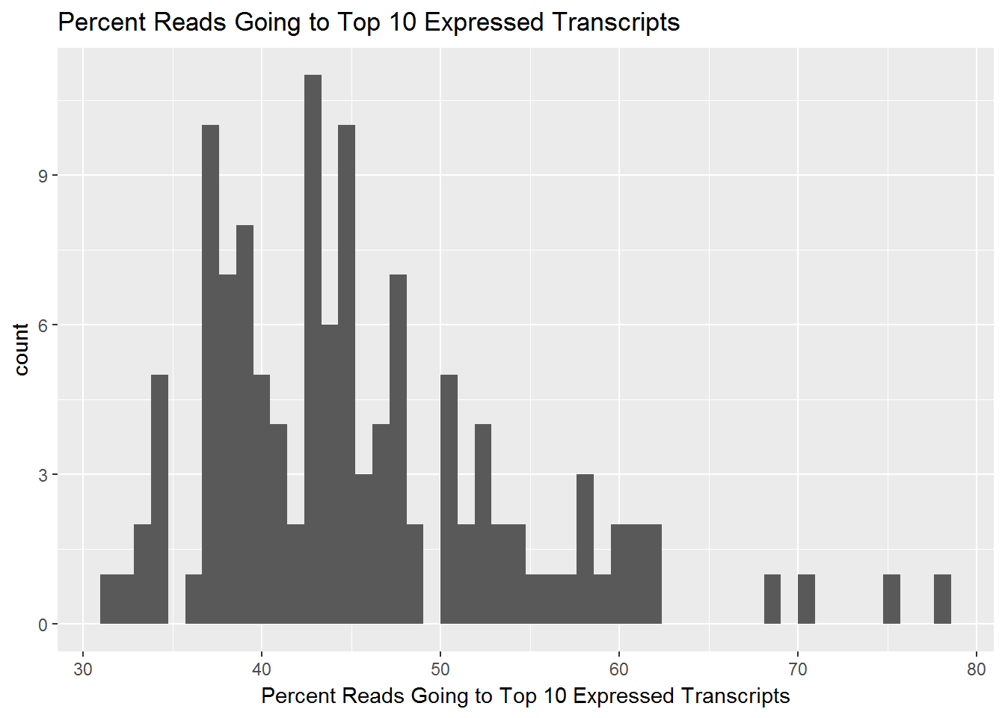
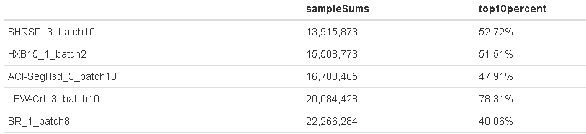
Reads Going to Few Transcripts
Currently poor quality samples are those defined as samples with < 10 million reads (based on RSEM expected counts)
What if there is a sample where there is a extremely high proportion of reads going to only a few genes?
LEW-Crl_3_batch10

Slide 21

Another Sample QC Filter
Try to make this histogram less skewed.
Remove those samples with >65% of their reads going to the top 10 expressed transcripts.
This removes 4 samples: SHRSP_2_batch8, SS_2_batch10, SS_3_batch10, LEW-Crl_3_batch10
This leaves the SS strain with 1 sample. All other strains still have 2-3 biological replicates.
ENSRNOT00000069133 shows up in the top 10 list 119 times (121 samples total). It’s for AY172581.24, which is a mitochondrial transcript.

Slide 22
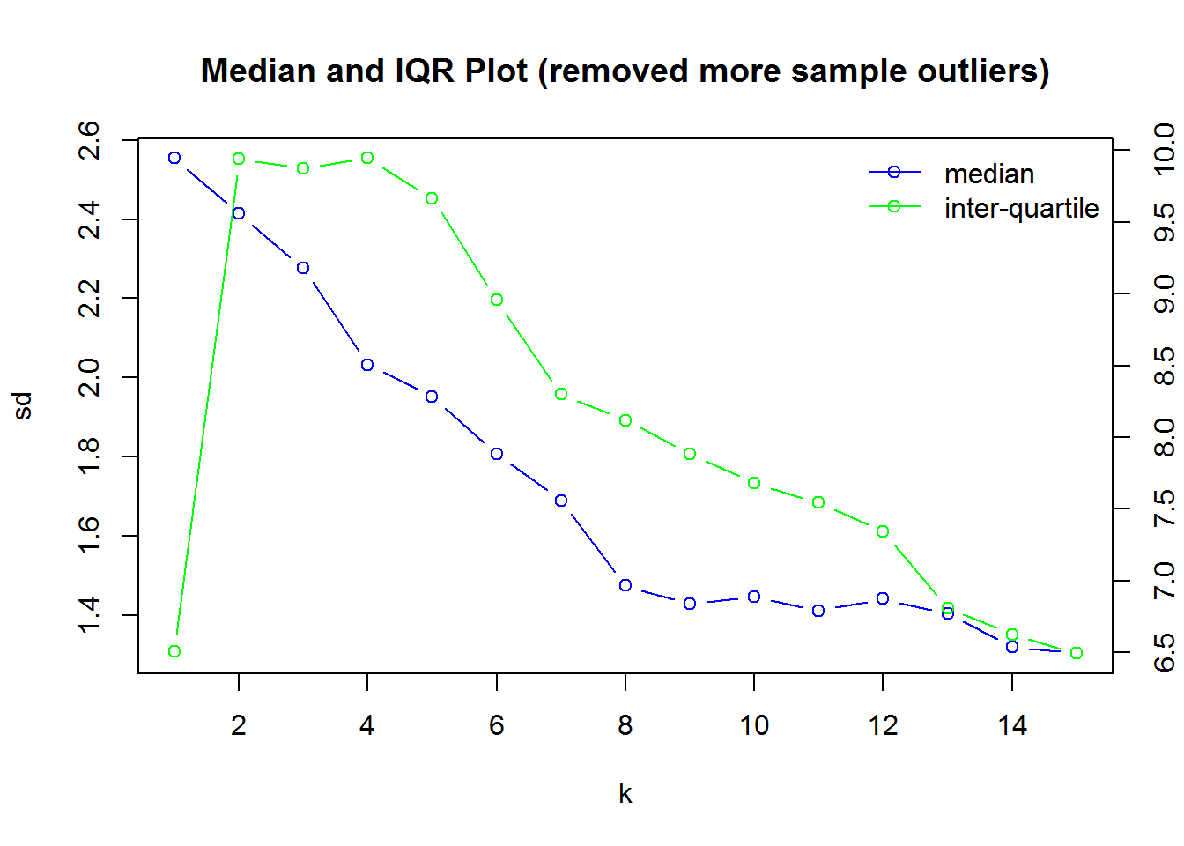
More QC Filters
Add in the sample QC of proportion of top 10 reads < 65%
117 samples
Add harsher feature level no more than 1/3 samples have 0’s
79,921 transcripts
The elbow plot looks almost the exact same.
Notes:
Step 2 in the 5 step process..

Slide 23
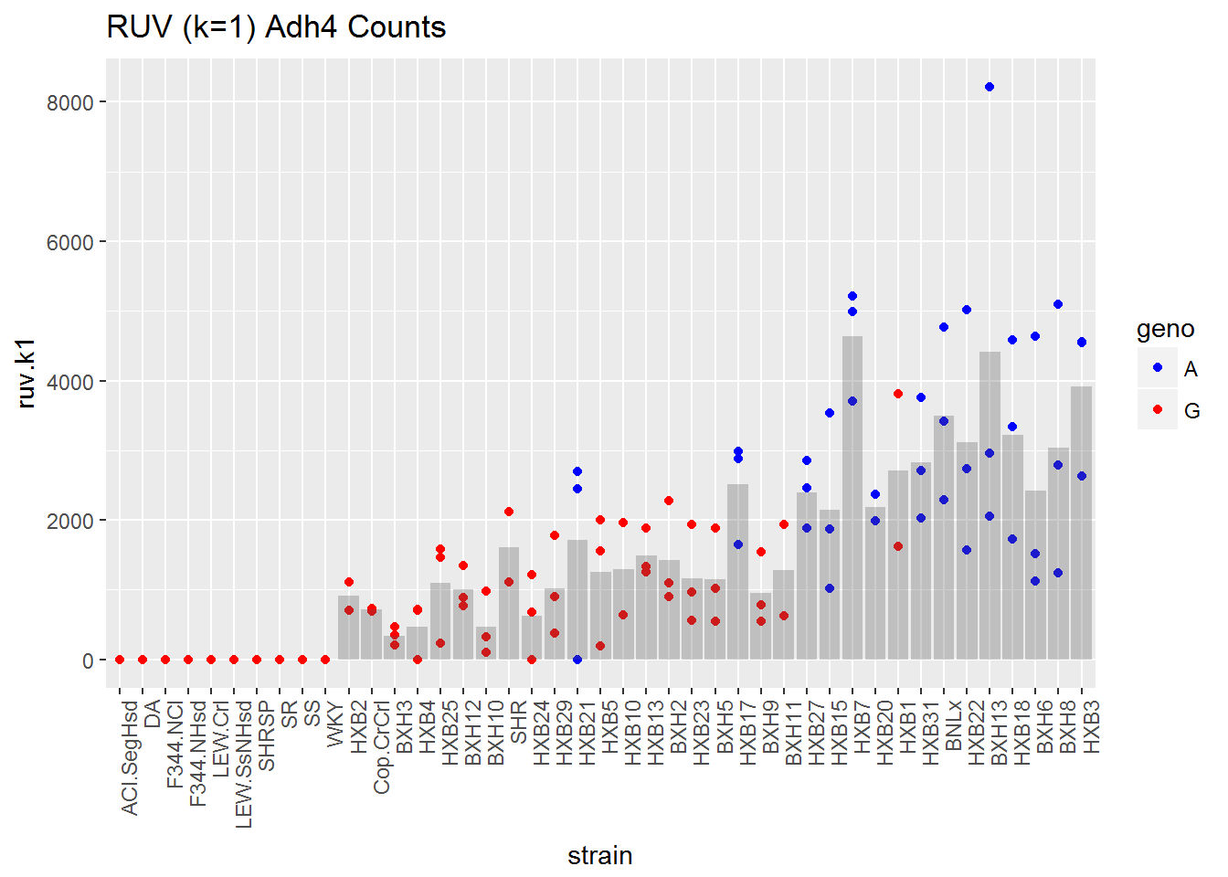
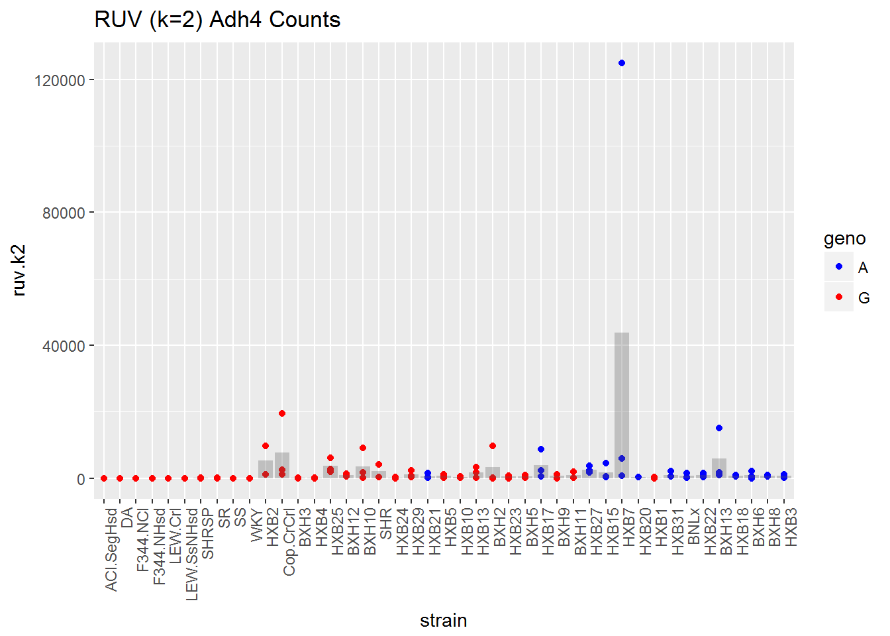
With New Filters…Same Issue at k=2

Slide 24
Future Work
Thoughts & Suggestions?
Look into k=2 with this new filter
Do a comparison with svaseq
Once happy with a pre-processing pipeline go back to GEMMA

