Slide 1
MANUFACTURE ANALYTICS

Slide 2




MODULES
Excel
Power BI
Tableau
My SQL

Slide 3
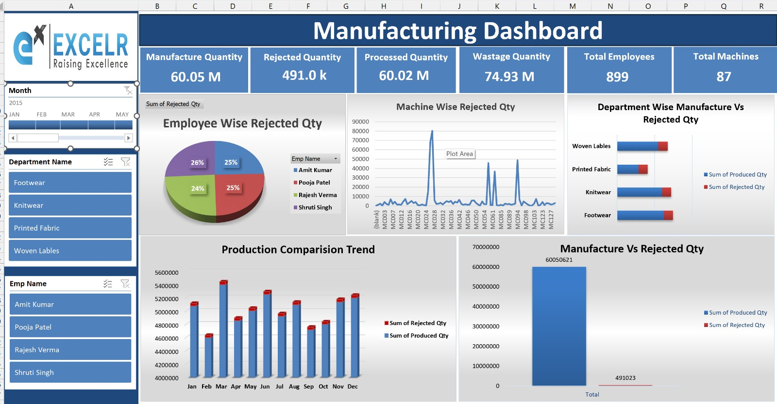
Overview of the Project
Completed the data analysis and visualization project in 3 phases.
Week 1: Created Excel dashboard – data cleaning, merging, and visualization. Pivot-based report with filters (Date, Dept, Machine, Employee) showing KPIs — Production, Rejection & Efficiency trends for daily analysis

Slide 4
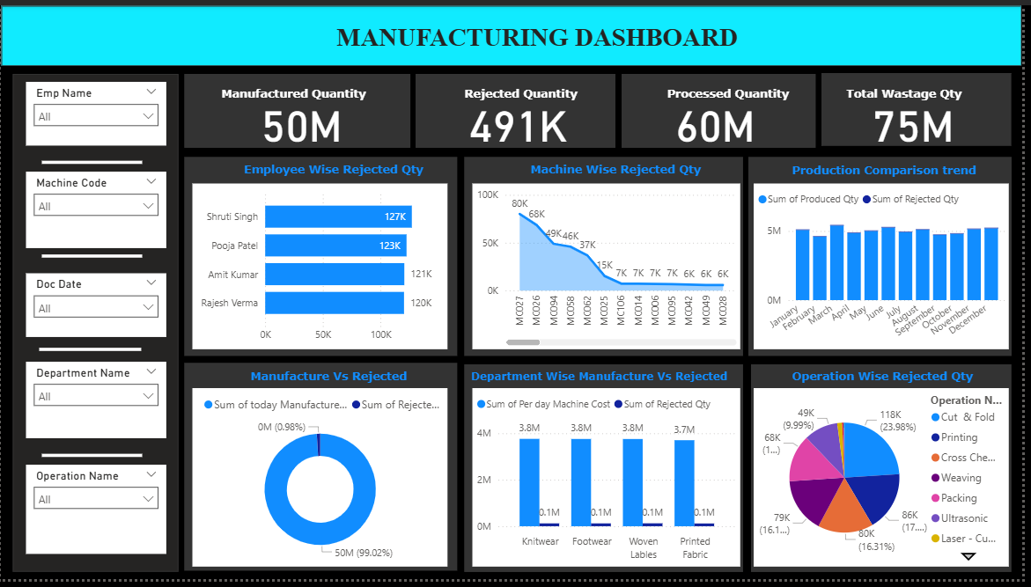
Week 2: Designed Power BI and Tableau dashboards for trend analysis and performance tracking.
Power BI Dashboard

Slide 5
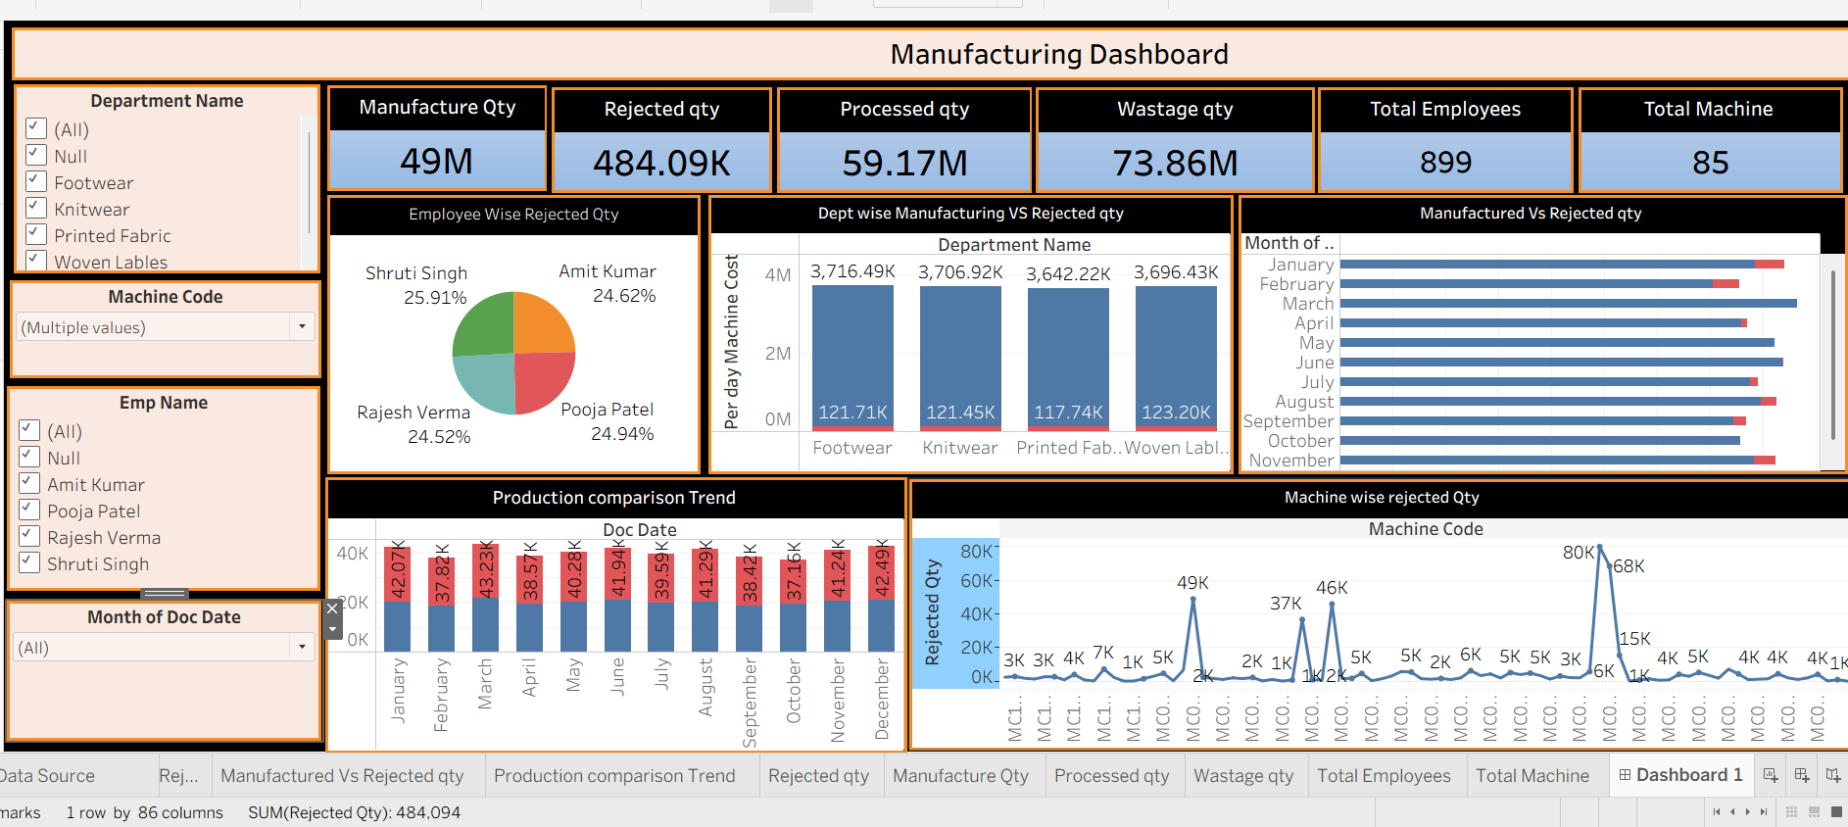
Tableau Dashboard
.

Slide 6
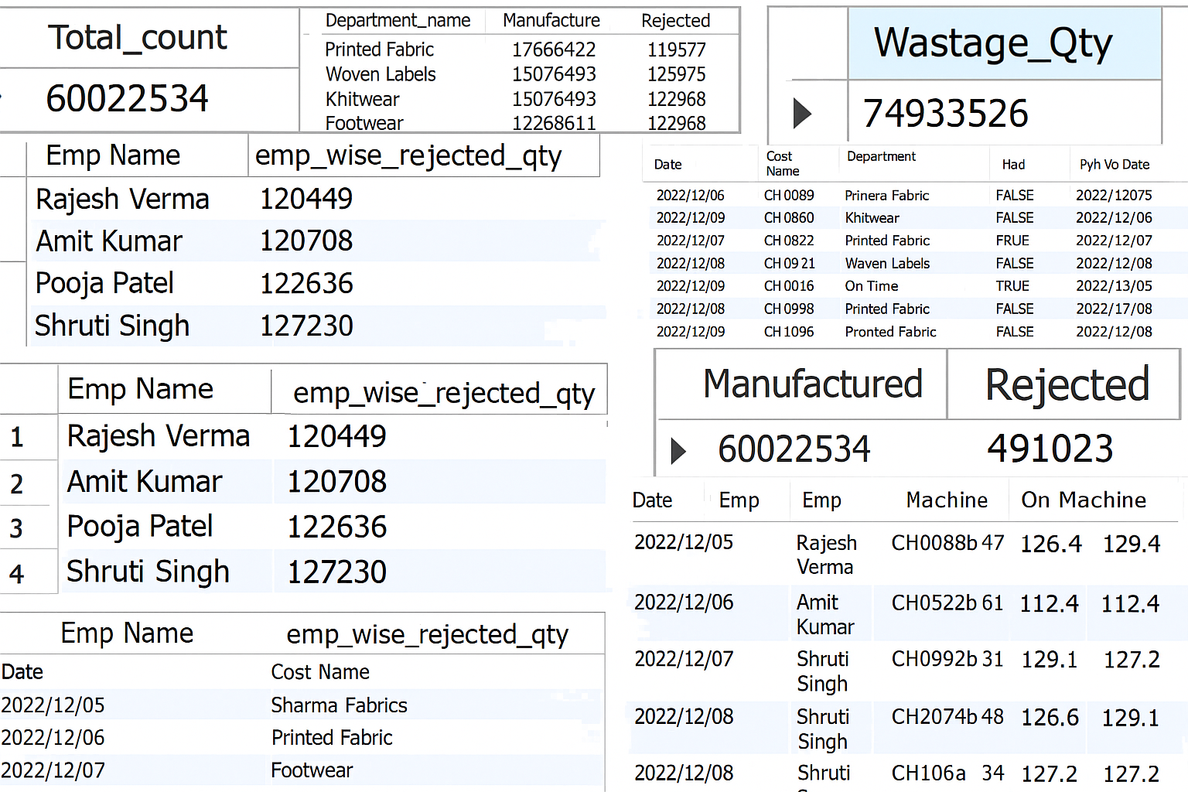
Week 3: Built SQL KPIs for extracting insights directly from the database.

Slide 7
Challenges Faced
Understanding Real time data flow and connections
Facing confusion while linking multiple sheets in one dashboard
Getting blank visuals due to wrong data
Getting wrong totals due to incorrect aggregation
Facing confusion while choosing chart types for comparison
Managing space properly for both charts and insights text
Difficulty summarizing large data into short insights

Slide 8
Solutions
Cleaned messy data before adding to the dashboard
Double checked every link to avoid data confusion
Tried different layouts until the dashboard looked clear
Took team feedback to improve the chart and insights
We handled all challenges through teamwork, continuous testing, and smart design choices, which made the dashboard accurate, clear, and easy to understand

Slide 9
Advantages and Disadvantages
Advantages
Helps in quick decision-making with clear visuals.
Saves time by combining all data in one place.
Easy to track production and employee performance.
Reduces manual work and errors
Real time updates improve accuracy

Slide 10
Disadvantages
Takes time to clean and prepare data.
Mistakes in linking sheets can give wrong results.
Large data may slow down the dashboard.
Hard to find small errors in large datasets
Small mistakes can change the whole dashboard result

Slide 11
Thank you

