Slide 1
Programming with R
Lecture-2
Vandna Batra
CSE,FET,MRIIRS

Slide 2
Numeric
Decimal values are called numerics in R. It is the default computational data type. If we assign a decimal value to a variable x as follows, x will be of numeric type.
> x = 10.5 # assign a decimal value > x # print the value of x [1] 10.5 > class(x) # print the class name of x [1] "numeric"
Furthermore, even if we assign an integer to a variable k, it is still being saved as a numeric value.
> k = 1 > k # print the value of k [1] 1 > class(k) # print the class name of k [1] "numeric"
> is.integer(k) # is k an integer? [1] FALSE

Slide 3
Integer
In order to create an integer variable in R, we invoke the integer function. We can be assured that y is indeed an integer by applying the is.integer function.
> y = as.integer(3) > y # print the value of y [1] 3 > class(y) # print the class name of y [1] "integer" > is.integer(y) # is y an integer? [1] TRUE
We can also declare an integer by appending an L suffix.
> y = 3L > is.integer(y) # is y an integer? [1] TRUE
Incidentally, we can coerce a numeric value into an integer with the as.integer function.
> as.integer(3.14) # coerce a numeric value [1] 3

Slide 4
Complex
A complex value in R is defined via the pure imaginary value i.
> z = 1 + 2i # create a complex number > z # print the value of z [1] 1+2i > class(z) # print the class name of z [1] "complex"
The following gives an error as −1 is not a complex value.
> sqrt(−1) # square root of −1 [1] NaN Warning message: In sqrt(−1) : NaNs produced
Instead, we have to use the complex value −1 + 0i.
> sqrt(−1+0i) # square root of −1+0i [1] 0+1i

Slide 5
Logical
A logical value is often created via comparison between variables.
> x = 1; y = 2 # sample values > z = x > y # is x larger than y? > z # print the logical value [1] FALSE > class(z) # print the class name of z [1] "logical"
Standard logical operations are "&" (and), "|" (or), and "!" (negation).
> u = TRUE; v = FALSE > u & v # u AND v [1] FALSE > u | v # u OR v [1] TRUE > !u # negation of u [1] FALSE

Slide 6
Character
A character object is used to represent string values in R. We convert objects into character values with the as.character() function:
> x = as.character(3.14) > x # print the character string [1] "3.14" > class(x) # print the class name of x [1] "character"
Two character values can be concatenated with the paste function.
> fname = "Joe"; lname ="Smith" > paste(fname, lname) [1] "Joe Smith"

Slide 7
Vector
A vector is a sequence of data elements of the same basic type.
Here is a vector containing three numeric values 2, 3 and 5.
> c(2, 3, 5) [1] 2 3 5
And here is a vector of logical values.
> c(TRUE, FALSE, TRUE, FALSE, FALSE) [1] TRUE FALSE TRUE FALSE FALSE
A vector can contain character strings.
> c("aa", "bb", "cc", "dd", "ee") [1] "aa" "bb" "cc" "dd" "ee"
Incidentally, the number of members in a vector is given by the length function.
> length(c("aa", "bb", "cc", "dd", "ee")) [1] 5

Slide 8
1. Combining Vectors
Vectors can be combined via the function c. For examples, the following two vectors n and s are combined into a new vector containing elements from both vectors.
> n = c(2, 3, 5) > s = c("aa", "bb", "cc", "dd", "ee") > c(n, s) [1] "2" "3" "5" "aa" "bb" "cc" "dd" "ee"

Slide 9
2. Vector Arithmetics
Arithmetic operations of vectors are performed member-by-member, i.e., memberwise.
For example, suppose we have two vectors a and b.
> a = c(1, 3, 5, 7) > b = c(1, 2, 4, 8)
Then, if we multiply a by 5, we would get a vector with each of its members multiplied by 5.
> 5 * a [1] 5 15 25 35
And if we add a and b together, the sum would be a vector whose members are the sum of the corresponding members from a and b.
> a + b [1] 2 5 9 15

Slide 10
Similarly for subtraction, multiplication and division, we get new vectors via memberwise operations.
> a - b [1] 0 1 1 -1 > a * b [1] 1 6 20 56 > a / b [1] 1.000 1.500 1.250 0.875

Slide 11
Recycling Rule
If two vectors are of unequal length, the shorter one will be recycled in order to match the longer vector. For example, the following vectors u and v have different lengths, and their sum is computed by recycling values of the shorter vector u.
> u = c(10, 20, 30) > v = c(1, 2, 3, 4, 5, 6, 7, 8, 9) > u + v [1] 11 22 33 14 25 36 17 28 39

Slide 12

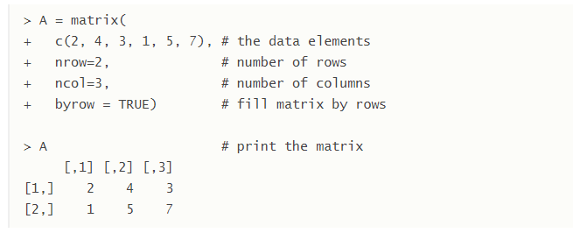
Matrix
A matrix is a collection of data elements arranged in a two-dimensional rectangular layout. The following is an example of a matrix with 2 rows and 3 columns.

Slide 13


An element at the m^{th} row, n^{th} column of A can be accessed by the expression A[m, n].
The entire m^{th} row A can be extracted as A[m, ].
Similarly, the entire n^{th} column A can be extracted as A[ ,n].

Slide 14
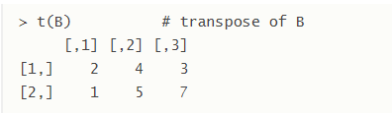
Transpose:We construct the transpose of a matrix by interchanging its columns and rows with the function t .
Combining Matrices
The columns of two matrices having the same number of rows can be combined into a larger matrix. For example, suppose we have another matrix C also with 3 rows.

Slide 15
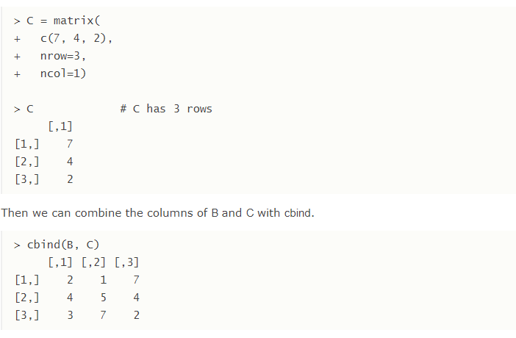

Slide 16
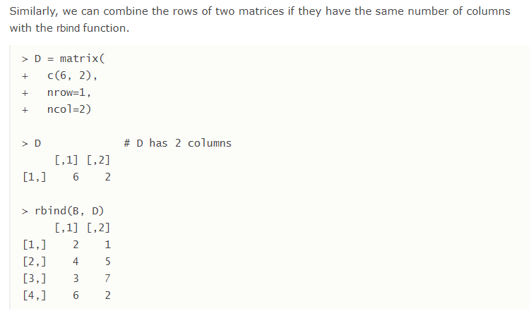

Slide 17
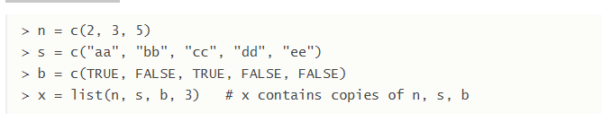
List
A list is a generic vector containing other objects.
For example, the following variable x is a list containing copies of three vectors n, s, b, and a numeric value 3.

Slide 18
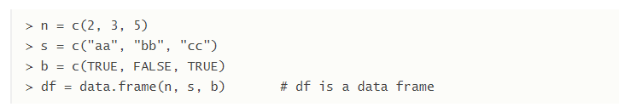
Data Frame
A data frame is used for storing data tables. It is a list of vectors of equal length. For example, the following variable df is a data frame containing three vectors n, s, b.

Slide 19
Built-in Data Frame
We use built-in data frames in R for our tutorials. For example, here is a built-in data frame in R, called mtcars.
To retrieve data in a cell, we would enter its row and column coordinates in the single square bracket "[]" operator. The two coordinates are separated by a comma.
the number of data rows in the data frame is given by the nrow function.
And the number of columns of a data frame is given by the ncol function.

