Slide 1
Programming with R
Lecture-2
Vandna Batra
CSE,FET,MRIIRS

Slide 2

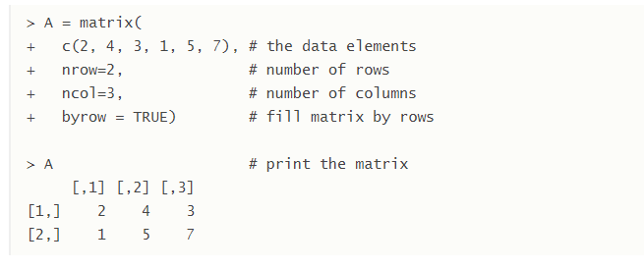
Matrix
A matrix is a collection of data elements arranged in a two-dimensional rectangular layout. The following is an example of a matrix with 2 rows and 3 columns.

Slide 3


An element at the m^{th} row, n^{th} column of A can be accessed by the expression A[m, n].
The entire m^{th} row A can be extracted as A[m, ].
Similarly, the entire n^{th} column A can be extracted as A[ ,n].

Slide 4
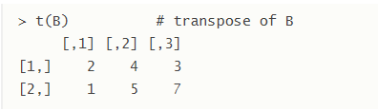
Transpose:We construct the transpose of a matrix by interchanging its columns and rows with the function t .
Combining Matrices
The columns of two matrices having the same number of rows can be combined into a larger matrix. For example, suppose we have another matrix C also with 3 rows.

Slide 5
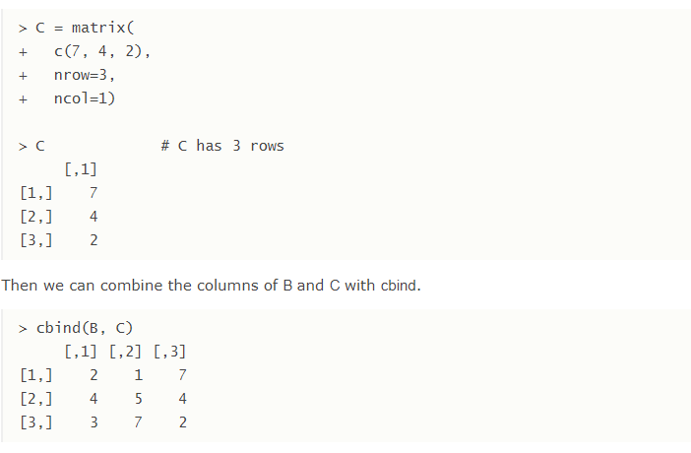

Slide 6
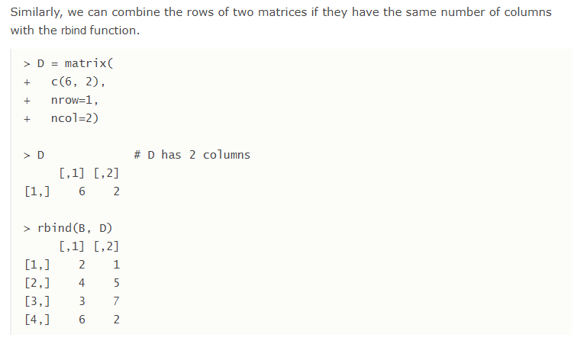

Slide 7
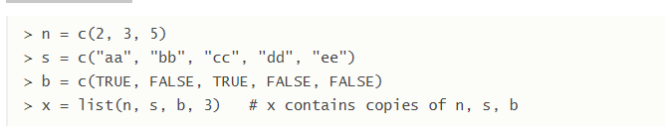
List
A list is a generic vector containing other objects.
For example, the following variable x is a list containing copies of three vectors n, s, b, and a numeric value 3.

Slide 8
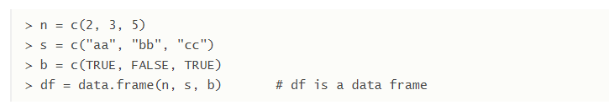
Data Frame
A data frame is used for storing data tables. It is a list of vectors of equal length. For example, the following variable df is a data frame containing three vectors n, s, b.

Slide 9
Built-in Data Frame
We use built-in data frames in R for our tutorials. For example, here is a built-in data frame in R, called mtcars.
To retrieve data in a cell, we would enter its row and column coordinates in the single square bracket "[]" operator. The two coordinates are separated by a comma.
the number of data rows in the data frame is given by the nrow function.
And the number of columns of a data frame is given by the ncol function.

