Slide 1
Data Science
Lecture-1

Slide 2
Data Science
Data Science has become the most demanding job of the 21st century. Every organization is looking for candidates with knowledge of data science.
Data science involves extracting knowledge from data you gather using different methodologies.

Slide 3
What is Data Science?
Data science is a deep study of the massive amount of data, which involves extracting meaningful insights from raw, structured, and unstructured data that is processed using the scientific method, different technologies, and algorithms.
It is a multidisciplinary field that uses tools and techniques to manipulate the data so that you can find something new and meaningful.
Data science uses the most powerful hardware, programming systems, and most efficient algorithms to solve the data related problems. It is the future of artificial intelligence.

Slide 4
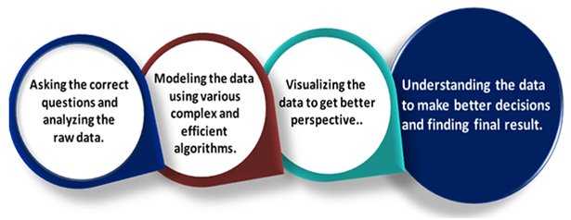
Data science is all about

Slide 5
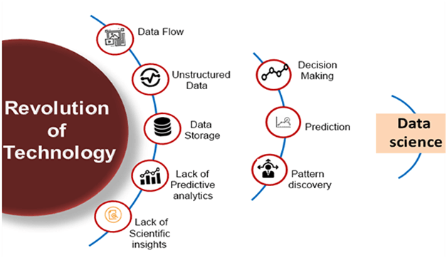
Need for Data Science:

Slide 6
With the help of data science technology, we can convert the massive amount of raw and unstructured data into meaningful insights.
Data science technology is opting by various companies, whether it is a big brand or a startup. Google, Amazon, Netflix, etc, which handle the huge amount of data, are using data science algorithms for better customer experience.
Data science is working for automating transportation such as creating a self-driving car, which is the future of transportation.
Data science can help in different predictions such as various survey, elections, flight ticket confirmation, etc.

Slide 7
Who is a Data Scientist?
Data Scientist is one who practices the art of Data Science. The term “Data Scientist” has been coined after considering the fact that a Data Scientist draws a lot of information from the scientific fields and applications whether it is statistics or mathematics.

Slide 8
What does a Data Scientist do?
Data scientists are those who crack complex data problems with their strong expertise in certain scientific disciplines
They work with several elements related to mathematics, statistics, computer science, etc.
They make a lot of use of the latest technologies in finding solutions and reaching conclusions that are crucial for an organization’s growth and development.
Data Scientists present the data in a much more useful form as compared to the raw data available to them from structured as well as unstructured forms.

Slide 9
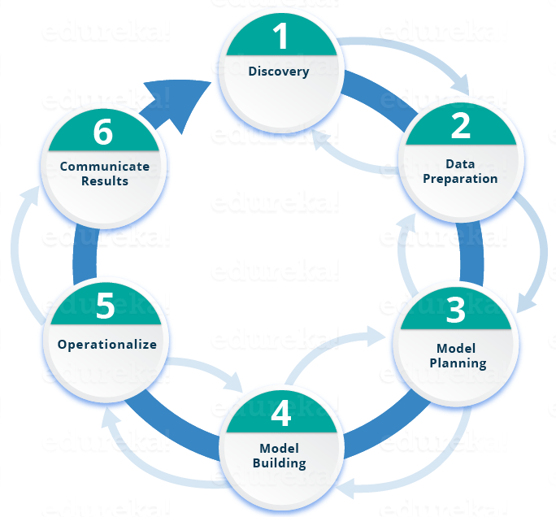
Lifecycle of Data Science

Slide 10
Phase 1—Discovery
Before you begin the project, it is important to understand the various specifications, requirements, priorities and required budget.
You must possess the ability to ask the right questions.
Here, you assess if you have the required resources present in terms of people, technology, time and data to support the project. In this phase, you also need to frame the business problem and formulate initial hypotheses (IH) to test.

Slide 11
Phase 2—Data preparation
In this phase, you require analytical sandbox in which you can perform analytics for the entire duration of the project.
You need to explore, preprocess and condition data prior to modeling. Further, you will perform ETLT (extract, transform, load and transform) to get data into the sandbox.
You can use R for data cleaning, transformation, and visualization. This will help you to spot the outliers and establish a relationship between the variables

Slide 12
Phase 3—Model planning
Here, you will determine the methods and techniques to draw the relationships between variables.
These relationships will set the base for the algorithms which you will implement in the next phase.
You will apply Exploratory Data Analytics (EDA) using various statistical formulas and visualization tools.

Slide 13

R has a complete set of modeling capabilities and provides a good environment for building interpretive models.
SQL Analysis services can perform in-database analytics using common data mining functions and basic predictive models.
SAS/ACCESS can be used to access data from Hadoop and is used for creating repeatable and reusable model flow diagrams.
Although, many tools are present in the market but R is the most commonly used tool.

Slide 14
Phase 5—Operationalize
In this phase, you deliver final reports, briefings, code and technical documents.
In addition, sometimes a pilot project is also implemented in a real-time production environment.
This will provide you a clear picture of the performance and other related constraints on a small scale before full deployment.

Slide 15
Phase 6—Communicate results
Now it is important to evaluate if you have been able to achieve your goal that you had planned in the first phase.
So, in the last phase, you identify all the key findings, communicate to the stakeholders and determine if the results of the project are a success or a failure based on the criteria developed in Phase 1.

