Slide 1
Unit-2
IOT TECHNOLOGIES BEHIND SMART AND INTELLIGENT DEVICES

Slide 2
FUTURE
The Internet of Things keeps promising us a smarter future: fridges able to replenish themselves by automatically ordering food at a local grocery store (in-fridge delivery included!), bridges warning the oncoming cars about a frozen surface, or smart gear that monitors your health and delivers real-time data straight to your doctor’s iPhone.

Slide 3
Which technology allows IoT smart devices to be smarter in a literal sense?
Machine learning will allow these smart devices to be smarter in a literal sense. It can analyze the data generated by the connected devices and get an insight into the human's behavioral pattern.

Slide 4
Drawback of IOT
Compatibility – As of now there is no international standard of compatibility. However, this problem should be easy to overcome. The manufacturing sector can agree to a standard such as Bluetooth, which is already available in the market. This really needs no innovation.
Privacy – When all data is transmitted to the IoT device, it increases the probability of privacy breach. Data encryption is not particularly a strong point of IoT. However, this too can be managed with software tools and protection protocol.

Slide 5
What is smart IoT devices?
IoT devices are basically smart devices which have support for internet connectivity and are able to interact with the other devices over the internet and grant remote access to a user for managing the device as per their need.

Slide 6
AUTOMATION
The primary drive for automation IoT is to significantly reduce operating expenditures when automation devices, sensors and actuators become Internet-enabled devices.

Slide 7
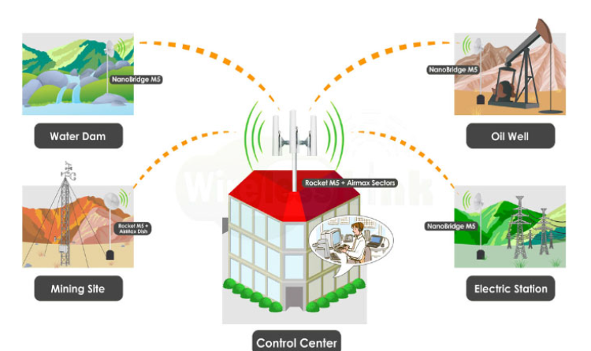
AUTOMATION

Slide 8
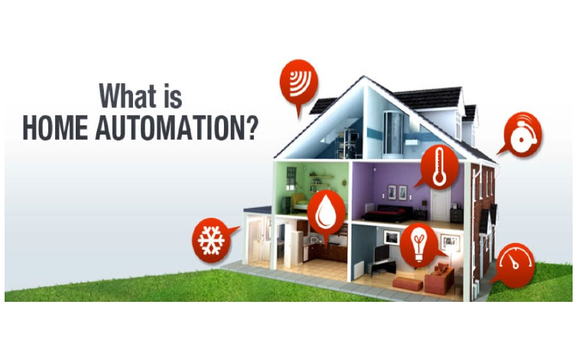

Slide 9
IoT home automation – Smart homes and Internet of Things The data is then used for monitoring, controlling and transferring information to other devices via the internet. This allows specific actions to be automatically activated whenever certain situations arise. In a simple example, consider a smart kettle.

Slide 10
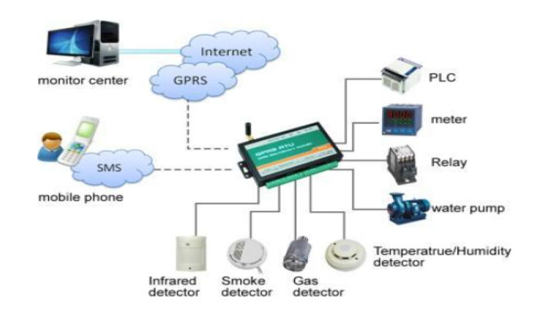

Slide 11
How IoT is used in home automation?
The IoT based Home Automation will enable the user to use a Home Automation System based on Internet of Things (IoT). The modern homes are automated through the internet and the home appliances are controlled. The user commands over the internet will be obtained by the Wi-Fi modems.

Slide 12
Why do we need home automation?
Control your heating and cooling and you control 48% of your energy spending. Home automation technologies such as smart thermostats, smart lighting, and smart appliances connect to a centralized control that can act on its own or be programmed to control energy consumption and increase savings.

Slide 13
Why Smart Home is needed?
Smart home ensures you save electricity and reduce your power and water bills. Often it is observed that lights remain on due to the laziness of standing up and turning them off. A smart home will allow you to turn off lights and other electronic items even when you are in bed and going to sleep.

Slide 14
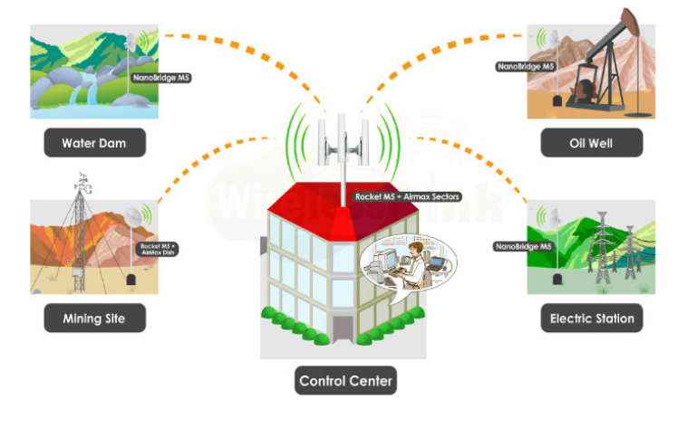

Slide 15
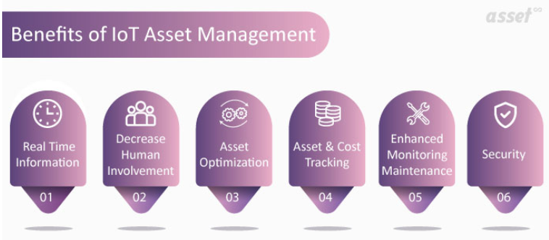
ASSET MANAGEMENT
How IoT is helpful in terms of Asset Management?

Slide 16
Real Time Information
IoT is capable of getting real-time information which can play a crucial role in future events and planning. For instance, let us take an agriculture-based organization. As the human population grows continuously, so does the demand for and supply of food. Smart farming with IoT is one of the rapidly growing sectors.
Farmers can utilize actionable information to improve yields and for increased return on investment. Detecting for soil moisture and nutrients, controlling water utilization for plant growth, and deciding which fertilizers are best for a growing plantation are some simple and effective usages of IoT technology.

Slide 17
Decrease Human Involvement
IoT enabled asset management uses sensors. This empowers organizations to know their assets’ information, eliminating the need for human effort. It actively keeps track of all assets through IoT sensors attached to each asset.
However, selecting the IoT sensor is also crucial. There is a variety of them to gauge measures such as acceleration, temperature, humidity, pressure, proximity, etc. Therefore, the right IoT sensor has to be selected as per the business need.
The sensors attached to the asset are used to generate data and the same is relayed to the Cloud platform. It sends data every 5 or 10 minutes (as programmed by the organization).

Slide 18
Asset Optimization
When an asset is purchased, it is obviously intended to generate revenue from the asset. Asset managers know the importance of keeping an asset in the running condition. When an asset tracking plan is executed, it is important to keep a clear picture of assets so that compatible plans can be made.
With IoT-enabled asset management, the organization has the capability to see if the asset performance is in line with the expectations or not. In case it is not working efficiently, preventive and predictive maintenance needs to be implemented for the purpose of asset optimization.
IoT sensors keep track of asset performance. With such information, the organization can make the appropriate decision in order to save expenses and extend the life of an asset.

Slide 19
Asset & Cost Tracking
Asset tracking is very important to keep up the productivity and growth of the organization. IoT enables to get real-time information of assets, thereby ensuring security and safety of the asset.
Without correcting the source from where costs originate, it is difficult for any business to reduce the upkeep expenses. For example, if the Maintenance Manager is not aware of the main problem of an asset, they cannot make the right and timely move to keep the asset in operation.
IoT-empowered assets furnish information arising from the root cause of any problem. It ensures that the issues are resolved, breakdown costs are saved and smart financial decisions can be taken in time.

Slide 20
Enhanced Monitoring Maintenance
With IoT technology, an enterprise can monitor its assets, machines, equipment, etc. in real-time. For instance, when a manufacturing unit monitors the health of its asset health, the related operational costs can be reduced.
An IoT sensor can alert plant managers when the operating parameters of assets such as temperature or environment are not in the permissible range.

Slide 21
Security
In spite of some concerns expressed for IoT devices, these asset trackers now come with better security. The IoT tracker uses bank-level AES-256 data authentication and data encryption to ensure that the data is kept private and secure.

Slide 22
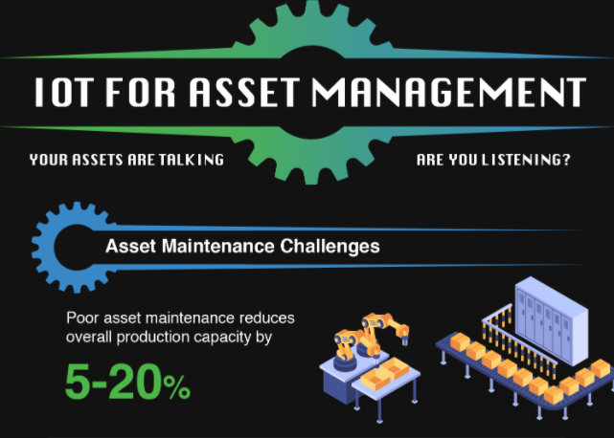
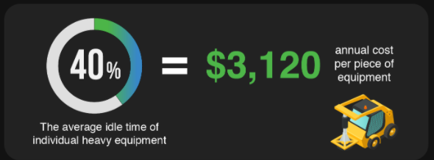

Slide 23
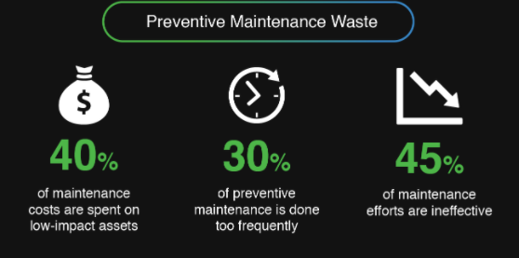

Slide 24
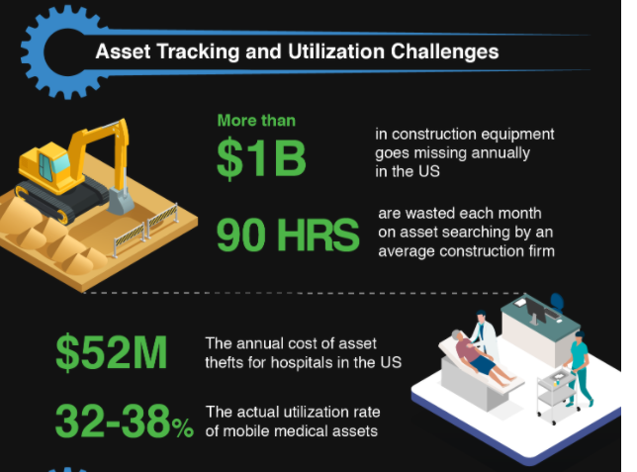

Slide 25
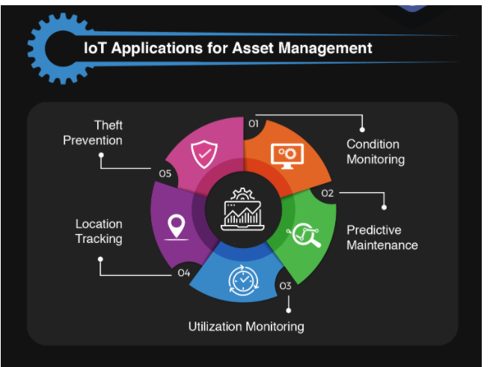

Slide 26
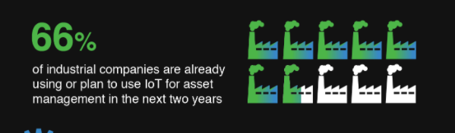

Slide 27
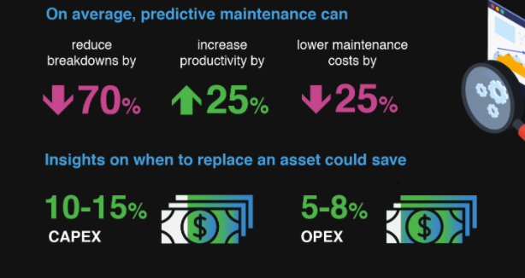

Slide 28
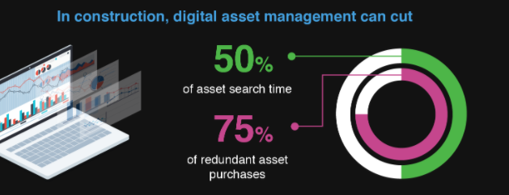

Slide 29
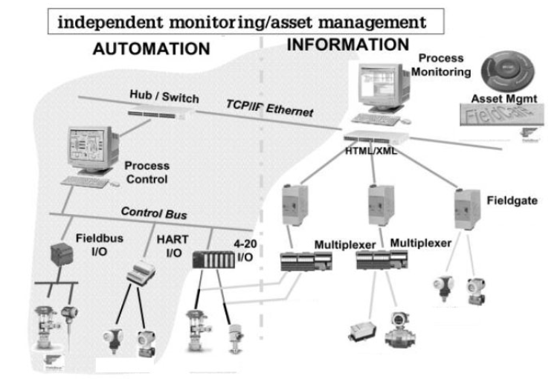

Slide 30
TELEMETRY
Data collected by the device is called telemetry. This is the eyes-and-ears data that IoT devices provide to applications. Telemetry is read-only data about the environment, usually collected through sensors. Each source of telemetry results in a channel.

Slide 31
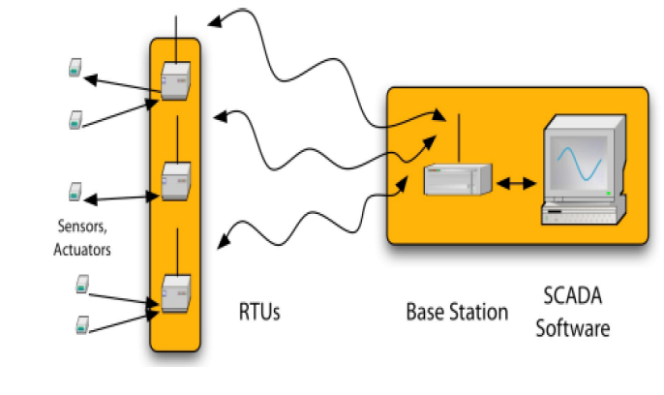

Slide 32
RTU-Remote Terminal Unit:RTU stands for Remote Terminal Unit, sometimes also called Remote Telemetry Unit or Remote Telecontrol Unit. A RTU is a microprocessor based device that monitors and controls field devices, that then connects to plant control or SCADA (supervisory control and data acquisition) systems.
What is Scada and how does it work?
Supervisory Control and Data Acquisition (SCADA) is a system that aims to monitor and control field devices at your remote sites. ... SCADA is a centralized system that monitors and controls the entire area. This supervisory system gathers data on the process and sends the commands control to the process.

Slide 33
Which Scada system is best?
Below are the leading SCADA companies:
Siemens WinCC.
Invensys Wonderware InTouch.
Intellution iFix.
Allen Bradley RS View.
Rockwell.
GE Fanuc Simplicity.

Slide 34
BASE STATION
They are very small devices that can be hand-held, they are not just stations. The station is a small device that will easily fit in your back pocket or in a backpack.
The station has 2 antennas, one for the short-range transceiver and one for the long-range transceiver. It also has 3 L.E.D.s that indicate the base station’s battery condition as well as data downloads in progress.
Stations will download GPS data from any white listed GPS device within range. The white list contains the transceiver addresses for all of your GPS devices. Without being represented in the white list a GPS device cannot automatically communicate with a base station. However, a manual connection between the base station and the GPS device can still be achieved but only by using a laptop connected to the base station.

Slide 35
How is telemetry used?
The telemetry unit changes the signals into pictures of each heartbeat. The pictures are sent to a monitor that looks like a television screen. The monitor displays the picture of your heartbeat continuously and trained nurses watch the monitor 24 hours a day. The monitor collects information about your heart.

Slide 36
How Telemetry Works
In a general sense, telemetry works through sensors at the remote source which measures physical (such as precipitation, pressure or temperature) or electrical (such as current or voltage) data. This is converted to electrical voltages that are combined with timing data. They form a data stream that is transmitted over a wireless medium, wired or a combination of both.
At the remote receiver, the stream is disaggregated and the original data displayed or processed based on the user’s specifications.

Slide 37
Where is IoT data stored?
IoT data is mostly unstructured and so can easily be stored in public cloud infrastructure. All the major cloud providers offer low-cost scalable storage systems based on object storage technology.

Slide 38
What makes IoT data valuable?
But the data generated from IoT devices is only valuable if users can effectively analyze it, and performing that analysis presents its own set of challenges related to security, variety, and volume. ... Also, each connected device will create its own type of data.

Slide 39
Which cloud is best for IoT?
IBM Watson IoT Platform. ...
AWS IoT Platform. ...
Cisco IoT Cloud Connect. ...
Salesforce IoT Cloud. ...
Kaa IoT Platform. ...
Oracle IoT Platform. ...
Thingspeak IoT Platform. Thingspeak is an open-source platform that allows you to collect and store sensor data to the cloud. ...
GE Predix IoT Platform. Predix is the world's first industrial platform.

Slide 40
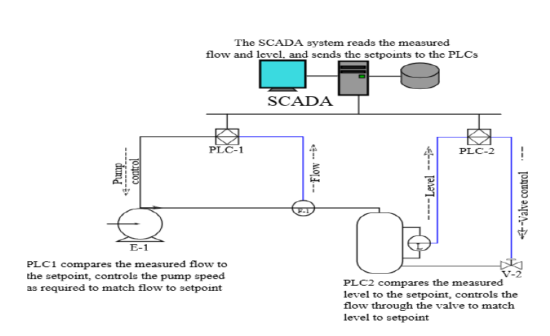

Slide 41
A PROGRAMMABLE LOGIC CONTROLLER (PLC) is an industrial computer control system that continuously monitors the state of input devices and makes decisions based upon a custom program to control the state of output devices.

