Slide 1
Introduction to IoT
UNIT1

Slide 2
What is IOT?
The Internet of Things (IoT) is a network of physical objects or people called "things" that are embedded with software, electronics, network, and sensors which allows these objects to collect and exchange data.

Slide 3
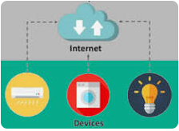

Slide 4
IoT is creating a giant network where all the devices are connected to each other and providing them with the capability to interact with each other.
This is driving the automation to a next level where devices will communicate with each other and make decisions on their own without any human interventions.

Slide 5
Examples
Refrigerator’s sensor can gather the data regarding the outside temperature and accordingly adjust the refrigerator’s temperature.
A room temperature sensor gathers the data and send it across the network, which is then used by multiple device sensors to adjust their temperatures accordingly.
Air conditioners can also adjust its temperature accordingly.
IoT is trying to expand the interdependence in human- i.e interact, contribute and collaborate to things.

Slide 6
Since IOT allows devices to be controlled remotely across the internet, thus it created opportunities to directly connect & integrate the physical world to the computer-based systems using sensors and internet.
The interconnection of these multiple embedded devices will be resulting in automation in nearly all fields and also enabling advanced applications.

Slide 7
This is resulting in improved accuracy, efficiency and economic benefit with reduced human intervention.
It encompasses technologies such as smart homes, intelligent transportation and smart cities

Slide 8
Benefits of IOT
Improved Customer Engagement – IoT improves customer experience by automating the action. For eg: For e.g. any issue in the car will be automatically detected by the sensors. The driver, as well as the manufacturer, will be notified about it. Till the time driver reaches the service station, the manufacturer will make sure that the faulty part is available at the service station.
Technical Optimization – IoT has helped a lot in improving technologies and making them better. The manufacturer can collect data from different car sensors and analyze them to improve their design and make them much more efficient.

Slide 9
Reduced Waste – Our current insights are superficial, but IoT provides real-time information leading to effective decision making & management of resources. For example, if a manufacturer finds fault in multiple engines, he can track the manufacturing plant of those engines and can rectify the issue with manufacturing belt.

Slide 10
IOT HARDWARE
sensors that will sense the environment,
a remote dashboard to monitor your output and display it in a clearer & conceivable form
a device with the capability of serving & routing.
The key task of the system would be detecting specific conditions and taking actions accordingly.
One thing to keep in mind is securing the communication between the devices and the dashboard.

Slide 11
Some common sensors
Accelerometers:Accelerometers are likewise used in cars as the industry method way of detecting car crashes and deploying airbags almost instantaneously. In another example, a dynamic accelerometer measures gravitational pull to determine the angle at which a device is tilted with respect to the Earth.
temperature sensors
magnetometers,
proximity sensors:used to detect any nearby physical objects.
gyroscopes: angular rate sensor in mobile for navigation stability.
image sensors-used in mobile camera
light sensors, pressure sensors, gas RFID sensors, humidity sensors

Slide 12
More examples
smartwatches, shoes & 3D glasses.
This is the best example of a smart solution.
3D glasses adjust television’s brightness and contrast according to your eye
Your smartwatches keeps track of your daily activities and fitness.

Slide 13
IoT uses multiple technologies and protocols to communicate with devices based on the requirements. (Cell phones)
The major technologies & protocols are: Bluetooth, wireless, NFC, RFID, radio protocols and WiFi-Direct.

Slide 14
IOT ACROSS VARIOUS DOMAINS
Energy Applications: The energy rates have raised to a great instinct. Individuals and organisations, both are searching ways to reduce and control the consumption. IoT provides a way to not only monitor the energy usage at the appliance-level but also at the house-level, grid level or could be at the distribution level. Smart Meters & Smart Grid are used to monitor energy consumption. It also detects threats to the system performance and stability, which protect appliances from downtime and damages.
Healthcare Application: Smartwatches and fitness devices have changed the frequency of health monitoring. People can monitor their own health at regular intervals. Not only this, now if a patient is coming to the hospital by ambulance, by the time he or she reaches the hospital his health report is diagnosed by doctors and the hospital quickly starts the treatment. The data gathered from multiple healthcare applications are now collected and used to analyze different disease and find its cure.

Slide 15
Education: IoT provides education aids which helps in fulfilling the gaps in the education industry. It not only improves the quality of education but also optimizes the cost and improves the management by taking into consideration students response and performance.
Government: Governments are trying to build smart cities using IoT solutions. IoT enhances armed force systems and services. It provides better security across the borders through inexpensive & high-performance devices. IoT helps government agencies to monitor data in real-time and improve their services like healthcare, transportation, education etc.

Slide 16
Air and Water Pollution: Through various sensors, we can detect the pollution in the air and water by frequent sampling. This helps in preventing substantial contamination and related disasters. IoT allows operations to minimize the human intervention in farming analysis and monitoring. Systems automatically detect changes in crops, soil, environment, and more.
Transportation: IoT has changed the transportation sector. Now, we have self-driving cars with sensors, traffic lights that can sense the traffic and switch automatically, parking assistance, giving us the location of free parking space etc. Also, various sensors in your vehicle indicate you about the current status of your vehicle, so that you don’t face any issues while travelling.
Marketing your product: Using IoT, organizations can better analyze & respond to customer preferences by delivering relevant content and solutions. It helps in improving business strategies in the real-time.

Slide 17
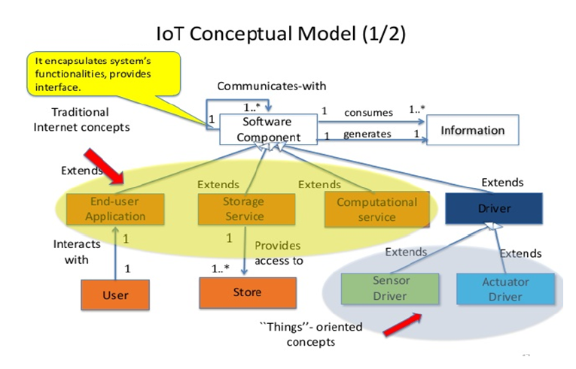
IOT CONCEPTUAL MODEL

Slide 18
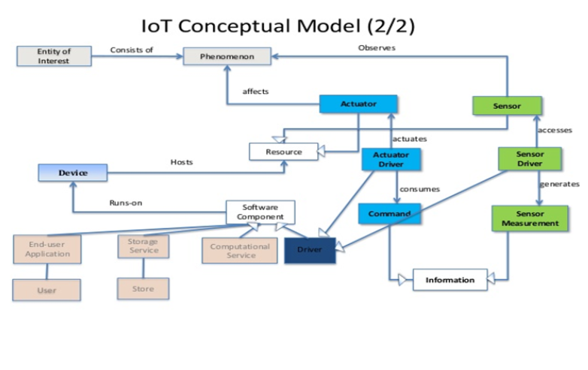

Slide 19
In a typical IoT system, a sensor may collect information and route to a control center. There, previously defined logic dictates the decision. As a result, a corresponding command controls an actuator in response to that sensed input. Thus, sensors and actuators in IoT work together from opposite ends.

Slide 20
Difference between Actuator and Sensor.
A sensor tends to convert a physical attribute to an electrical signal.
An actuator does the opposite: it changes an electrical signal to physical action.

Slide 21
Example of smartphone for sensor and actuators
A sensor transforms interesting, useful energy into electrical data.
By contrast, an actuator transforms electrical data into interesting, useful energy.
Our smartphones are full of transducers — the camera and microphone are sensors whereas the speakers and screen are actuators.

Slide 22
BRIEF HISTORY OF IOT
The Internet of Things (IoT) has not been around for very long.
However, there have been visions of machines communicating with one another since the early 1800s.
Machines have been providing direct communications since the telegraph (the first landline) was developed in the 1830s and 1840s.
Described as “wireless telegraphy,” the first radio voice transmission took place on June 3, 1900, providing another necessary component for developing the Internet of Things.
The development of computers began in the 1950s.

Slide 23
The Internet, itself a significant component of the IoT, started out as part of DARPA (Defense Advanced Research Projects Agency) in 1962, and evolved into ARPANET in 1969.
Global Positioning Satellites (GPS) became a reality in early 1993, with the Department of Defense providing a stable, highly functional system of 24 satellites.
One additional and important component in developing a functional IoT was IPV6’s remarkably intelligent decision to increase address space.

Slide 24
One of the first examples of an Internet of Things is from the early 1980s, and was a Coca Cola machine, located at the Carnegie Melon University.
By the year 2013, the Internet of Things had evolved into to a system using multiple technologies, ranging from the Internet to wireless communication and from micro-electromechanical systems (MEMS) to embedded systems.
The traditional fields of automation (including the automation of buildings and homes), wireless sensor networks, GPS, control systems, and others, all support the IoT.
Kevin Ashton, the Executive Director of Auto-ID Labs at MIT, was the first to describe the Internet of Things, while making a presentation for Procter & Gamble.

Slide 25
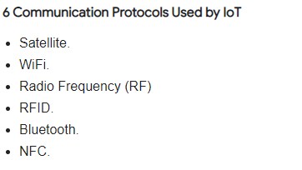
Introduction to IOT Communication

Slide 26
Depending on the application, factors such as range, data requirements, security and power demands and battery life will dictate the choice of one or some form of combination of technologies.

Slide 27
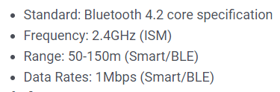
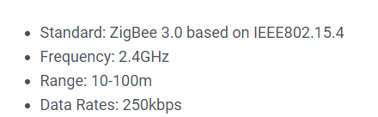
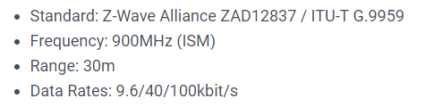
Bluetooth:
Zigbee:
Z-Wave:

Slide 28
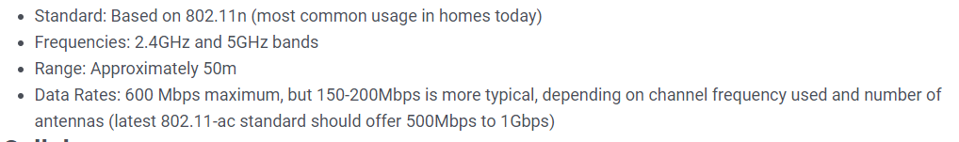
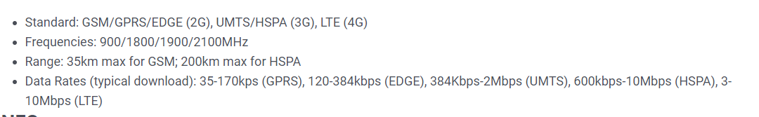
WiFi:
Cellular:

Slide 29
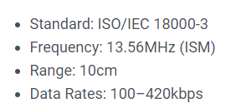
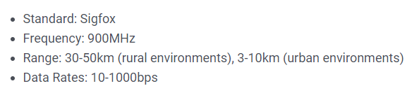
NFC:
Sigfox:

Slide 30
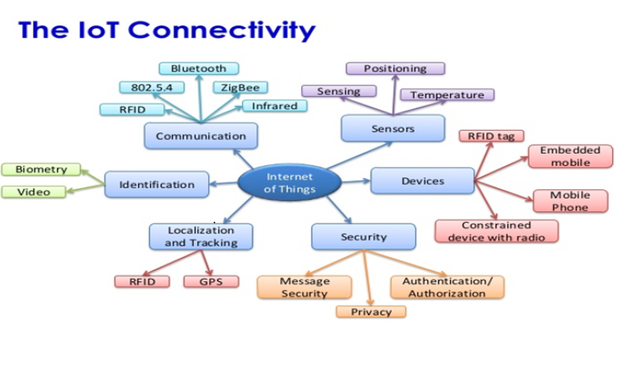
IOT CONNECTIVITY

Slide 31
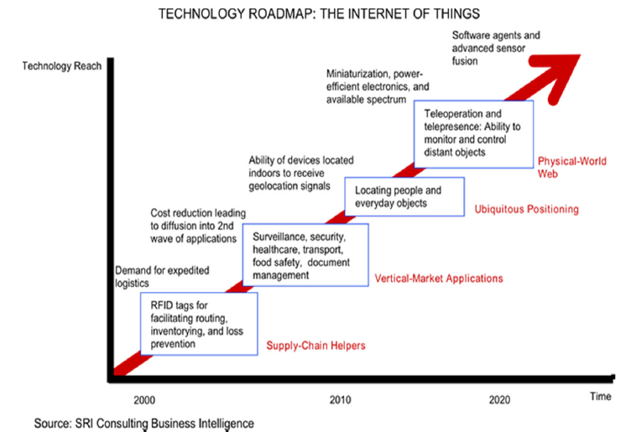
TECHNOLOGY ROADMAP

Slide 32
TELEMETRY VS IOT
Telemetry is the automatic recording and transmission of data from remote or inaccessible sources to an IT system in a different location for monitoring and analysis.

Slide 33
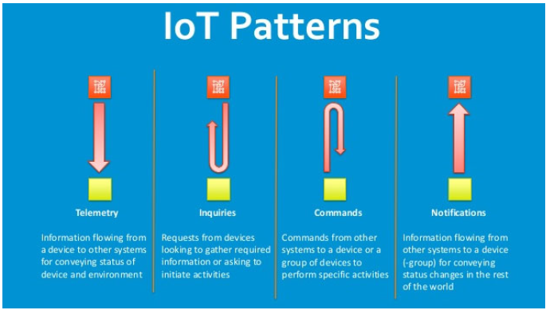

Slide 34
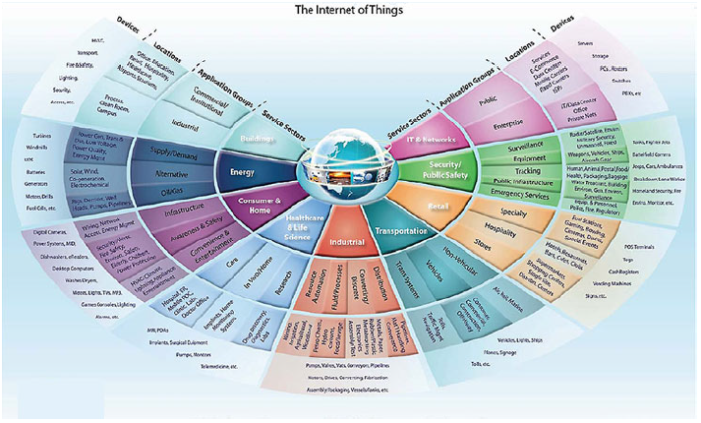
Applications of IOT Communication

Slide 35
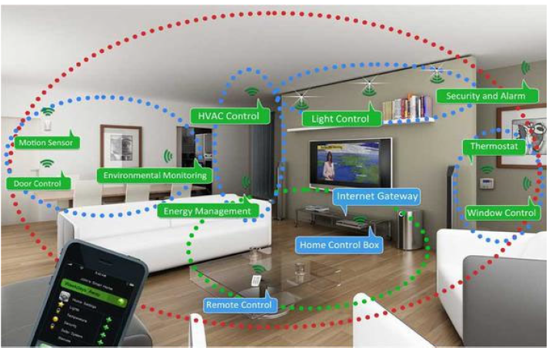
INTELLIGENT HOME

Slide 36
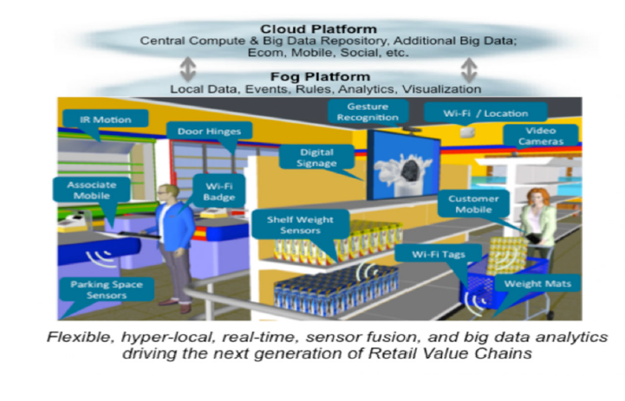
SHOPPING

Slide 37
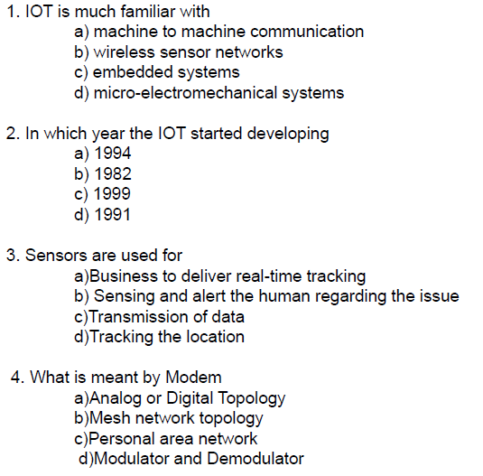
MCQS

Slide 38
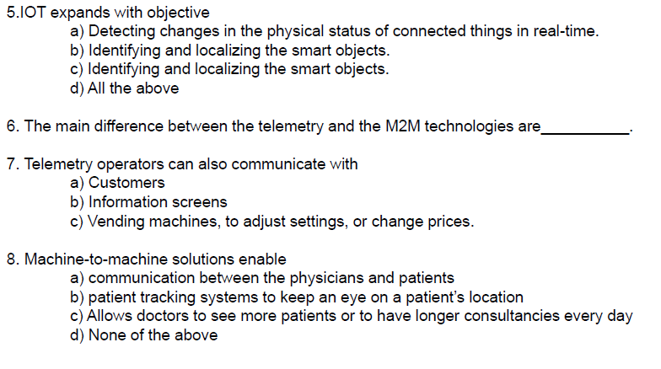

Slide 39
