Slide 1
Attitudinal Trends in postsecondary learning
John Vandivier
GMU
jvandivi@gmu.edu
@JohnVandivier

Slide 2
Definitions and motivation
Traditional:
Immediate, public, accredited, 4-year, business degree
Offline, credit hours
No career, house, marriage, kids
Alternatives
Private, vocational, unaccredited, 2-year
Online, credit by exam, prior learning assessments
Udacity Nanodegree
Motivation
Debt crisis
Cheaper, better employees
Individual career entry and switching

Slide 3
Methodology
Unbalanced Panel Survey
Multiple sources: Mechanical Turk, SurveyMonkey, other
n = 1190, 114 independent vars, 2 dependent vars
4 administrations across 2018 and 2019

Slide 4
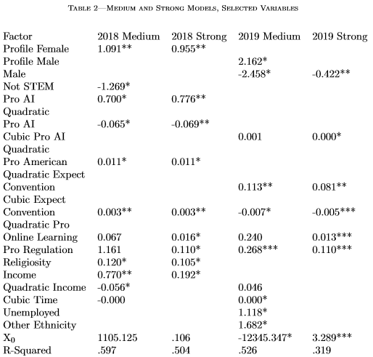
Results
Preferred nonlinear r-squared = .8691 form =
Preferred multivariate 2019 Medium

Slide 5
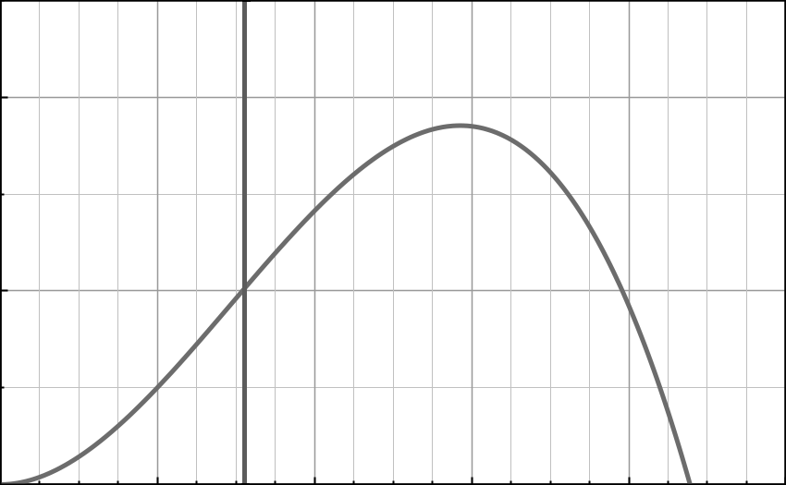
Suitability over conventionality

Slide 6
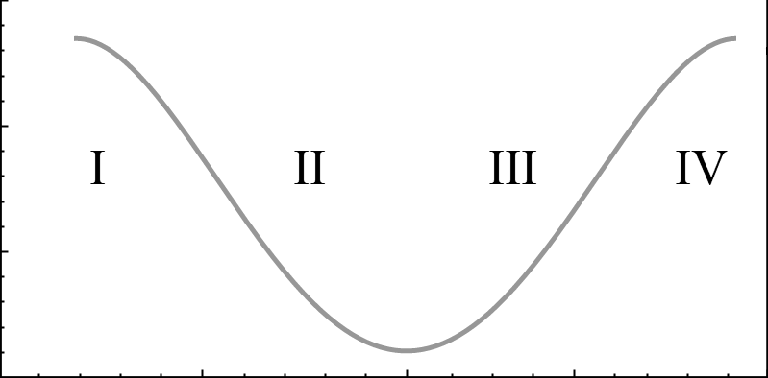
Employer-driven favorability

Slide 7
Other interesting results
Elder favorability and youth antagonism
Nonbinary antagonism
Mechanical Turk was the cheapest source

Slide 8
Summary & Application
Employers are favorable, but so is everyone
Employer favorability decreasing in short term
Favorability is expected to stabilize over 5
SO…
Individuals: Prefer both not either
Firms: Remove degree requirement
Policy: Consider and enable alternative education, freeze or reduce subsidies

Slide 9
Artifacts, questions, comments
https://papers.ssrn.com/sol3/papers.cfm?abstract_id=3387110
https://github.com/Vandivier/research-dissertation-case-for-alt-ed/tree/master/papers/alt-ed-survey/
Email: jvandivi@gmu.edu
Twitter: @JohnVandivier

