Slide 1
LOAD TESTING , STRESS TESTING , ENDURANCE TESTING & VOLUME TESTING
Marteena Roy

Slide 2
What is Testing ?
According to Wikipedia “Revealing a person's capabilities by putting them under strain; challenging.”

Slide 3
Types of Testing
Functional Testing
Usually done first, to test application functionality not performance
Very Comprehensive! Tries to cover all aspects of a System Application.
Tests at the Presentation Layer or user Interface (UI) level.
Performance Testing
Once the application passes functional testing, it is generally submitted for performance testing
During this process, the system/application is stressed to see how well it performs when used by many users simultaneously
Usually tests at the Protocol or Middleware level although more modern techniques test at the UI.

Slide 4

Wikipedia says: “In the computer industry, software performance testing is used to determine the speed or effectiveness of a computer, network, software program or device. This process can involve quantitative tests done in a lab, such as measuring the response time or the number of MIPS (millions of instructions per second) at which a system functions. Qualitative attributes such as reliability, scalability and interoperability may also be evaluated. Performance testing is often done in conjunction with stress testing.”
Our Simplified Definitions Performance Testing = how fast & stable is the system?

Slide 5

Why does performance matter?

Slide 6
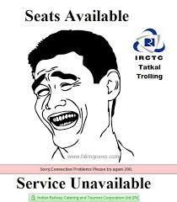



Slide 7
• Loss of revenue
Amazon states that for every 100ms of latency, they lose 1% of their sales.
• Loss of customers
Flipkart says “57% of shoppers will abandon a site after waiting 3 seconds for a page to load, out of them 80% don’t return again on same site.”
Loss of productivity
Reddit, states that their performance focus is on page load speed. “If we can get 10% more performance, we immediately see 10% more traffic.”
Backlog of Work
On an average 1.2 million people try to book tickets in the first ten minutes of the Tatkal timeframe, Of that only 50000 people come out of the website with tickets, at the success rate of 4.16% only due to service backlog during peak.

Slide 8
Microsoft found that Bing searches that were 2 seconds slower resulted in a 4.3% drop in revenue per user
When Mozilla shaved 2.2 seconds off their landing page, Firefox downloads increased 15.4%
Making Barack Obama’s website 60% faster increased donation conversions by 14%
Amazon and Walmart increase revenue 1% for every 100ms of improvement

Slide 9
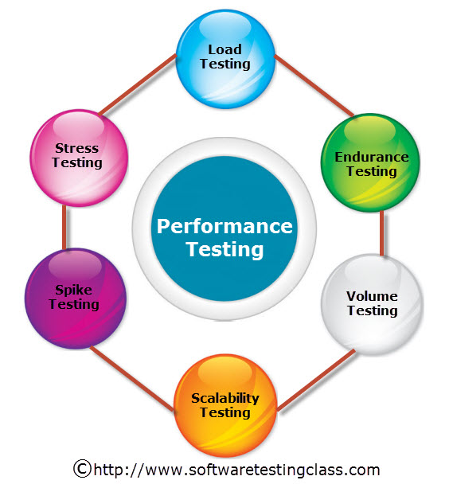
Types Performance testing

Slide 10
Load Testing
• The “Classic” performance test
Validates the system/application to determine if it meets the performance targets.
Provide information that will assist in performance tuning under various workload conditions, hardware configurations, and database sizes
Helps identify key performance data such as:
• Capacity
• Latency
• Response time
• Throughput
• Memory Management

Slide 11
Cont.
1. Load Testing
Load Testing help us to study the behavior of the application under various loads. The main parameter to focus is response time. This study reveals how the application handles concurrent users effectively.
Main parameter to focus: Response Time
Load Testing
Process of exercising the system under test by feeding it the largest tasks it can operate with.
Constantly increasing the load on the system via automated tools to simulate real time scenario with virtual users.
Examples:
Testing a word processor by editing a very large document.
For Web Application load is defined in terms of concurrent users or HTTP connections.

Slide 12
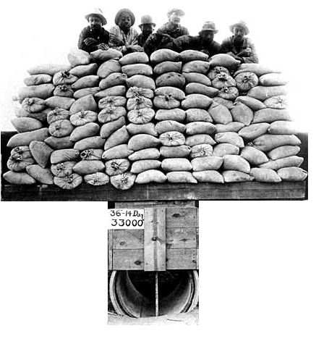

Slide 13

Stress Testing
2. Stress Testing
Stress Testing help us to observe the stability of the application. The main intention is to identify the breaking point of the server. The main parameter to focus is throughput
(how much data is being transferred between client and server)
Main parameter to focus: Response Time and Throughput
Trying to break the system under test by overwhelming its resources or by taking resources away from it.
Purpose is to make sure that the system fails and recovers gracefully.

Slide 14
Stress Testing is performance testing type to check the stability of software when hardware resources are not sufficient like CPU, memory, disk space etc.
“To determine or validate an application’s behavior when it is pushed beyond normal or peak load conditions.”
Stress testing is Negative testing where we load the software with large number of concurrent users/processes which cannot be handled by the systems hardware resources. This testing is also known as Fatigue testing, this testing should capture the stability of the application by testing it beyond its bandwidth capacity.
The main idea behind stress testing is to determine the failure of system and to keep an eye on how the system gracefully get recover back, this quality is known as recoverability. Stress testing comes under the Non Functional Testing & it is designed to test the non-functional requirements of a software application. This testing is to be carried out under controlled environment before launch, so that we can accurately capture the system behavior under most erratic scenarios

Slide 15
Example:
Double the baseline number for concurrent users/HTTP connections.
Randomly shut down and restart ports on the network switches/routers that connects servers.

Slide 16
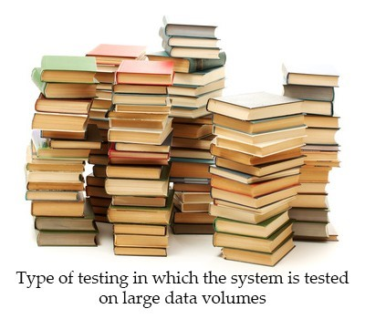
Volume Testing
It refers to the tests designed to measure the throughput of the system more in a batch processing, messaging kind of environment. The objective of this test is to identify the processing capacity.
For example, if you want to volume test your application with a specific database size, you will expand your database to that size and then test the application's performance on it.
Volume testing: The objective is to assess your volume needs to help you plan your capacity. Under Volume testing large number of Data is populated in database and the overall software system's behavior is monitored.
Volume testing is non-functional testing which refers to testing a software application with a large amount of data to be processed to check the efficiency of the application. The main goal of this testing is to monitor the performance of application under varying database volumes

Slide 17
Endurance testing
4) Endurance testing:
Endurance testing is a non functional type of testing. Endurance testing involves testing a system with a expected amount of load over a long period of time to find the behavior of system. Let’s take a example where system is designed to work for 3 hrs of time but same system endure for 6 hrs of time to check the staying power of system. Most commonly test cases are executed to check the behavior of system like memory leaks or system fails or random behavior. Sometimes endurance testing is also referred as Soak testing.
What about sustained load for long periods of time? The objective is to make sure the application can handle the expected load over a long period of time.

