Slide 1
Food Truck Viability in Los Angeles

Slide 2
Business Problem
In this project we will try to find the viability to establish a food truck in Los Angeles, specifically in Pershing Square. This report will be targeted to stakeholders interested in opening a Food Truck in Los Angeles, California.
Since there are lots of Food Trucks and restaurants in Los Angeles we will try to detect the locations of all Restaurants and Food Trucks nearby, this way we can see if the chosen location is a viable point for a new Food Truck.

Slide 3
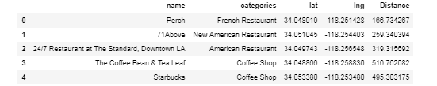
Data
The that we use where mostly the coordinates from the restaurants and food trucks around Pershing Square in Los Angeles.
Example of the Data used:

Slide 4
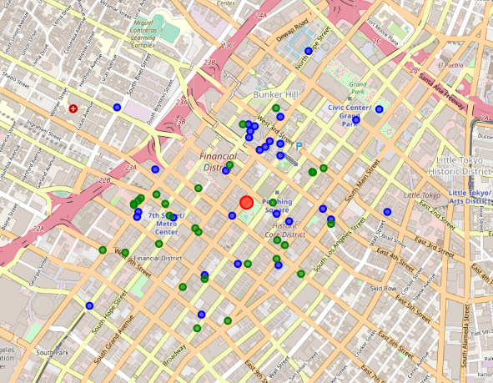
Locations
Location and type (category) of every restaurants and Food Trucks within 1km from Pershing Square.
The ones in green are the food trucks and the ones un blue the restaurants.
The red circle represents Pershing Square.

Slide 5
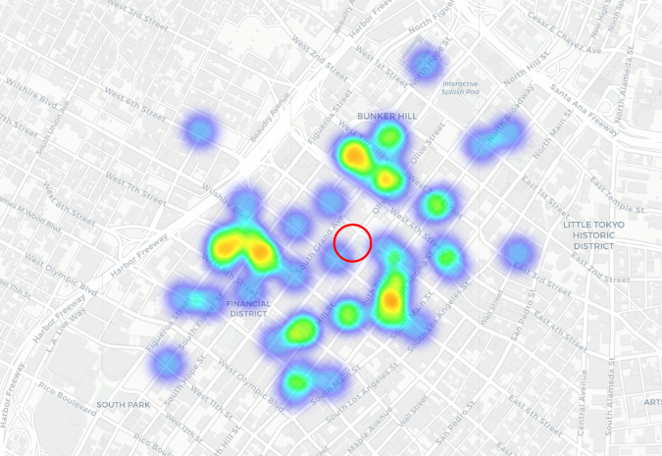
Heat map
Heat map were used to identify the areas with the high number of restaurants and food trucks nearby.

Slide 6
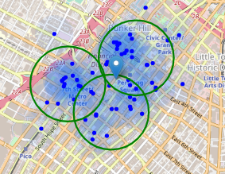
K-mean
K-mean is used to cluster the areas with more restaurants and Food Trucks to identify the quantity and distance between the restaurants and food trucks from Pershing Square.

Slide 7
Results
The number of restaurants and food trucks in Los Angeles around Pershing Square was only 60.
The Highest concentration of restaurants is in the north and west from Pershing Square.
The lowest density is located in the east from Pershing Square.
There are a low density of restaurants and food trucks near Pershing Square.
The nearest Restaurant was 166.7 mts and the nearest Food Truck was 120.75 mts close.
Pershing Square is between 2 clusters generated using k-means.

