Slide 1







Emerging Trending Skills Required In IT industry In the future
Vanessa Vidal Cáceres
May 20, 2025

Slide 2



OUTLINE
Executive Summary
Introduction
Methodology
Results
Visualization – Charts
Dashboard
Discussion
Findings & Implications
Conclusion
Appendix

Slide 3

EXECUTIVE SUMMARY
IT industry is a competitive and ever changing industry which require constant refine new programing skill and DataBases. This project is used to analyze the trends
This project is used to analyze the trend:
Current Technology Usage
Future Technology Trend
Demographics in IT industry
The project is to identify the top programming languages
Identifying top database skills in demand
Popular IDEs

Slide 4

INTRODUCTION
What is the emerging trend and future skill requirements in the Industry?
What are the top programming language in demand?
What are the top database skills in demand?
What are the popular IDEs?
collecting data from various sources and identifying trends for this year's report on emerging skills:
Job Postings
Training Portals
Surveys
A Data Analyst in a global IT and business consulting services firm that is known for their expertise in IT solutions and their team of highly experienced IT consultants. In order to keep pace with changing technologies and remain competitive, your organization regularly analyzes data to help identify future skill requirements.

Slide 5

METHODOLOGY
Data Source: Stack Overflow, Two data is used Demographics and Survey data technologies
Survey Data technologies was used to analyze the current technology trend and future technology trend:
Respondents
LanguageWorked With, DataBaseWorked With, PlatfarmWorked With, WebframeWorked With
LanguageDesireNextYear, DataBaseDesireNextYear, PlatformDesireNextYear, WebframeDesireNextYear,
Demographic data was used for demographic data:
Man and woman
Age
Formal education level and Countries
Data is filtered with:
NoValue or null is cleaned
Demographic: man and woman only
Illustration of the data is used as follows:
Python libraries: Numpy, Matplotlib, Pandas,Seaborn
IBM Cognos Analytics Dashboard
Jupyternotebook for Data Cleaning and Data Science Analysis

Slide 6
RESULTS
The Results shown as follows are the analysis comparing the graphs between the current technology usage and Future technology usage.
Results as follows:
Programming Language trends
DataBase trends
IDEs trends

Slide 7
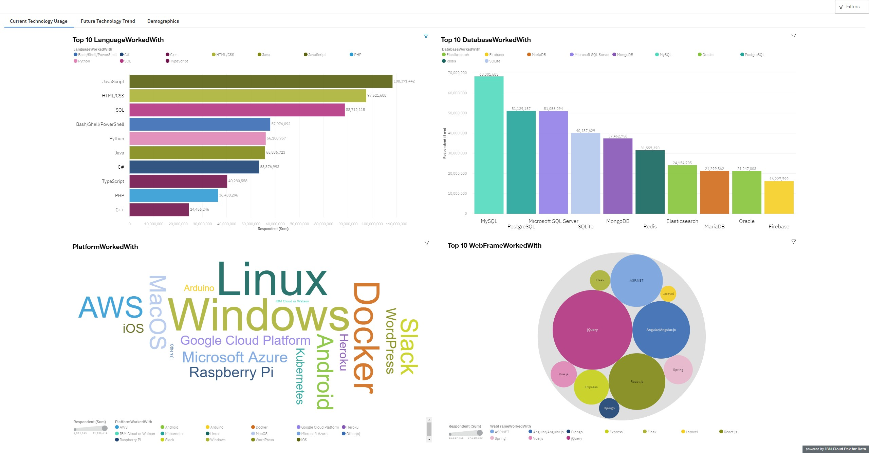
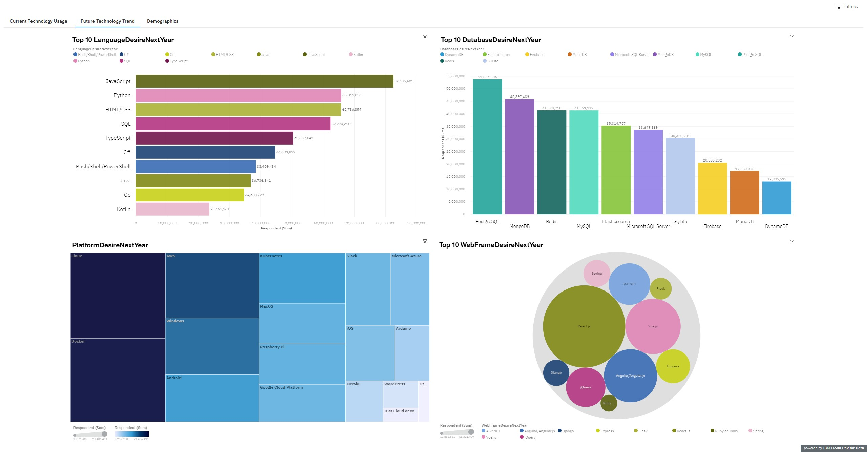
PROGRAMMING LANGUAGE TRENDS
Current Year
Next Year
< Bar chart of top 5 programming languages for the next year goes here.>

Slide 8
PROGRAMMING LANGUAGE TRENDS - FINDINGS & IMPLICATIONS
Findings:
JavaScript is the top most demanded for current and future programming language.
Significantly Increasing desire for Python
The trends of programming language has shifted
Top 5 language are:
JaveScript, Python,HTML,SQL, TypeScript
Implications:
JavaScript is still most popular and widely used in programming language in IT industry.
Python has become a new desired and required skills in IT industry.
JavaScript, Python, HTML/CSS,SQL, TypeScript are the top 5 most desired skills.
The Desire Skill for programming language has certainly Shifted.

Slide 9
DATABASE TRENDS
Current Year
Next Year
< Bar chart of top 5 databases for the current year goes here >
< Bar chart of top 5 databases for the next year goes here.>

Slide 10
DATABASE TRENDS - FINDINGS & IMPLICATIONS
Findings:
PostgreSQL,MongoDB, Redis have become the most desired Database.
MongoDB, Redis, Elasticsearch are becoming increasingly popular for desiredDatabased roughly 10,000 increased in respondants.
Oracle Database has become less popular and less desired
Drastic increase in the desire database skills especially for MongoBD and DynamoBD
Implications:
PostgreSQL, MongoDB,Redis,MySQL,Elasticsearch are the desired and most used Database.
MongoDb, Redis,Elasticsearch have new and better functionalities or services.
Oracle Database is to avoid
Usage of DynamoBD more research may needed.

Slide 11
IDE TRENDS
Current Year
Next Year
< Bar chart of top 5 databases for the current year goes here >
< Bar chart of top 5 databases for the next year goes here.>

Slide 12
IDE TRENDS - FINDINGS & IMPLICATIONS
Findings:
There shows a trend in IDEs:
The user for jQuery has drastically decreased.
React.js and Vue.js have dramatically increase for the desire IDE as compared to current WebFrame worked with as illustrated in the hierarchy buble.
Implications:
People are shifting to use a better webframe such as React.js or Vue.js
jQuery might be lacking of some functionality as compare to webframe competitors
jQuery can be omitted from the new requirements of new technological skills

Slide 13

DASHBOARD
https://dataplatform.cloud.ibm.com/dashboards/605c0ca9-4f1e-4293-9a8b-5d07d706cf44/view/7520e63c158c2aed48d1b1e407cf2e0574342208bbbbd25780d67b490b627897a93c4099c82843098b15506aa6e4155198

Slide 14
DASHBOARD TAB 1

Slide 15
DASHBOARD TAB 2

Slide 16
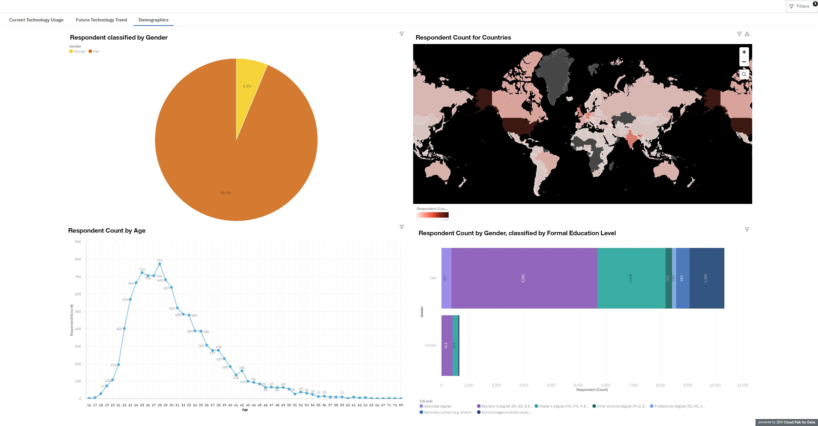
DASHBOARD TAB 3

Slide 17
DISCUSSION
For future skills requirements and recommendations:
What are the Skill must have? Or DESIRE to be in the industry?
Top programming languages FutureDesire are:
JavaScripts, Python, HTML/CSS,SQL,TypeScript have become the new desire programming language that are gaining popularity in the IT industry
Top Database Skills:
PostgreSQL, MongoDB,Redis, MySQL, Elasticsearch are becoming more sought after as compared to current most popular databases that people worked with.
Popular IDEs:
React.js,Angular/Angular.js,Vue.js , jquery and ASP.net are the popular IDEs.

Slide 18
OVERALL FINDINGS & IMPLICATIONS
Findings
JavaScripts, Python, HTML/CSS,SQL,TypeScript are the new desire programming language
PostgreSQL, MongoDB,Redis, MySQL, Elasticsearch are the new desired Database
React.js,Angular/Angular.js,Vue.js , jquery and ASP.net are the popular IDEs
The trends shows a drastic changes in Desire for nextyear programming languages, Database and IDEs
Implications
Future Skills Requirements implements:
Programming Language:
JavaScripts, Python, HTML/CSS,SQL,TypeScript
Database:
PostgreSQL, MongoDB,Redis, MySQL, Elasticsearch
IDEs:
React.js,Angular/Angular.js,Vue.js , jquery and ASP.net
There are a few Databases that are also increasingly desire such like DynamoBd
The numbers of Skills requirements to be able to be competitive in the IT industry has been changing in the vast development and redefine of current techonoly.

Slide 19
Additional FINDINGS & IMPLICATIONS
Findings
The survey that is done where Men are more involve in the IT industry as depicts from the DashBoard 3 Pie chart where it shown about 93.7% of the industry are men.
From the research it also shows that the respondent for the survey are roughly around age of 18-40
From the survey also illustrated that most respondent has atleast an education level of a bachelors degree
Implications:
There might be a relationship related between the next year desire skills and the education level of the respondent.
Gender might plays a role in the ever changing industry of IT

Slide 20

CONCLUSION
The Open source data collected from StackFlow can be recreated and analyze to avoid any data biased.
The technologies that worked with in current year has shown a shift in trend, in order to remain competitive changes in skills requirements are needed.
The significant changes and desires are shown in programming languages and the databases.Hence the new requirements:
Programming Language:
JavaScripts, Python, HTML/CSS,SQL,TypeScript
Database:
PostgreSQL, MongoDB,Redis, MySQL, Elasticsearch
IDEs:
React.js,Angular/Angular.js,Vue.js , jquery and ASP.net

Slide 21

APPENDIX
file named popular-languages.csv
Language | Average Annual Salary
Python | $114,383
Java | $101,013
R | $92,037
Javascript | $110,981
Swift | $130,801
C++ | $113,865
C# | $88,726
PHP | $84,727
SQL | $84,793
Go | $94,082

Slide 22
APPENDIX
file named popular-languages.csv
Language | Average Annual Salary
Python | $114,383
Java | $101,013
R | $92,037
Javascript | $110,981
Swift | $130,801
C++ | $113,865
C# | $88,726
PHP | $84,727
SQL | $84,793
Go | $94,082

Slide 23
APPENDIX
file named popular-languages.csv
Language | Average Annual Salary
Python | $114,383
Java | $101,013
R | $92,037
Javascript | $110,981
Swift | $130,801
C++ | $113,865
C# | $88,726
PHP | $84,727
SQL | $84,793
Go | $94,082

Slide 24
APPENDIX
file named popular-languages.csv
Language | Average Annual Salary
Python | $114,383
Java | $101,013
R | $92,037
Javascript | $110,981
Swift | $130,801
C++ | $113,865
C# | $88,726
PHP | $84,727
SQL | $84,793
Go | $94,082

Slide 25
APPENDIX
file named popular-languages.csv
Language | Average Annual Salary
Python | $114,383
Java | $101,013
R | $92,037
Javascript | $110,981
Swift | $130,801
C++ | $113,865
C# | $88,726
PHP | $84,727
SQL | $84,793
Go | $94,082

Slide 26
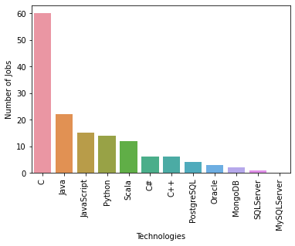
GITHUB JOB POSTINGS
In Module 1 you have collected the job postings data using GitHub API in a file named “github-job-postings.xlsx”. Present that data using a bar chart here. Order the bar chart in the descending order of number of job postings.

Slide 27
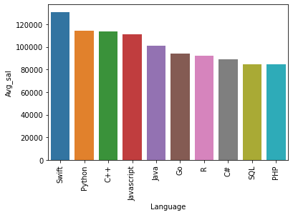
POPULAR LANGUAGES
In Module 1 you have collected the job postings data using web scraping in a file named “popular-languages.csv”. Present that data using a bar chart here. Order the bar chart in the descending order of salary.

