Slide 1
Module 2: Requirements Elicitation Techniques
Dr. Collins ODOYO
Masinde Muliro University of Science and Technology
with material from:
Jo Atlee, Nancy Day, Dan Berry (all University of Waterloo);
Lethbridge & Laganière, Chapter 7; Bruegge & Dutoit, Chapter 4;
I. Alexander; Amyot 2008-2009; Somé 2008

Slide 2
Table of Contents
Elicitation Techniques
  Analysis of Existing Systems
    Documentation, Observation, and Ethnography
  Interviews
  Brainstorming
  Joint Application Design (JAD)
  Prototyping
  Use Cases
When people talk, listen completely. Most people never listen.¹
[1] Ernest Miller Hemingway (1899-1961)

Slide 3
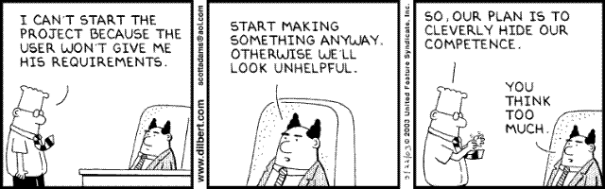

Slide 4

Elicitation Techniques
Elicitation Techniques Existing Systems Interviews Brainstorming Joint Application Design Prototyping Use Cases
Elicitation techniques
  Stakeholder analysis
  Analysis of existing systems or documentation,
  background reading
  Discourse analysis
  Task observation, ethnography
  Questionnaires
  Interviewing
  Brainstorming
  Joint Application Design (JAD)
  Prototyping
  Pilot system
  Use cases and scenarios
  Risk analysis

Slide 5
Comparison of Data-Gathering Techniques¹
Elicitation Techniques Existing Systems Interviews Brainstorming Joint Application Design Prototyping Use Cases
Technique | Good for | Kind of data | Plus | Minus
Questionnaires | Answering specific questions | Quantitative and qualitative data | Can reach many people with low resource | The design is crucial. Response rate may be low. Responses may not be what you want
Interviews | Exploring issues | Some quantitative but mostly qualitative data | Interviewer can guide interviewee. Encourages contact between developers and users | Time consuming. Artificial environment may intimidate interviewee
Focus groups and workshops | Collecting multiple viewpoints | Some quantitative but mostly qualitative data | Highlights areas of consensus and conflict. Encourages contact between developers and users | Possibility of dominant characters
Naturalistic observation | Understanding context of user activity | Qualitative | Observing actual work gives insight that other techniques cannot give | Very time consuming. Huge amounts of data
Studying documentation | Learning about procedures, regulations, and standards | Quantitative | No time commitment from users required | Day-to-day work will differ from documented procedures
[1] Preece, Rogers, and Sharp “Interaction Design: Beyond human-computer interaction”, p214

Slide 6
Analysis of Existing Systems

Slide 7
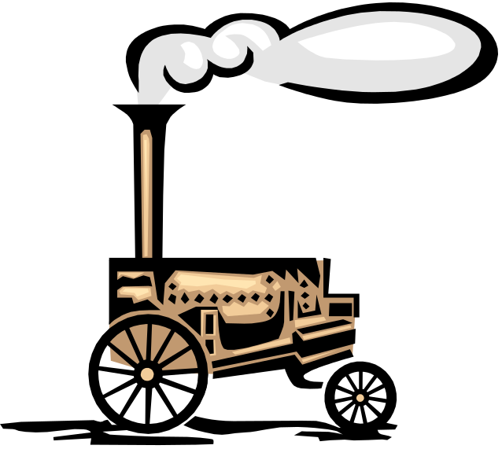
Analysis of Existing Systems (1)
Elicitation Techniques Existing Systems Interviews Brainstorming Joint Application Design Prototyping Use Cases
Useful when building a new improved version of an existing system
Important to know:
  What is used, not used, or missing
  What works well, what does not work
  How the system is used (with frequency and importance) and it was supposed to be used, and how we would like to use it

Slide 8
Analysis of Existing Systems (2)
Elicitation Techniques Existing Systems Interviews Brainstorming Joint Application Design Prototyping Use Cases
Why analyze an existing system?
  Users may become disillusioned with new system or do not like the new system if it is too different or does not do what they want (risk of nostalgia for old system)
  To appropriately take into account real usage patterns, human issues, common activities, relative importance of tasks/features
  To catch obvious possible improvements (features that are missing or do not currently work well)
  To find out which "legacy" features can/cannot be left out

Slide 9
Review Available Documentation
Elicitation Techniques Existing Systems Interviews Brainstorming Joint Application Design Prototyping Use Cases
Start with reading available documentation
  User documents (manual, guides…)
  Development documents
  Requirements documents
  Internal memos
  Change histories
  …
Of course, often these are out of date, poorly written, wrong, etc., but it's a good starting point
Discourse analysis
  Use of words and phrases is examined in written or spoken language

Slide 10
Observation and Related Techniques (1)
Elicitation Techniques Existing Systems Interviews Brainstorming Joint Application Design Prototyping Use Cases
Observation
  Get into the trenches and observe specialists “in the wild”
  Shadow important potential users as they do their work
  Initially observe silently (otherwise you may get biased information)
  Ask user to explain everything he or she is doing
  Session videotaping
Ethnography also attempts to discover social, human, and political factors, which may also impact requirements

Slide 11
Observation and Related Techniques (2)
Elicitation Techniques Existing Systems Interviews Brainstorming Joint Application Design Prototyping Use Cases
Can be supplemented later with questionnaires
  Based on what you know now – the results of observation
  To answer questions that need comparison or corroboration (confirmation)
  To obtain some statistics from a large number of users (look for statistical significance!), e.g.:
    How often do you use feature X?
    What are the three features you would most like to see?
Can be supplemented later with interviews
  After getting a better idea of what is to be done, probably some questions require more detailed answers
  You will not be wasting other people's time or your own
  This is very labour intensive!

Slide 12
Ethnography – Overview (1)
Elicitation Techniques Existing Systems Interviews Brainstorming Joint Application Design Prototyping Use Cases
Comes from anthropology, literally means "writing the culture"
Essentially seeks to explore the human factors and social organization of activities → understand work
  Studies have shown that work is often richer and more complex than is suggested by simple models derived from interviews
Social scientists are trained in observation and work analysis
Discoveries are made by observation and analysis, workers are not asked to explain what they do
  Collect what is ordinary/what is it that people do (aim at making the implicit explicit)
  Study the context of work and watch work being done

Slide 13
Ethnography – Overview (2)
Elicitation Techniques Existing Systems Interviews Brainstorming Joint Application Design Prototyping Use Cases
Useful to discover for example
  What does a nuclear technician do during the day?
  What does his workspace look like?
Less useful to explore political factors
  Workers are aware of the presence of an outside observer

Slide 14
Ethnography – Example (1)
Elicitation Techniques Existing Systems Interviews Brainstorming Joint Application Design Prototyping Use Cases
Sommerville et al. were involved in a project where they had to elicit the requirements of an air traffic control system
They observed the air traffic controllers in action with the existing system
Surprising observations
  Controllers often put aircrafts on potentially conflicting headings with the intention of fixing them later
  System generates an audible alarm when there is a possible conflict
  The controllers close the alarms because they are annoyed by the constant warnings
Incorrect conclusion
  The controllers do not like audible alarms because they close them
More accurate observation
  The controllers do not like being treated like idiots

Slide 15
Ethnography – Example (2)
Elicitation Techniques Existing Systems Interviews Brainstorming Joint Application Design Prototyping Use Cases
Dealers at a stock exchange write tickets to record deals with old-fashioned paper/pencil method
It was suggested to replace this with touch screens and headphones for efficiency and to eliminate distracting noise
Study found that the observation of other dealers is crucial to the way deals are done
  Market position was affected if deals were not continuously monitored
  Even if only peripheral monitoring takes place
“Improvements" would have destroyed the very means of communication among dealers
Source: Preece, Rogers, and Sharp “Interaction Design: Beyond human-computer interaction”

Slide 16
Interviews

Slide 17
Interviews (1)
Elicitation Techniques Existing Systems Interviews Brainstorming Joint Application Design Prototyping Use Cases
Requires preparation and good communication management
  Achieve interview objectives without preventing the exploration of promising leads
Interview as many stakeholders as possible
  Not just clients and users
Ask problem-oriented questions
  Ask about specific details, but…
  Detailed and solution-specific questions may miss the stakeholder’s real requirements. Example:
    Would you like Word 2007, Excel 2007 or both?
    vs.
    Would you like to do word processing, computations, or both?

Slide 18
Interviews – Objectives and Process (2)
Elicitation Techniques Existing Systems Interviews Brainstorming Joint Application Design Prototyping Use Cases
Three main objectives:
  Record information to be used as input to requirements analysis and modeling
  Discover information from interviewee accurately and efficiently
  Reassure interviewee that his/her understanding of the topic has been explored, listened to, and valued
Process consists of four important steps:
  Planning and preparation
  Interview session
  Consolidation of information
  Follow-up
Many strategies for questioning

Slide 19
Interviews – Planning and Preparation
Elicitation Techniques Existing Systems Interviews Brainstorming Joint Application Design Prototyping Use Cases
Important to plan and prepare interviews
  Set goals and objectives for the interview
  Acquire background knowledge of the subject matter to conduct an effective interview
    About the domain (vocabulary, problems...) but also about the interviewee (work tasks, attitude...)
  Prepare questions in advance, by subject
  Organize the environment for conducting an effective interview
    Determine how the elicitation notes will be taken (manually, audio, video, by whom…)

Slide 20
Interviews – Session
Elicitation Techniques Existing Systems Interviews Brainstorming Joint Application Design Prototyping Use Cases
Make the interviewee comfortable and confident
Be polite and respectful!
Adjust to the interviewee
  You have your goals – be persistent but flexible
Interview several people at once to create synergy
Try to detect political aspects as they may influence the said and the unsaid

Slide 21
Interviews – Elicitation Notes
Elicitation Techniques Existing Systems Interviews Brainstorming Joint Application Design Prototyping Use Cases
Revise and complete the elicitation notes after the interview
  Needs to be done soon after because one forgets the details (and everything else)
Identify inconsistencies and address them in a follow-up interview or by email
Keep all diagrams, charts, models created during the discussions
You are learning, so be precise
  Pay attention to terminology
  Use the interviewee’s terminology
  Identify synonyms
  Create a glossary if necessary

Slide 22
Common Interviewing Mistakes (1)
Elicitation Techniques Existing Systems Interviews Brainstorming Joint Application Design Prototyping Use Cases
Not interviewing all of the right people
  Different points of view of stakeholders
Asking direct questions too early
  E.g., design of a transportation system:
    How much horsepower do you need? (direct)
    How many passengers? How far? How fast? (indirect)
  E.g., camera design for novice photographer:
    How important is control over shutter speed and aperture? (direct)
    Will you be taking action shots, still shots, or both? (indirect)

Slide 23
Common Interviewing Mistakes (2)
Elicitation Techniques Existing Systems Interviews Brainstorming Joint Application Design Prototyping Use Cases
Interviewing one-at-a-time instead of in small groups
  More people might help get juices flowing as in brainstorming
  Users cannot think of everything they need when asked individually, but will recall more requirements when they hear others' needs
  Reduces spotlight on individuals (may produce more interesting answers)
  This interaction is called synergy, the effect by which group responses outperform the sum of the individuals' responses
  Do not let one participant dominate the discussion
Assuming that stated needs are exactly correct
  Often users do not know exactly what they want and order "what he is eating"
  Need to narrow what is asked for down to what is needed

Slide 24
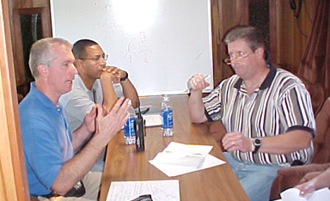
Common Interviewing Mistakes (3)
Elicitation Techniques Existing Systems Interviews Brainstorming Joint Application Design Prototyping Use Cases
Trying to convince stakeholders that YOU are smart – wrong place to do that!
  Instead take every opportunity to show you think the stakeholder is smart
  Contrast these two cases¹
My Elevators Are
Too Slow!
I See.
Tell Me Why
You Feel They
Are Too Slow.
I Don’t Think So.
I Think You Have an
Elevator Throughput
Problem, not a Speed Problem
[1] Alan M. Davis “Just enough requirements management”

Slide 25
Interviews – Start Up Questions (1)
Elicitation Techniques Existing Systems Interviews Brainstorming Joint Application Design Prototyping Use Cases
Context-free questions to narrow the scope a bit (Weinberg)
Identify customers, goals, and benefits
  Who is (really) behind the request for the system?
  Who will use the system? Willingly?
  Are there several types of users?
  What is the potential economic benefit from a successful solution?
  Is a (pre-existing) solution available from another source?

Slide 26
Interviews – Start Up Questions (2)
Elicitation Techniques Existing Systems Interviews Brainstorming Joint Application Design Prototyping Use Cases
When do you need it by?
  Can you prioritize your needs?
  What are your constraints?
    Time
    Budget
    Resources (human or otherwise)
  Expected milestones (deliverables and dates)?

Slide 27
Interviews – Start Up Questions (3)
Elicitation Techniques Existing Systems Interviews Brainstorming Joint Application Design Prototyping Use Cases
Try to characterize the problem and its solution
  What would be a "good" solution to the problem?
  What problems is the system trying to address?
  In what environment will the system be used?
  Any special performance issues?
  Other special constraints?
  What is (un)likely to change?
  Future evolution?
  What needs to be flexible (vs. quick & dirty)?

Slide 28
Interviews – Start Up Questions (4)
Elicitation Techniques Existing Systems Interviews Brainstorming Joint Application Design Prototyping Use Cases
Calibration and tracking questions
  Are you the right person to answer these questions?
  Are your answers "official"? If not, whose are?
  Are these questions relevant to the problem as you see it?
  Are there too many questions? Is this the correct level of detail?
  Is there anyone else I should talk to?
  Is there anything else I should be asking you? Have you told me everything you know about the problem?
  Do you have any questions?

Slide 29
Interviews – Start Up Questions (5)
Elicitation Techniques Existing Systems Interviews Brainstorming Joint Application Design Prototyping Use Cases
Questions that cannot be asked directly (ask indirectly)
  Are you opposed to the system?
  Are you trying to obstruct/delay the system?
  Are you trying to create a more important role for yourself?
  Do you feel threatened by the proposed system?
  Are you trying to protect your job?
  Is your job threatened by the new system?
  Is anyone else's?

Slide 30
Interviews – Specific Questions (1)
Elicitation Techniques Existing Systems Interviews Brainstorming Joint Application Design Prototyping Use Cases
Functional requirements
  What will the system do?
  When will the system do it?
  Are there several modes of operations?
  What kinds of computations or data transformations must be performed?
  What are the appropriate reactions to possible stimuli?
  For both input and output, what should be the format of the data?
  Must any data be retained for any period of time?

Slide 31
Interviews – Specific Questions (2)
Elicitation Techniques Existing Systems Interviews Brainstorming Joint Application Design Prototyping Use Cases
Design Constraints
  Physical environment
    Where is the equipment to be located?
    Is there one location or several?
    Are there any environmental restrictions, such as temperature, humidity, or magnetic interference?
    Are there any constraints on the size of the system?
    Are there any constraints on power, heating, or air conditioning?
    Are there constraints on the programming language because of existing software components?

Slide 32
Interviews – Specific Questions (3)
Elicitation Techniques Existing Systems Interviews Brainstorming Joint Application Design Prototyping Use Cases
Design Constraints
  Interfaces
    Is input coming from one or more other systems?
    Is output going to one or more other systems?
    Is there a prescribed way in which input/output need to be formatted?
    Is there a prescribed way for storing data?
    Is there a prescribed medium that the data must use?
  Standards
    Are there any standards relevant to the system?

Slide 33
Interviews – Specific Questions (4)
Elicitation Techniques Existing Systems Interviews Brainstorming Joint Application Design Prototyping Use Cases
Performance
  Are there constraints on execution speed, response time, or throughput?
  What efficiency measure will apply to resource usage and response time?
  How much data will flow through the system?
  How often will data be received or sent?

Slide 34
Interviews – Specific Questions (5)
Elicitation Techniques Existing Systems Interviews Brainstorming Joint Application Design Prototyping Use Cases
Usability and Human Factors
  What kind of training will be required for each type of user?
  How easy should it be for a user to understand and use the system?
  How difficult should it be for a user to misuse the system?

Slide 35
Interviews – Specific Questions (6)
Elicitation Techniques Existing Systems Interviews Brainstorming Joint Application Design Prototyping Use Cases
Security
  Must access to the system or information be controlled?
  Should each user's data be isolated from data of other users?
  Should user programs be isolated from other programs and from the operating system?
  Should precautions be taken against theft or vandalism?

Slide 36
Interviews – Specific Questions (7)
Elicitation Techniques Existing Systems Interviews Brainstorming Joint Application Design Prototyping Use Cases
Reliability and Availability
  Must the system detect and isolate faults?
  What is the prescribed mean time between failures?
  Is there a maximum time allowed for restarting the system after failure?
  How often will the system be backed up?
  Must backup copies be stored at a different location?
  Should precautions be taken against fire or water damage?

Slide 37
Interviews – Specific Questions (8)
Elicitation Techniques Existing Systems Interviews Brainstorming Joint Application Design Prototyping Use Cases
Maintainability
  Will maintenance merely correct errors, or will it also include improving the system?
  When and in what ways might the system be changed in the future?
  How easy should it be to add features to the system?
  How easy should it be to port the system from one platform (computer, operating system) to another?

Slide 38
Interviews – Specific Questions (9)
Elicitation Techniques Existing Systems Interviews Brainstorming Joint Application Design Prototyping Use Cases
Precision and Accuracy
  How accurate must data calculations be?
  To what degree of precision must calculations be made?

Slide 39
Brainstorming

Slide 40

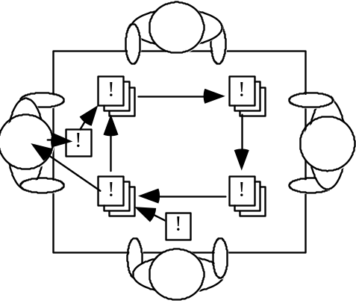
Brainstorming
Elicitation Techniques Existing Systems Interviews Brainstorming Joint Application Design Prototyping Use Cases
To invent new way of doing things or when much is unknown
  When there are few or too many ideas
  Early on in a project particularly when:
    Terrain is uncertain
    There is little expertise for the type of applications
    Innovation is important (e.g., novel system)
Two main activities:
  The Storm: Generating as many ideas as possible (quantity, not quality) – wild is good!
  The Calm: Filtering out of ideas (combine, clarify,
  prioritize, improve…) to keep the best one(s) –
  may require some voting strategy
Roles: scribe, moderator (may also provoke),
participants

Slide 41
Brainstorming – Objectives
Elicitation Techniques Existing Systems Interviews Brainstorming Joint Application Design Prototyping Use Cases
Hear ideas from everyone, especially unconventional ideas
  Keep the tone informal and non-judgemental
  Keep the number of participants “reasonable“ – if too many, consider a “playoff “-type filtering and invite back the most creative to multiple sessions
Encourage creativity
  Choose good, provocative project name.
  Choose good, provocative problem statement
  Get a room without distractions, but with good acoustics, whiteboards, coloured pens, provide coffee/donuts/pizza/beer
  Provide appropriate props/mock-ups

Slide 42
Brainstorming – Roles
Elicitation Techniques Existing Systems Interviews Brainstorming Joint Application Design Prototyping Use Cases
Scribe
  Write down all ideas (may also contribute)
  May ask clarifying questions during first phase but without criticizing
Moderator/Leader
  Cannot be the scribe
  Two schools of thought: traffic cop or agent provocateur
  Traffic cop – enforces "rules of order", but does not throw his/her weight around otherwise
  Agent provocateur – traffic cop plus more of a leadership role, comes prepared with wild ideas and throws them out as discussion wanes
    May also explicitly look for variations and combinations of other suggestions

Slide 43
Brainstorming – Participants
Elicitation Techniques Existing Systems Interviews Brainstorming Joint Application Design Prototyping Use Cases
Virtually any stakeholder, e.g.
  Developers
  Domain experts
  End-users
  Clients
  ...
“Ideas-people” – a company may have a special team of people
  Chair or participate in brainstorming sessions
  Not necessarily further involved with the project

Slide 44
Brainstorming – The Storm
Elicitation Techniques Existing Systems Interviews Brainstorming Joint Application Design Prototyping Use Cases
Goal is to generate as many ideas as possible
Quantity, not quality, is the goal at this stage
Look to combine or vary ideas already suggested
No criticism or debate is permitted – do not want to inhibit participants
Participants understand nothing they say will be held against them later on
Scribe writes down all ideas where everyone can see
  E.g., whiteboard, paper taped to wall
  Ideas do not leave the room
Wild is good
  Feel free to be gloriously wrong
  Participants should NOT censor themselves or take too long to consider whether an idea is practical or not – let yourself go!

Slide 45
Brainstorming – The Calm
Elicitation Techniques Existing Systems Interviews Brainstorming Joint Application Design Prototyping Use Cases
Go over the list of ideas and explain them more clearly
Categorize into "maybe" and "no" by pre-agreed consensus method
  Informal consensus
  50% + 1 vote vs. “clear majority”
  Does anyone have veto power?
Be careful about time and people
  Meetings (especially if creative or technical in nature) tend to lose focus after 90 to 120 minutes – take breaks or reconvene later
  Be careful not to offend participants
Review, consolidate, combine, clarify, improve
Rank the list by priority somehow
Choose the winning idea(s)

Slide 46



Brainstorming – Eliminating Ideas
Elicitation Techniques Existing Systems Interviews Brainstorming Joint Application Design Prototyping Use Cases
There are some common ways to eliminate some ideas
Blending ideas
  Unify similar ideas but be aware not to force fit
  everything into one idea
Give each participant $100 to spend on the ideas
Apply acceptance criteria prepared prior to meeting
  Eliminate the ideas that do not meet the criteria
Various ranking or scoring methods
  Assign points for criteria met, possibly use a
  weighted formula
Vote with threshold or campaign speeches
  Possibly select top k for voting treatment

Slide 47


Brainstorming – Voting on Ideas
Elicitation Techniques Existing Systems Interviews Brainstorming Joint Application Design Prototyping Use Cases
Voting with threshold
  Each person is allowed to vote up to n times
  Keep those ideas with more than m votes
  Have multiple rounds with smaller n and m
Voting with campaign speeches
  Each person is allowed to vote up to j < n times
  Keep those ideas with at least one vote
  Have someone who did not vote for an idea
  defend it for the next round
  Have multiple rounds with smaller j

Slide 48

Brainstorming – Tool Support
Elicitation Techniques Existing Systems Interviews Brainstorming Joint Application Design Prototyping Use Cases
With many good ideas, some outrageous and even farfetched, brainstorming can be really fun!
Creates a great environment that stimulates
people and motivates them to perform well!
Can be done by email, but a good moderator/leader is needed to
  Prevent flamers to come into play
  Prevent race conditions due to the asynchronous communication medium
  Be careful not to go into too much detail
Collaboration tools are also possible
  TWiki and many other more appropriate tools such as BrainStorm and IdeaFisher

Slide 49
Joint Application Design (JAD)

Slide 50
Joint Application Design (JAD)
Elicitation Techniques Existing Systems Interviews Brainstorming Joint Application Design Prototyping Use Cases
A more structured and intensive brainstorming approach
Developed at IBM in the 1970s
  Lots of success stories
"Structured brainstorming", IBM-style
  Full of structure, defined roles, forms to be filled out...
Several activities and six (human) roles to be played
JAD session may last few days
The whole is more than the sum of its parts. The part is more than a fraction of the whole.¹
[1] Aristotle (384 BC – 322 BC)

Slide 51
Joint Application Design – Four Main Tenets
Elicitation Techniques Existing Systems Interviews Brainstorming Joint Application Design Prototyping Use Cases
Effective use of group dynamics
  Facilitated and directed group sessions to get common understanding and universal buy-in
Use of visual aids
  To enhance understanding, e.g., props, prepared diagrams
Defined process
  I.e., not a random hodgepodge
Standardized forms for documenting results

Slide 52
Joint Application Design – Applicability
Elicitation Techniques Existing Systems Interviews Brainstorming Joint Application Design Prototyping Use Cases
Used for making decisions on different aspects of a project
Any process where consensus-based decision making across functional areas is required, e.g.,
  Planning a project
  Defining requirements
  Designing a solution

Slide 53
Joint Application Design – Activities
Elicitation Techniques Existing Systems Interviews Brainstorming Joint Application Design Prototyping Use Cases
Preparation
  Pre-session Planning
  Pre-work
Working Session
Summary
  Follow-up
  Wrap-up

Slide 54
Joint Application Design – Pre-session Planning
Elicitation Techniques Existing Systems Interviews Brainstorming Joint Application Design Prototyping Use Cases
Preparation is essential – this is not an informal session
Evaluate project
  Identify contentious issues and scope of JAD session
Select JAD participants
Create preliminary agenda
Determine deliverables for the working session
Enable participants to prepare for the session

Slide 55
The 6 “P”s
Elicitation Techniques Existing Systems Interviews Brainstorming Joint Application Design Prototyping Use Cases
Purpose
  Why do we do things? (Goals, needs, motivation)
Participants
  Who is involved? (People, roles, responsibilities)
Principles
  How do we function? (Guidelines, working agreements, ground rules)
Products
  What do we create? (Deliverables, decisions, plans, next steps)
Place
  Where is it located? (Venue, logistics)
Process
  When do we do what? (Activities, sequence)
[1] Ellen Gottesdiener, Requirements by Collaboration: Facilitating Workshops to Define Stakeholder Needs, RE Conference 2006

Slide 56
Joint Application Design – Pre-work
Elicitation Techniques Existing Systems Interviews Brainstorming Joint Application Design Prototyping Use Cases
Gather information
Clear schedules for the working session
Refine session agenda
Finalize pre-session assignments
Prepare material for session (flip-charts, presentations, markers, pizza...)

Slide 57
Joint Application Design – Working Session
Elicitation Techniques Existing Systems Interviews Brainstorming Joint Application Design Prototyping Use Cases
Set-up stage
  Session leader welcomes participants, presents task to be discussed, establishes rules and what is on/off topic…
Generate common understanding
  Brainstorming…
Achieve consensus on decisions
Generate ownership of results
Create the deliverables (using standard JAD forms)
Identify open issues and questions

Slide 58
Joint Application Design – Follow-up and Wrap-up
Elicitation Techniques Existing Systems Interviews Brainstorming Joint Application Design Prototyping Use Cases
Follow-up
  Resolve open issues and questions
  Follow-up on action items
  Re-evaluate project
Wrap-up
  Review results of follow-up items
  Evaluate the JAD process
  Discuss "lessons learned"
  Finalize deliverables

Slide 59
Joint Application Design – Roles (1)
Elicitation Techniques Existing Systems Interviews Brainstorming Joint Application Design Prototyping Use Cases
Session leader
  Organizer, facilitator, JAD expert
  Good with people skills, enthusiastic, sets tone of meeting
Analyst
  Scribe++
  Produces official JAD documents, experienced developer who understands the big picture, good philosopher/writer/organizer
Executive sponsor
  Manager who has ultimate responsibility for product being built
  Provides strategic insights into company's high-level goals/practices, makes executive decisions later on as required

Slide 60
Joint Application Design – Roles (2)
Elicitation Techniques Existing Systems Interviews Brainstorming Joint Application Design Prototyping Use Cases
User representatives
  Selection of knowledgeable end-users and managers
  Come well-prepared with suggestions and ideas of needs, will brainstorm for new or refined ideas, eventually review completed JAD documents
Information system representatives
  Technical expert on ISs
  Helps users think big, know what is easy/hard/cheap/expensive, mostly there to provide information rather than make decisions
Specialists
  Technical expert on particular narrow topics, e.g., security, application domain, law, UI issues…

Slide 61
Prototyping

Slide 62
Prototyping
Elicitation Techniques Existing Systems Interviews Brainstorming Joint Application Design Prototyping Use Cases
A software requirements prototype is a mock-up or partial implementation of a software system
  Helps developers, users, and customers better understand system requirements
  Helps clarify and complete requirements
  Provides early response to “I'll know it when I’ll see (or won’t see) it” attitude
  Effective in addressing the “Yes, But” and the “Undiscovered Ruins” syndromes
  Helps find new functionalities, discuss usability, and establish priorities
Prototyping is effective in resolving uncertainties early in the development process
  Focus prototype development on these uncertain parts
  Encourages user participation and mutual understanding

Slide 63
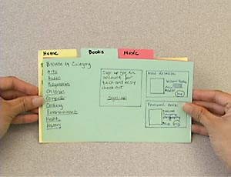
Prototyping – Realizations
Elicitation Techniques Existing Systems Interviews Brainstorming Joint Application Design Prototyping Use Cases
Prototypes can take many forms:
  Paper prototypes (see http://www.paperprototyping.com/)
    Prototype on index card
    Storyboard
  Screen mock-ups
  Interactive prototypes
    Using high-level languages (e.g., Visual Basic, Delphi, Prolog)‏
    Using scripting languages (e.g., Perl, Python)‏
    Using animation tools (e.g., Flash/Shockwave)‏
  Models (executables)
  Pilot systems
  …

Slide 64
Prototyping – Types
Elicitation Techniques Existing Systems Interviews Brainstorming Joint Application Design Prototyping Use Cases
Horizontal: focus on one layer – e.g., user interface
Vertical: a slice of the real system
Evolutive: turned into a product incrementally, gives users a working system more quickly (begins with requirements that are more understood)
Throw-away: less precise, thrown away, focusing on the less well-understood aspects of the system to design, designed to elicit or validate requirements

Slide 65
Prototyping – Fidelity (1)
Elicitation Techniques Existing Systems Interviews Brainstorming Joint Application Design Prototyping Use Cases
Fidelity is the extent to which the prototype is real and (especially) reactive
Fidelity may vary for throw-away prototypes
High-fidelity
  Applications that "work" – you press a button and something happens
  Often involves programming or executable modeling languages
  Advantages:
  provides an understanding of functionality, reduce design risk, more precise verdicts about requirements
  Disadvantages:
  takes time to build, more costly to build, sometimes difficult to change, false sense of security, often focuses on details rather than on the goals and important issues

Slide 66
Prototyping – Fidelity (2)
Elicitation Techniques Existing Systems Interviews Brainstorming Joint Application Design Prototyping Use Cases
Low-fidelity
  It is not operated – it is static
  Advantages:
  easy and quick to build, cheaper to develop, excellent for interfaces, offers the opportunity to engage users before coding begins, encourage creativity
  Disadvantages:
  may not cover all aspects of interfaces, are not interactive, may seem non-professional in the eyes of some stakeholders (sigh!)

Slide 67
Prototyping – Risks
Elicitation Techniques Existing Systems Interviews Brainstorming Joint Application Design Prototyping Use Cases
Prototypes that focus on user-interface tends to lose the focus of demonstrating/exploring functionality
Prototypes can bring customers’ expectations about the degree of completion unrealistically up
Do not end-up considering a throwaway prototype as part of the production system
  Always clearly state the purpose of each prototype before building it

Slide 68
Use Cases

Slide 69
Developing Use Case Models of Systems
Elicitation Techniques Existing Systems Interviews Brainstorming Joint Application Design Prototyping Use Cases
Description of a sequence of interactions between a system and external actors
Developed by Ivar Jacobson
  Not exclusively for object-oriented analysis
Actors – any agent that interact with the system to achieve a useful goal (e.g., people, other software systems, hardware)
Use case describes a typical sequence of actions that an actor performs in order to complete a given task
  The objective of use case analysis is to model the system
    … from the point of view of how actors interact with this system
    … when trying to achieve their objectives
  A use case model consists of
    A set of use cases
    An optional description or diagram indicating how they are related

Slide 70
Use Cases
Elicitation Techniques Existing Systems Interviews Brainstorming Joint Application Design Prototyping Use Cases
A use case should describe the user’s interaction with the system ...
  Not the computations the system performs
In general, a use case should cover the full sequence of steps from the beginning of a task until the end
A use case should only include actions in which the actor interacts with the computer
  Some views differ on this one!!!

Slide 71
Use Cases – Abstraction Level
Elicitation Techniques Existing Systems Interviews Brainstorming Joint Application Design Prototyping Use Cases
A use case should be written so as to be as independent as possible from any particular implementation / user interface design
Essential use cases (Constantine & Lockwood)
  Abstract, technology free, implementation independent
  Defined at earlier stages
  E.g., customer identifies herself
Concrete use cases
  Technology/user interface dependent
  E.g., customer inserts a card, customer types a PIN

Slide 72
Scenarios (1)
Elicitation Techniques Existing Systems Interviews Brainstorming Joint Application Design Prototyping Use Cases
A scenario (according to the UML/UC community) is an instance of a use case
  It expresses a specific occurrence of the use case (a specific path through the use case)
    A specific actor ...
    At a specific time ...
    With specific data …
  Many scenarios may be generated from a single use case description
  Each scenario may require many test cases
Rather used in a generic way in this course (as is often the case in requirements engineering)

Slide 73
Scenarios (2)
Elicitation Techniques Existing Systems Interviews Brainstorming Joint Application Design Prototyping Use Cases
A use case includes primary and secondary scenarios
1 primary scenario
  Normal course of events
0 or more secondary scenarios
  Alternative/exceptional course of events, variations of primary scenario
  An alternative scenario meets the intent of the use case but with a different sequence of steps
  An exceptional scenario addresses the conditions of main case and alternative cases that differ from the norm and cases already covered
  Example with consensus as a goal
    Primary scenario: vote in a session
    Alternative scenario: voting in several sessions
    Exceptional scenario: what to do with a non-registrant who wishes to vote

Slide 74
Types of Scenarios
Elicitation Techniques Existing Systems Interviews Brainstorming Joint Application Design Prototyping Use Cases
As-is scenario
  Used in describing a current situation, usually used in re-engineering projects, the user describes the system
Visionary scenario
  Used to describe a future system, usually used in greenfield engineering and reengineering projects
  Can often not be done by the user or developer alone
Evaluation scenario
  User tasks against which the system is to be evaluated
Training scenario
  Step by step instructions that guide a novice user through a system

Slide 75
Representation of Scenarios (1)
Elicitation Techniques Existing Systems Interviews Brainstorming Joint Application Design Prototyping Use Cases
Various approaches
  Text (informal, formal), diagrams (state, sequence ...), video, animation, comics, storyboard, collaborative workshops (pass the microphone or the ball)…
  There are specialized notation such as UML (sequence, activity, use case, interaction, and collaboration diagrams), Message Sequence Charts (MSC), Live Sequence Charts, and Use Case Maps (UCM)

Slide 76
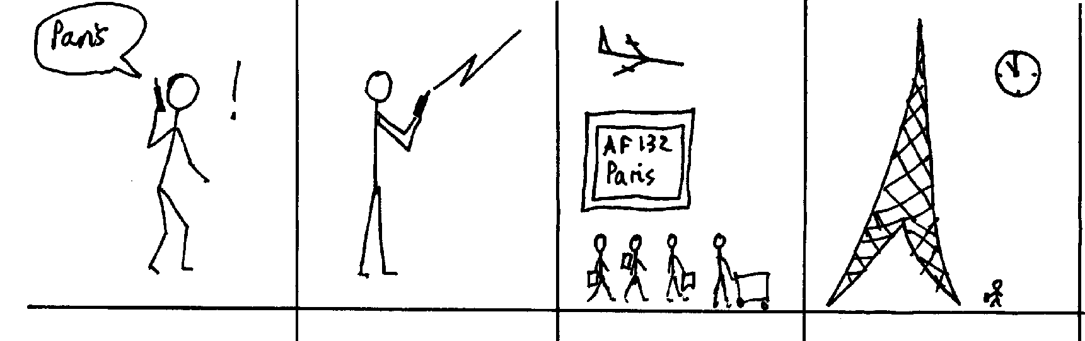
Representation of Scenarios (2)
Elicitation Techniques Existing Systems Interviews Brainstorming Joint Application Design Prototyping Use Cases
Different representations may be useful in specific situations
  For example, storyboards, often used in the film industry, can describe situations, roles, and sequences of tasks in a fast, compact, and polyglot way¹
Some scenario-based approaches are very ideological or dogmatic
[1] I. Alexander

Slide 77
Use Case-Driven Software Lifecycle Activities (1)
Elicitation Techniques Existing Systems Interviews Brainstorming Joint Application Design Prototyping Use Cases
Requirements
Elicitation
Requirements
Analysis
System
Design
Object
Design
Implemen-
tation
Testing
Implemented
By
Expressed in Terms Of
Structured By
Realized By
Verified
By
class...
class...
class...
?
class....
?
Use Case
Model
Application
Domain
Objects
Solution Domain
Objects
Subsystems
Source
Code
Test
Cases

Slide 78
Use Case-Driven Software Lifecycle Activities (2)
Elicitation Techniques Existing Systems Interviews Brainstorming Joint Application Design Prototyping Use Cases
Scenarios guide elicitation, analysis, design, and testing
  There are many scenario-based approaches
  E.g., XP employs user stories (scenarios) to directly generate tests that will guide software design and verification
Developers are often unable to speak directly to users
Scenarios provide a good enough approximation of the “voice of the user”

Slide 79
Use Case Modeling with UML
Elicitation Techniques Existing Systems Interviews Brainstorming Joint Application Design Prototyping Use Cases
But: Where are the use cases?
use case
<<extend>>
Reserve Facility
Handle Waiting List
Register Member
generalization
<<include>>
<<include>>
Hotel Counter Staff
Customer
Reserve Room
Check In Customer
Check Room
Details
<<include>>
actor
extension
point
<<extend>>
Member
Earn and Redeem Credits
Check Out Customer

Slide 80
Use Case Diagrams
Elicitation Techniques Existing Systems Interviews Brainstorming Joint Application Design Prototyping Use Cases
To define system boundary (subject), actors, and use cases
  Subject could be: a physical system, a component, a subsystem, a class
To structure and relate use cases
  Associate actors with use cases
  Include relation
  Extend relation
  Generalization (of actors and use cases)

Slide 81
Use Case Diagrams – <<include>> (Inclusions)
Elicitation Techniques Existing Systems Interviews Brainstorming Joint Application Design Prototyping Use Cases
Inclusions allow one to express commonality between several different use cases
Inclusions are included in other use cases
  Even very different use cases can share a sequence of actions (reuse)
  Enable you to avoid repeating details in many use cases (consistency)
An inclusion represents the execution of a lower-level task with a lower-level goal (→ decomposition of complex tasks)
Base use case references the included use case as needed
Base use case cannot exist without the included use case
When included use case is done, control returns to base use case
Disadvantage: have to look in multiple places to understand use case

Slide 82
Use Case Diagrams – <<extend>> (Extensions)
Elicitation Techniques Existing Systems Interviews Brainstorming Joint Application Design Prototyping Use Cases
Used to make optional interactions explicit or to handle exceptional cases
By creating separate use case extensions, the description of the basic use case remains simple
  Note: the base use case can still be executed without the use case extension
Extension points must be created explicitly in the base use case
Use sparingly: there is disagreement over the semantics

Slide 83
Use Case Diagrams – Generalizations
Elicitation Techniques Existing Systems Interviews Brainstorming Joint Application Design Prototyping Use Cases
Much like super-classes in a class diagram
  Need to satisfy “is-a” relation
Applies to use cases and to actors
  A generalized use case represents several similar use cases
  One or more specializations provide details of the similar use cases
  Inheriting use case can replace steps of inherited use case
  Particularly useful for actors (clearer here, unlike use case generalization where the semantics are unclear – use generalization of use cases with caution)

Slide 84
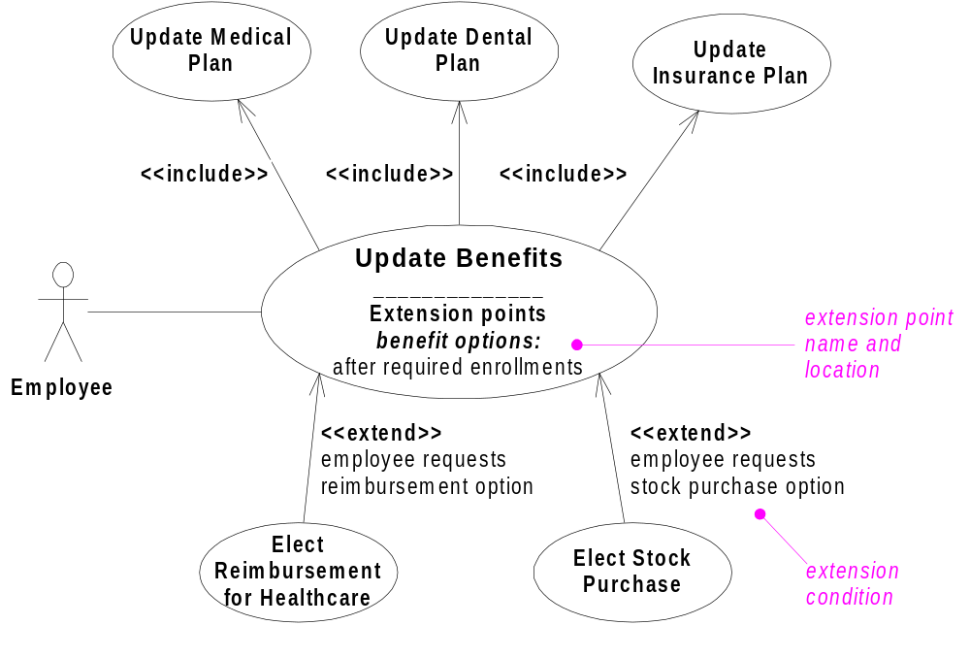
Example: HR System
Elicitation Techniques Existing Systems Interviews Brainstorming Joint Application Design Prototyping Use Cases

Slide 85
Use Case Templates (1)
Elicitation Techniques Existing Systems Interviews Brainstorming Joint Application Design Prototyping Use Cases
There are many different templates for use cases but they often consist of a subset of the following items:
Identifier: unique label for use case used to reference it elsewhere
Name: succinctly state user task independently of the structure or implementation
  Suggested form “verb object” (e.g., Order a product)
Authors: people who discovered use case
Goal: short description of expected outcome from actors’ point of view
Preconditions: what needs to be satisfied before use case can begin
Postconditions: state of system after completion of use case
  Minimal guarantee: state of system after completion regardless of outcome

Slide 86
Use Case Templates (2)
Elicitation Techniques Existing Systems Interviews Brainstorming Joint Application Design Prototyping Use Cases
Primary actor: initiates the use case
Participants (secondary actors): other actors involved in use case, provide services to the system and interact with the system after the use case was initiated
Related requirements: identifiers of functional and non-functional requirements linked to the use case
Related use cases: identifiers of related use cases
  Specify relationship: e.g.
      Supposes use case UC2 has been successfully completed
      Alternative to use case UC3
      ...
Description of events (scenarios)
  Different use case description formats
  Narrative, Simple column, Multiple columns

Slide 87
Use Case Templates – Narrative Form
Elicitation Techniques Existing Systems Interviews Brainstorming Joint Application Design Prototyping Use Cases
Paragraph focusing on the primary scenario and some secondary ones
Very useful when the stakeholders first meet
A User inserts a card in the Card reader slot. The System
asks for a personal identification number (PIN). The User
enters a PIN. After checking that the user identification is
valid, the System asks the user to chose an operation...

Slide 88
Use Case Templates – Simple Column Form
Elicitation Techniques Existing Systems Interviews Brainstorming Joint Application Design Prototyping Use Cases
Linear sequences (main and alternatives)
1. A User inserts a card in the Card reader slot.
2. The system asks for a personal identification number (PIN).
3. The User enters a PIN.
4. The System checks that the user identification is valid.
5. The System asks the user to chose an operation
1.a The Card is not valid.
1.a.1. The System ejects the Card.
4.a The User identification is not valid.
4.a.1 The System ejects the Card.

Slide 89
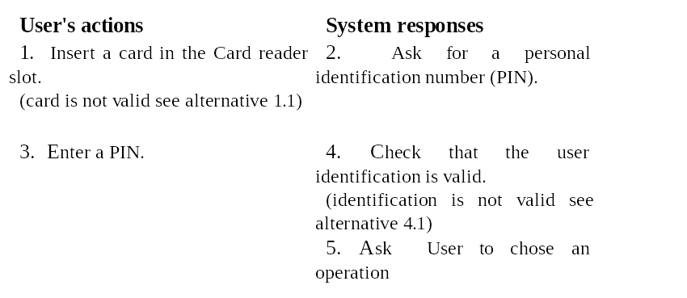
Use Case Templates – Multiple Column Form
Elicitation Techniques Existing Systems Interviews Brainstorming Joint Application Design Prototyping Use Cases
One column per actor
Allows for a more detailed view

Slide 90
Use Case Templates – Example Template
Elicitation Techniques Existing Systems Interviews Brainstorming Joint Application Design Prototyping Use Cases
A. Name: Give a short, descriptive name to the use case
B. Actors: List the actors who can perform this use case
C. Goals: Explain what the actors are trying to achieve
D. Preconditions: State of the system before the use case
E. Description: Give a short informal description
F. Trigger: Describe the event that initiates the activity
G. Summary: Summarize what occurs as the actors perform the use case
F. Related use cases: (in accordance with use case diagram)
G. Steps: Describe each step using some form (single/multiple columns)
H. Postconditions: State of the system following completion
I. Special Requirements: Non-functional requirements and constraints

Slide 91
Use Case Development – Example: ATM System (1)
Elicitation Techniques Existing Systems Interviews Brainstorming Joint Application Design Prototyping Use Cases
1. Determine candidate system scope and boundaries
  Identify stakeholders
  Identify problem - Create problem statement
  Use interviews and other techniques
ATMs + Bank
ATMs
ATM Software
1
- Customer
2
- Customer
- Bank
3
- Card reader
- Cash dispenser
- Key pad
- Touch screen
- Printer
- Bank

Slide 92
Use Case Development – Example: ATM System (2)
Elicitation Techniques Existing Systems Interviews Brainstorming Joint Application Design Prototyping Use Cases
2. Identify actors
  Who interacts with the system?
    Who or what uses the system?
      For what goals?
      What roles do they play?
    Who installs the system?
    Who or what starts and shuts
    down the system?
    Who maintains the system?
    Who or what gets and provides
    information to the system?
    Does anything happen at a fixed time?
  Check for possible actor generalization
Example ATM with scope 2
Bank Customer
Installation Technician
Administrator
Administrator
Bank
Weekly Reports

Slide 93
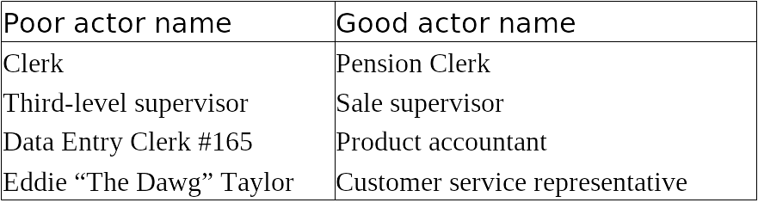
Use Case Development – Example: ATM System (3)
Elicitation Techniques Existing Systems Interviews Brainstorming Joint Application Design Prototyping Use Cases
2. Identify actors (cont’d)
  Choose actors’ names carefully
  Actors give value, get value from system or both
  Should reflect roles rather than actual people
    An actor specifies a role an external entity adopts when it interacts directly with your system
    People / things may play multiple roles simultaneously or over time
  Use right level of abstraction

Slide 94
Use Case Development – Example: ATM System (4)
Elicitation Techniques Existing Systems Interviews Brainstorming Joint Application Design Prototyping Use Cases
3. Identify use cases
  Identify and refine actors’ goals
    Why would actor AAA use the system?
  Identify actors’ tasks to meet goals
    What interactions would meet goal GGG
    of actor AAA?
  Chose appropriate use case names
    Verb-noun construction
    No situation-specific data
    Not tied to organization structure, paper forms, computer implementation, or manual process (e.g., enter form 104-B, complete approval window, get approval from immediate supervisor in Accounting Department)
Example actor: Customer
Goal: Access account 24/7 for
regular banking operations
(withdrawal, deposit, statement...)
in a timely and secure way.
To be refined into sub-goals.
From goals we can identify tasks:
Withdraw Cash, Make Deposit,
Print Account Statement....

Slide 95
Use Case Development – Example: ATM System (5)
Elicitation Techniques Existing Systems Interviews Brainstorming Joint Application Design Prototyping Use Cases
3. Identify use cases (cont’d)
  Develop a brief description in narrative form
  E.g., description of use case Withdraw Cash
4. Identify preconditions
  E.g., preconditions of use case Withdraw Cash
    System is in operation, cash is available
The Customer identifies herself to the system, then selects the cash withdrawal operation. The system asks for the amount to withdraw. The Customer specifies the amount. The system provides the requested amount. The Customer takes the amount and leaves.

Slide 96
Use Case Development – Example: ATM System (6)
Elicitation Techniques Existing Systems Interviews Brainstorming Joint Application Design Prototyping Use Cases
5. Definition of primary scenario
  Happy day story where everything goes fine
6. Definition of secondary scenarios (alternatives/exceptions)
  A method for finding secondary scenarios is to go through the primary scenarios and ask:
    Is there some other action that can be taken at this point? (alternate scenario)
    Is there something that could go wrong at this point? (exception scenario)
    Is there some behavior that could happen at any time? (alternative scenario unless it is an error, then it would be an exception scenario)
Example use case: Withdraw Cash
Not enough cash available
Incorrect identification
Customer forgets card in card reader
Incorrect amount entered
Customer forgets cash in dispenser

Slide 97
Use Case Development – Example: ATM System (7)
Elicitation Techniques Existing Systems Interviews Brainstorming Joint Application Design Prototyping Use Cases
7. Structure use case diagram
  Identify commonalities and specify included use cases
  Identify variants and specify extended use cases
Withdraw Cash
Identify Customer
Bank
<<include>>
<<include>>
<<include>>
Customer
Make Deposit
Print Account Statement

Slide 98
Use Cases Development (1)
Elicitation Techniques Existing Systems Interviews Brainstorming Joint Application Design Prototyping Use Cases
Heuristics for finding use cases
  Select a narrow vertical slice of the system (i.e., one scenario)
    Discuss it in detail with the user to understand the user’s preferred style of interaction
    Could target high value or high risk first
  Select a horizontal slice (i.e., many scenarios) to define the scope of the system
    Discuss the scope with the user
  Use illustrative prototypes (e.g., mock-ups) as visual support
  Find out what the user does
    Task observation (preferable to questionnaires)

Slide 99
Use Cases Development (2)
Elicitation Techniques Existing Systems Interviews Brainstorming Joint Application Design Prototyping Use Cases
Alternative ways of identifying use cases (Ham, Larman)‏
  Identify external events to which the system must respond, and then relate these events to participating actors and specific use cases
  Express business processes in terms of specific scenarios, generalize the scenarios into use cases, and identify the actors involved in each use case
  Derive likely use cases from existing functional requirements – if some requirements do not trace to any use case, consider whether you really need them

Slide 100
Use Cases Development (3)
Elicitation Techniques Existing Systems Interviews Brainstorming Joint Application Design Prototyping Use Cases
Often one use case (or a very small number) can be identified as central to the system
  The entire system can be built around this particular use case
There are other reasons for focusing on particular use cases:
  Some use cases will represent a high risk because for some reason their implementation is problematic
  Some use cases will have high political or commercial value
Approach is iterative
  System scope and boundaries may change as more information is known about actors, their goals, and use cases

Slide 101
Example: University Registration System (1)
Elicitation Techniques Existing Systems Interviews Brainstorming Joint Application Design Prototyping Use Cases
Enroll in
University
<<include>>
Enroll in
Course
Registrar
<<extend>>
Applicant
Enroll Family
Member of Staff
Perform
Security Check
International Applicant
RCMP Security System

Slide 102
Example: University Registration System (2)
Elicitation Techniques Existing Systems Interviews Brainstorming Joint Application Design Prototyping Use Cases
Name: Enroll in University
Identifier: UC 19
Goal: Enroll applicant in the university
Preconditions:
  The Registrar is logged into the system.
  The Applicant has already undergone initial checks to verify that they are eligible to enroll.
Postconditions:
  The Applicant will be enrolled in the university as a student if they are eligible.

Slide 103
Example: University Registration System (3)
Elicitation Techniques Existing Systems Interviews Brainstorming Joint Application Design Prototyping Use Cases
Main Flow:
1. An applicant wants to enroll in the university.
2. The applicant hands a filled out copy of form UI13 University Application Form to the registrar.
3. The registrar visually inspects the forms.
4. The registrar determines that the forms have been filled out properly.
5. The registrar selects to Create New Student.
6. The system displays the Create Student Screen.
7. The registrar inputs the name, address, and phone number of the applicant.
[Extension Point: XPCheck]
8. The system determines that the applicant does not already exist within the system.
9. The system determines that the applicant is on the eligible applicants list.
10. The system adds the applicant to its records.
11. The registrar enrolls the student in courses via use case UC 17 Enroll in Course.
12. The system prepares a bill for the applicant enrollment fees.
Alternate Flows:
4.a The forms have not been adequately filled…

Slide 104
Example: University Registration System (4)
Elicitation Techniques Existing Systems Interviews Brainstorming Joint Application Design Prototyping Use Cases
Name: Perform Security Check
Identifier: UC 34
At Extension Point XPCheck:
1. The registrar asks for security check results about applicant.
2. The system asks RCMP Security System for applicant security check results.
3. The RCMP Security System responds that applicant has been cleared.
3.a The Security System responds that applicant has not been cleared

Slide 105
Example: University Registration System (5)
Elicitation Techniques Existing Systems Interviews Brainstorming Joint Application Design Prototyping Use Cases
Name: Enroll Family Member of Staff
Identifier: UC 20
Inherits From: UC 19
Main Flow:
1. An applicant family member wants to enroll in the university.
2. The applicant hands a filled out copy of form UI15 University Application Form for Family Members to the registrar.
…
12. The system prepares a bill for the applicant enrollment fees based on staff family members rate.
Alternate Flows: …

Slide 106
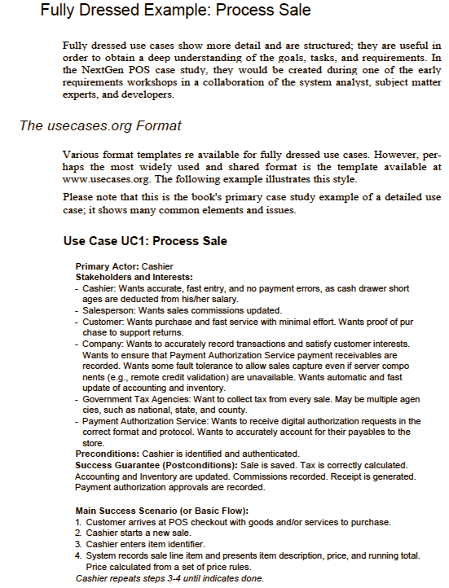
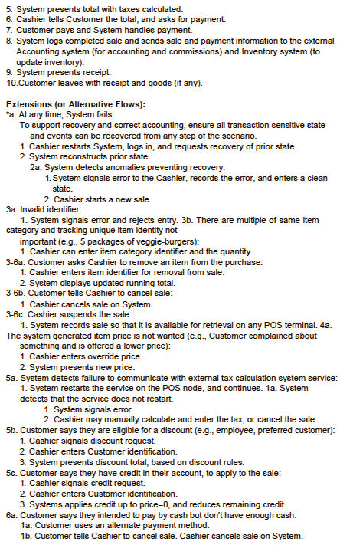
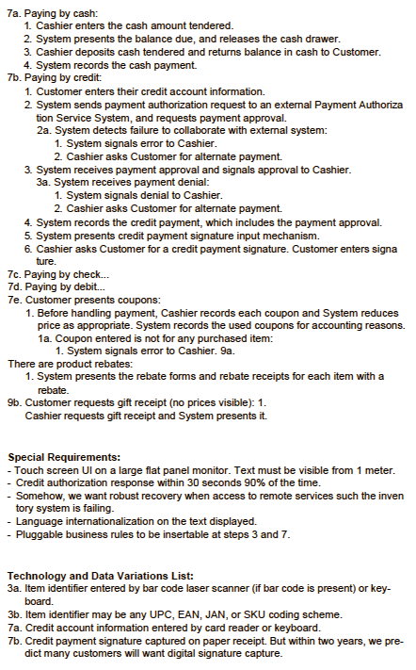
Example: Point of Sale Application
Elicitation Techniques Existing Systems Interviews Brainstorming Joint Application Design Prototyping Use Cases
Source: Craig Larman “Applying UML and Patterns”

Slide 107
Use Case Development – Rules of Thumb (1)
Elicitation Techniques Existing Systems Interviews Brainstorming Joint Application Design Prototyping Use Cases
Be careful not to over specify behavior
  Keep it short, keep it simple: main flow should fit on a single page
  Focus on what, not how:
    Focus on externally visible behavior
    Are you specifying a sequence of events, in which the sequence does not really matter?
      Example: Order of entering data for new customer
    Do you specify which elements from a set are selected, when any arbitrary element is needed?
      Example: Selecting new arbitrary phone number

Slide 108
Use Case Development – Rules of Thumb (2)
Elicitation Techniques Existing Systems Interviews Brainstorming Joint Application Design Prototyping Use Cases
Be careful not to under specify behavior
  Do not forget variations on basic flow
  Do not forget exceptions
    For example, what happens to a phone call if there are no resources to allocate to it?
Specify behavior for all possible inputs, both valid and invalid input

Slide 109
Use Case Development – Rules of Thumb (3)
Elicitation Techniques Existing Systems Interviews Brainstorming Joint Application Design Prototyping Use Cases
Keep names, data at an abstract level suitable for users
  For example, input and output events should have intuitive names
  Avoid data definition in use cases
Use cases need to be understandable by users
  They must validate them
Avoid functional decomposition
  Do not try to structure the use cases as nested functions with «includes»
  Avoid deep hierarchies with «includes»

Slide 110
Use Case Development – Rules of Thumb (4)
Elicitation Techniques Existing Systems Interviews Brainstorming Joint Application Design Prototyping Use Cases
Think of use cases before use case diagram
Do not spend too much time on the use case diagram – the textual description is the most important part
Avoid too much use of "extends" and "includes" in use case diagrams
Do not describe the user interface
You do not want too many use cases; if you have too many, you have probably included too much detail
(“If in doubt, leave it out”)
  Do not attempt to describe everything – too many variations – too many things that can go wrong
  The requirements specification captures a more complete picture

Slide 111
Benefits of Use Case-Based Software Development
Elicitation Techniques Existing Systems Interviews Brainstorming Joint Application Design Prototyping Use Cases
They can help to define the scope of the system
They are often used to plan the development process
They are used to both develop and validate the requirements
  Simple, easy to create
  All stakeholders understand them
  Often reflect user's essential requirements
  Separates normal behavior from exceptional behavior
They can form the basis for the definition of test cases
They can be used to structure user manuals

Slide 112
Use Cases are Not a Panacea…
Elicitation Techniques Existing Systems Interviews Brainstorming Joint Application Design Prototyping Use Cases
The use cases themselves must be validated
  Using the requirements validation methods
  Question/observe many types of users
There are some aspects of software that are not covered by use case analysis
  How to integrate nun-functional requirements?
Innovative solutions may not be considered
Scalability and maintainability
Others discussed by Stephen Ferg in “What's Wrong with Use Cases”

Slide 113
Tools
Elicitation Techniques Existing Systems Interviews Brainstorming Joint Application Design Prototyping Use Cases
Many UML tools support use case diagrams, without really supporting use cases well
UCEd tool (Prof. Somé), to help capture/validate use cases
  Use Case edition (structured English)
  Domain model edition (and automatic extraction)
  Scenario edition
  Use Case & Domain model validation
  Use Cases combination in state models
  Simulation of executable model derived from Use Cases
  Scenario generation
  http://www.site.uottawa.ca/~ssome/Use_Case_Editor_UCEd.html

Slide 114
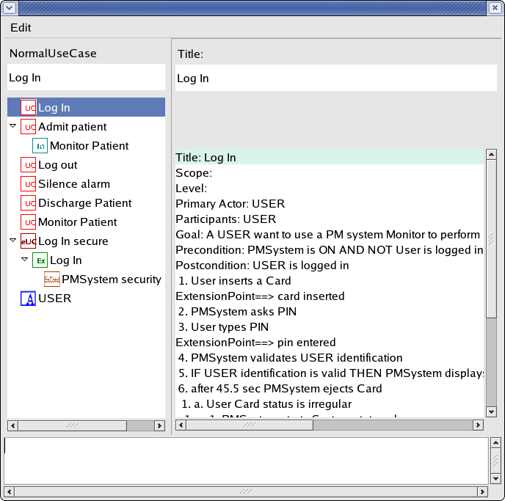
Use Case Edition with UCEd
Elicitation Techniques Existing Systems Interviews Brainstorming Joint Application Design Prototyping Use Cases
Use Case
model edition area
Use Case
description edition area
Use Case model
(use case, extend, include, actor…)
Use Case
description

Slide 115
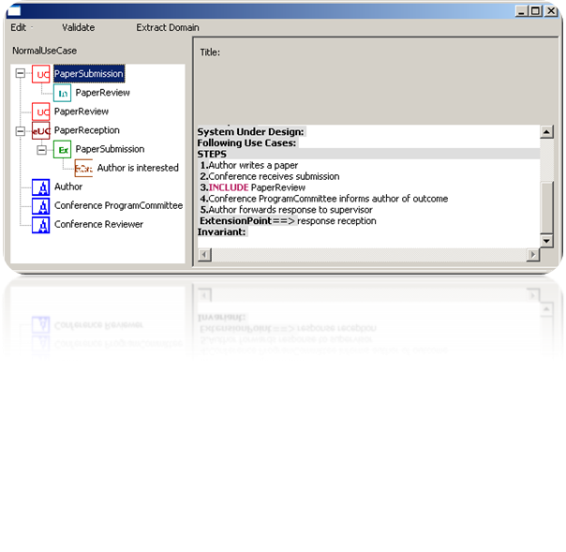
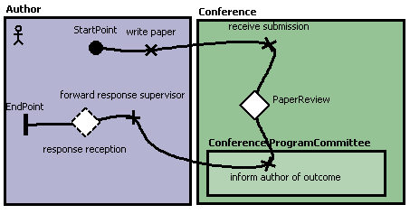
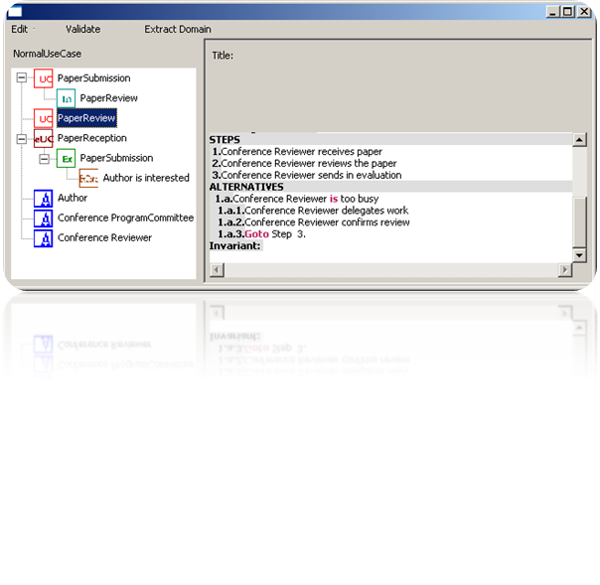
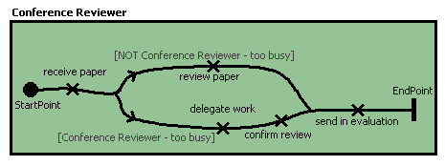
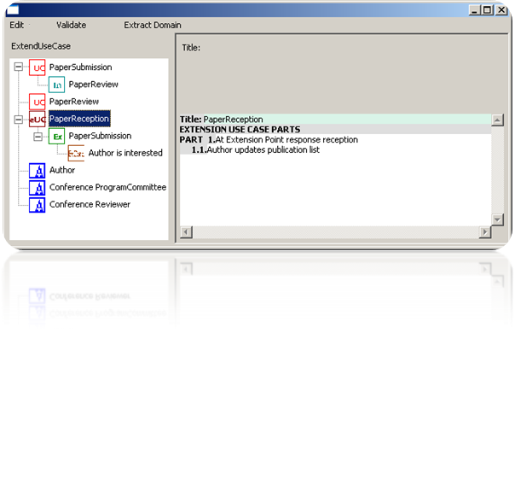
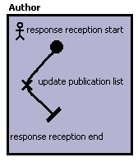

UCEd Model Import in jUCMNav
Elicitation Techniques Existing Systems Interviews Brainstorming Joint Application Design Prototyping Use Cases

Slide 116
Don’t be Negative, But…
Elicitation Techniques Existing Systems Interviews Brainstorming Joint Application Design Prototyping Use Cases
Be ready to face the music!
  In business, some people might wish to see you fail…
  There are unforeseen events in any project
  Open systems are subject to various threats
  Software contains various kinds of bugs
Remember Murphy’s Law…
  “Anything that can go wrong will go wrong.”

Slide 117
Think about Negative Scenarios?
Elicitation Techniques Existing Systems Interviews Brainstorming Joint Application Design Prototyping Use Cases
A negative scenario is a scenario whose goal is
  Undesirable from the business organization’s viewpoint
  Desirable from a hostile agent’s viewpoint (not necessarily human)
Consider them beforehand
  As well as potential solutions
Or…
  Wait until it is too late to react…

Slide 118
Misuse Case
Elicitation Techniques Existing Systems Interviews Brainstorming Joint Application Design Prototyping Use Cases
Proposed by Sindre et Opdahl (2000)
  Capture use cases that a system must be protected against
  Goal is to threaten the system
  Obvious applications for security and risk analysis
The misuse case’s misactor is a hostile agent
The colors of the ellipse are inverted
threatens
Drive Car
Steal Car
Thief

Slide 119
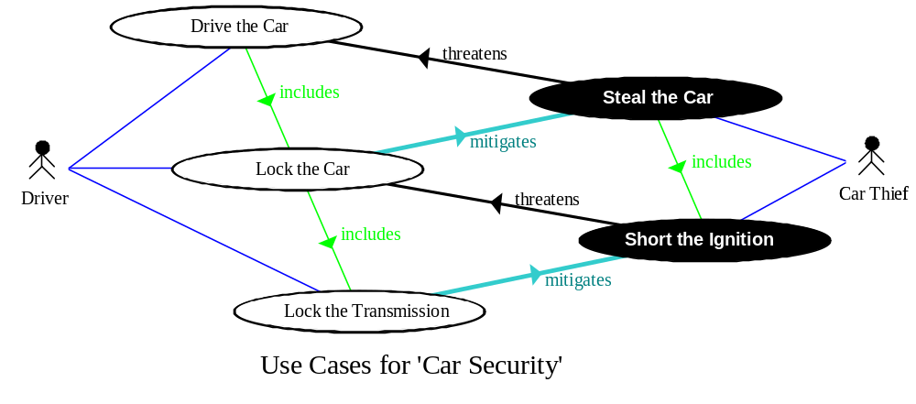
A MiniMax¹ for Security
Elicitation Techniques Existing Systems Interviews Brainstorming Joint Application Design Prototyping Use Cases
Similar to a chess match…
  White’s best move is to find Black’s best move and to counter it
New relations:
  threatens (from misuse case to use case)
  mitigates (from use case to misuse case)
[1] Minimax: minimizing the maximum possible loss

Slide 120
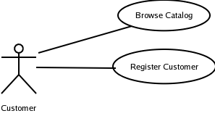
Finding Misuse Cases – Step 1
Elicitation Techniques Existing Systems Interviews Brainstorming Joint Application Design Prototyping Use Cases
Start from a normal use case diagram
Find misactors (hostile roles)
  Who are the misactors, who want:
  To harm the system, its stakeholders, or their resources intentionally
  or
  To achieve goals that are incompatible with the system's goals
Competitor
Crook
…

Slide 121
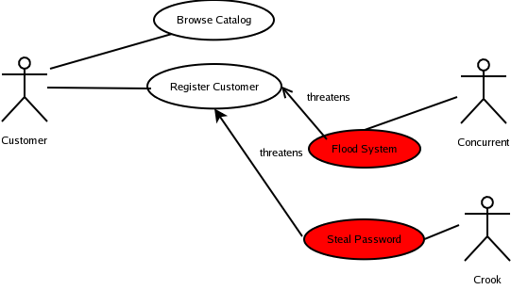
Finding Misuse Cases – Step 2
Elicitation Techniques Existing Systems Interviews Brainstorming Joint Application Design Prototyping Use Cases
Find misuse cases
  Ask what would a misactor do to harm system
  Express goals of misactors (if needed elaborate with scenarios)
  Add relationships (threaten)
Competitor

Slide 122
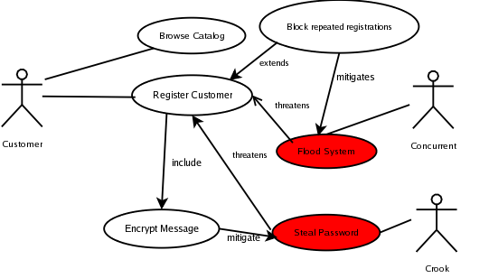
Finding Misuse Cases – Step 3
Elicitation Techniques Existing Systems Interviews Brainstorming Joint Application Design Prototyping Use Cases
Mitigate misuse cases
  Ask what would neutralize the threats
  New included use case, new extension use case, or new secondary scenario to existing use case might be added
Competitor

Slide 123
Benefits and Risks of Misuse Cases
Elicitation Techniques Existing Systems Interviews Brainstorming Joint Application Design Prototyping Use Cases
Benefits
  Elicitation of security and safety requirements
  Early identification of threats, mitigations, and exceptions that could cause system failure
  Early identification of test cases
  Documentation of rationales
Risks
  Get into premature design solutions in step 3 (mitigation)
    Goal should be to find requirements (safety, security…)
  Missing misactors and threats in a partial view

Slide 124
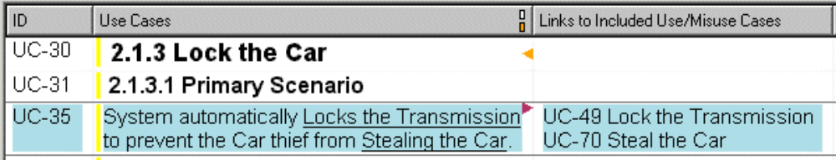
Tool: DOORS Plug-in
Elicitation Techniques Existing Systems Interviews Brainstorming Joint Application Design Prototyping Use Cases
Scenario Plus (for Telelogic DOORS)
Textual / Graphical output (HTML)
Automatic links, metrics, etc.
Upon referencing: automatic creation of use/misuse cases
Automatic creation of links between misuse and use cases,
by searching for underlined use case names with simple fuzzy matching

Slide 125
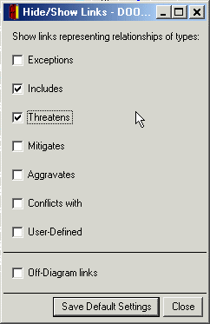
Conflict and Trade-off Analysis
Elicitation Techniques Existing Systems Interviews Brainstorming Joint Application Design Prototyping Use Cases
New relations: aggravates and conflicts with
threatens
Sabotage
Rogue Employee
Access the Services
threatens
aggravates
includes
threatens
Frustrated by Controls
mitigates
Service User
mitigates
Service User
includes
Control Loosely
threatens
conflicts with
aggravates
Denial-of-Service Attack
Security Officer
aggravates
Control Strictly
mitigates
includes
Intrude into System
Hacker
Hacker
Hacker
Hacker
Hacker
includes
Log Access Attempts
includes
mitigates
includes
includes
Brute-Force Password Attack
Operate Firewall
includes
mitigates
Attack Unblocked Ports
Recognize Users
mitigates
Impersonate Users
Use Cases for 'Web Portal Security'

