Slide 1
LLM
Classification Finetuning
Term-Project
Group: 46
Members: 林俞琛、林鈺承、徐綉惠

Slide 2
Outline
Introduction
Reference Codes
Our Proposed Methods
Experimental Results
Analysis and Comparison
Kaggle Competition Ranking
Conclusion

Slide 3
Outline
Introduction
Reference Codes
Our Proposed Methods
Experimental Results
Analysis and Comparison
Kaggle Competition Ranking
Conclusion

Slide 4
Introduction
This task focuses on predicting user preferences in head-to-head comparisons of chatbot responses.
Using a dataset from the Chatbot Arena, featuring conversations generated by various large language models (LLMs).
The goal is to create an effective machine learning model to enhance chatbot interactions with users.
The outcome aims to ensure chatbots align more closely with human preferences.

Slide 5
Dataset
ChatBot Arena
Training set (train.csv) : 55,000 rows, which include id, model_[a/b], prompt, response_[a/b], winner_model_[a/b/tie].
Testing set (test.csv) : 25,000 rows , which include id, prompt, response_[a/b].
Submission file (submission.csv) : Predictions from the testing set, which include id, winner_model_[a/b/tie].
id | A unique identifier for the row.
model_[a/b] | The identity of model_[a/b].
prompt | The prompt that was given as an input (to both models).
response_[a/b] | The response from model_[a/b] to the given prompt.
winner_model_[a/b/tie] | Binary columns marking the judge's selection. The ground truth target column.

Slide 6
Outline
Introduction
Reference Codes
Our Proposed Methods
Experimental Results
Analysis and Comparison
Kaggle Competition Ranking
Conclusion

Slide 7
LMSYS: KerasNLP Starter
This approach focuses on fine-tuning the DebertaV3 model for the task.
It utilizes the Shared Weight strategy, akin to training Multiple Choice Question (MCQ) models.
KerasNLP is the framework used for this fine-tuning process.
Mixed precision will be employed to enhance training and inference speed.
Key Point: Contextualize the Response with the Prompt
This means that for each response, the model will be provided with the same set of prompts along with their respective responses.
e.g., (P + R_A), (P + R_B), etc.

Slide 8
Predicting Chatbot Response Preferences with LLMs
Apply Term Frequency-Inverse Document Frequency(TF-IDF) transformation to convert text into numerical form for feature extraction.
Chose Logistic Regression for multiclass classification.
Use Log Loss to evaluate model performance.
Key Point: Contextualize the Response with the Prompt
This means that for each response, the model will be provided with the same set of prompts along with their respective responses.
e.g., (P + R_A), (P + R_B), etc.

Slide 9
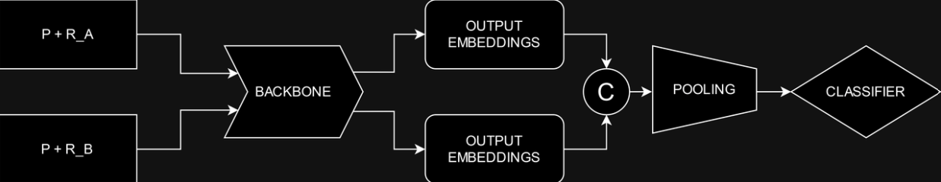
Baseline Method Framework
Please note that the same model used for all responses employs shared weights, in contrast to the distinct models proposed in the diagram.

Slide 10
Outline
Introduction
Reference Codes
Our Proposed Methods
Experimental Results
Analysis and Comparison
Kaggle Competition Ranking
Conclusion

Slide 11
Pre-Trained Model-TinyBERT
TinyBERT is a compact version of BERT, being 7.5 times smaller and 9.4 times faster in inference.
The model employs a novel transformer distillation process during both pre-training and task-specific learning stages.
The original BERT-base model is used as the teacher without fine-tuning.
A large-scale text corpus serves as the learning data for the distillation process.
General TinyBERT is created through transformer distillation on general domain text, providing a solid foundation for task-specific distillation.

Slide 12
Data Preprocessing
Split
Training Set: 90% rows
Validation Set: 10% rows
Tokenization (TinyBERT Tokenizer)
Transform input strings into a dictionary that contains two components:
`token_ids` and `padding_mask`.
DataLoader
Batch size for training and validation sets is 16.

Slide 13
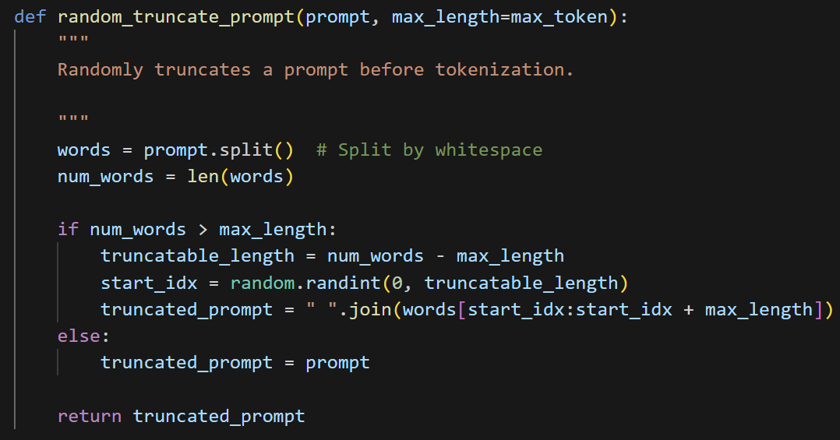
Random Truncation Text Function
Input: A text (prompt or response) along with a specified maximum length for the text.
Operation: Randomly truncates the text by:
Step 1. Divide the text into individual words.
Step 2. Ensure that the text does not exceed the maximum length.
Step 3. Randomly select a contiguous subset of words, ensuring that it does not exceed a specified maximum length if the text is excessively long.
Output: The truncated text.

Slide 14
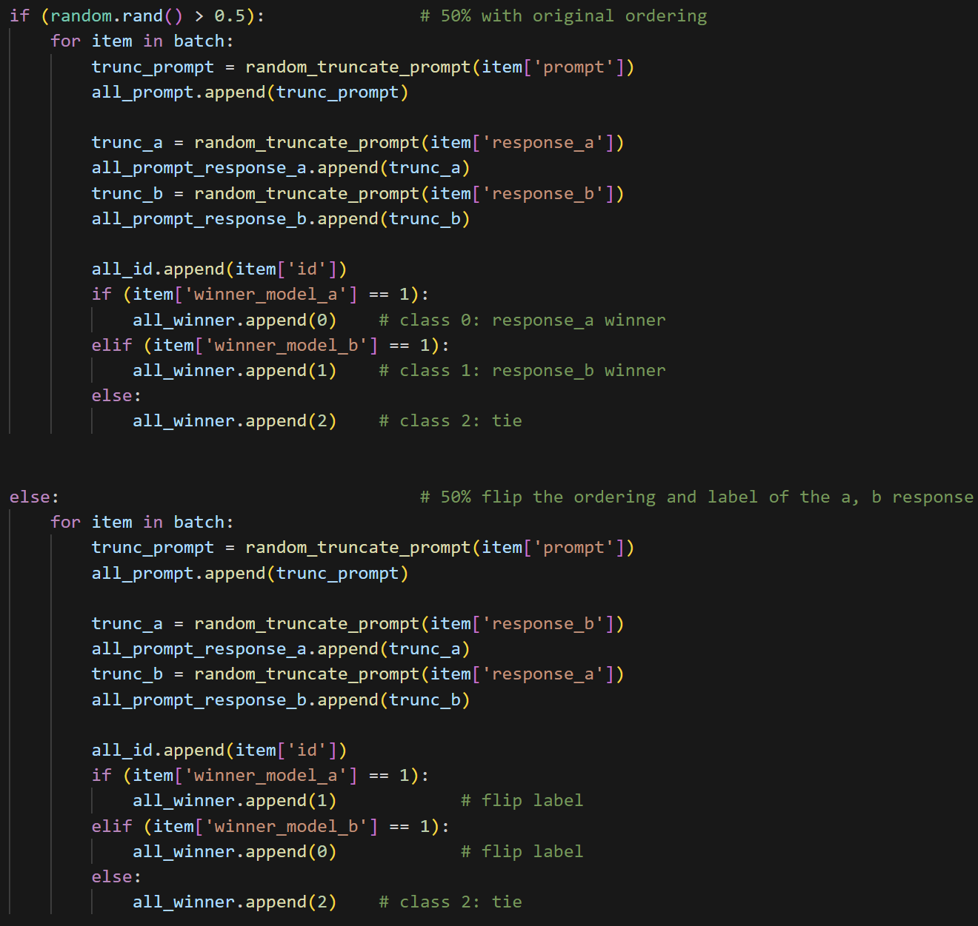
Random Ordering in Collation Function
Operation:
50% chance of maintaining the original order of responses.
50% chance of swapping the order of `response_a` and `response_b`, as well as flipping their corresponding labels.
Labels:
If `winner_model_a` equals 1, then the label is 0, indicating that `response_a` is better.
If `winner_model_b` equals 1, then the label is 1, indicating that `response_b` is better.
If neither option is selected, label it as 2 (indicating a `tie`).

Slide 15
Our Proposed Method Framework
P
BACK
BONE
3 OUTPUT
EMBEDDINGS
CLASSIFIER
TOKENIZER
C
R_A
R_B
We concatenate the prompt and responses after tokenizer and backbone, unlike the previous methods.

Slide 16
Training Settings
Hyperparameters
Learning Rate: 0.00003
Epochs: 2
Weight Decay: 0.01
Max Length: 512
Optimizer
AdamW
Loss Function
Cross-Entropy Loss / Log Loss
Number of Classes: 3 (`winner_model_a`, `winner_model_b`, and `tie`)

Slide 17
Outline
Introduction
Reference Codes
Our Proposed Methods
Experimental Results
Analysis and Comparison
Kaggle Competition Ranking
Conclusion

Slide 18
Experiments
Experiment | Method | Model | Data Augmentation | Validation Accuracy | Validation F1 Score
Case 1 | Baseline | TinyBERT | No | 0.4548 | 0.4346
Case 2 | Our | TinyBERT | No | 0.4763 | 0.4644
Case 3 | Our | TinyBERT | Yes | 0.4828 | 0.4711
Please note that data augmentation refers to the addition of the random truncation text function and the random ordering in the collation function.

Slide 19
Outline
Introduction
Reference Codes
Our Proposed Methods
Experimental Results
Analysis and Comparison
Kaggle Competition Ranking
Conclusion

Slide 20
Quantitative Analysis
From the comparison of the numerical results of Case 1 and Case 2, it is evident that by utilizing the same pretrained model and data preprocessing techniques, our method achieves higher accuracy and F1 score on the validation dataset. This improvement is achieved by incorporating three inputs in our method, as opposed to the two inputs used in the baseline method.
The comparison of the numerical results from Case 2 and Case 3 further demonstrates that applying the random truncation technique to prompts and responses enables our method to achieve superior accuracy and F1 score on the validation dataset. It is evident that randomly extracting text yields better results than the default method of extracting text from scratch.

Slide 21
Outline
Introduction
Reference Codes
Our Proposed Methods
Experimental Results
Analysis and Comparison
Kaggle Competition Ranking
Conclusion

Slide 22
Kaggle Competition Ranking
1.04387 log loss at 55th place.
# | Score
55 | 1.04387

Slide 23
Outline
Introduction
Reference Codes
Our Proposed Methods
Experimental Results
Analysis and Comparison
Kaggle Competition Ranking
Conclusion

Slide 24
Conclusion
We have adjusted the selection of pre-trained model based on the baseline method, modified the input structure of the model, and applied data augmentation during preprocessing. The numerical results indicate that these methods effectively enhance the model's performance, resulting in higher accuracy and F1 score.
Future Work:
In order to enhance accuracy and F1 score for better ranking in Kaggle competition, we manage to collect the win rate between different models and use multitask to let the model consider it when training.

Slide 25
References
https://www.kaggle.com/code/addisonhoward/lmsys-kerasnlp-starter
https://www.kaggle.com/code/salmarashwan/predicting-chatbot-response-preferences-with-llms
https://huggingface.co/huawei-noah/TinyBERT_General_4L_312D

Slide 26
Presentation Video Link
https://youtu.be/B9_mr-H1Hbg

