Slide 1
Water Segmentation
using Convention Method
By 林家榆、徐綉惠
Team: 28

Slide 2
Outline
Introduction
Methods
  Watershed
  Morphological Gradient
MAP model
Experimental Results
Analysis
Comparison
Conclusion

Slide 3
Introduction
We employed two conventional feature extraction methods to accomplish the task of water segmentation.
We implemented the watershed algorithm and the morphological gradient algorithm, applying the Maximum A Posteriori (MAP) statistical model to both methods to enhance their performance.

Slide 4
Method -- Watershed
Convert to Grayscale :
The input image is converted to grayscale for compatibility with image processing operations.
2. Otsu's Method :
Determine an optimal threshold, creating a binary mask by assigning values based on pixel intensity.
  Pixels below the threshold are set to 255 (white) for the foreground.
  Pixels above the threshold are set to 0 (black) for the background.

Slide 5
Method -- Watershed
3. Morphological Refinement :
Using a 5x5 elliptical kernel with a closing operation to smooth boundaries and eliminate small holes.
4. Distance Transform :
Calculate the distance of each pixel to the nearest zero pixel, identifying
"sure foreground" pixels that exceed 40% of the maximum distance.
5. Perform Dilation :
Expand the foreground regions, defining the "sure background," and
the foreground is subtracted from the background to find the "unknown"
region.

Slide 6
Method -- Watershed
6. Connected Components Algorithm :
Label each region in the "sure foreground" uniquely, with background pixels initially labeled as 0 and then incremented to 1, and the pixels in the unknown region are reassigned to 0.
7. Watershed Algorithm :
Treating the image as a topographical surface and flooding it from labeled
markers, and the boundaries between regions are labeled as -1.
8. Binary Segmentation :
The final result is produced by setting pixels with labels greater than 1 to
white (255) and boundary pixels (-1) to black (0).

Slide 7
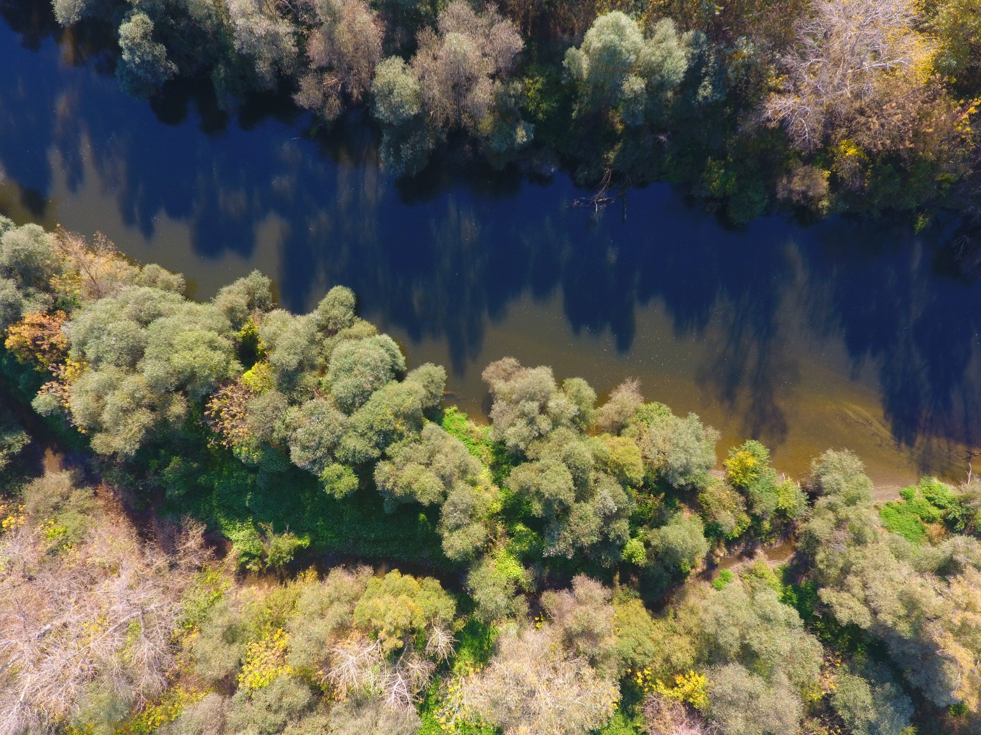
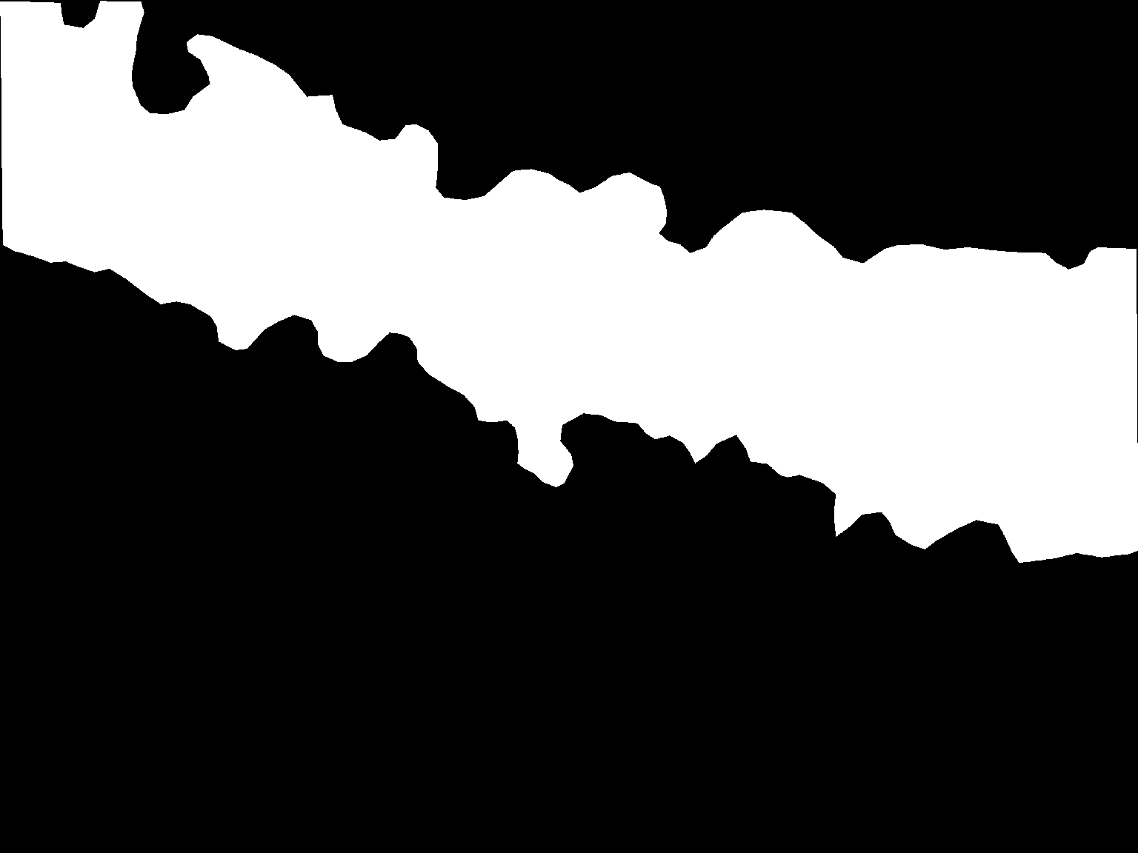
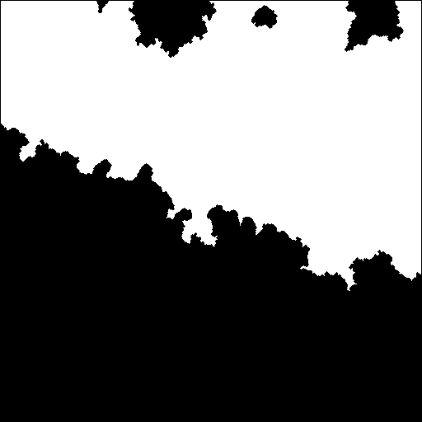
Experimental Results -- Watershed
Intersection over Union (IoU) : 0.62
image
actual mask
predicted mask

Slide 8
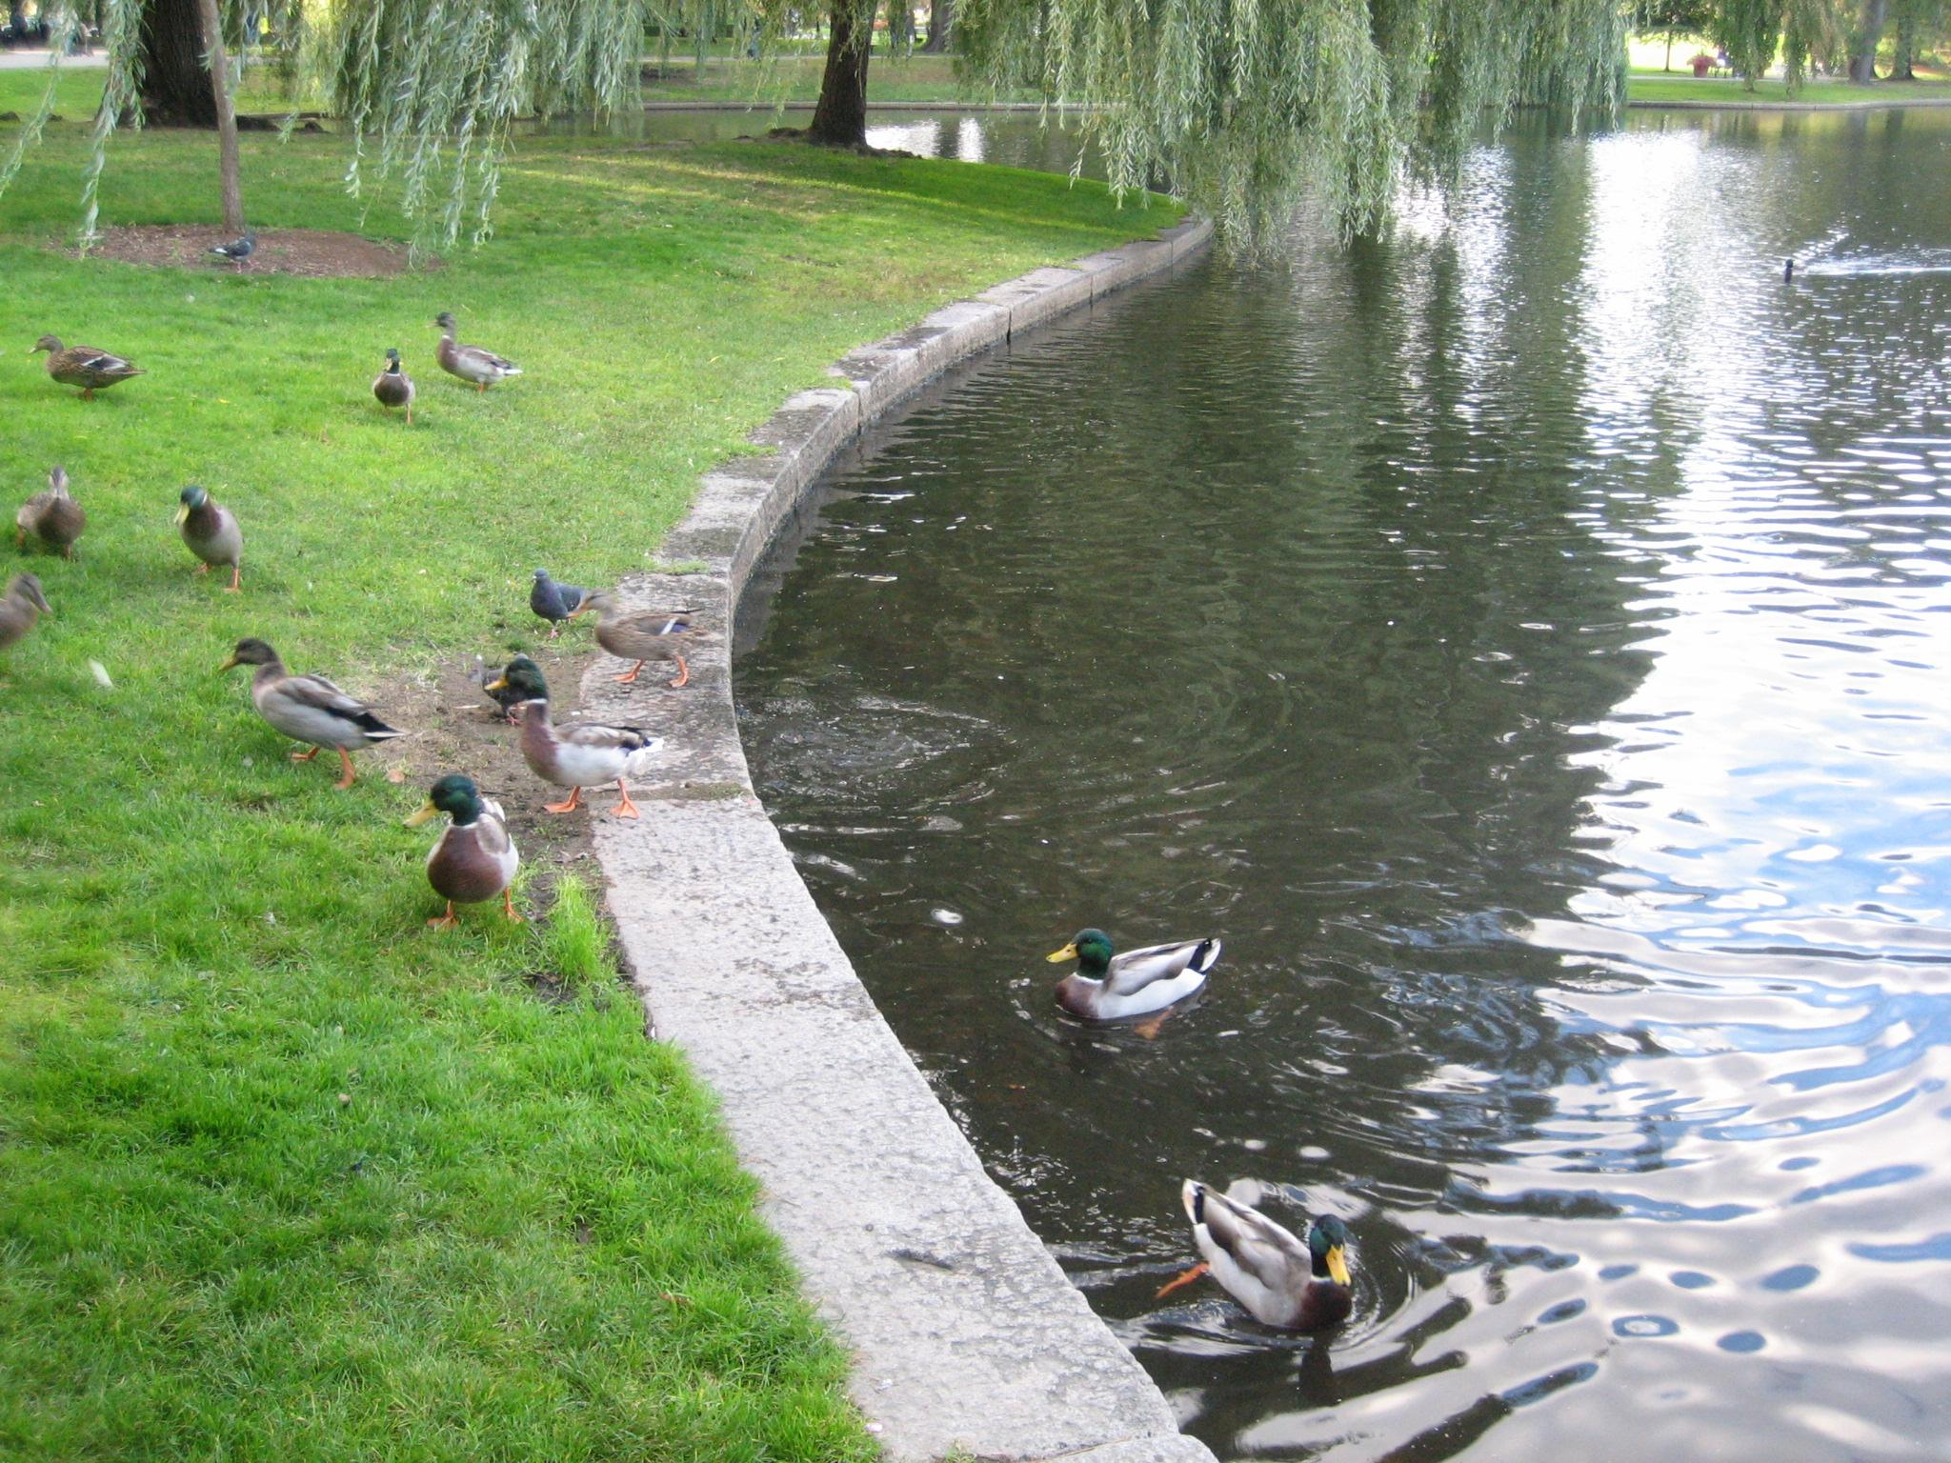
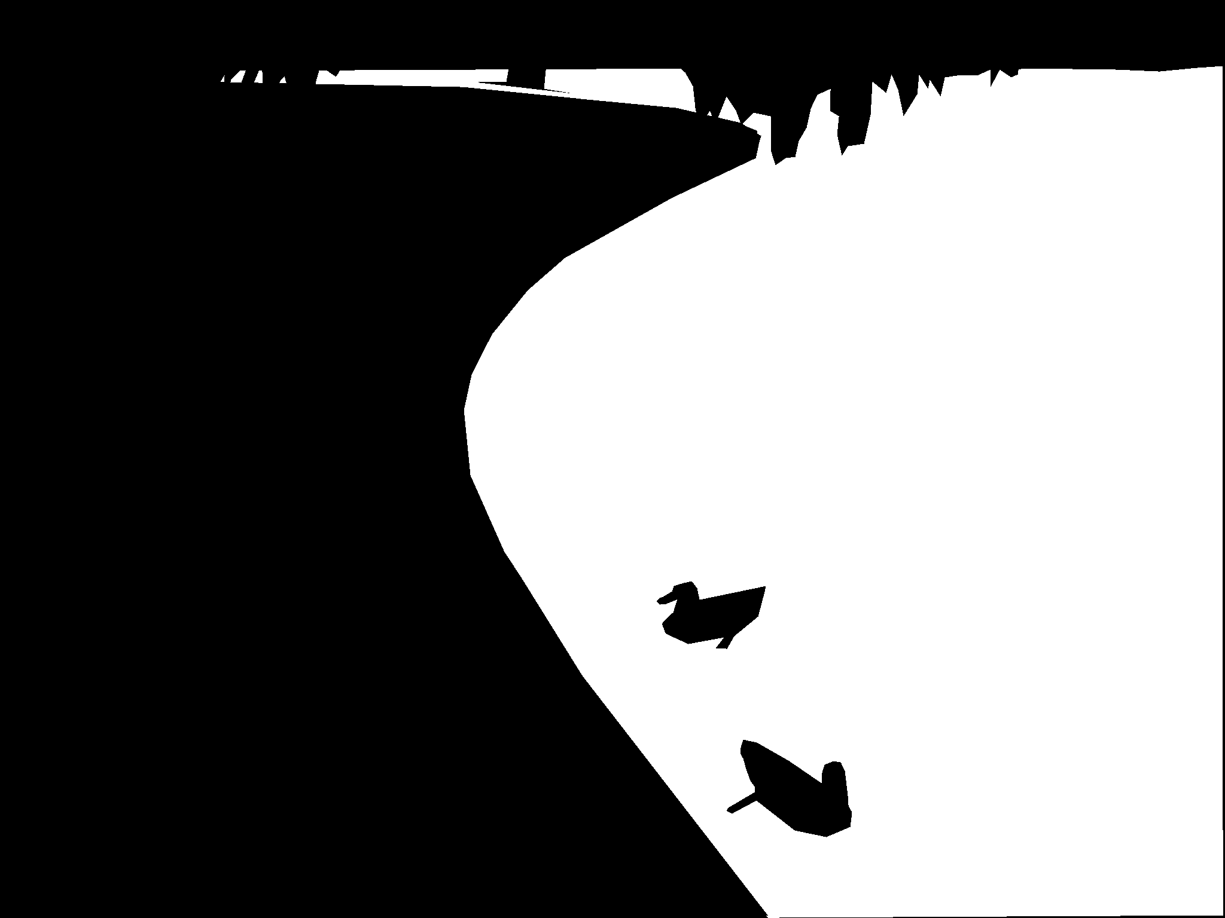
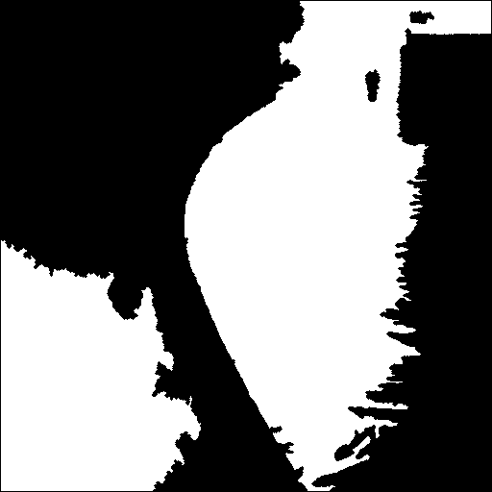
Experimental Results -- Watershed
Intersection over Union (IoU) : 0.40
image
actual mask
predicted mask

Slide 9
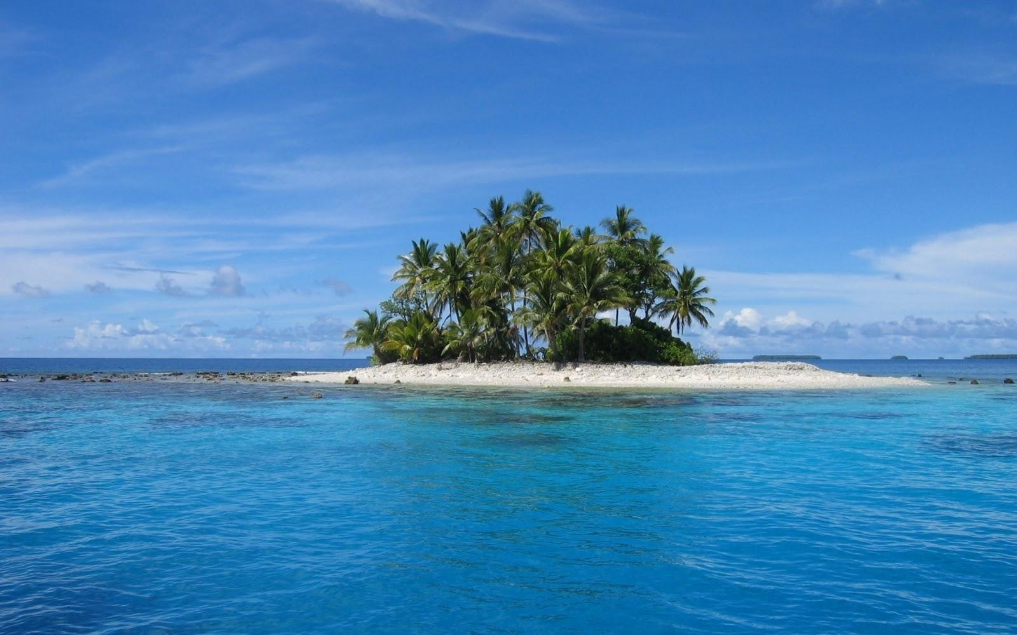
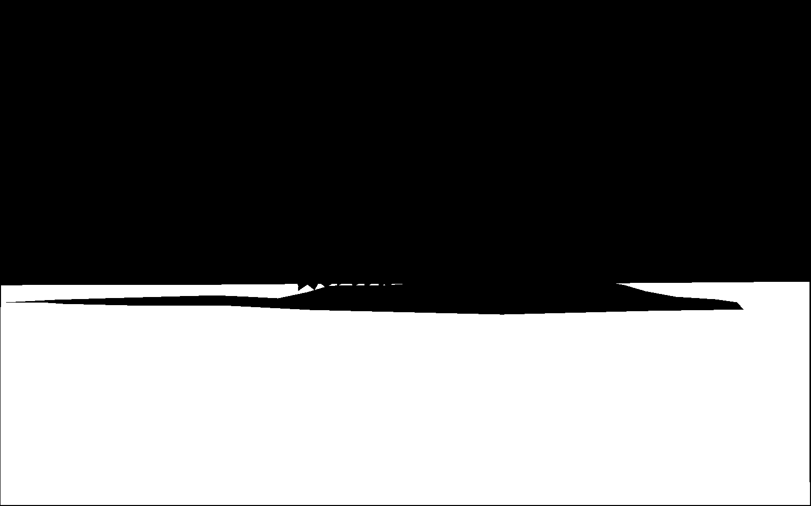
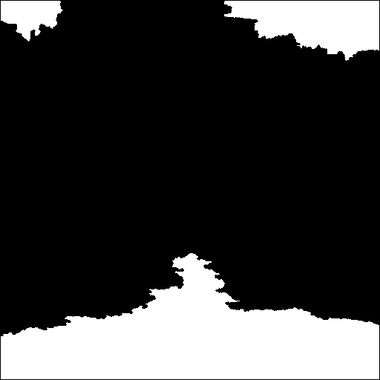
Experimental Results -- Watershed
Intersection over Union (IoU) : 0.40
image
actual mask
predicted mask

Slide 10
Analysis -- Watershed
However, upon examining the output of the watershed algorithm, I find that while the algorithm can reasonably predict the edges of the objects in the input image, it struggles to accurately differentiate between water and non-water areas.
Proposed Solution :
  We plan to develop a statistical model, known as the Maximum A Posteriori (MAP) estimation, to address this issue more effectively.

Slide 11
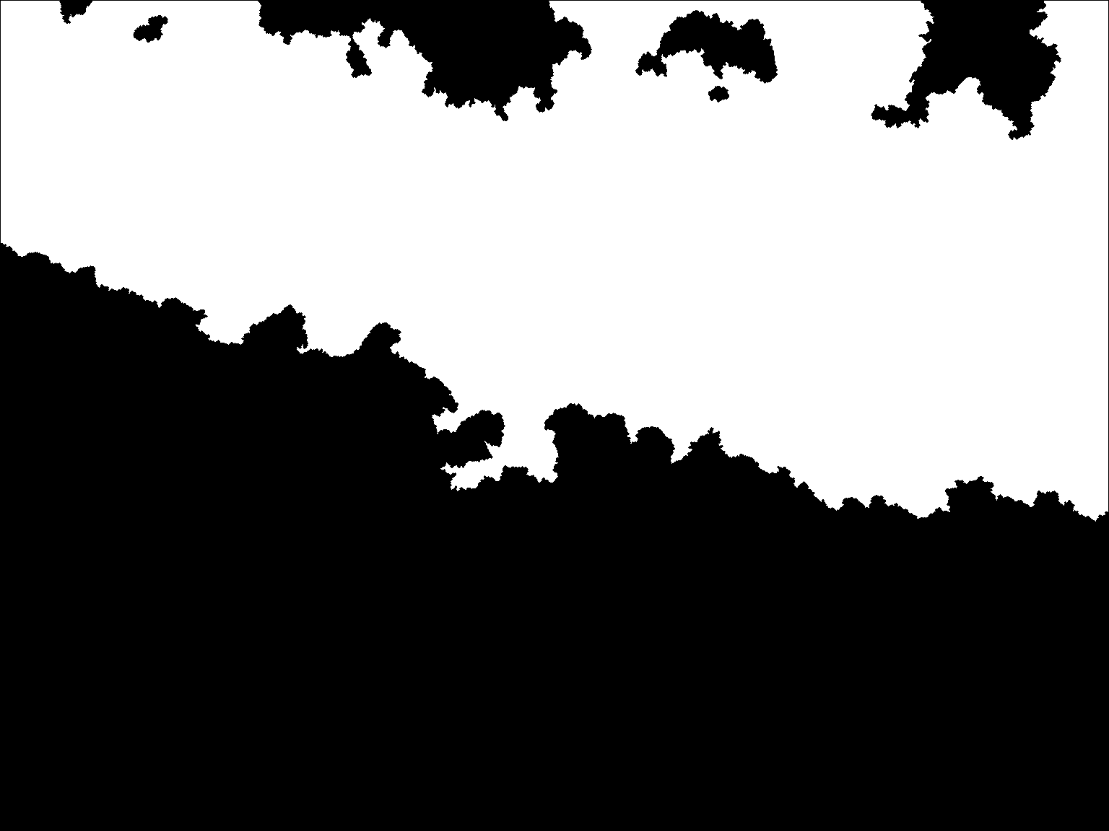
Experimental Results -- Watershed with MAP
Intersection over Union (IoU) : 0.64
image
actual mask
predicted mask

Slide 12
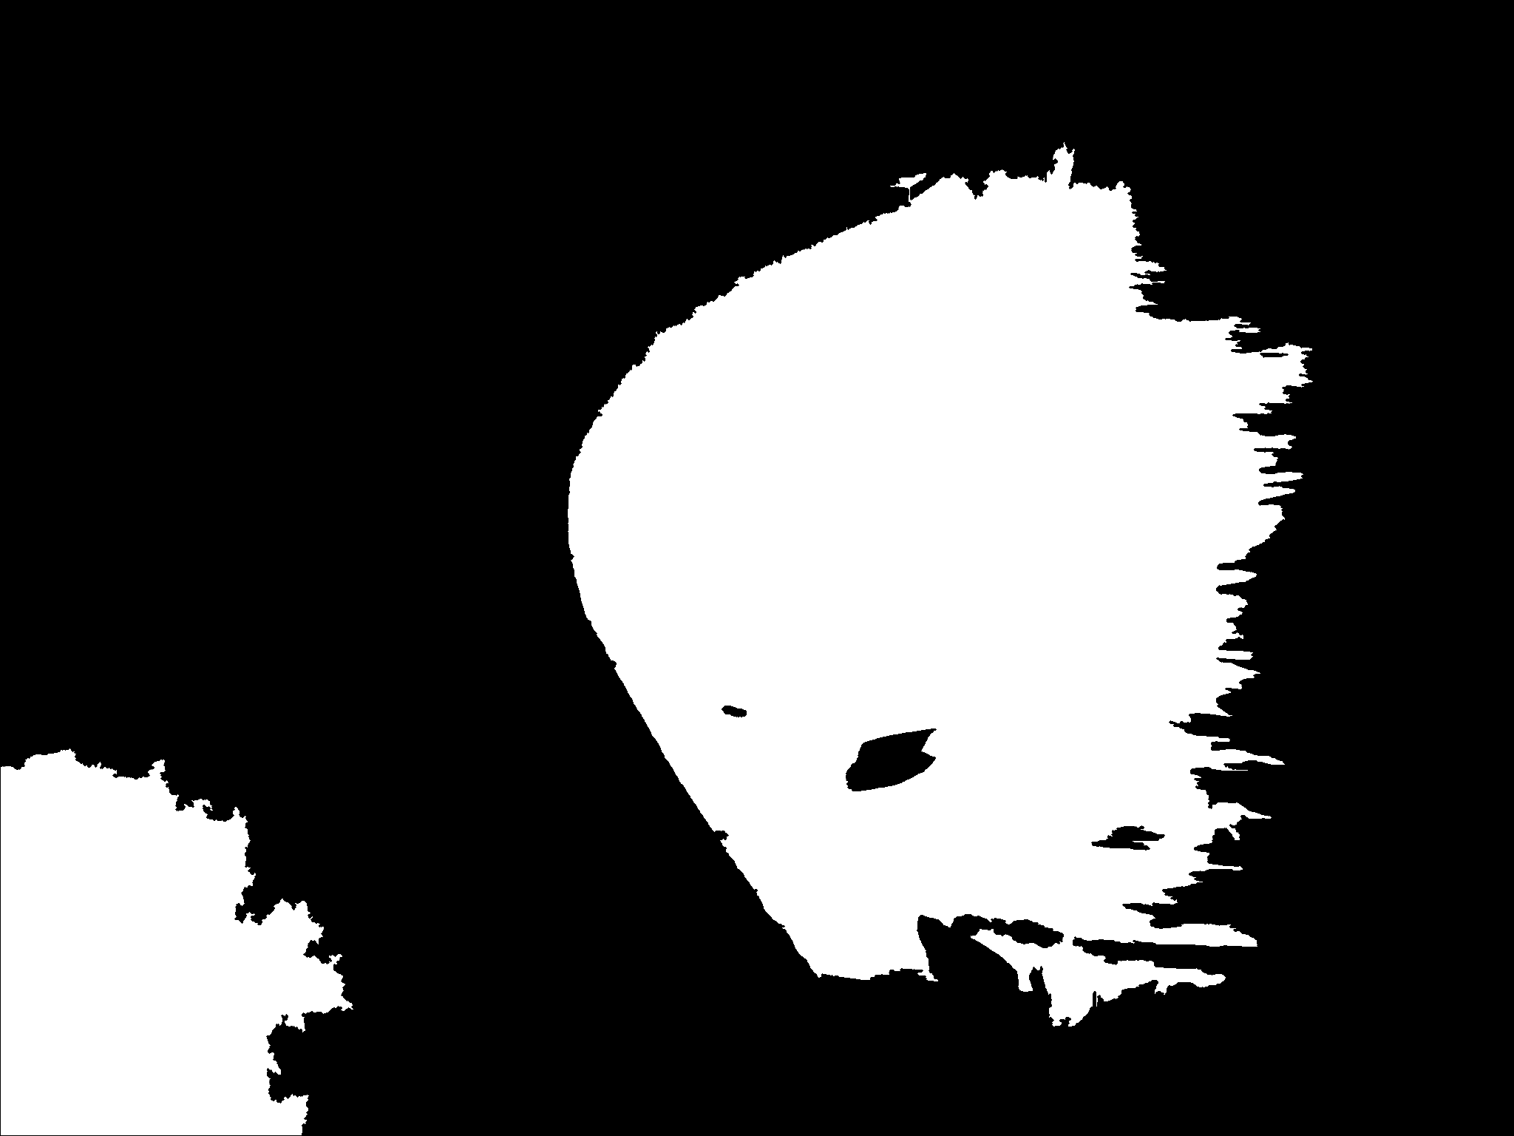
Experimental Results -- Watershed with MAP
Intersection over Union (IoU) : 0.45
image
actual mask
predicted mask

Slide 13
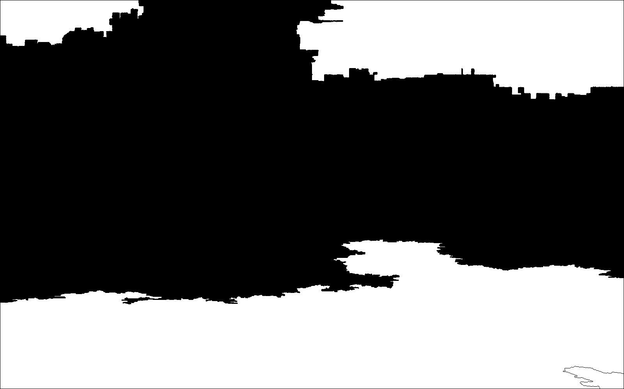
Experimental Results -- Watershed with MAP
Intersection over Union (IoU) : 0.52
image
actual mask
predicted mask

Slide 14
Analysis -- Watershed with MAP
By analyzing the output of the watershed algorithm in conjunction with the MAP model, it is evident that the distinction between water and non-water areas has become more precise; however, the average IoU values have not shown significant improvement.
Potential Problems :
  As evidenced by the disparity between the actual and predicted masks, there is still an inaccurate assessment of the luminance variations on the water's surface and the differentiation between similar colors, such as water and sky.

Slide 15
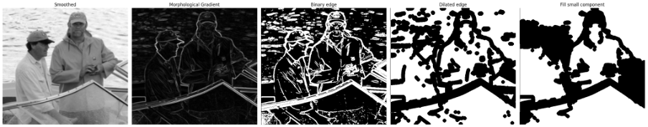
Method -- Morphological Gradient
Assumtion: water region would be smooth and non-water would be complex
Transform the image into gray scale and apply Gaussian Smoothing

Slide 16
Method -- Morphological Gradient
Assumtion: water region would be smooth and non-water would be complex
2. Apply morphological gradient

Slide 17
Method -- Morphological Gradient
Assumption: water region would be smooth and non-water would be complex
3. Use the mean of gradient as threshold to convert the grayscale into binary

Slide 18
Method -- Morphological Gradient
Assumption: water region would be smooth and non-water would be complex
4. Apply binary opening and dilation to smooth and connect the edges

Slide 19
Method -- Morphological Gradient
Assumption: water region would be smooth and non-water would be complex
5. Fill element that is smaller than pre-define threshold

Slide 20
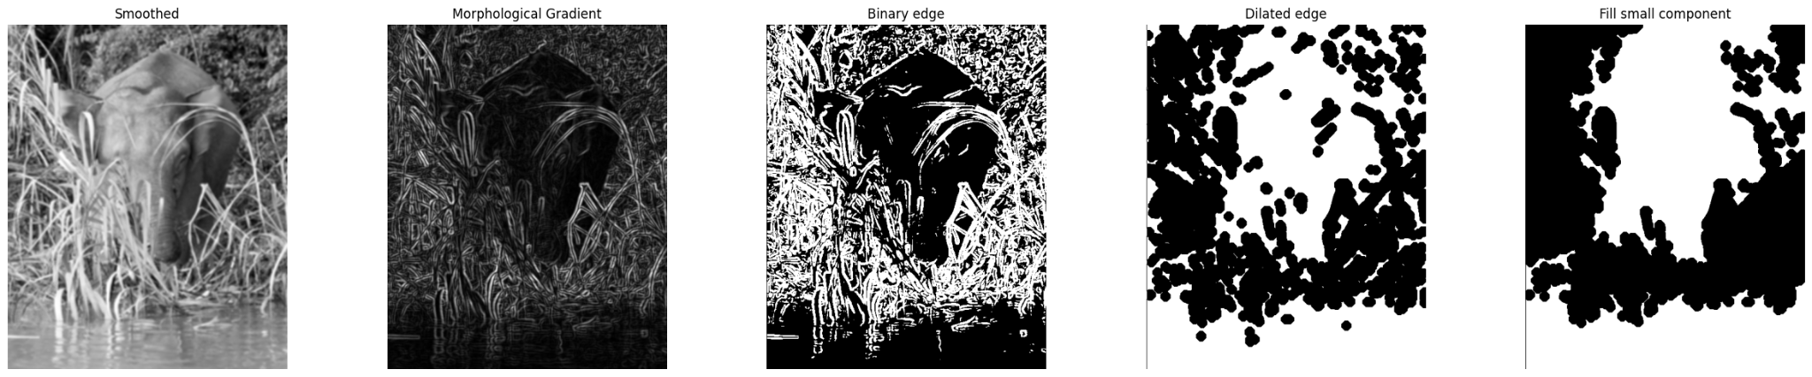
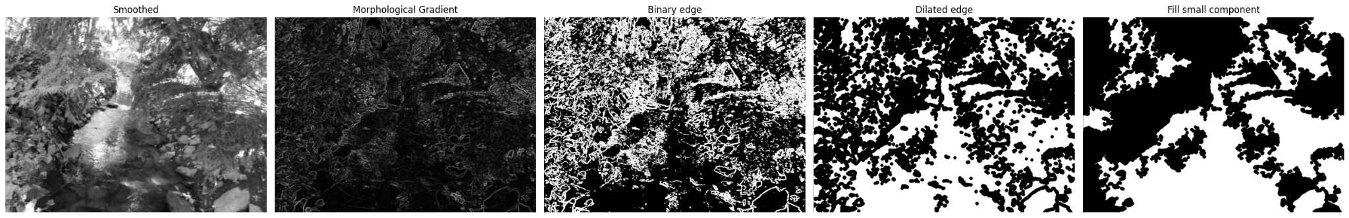
Method -- Morphological Gradient

Slide 21
MAP Model
Features:
Color
  mean, std of RGB and HSB color space
Texture
  Local Binary pattern
  Haralick features such as energy, correlation
  Entropy

Slide 22
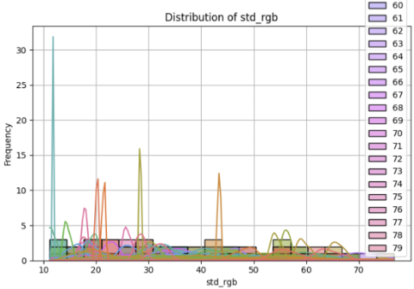
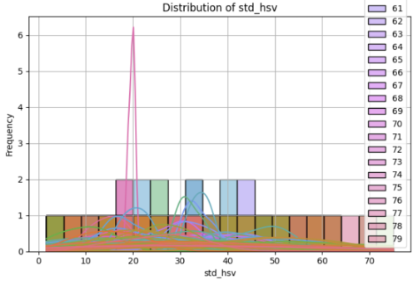
Feature Distribution

Slide 23
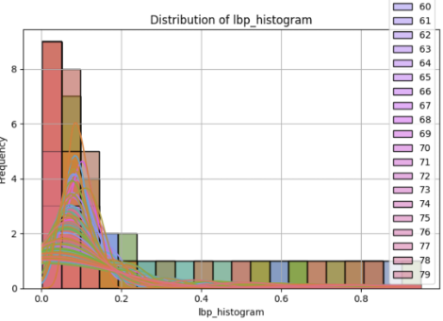
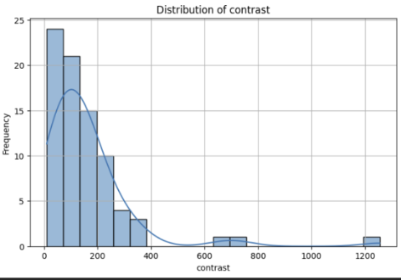
Feature Distribution

Slide 24
MAP model
Training:
Find prior probability
Estimate likelihood function using Gaussian function
Classificastion
Select the group that has highest product of prior and likelihood function
Model result
Training / Testing images accuracy: 0.66 / 0.78

Slide 25
Final Algorithm
Procedures:
Train MAP model using training data and provided mask.
Segment the image based on the edges.
  Convert the png image into a grayscale array.
  Apply Gaussian Smoothing to reduce noise and detail.
  Calculate the morphological gradient to highlight edges.
  Determine the threshold for the image based on its mean and standard deviation.
  Connect edgels using multiple thresholds obtained in step d.
  Apply a binary closing operation to remove small edgel artifacts and smooth the edges.
  Identify connected elements; if an element is too small, classify it as part of the background.)
Classify each connected element using the MAP model.

Slide 26
Improvement
Connecting edge using multiple thresholds
Eliminating assumptions
Segmentation and classification
Fail Prevention

Slide 27
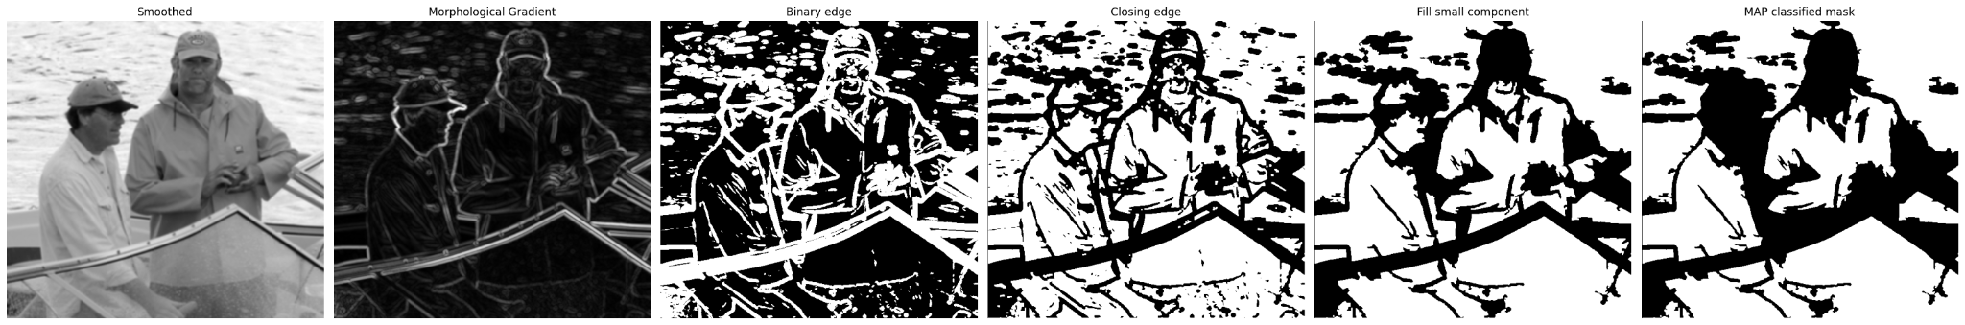
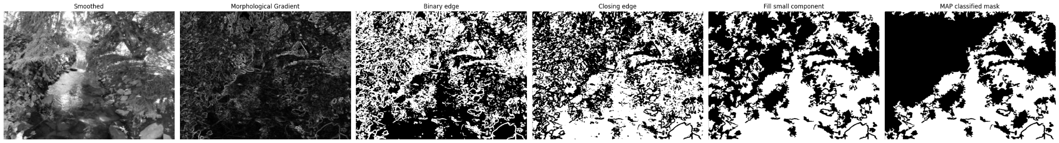
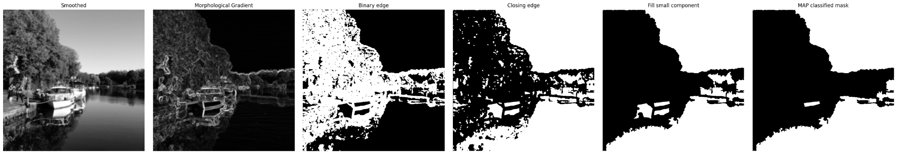
Final result:
Average IoU (training/testing/demo): 0.3218 / 0.4288 / 0.2705

Slide 28
Comparison
 | Average training IoU | Average testing IoU
Watershed | 0.3034 | 0.3203
Watershed + MAP | 0.2927 | 0.2864
Original Morphological | 0.3093 | 0.3320
Final algorithm | 0.3218 | 0.4288

Slide 29
Possible reasons that cause poor accuracy
Inadequate Likelihood Function Assumption
Limitations of Manually Selected Features
Difficulty Differentiating Similar Regions:
Sensitivity to Brightness Changes
Global Thresholding Limitations
Simplicity of the MAP Model

Slide 30
Conclusion
Watershed algorithm was useful for edge detection but struggled to differentiate between water and non-water areas.
Morphological gradient algorithm added smoothness for segmenting water but were too simplistic and error-prone in complex situations.
The MAP model improved classification accuracy by using statistical features like color and texture, along with prior probabilities and likelihood estimation. Although the MAP model achieved higher IoU scores, its reliance on Gaussian assumptions and manually selected features limited its performance.
The final approach combined edge detection with the MAP model to address some limitations.
Challenges remained in distinguishing visually similar regions (e.g., water vs. sky) and managing brightness variations.

