Slide 1
Facilitate DDPMs in MONAI
Group: 8
Members: 徐綉惠、王家駿、林俞琛

Slide 2
Outline
Introduction
Review of Previous Work
Technical Part
Experiments
Conclusions
References

Slide 3
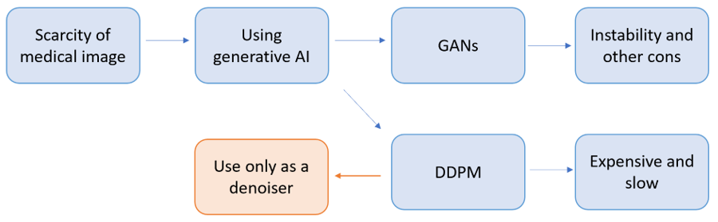
Introduction
Framework

Slide 4
Introduction
Generative Models in Medical Imaging:
Generative models address data scarcity and variability in medical imaging by enabling tasks such as data augmentation, image reconstruction, and rare condition synthesis, improving diagnostic accuracy.
Challenges with GANs:
Generative Adversarial Networks (GANs) are effective at generating high-quality medical images but often suffer from mode collapse, training instability, and high computational demands.

Slide 5
Introduction
Trade-offs of DDPMs:
Denoising Diffusion Probabilistic Models (DDPMs) produce stable and diverse outputs by adding and removing noise iteratively. However, their high computational cost and slow image generation process are significant drawbacks.
Proposed DDPM Improvement:
Using noised images as inputs transforms DDPMs into denoisers, reducing training time while retaining the benefits of stable and diverse image generation.

Slide 6
Review of Previous Work
Denoising Diffusion Implicit Models (DDIMs) improve the efficiency of DDPMs by incorporating key modifications that significantly reduce training time:
Deterministic Sampling:
DDIM uses a deterministic reverse diffusion process, avoiding randomness in DDPMs and enabling more direct and efficient denoising.
(2) Non-Markovian Forward Process:
By removing timestep dependency, DDIM’s non-Markovian forward process leverages all previous steps simultaneously, enabling faster training convergence.

Slide 7
Review of Previous Work
Denoising Diffusion Implicit Models (DDIMs) improve the efficiency of DDPMs by incorporating key modifications that significantly reduce training time:
(3) Reduced Diffusion Steps:
DDIM optimizes the diffusion schedule, requiring fewer steps to generate high-quality images, reducing training time.
(4) Efficient Computation:
With parameter sharing and efficient techniques, DDIM lowers computational overhead per step, ensuring faster training without performance loss.

Slide 8
Technical Part
Summary of the technical solution
(1) Dataset Selection and Preparation:
Utilize the Medical Open Network for AI (MONAI) framework to access the Medical MNIST (MedNIST) dataset.
(2) Model Training:
Train a DDPMs model with the training data.

Slide 9
Technical Part
Summary of the technical solution
(3) Noise Augmentation:
Add noise to the dataset.
(4) Image Generation:
During image generation, input the noisy images from step 3 instead of random noise.

Slide 10
Technical Part
Summary of the technical solution
(5) Evaluation Metrics:
Assess the similarity between the generated images and the original images using Structural Similarity Index Measure (SSIM) and Peak Signal-to-Noise Ratio (PSNR).

Slide 11
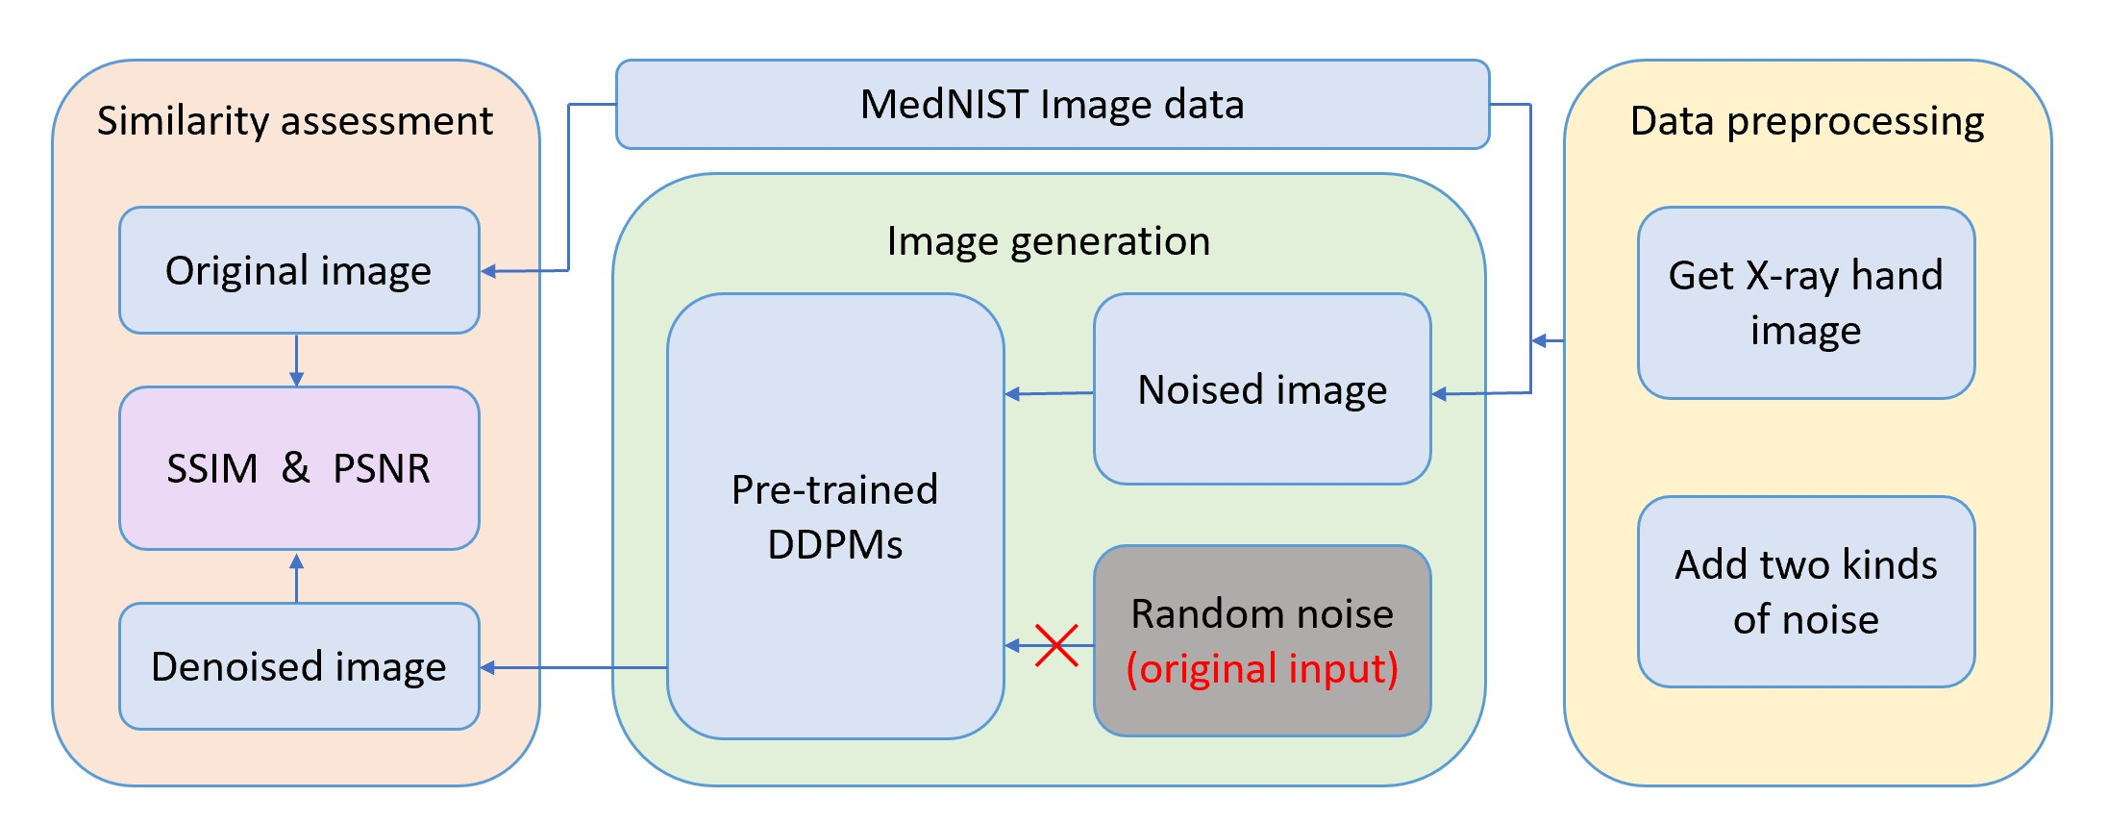
Technical Part
Workflow

Slide 12
Technical Part
Details of the technical solution
(1) Dataset Selection and Preparation:
We only selected hand X-ray images from the MedNIST dataset. There is total 9000 images inside. 8000 of the images were for training and 1000 of them were evaluation data.
(2) Model Training:
We referred to the DDPMs model from the MONAI official website and trained a simple DDPMs model for 20 epochs with the 8000 training data.

Slide 13
Technical Part
Details of the technical solution
(3) Noise Augmentation:
Add two types of noise—Gaussian and salt-and-pepper—to the 1000 evaluation data for afterward denoising process.
(4) Image Generation:
Use the 1000 noised data as the input into the DDPMs instead of random noise. And then let the model iterate through 100 timesteps, generating 1000 denoised image each time.

Slide 14
Technical Part
Details of the technical solution
(5) Evaluation Metrics:
We operated the similarity assessment by SSIM and PSNR. And we recorded the SSIM and PSNR every timestep to kept track of the similarity during the whole iteration. Lastly, plot out the results and print a sample for each timesteps for direct inspection of the denoise performance.

Slide 15
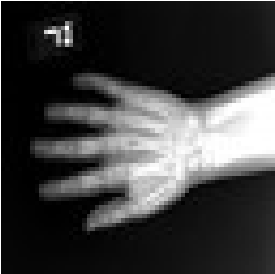
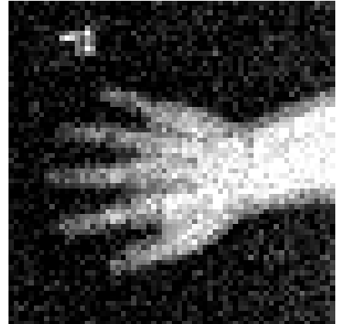
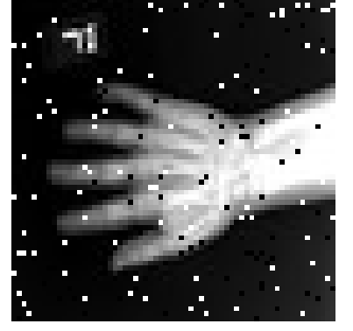
Experiments
Noisy
Original
Gaussian noise
S & P noise

Slide 16
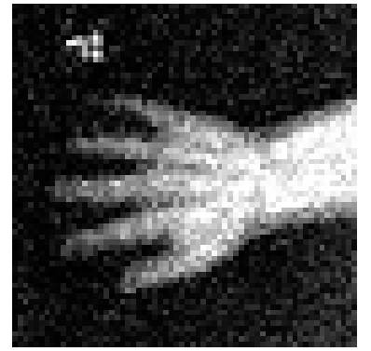
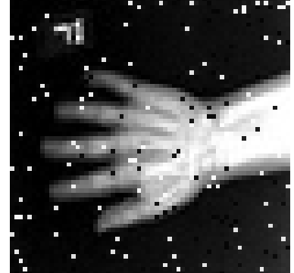
Experiments
Timestep 1
Original
Gaussian noise
S & P noise

Slide 17
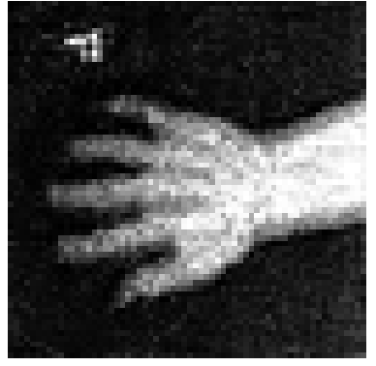
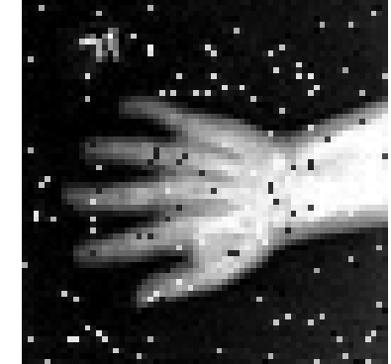
Experiments
Timestep 5
Original
Gaussian noise
S & P noise

Slide 18

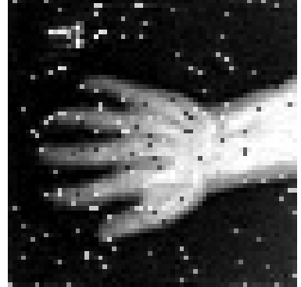
Experiments
Timestep 10
Original
Gaussian noise
S & P noise

Slide 19

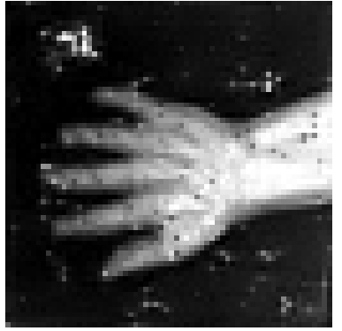
Experiments
Timestep 20
Original
Gaussian noise
S & P noise

Slide 20

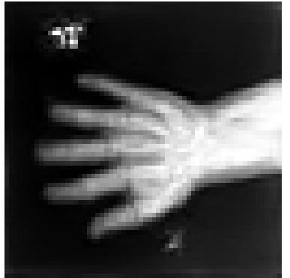
Experiments
Timestep 40
Original
Gaussian noise
S & P noise

Slide 21
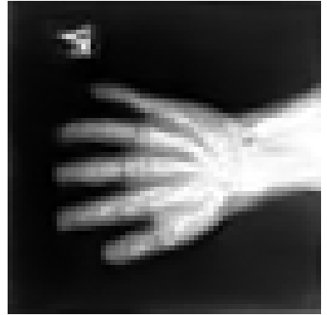

Experiments
Timestep 90
Original
Gaussian noise
S & P noise

Slide 22
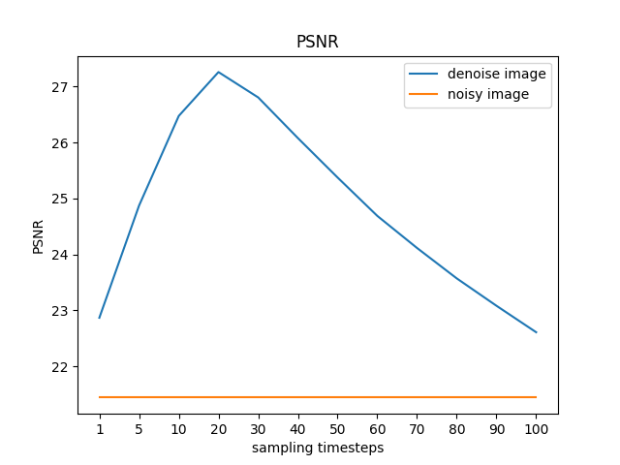
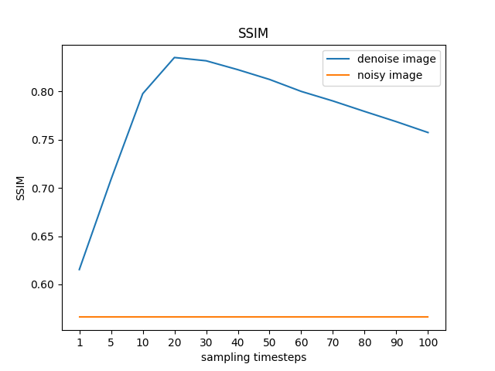
Experiments
Gaussian noise

Slide 23
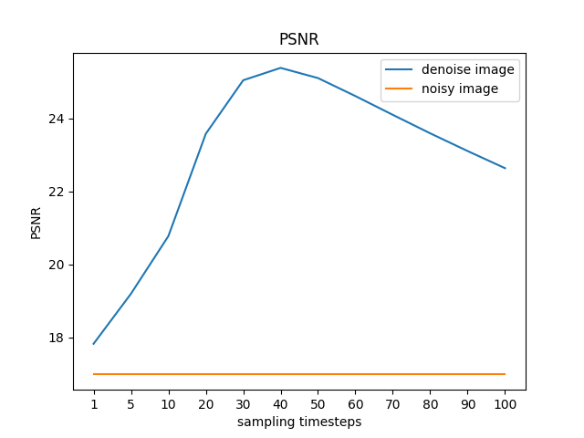
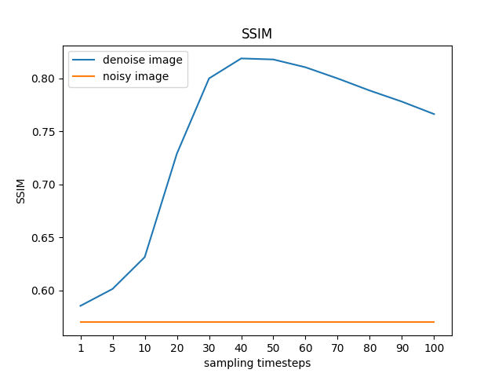
Experiments
S & P noise

Slide 24
Conclusions
Our proposed method enables the generation of new types of images without the necessity of retraining a DDPM from scratch. Theoretically, any pre-trained DDPM are capable of the denoising task. This approach allows us to reduce the number of timesteps from the typical hundreds to fewer than 50, significantly accelerating the process. Given that DDPMs are specifically designed for denoising, the results remain highly effective, preserving the quality of the generated images. Consequently, this method is both efficient and practical for applications in medical imaging.

Slide 25
References
Project-MONAI/MONAI: AI Toolkit for Healthcare Imaging
mednist_GAN_tutorial.ipynb - Colab
autoencoder_mednist.ipynb - Colab
Mastering Denoising Diffusion Probabilistic Models (DDPMs) | by LM Po | Medium
GenerativeModels/tutorials/generative/2d_ddpm/2d_ddpm_tutorial.ipynb at main · Project-MONAI/GenerativeModels

