Slide 1
Save Your Photo
CVPDL Final Project Group 8
NTHU 廖邦宸、林鈺承、張愛翎、洪渝喬、徐綉惠

Slide 2
Outline
Introduction
Related Work
Method
Proposed Dataset
Experiment
Discussion
Conclusion

Slide 3
Outline
Introduction
Related Work
Method
Proposed Dataset
Experiment
Discussion
Conclusion

Slide 4
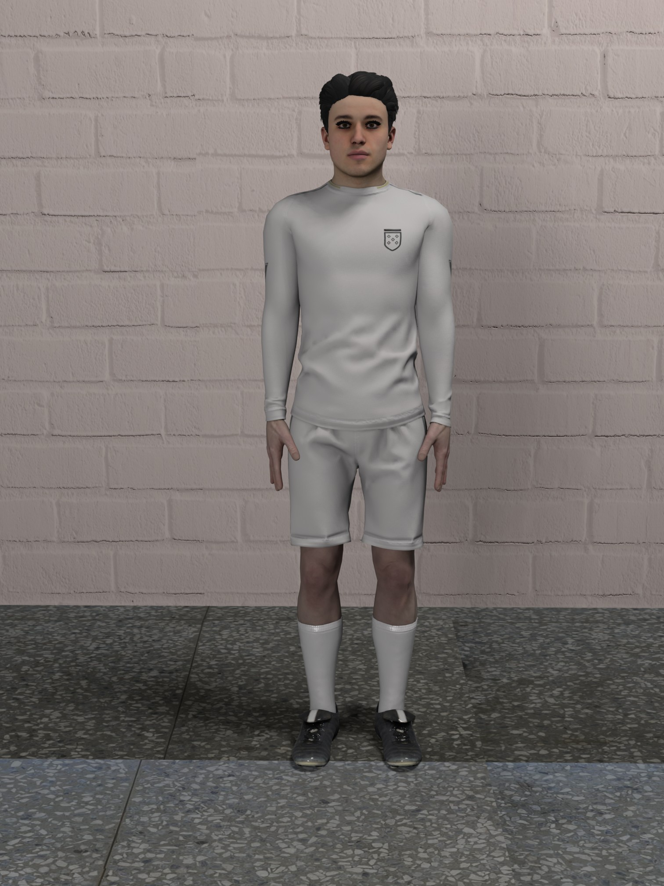
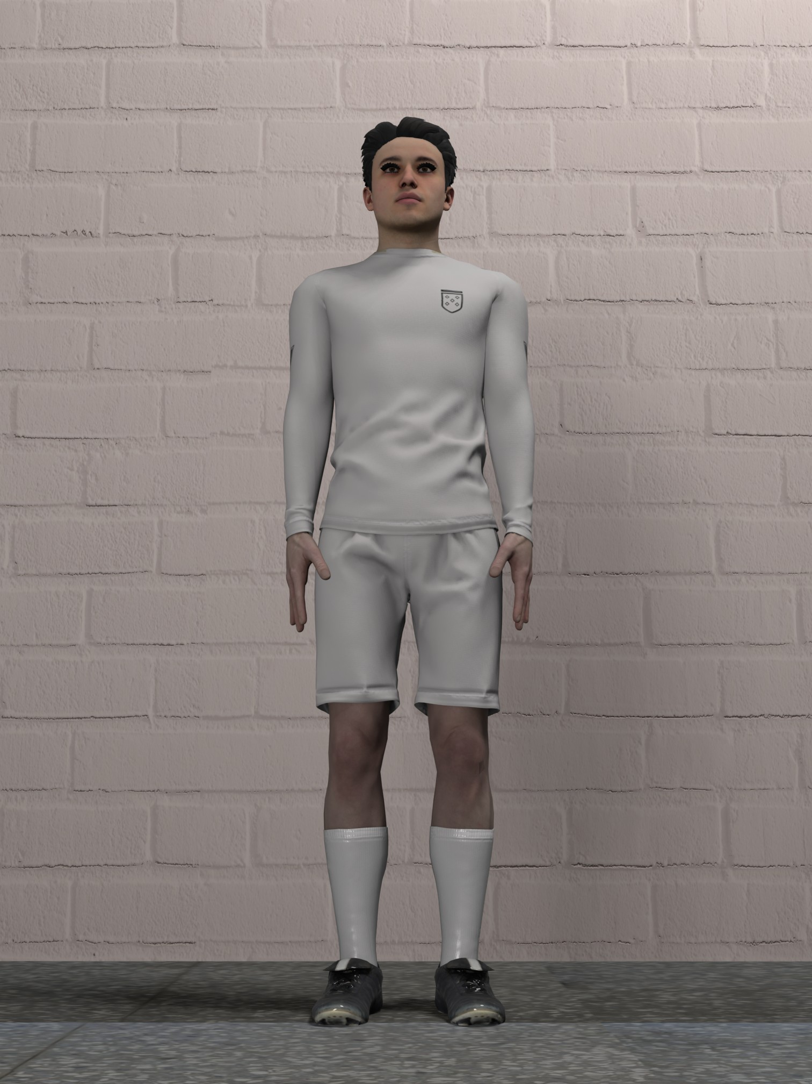
Introduction
Turn bad camera angles into good angles!
High-angle: legs shorten, face bigger
Low-angle: legs lengthen, face smaller, looks taller
looks short…
looks tall!

Slide 5
Outline
Introduction
Related Work
Method
Proposed Dataset
Experiment
Discussion
Conclusion

Slide 6
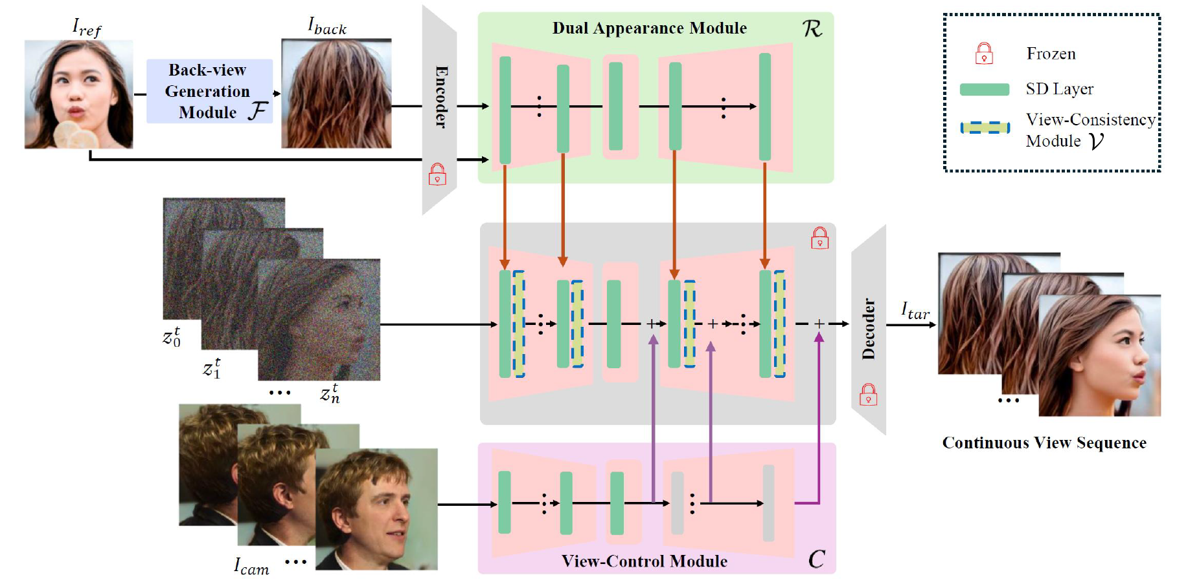
DiffPortrait360 (CVPR2025)
From a single frontal image, the model synthesizes a full 360° horizontal rotation of the face, covering front, side, and back views only.
Notes:
For the task of full-range 360-degree novel view synthesis, DiffPortrait360 employs a frozen pre-trained Latent Diffusion Model
(LDM) as a rendering backbone and incorporates three auxiliary trainable modules for disentangled control of dual appearance R, camera
control C, and U-Nets with view consistency V. Specifically, R extracts appearance information from Iref and Iback, and C derives the
camera pose, which is rendered using an off-the-shelf 3D GAN. During training, we utilize a continuous sampling training strategy to
better preserve the continuity of the camera trajectory. We enhance attention to continuity between frames to maintain the appearance
information without changes due to turning angles. For inference, we employ our tailored back-view image generation network F to
generate a back-view image, enabling us to generate a 360-degree full range of camera trajectories using a single image portrait. Note that
z stands for latent space noise rather than image.

Slide 7
Outline
Introduction
Related Work
Method
Proposed Dataset
Experiment
Discussion
Conclusion

Slide 8
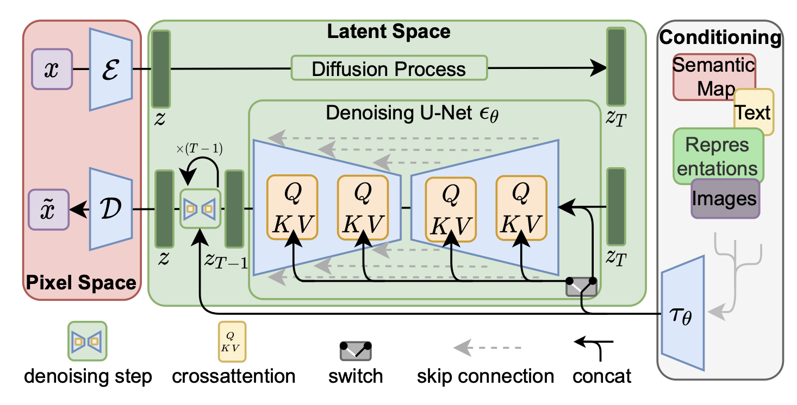
Stable Diffusion 1.5
Notes:
為了實現不同視角的高品質圖像生成與精準幾何結構操控，使用了Stable Diffusion， 一種基於 Latent Diffusion Model, LDM 的生成架構作為核心 backbone。其運算過程發生在由 VAE 壓縮後的latent space z 中，而非直接處理原始圖像像素，如此可大幅降低計算複雜度並提升生成效率。

Slide 9
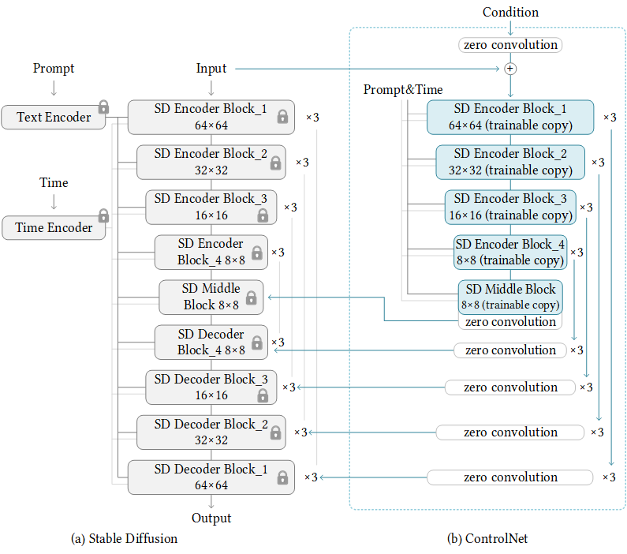
ControlNet
Use 2 trainable
ControlNet as input.
1. Bad angle RGB input
2. Pose/depth map condition
Notes:
我們加入了tile跟depth controlnet並對兩個controlnet作微調，depth control 使模型著重於學習從預測depth map到latent space幾何特徵的非線性映射、Tile Control則是讓模型在視角轉換時能敏銳地辨識並保留原始影像的紋理細節。

Slide 10
Outline
Introduction
Related Work
Method
Proposed Dataset
Experiment
Discussion
Conclusion

Slide 11
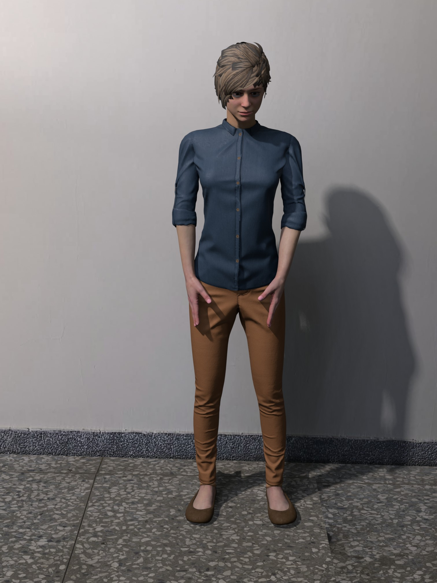
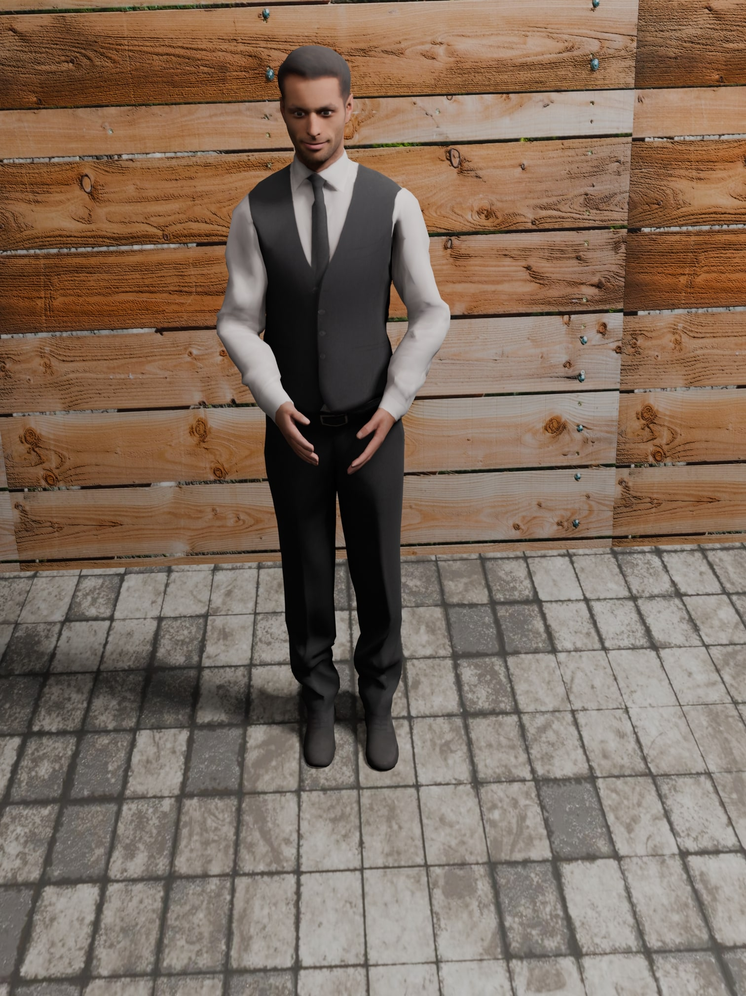
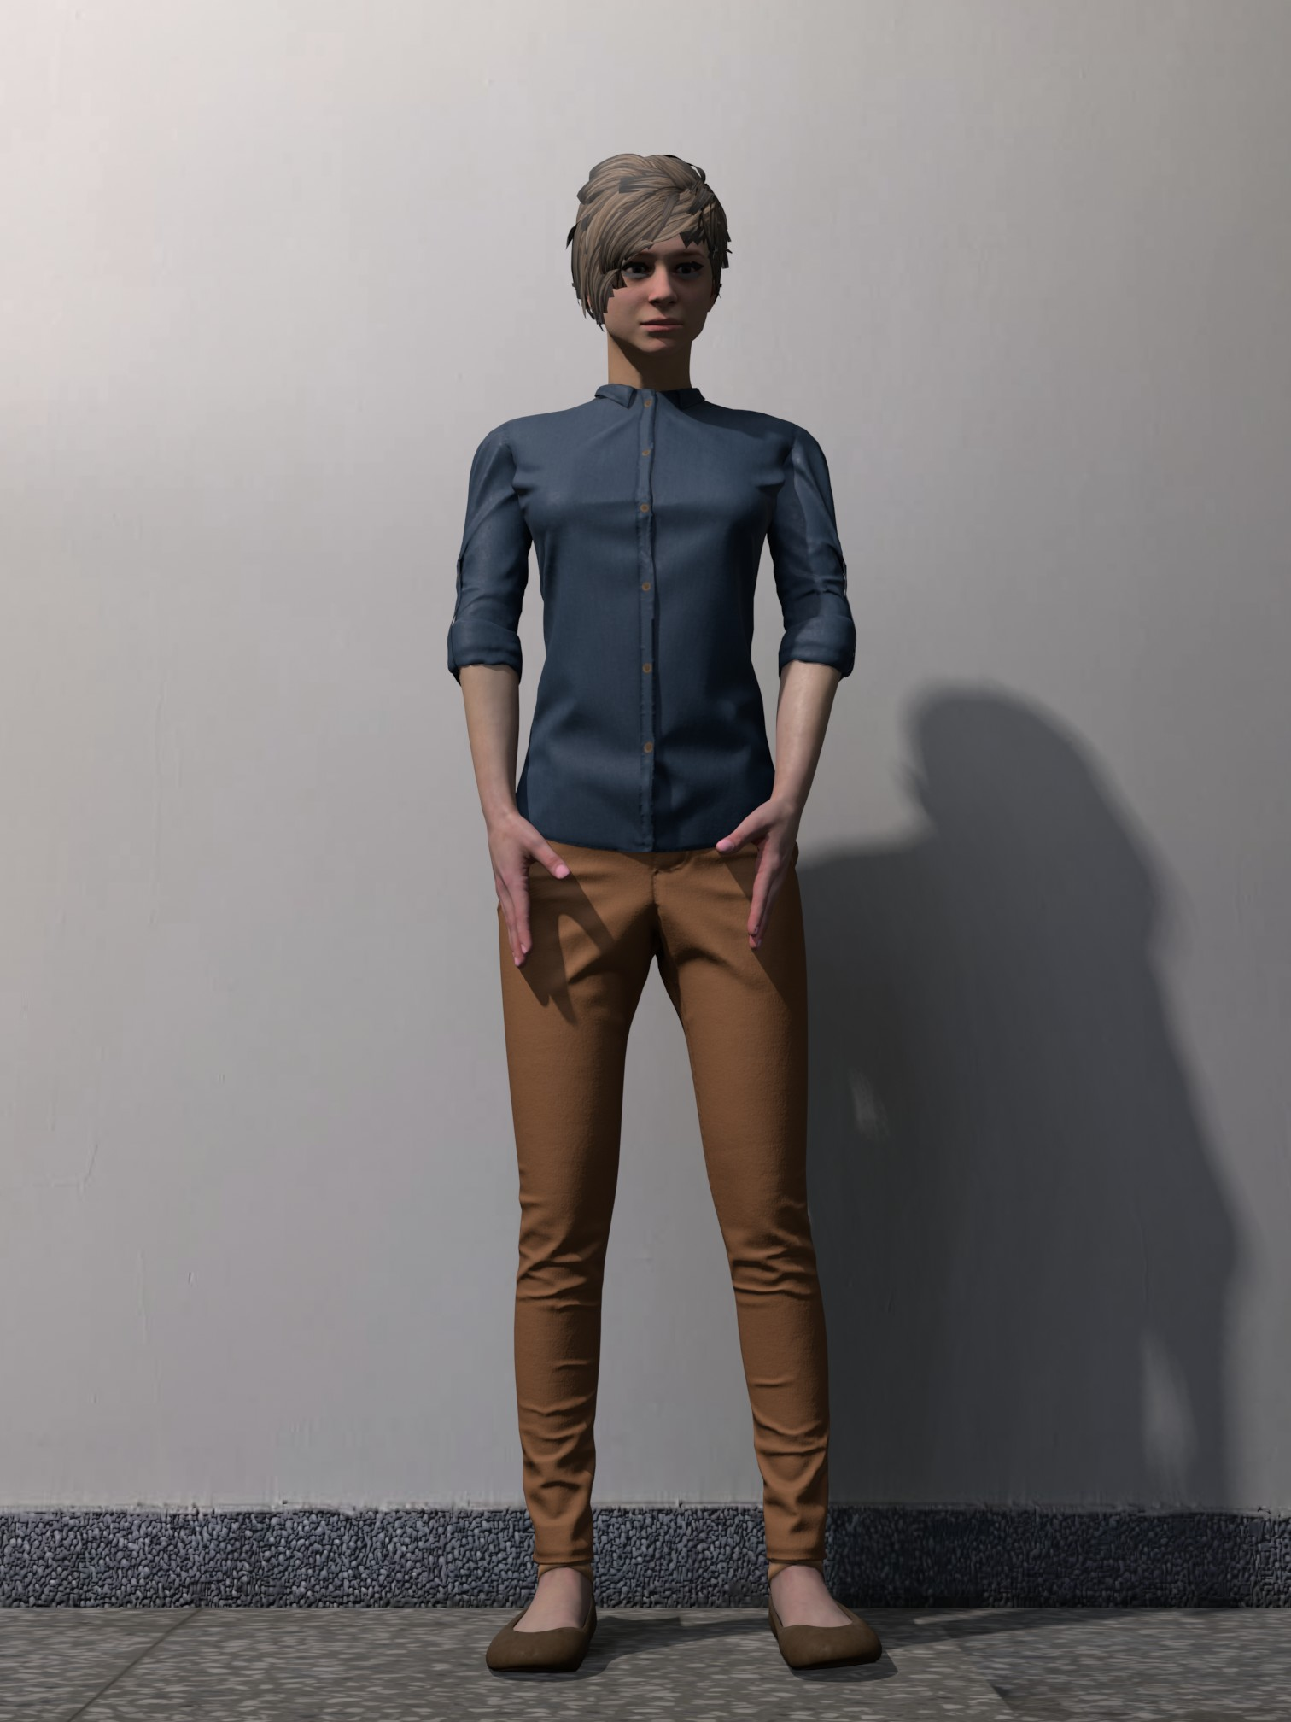
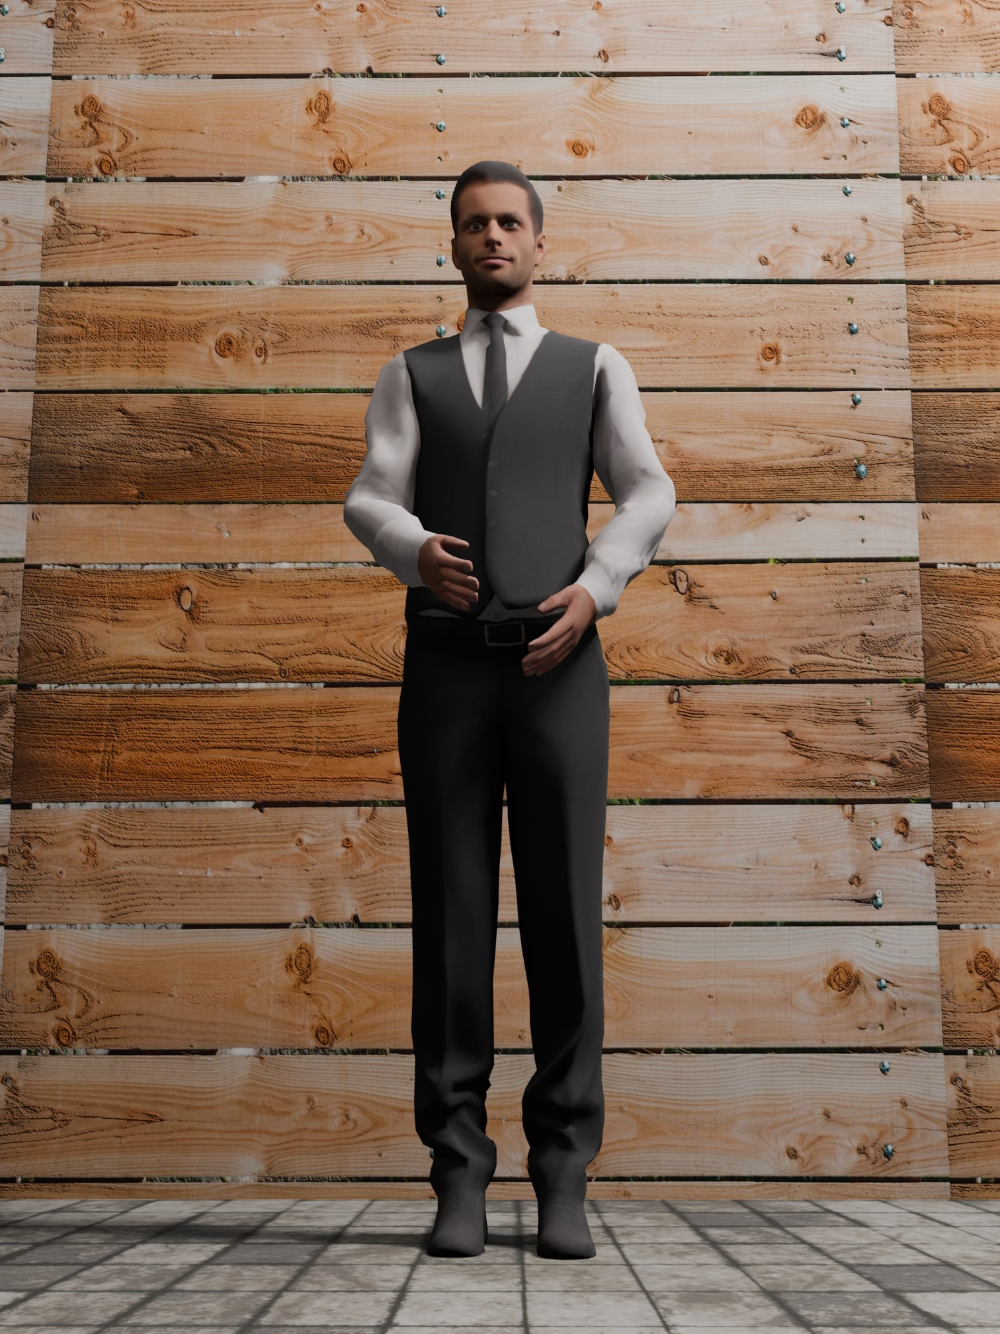
Proposed Dataset
Total of 698 good/bad angle paired images (600 synthetic, 98 real)
Synthetic (600 pairs):
Different walls/floor/lighting/pose with 40 different
characters.
Created with blender.
Real (98 pairs):
Different poses with 9 different people.
Taken with iPhones.
bad
good
synthetic

Slide 12
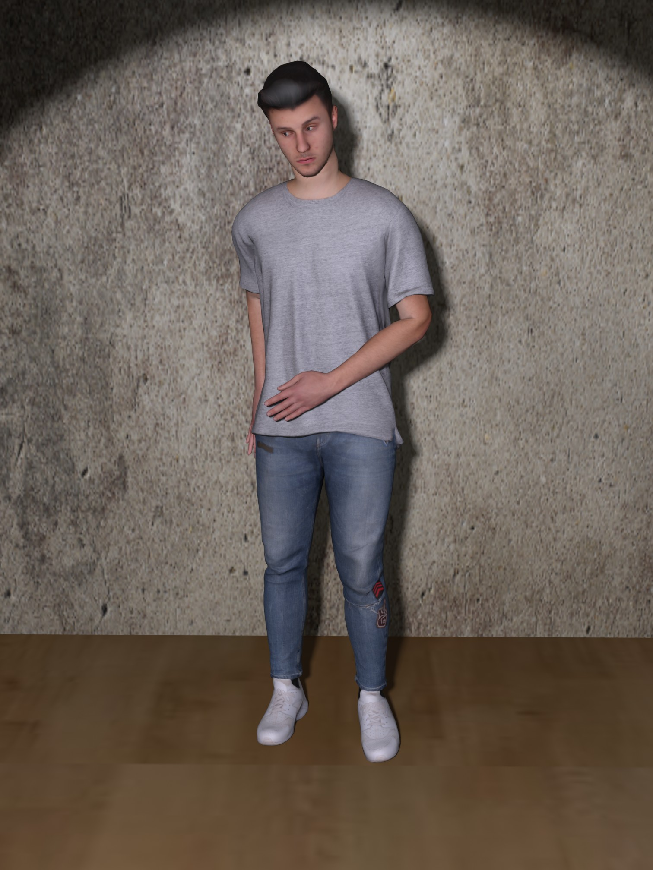
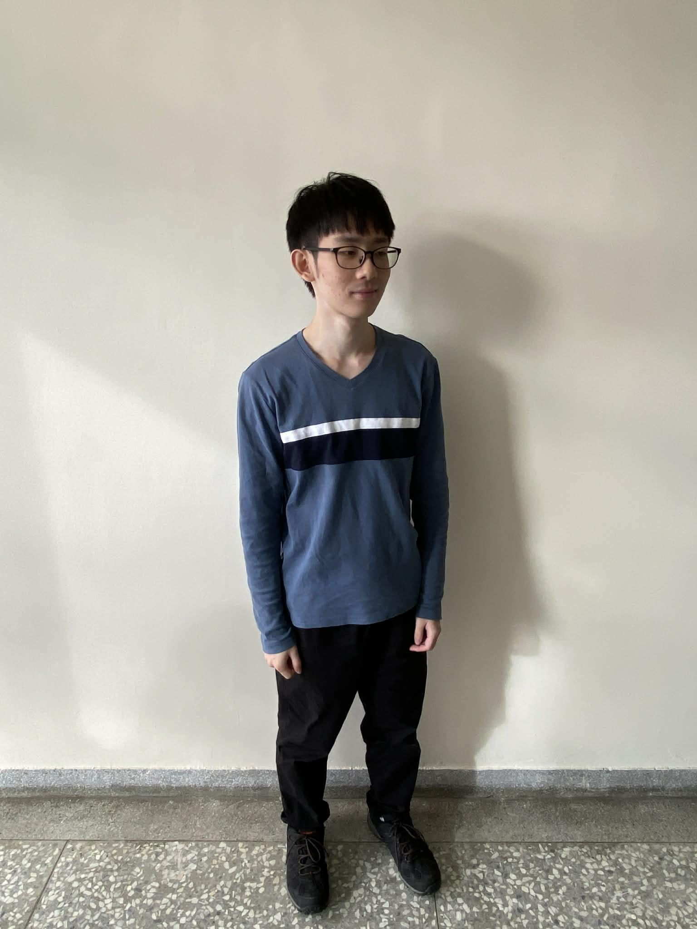
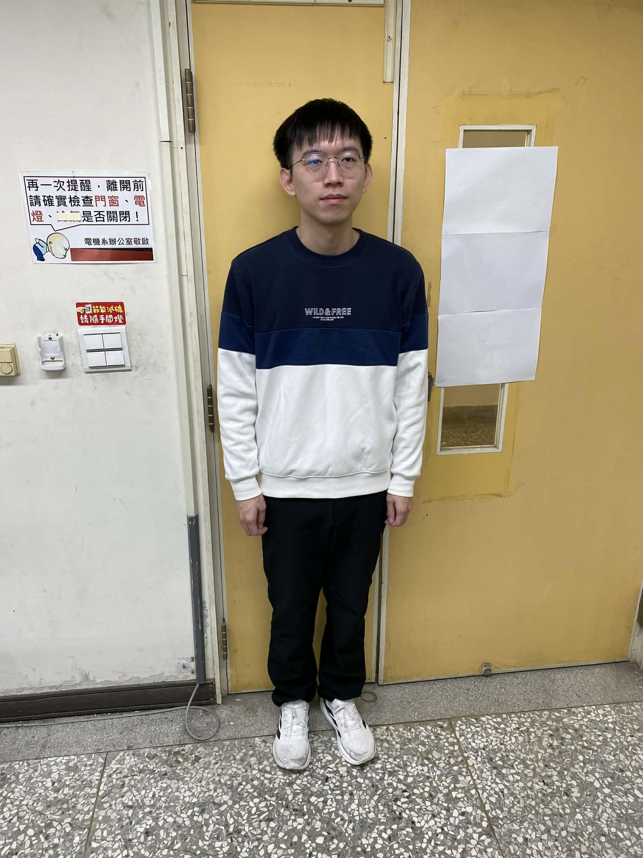
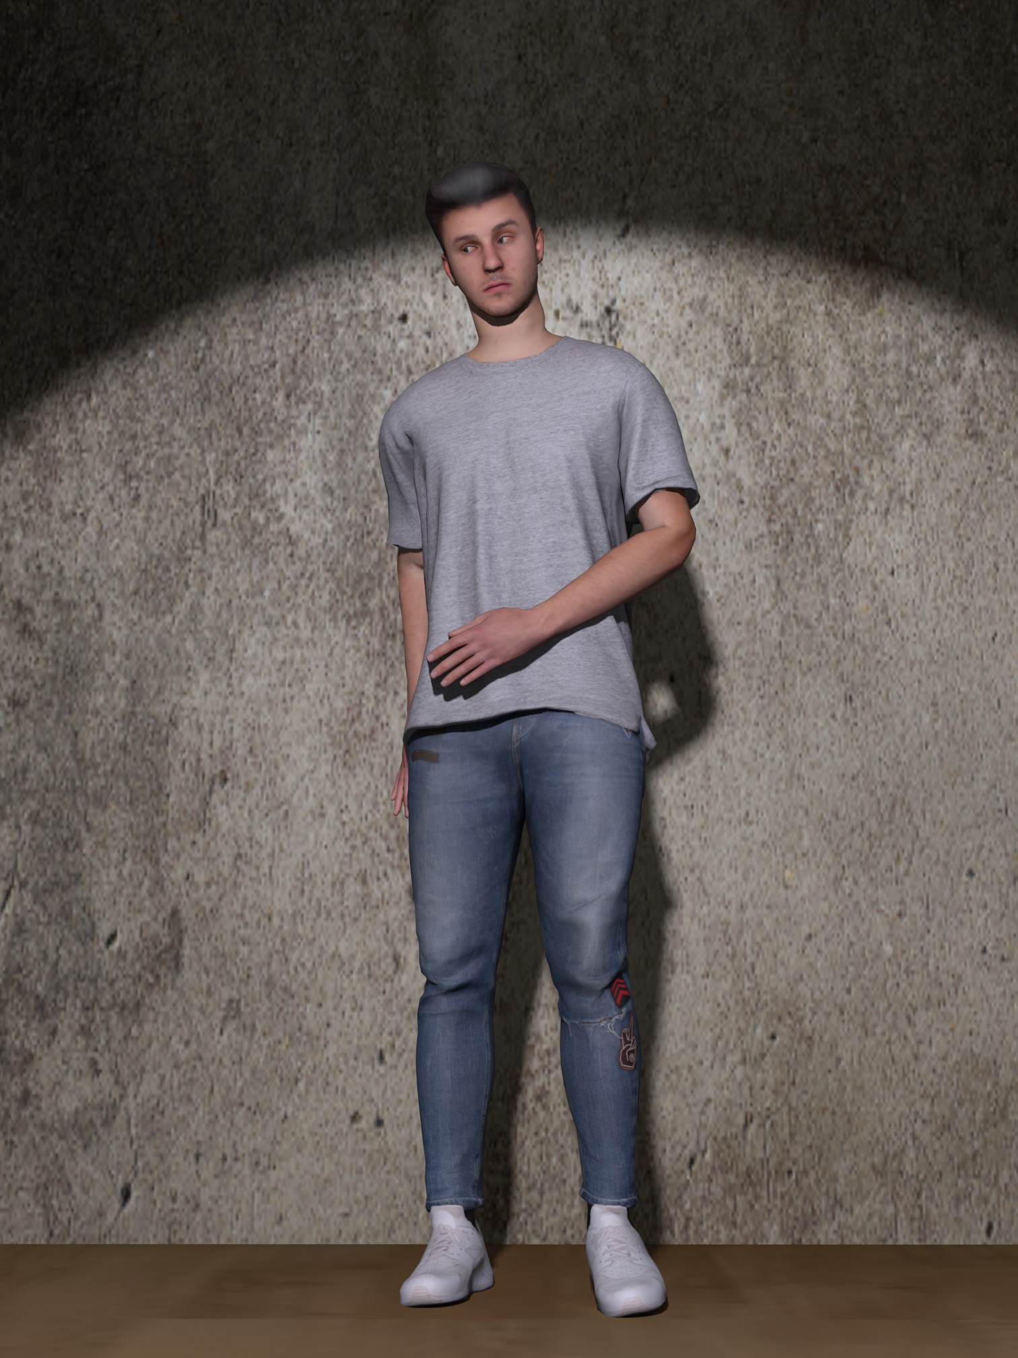
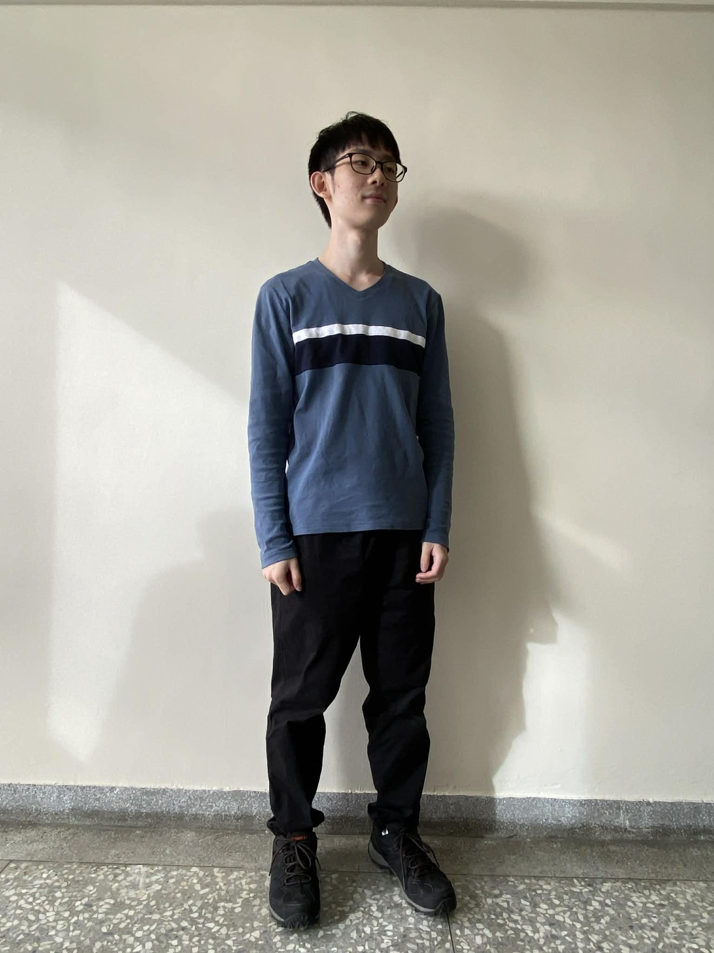
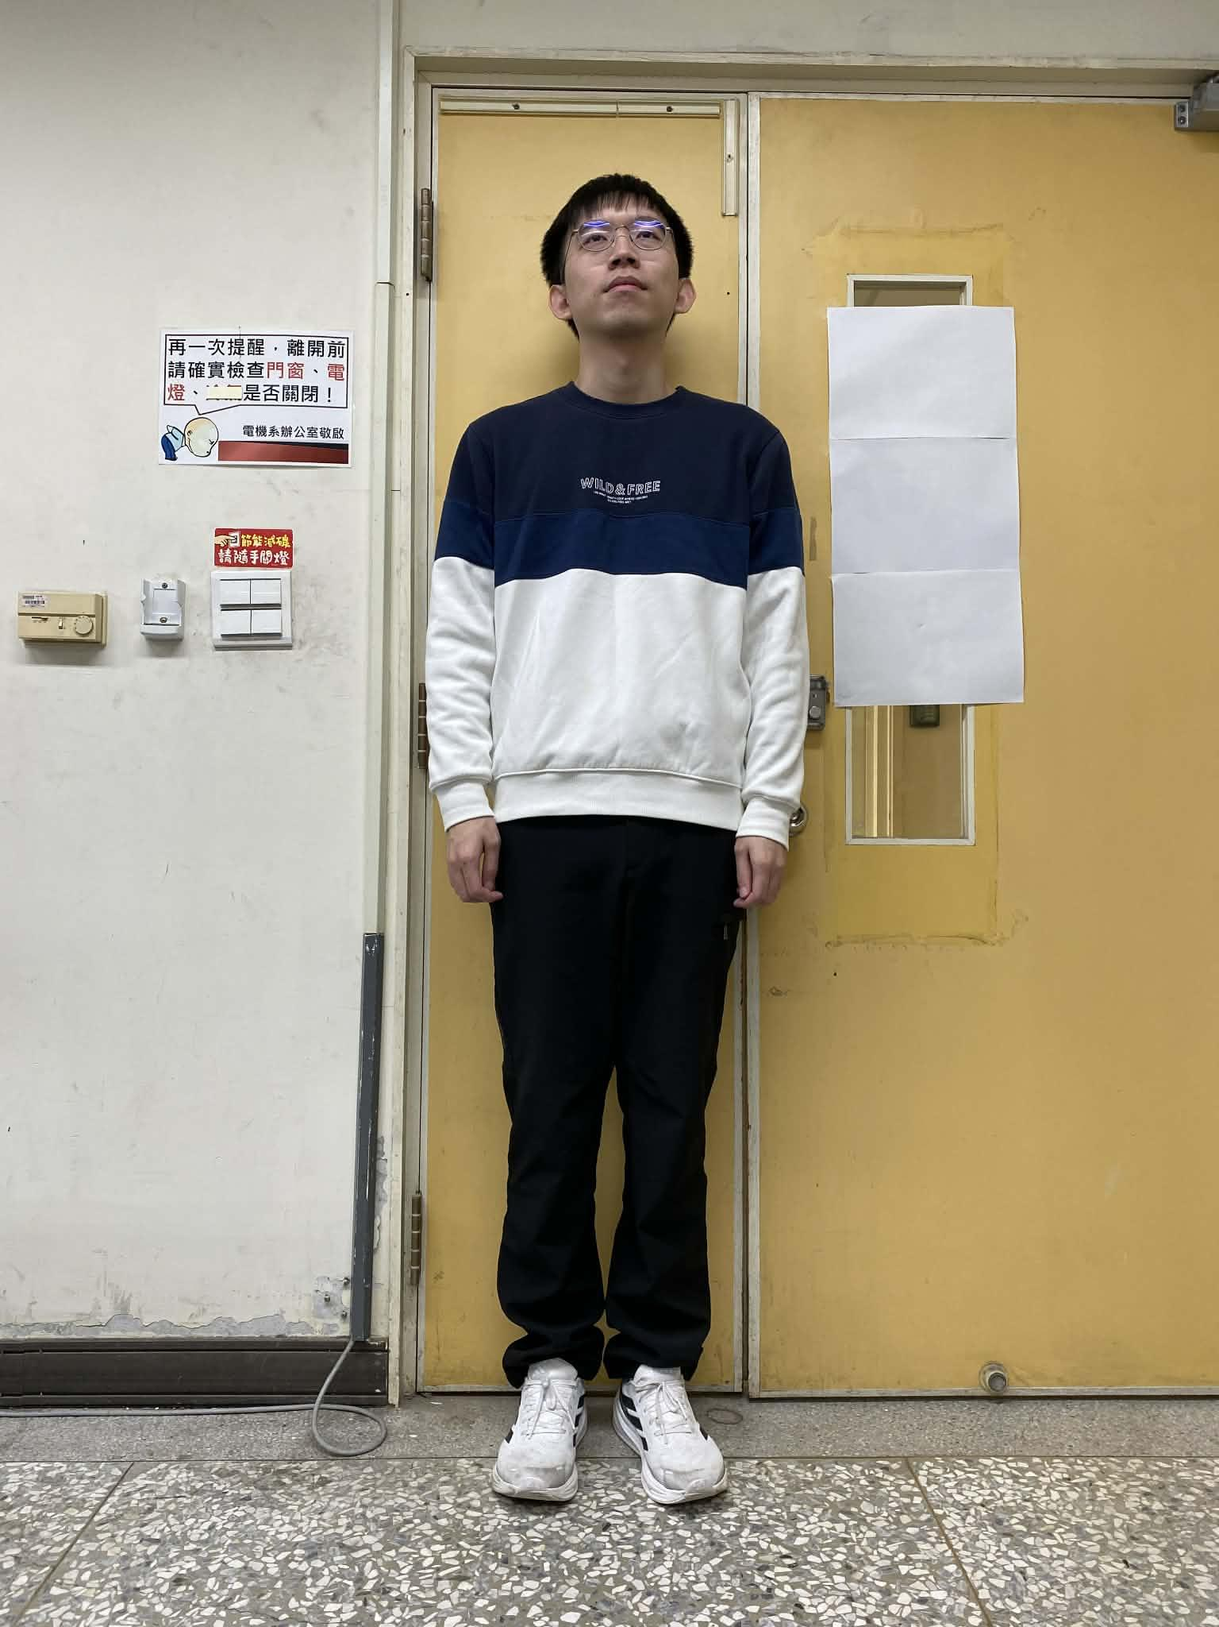
Proposed Dataset
bad angle
(input)
good angle
(ground truth)
synthetic
real

Slide 13
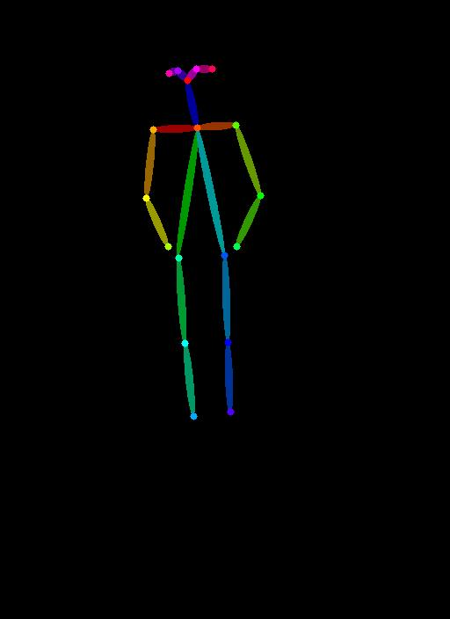
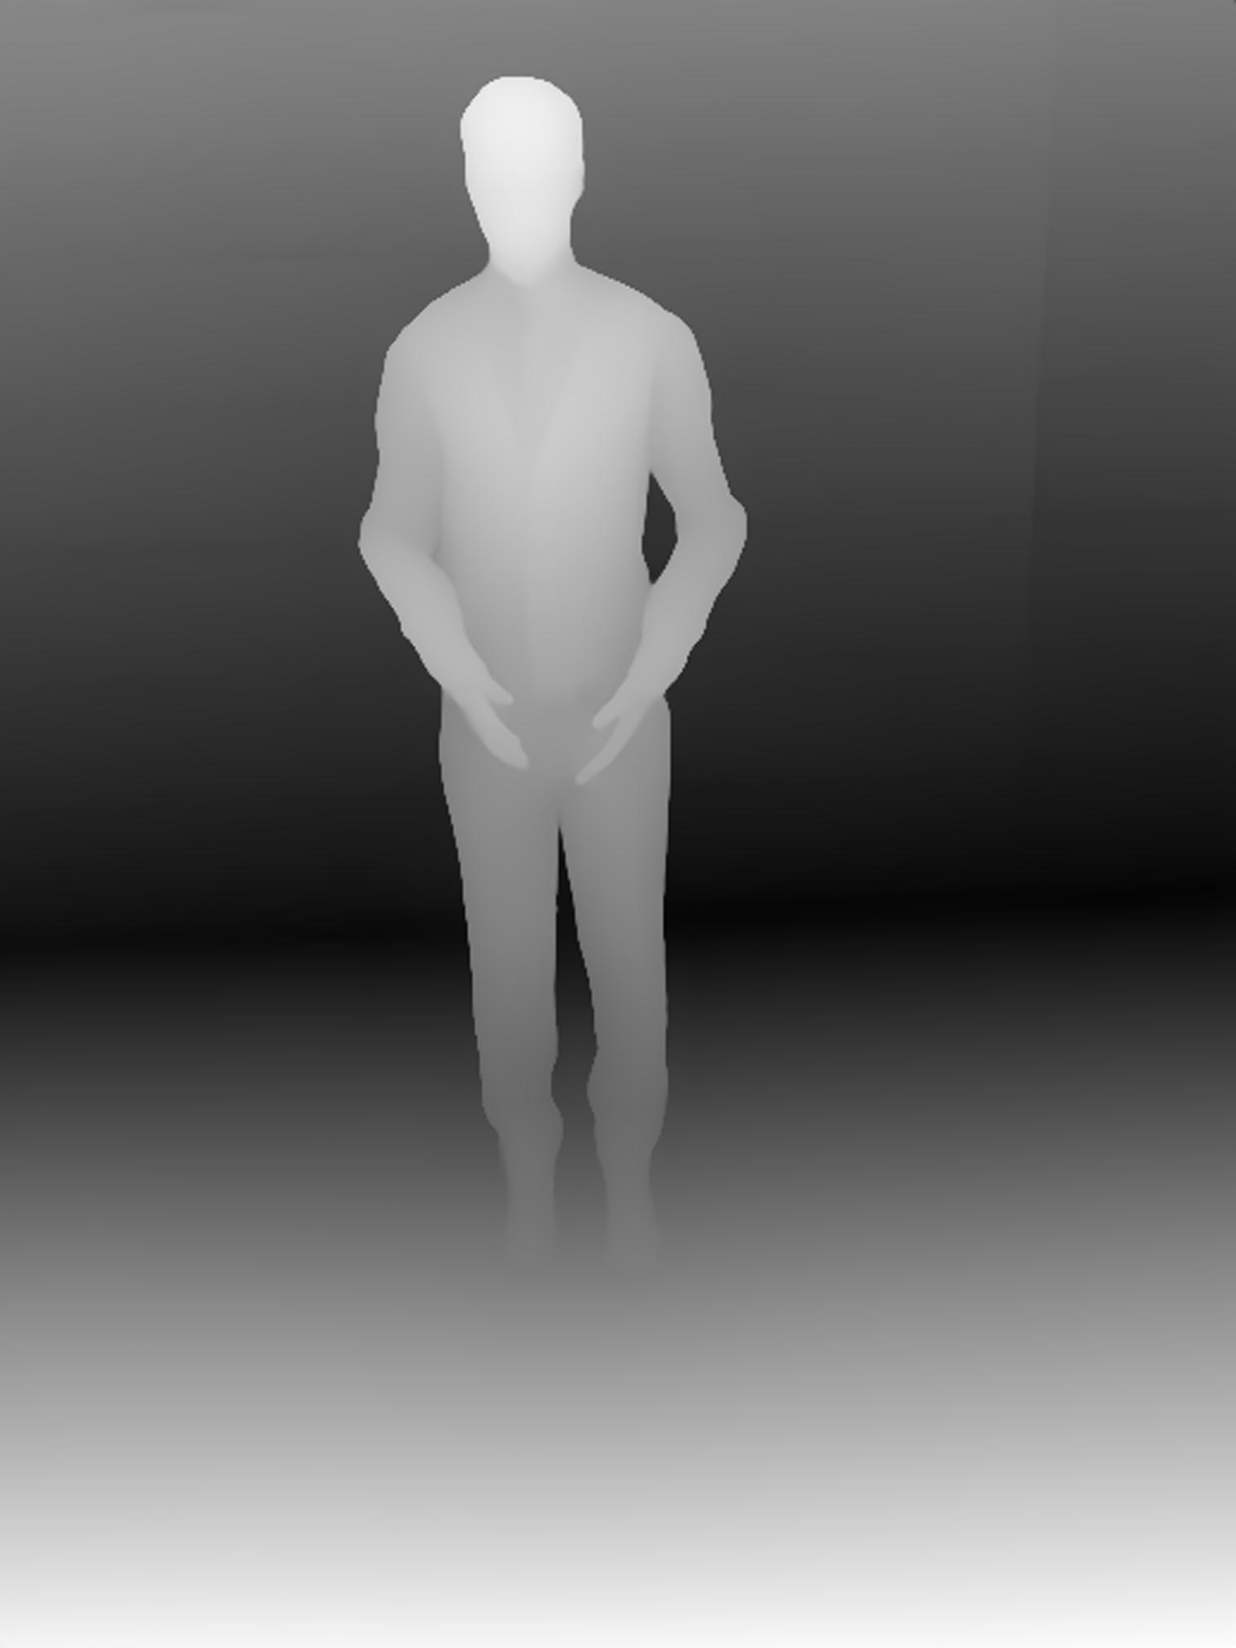
Create ControlNet Inputs
Input
Pose map
Depth map
OpenPose
Depth Anything V2

Slide 14
Outline
Introduction
Related Work
Method
Proposed Dataset
Experiment
Discussion
Conclusion

Slide 15
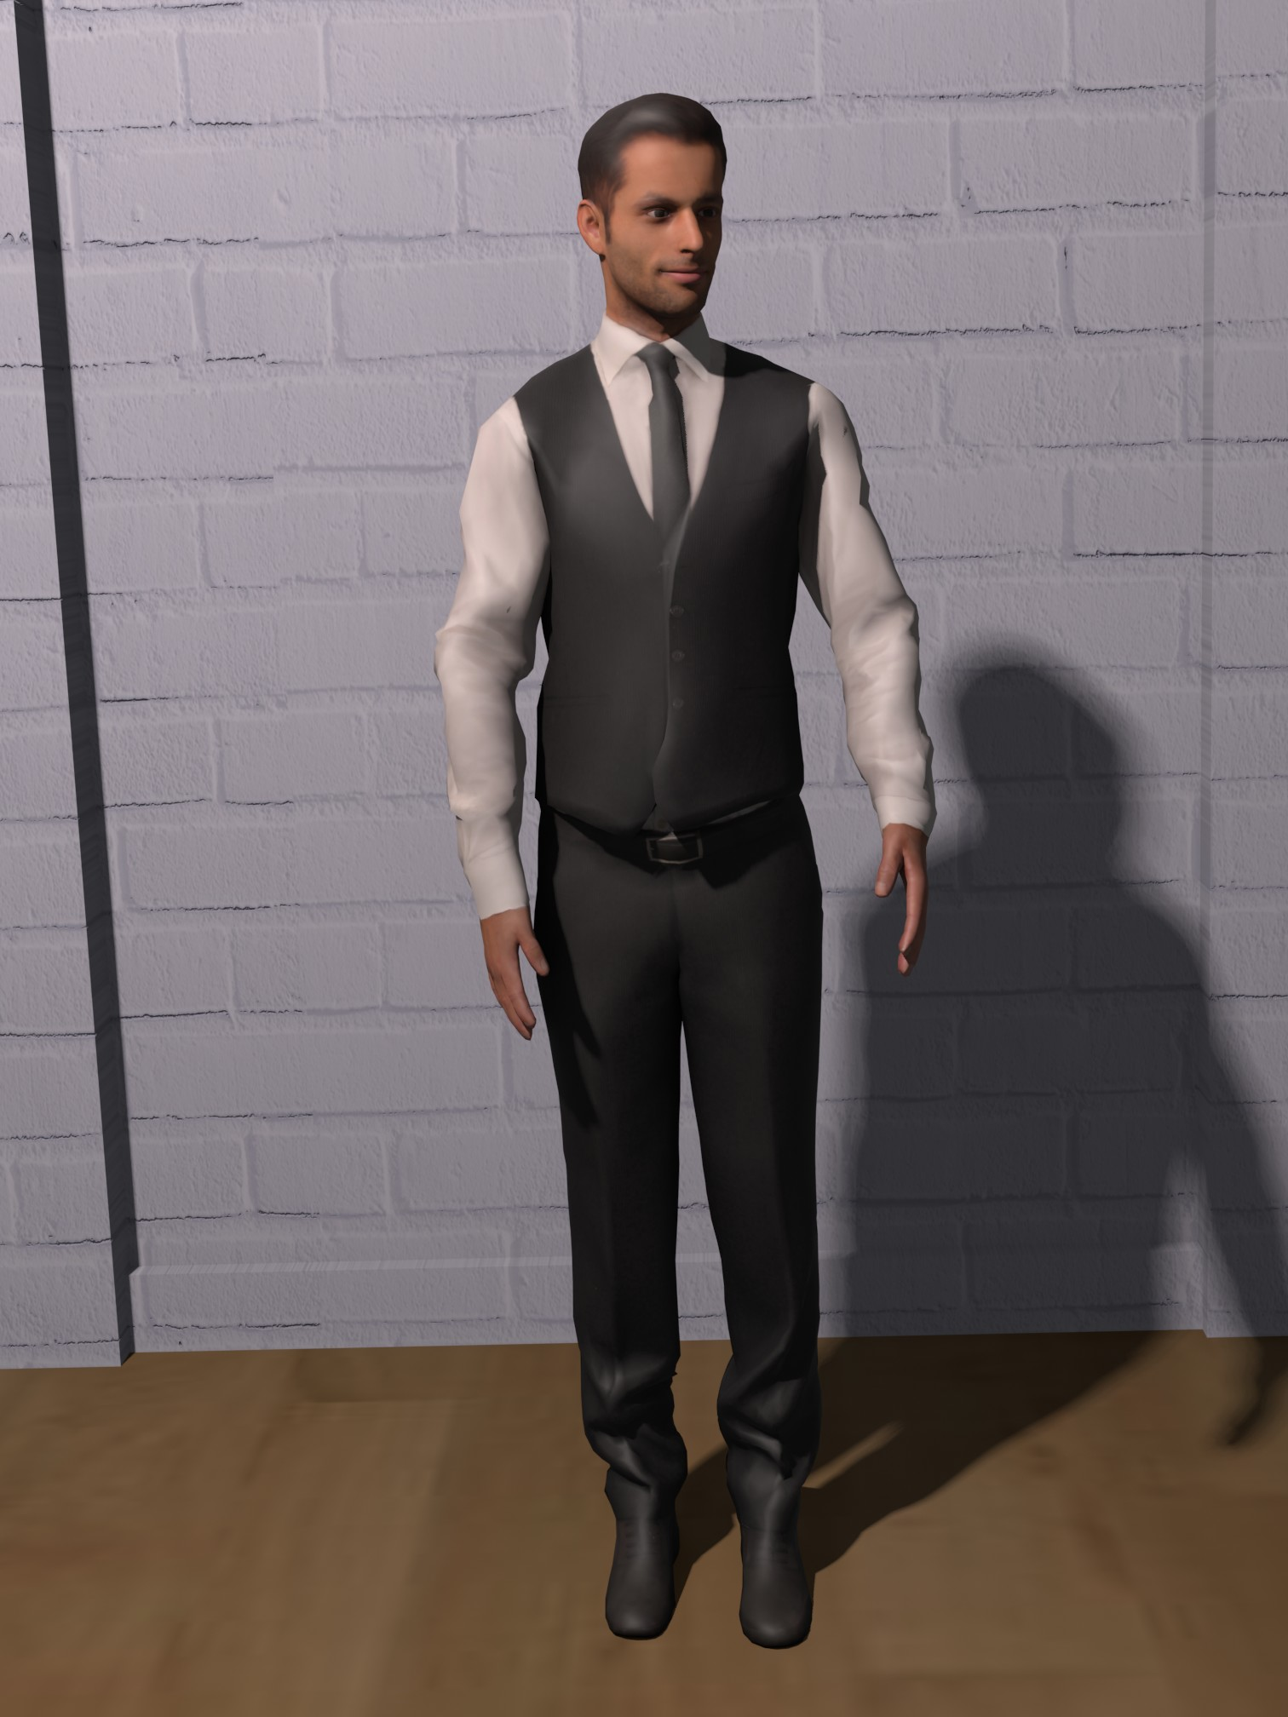
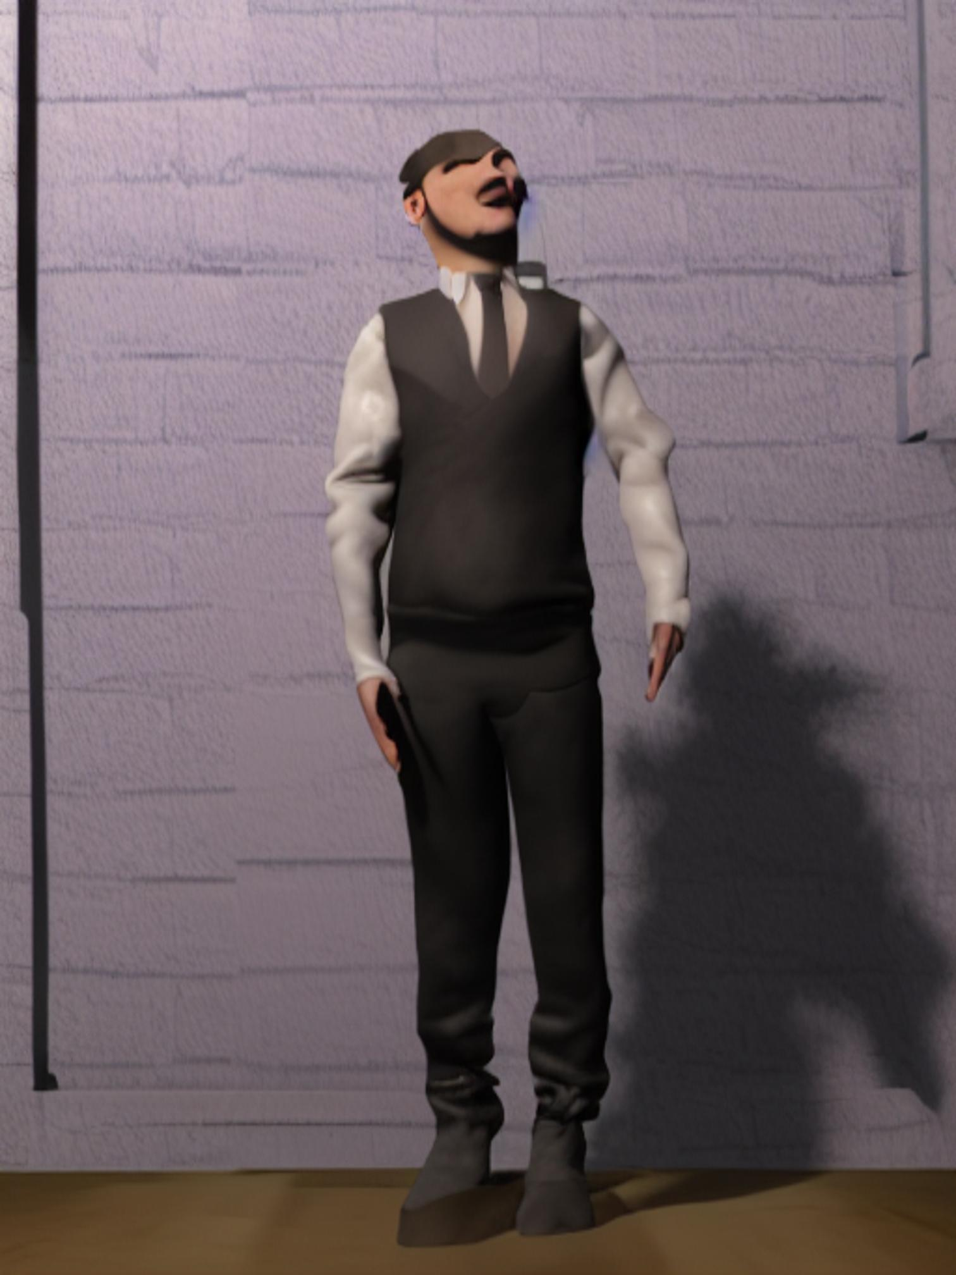
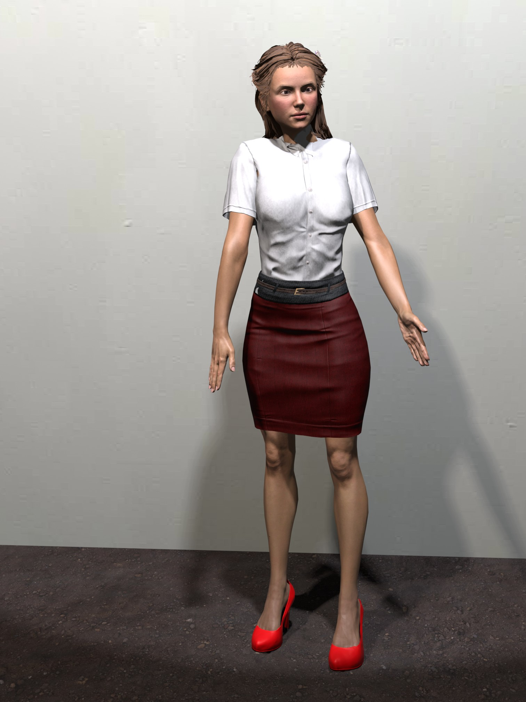
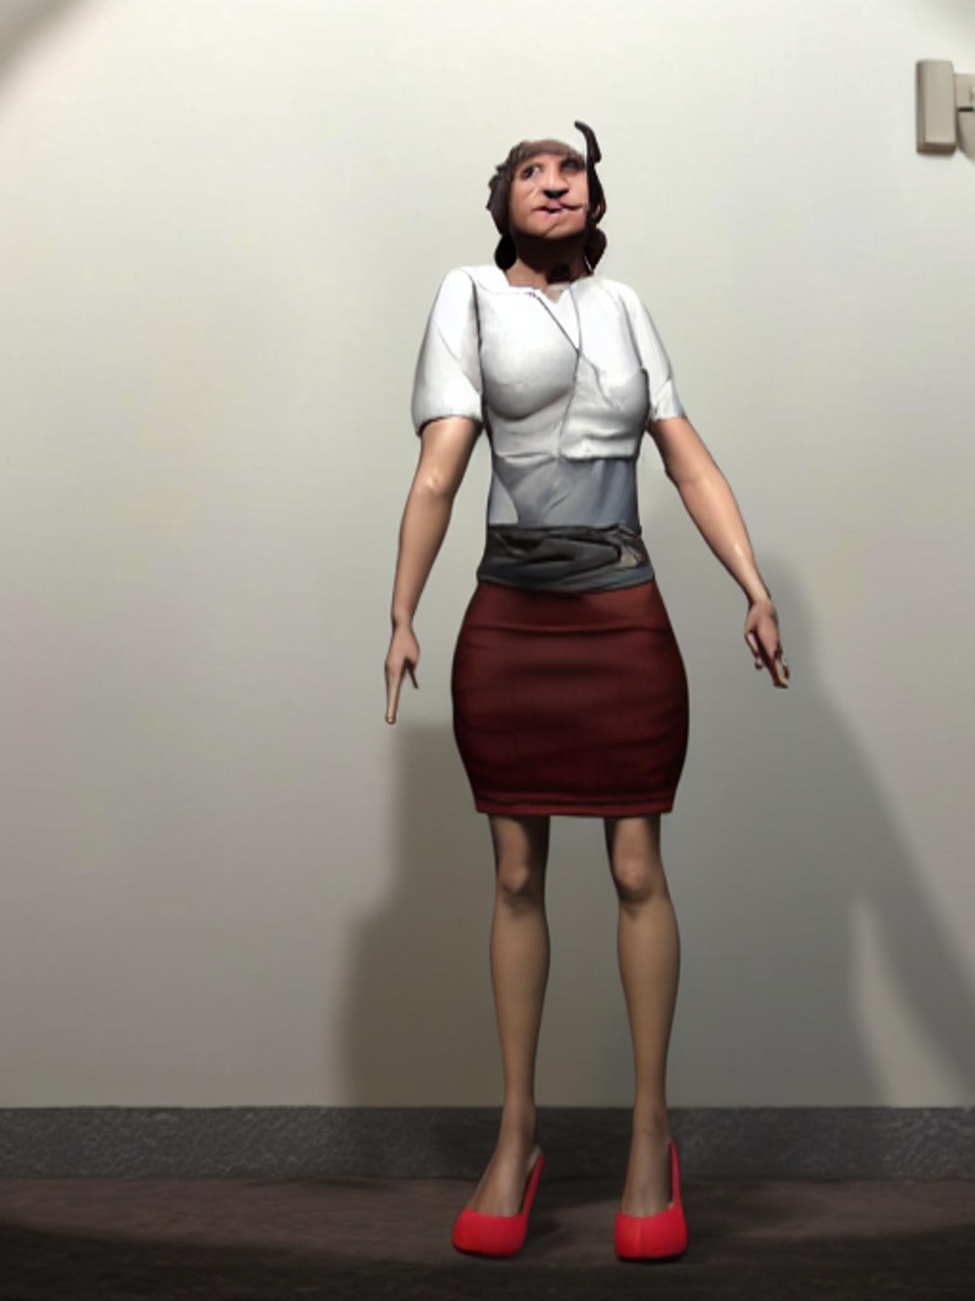
Stable Diffusion with RGB/Pose Map
Input
Output
Input
Output

Slide 16
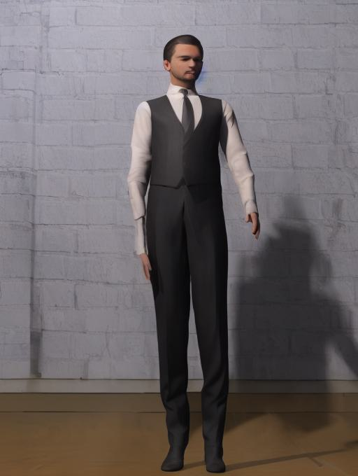
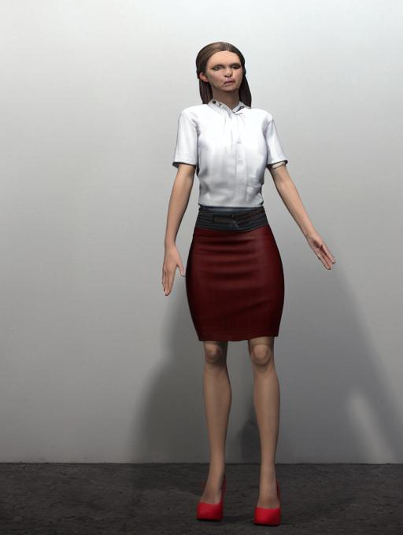
Main Result - Stable Diffusion with RGB/Depth Map
Input
Output
Input
Output

Slide 17
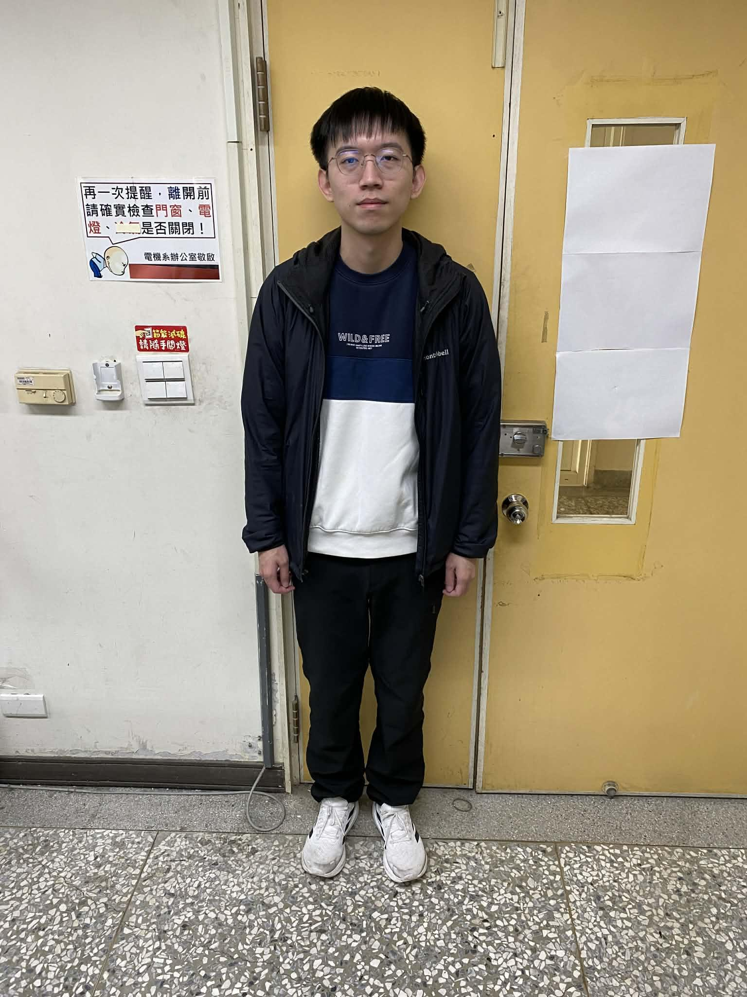
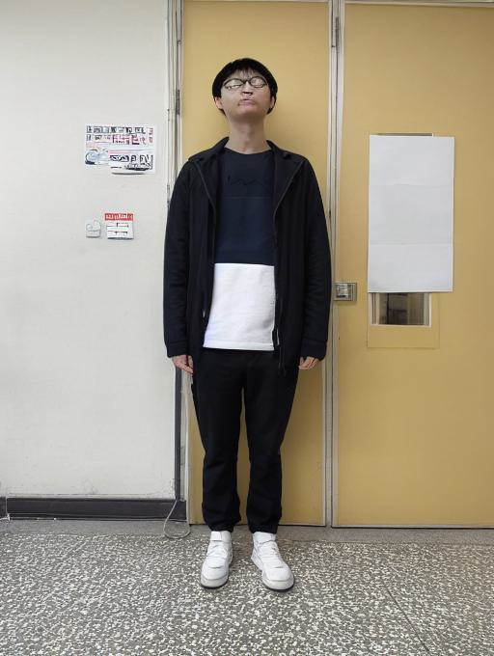
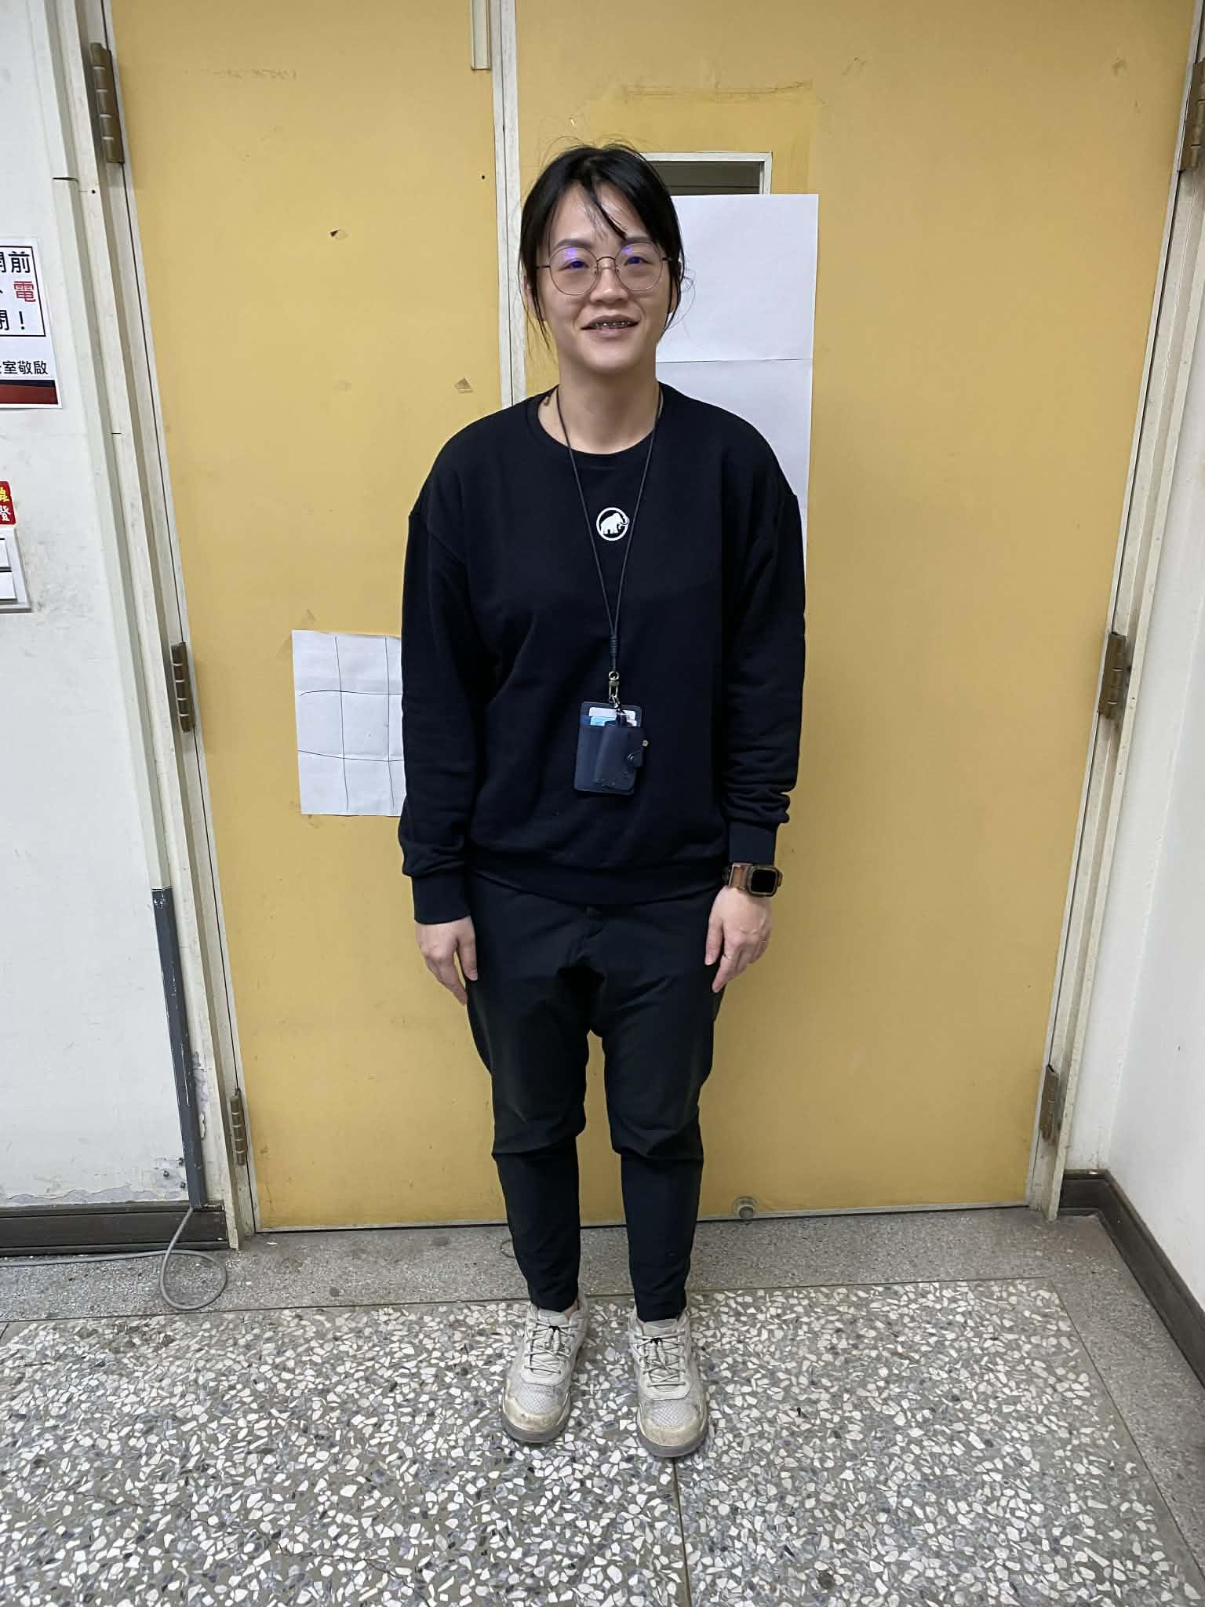
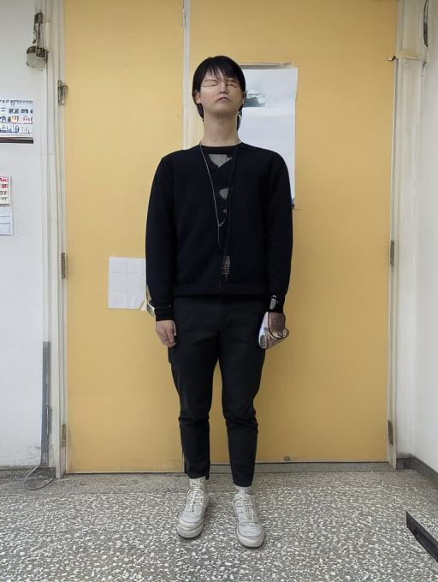
Main Result - Stable Diffusion with RGB/Depth Map
Input
Output
Input
Output

Slide 18
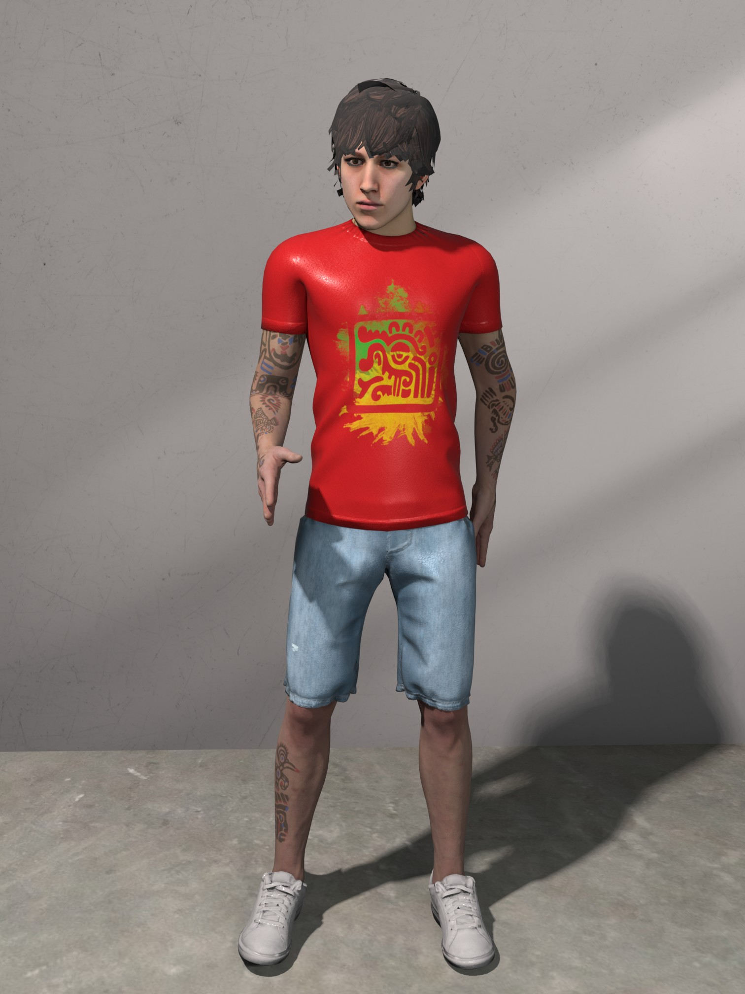
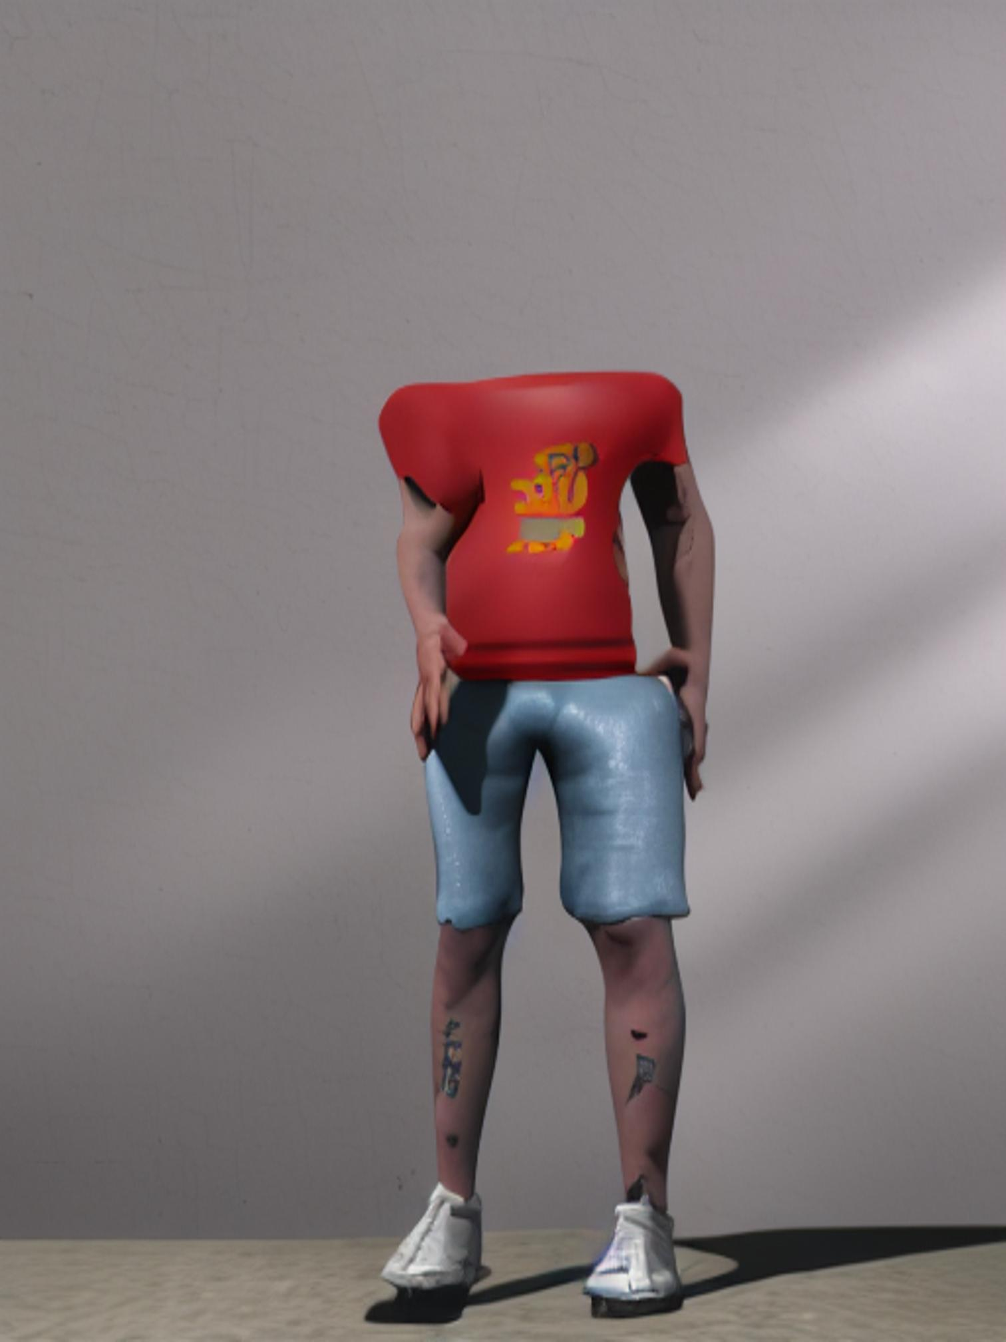
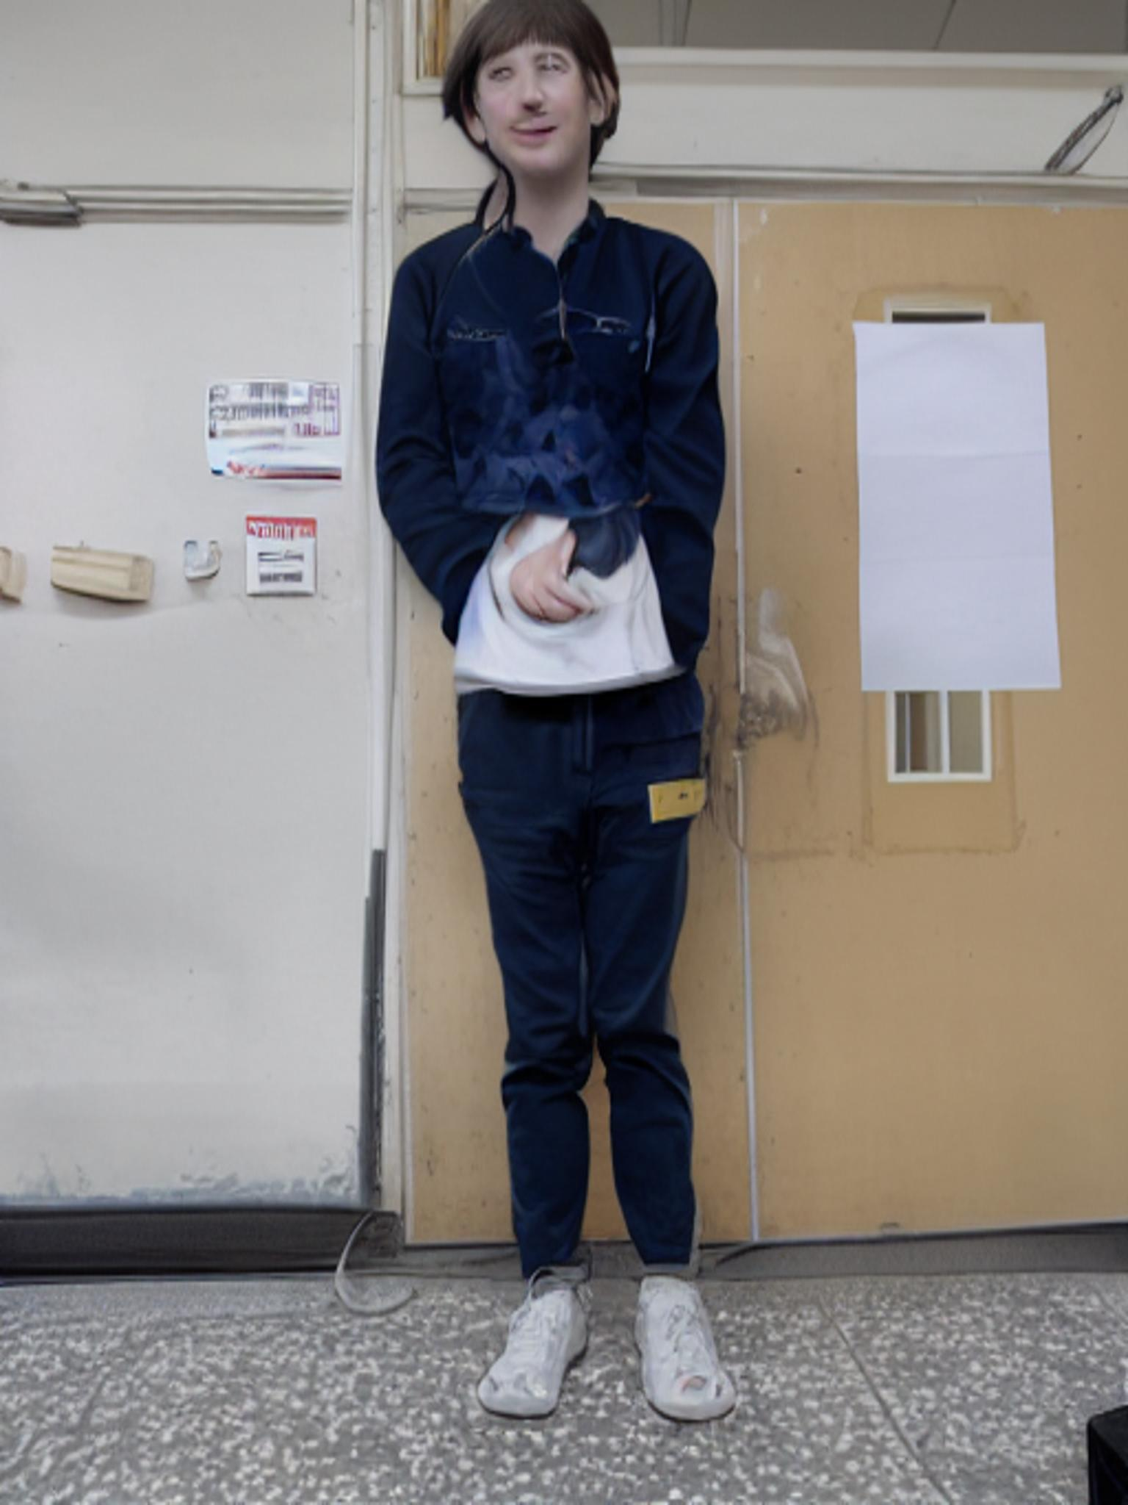
Ablation - Remove Pose/Depth Map ControlNet
Input
Output
Input
Output

Slide 19
FID Results
Calculate FID between predictions and ground truths.
ControlNet | img2img | FID
RGB | X | 113.3175
RGB + Pose Map | X | 108.9777
RGB + Pose Map | O | 105.1208
RGB + Depth Map | O | 102.88

Slide 20
Outline
Introduction
Related Work
Method
Proposed Dataset
Experiment
Discussion
Conclusion

Slide 21
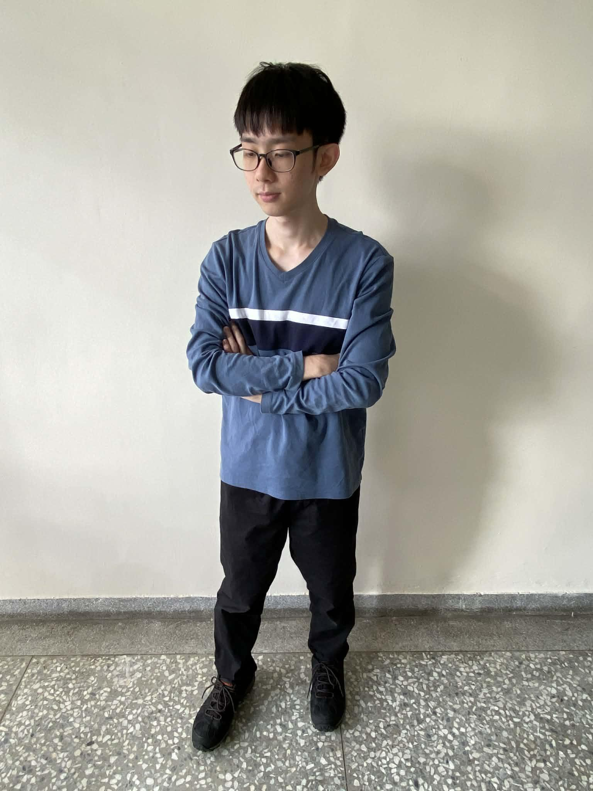
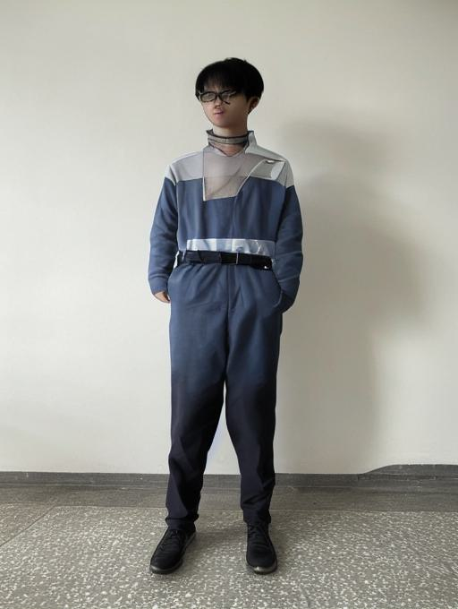
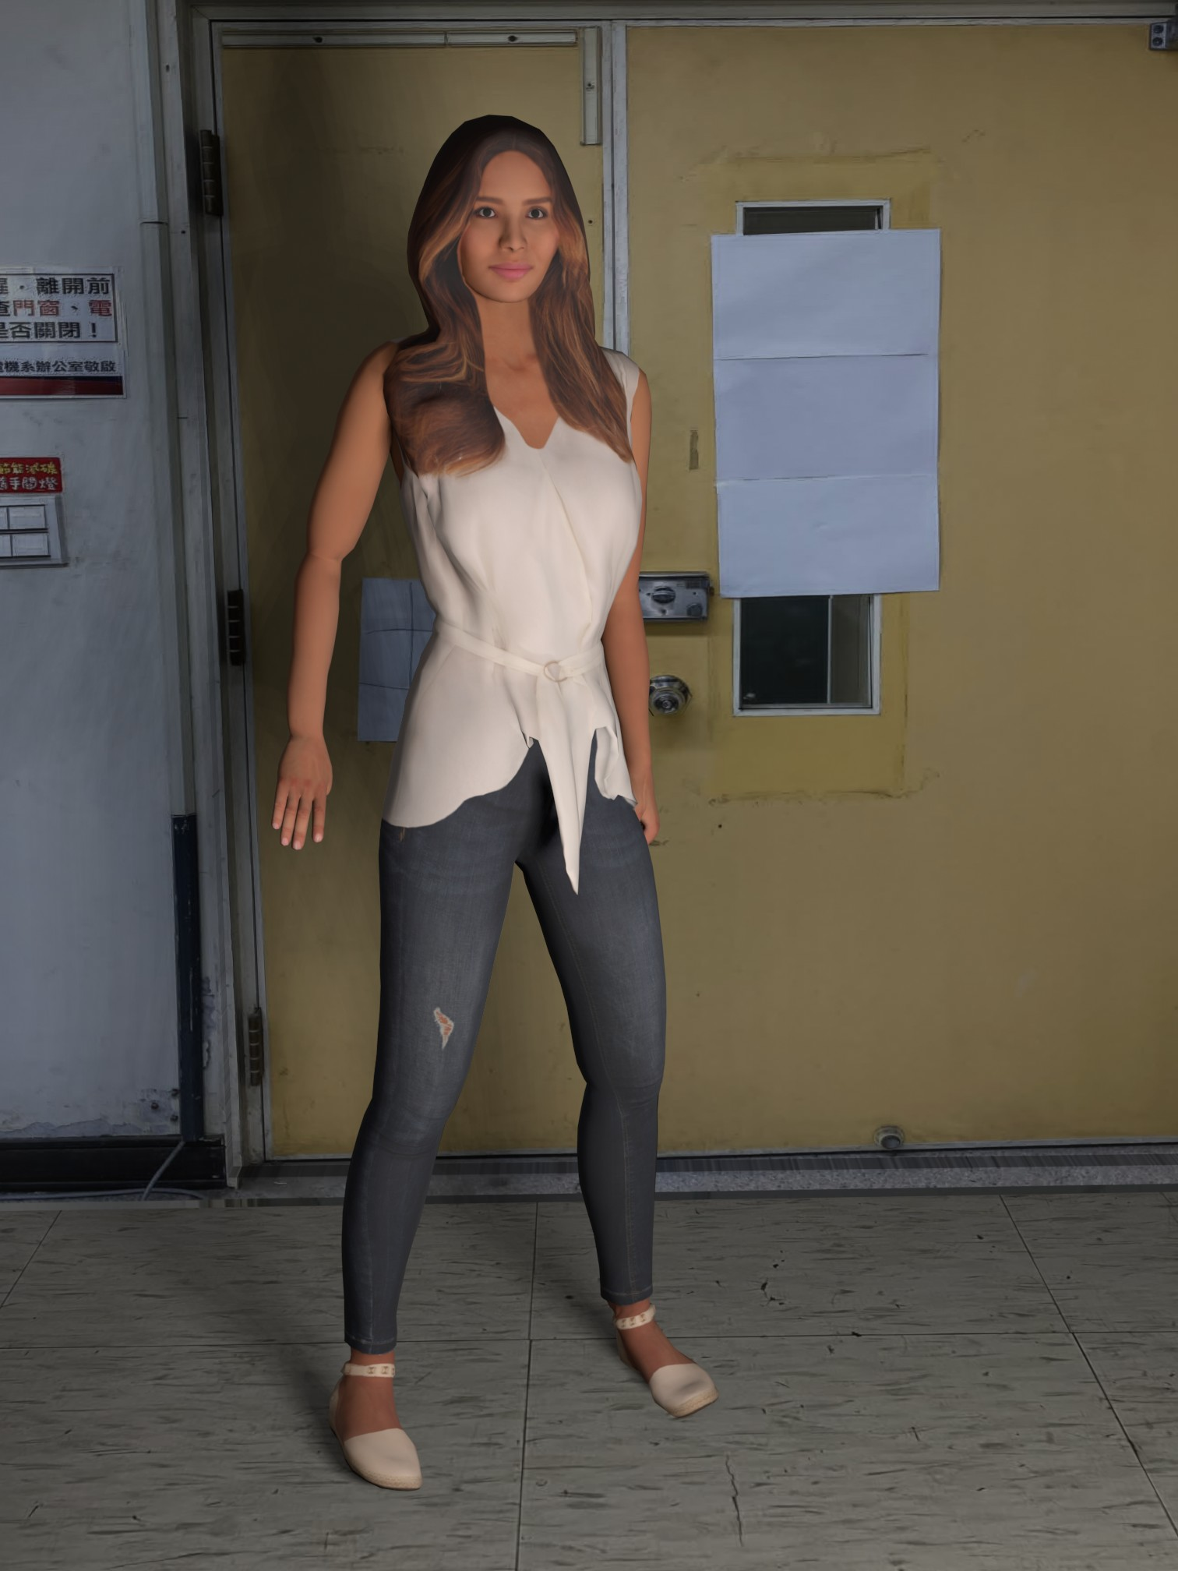
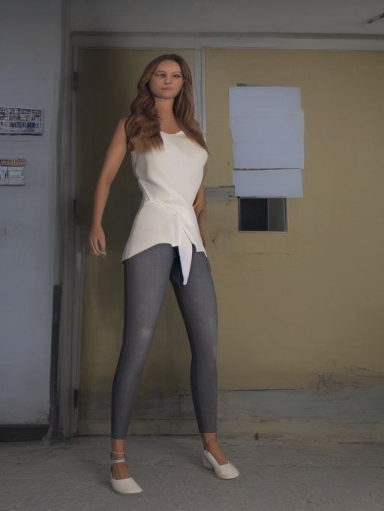
Limitation
Appearance difference 2. Stretching

Slide 22
Outline
Introduction
Related Work
Method
Proposed Dataset
Experiment
Discussion
Conclusion

Slide 23
Conclusion
Proposed a paired dataset with bad/good angles.
Using Stable Diffusion and ControlNet to perform camera angle enhancement.
Future Work:
Add both pose and depth maps as control.
Create larger and more diverse dataset to help generalization.
Give more facial information to fix blurry face issues.

