Slide 1
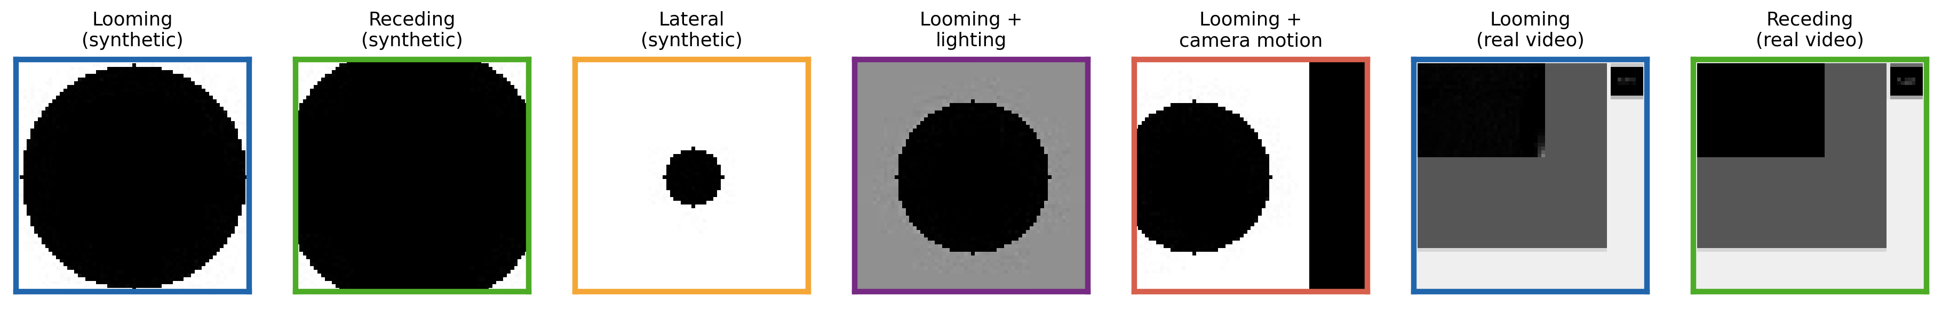
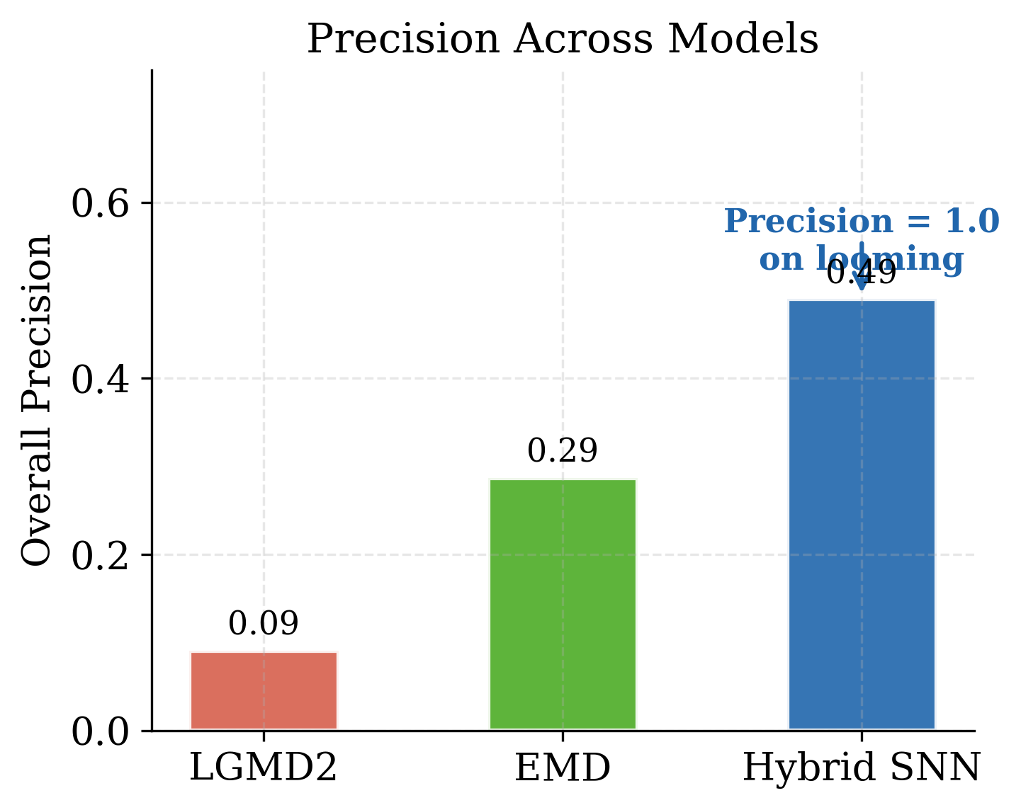
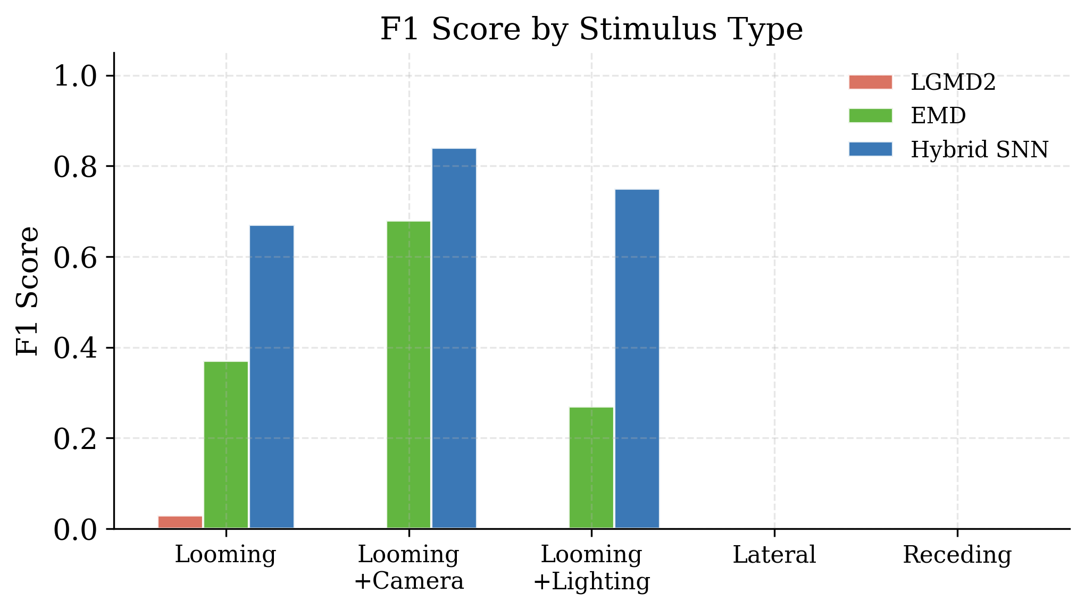
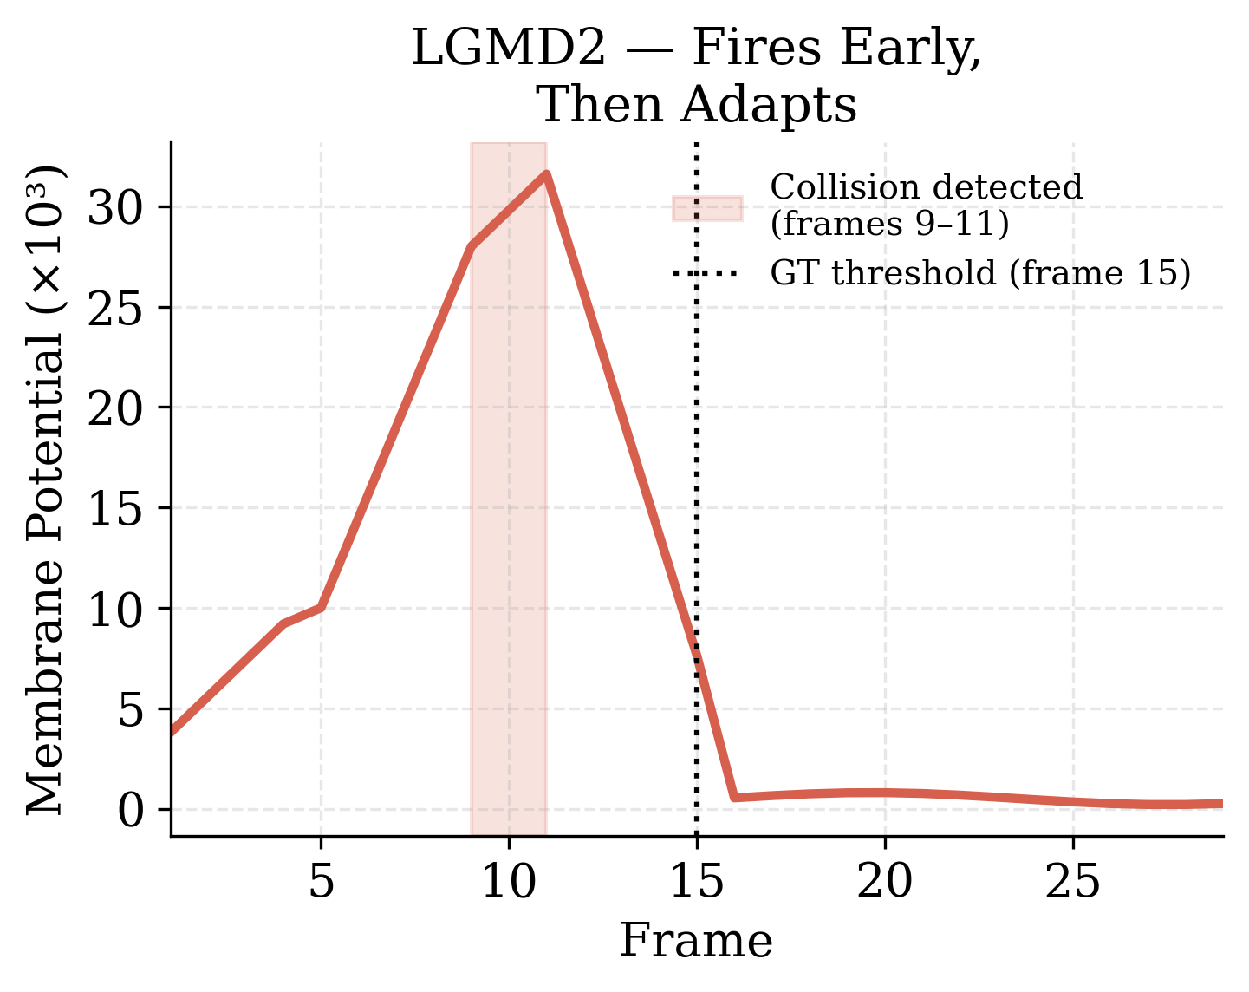
Comparative Evaluation of Biologically Inspired Motion Detection Models: LGMD, EMD, and a Hybrid Spiking Neural Network
LGMD
Lobula Giant Motion Detector
EMD
SNN
Elementary Motion Detector
Spiking Neural Network
Fires at frames 9–11, before magnitude threshold
Motion energy ≈ 0 on looming: directional cancellation confirmed
Precision = 1.00 on looming (zero false positives)
rate-sensitive, fires early, biologically faithful
trainable, precision=1.0, sim-to-real gap identified
directional detector, not a collision classifier by design
Hybridising bio-inspired motion detectors within a spiking framework produces reproducible collision prediction with zero false positives on looming stimuli.

