Slide 1
Opioid Utilization Rates and Substance Use Disorder Trends
Kameron thao, mary vang and Sandra braun

Slide 2
Background
Substance Use Disorder (SUD)¹
Treatable, Chronic Disease, Unhealthy Pattern of Use
Health Impairments, Social Dysfunction, Lack of Control of Usage
Continuous Use in spite of Harmful Effects
Can affect anyone regardless of race, gender, income level, or social class
Opioids²
Class of Drugs That Bind to Opioid Receptors on Nerve Cells in the Body and Brain, Resulting in Decreased Pain Signals and Sensations
Heroin, Fentanyl, Oxycodone, Hydrocodone, Codeine, and Morphine
One in Seven Americans Reported in 2020 the presence of SUD
40.3 million Americans in 2020 reported a SUD
2.7 millions Americans in 2020 reported an opioid use disorder, specifically

Slide 3
Research Questions
Is there an association between usage, risk, and disorder rates to total population?
Is there a state correlation?
Which state has the highest amount of heroin abuse?
What are the top 5 states with the highest numbers of prescriptions?
Is there an association between opioid prescribing rates and substance use disorder?
Is there an association between heroin usage and substance use disorder?
Is there an association between perceived risk of using opioids and substance use disorder?

Slide 4
Data Sources
CMS State Drug Utilization Data³
https://www.medicaid.gov/medicaid/prescription-drugs/state-drug-utilization-data/index.html
2019-2020 National Survey on Drug Use and Health: Model-Based Prevalence Estimates (50 States and the District of Columbia)⁴
https://www.samhsa.gov/data/report/2018-2019-nsduh-state-prevalence-estimates
American Community Survey - Demographic and Housing Estimates⁵
https://data.census.gov/table?q=DP05

Slide 5
Methods
Datasets were cleaned and merged by state and state was set as the indexed value
Prescription data was limited to opioids only and rates of prescriptions were calculated by quantity of prescriptions over the total population
Correlation analyses were conducted to determine relationships between prescriptions, SUD, risk perception and usage.
Analysis was limited to top five states based on raw counts and rates of prescription, further descriptive statistics were performed and visualized.

Slide 6
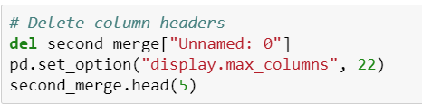

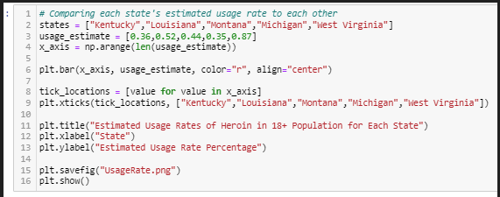
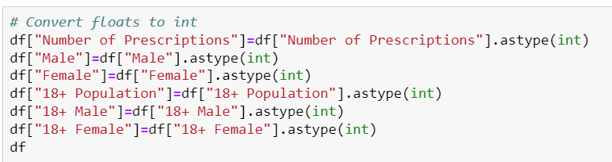
Data Cleaning & Manipulation

Slide 7
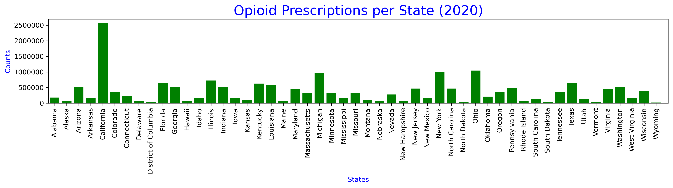
Data Analysis
Conclusions:
State with the highest numbers of prescriptions in 2020 is California at 2,567,486.
State with the lowest numbers of prescriptions in 2020 is Wyoming at 16,027.

Slide 8
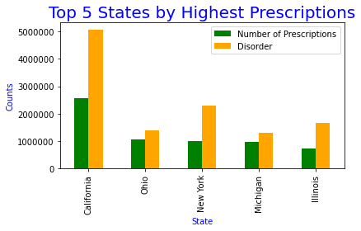
Data Analysis
Conclusions:
Top 5 states in 2020 with the highest number of prescriptions are California, Ohio, New York, Michigan, and Illinois.

Slide 9
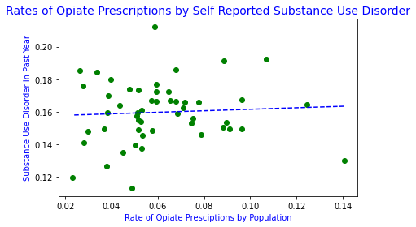
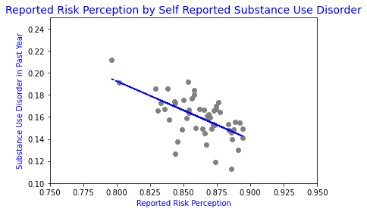
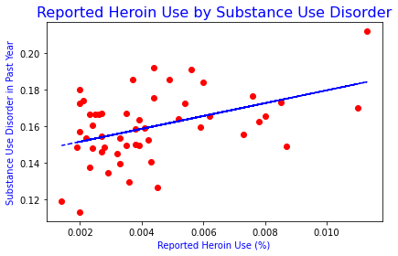
Data Analysis
Conclusions:
The correlation coefficient between opiate prescribing rates and substance use disorder is 0.06.
The correlation coefficient between perceptions of risk of using heroin once or twice and substance use disorder is -0.61.
The correlation coefficient between reported heroin use and substance use disorder is 0.43.

Slide 10
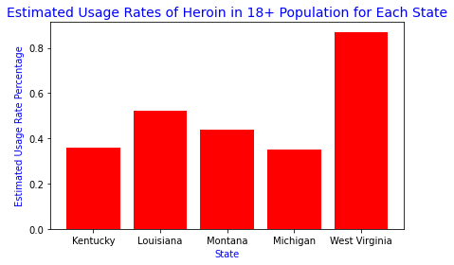
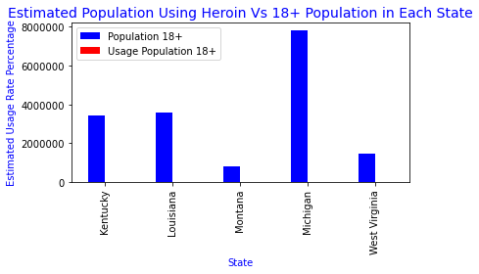
Comparison of Estimated Heroin Usage and 18+ Population for Each State

Slide 11
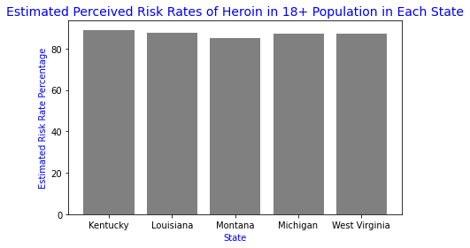
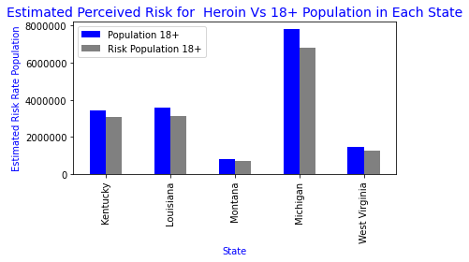
Comparison of Estimated Perceived Risks of Heroin Usage and 18+ Population for Each State

Slide 12
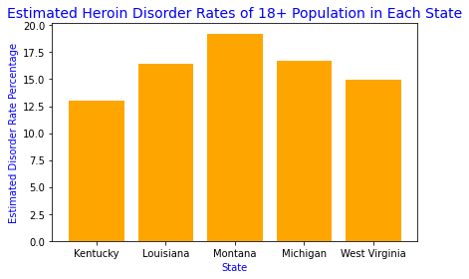
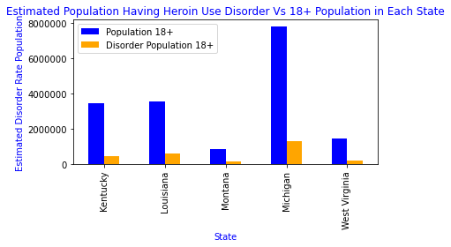
Comparison of Estimated Heroin Disorder and 18+ Population for Each State

Slide 13
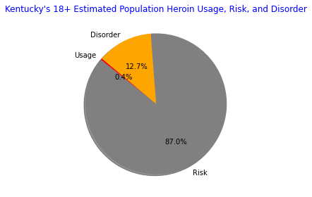
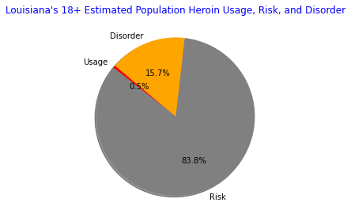

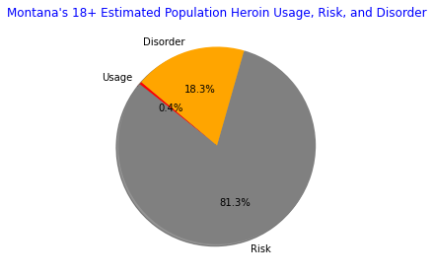
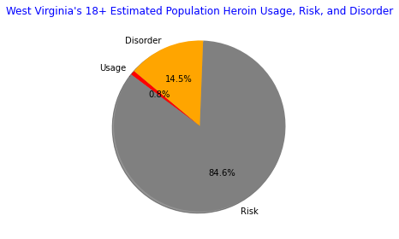
18+ Estimated Population for Heroin Usage, Rate, and Disorder for Each State

Slide 14
Conclusion
Which state has the highest amount of heroin abuse?
From the data, we can conclude that the state with the highest amount of heroin abuse is Montana.

Slide 15
Conclusion(cont’d)
Is there an association between usage, risk, and disorder rates to total population?
Based on our findings, there is an association because the highly populated states will end up with higher rates than lower populated states as supported by the graphs:

Slide 16
Limitations
Suppression in the state drug utilization data
Substance Use Disorder encompasses more than opioids only
Number of states made visualizations difficult to interpret/too crowded

Slide 17
Citations
“Substance Use Disorders (SUDS).” Centers for Disease Control and Prevention, Centers for Disease Control and Prevention, 5 Oct. 2022, https://www.cdc.gov/dotw/substance-use-disorders/index.html.
“Opioid Use Disorders (SUDS).” Centers for Disease Control and Prevention, Centers for Disease Control and Prevention, 5 Oct. 2022, https://www.cdc.gov/dotw/opioid-use-disorder/index.html.
“State Drug Utilization Data.” Center for Medicare and Medicaid Services, Health and Human Services, https://www.medicaid.gov/medicaid/prescription-drugs/state-drug-utilization-data/index.html.
“2019-2020 National Survey on Drug Use and Health: Model-Based Prevalence Estimates (50 States and the District of Columbia).” Substance Abuse and Mental Health Services Administration, U.S. Department of Health &amp; Human Services, 29 Dec. 2021, https://www.samhsa.gov/data/report/2019-2020-nsduh-state-prevalence-estimates.
“2020 Demographic and Housing Five Year Estimates.” American Community Survey, U.S. Census Bureau, https://data.census.gov/table?q=DP05.
“NDC MME TABLE.” Opioid Drug Listing, New York State Department of Health, 4 Jan. 2021, https://health.ny.gov/professionals/narcotic/docs/opioid_drug_listing.pdf.

