Slide 1
Hackathon on
Customer Churn Prediction
V. Lakshmi USE CASE: 1.1

Slide 2
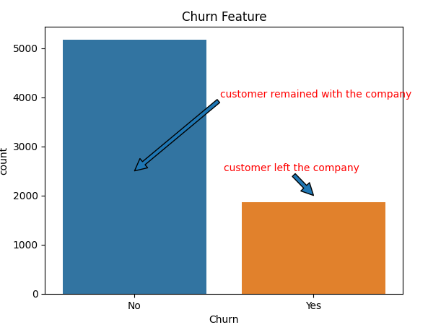
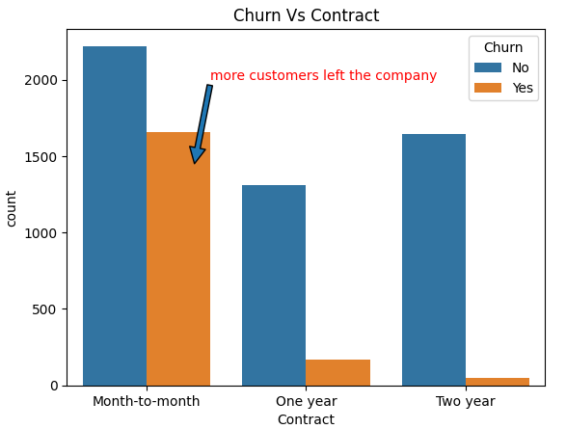
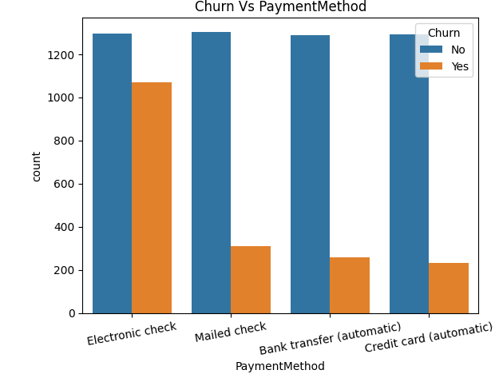
Observations: 1. Whoever Choose the Payment Method is ELECTRONIC CHECK,most of these customers are left the company compare to remaining categories of payment methods.
2. Whoever choose the Contract is Month to Month, more customers are left from the company from these category.

Slide 3
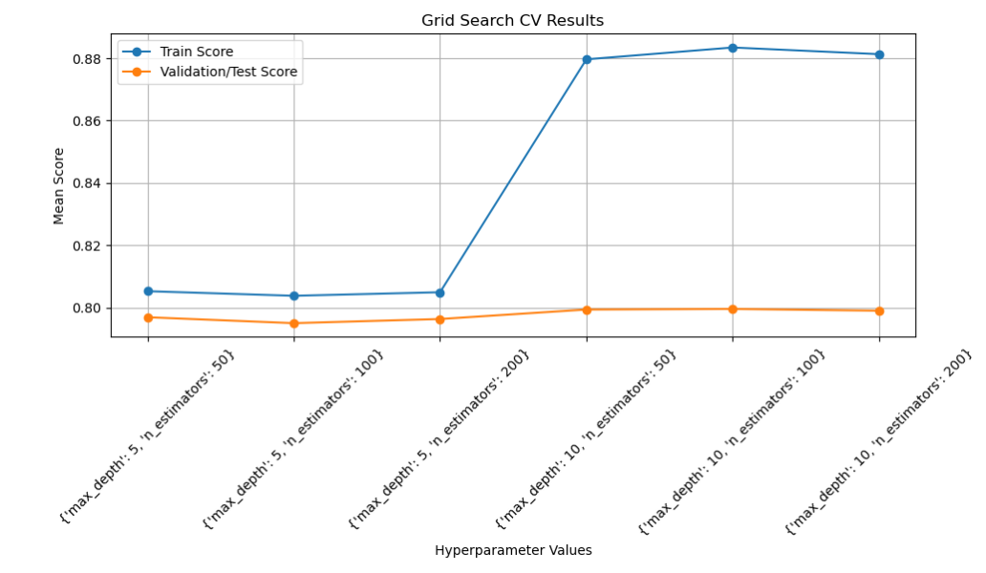
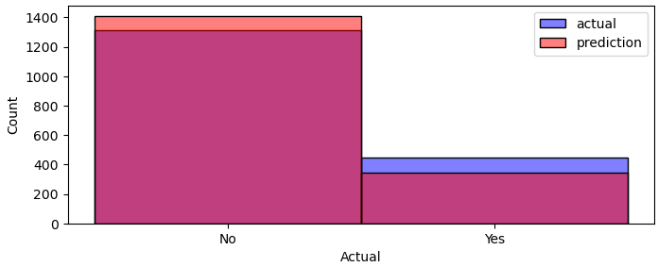
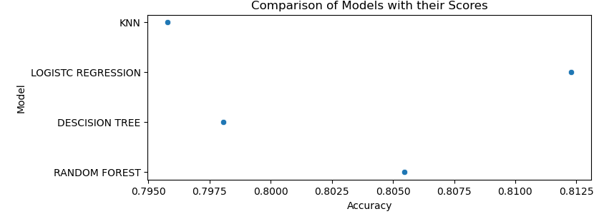
Observation: For this problem statement i applied KNN, Logistic Regression, Decision Tree and Random Forest. I got 81% accuracy. Using Logistic regression. This logistic regression alg is best algorithm for this problem compare to remaining algorithms

