Slide 1
Intro to React.js
Vangel Hristov – Semos Education

Slide 2
React.js
Officially – ‘A javascript library for building user interfaces’
Open-source since 2013
Developed by Facebook
React is a tool for building UI components.
Can be used for web, mobile, gaming and desktop apps.

Slide 3
How does React work
Components – class and functional
JSX – Javascript XML
State and props
Virtual DOM
React renderer
One way data binding
React elements
Hooks
Lifecycle methods
Context API
React router

Slide 4
Key takeaways
How to get started
Creating a React app with Vite or create-react-app (bundler tool)
JSX
Folder structure
Components
Potential errors
Re-using components (Atomic design)

Slide 5
Actually get started
Installing Node and npm
Node allows us to run JavaScript on our desktop rather than our browser
Node Package Manager – npm

Slide 6
Instalation
Not recommended (the old way)
npm install -g create-react-app or npx create-react-app
With Vite
npm create vite@latest npm create vite@latest my-vite-react -- --template react
With Next.js
npx create-next-app@latest
Find out more here --> https://vitejs.dev/guide/ , https://nextjs.org/docs/getting-started/installation

Slide 7
Vite
Modern build tool that makes development faster and more efficient than traditional bundlers.
Two major components:
Dev server leveraging native ES modules and Hot module replacement
Build tool that bundles your code using Rollup for optimized app for production
Key features:
Serving files on-demand
HMR – change the code in the browser instantly without a full refresh
Uses ES modules
Optimized production builds

Slide 8
Vite
Dev server divides the modules in two categories
Dependencies – plain JS files not likely to change, prebuild with ES build
Source code – this is the code where we work
Server side rendering support – by using server.js at the root of the project
vite.config.js – file where vite configures react

Slide 9
Exports
Default – only one default export in file
Named – indefinite exports

Slide 10
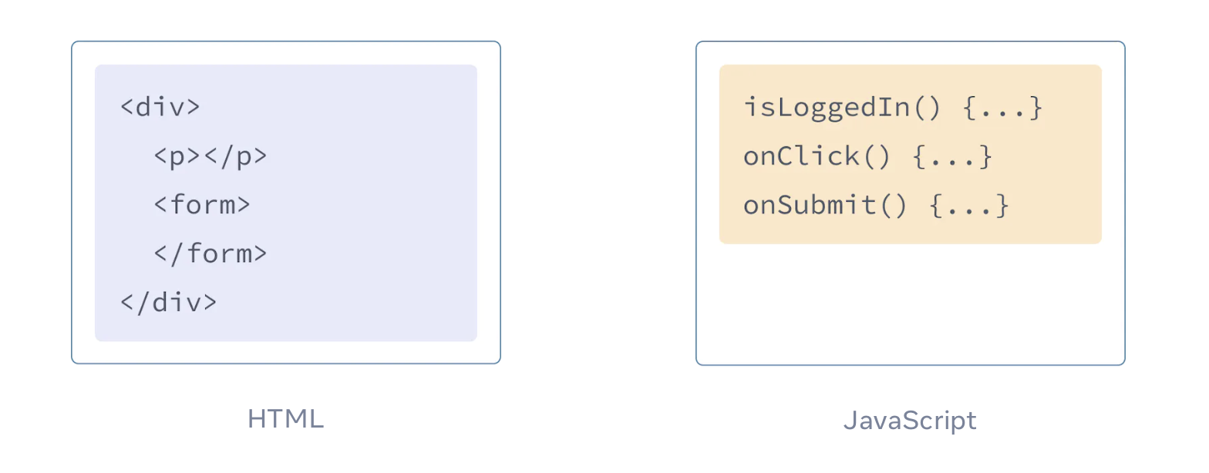
JSX
JSX is a syntax extension for JavaScript that lets you write HTML-like markup inside a JavaScript file.
JSX: Putting markup into JavaScript
ΩΩΩ

Slide 11
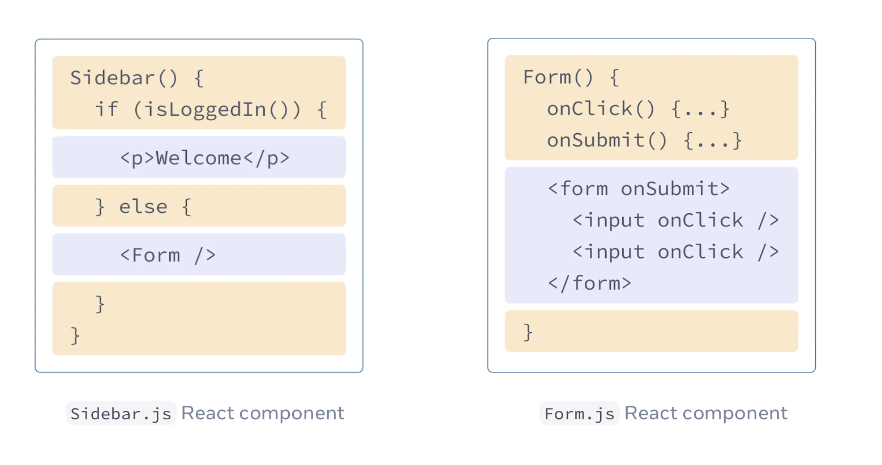
JSX
But as the Web became more interactive, logic increasingly determined content. JavaScript was in charge of the HTML! This is why in React, rendering logic and markup live together in the same place—components.

Slide 12
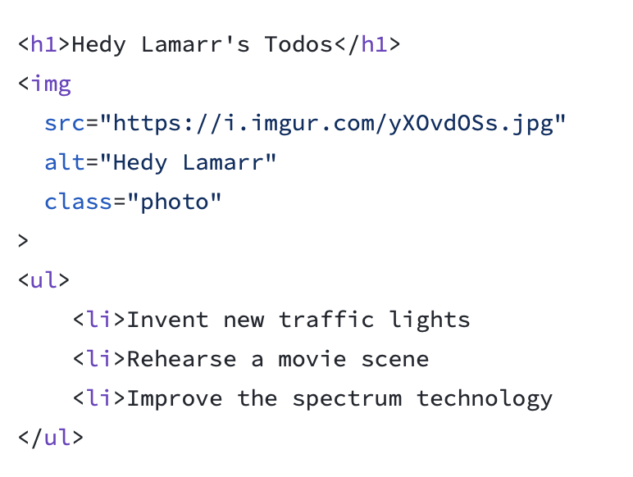
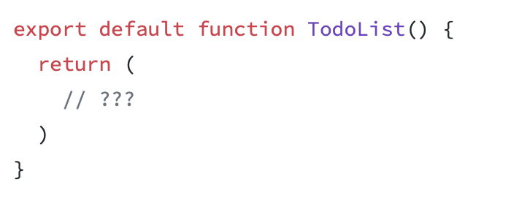
Converting HTML to JSX

Slide 13
Rules of JSX
Return a single root element
Close all the tags
camelCase most of the things (className, onClick)
{} to display JavaScript values
{{}} to display css style

Slide 14
Folder Structure
React doesn’t have opinions on how you put files into folders. That said there are a few common approaches popular in the ecosystem you may want to consider.
One common way to structure projects is to locate CSS, JS, and tests together inside folders grouped by feature or route.
Another popular way to structure projects is to group similar files together.

Slide 15
Components
React components use props to communicate with each other. Every parent component can pass some information to its child components by giving them props. Props might remind you of HTML attributes, but you can pass any JavaScript value through them, including objects, arrays, and functions.

Slide 16
Potentional errors
Each child in a list should have a unique key prop.
Prevent usage of Array index in keys
React Hook has a missing dependency: ‘XXX’. Either include it or remove the dependency array
Can’t perform a React state update on an unmounted component
Too many re-renders. React limits the number of renders to prevent an infinite loop
Objects are not valid as a React child / Functions are not valid as a React child
Adjacent JSX elements must be wrapped in an enclosing tag

Slide 17
Re-using components
What is Atomic Design ?
Atomic Design is a methodology that involves breaking down complex systems into smaller, more manageable parts. In React, components are the building blocks of the application.
Atoms: The smallest building blocks:
They are simple UI elements that cannot be broken down any further examples include buttons, icons, input fields, labels, typography, colours, images, form elements, separators and links.
Molecules: Combinations of atoms:
Molecules are combinations of atoms that work together to form a more complex UI element. A molecule could be a search bar that allows users to search for posts. Other examples include form label with input, navigation link with icon, search form with buttons, dropdown menu with options, card with image and text, list item with icon and text.
Organisms: Fully functional components:
Organisms are fully functional components that are made up of molecules and atoms. They are complex UI elements that can be used throughout the application. Organisms could be a list of posts that includes a search bar and buttons to like and share posts.

Slide 18
Task
Create single page application with your name and picture.

Slide 19
Questions
What is JSX ?
How to create react component ?
Is React a framework or library ?
How to call React Component ?
In which file in hosted React ?

