Slide 1
Props and state
Vangel Hristov – Semos Education

Slide 2
Props
Props stands for properties, it is a way for React components to communicate with each other.
Every parent can pass props to its child components
They might remind you of HTML attributes like <img src=“” alt=“” />
Through props we can pass objects, arrays, functions etc.
Props can have a default value
Props are immutable

Slide 3
Conditional rendering
Diplaying a different view depending on different conditions
To achieve conditional rendering use
If statements
&& logical and
? : i.e ternary operator
|| (falsy value check i.e false, 0, “”, null, undefined, Nan) logical or
?? (null or undefined) nullish coalescing operator
When we do not want to return anything return null (not common)
Conditionally including JSX

Slide 4
Rendering lists
filter
map
Arrow function return
Curly brace return
Keys should always be included (unique values)!
Warning: Each child in a list should have a unique “key” prop.

Slide 5
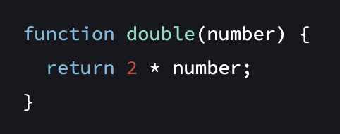
Pure components
It does not change any objects or variables that existed before it was called
Same inputs, same output

Slide 6
PropTypes
The purpose is to check the props types that we use in our components
To use we need to run: npm i prop-types --save
Types of checkings:
Single values: any, string, boolean…
Multiple types: oneOf(), oneOfTypes()
Collective types: arrayOf(), objectOf(),
Object validations with: shape({}), exact({})
Other checkings: PropTypes.element to check if the prop is a React component
Usage: ComponentName.propTypes = { myString: PropTypes.string }

Slide 7
Event handlers
Functions that React runs when we perform an action.
Clicking a button
Changing an input field
They are defined inside our components but don’t run during rendering.
In React we can add our custom event handlers to JSX
Functions passed to event handlers should not be called, just passed as reference
Event propagation - bubbling

Slide 8
Event handlers
e.stopPropagation() – stops the event handlers from bubbling
e.preventDefault() - prevents the default browser behavior for the few events that have it (ex. form)

Slide 9
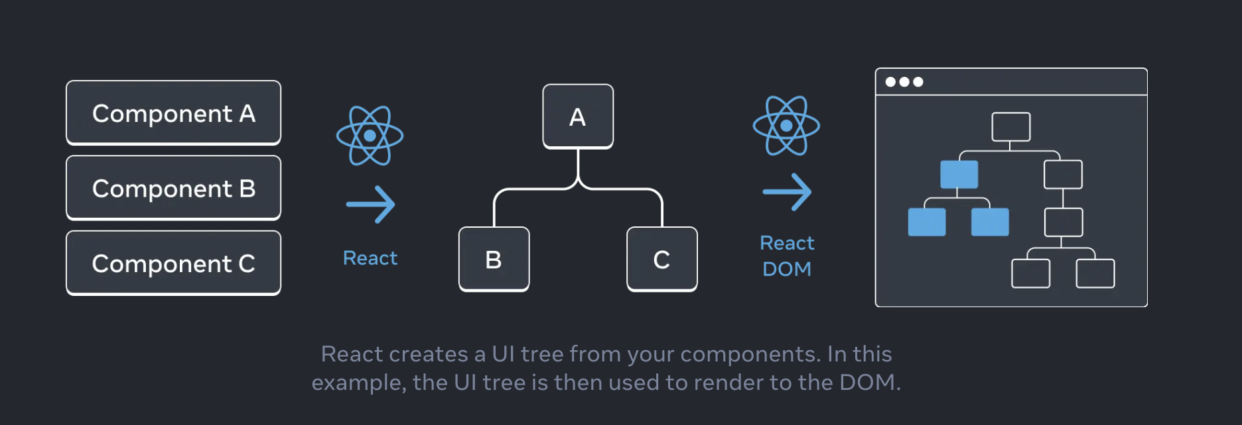
Your UI as a tree

Slide 10
State in React
State is data that changes over time
State can change when we want to update in response of an action.
User input
Clicking an image
State can be added to any component
To use state in react, we need the useState hook
Setting a state triggers a re-render
State as a snapshot
Setting a new state can only change current state for the next render
State batching

Slide 11
Objects and arrays
Objects that hold React state should not be changed directly
Arrays should also be treated as immutable when stored in React state
In arrays we should use concat, spread opeartor, filter, slice, map becauase they return a new array. We should avoid using push, unshift, pop, splice, reverse, sort.

Slide 12
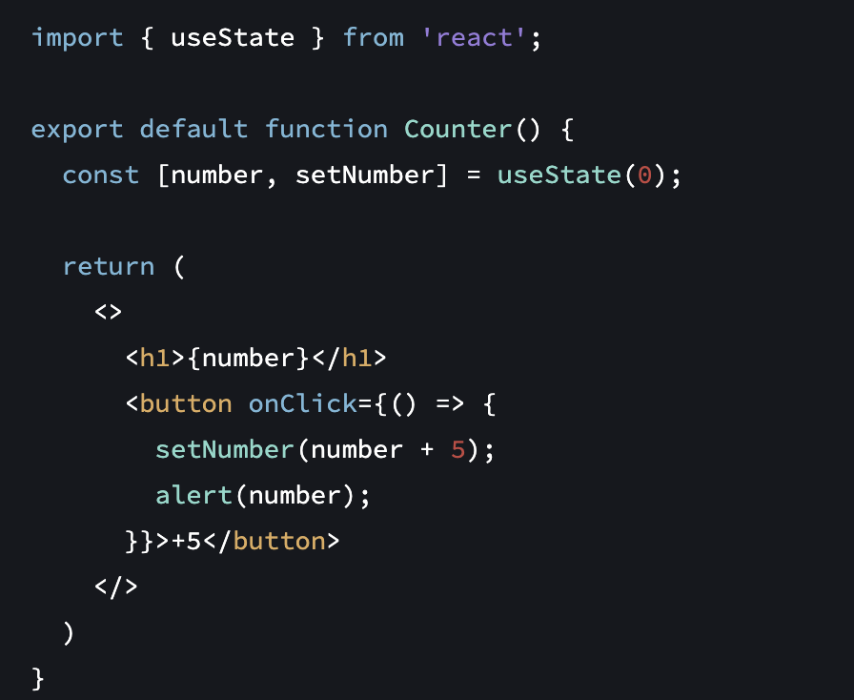
Counter Component

Slide 13
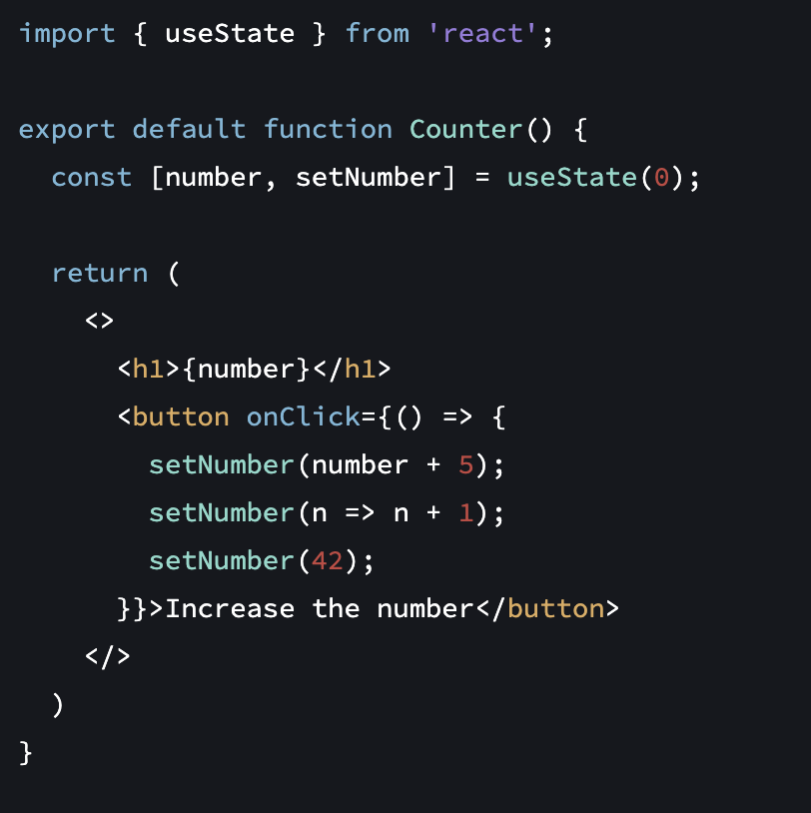
State batching example

