Slide 1
Redux
Vangel Hristov – Semos Education

Slide 2
Starting with Redux in code
Use this command to install the needed packages:
npm install @reduxjs/toolkit react-redux
If you want to persist the state of the reducers in Redux you can use:
npm install redux-persist

Slide 3
What is Redux
State management library for JavaScript apps (not only React)
Manages global state
Centralised state - Redux store
Predictability – strict rules with reducers
Easy debugging – Redux DevTools
Scalability – managing complex state logic
Data sharing – sharing data across components

Slide 4
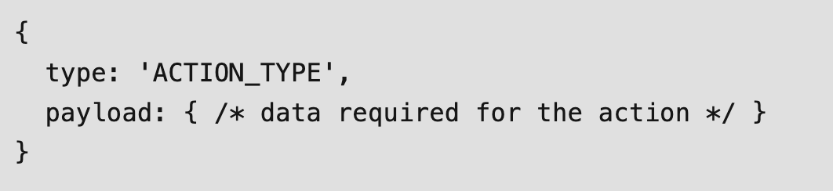
Concepts
Actions – a simple JavaScript object that contains the type of action to perform and the payload i.e the data required to perform the action

Slide 5
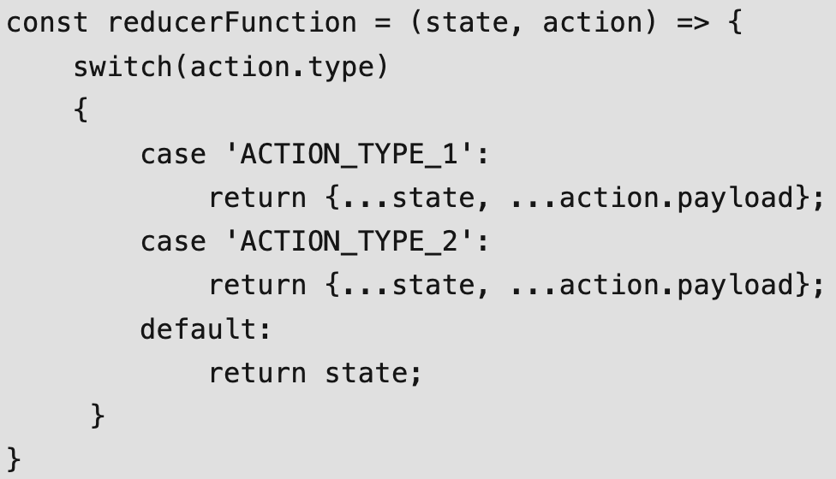
Concepts
Reducers – pure functions that take the current state and action and returns the new state

Slide 6
Concepts
Store – a place where we store all the data, a single and centralized store from which every component can get state
We initiate the store with createStore()
dispatch() to update the store
getState() to get the state from the store

Slide 7
Redux toolkit
Simplifies Redux
Reducing boilerplate
Built-in support for async actions
createSlice – to make a reducer

Slide 8
When to avoid Redux
If you are not sharing data across multiple components
If state affects a single component
Prop drilling is not a problem
No complex state logic

