Slide 1


PISA 2018 Results Presentation
M.Sc.: Business Analytics - FT
Course: Analytics Practicum II
Student Name: Vangelis Lakkas – Pyknis
Registration No.: 2822306
E-mail: eva.lakkaspyknis@aueb.gr

Slide 2

What is PISA?
PISA (Programme for International Student Assessment) is a competition organized by OECD that aims to evaluate the students and the educational systems of the participating countries.
PISA results refer to students 15 years old.
It measures the ability of the students in reading, mathematics, science and in the solution of practical problems (Global Competence/GLCM)

Slide 3
Goals of the presentation
The aim of this presentation is to gain an insight in:
The position of Greece compared to the other participating countries
The gap in the performance of boys and girls in various subjects
To achieve the previous we will explore ten visualizations

Slide 4
Remarks on the Data
The results of the PISA competition that were used to produce the vizualizations that will be displayed later refer to 2018.
The data contain information about 77 different countries,over 606,000 students (approximately 302,000 females and 304,000 males)
The results of a few regions that existed in the original dataset were aggregated with one country (for example Tatarstan and Moscow region were aggregated with the Russian Federation).

Slide 5
Remarks on the Data
To add more information in specific visualizations (the two bubble plots that will be shown later) I searched data on the government spending in education of each country for 2018 (as % of the GDP) and I exploited the corresponding dataset of the World Bank.
The full dataset for spending on education can be found here
(Note: Some comments on the data cleaning of the World Bank dataset are given in the separate file that I uploaded on moodle together with the data)

Slide 6

Position of Greece within the participating States

Slide 7
Trellis Dot Plot
In the following diagram, we see that:
Greece has approximately a mean score 450 units for all subjects
In this plot we can see that countries are separated into three tiers based on their mean scores: Countries with scores close to 500 or above (tier A), countries with scores above 400 but not close to 500 (tier B), and countries with scores close to 400 or below.
Greece belongs to the 2nd tier

Slide 8
Trellis Dot Plot
Indicatively, we can see that Greece performs better than most countries in the Balkans, South/Central America and certain countries of Asia (e.g. Jordan, Indonesia and United Arab Emirates)
Greece performs worse than most states of North America, Western Europe and Far East (e.g. Japan, China, Hong Kong etc.)

Slide 9
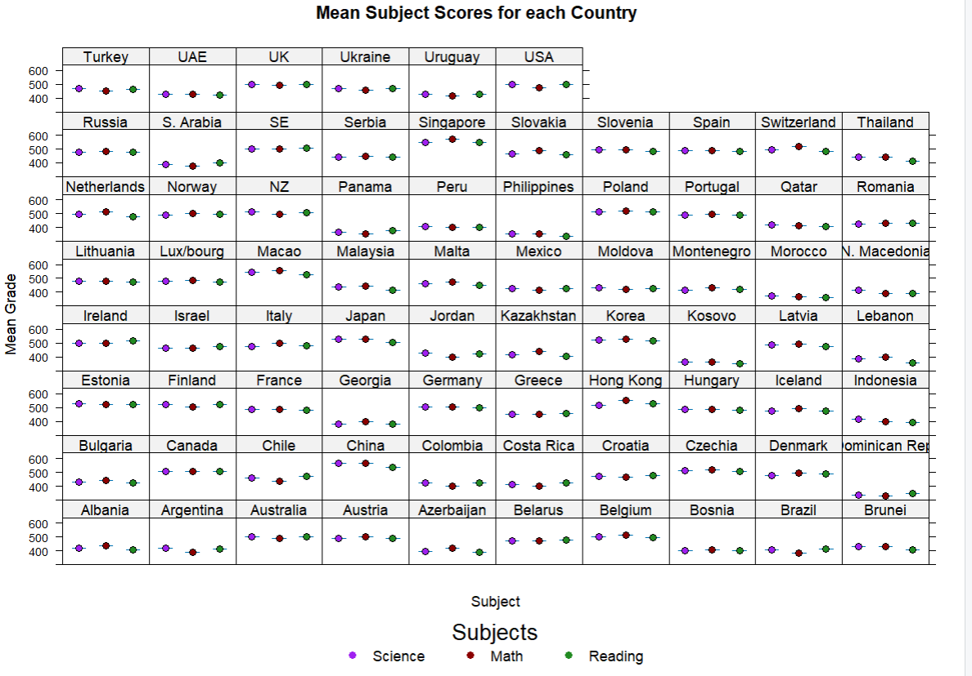

Slide 10
Colorpleth Map
Let’s focus on reading performance in Europe:
In the map below we can see each European country colored according to each mean score in reading.
Greece is again leading in the Balkans area as stated before in the trellis plot and outperforms a few countries of Eastern Europe (such as Romania and Moldova)
However Greece is once again far behind Scandinavia and Central/Western Europe and big countries of Eastern Europe (such as Russia and Poland)

Slide 11
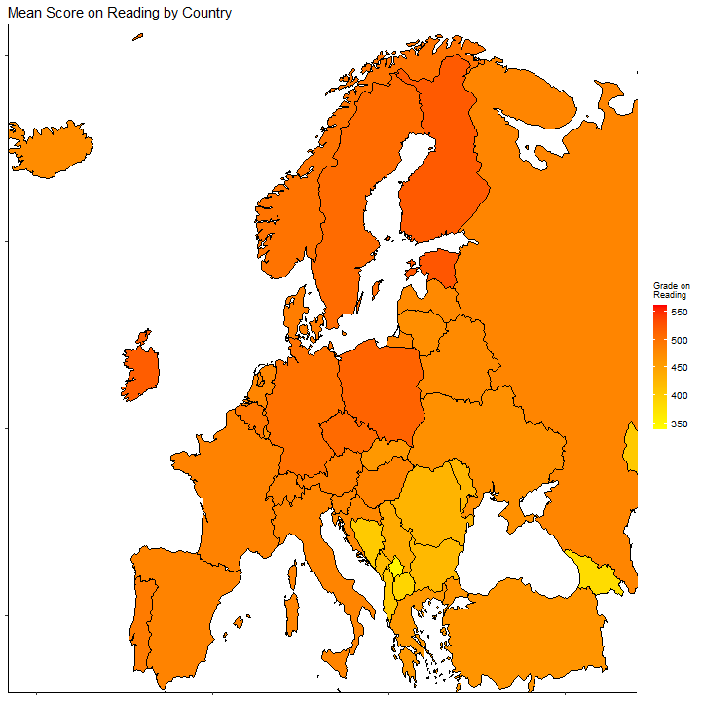

Slide 12

Trellis Density Plot
Except from the means that we saw above, let’s also explore the distributions of math scores in each country. Mean sometimes is not the best representative measure because it can be sensitive to outliers. In the density plot below, we can see that:
Greece’s math scores approach the normal distribution which means that the mean can be a good driver for conclusions.

Slide 13
Trellis Density Plot
From the density plots below we can once again reassure that Greece has a mediocre performance because the countries we saw that have strong educational systems tend to have a slightly left-skewed distribution. While distributions of underdeveloped systems present a slight right-skewness.
This fact means that many students in countries like Hong Kong or France achieve higher scores than the average, while in Greece most students will gain simply the average.

Slide 14
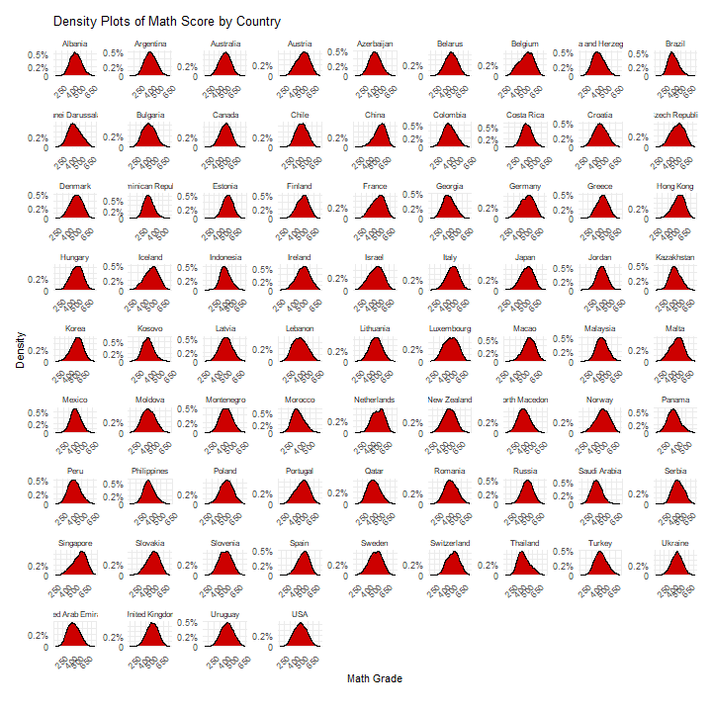

Slide 15

Bubble Plots
Now let’s explore the position of various countries using their mean scores on two subjects simultaneously and by considering the size of their investment in education (as a % of their GDP) which specifies the final size of each “bubble”.
So, the bigger the investment the bigger the country’s “bubble”.

Slide 16
Bubble Plots
In the following plot, we observe that:
Greece is marginally below the mean score of mathematics and above the corresponding score of reading for all the PISA participant countries.
Most European countries are concentrated into a cluster above the previously referred means along with Canada, USA, Australia and New Zealand. Greece is obviously far from this cluster. And we can see that a small group of 4 Asian countries outperform again the rest of the world.
In terms of expenditure Greece is not far behind from the rest of European countries although it generally invests a small part of the GDP in education (≈4%)

Slide 17
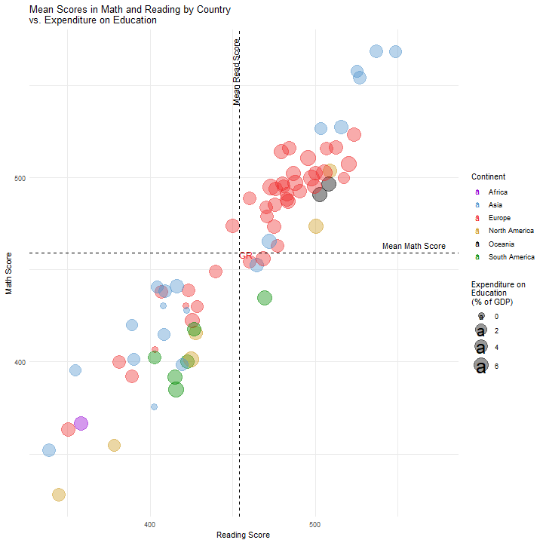

Slide 18
Bubble Plots
As for the country scores on GLCM (the ability to solve real-life problems) based on the countries that had available data for this measure. We notice that Greece with a score lower than the PISA average manages to perform a mean score that is significantly above the PISA average.

Slide 19
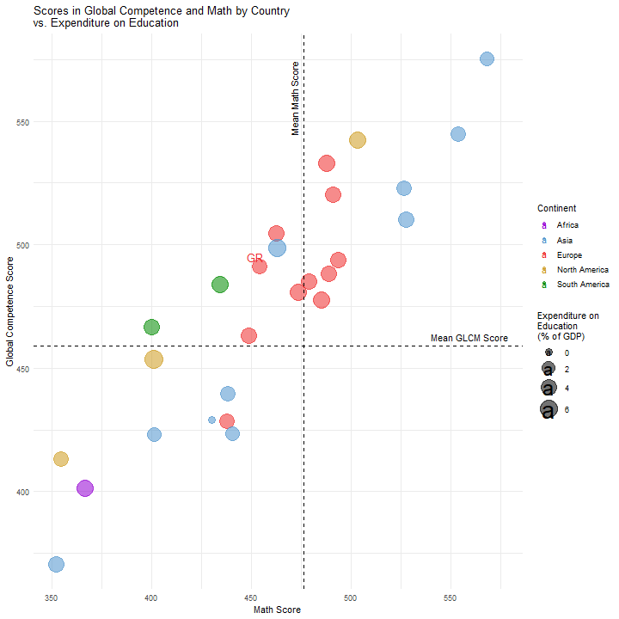

Slide 20

Gender Gap

Slide 21
Scatter Plot
In the following visualization, we can see the comparison of the mean math scores according to gender. The diagonal line symbolizes the equality in the performance of the two genders.
We notice that:
Greece (GR) performs well in terms of gender gap because it is very close to the “equality” line. The same stands for the majority of Europe.
Countries in Asia and in America have the biggest issue in the gender gap. Asian countries tend to have significantly higher female performance while North and South America present the opposite behaviour.

Slide 22
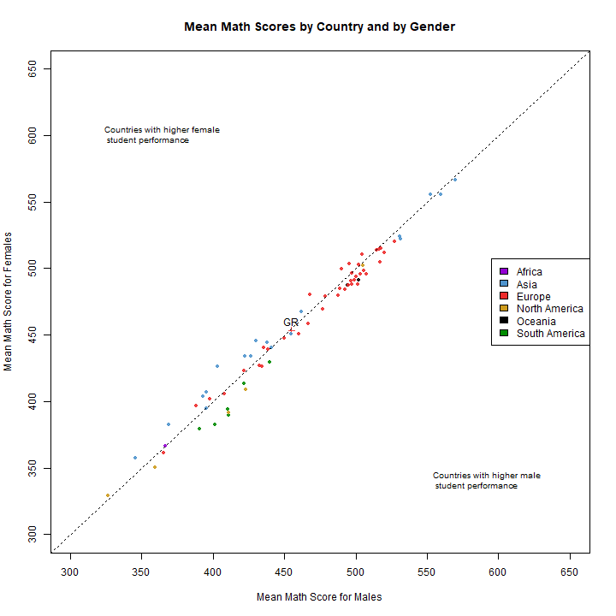

Slide 23
Gender Gap Bar Plot
The following plot quantifies the gender gap in mean math scores for each country.
Once again we notice that Greece is one of the countries with the smallest gap
As shown from the scatter plot previously America and Asia face the biggest challenges. Colombia, Costa Rica and Argentina present the biggest gender gap in favor of the boys, while Qatar, Saudi Arabia, and Thailand do the opposite.

Slide 24
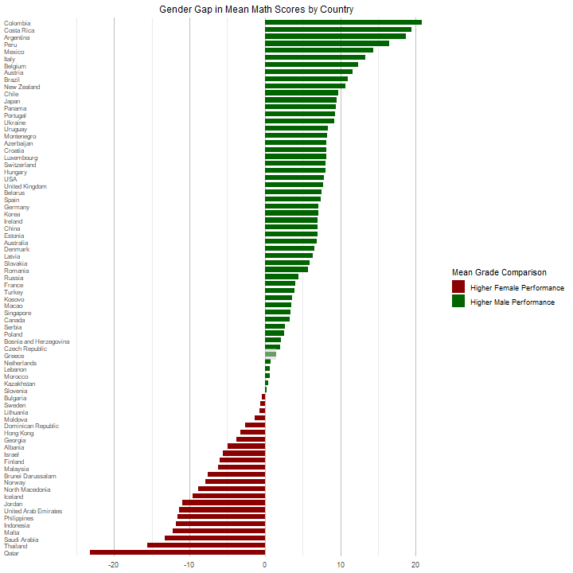

Slide 25
Colorpleth Map
Now let’s explore the gender gap in science for European countries. In the following map visualization, each state is colored based on which gender performs better in science and how much better.
We notice that females are generally better in science mostly in Scandinavia (for example Finland) and in many countries of the Balkans (mostly Bulgaria and North Macedonia and slightly in Greece).
Males seem to perform better in Ukraine and Belarus and marginally in Western Mediterranean. The gender gap in the rest of Europe seems to be insignificant.

Slide 26
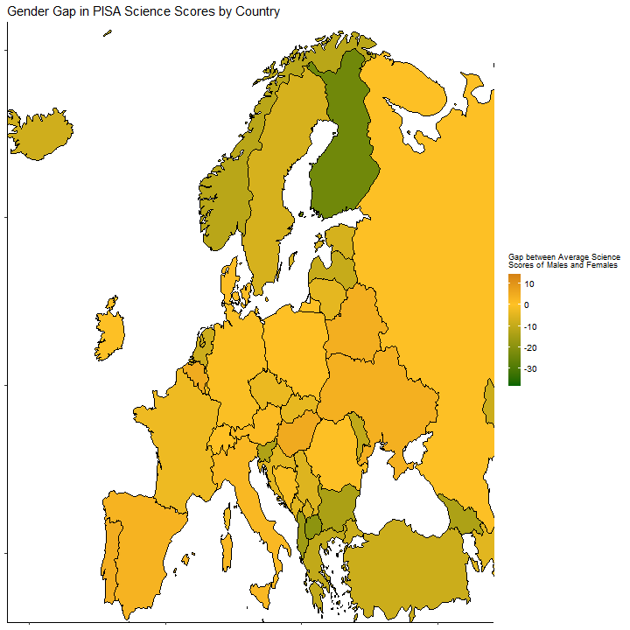

Slide 27
Bar Plot for Gender Gap on Reading
In the following bar plot we the mean score of each gender on reading.
This time we observe that girls perform better than the boys in all countries.
However, in most countries these difference seems to be very small and insignificant. Countries of the Middle East have an important difference between the two genders. The same holds for certain countries of the Balkans (Bulgaria and North Macedonia) and Scandinavia.

Slide 28
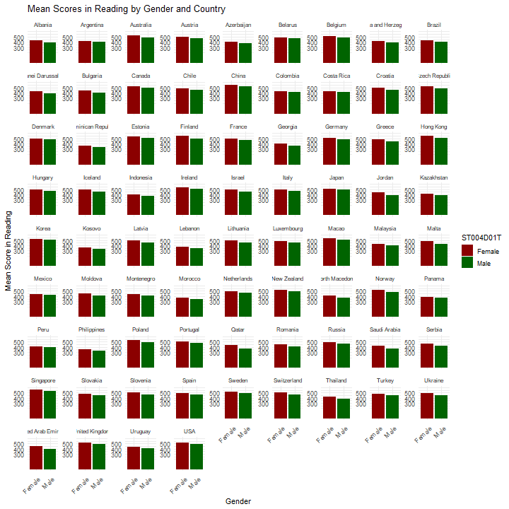

Slide 29
Math Scores Box Plot by Gender
Below we see the boxplot for the math score by gender indicatively for 14 countries.
Generally, we see that the scores of males tend to have a bigger variance than those of the girls in most countries. For example, this holds for Belgium, Germany, France, and the USA.
The above does not apply to Greece. Greece shares this common characteristic with Italy and Spain.
Also females tend to have more outliers that the males (e.g. Spain, Finland, Italy and Russia). This holds also for Greece but in a smaller scale.

Slide 30
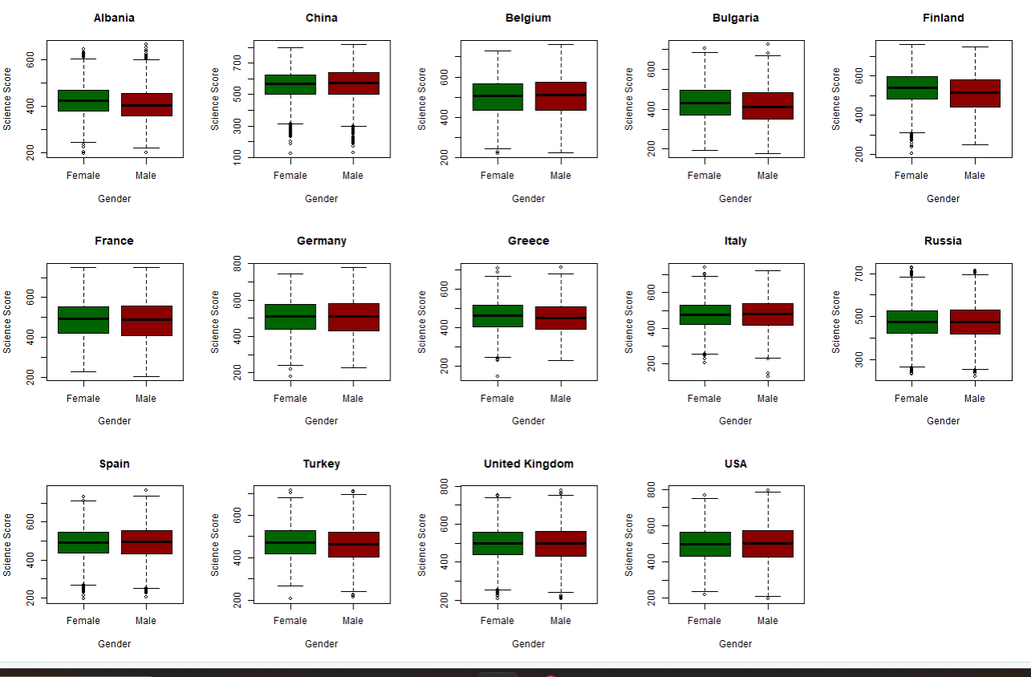

Slide 31

Thank you for your attention!!

